Slide 1
ILC DR Lower Horizontal Emittance, preliminary study
20170629
Kiyoshi Kubo (KEK)

Slide 2
Motivation
Modification of parameter set for higher luminosity is planned.
For High Luminosity, low Horizontal Emittance is required
At IP, 10 μm (TDR) → 5 μm or lower
(normalized horizontal emittance)

Slide 3
Horizontal emittance design in TDR
At IP: 10 μm
At Linac end: 9.4 μm
At Linac entrance: 8.4 μm
Growth in RTML: 0.9 μm (synchrotron radiation)
In DR: 6.3 μm
Growth by 0.9 in RTML, but source of other 2.8 μm growth is not clear.
(90 nm (1.1%) in the Arc, 380 nm (4.8%) in the Turn-around, and 430 nm (5.4%) in the Bunch Compressor in its nominal configuration)
For 5 μm at IP, ~4 μm in DR is probably OK (?)

Slide 4
Possible Problems of small horizontal emittance
Electron Cloud in e+ Ring
Dynamic Aperture
???

Slide 5
Electron Cloud with lower emittance
Electron cloud density will not depend on beam emittance.
Electron density threshold for instability will be reduced for smaller horizontal emittance.
Threshold ~ (horizontal beam size)^{1/2} (see next slide)
~ (horizontal emittance)^{1/2}
TDR: 6.4.4.3 EC Instability
The above estimates of cloud density place an upper limit on the ring-averaged density of about 4×10¹⁰m⁻³, about a factor of three below the expected single bunch instability threshold [110].
→ Probably OK
Dependence is weak

Slide 6
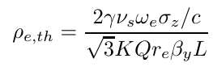
Formula from Ohmi for e- cloud
E-cloud density threshold:
(Private communication with K.Ohmi)

Slide 7
Modification of DR optics was tried
Based on TDR DR Lattice data
  Given by M. Woodley, ILC DR lattice (2016)
  Translated to “SAD” format
Modified arc cell optics to reduce horizontal emittance.
Looked dynamic aperture

Slide 8
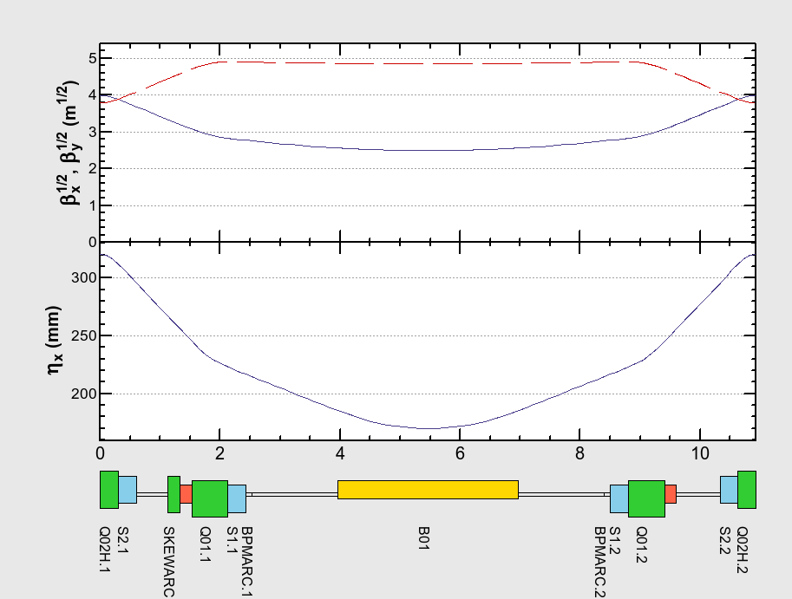
ILC-DR SAD deck was made from Lattice file 2016 by M.Woodley
Optics of Arc Cell
SAD
TDR

Slide 9
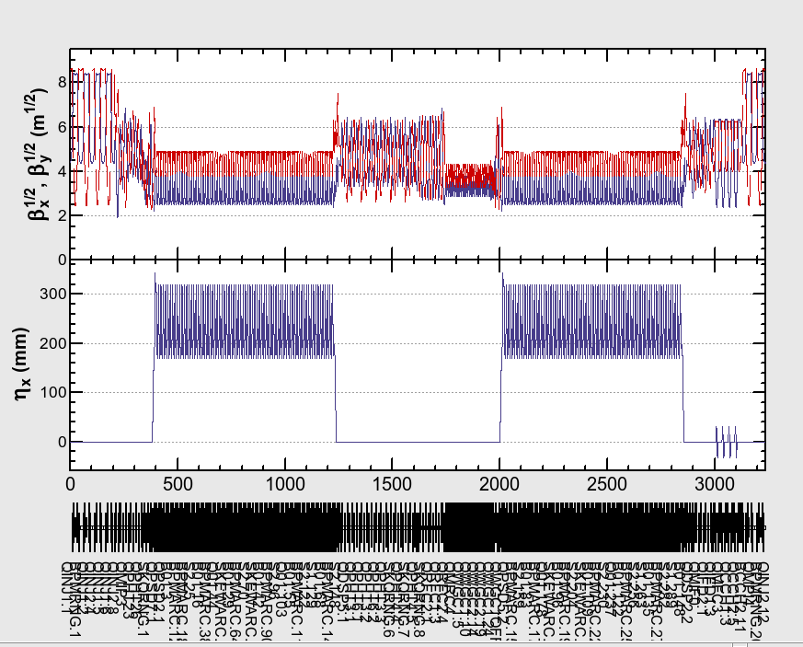
Optics of Whole Ring
SAD
TDR

Slide 10
Comparison of some parameters
 | SAD (deck translated from Woodley’s data) | TDR (MAD by M.W.)
Circumference (km) | 3.2386807 | 3.238 (3.238680589)
Damping time x/y/z (ms) | 23.88/23.87/11.94 | 23.95/23.95/12.0
Horizontal normalized Emittance (um) | 5.74, 6.27 (IBS) | 5.7
Tune x/y | 48.264315 /26.762788 | (48.264313 /26.762786)
Translation seems OK.
Horizontal emittance is 6.27 um with intra-beam scattering.

Slide 11
2 ways of Reduction of Horizontal Emittance
Reduce dispersion and/or beta_x in bending magnets
Stronger focusing
  Reduction of dynamic aperture expected
Reduction of bending field
In Wiggler dominant ring, emittance ~ 1/rho^2 in arc
Bending magnet can be longer (3 m → e.g. 5 m)
Tried 5 m long bend optics
No change in straight sections, except for minor changes for optics matching
Set phase advance/cell for emittance = 4 um with IBS

Slide 12
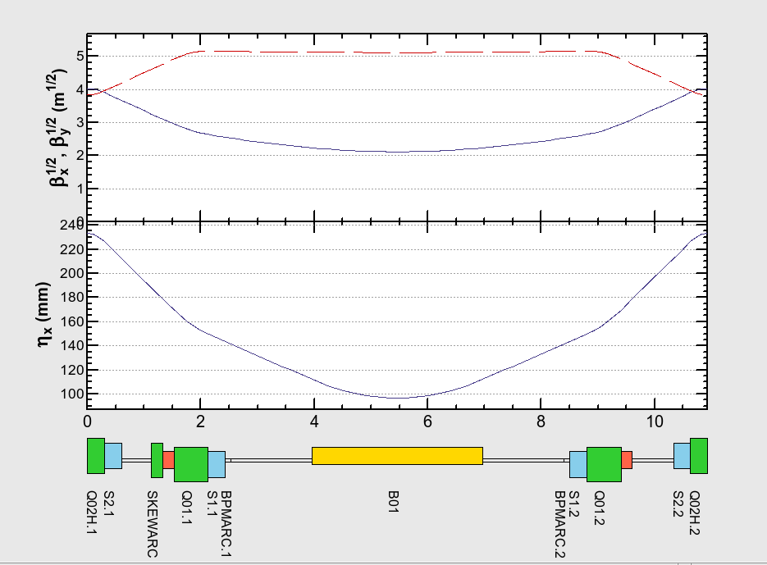
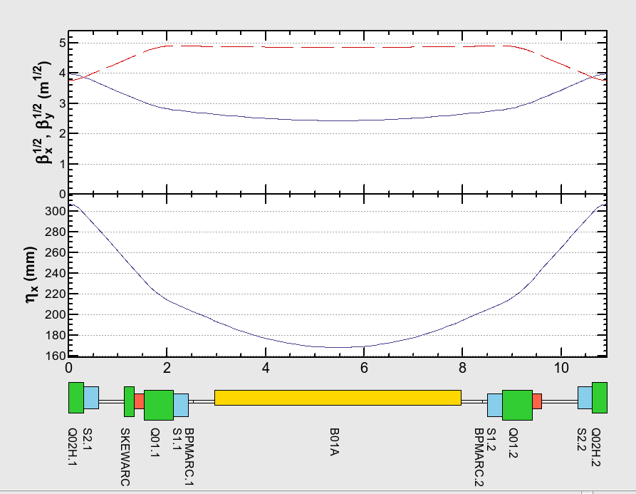
Optics of Arc Cell
Original
New (Stronger focus)
New (long bend)

Slide 13
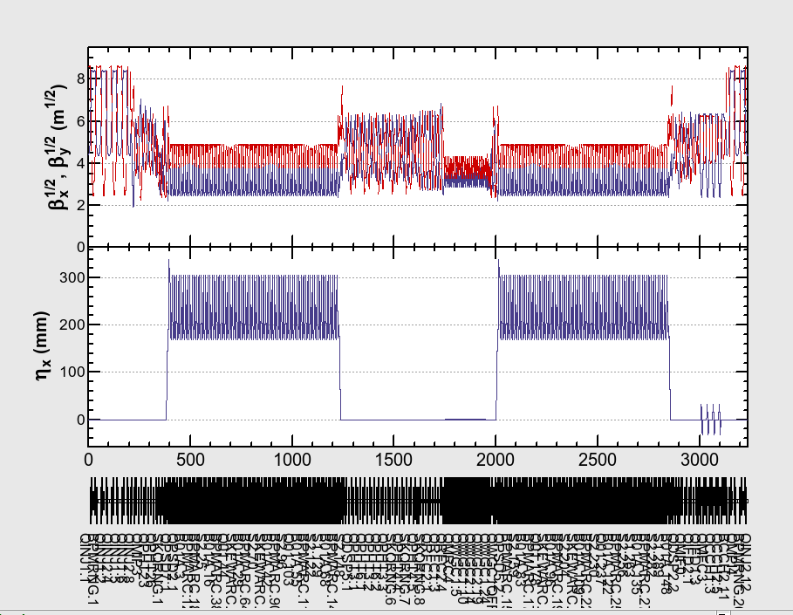
Optics of Whole Ring
Original
New (long bend)

Slide 14
 | Original | New (stronger focus) | New (long bend)
Horizontal normalized Emittance (um) | 5.74, 6.27 (IBS) | 3.22, 4.00(IBS) | 3.14, 3.97 (IBS)
Tune x/y | 48.26/26.76 | 57.79/26.46 | 49.33/26.86
phase adv./cell /2pi x/y | 0.21891 /0.08098 | 0.2788 /0.08 | 0.2250 /0.0808
Damping time x/y/z (ms) | 23.9/23.9/11.9 | 23.9/23.9/11.9 | 25.5/25.5/12.8
For new designs, emiitance is adjusted as ~4 um.
Some surveys of phase advances/cell and total tunes were performed, for good dynamic aperture. (Surveys were not complete.)

Slide 15
Dynamic aperture and emittance
Stronger focus makes emittance smaller, but need stronger sextupoles and reduce dynamic aperture.
Dynamic aperture in TDR is already tight compare with assumed injection positron beam quality.
(positron beam quality was determined by DR aperture?)
TDR: “In practice, the dynamic aperture shrinks as the focusing strength is increased”
Proceedings of IPAC2011, MOOCA03 “UPDATES TO THE INTERNATIONAL LINEAR COLLIDER DAMPING RINGS BASELINE DESIGN” Susanna Guiducci,et.al.: “There is some flexibility to vary emittance and momentum compaction by adjusting the arc cell focusing, but typically this comes at the expense of dynamic aperture.”

Slide 16
Dynamic Aperture calculation
Tool prepared in SAD
Set initial orbit and energy deviation and perform tracking
Survived in 1000 turns tracking → “accepted”
No special treatment of wiggler’s magnetic field.

Slide 17
Aperture with original arc cell
(Tune surveyed roughly)
Original
Tune x 48.2643 y 26.7628
Original cell, change tunes
Tune x 48.14 y 26.68

Slide 18
Dynamic Aperture in TDR
Dynamic aperture in TDR cannot be reproduced.. ??

Slide 19
Dynamic aperture: stronger focus
New arc cell: stronger focus
tune/cell: x.2788 y.0800
Tune: x 57.79 y 26.46
Horizontal aperture significantly reduced.

Slide 20
Dynamic aperture: long bend
New arc cell: long (5 m) bend
tune/cell: x.225 y.0808
Tune: x49.33 y26.86
Aperture is larger than requirement

Slide 21
Dynamic aperture: long bend
Misalignment + correction
New arc cell: long (5 m) bend
tune/cell: x.225 y.0808
Tune: x49.33 y26.86
Quadrupole & sextupole offset: 50 um
Quadrupole roll: 100 urad
BPM offset: 100 um
BPM roll: 10 mrad
COD & Dispersion correction
These errors are not important for dynamic aperture.

Slide 22
Summary & Discussion
Electron cloud will not be an issue. (very rough estimation)
Easy way to reduce emittance, keeping dynamic aperture, is using longer bending magnets in arcs.
  E.g., 3 m → 5 m (any problems with long bend?)
  Horizontal emittance 4 um seems possible
Dynamic aperture of original lattice in past paper(s) could not be reproduced.
Stronger focusing (for lower emittance) reduces dynamic aperture.
Low emittance with larger dynamic aperture may be possible with major changes of design. (not studied here)
  More wigglers
  Stronger focus of more sophisticated optics deign (like Hybrid Multi Bend Acrhomat in new generation light sources ?)

