Slide 1

SLAC: SiD AHCAL
Status and Update
Ross McCoy, Andrew Myers, Andy White

Slide 2

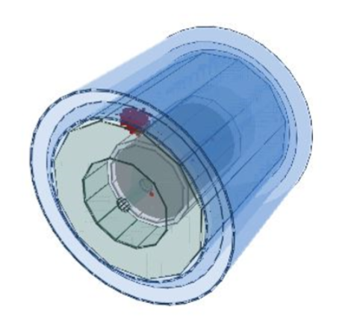
Introduction
The University of Texas at Arlington has joined the SiD optimization in plans to design and calibrate the AHCal
Initial calibration effort performed using single particle studies
Graphic generated from ced2go event display
Notes:
No jets

Slide 3
SiD AHCAL DD4HEP Migration
Previous simulation and reconstruction process was based on ILCSoft with multiple tools needed for each step
Many of these tools were outdated or no longer supported, necessitating move to new software
DD4HEP offers simplified and standardized approach to simulation and reconstruction with fewer tools needed, reducing potential points of failure in software
First AHCAL geometry in DD4HEP based on sidloi3 model, using RPC gas detectors in active layer, then redesigned to use scintillator
Current AHCAL geometry (SiD_o2_v02) accurately reflects July 2016 engineering model, with active layer based on CALICE test beam design

Slide 4
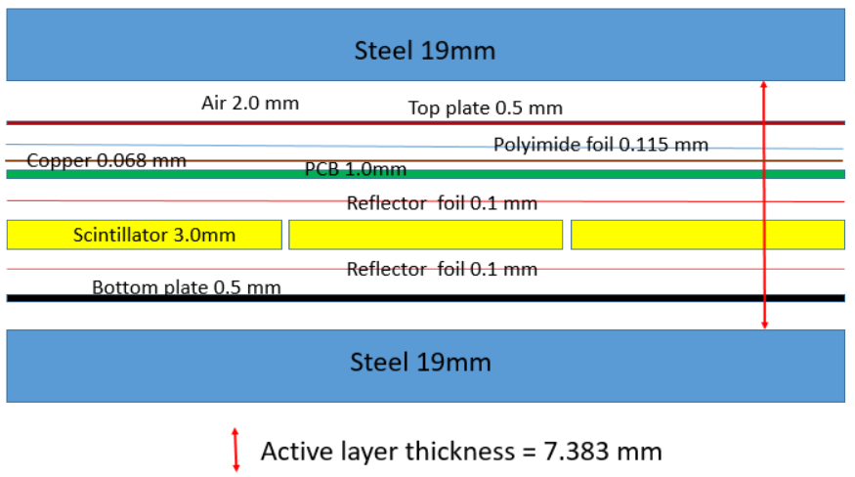
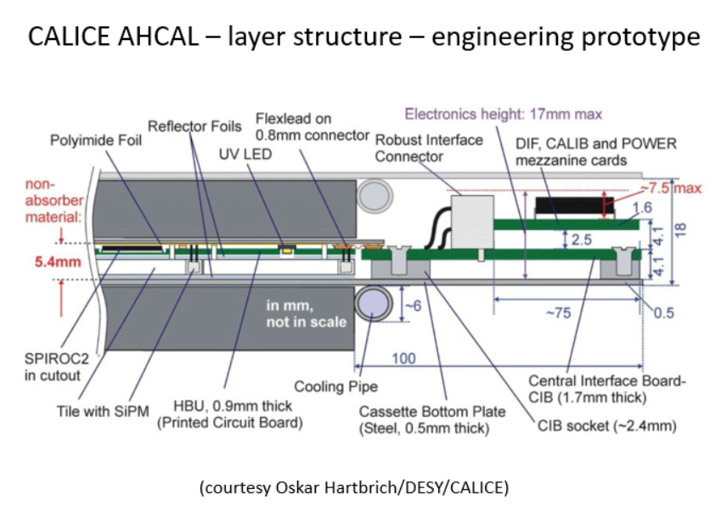
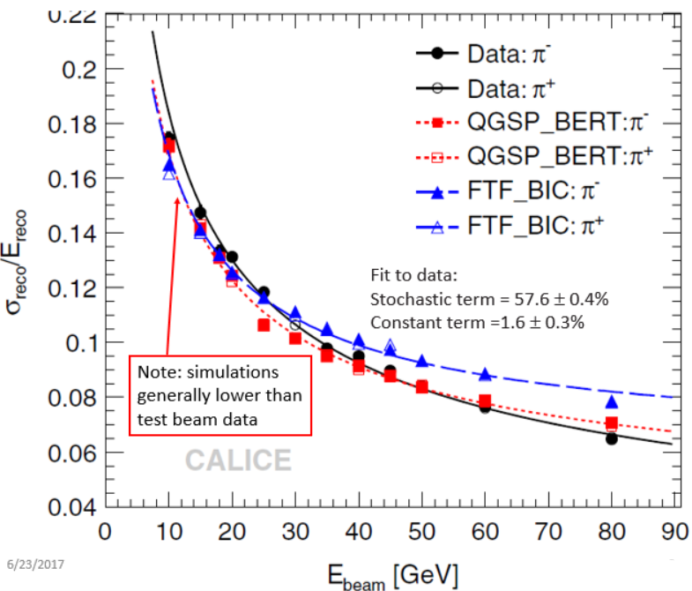
Adapting AHCAL Design for SiD
Initial goal: compare simulated single particle energy resolution with actual CALICE test beam results
Notes:
This slide shows the design layout of the active layers and how it connects to the data acquisition and read out hardware.

Slide 5
Data File Specifics
Detector Version: SiD_o2_v02
Physics list: FTFP_BERT
Particles: Pions and Photons
Sample Size: 10,000 events
All events were run with full simulation and reconstruction process unless otherwise noted
Analysis performed using C++, Python, and Modular Analysis and Reconstruction for the Linear Collider (MARLIN)

Slide 6
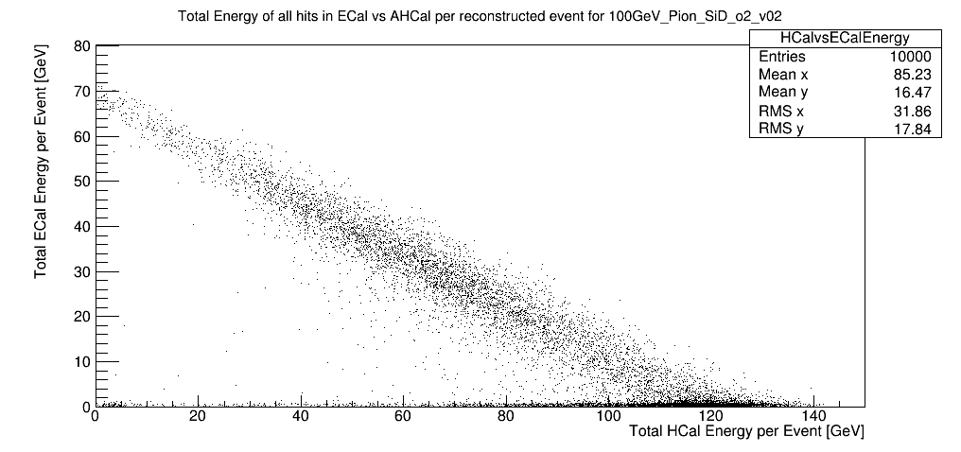
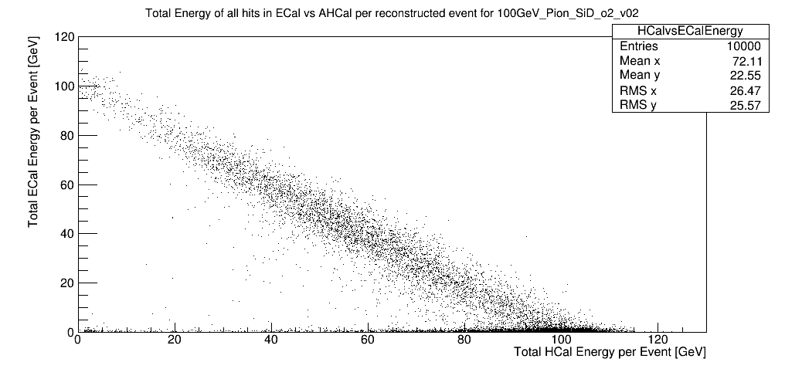
SiD AHCAL Calibration
Analysis of 5-100 GeV pion data post-reconstruction revealed existing calibration values for ECal and HCal were incorrect (Left image, only 100 GeV data shown)
Manual adjustment of calibration factors (Right image) for ECal and HCal show good agreement with initial input particle energy
Notes:
Images shown are for 100 GeV pions only, but initial calibration was incorrect for all measured input particle energies between 5 and 100 GeV

Slide 7
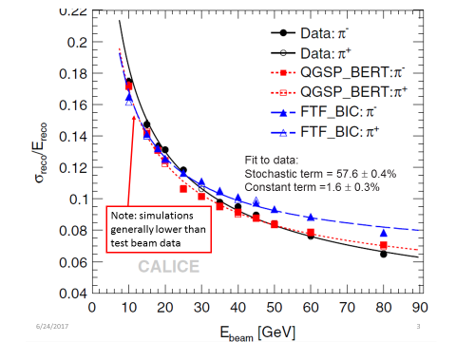
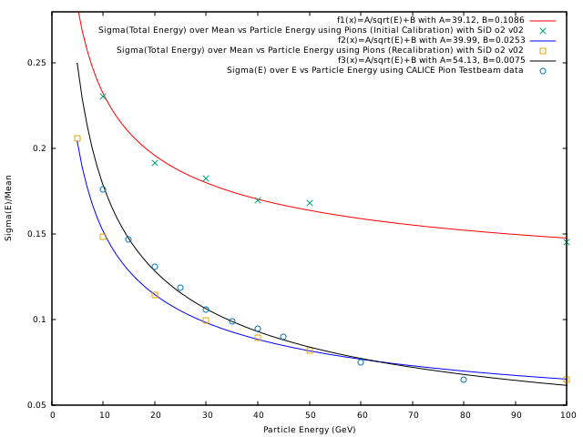
SiD AHCAL Calibration
After manual calibration, energy resolution shows better agreement with CALICE Pion test beam results
As expected, results from simulation are lower than actual test beam data
Notes:
Red is initial calibration, blue is recalibration, black is CALICE data

Slide 8
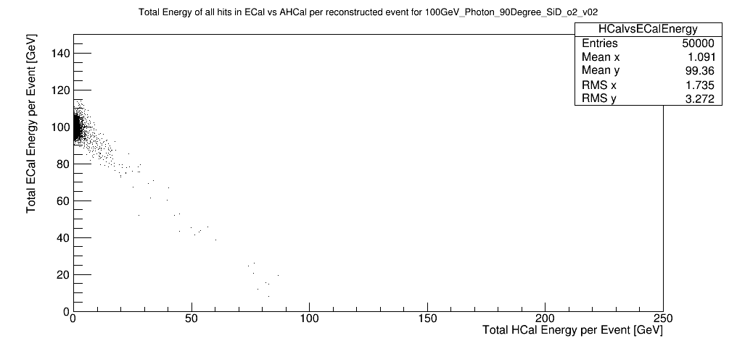
SiD AHCAL Calibration
Initial attempt at manual recalibration for ECal and AHCal shows good results, however, further research is needed into effects of electromagnetic component of energy deposition
More sophisticated calibration software development needed
Current studies are ongoing into measuring leakage from EM showers inside ECal and comparing with expected energy deposition in AHCal

Slide 9
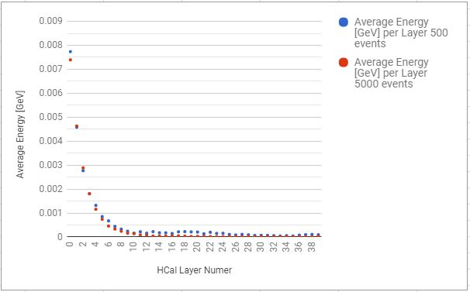
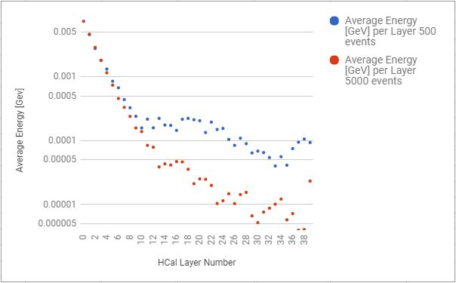
SiD AHCAL Calibration
Above photon data courtesy of A. Steinhebel (U.Oregon)
Plots are pre-reconstruction

Slide 10
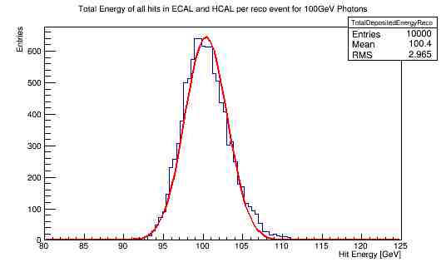
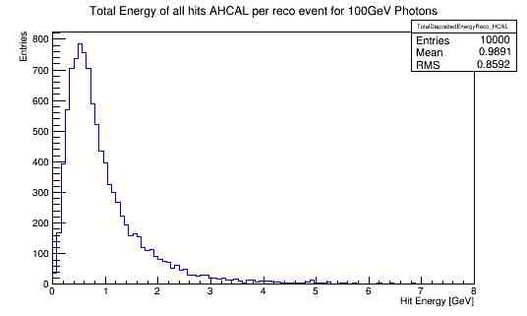
SiD AHCAL Calibration
Results generated using UTA’s manual calibration factors
We observe approximately 1% leakage from ECal into AHCal

Slide 11
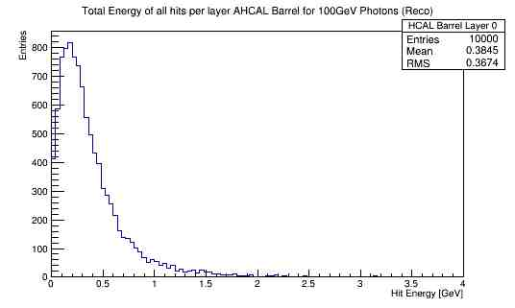
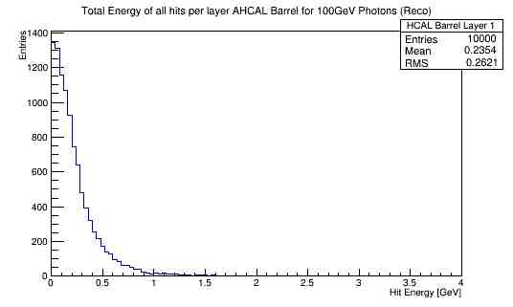
SiD AHCAL Calibration
~65% of energy deposited into first two layers of AHCal from a 100 GeV photon

Slide 12
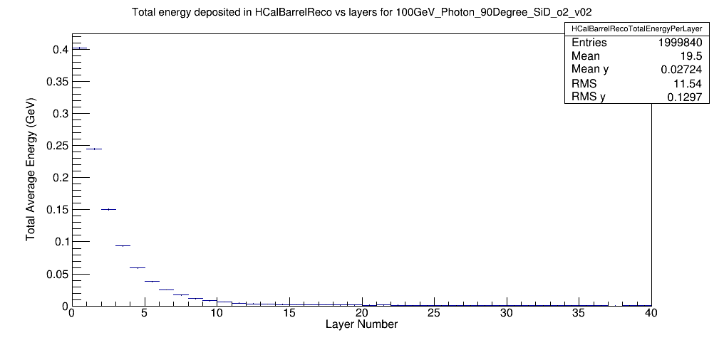
SiD AHCAL Calibration
Reconstructed average total energy per layer deposited in HCAL Barrel for 100 GeV photons for 50,000 events

Slide 13
UTA SiD AHCAL Future Plans
Continue to run single particle studies if any major changes in geometry
Continue photon calibration studies in preparation for jet studies
Adapt and implement Jan’s JULIA calibration code instead of using manual calibration
Adapt and implement Pandora particle flow algorithm in DD4HEP
Begin jet energy resolution studies
Discussing steps towards realization of SiD-specific HCAL – opportunity afforded by U.S. – Japan funding
Need engineering support (through SLAC)
Continue to work with SLAC on refining the module design and include the results in the simulation

Slide 14


Slide 15
Relevant Information
All particles used were pions, fired using single particle gun at θ=65°, for a run of 10000 events
Geometry used was SiD_o2_v02
Full simulation, including digitization and reconstruction, performed as usual
ECal: calibration_factorsMipGev increased from 6.58e-3 and 13.16e-3 to 9.212e-3 and 18.424e-3
HCal: calibration_factorsMipGev decreased from 3.0e-2 to 2.5e-2

