Slide 1
SiD Optimizations
Aidan Robson, Glasgow
Jan Strube, PNNL

Slide 2
A few words
We started ~3 years ago as a self-help group to support summer students
Now, regular meetings with 2 conveners and stable participation
  next meeting is #110
  Thank you for all of your hard work and lots of interesting discussions
We will need to pull together to maintain the current level of effort
  Keep thinking about small, self-contained studies and write them down when you come up with one
  We need to increase our efforts to get sponsored summer students, e.g. SULI

Slide 3
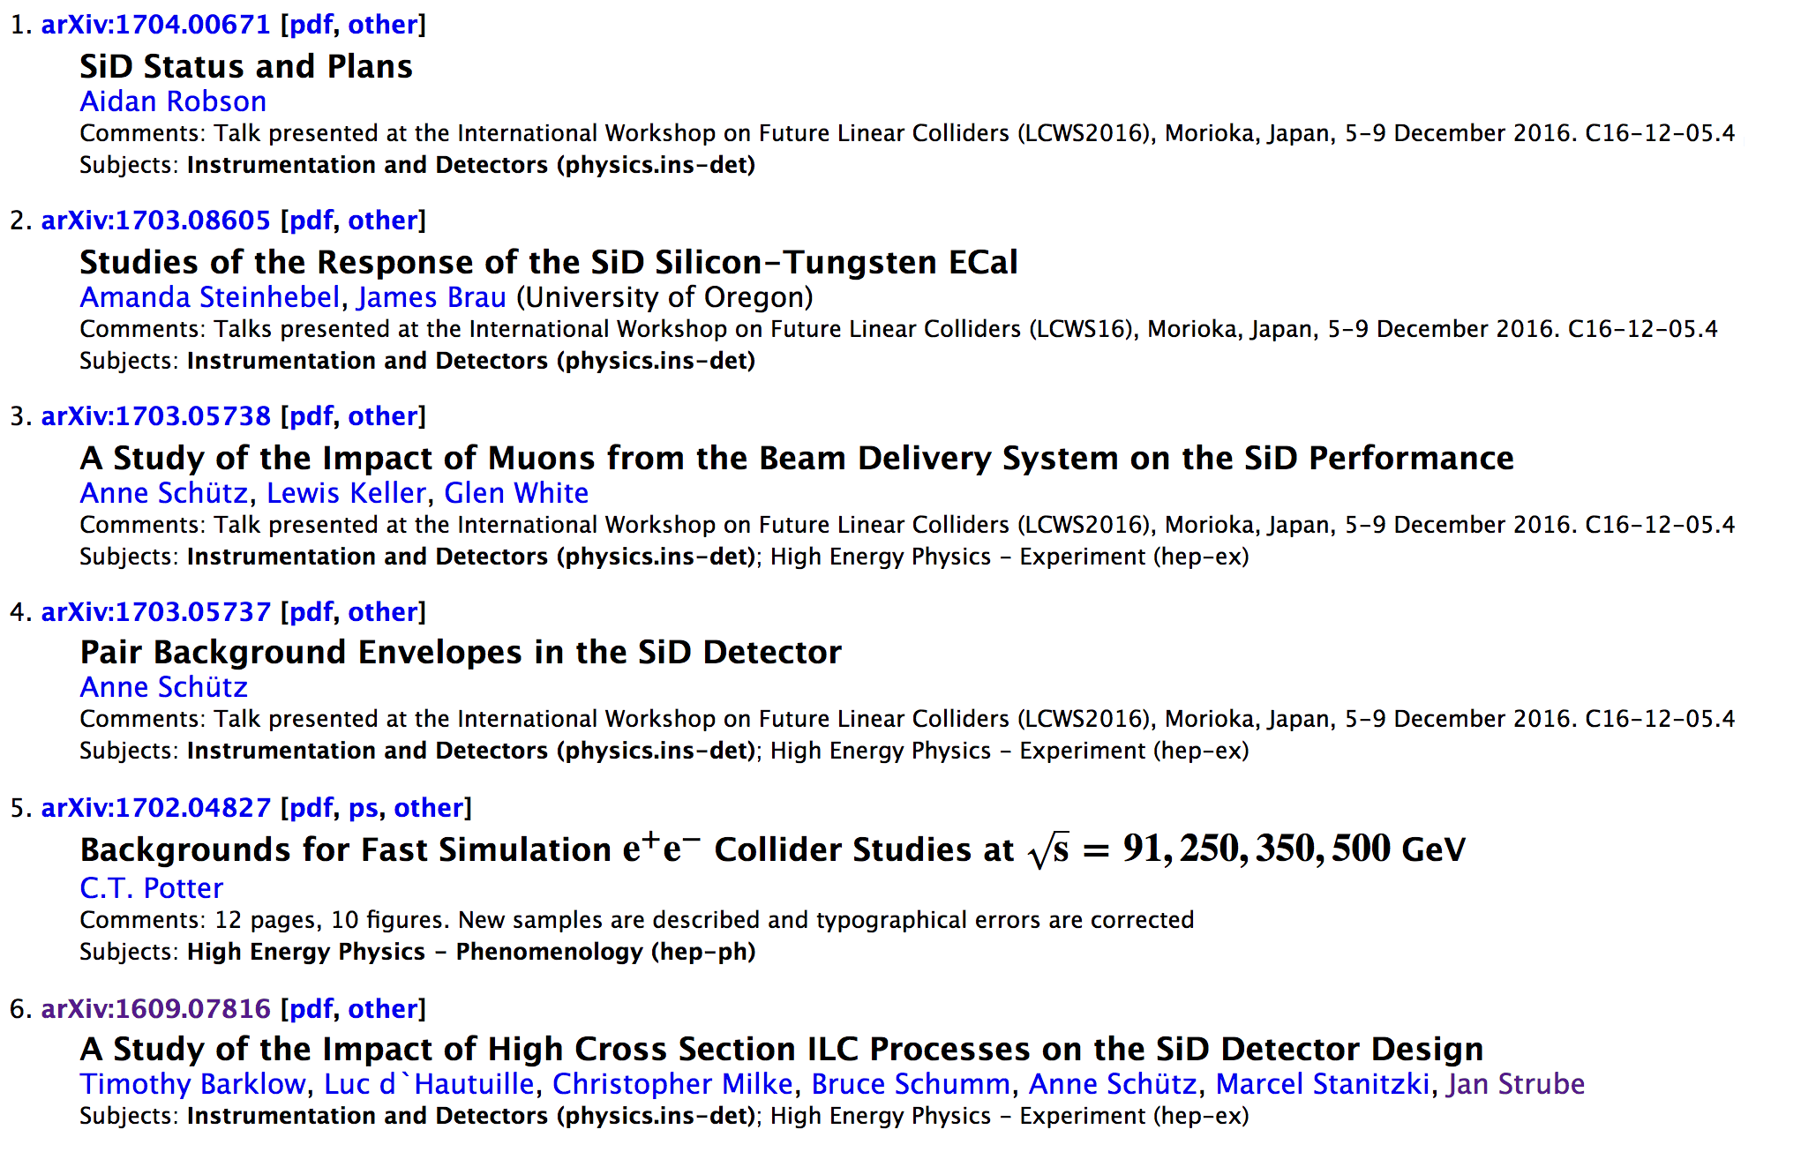
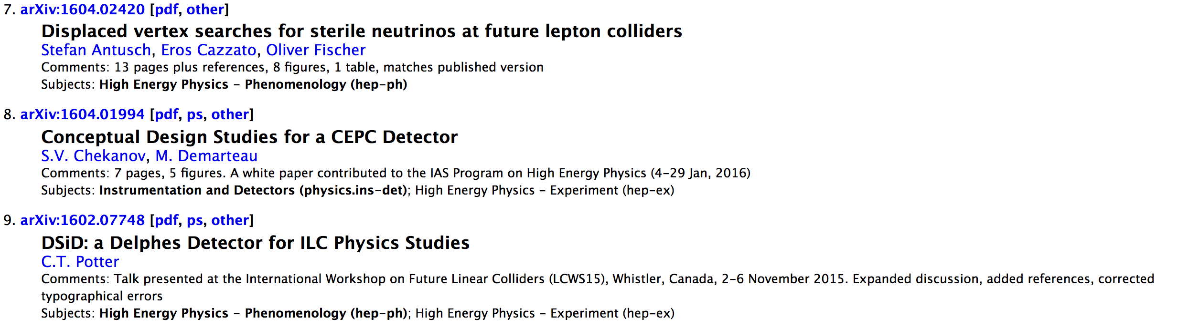

Slide 4
Existing Notes
A Study of the Impact of High Cross Section ILC Processes on the SiD Detector Design https://arxiv.org/abs/1609.07816
…

Slide 5
Notes to come (hopefully)
Oregon ECAL studies
UCSC forward processes
Glasgow simulation model
Bristol / PNNL alignment
DESY neutrons
UCSC neutrons
DESY muons
Pair envelopes
…
These don’t have to be arXiv – level documents.

Slide 6
Collaborative Tools
Code development
  development on github seems to work well
  contributions to LCIO and LCFIPlus
Documentation
  This is still a big headache
  https://wikis.bristol.ac.uk/display/sid/SiD+Wiki
  https://confluence.slac.stanford.edu/display/ilc/Home
  https://confluence.slac.stanford.edu/display/SiD/SiD+Confluence+Wiki
  https://twiki.ppe.gla.ac.uk/bin/view/LinearCollider
  We need to resolve this urgently

Slide 7
Priorities for the next couple months
Wrap up existing studies
  update for 250 GeV priorities where necessary
Continue progress on understanding the detector in detail
  Studies of calibration details
  Studies of occupancies
Maintain the vision for the baseline program
  Regardless of what the current priorities are, the detector should operate in a 500 GeV ILC
  The 500 GeV stage is no longer the first one. We need to keep an eye on technology and start thinking more about upgrade paths and detector lifetimes

