Slide 1
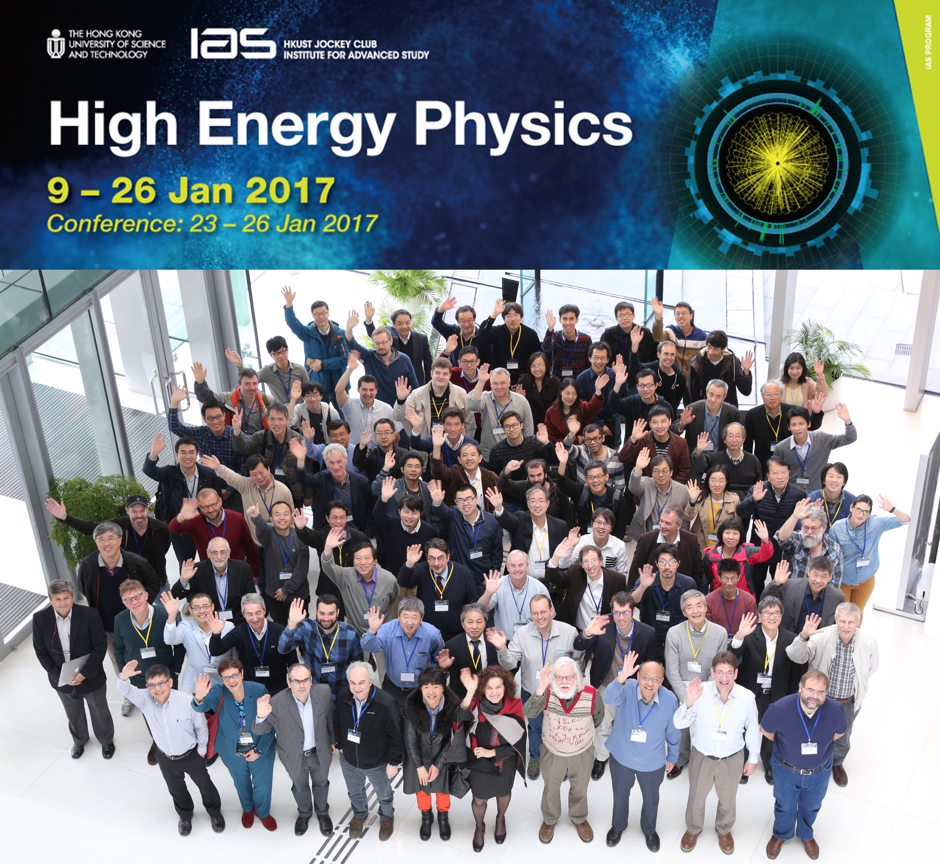
IAS Summary

Slide 2
The Program
Two weeks mostly discussions
Usually one talk in the morning, one in the afternoon
One week conference program
Theory, Accelerator, different experiments
http://iasprogram.ust.hk/hep/2017/program.html

Slide 4
Some Takeaway messages
Some People will keep telling you to wait with a decision for a new machine until their favorite project is approved
People take numbers for ILC Higgs precision measurements from random places
Marcel has initiated some discussions on a canonical place so that only agreed numbers are shown
CEPC people defer to the ILC for energies of 350 GeV and up
Yokoya-san: Large cost savings, if ILC not below 250 GeV (see also next slide and his talk for details)
CEPC is still very much interested in a 91 GeV hi-Lumi run

Slide 6
CEPC news

Slide 11
Panel Discussion
Members
Phil Burrow, Yifang Wang, Akira Yamamoto
Michelangelo Mangano , John Ellis, Riccardo Rattazzi
Some Key points
Luminosity/Power as new figure of merit
Running on ttbar is for the ILC

Slide 12
Comparisons of Future Lepton Colliders (as of 17/01/26)
 | Unit | ILC H, tt_{-bar}, HHZ, tt_{-bar}H | CLIC tt_{-bar}, tt_{-bar}, . . . | CEPC Z / HZ | FCC-ee H / tt_{-bar}
Technology |  | Linear SRF, Klystron-driven | Linear NRF, Two-beam-driven | Circular SRF | Circular SRF
Energy (CoM) | GeV | 250 | 500 | 1,000 | 380 | 500–A/B | 3,000 | 91 / 240 | 240 / 350
Acc. Length | km | ~21 | 31 | 50 | 11 | 13 | 48 | 100 | 100
Lumin. / IP | 10³⁴ cm⁻²s⁻¹ | 0.82* | 1.8 | 3.6 | 1.5* | 2.3 | 5.9 | 18 / 3.3 ** | 5.1 / 1.3 **
Acc. Gradient | MV/m | 31.5 | 31.5 | 31.5/45 | 72 | 80/100 | 100 | 14
Res. Frequency | GHz | 1.3 | 1.3 | 1.3 | 12 | 12 | 12 | 0.65 | 0.65
IR, v. beam-size | nm | 7.7 | 5.9 | 2.7 | 2.9 | 2.3 | 1 | -- | --
Beam Power | MW (2-beams) | 2 x 2.9 | 2 x 5.2 | 2 x 13.6 |  | 2 x 4.7 | 2 x 14 | -- | --
SR loss | MW |  |  |  |  |  |  | 12.7 / 30 | 100 (tbc)
AC Power | MW | 129 | 163 | 300 | 252 | 271 | 589 | 89 / 210 | 308 / 364
L / AC-P. | Relative | 0.64* | 1.1 | 1.2 | 0.60* | 0.85 | 1.0 | 22 / 1.6 ** | 1.7 / 0.52**
* enable to be further optimized for staging
** effectively x 2 (N_{IR})
A, Yamamoto, 17/01/26

Slide 13
Summary
Great Workshop
Discussions, Talks, Atmosphere
Clear Consensus
We want e⁺e⁻
Potential Best Outcome
ILC
Circular Z/W (maybe Higgs) Factory

