Slide 1
ILC DR Lower Horizontal Emittance?
K.Kubo
20170228

Slide 2
DR Lattice data
  M. Woodley gave ILC DR lattice (2016) in primitive format.
  Translation to SAD format looks OK.
Tried modifications of arc cell optics to reduce horizontal emittance.
Discussion on
  Dynamic aperture
  Electron cloud

Slide 3
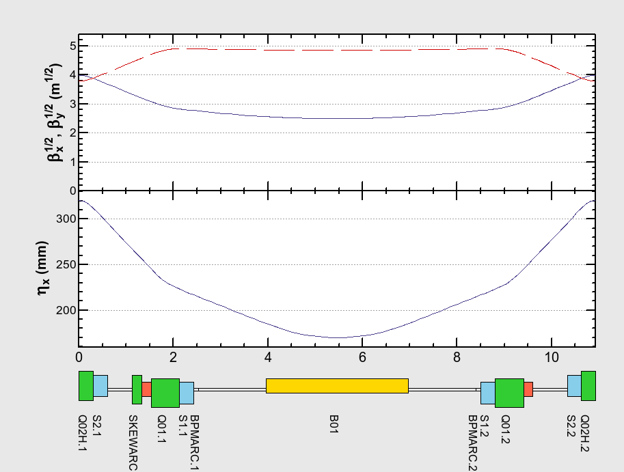
ILC-DR SAD deck was made from Lattice file 2016 (primitive form) by M.Woodley
Optics of Arc Cell
SAD
TDR

Slide 4
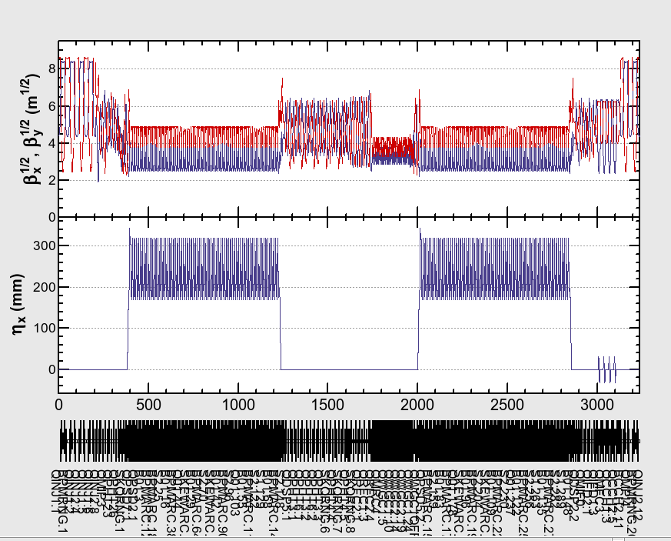
Optics of Whole Ring
SAD
TDR

Slide 5
Comparison of some parameters
 | SAD (deck translated from Woodley’s data) | TDR (MAD by M.W.)
Circumference (km) | 3.2386807 | 3.238 (3.238680589)
Damping time x/y/z (ms) | 23.88/23.87/11.94 | 23.95/23.95/12.0
Bunch length (mm) wo, w IBS | 6.23, 6.25 | 6.02
Energy spread (%) wo, w IBS | 0.111, 0.111 | 0.11
Horizontal normalized Emittance (um) wo, w IBS | 5.74, 6.09 | 5.7
Tune x/y | 48.264315 /26.762788 | (48.264313 /26.762786)

Slide 6
Horizontal Emittance in TDR
At IP: 10 um
At Linac end: 9.4 um
At Linac entrance: 8.4 um
Growth in RTML: 0.9 um (synchrotron radiation)
In DR: 6.1 um
0.9 in RTML, but source of other 3 um growth is not clear.
(90 nm (1.1%) in the Arc, 380 nm (4.8%) in the Turn-around, and 430 nm (5.4%) in the Bunch Compressor in its nominal configuration)
For 5 um at IP, ~4 um in DR is OK??????

Slide 7
Per lattice file "ilc000.ILC_common.xsif", emittances budget are following:
Emittance budget parameters (500 GeV cm, "Nominal" parameter set)
EXN_DR := 8.0E-6 !damping ring extraction
EXN_ML1 := EXN_DR*(1.10) !10% growth in bunch compressor
EXN_ML2 := EXN_DR*(1.12) !2% growth in main linac (part 1)
EXN_BDS := EXN_DR*(1.15) !5% growth in main linac (total)
EXN_IP1 := EXN_DR*(1.20) !5% growth in beam delivery (1)
EXN_IP2 := EXN_DR*(1.20) !5% growth in beam delivery (2)
EXN_IP := 1.0E-5 !parameter table
EYN_DR := 2.0E-8 !damping ring extraction
EYN_ML1 := EYN_DR*(1.20) !20% growth in bunch compressor
EYN_ML2 := EYN_DR*(1.40) !20% growth in main linac (part 1)
EYN_BDS := EYN_DR*(1.70) !50% growth in main linac (total)
EYN_IP1 := EYN_DR*(2.00) !30% growth in beam delivery (1)
EYN_IP2 := EYN_DR*(2.00) !30% growth in beam delivery (2)
EYN_IP := 4.0E-8 !parameter table
Nikolay

Slide 8
Reduction of horizontal emittance
Reduce dispersion and/or beta_x in bending magnets
No change in straight sections (for simplicity)
A: Strengthen quadrupole field of arc cell
B: Reduce length of arc cell (increase number of cells)
Matching with straight sections: by tuning quadrupoles in Dispersion Surpressor (2 bends for each end)

Slide 9
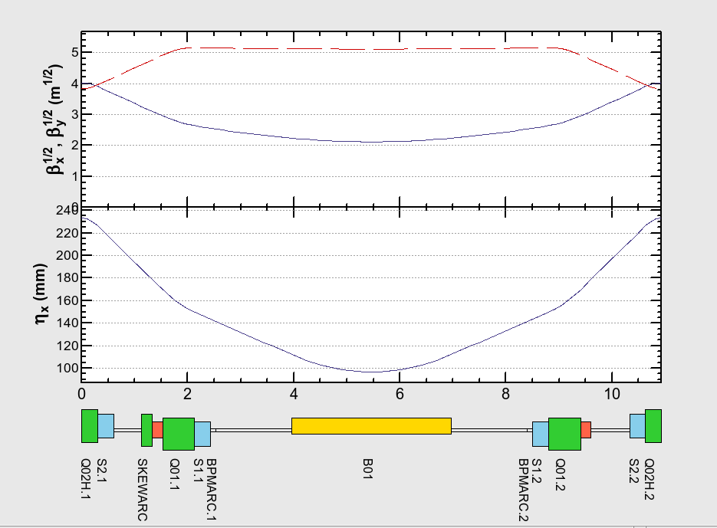
Strengthen Quadrupole field -1
Q02H (focus) x1.163, Q01 (defocus) x1.103

Slide 10
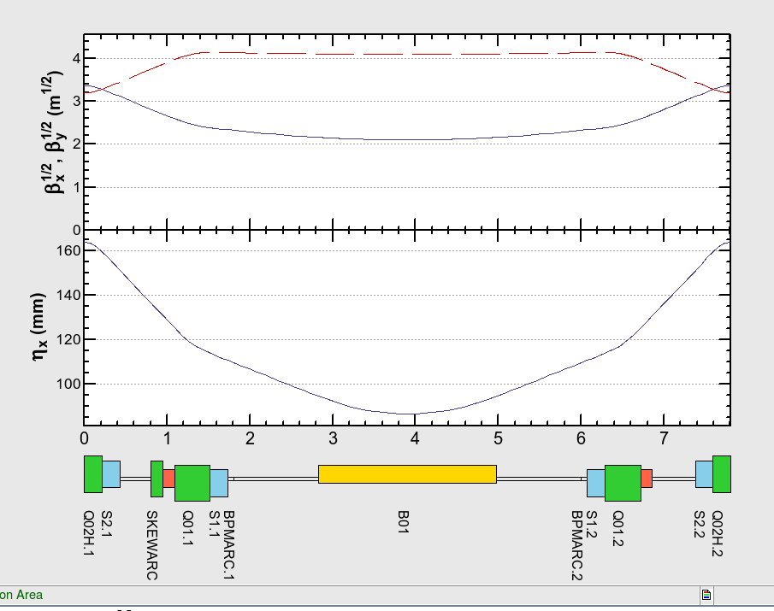
Reduce arc cell length (increase number of cells, 75 -> 100/arc)
(Strengthen quadrupoles)

Slide 11
 | Original | Stronger Q -1 | Stronger Q -2 | Shorter Cell
Horizontal normalized Emittance (um) wo, w IBS | 5.74, 6.09 | 3.47, 3.86 | 3.45, 3.86 | 2.96, 3.40
Tune x/y | 48.26/26.76 | 56.19/25.60 | 56.33/27.24 | 73.85/31.76

Slide 12
Dynamic aperture?
Small horizontal emittance needs small beta_x and small dispersion
Need strong sextupole field for chromaticity correction
Smaller dynamic aperture cannot be avoided?
Aperture in TDR is already tight compare with assumed injection positron beam quality.
(positron beam quality was determined by DR aperture?)
TDR: “In practice, the dynamic aperture shrinks as the focusing strength is increased to reduce momentum compaction.”
Proceedings of IPAC2011, MOOCA03 “UPDATES TO THE INTERNATIONAL LINEAR COLLIDER DAMPING RINGS BASELINE DESIGN” Susanna Guiducci,et.al.: “There is some flexibility to vary emittance and momentum compaction by adjusting the arc cell focusing, but typically this comes at the expense of dynamic aperture.”
???

Slide 13
Dynamic Aperture
TDR (with errors)
SAD (no error)
Dynamic aperture in TDR cannot be reproduced.. ??

Slide 14
Dynamic Aperture
Nominal SAD
Strong Q -2 SAD
Strong Q -1 SAD
Short Cell SAD

Slide 15
Electron Cloud
Electron cloud density will not depend on beam emittance.
Electron density threshold for instability will reduced for smaller horizontal emittance.
Threshold ~ (horizontal beam size)^{1/2} (see next slide)
~ (horizontal emittance)^{1/2}
TDR: 6.4.4.3 EC Instability
The above estimates of cloud density place an upper limit on the ring-averaged density of about 4×10¹⁰m⁻³, about a factor of three below the expected single bunch instability threshold [110].
→ Probably OK

Slide 16
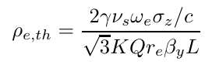
Formula from Ohmi
E-cloud density threshold:

