Slide 1
Back to the Beginning
This may change everything…or nothing.
Ryan Bodenstein
FONT Meeting
2017/2/24

Slide 2
Nothing was working!!
Tried everything that is currently done with the Local scheme
Re-did the lattice to include 4 dimensionless skew sextupoles
All results showed almost negligible improvement
Decided to go all the way back to the beginning
  Investigate all the parameters used
  Turns out, taking over a project means that I also inherited previous oversights

Slide 3
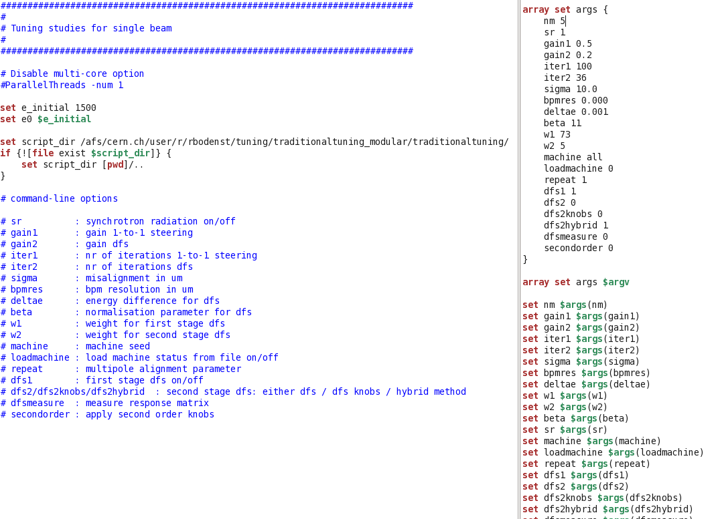
Let’s start at the actual beginning:

Slide 4
Let’s start at the actual beginning:

Slide 5
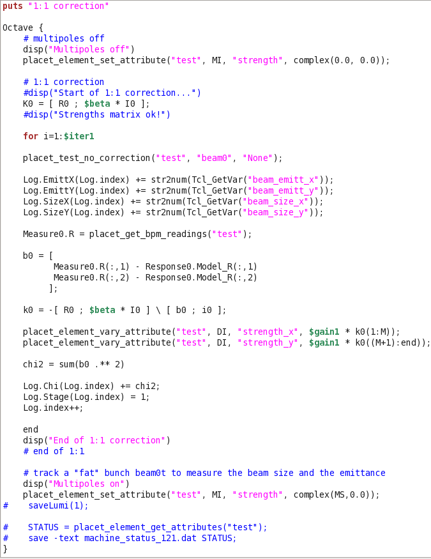
Here’s the 121 Code:
Here’s the first place β is used
This is essentially a weighting function for the dipole kicks being applied
Should be nonzero, or 121 tuning will not occur

Slide 6
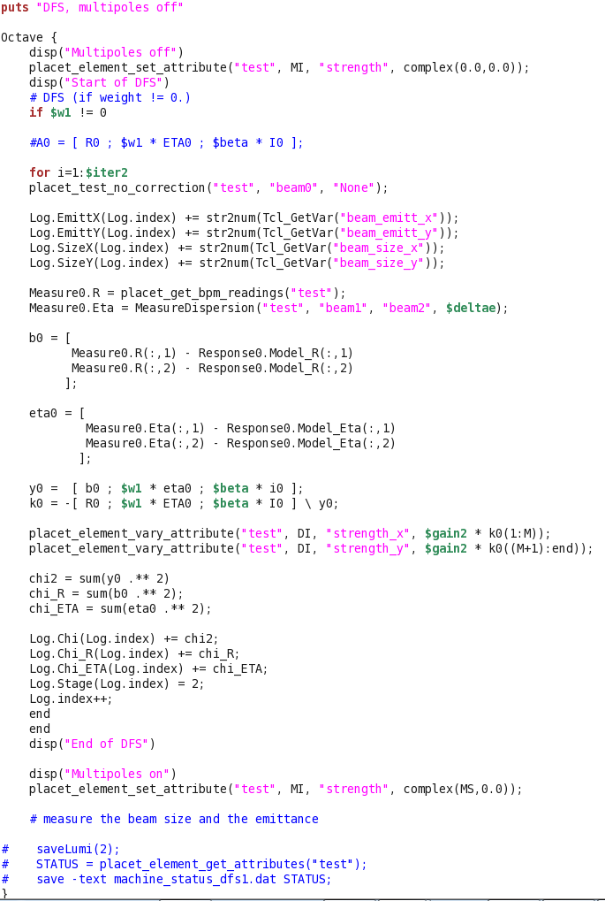
Here’s the DFS1 Code:
Here both β and ω₁ are used
Again, these are weighting factors, applied to a different correction scheme
If ω₁ is zero, then DFS1 cannot occur, but 121 still can

Slide 7
Need to scan the parameters!
Had assumed (believe I was actually told) that these terms were already accurately determined
  True for the Local scheme
  Unsure if true for Traditional (looks like it wasn’t true)
Currently scanning β and ω₁ to see what values should actually be used
Requires MANY batch jobs (currently 4320 jobs * 40 machines = 172,800 seeds, plus re-run failures)
To save time, looking at beam size instead of luminosity
  Two preliminary possibilities:
    DFS1 may be making things worse
    May have to tune each plane independently

Slide 8
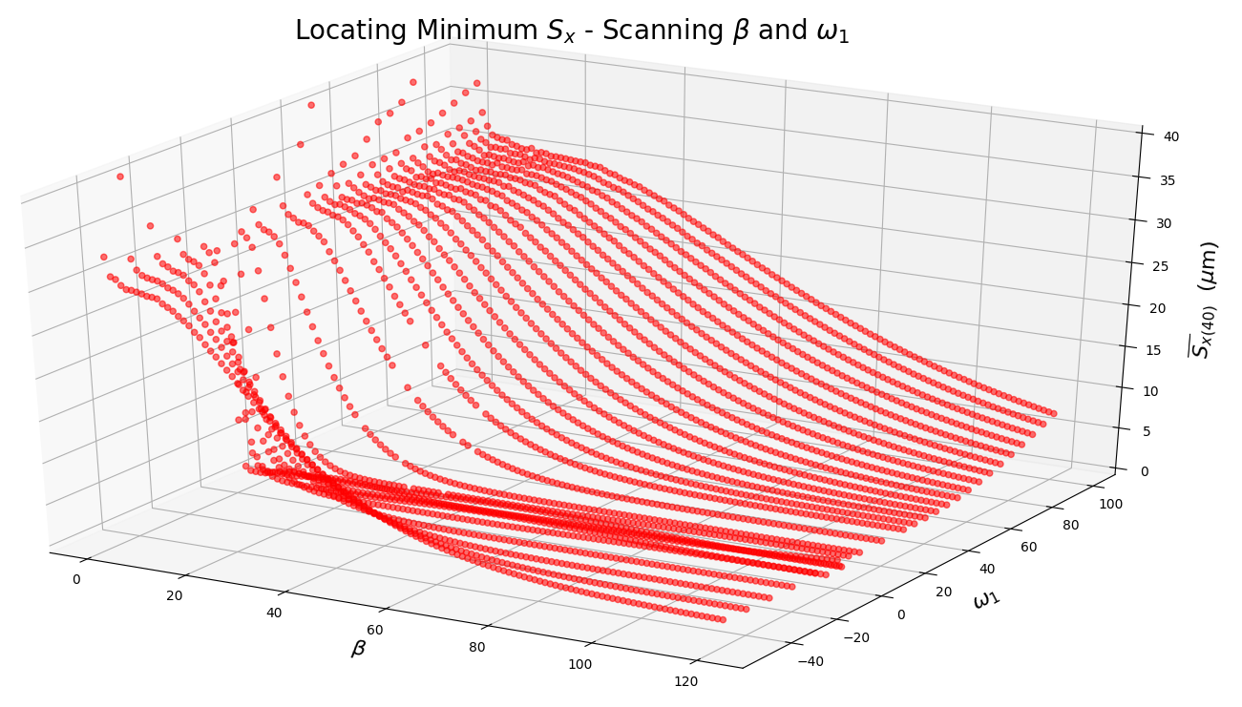
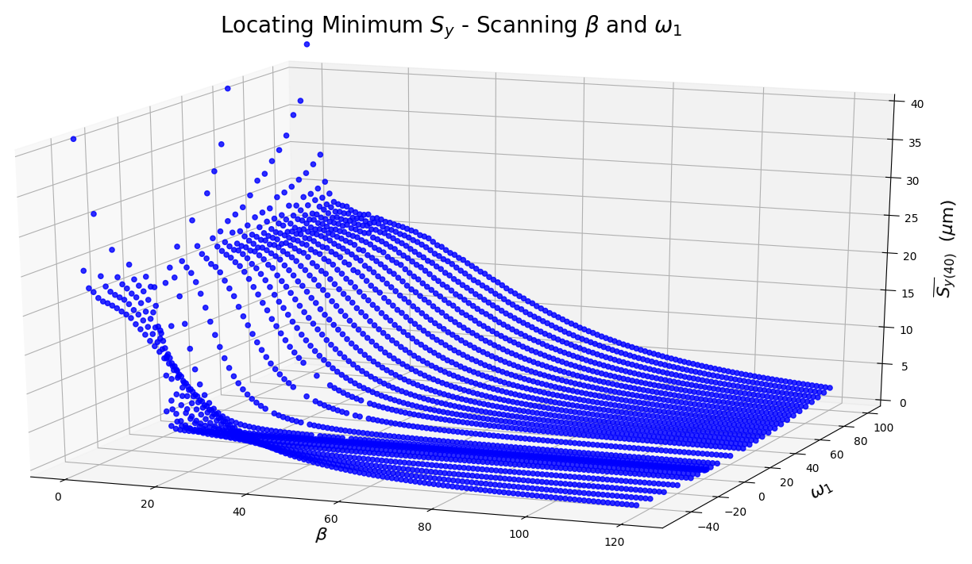
Each point is the average of 40 machines (seeds)
These results are preliminary – still running ~1200 jobs (40 machines each)
When including ω₁ = 0, best results:
  β = 1, ω₁ = 0
  Sx = 0.462127568975
  β = 11, ω₁ = 0
  Sy = 0.0779053202139
When excluding ω₁ = 0, best results:
  β = 118, ω₁ = -5
  Sx = 1.56542499589
  β = 8, ω₁ = 1
  Sy = 0.230448485582

Slide 9
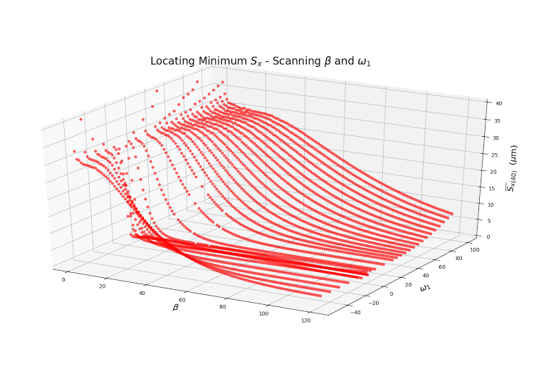

Slide 10
What’s next?
Need to see if DFS1 is behaving properly
  If so, need to see if it is necessary
    If so, why getting best results at ω₁ = 0?
If DFS1 is unnecessary, then need to run 100 seeds as a full simulation through 121 and save the outputs to use for the next part
  May require new tuning, separated by plane so that the proper weighting functions can be used
    This is true even if DFS1 is required
From saved machines, keep β the same and vary ω₂ to find correct value for DFS2
Once ω₂ found, run full simulations again, and save outputs
Using saved machine files, can then re-start tuning knobs procedures

