Slide 1
IP electronics tests
N. Blaskovic, T. Bromwich, R. Ramjiawan

Slide 2
Outline
Repeating some of the anomalous IP processing electronics diagnostic tests on the first stage and the limiter.
Check for unwanted harmonics in the output of the frequency multiplier
Look at the output of the first stage electronics with changing input power.
- The output power was previously found to not be decreasing with input power at low levels.
Look at the outputs of the limiting amplifier with changing input power.
- Output of the limiter diode in previously tests showed discontinuities due to difficulties using the oscilloscope.
- Output voltage of the beam intensity monitor was previously observed to be very jittery.

Slide 3
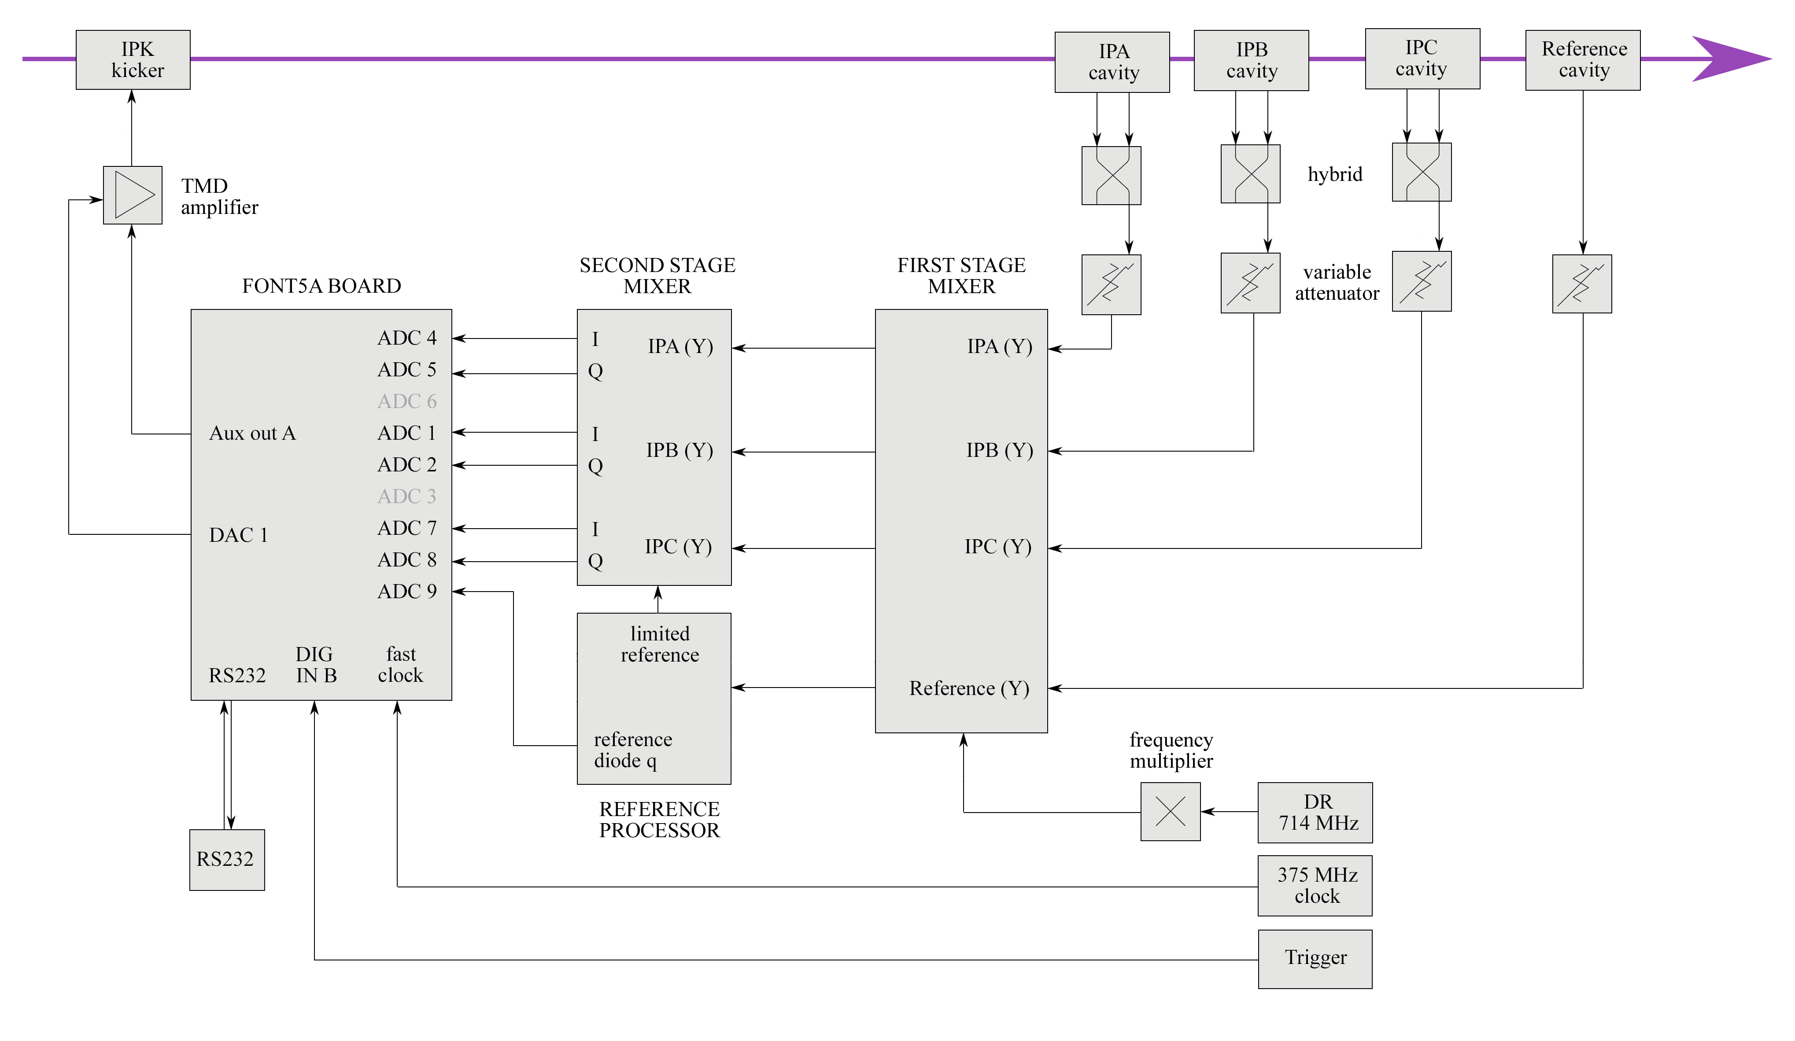
Reminder of IP electronics
First test:
output of the frequency multiplier
Second test:
output of the first stage reference
Third test:
outputs of the limiter; both the limited reference going into the second stage (Ref LO RF), and the reference diode (beam intensity monitor)

Slide 4
Output of the frequency multiplier
SPECTRUM
ANALYSER
y = 6.4 GHz
x = 5.7 GHz
Damping Ring
714 MHz
Frequency
Multiplier
Working without beam, look at the output of the frequency multiplier on a spectrum analyser.

Slide 5
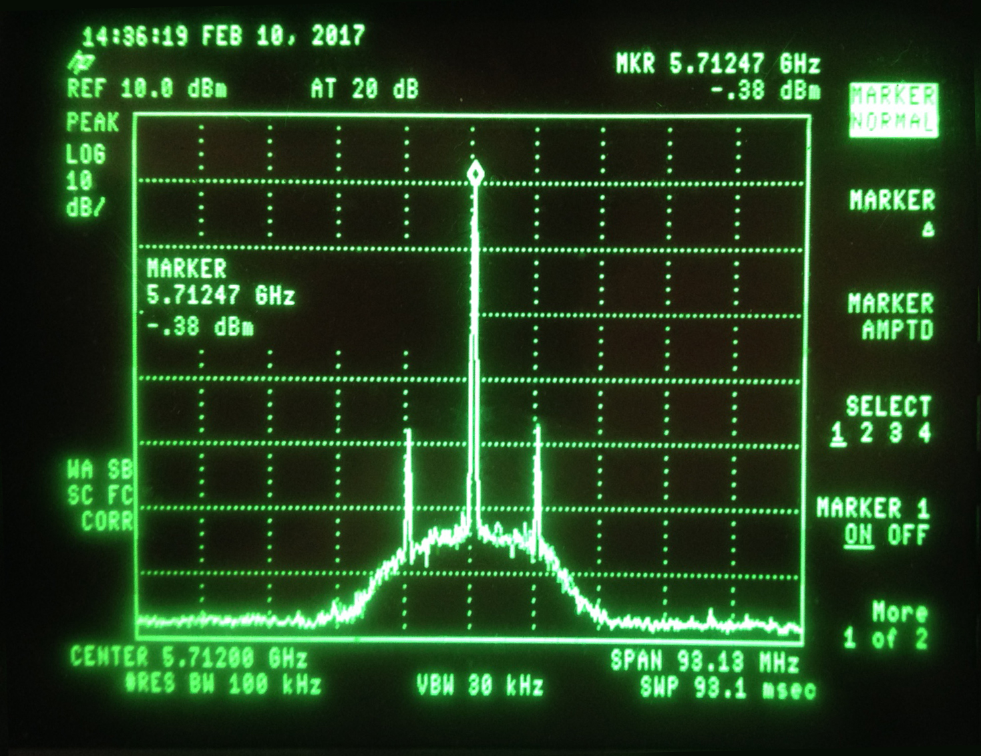
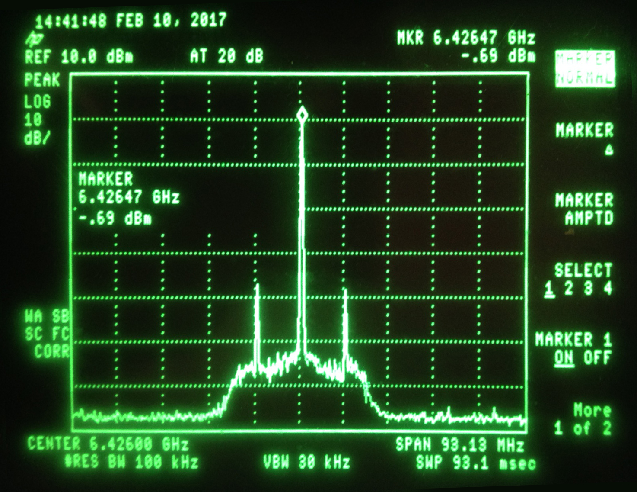
Outputs of the frequency multiplier
Look at the output of the 1st stage frequency multiplier using a spectrum analyser. Check the levels of 714MHz and other unwanted harmonics (particularly, +/-714MHz from the wanted output)
Both Y (5.712GHz) and X (6.426 GHz) LO outputs show peaks +/- 10 MHz either side of the required frequency.

Slide 6
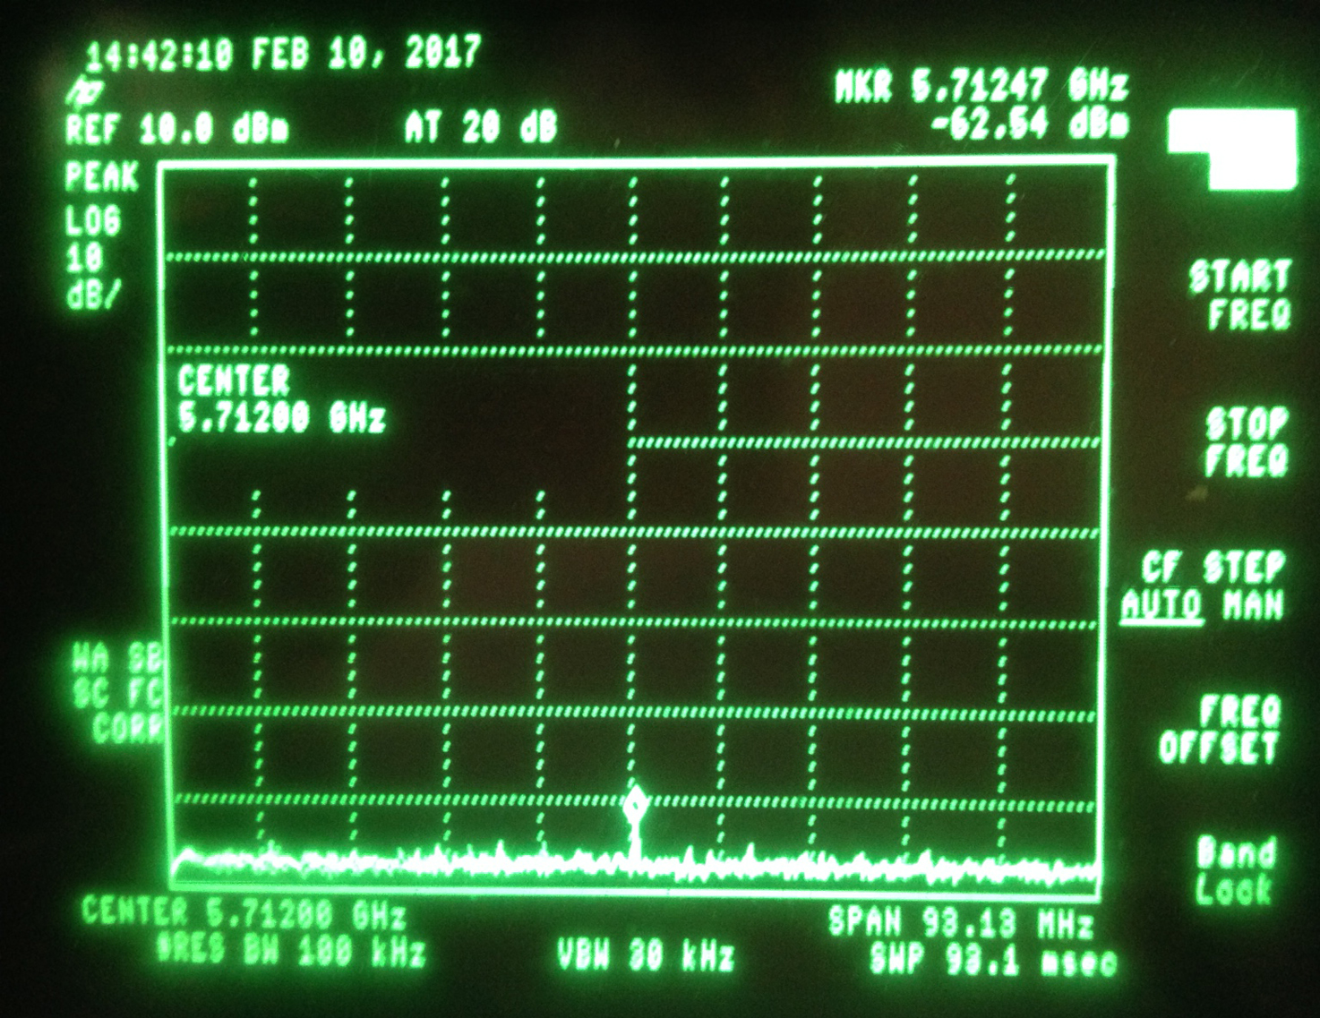
Outputs of the frequency multiplier
1GHz span scans from 0 to 10 GHz on both Y and X outputs to look for unwanted harmonics.
Only non-wanted peak found on X (6.426 GHz) LO output at Y LO frequency of 5.712 GHz, very low levels.

Slide 7
Reference output of first-stage
FIRST STAGE MIXER
Dipole
Reference
SIGNAL GENERATOR
y = 6.4 GHz
x = 5.7 GHz
SPECTRUM
ANALYSER
714 MHz
Damping Ring
714 MHz
Frequency
Multiplier
Working without beam, use a signal generator to produce 6.426 GHz.
Look at the outputs of the first stage on a spectrum analyser.
Change the strength of the signal generator to vary input power.
Monitor reference output power as a function of input power.

Slide 8
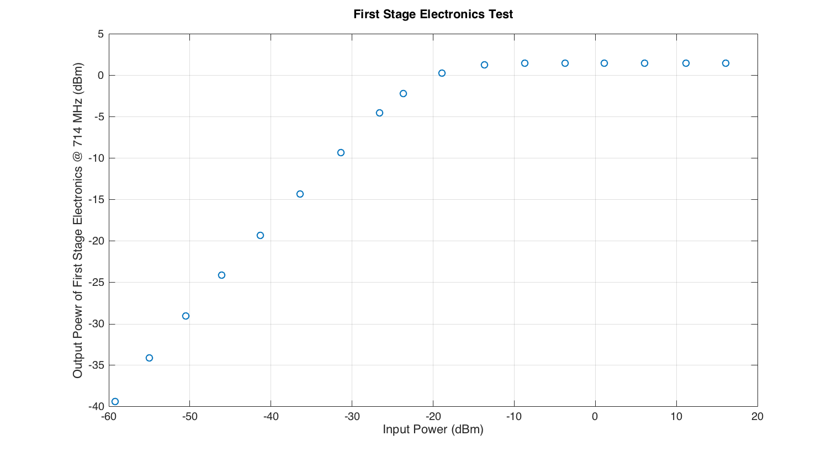
Reference output of first-stage
This is the plot that in previous tests showed the output powers not decreasing as the input powers were decreased to very low levels. This was found to be a fault with the signal generator which becomes “unlevelled” below 20 dBm. This new data was taken by placing 40 dB attenuation on the input signal to reach lower attenuation ranges.
Linear operating range below
-25 dBm. We typically place 50 dB attenuation on the reference input to the first stage.

Slide 9
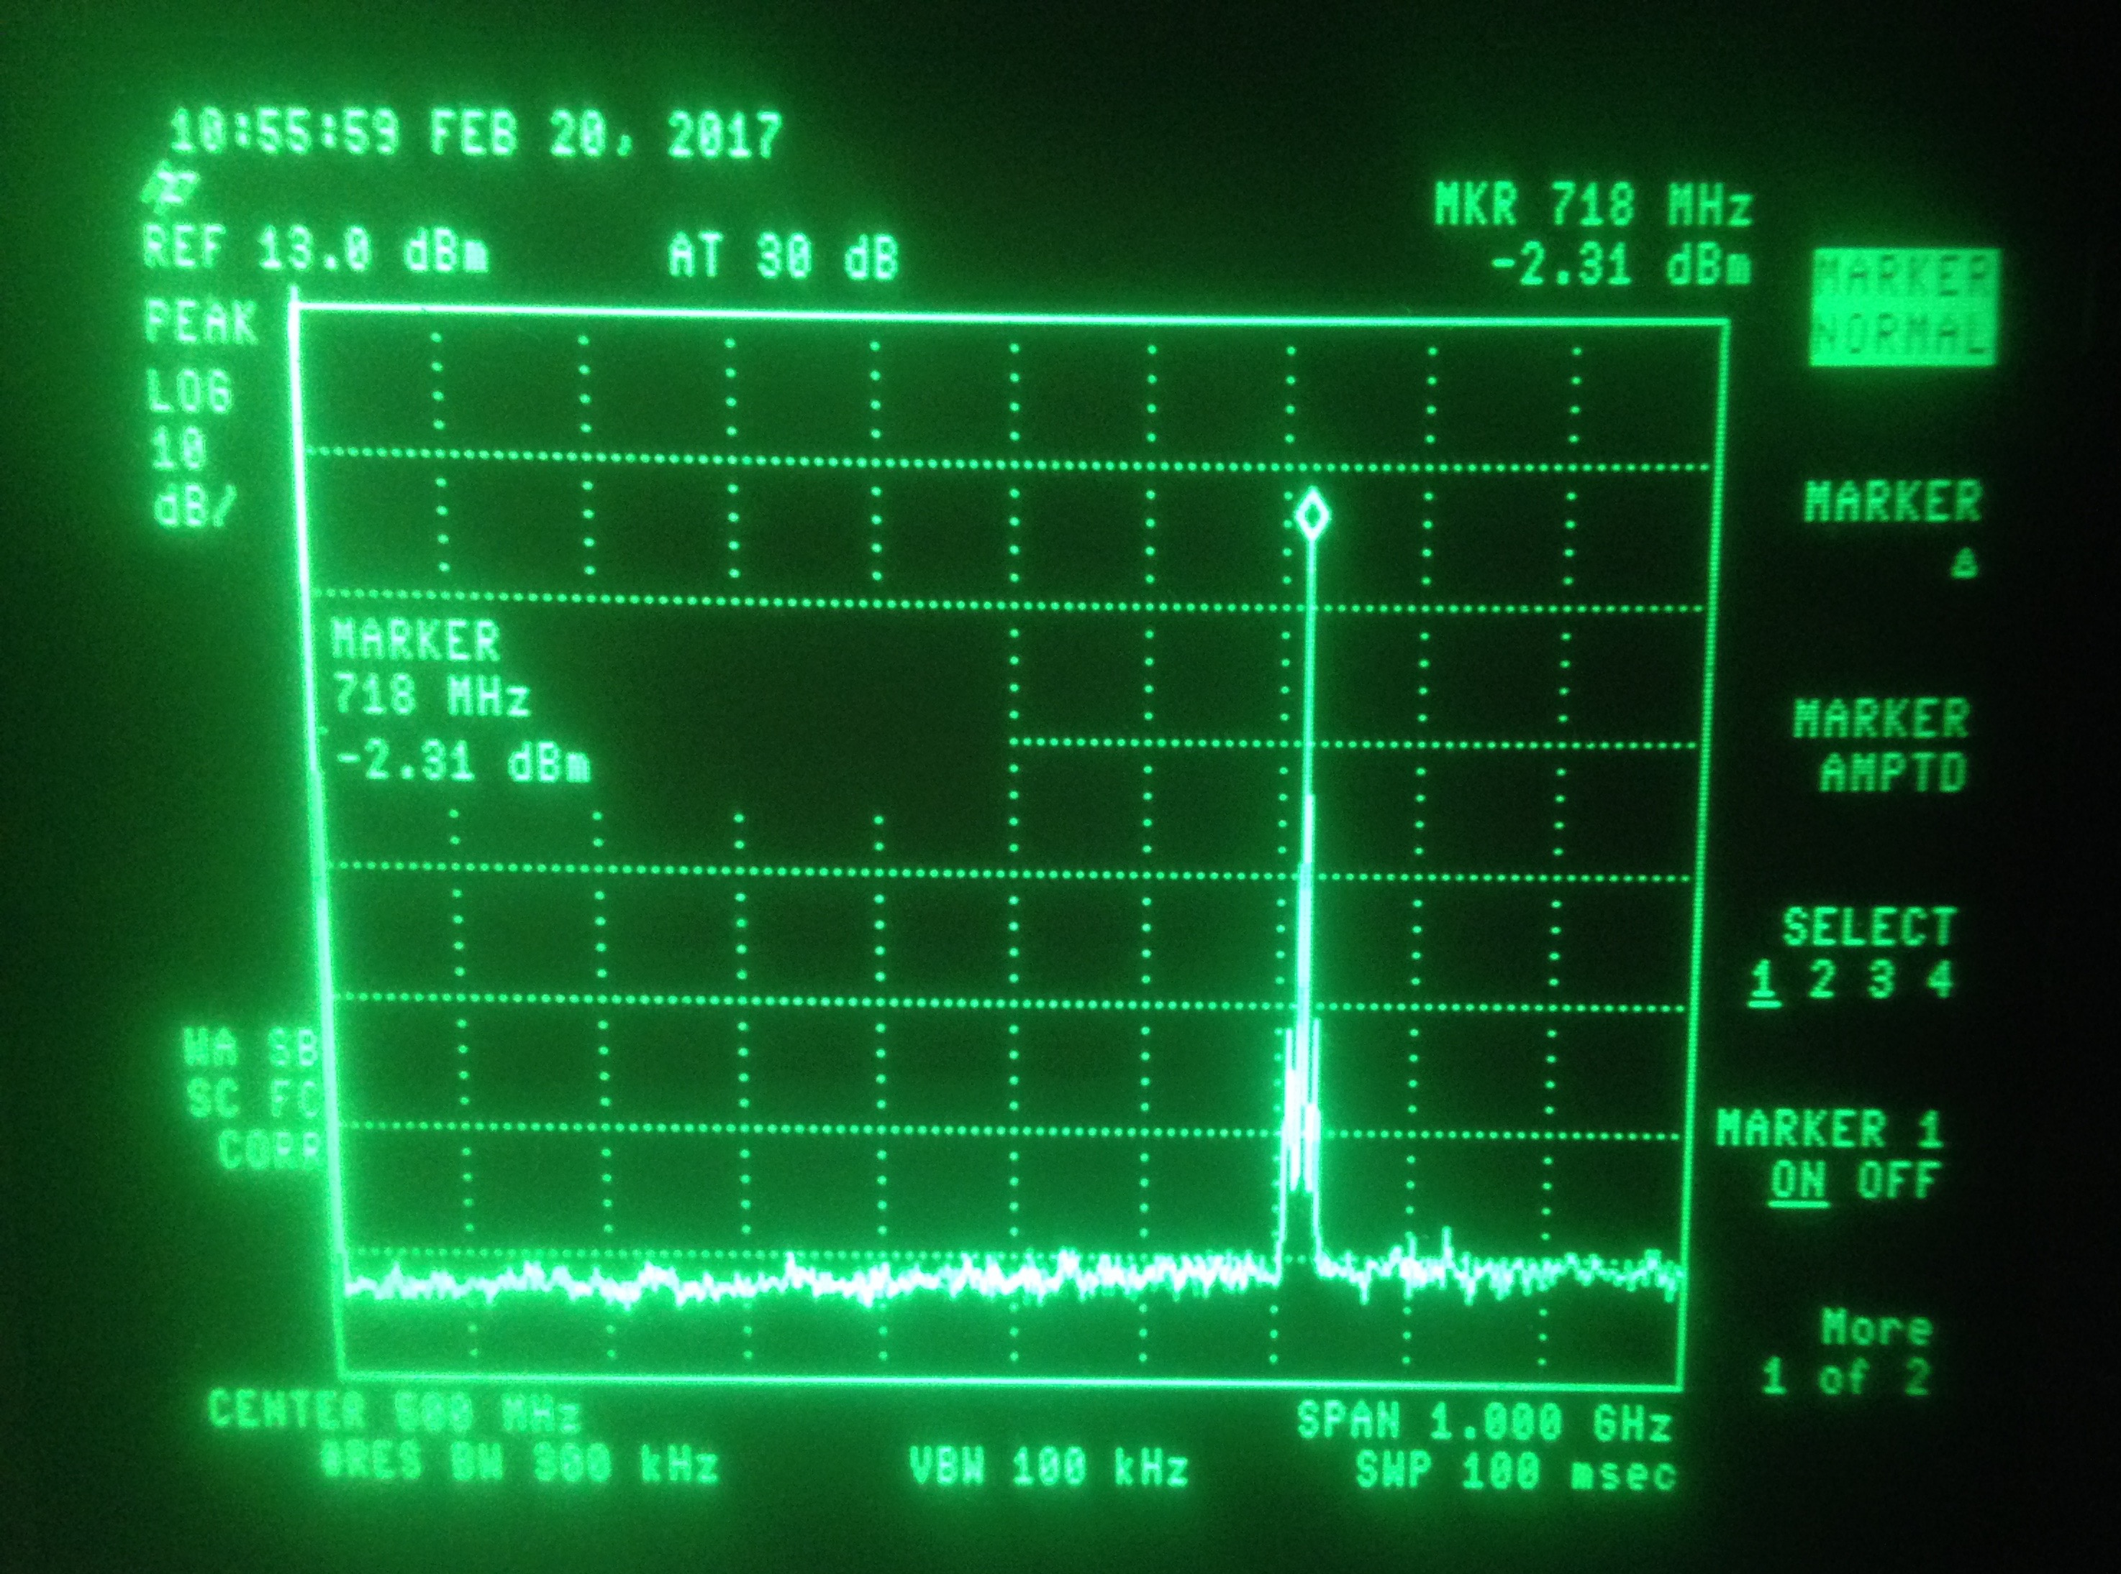
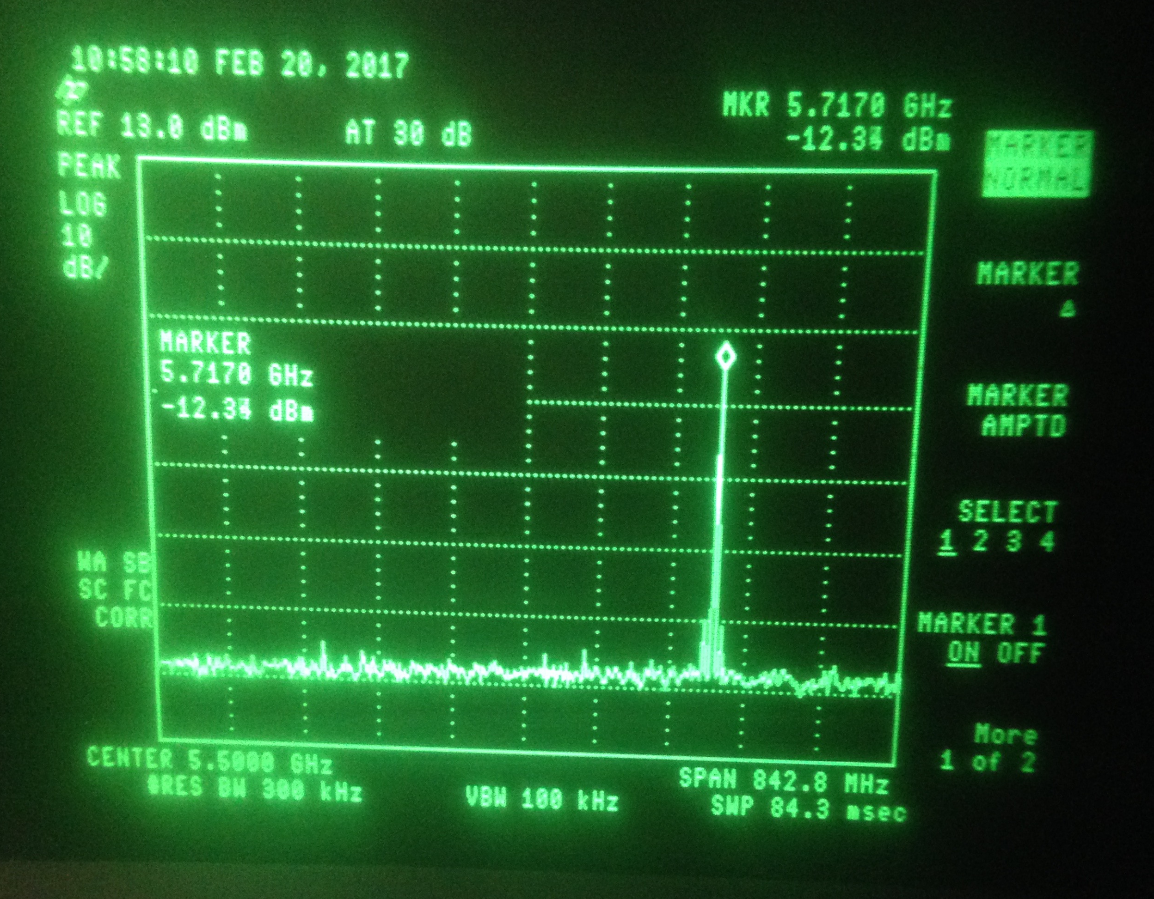
Reference output of first-stage
Lots of frequency multiples observed in the first stage output. These are (mostly) removed by the limiter, but they are recorded here anyway, along with their output power levels as measured on the spectrum analyser given an input signal ~ -20 dBm.
Frequency (GHz) Output Power (dBm)
0.714 -2.3
1.433 -55.8
2.141 -31.2
3.921 -55.8
4.287 -46.6
5.717 -12.3
6.426 -26.1
7.140 -41.2
Example screenshots of spectrum analyser.
Above: 714 MHz peak at -2.4 dBm. Below 5.7 GHz peak at -12.3 dBm.

Slide 10
Output of the limiting amplifier
FIRST STAGE MIXER
Dipole
Reference
SIGNAL GENERATOR
y = 6.4 GHz
x = 5.7 GHz
SPECTRUM
ANALYSER or
SCOPE
714 MHz
Limiting Amplifier
Damping Ring
714 MHz
Frequency
Multiplier
Provide the input to the first stage using a signal generator.
Change the strength of the signal generator to vary input power.
Monitor one of the output channels and the limiter diode.

Slide 11
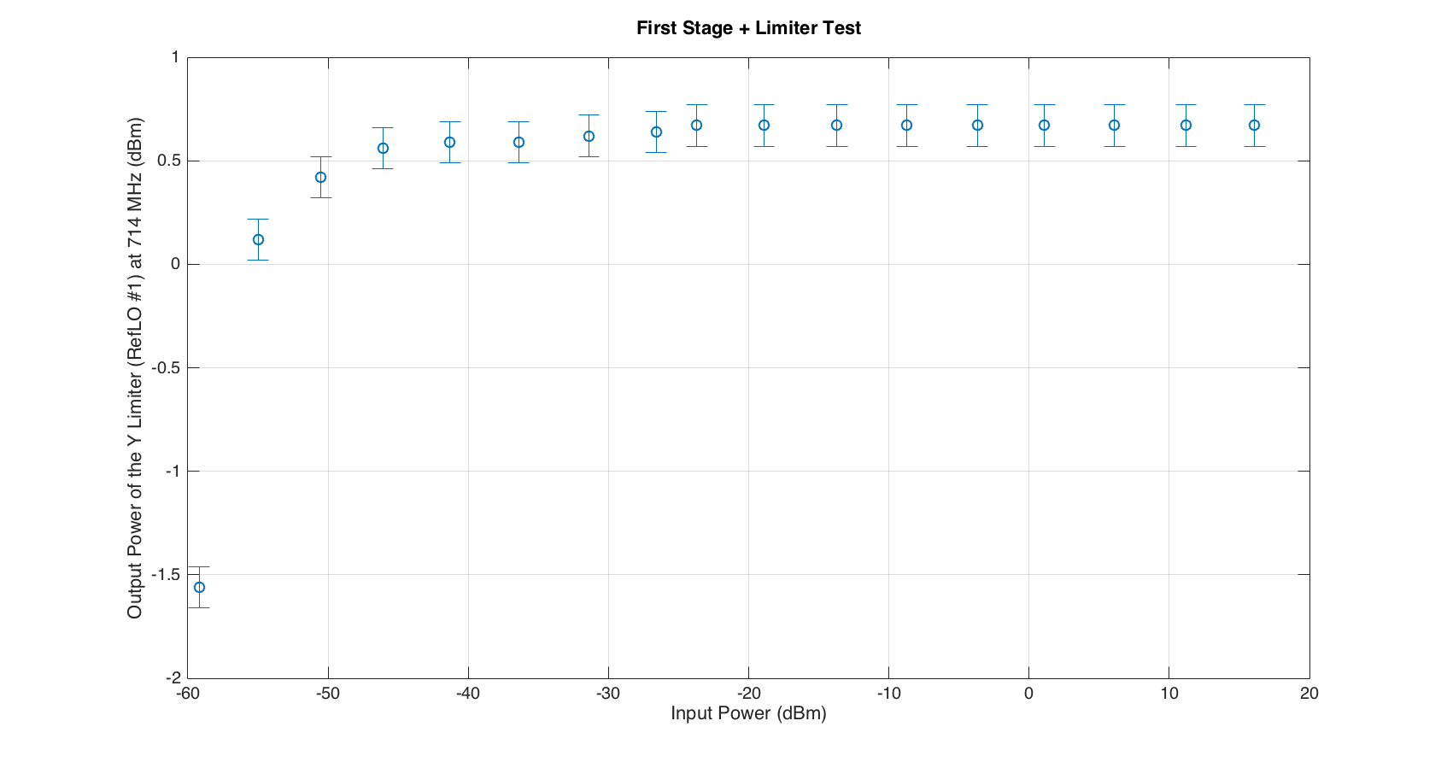
Output of the limiting amplifier
Output of the Y limiting amplifier, channel RefLO #1, at 714 MHz, as a function of the 6.426 GHz input power to the first stage electronics

Slide 12
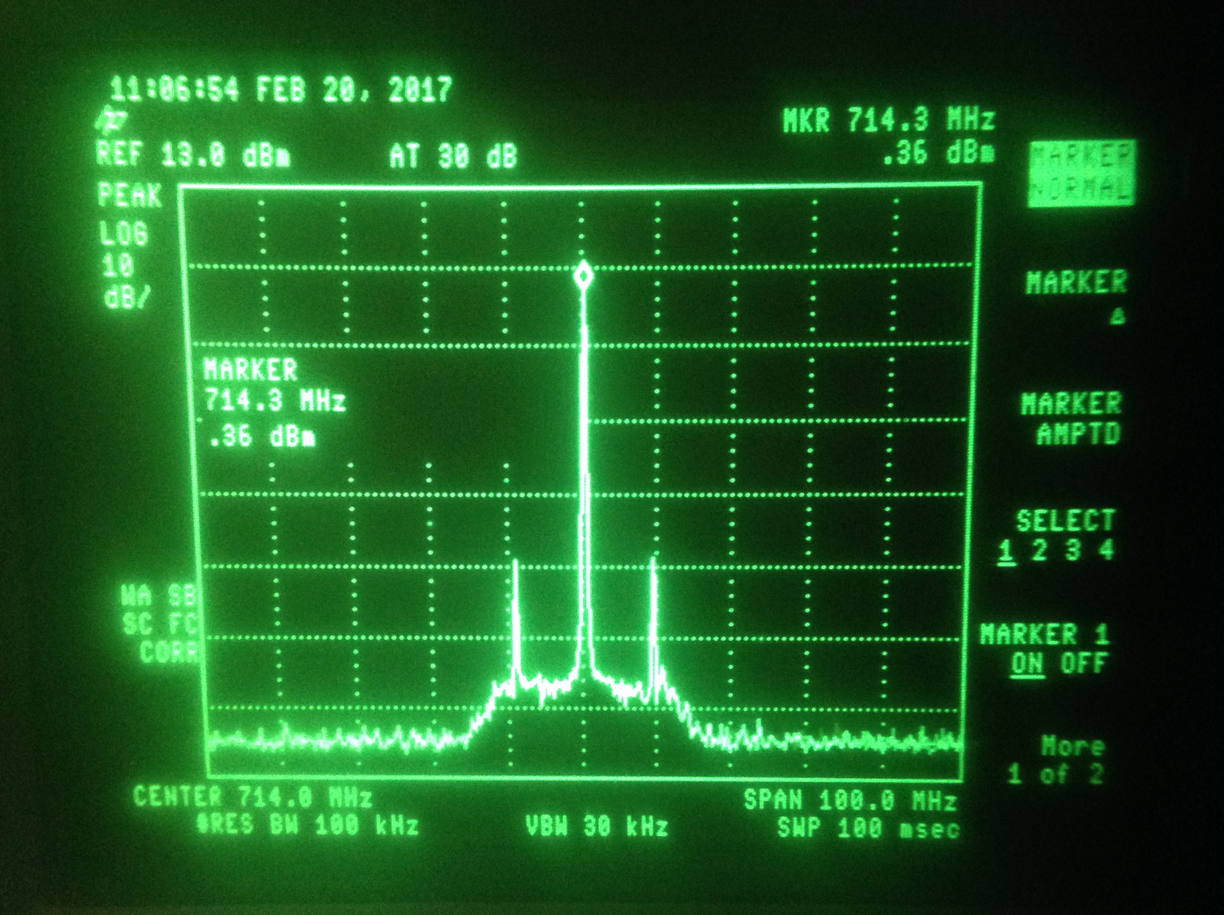
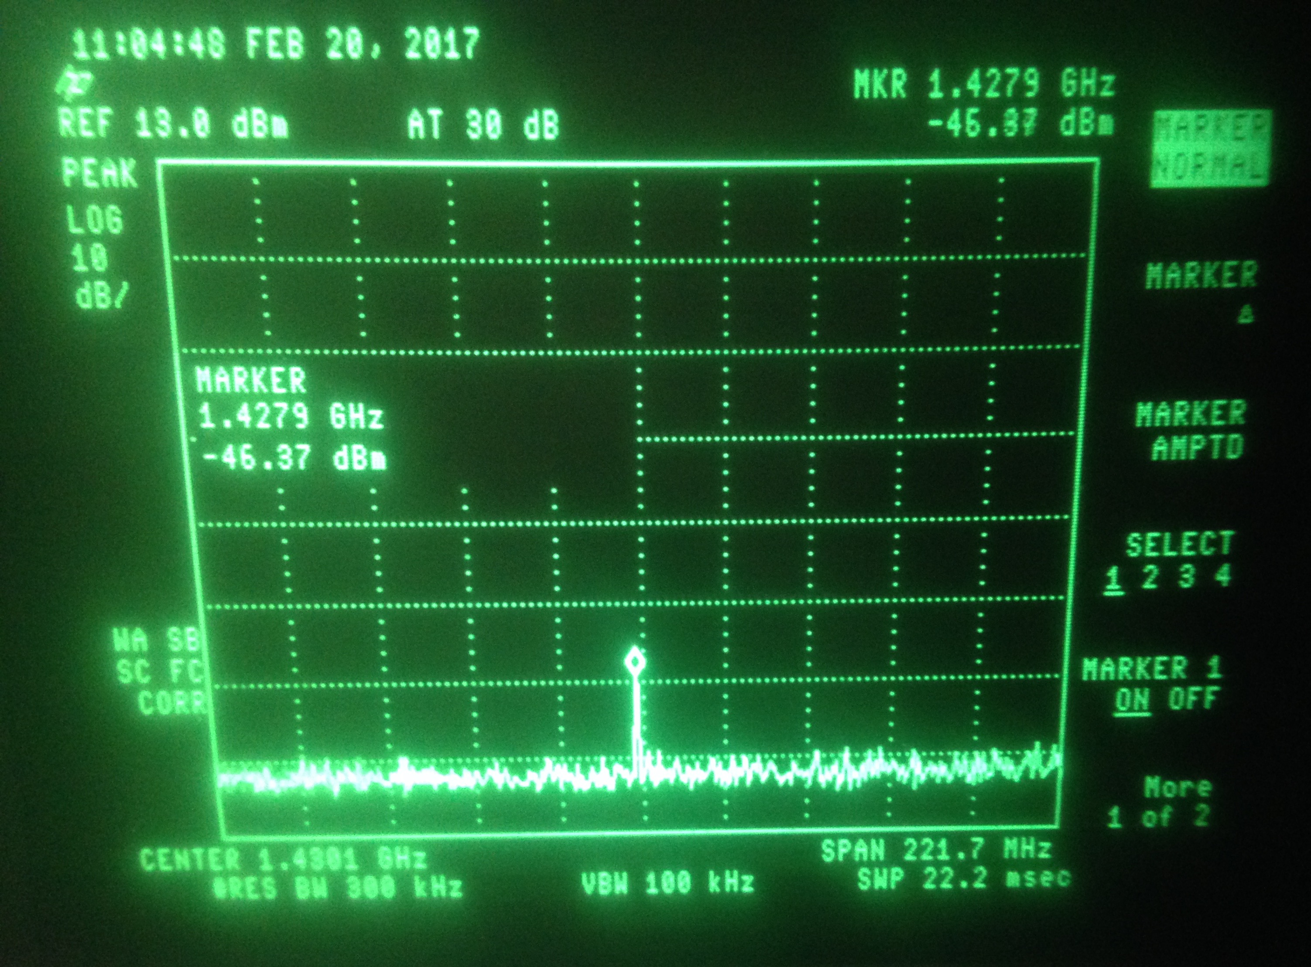
Output of the limiting amplifier
Almost all frequency multiples observed in the first stage output have been removed by the limiter. There is a very low-level peak observed at 1.43 GHz (see screenshots right).
Frequency (GHz) Output Power (dBm)
0.714 0.4
1.428 -46.9
The two peaks +/- 10 MHz either side of the 714 MHz (first observed when we tested the set-up briefly in the first week) are still clearly visible.

Slide 13
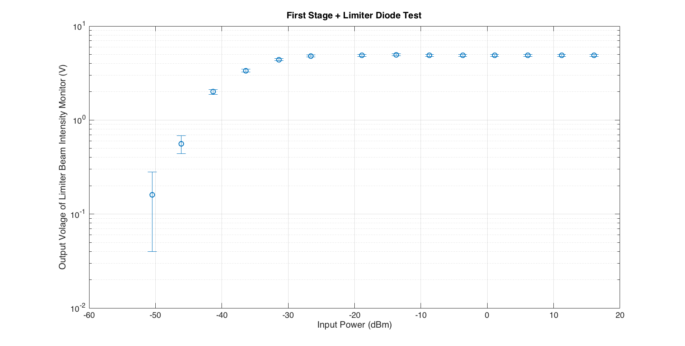
Output of the limiting amplifier - beam intensity monitor
Output of the Y limiting amplifier, beam intensity monitor, measured as
a DC voltage level on the oscilloscope at different input powers to the first stage electronics.

Slide 14
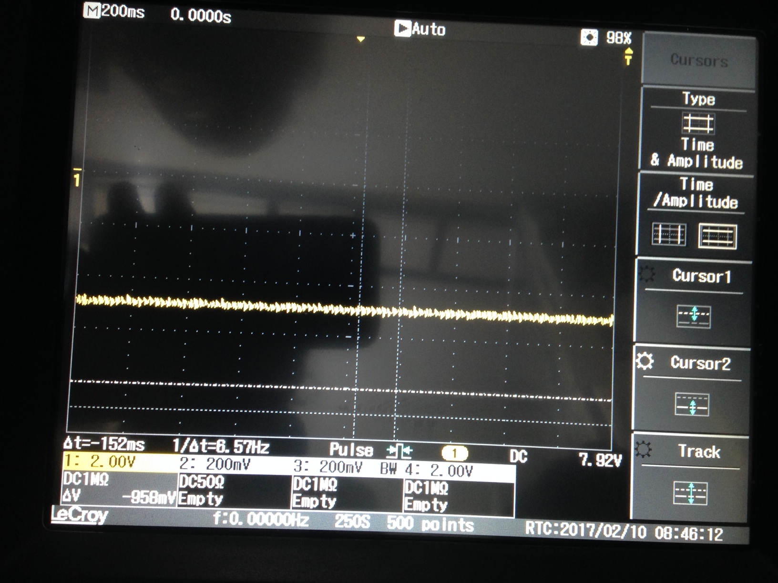
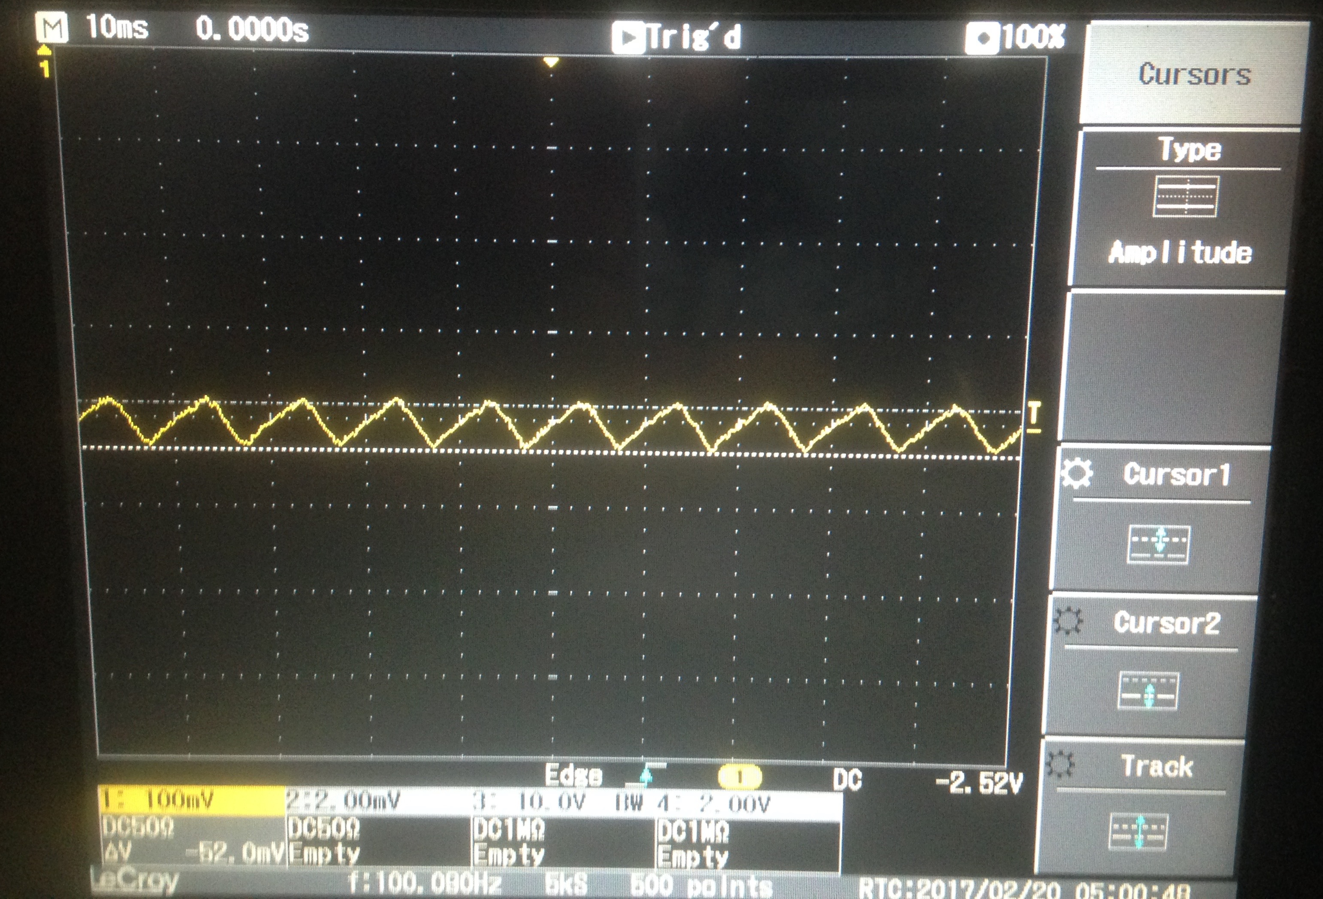
Output of the limiting amplifier - beam intensity monitor
On previous tests we saw a very jittery signal at discreet values. We hoped this was just a user error with the 1GHz scope settings.
Week 1, shown left, we were able to observe a static DC signal on the 200 MHz scope.
Week 2, shown right, using the 200 MHz scope again, shows a varying signal. What are we doing wrong with the settings?
Scope settings Wk 1 200ns per division
2 V per division
Scope settings Wk 2
10 ms per division
100 mV per division

Slide 15
Conclusion
Checked for unwanted harmonics in the output of the frequency multiplier
- Found two peaks +/- 10 MHz of the 714 MHz.
Looked at the output of the first stage electronics with changing input power.
- The output power is now decreasing with input power at low levels.
- Many multiples of 714 MHz observed in the output using the spectrum analyzer.
Looked at the outputs of the limiting amplifier with changing input power.
- Output power plotted as function of input power to the first stage.
- Slight remnant of 2 x 714 MHz signal observed on spectrum analyzer.
- Two side peaks +/- 10 MHz of the 714 MHz still observed.
- Output voltage of the beam intensity monitor plotted as a function of input power to the first stage.
- Some oscillation still observed in the output signal. User error?

