Slide 1
CRWG+PositronWG Status
K. Yokoya
2017.3.22 TCMB

Slide 2
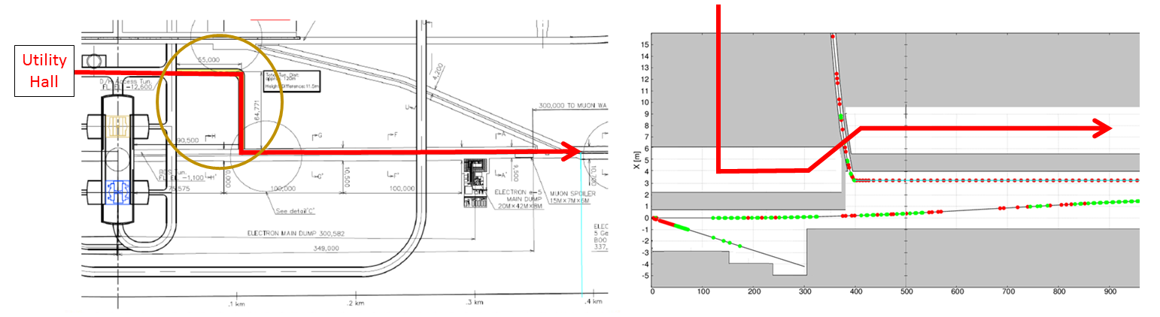
CRWG : CR for Positron BDS (1)
Going to submit Change Request on positron BDS tunnel
  drafted by Okugi & Miyahara
Positron BDS tunnel :
TDR: twin tunnel (linac end → LTR entrance)
single tunnel (LTR entrance → Detector Hall)
CR: kamaboko tunnel (linac end → Detector Hall)
  power line from utility hall near DH to BDS and electron linac

Slide 3
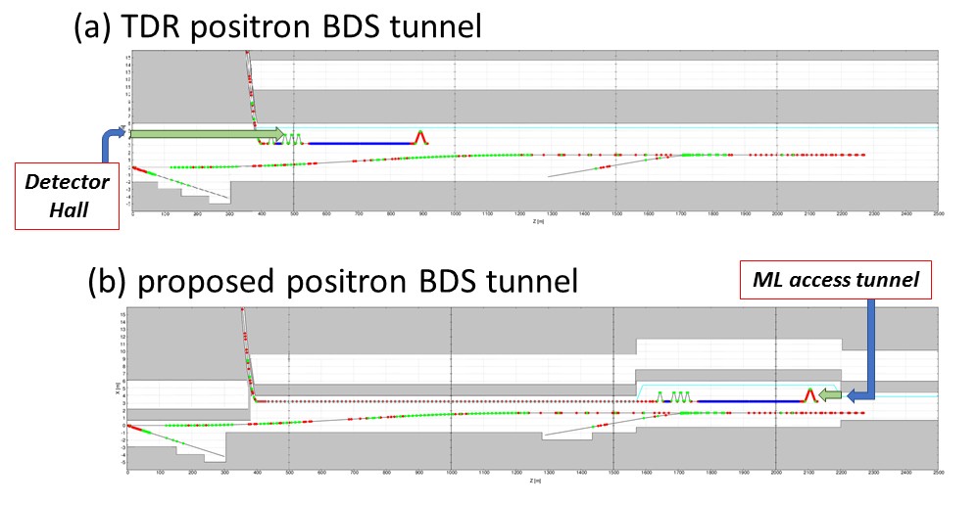
CRWG : CR for Positron BDS (2)
Move electron source upstream
  Advantage:
    shorter helium line
    avoid radiation from collimator to shower on electron cryomodules
  Disadvantage:
    longer electron transport line
Schematic figure of the helium transfer paths

Slide 4
CRWG : CR for Positron BDS (3)
Cost of kamaboko tunnel is more expensive than TDR (2240m, ~50MILCU) by ~1.2MILCU
But, if penetration cost were added to TDR, kamaboko tunnel would be less expensive by ~2.0 MILCU
  (Above numbers are based on kamaboko tunnel model with 1.5m shield wall and 6.75m separation in TDR twin tunnel)
Cost increase by longer electron line (+2.2km) is ~2.2MILCU, whereas cost decrease by shorter helium line (~500m) is 2.5MILCU
In any case, the cost change is minor (only a few MILCU)

Slide 5
CRWG Future
Remaining items
  Electron BDS tunnel
  Commissioning
  Review of safety issues
  etc
Interruption for several months
Waiting for progress of positron source

Slide 6
Positron Working Group
Charges (from Shin)
  Evaluate undulator? Conventional? At 250GeV CM
  Evaluate technical difficulty, cost (based on TDR), commissioning
  Submit final report by June 2017 including
    essential R&D in 2018-19
    proposal of positron scheme
Members
  Germany
    Andriy Ushakov, Gudrid Moortgat, Sabine Riemann, Peter Sievers, Benno List
  Japan
    Tohru Takahashi , Tsunehiko Omori, Masao Kuriki
    Kaoru Yokoya (chair), Toshiyuki Okugi, Akira Yamamoto
  US
    Wei Gai
Plan of WG (discussed in the 1st meeting on Mar.2)
  1st priority: Make a plan of R&D for FY2017-2019
  2nd priority: Consistent design

Slide 7
2nd Meeting on Mar.15 (1)
R&D Plan for e-Driven Scheme
  Concentrate on 1312 bunches
    Problem with 2625 bunches is the bunch interval 3ns because of high and quick transient beam-loading
  Target
    Prove feasibility within JFY2017
    Assume we will get ~100k$ in JFY2017
    Target test
      Evaporation of magnetic fluid?
      50cm diameter model (not tungsten)
  Presumably, downstream part (FC, capture cavities) are OK if 1312 bunches. Simulation studies are still needed but don’t need money
But no much progress in the meeting
Will discuss by email communication

Slide 8
2nd Meeting on Mar.15 (2)
Planned to fix the undulator scheme parameters for 250GeV CM
but we had only ~5 minutes
Move undulator downstream (closer to the target)
  Smaller photon spot size
Okugi san
  shorter dogleg possible for Ee=125GeV
Andriy
  Calculated heating of target and FC
  No essential improvement from long to short dogleg

Slide 9
Andriy’s simulation base on Okugi’s geometry
PEDD limit of Cu is 7-12 J/g

Slide 10
FC Heating Problem (undulator scheme)
PEDD at the tip of FC is serious for 125GeV beam
  Low energy photon → larger spot and wider shower development in the target material
  Less serious for 250GeV beam
Possible cures (to be discussed in coming meetings)
  Shorter distance from undulator to target
    Andriy’s simulation showed only ~15% reduction of PEDD
  Larger beam hole of FC
    Compatible with 3Tesla field?
  Lower K of undulator
    smaller angle spread and higher photon energy (1/(1+K²))
    But reduces photon number (propt. K²)
  Thinner target
    Less development of shower angle
    But reduces positron yield
  Photon collimator (originally for higher polarization)
    Scrape out low energy photons (useless for positron production and cause larger angle in target)
    But reduces positron yield
Minimum baseline
  DC QWT: how much is the luminosity reduction?

Slide 11
3rd Meeting on Mar.30: R&D Plan for Undulator Scheme
Sabine will give a draft on the R&D plan for JFY2017 and JFY2018-19
Expect some budget
Also an important topics in the “staging miniWS”

Slide 12
Staging miniWS
Apr.5 afternoon (2 hours)
  Undulator scheme
  R&D plan
  Parameters for 250GeV CM
    Problem of PEDD on FC
  Photon dump
  Manpower
Apr.6 morning (2 hours)
  e-Driven scheme
  R&D plan

