Slide 1
Reports at LCB and KEK’s review
Shin MICHIZONO (KEK)
LCB report (Feb.16)
8th (KEK’s) linear collider review (Mar.6)

Slide 2
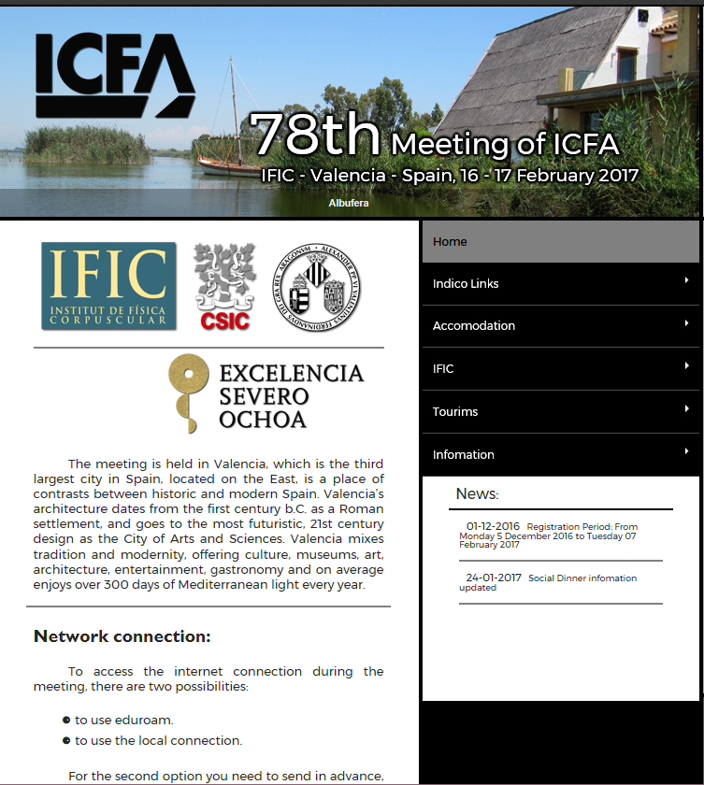
http://icfa2017.es/

Slide 3
LCB/LCC structure
Ｃｈａｉｒ：Ｇ．Ｂｌａｉｒ
Ｃｈａｉｒ：Ｔ．Ｎａｋａｄａ
Ｌｙｎ Ｅｖａｎｓ
Ｈ． Ｍｕｒａｙａｍａ
Ｓ． Ｍｉｃｈｉｚｏｎｏ
Ｓ． Ｓｔａｐｎｅｓ
Ｊ． Ｂｒａｕ

Slide 4
Preliminary Cost Estimate for the ILC Staging with 250GeV
Rev. 170205
 | e-/e [GeV] | Tunnel [GeV] | Value Fraction CFS* [GILCU] | Value Fraction SRF [GILCU] | Value Fraction Others** [GILCU] | Value Total (GILCU] (Oku-JY) | Value Total [%] | Reduct. [%] | Cost- Red. R&D Effect [%] | Total Impact to Reduction [mid. %] | Human resources (M p-hr)&(%)
TDR | 250/250 | 500 | 2.375 | 2.757 | 2,855 | 7.987 (8,309) | 100 % | 0 | - 11.9 % - (13.5-1.6#) | - 11.9 % | 23, (0%)
TDR updated | 250/250
Opt. F | 125/125 | 500
Opt. E | 125/125 | 500
Opt. D | 125/125 | 500
Opt. C | 125/125 | 250
WG2
WG1
WG3
WG3
It is recommended to evaluate 350GeV tunnel (250GeV beam) version.
TDR:
250 GeV e-
250 GeV e+
Option F:
125GeV e-
125GeV e+
Option E:
125GeV e-
125GeV e+
Option D:
125GeV e-
125GeV e+
125GeV e-
125GeV e+
Simple tunnel
Option C:

Slide 5
LCC and CLIC
ILC and CLIC: cost comparison for 250 GeV requested (in 6 months)
From summary of Nakada (ICFA-LCB meeting in Valencia):
  Work for the August LCB meeting
  • Cost of Phase-one 250 GeV machine:
  – Based on the “ILC technology” (with some options) and a normal conducting technology
  version for a comparison purpose
  • Re-assessing physics of a 250 GeV machine
  • Further dialog with the community on a staged approach
  • Try to understand vary carefully and realistically what means “affordable”
  ⇒ For defining “the Phase-one machine”
  • and LCC budget
This study will be done (was anyway foreseen for 380 GeV machine so will be the same) but we will not be able to resolve all details by that date.
Doing some serious work on the klystron option costing is anyway starting (uncertainties today are very large) and we need this effort to understand minimum and cross-over point (indenpently of LCC)
S. Stapnes CLIC-Week 2017 at CERN, 6-10 March
https://indico.cern.ch/event/577810/timetable/#20170306

Slide 6
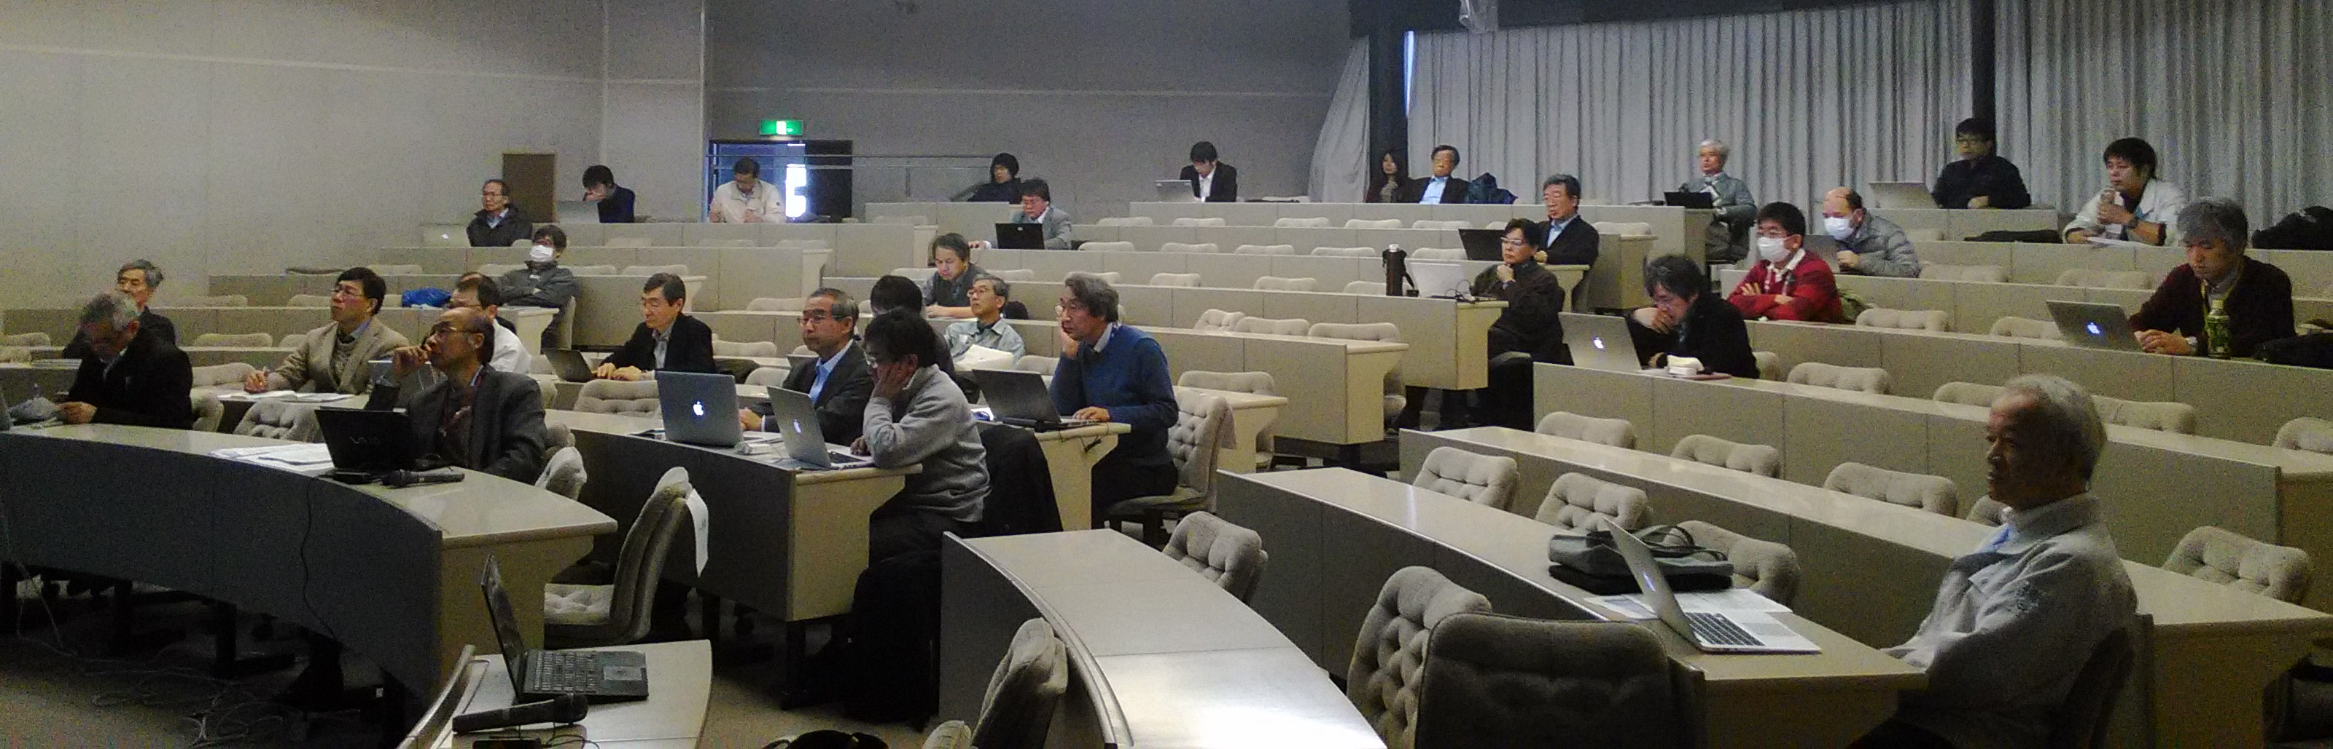
8th (KEK’s) linear collider review
Date: March 6th (Mon.)
Place: KEK
Aim of the review
Report the progress from JFY2014 (after 7th review committee)
Include the plan for
  Cost reduction study with new technology*
  Feasibility study with current technology*
* ILC advisory panel (in MEXT) pointed out them on July 2016.
Indico: https://kds.kek.jp/indico/event/23454/
Most of materials are in English
This is the technical review and so the “staging” was not included in the discussion.

Slide 7
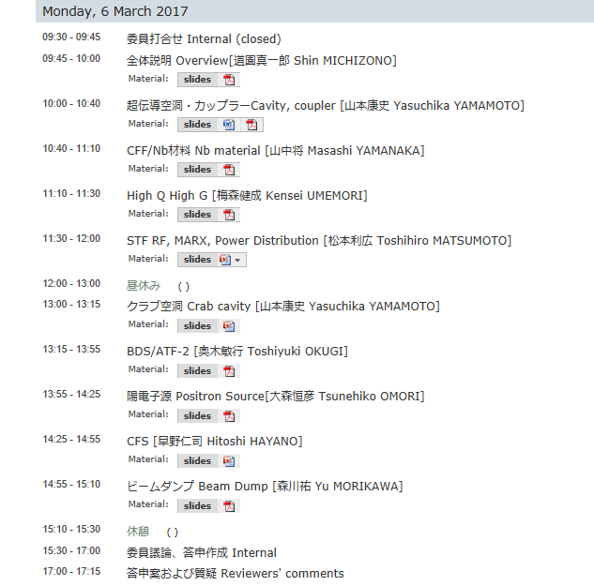
https://kds.kek.jp/indico/event/23454/

Slide 8
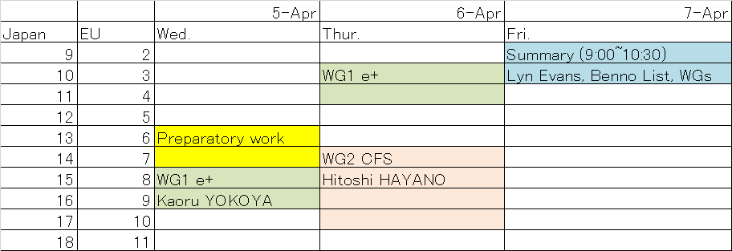
Draft plan of “staging” mini-workshop

Slide 9
WG2 （CFS for staging) session plan
(by Hayano san)
April 6 (Thursday) 14:00~18:00
(1) Hayano; staging plan : strategy and conditions ( total 1 hours)
(2) Nakai: optimum number of cryogenics: cryogenics charge of cryomodule numbers and locations(total 1hour)
(3) Miyahara: tunnel cost and schedules basement: to calculate cost and schedule of CFS modifications(total 1 hour)
(4) discussion 1 hour

