Slide 1
Firmware Update
29/03/2017

Slide 2
Update on Firmware Progress
Feedback module:
takes inputs AI, AQ, CI, CQ, q, gains, etc. and calculates value to be clocked to DAC.
Confirm feedback module working step-by-step with test-bench.
Test feedback module with trigger 3 from ipfbRun7 .dat file (24/02/17 best FB run).
Confirm kick calculated using FB module with those saved in .dac file ✔
Calculate kick integrating over several samples.

Slide 3
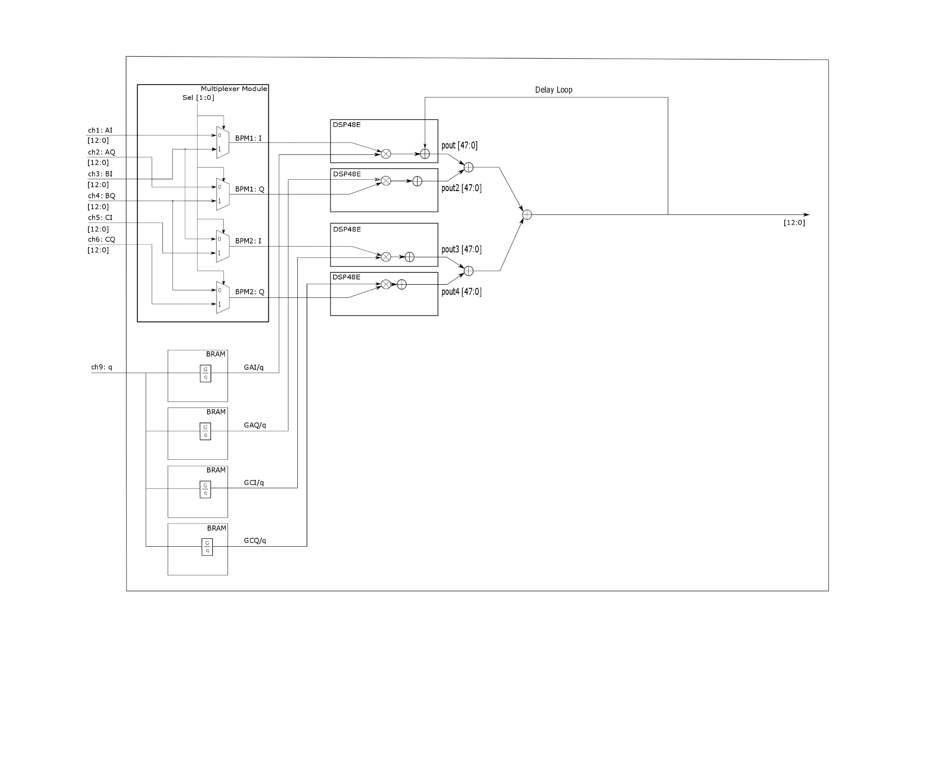
Multiplexer module
Use MUX to select which are feedback BPMs
(sel [1:0]).
assign bpm1_i = (sel[0])? bi_in: ai_in;
assign bpm1_q = (sel[0])? bq_in: aq_in;
assign bpm2_i = (sel[1])? ci_in: bi_in;
assign bpm2_q = (sel[1])? cq_in: bq_in;
Such that sel [1:0] = 2’b10 takes input from IPA and IPC to drive feedback at IPB.
Selecting sel [1:0] = 2’b01 will give use only information from IPB, and if you half the gains will give you single loop feedback.

Slide 4
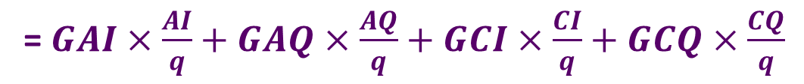
Block Diagram
Muxes
Delayed value added in using multiplier-adder DSP48E module to reduce latency.
Four LUTs each loaded with a different gain. Address of LUT given by charge value.
= $GAI×\frac{AI}{q}+GAQ×\frac{AQ}{q}+GCI×\frac{CI}{q}+GCQ×\frac{CQ}{q}$

Slide 5
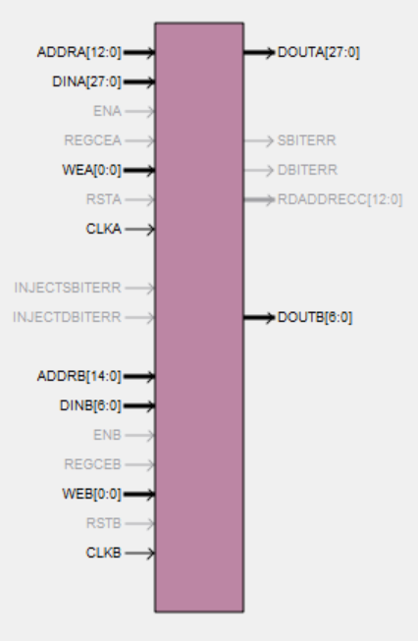

Look-Up Tables
Uses 4 LUTs each loaded with relevant (Gain*4096) divided by charge.
Factor of 4096 added to allow us to deal with decimal numbers in binary.
True dual port RAM used so can clock ports with separate clocks (clka, clkb).
Port A: 357 MHz clock. Used for feedback calculations.
Port B: 40 MHz clock. RS232 comm.
Generating files to load LUT in MATLAB (.coe files).
Can read values back out to .txt files to check LUT (when store strobe goes low).
$$DOUTA=gain×\frac{4096}{ADDRA}$$

Slide 6
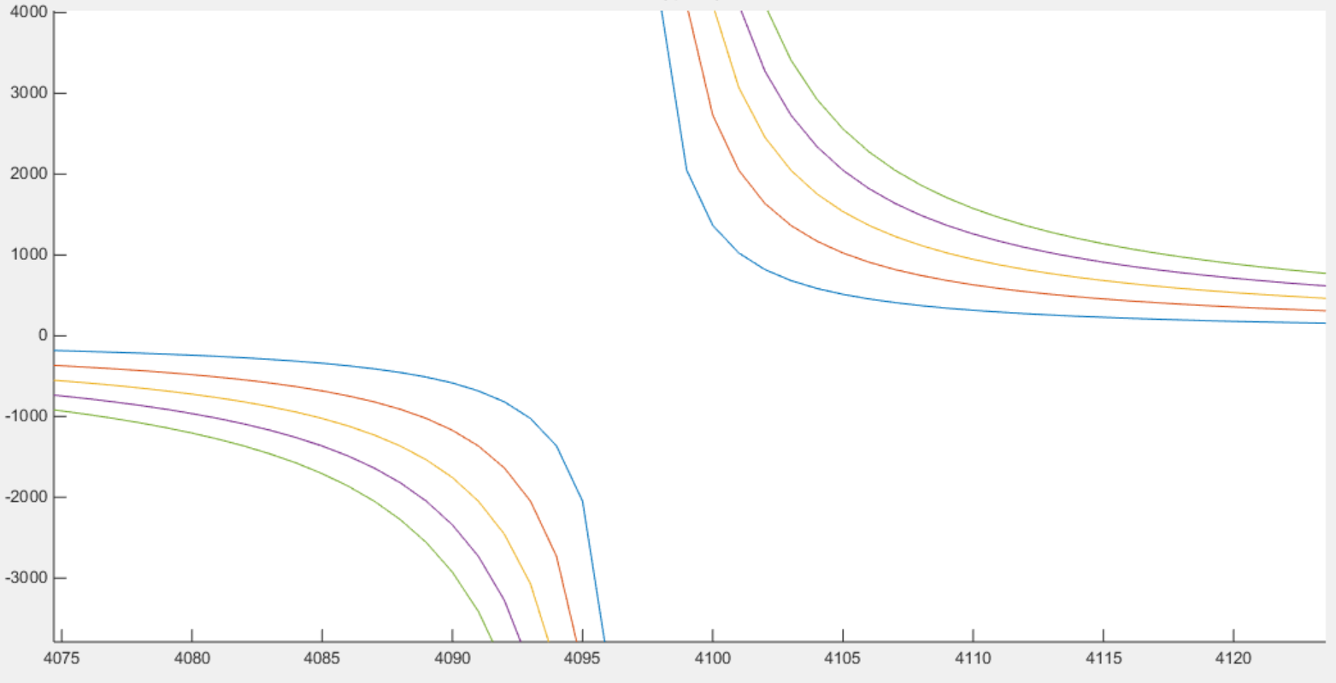
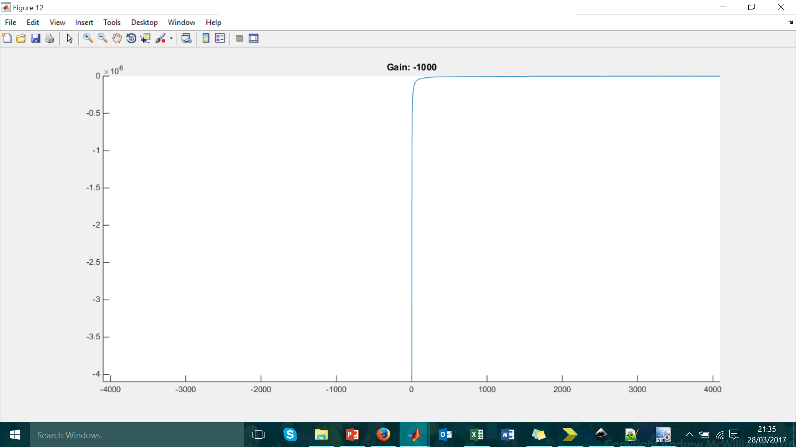
LUT Graph Mapping Decimal
Increasing gain.
Blue = gain 1 up to
green = gain 5.
Output of LUT in decimal
Input to LUT in decimal

Slide 7
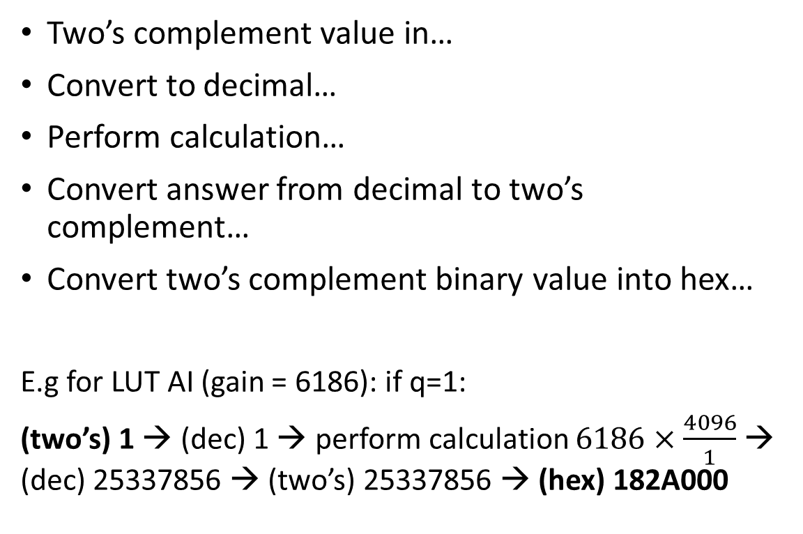
Entering Values into LUT
Two’s complement value in…
Convert to decimal…
Perform calculation…
Convert answer from decimal to two’s complement…
Convert two’s complement binary value into hex…
E.g for LUT AI (gain = 6186): if q=1:
(two’s) 1 → (dec) 1 → perform calculation $6186×\frac{4096}{1}$ → (dec) 25337856 → (two’s) 25337856 → (hex) 182A000
memory_initialization_radix=16;
memory_initialization_vector=
000000,
182A000,
C15000,
80E000,
60A800,
4D5333,
407000,
373B6E,
305400,
2AF555,
26A99A,
2325D1,
…….
Example .coe file

Slide 8
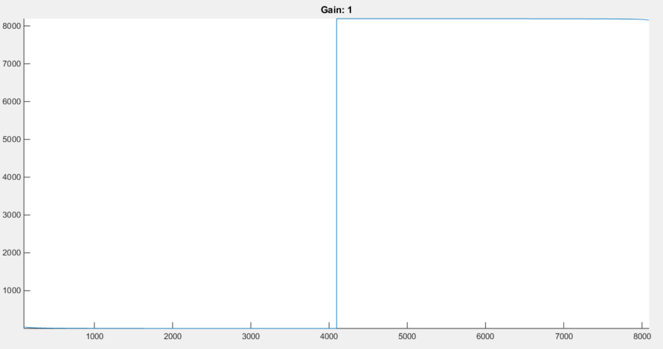
Mapping of Two’s Complement
Shape of plot – 8192 jump removed to show shape more clearly
Value LUT Output (two’s complement
Value LUT Input (two’s complement)
Two’s Complement
0 4095 4096 8191
0 4095 -4096 -1
Decimal

Slide 9
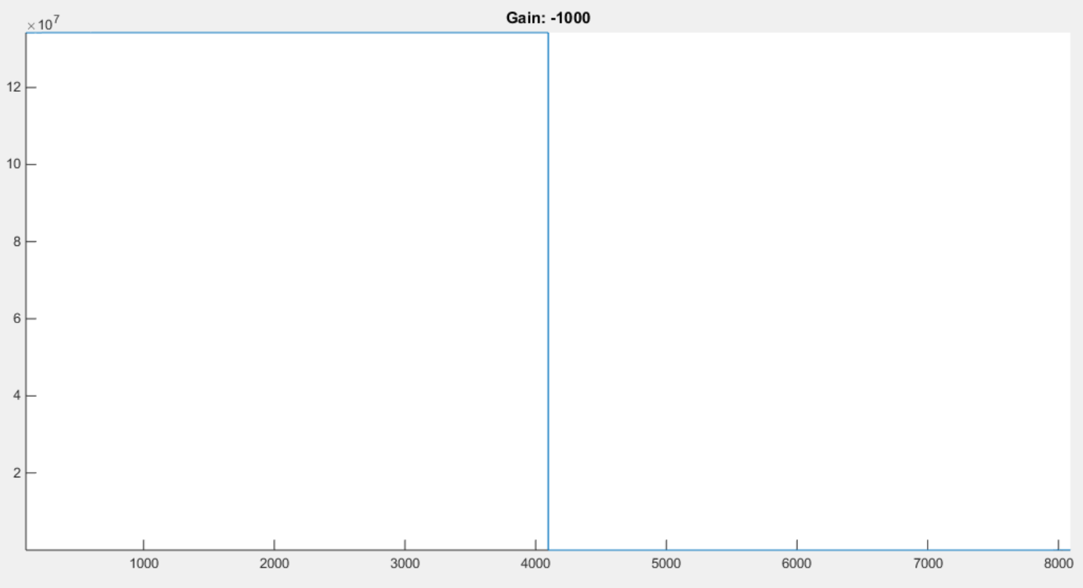
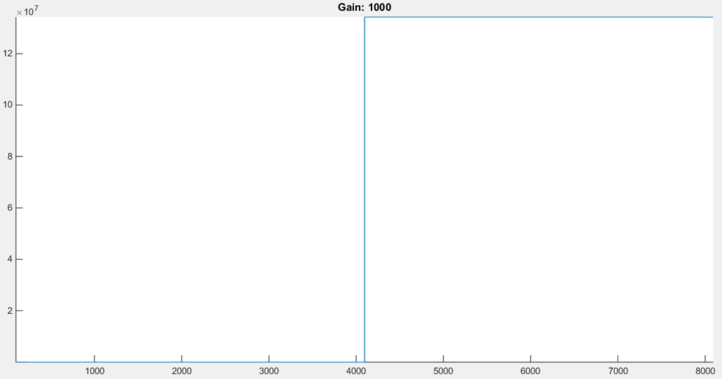
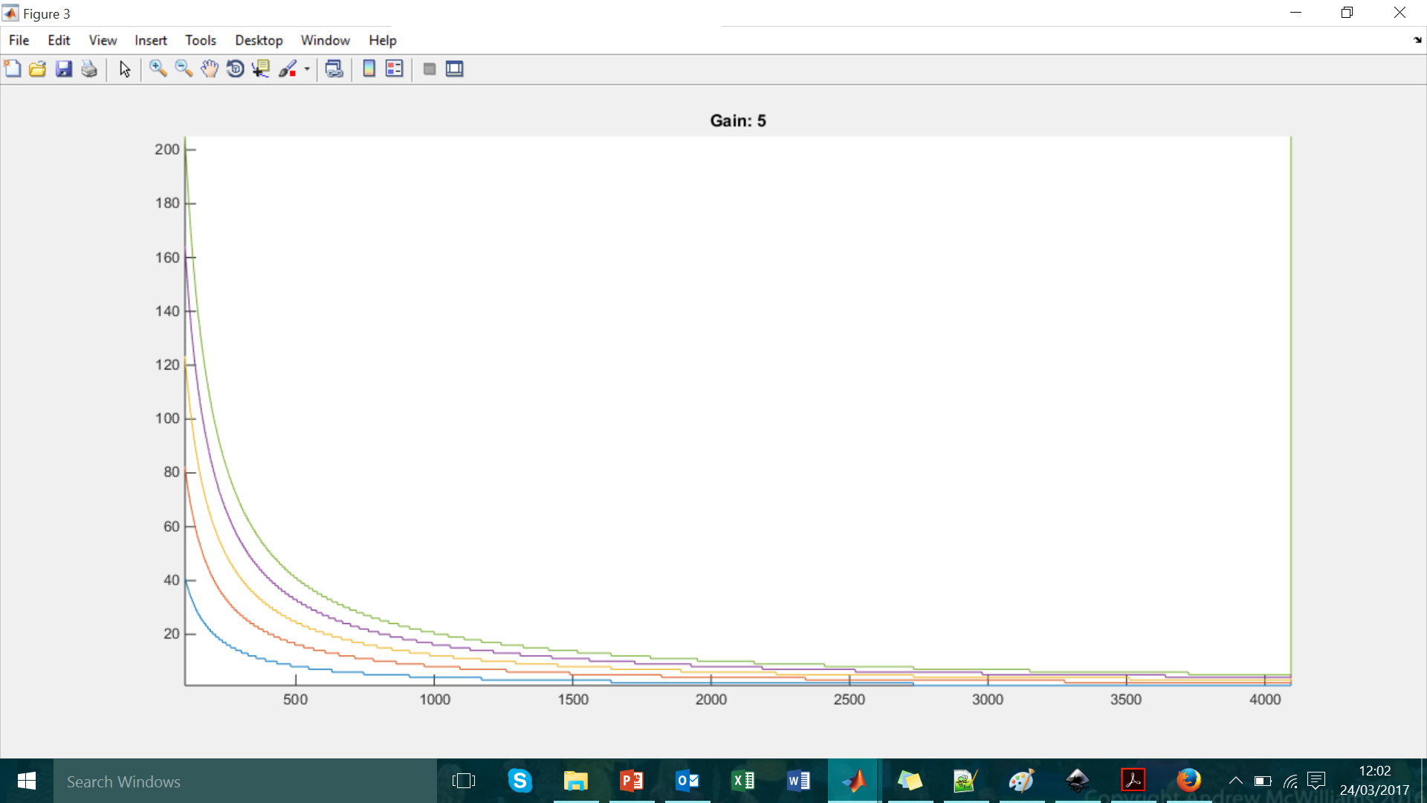
Positive and Negative Gains
Axes in two’s complement representation.
Positive gain: 1000
Negative gain: -1000
Output from LUT
Input to LUT
Input to LUT
Value inputted to LUT (two’s complement value) and value output (two’s complement value)

Slide 10

Feedback Calculation
For 2 BPM stabilisation at IPB.
delay
AI
G₁/q
AQ
G₂/q
= $GAI×\frac{AI}{q}+GAQ×\frac{AQ}{q}+GCI×\frac{CI}{q}+GCQ×\frac{CQ}{q}$
CI
G₃/q
CQ
G₄/q

Slide 11
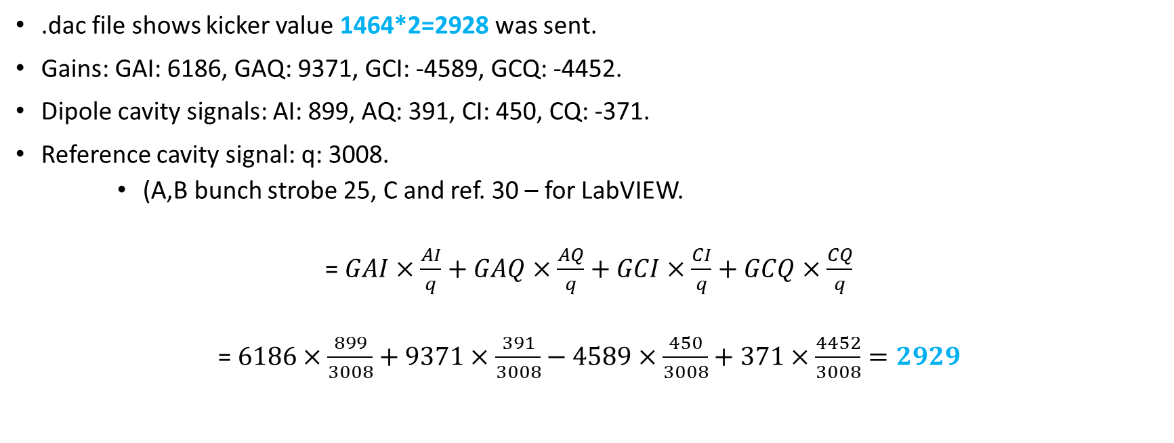
Calculation
1464 1464 -362 -362 0 0 1464 1464 -362 -362 0 0
.dac file shows kicker value 1464*2=2928 was sent.
Gains: GAI: 6186, GAQ: 9371, GCI: -4589, GCQ: -4452.
Dipole cavity signals: AI: 899, AQ: 391, CI: 450, CQ: -371.
Reference cavity signal: q: 3008.
(A,B bunch strobe 25, C and ref. 30 – for LabVIEW.
= $GAI×\frac{AI}{q}+GAQ×\frac{AQ}{q}+GCI×\frac{CI}{q}+GCQ×\frac{CQ}{q}$
= $6186×\frac{899}{3008}+9371×\frac{391}{3008}−4589×\frac{450}{3008}+371×\frac{4452}{3008}=2929$

Slide 12
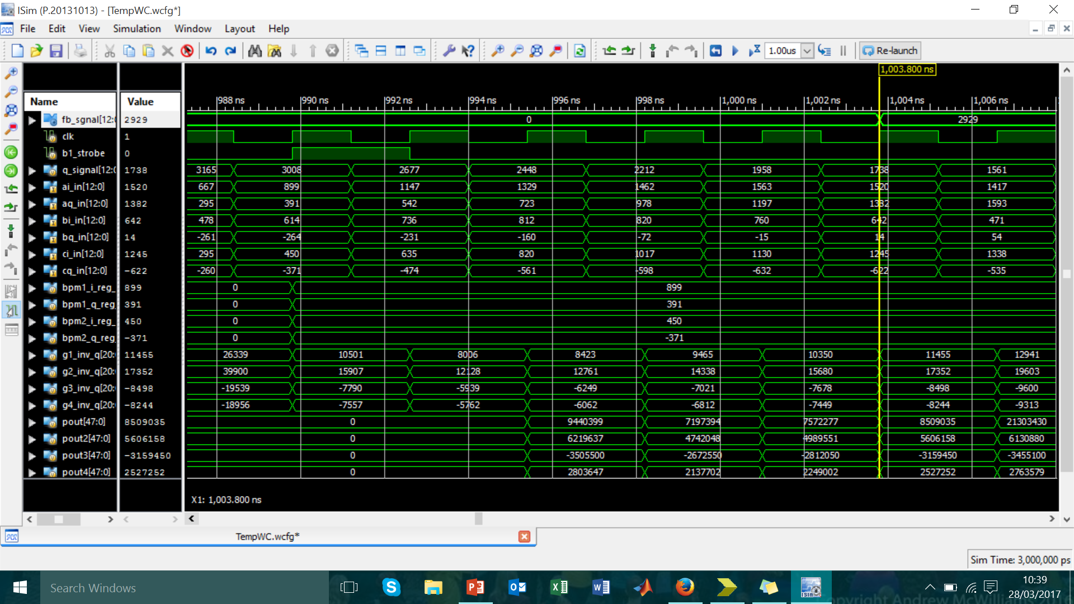

Bunch strobe
Sum all four outputs and remove factor of 4096 added during LUT:
>>12
Register on rising edge of clock
Output from LUT: 4096*G/q
After multiplying
$$×$$

Slide 13
Kick calculated for Bunch 3
Check against the .dac file the kicks calculated:
for bunch two: 2928 ✔
and for bunch three: -724 ✔
Simulated FB module agrees with both values (when delay loop disabled).
If enabled, delay loop correctly adds the two values and clears the delay loop on the falling edge of store strobe.
Will the same gains be valid for future bunches? Calibration constant variation for bunches within the same train.

Slide 14
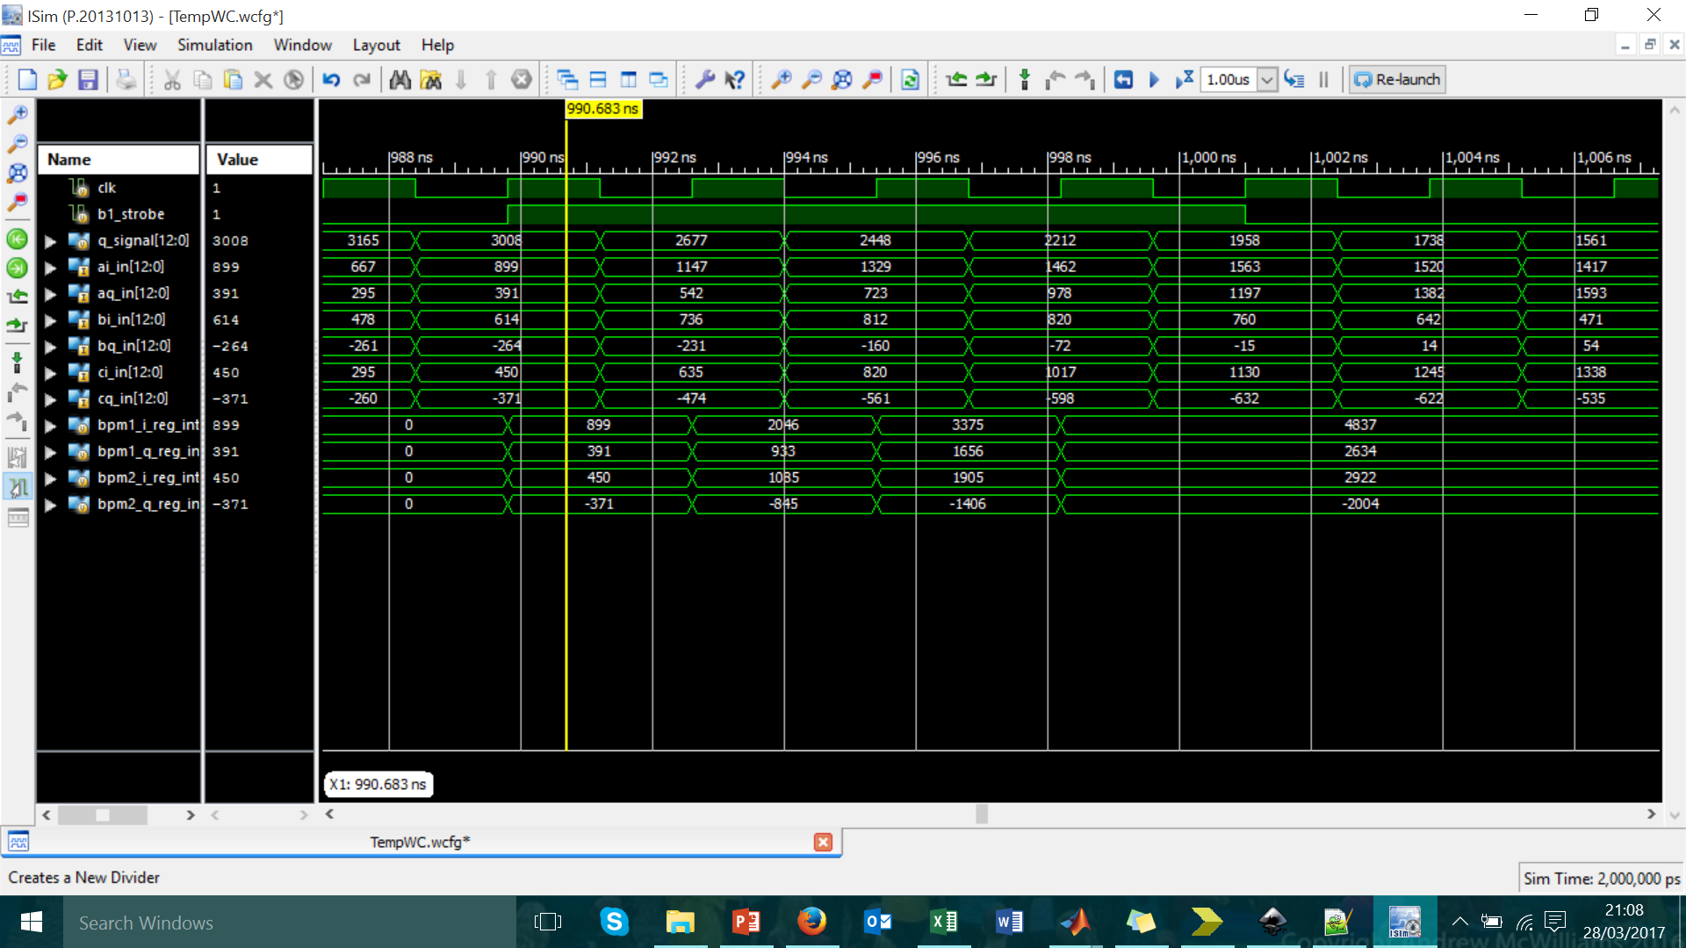
Integrated Samples
899 = 899, 2046 = 899 + 1147, 3375 = 899 + 1147 + 1329, 4837 = 899 + 1147 + 1392 + 1462
On rising clock edges (while bunch strobe is high) add dipole signal value to previous value. Clear registers after feedback signal clocked.

Slide 15
Integration Window
FB output if integrate over multiple samples.
Re-calculate gains for new sample window and regenerate LUT with new gain values.
Use extended bunch strobe and sum the values on rising clock edges while this strobe high.
Number of Samples Integrated | FB module output to DAC
1 | 2929
2 | 3010.329
3 | 3050.828
4 | 3120.121

Slide 16
Next Steps
Consider how this module fits in with other modules, as it’s currently a stand-alone unit.
Consider different designs for FIR filter.
Successfully implement design.
Automate testing using real data for more than one trigger. Reading, converting, comparing all done in MATLAB.

