Slide 1

ILC in EUROPE – Assorted Issues
Thomas Schörner-Sadenius (DESY)
MDI / CFS Mini-Workshop
KEK, 16 May 2017

Slide 2
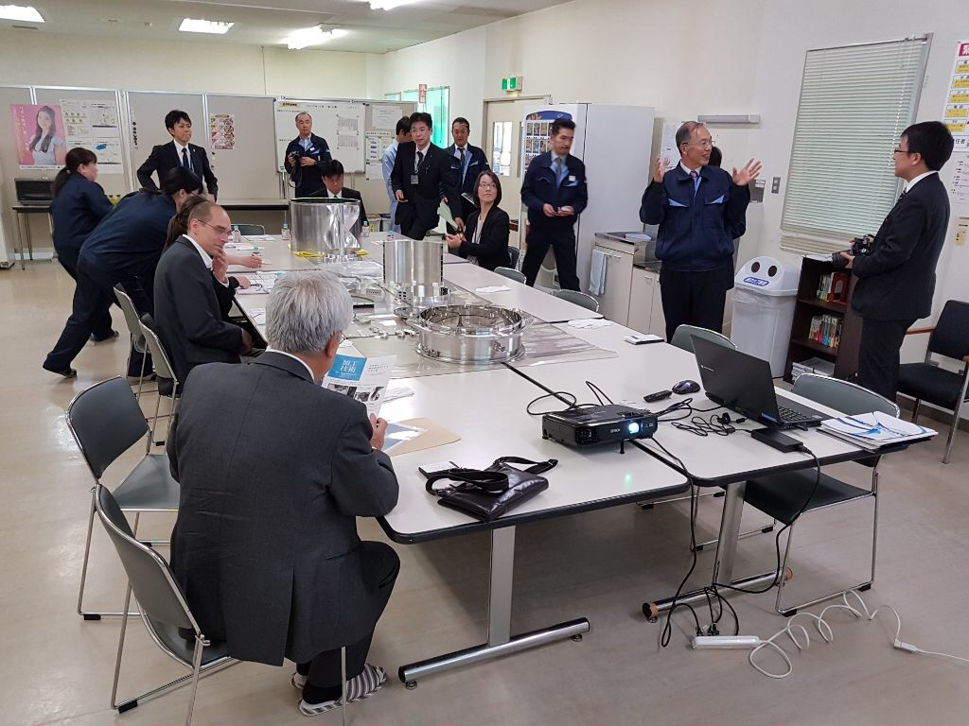
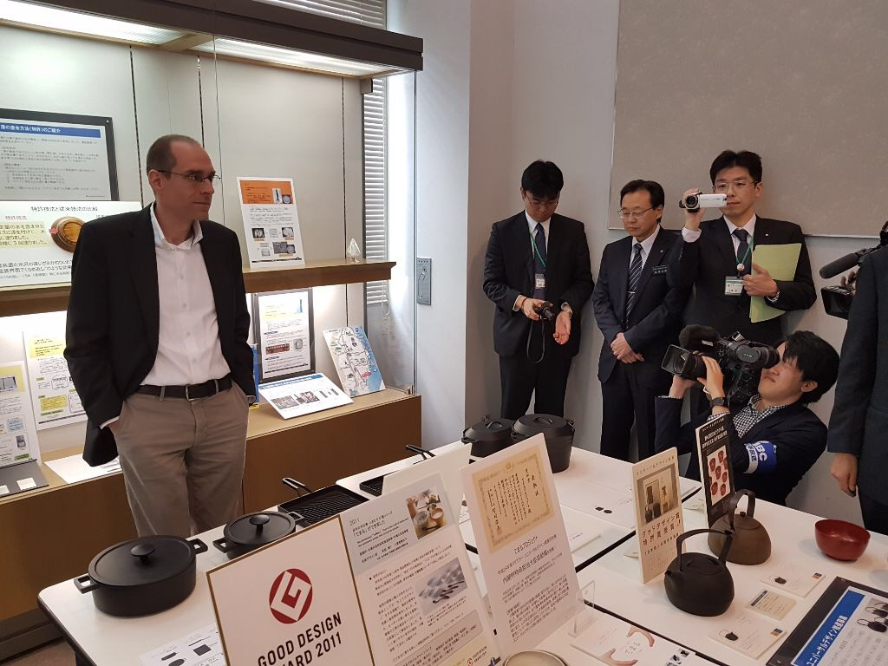
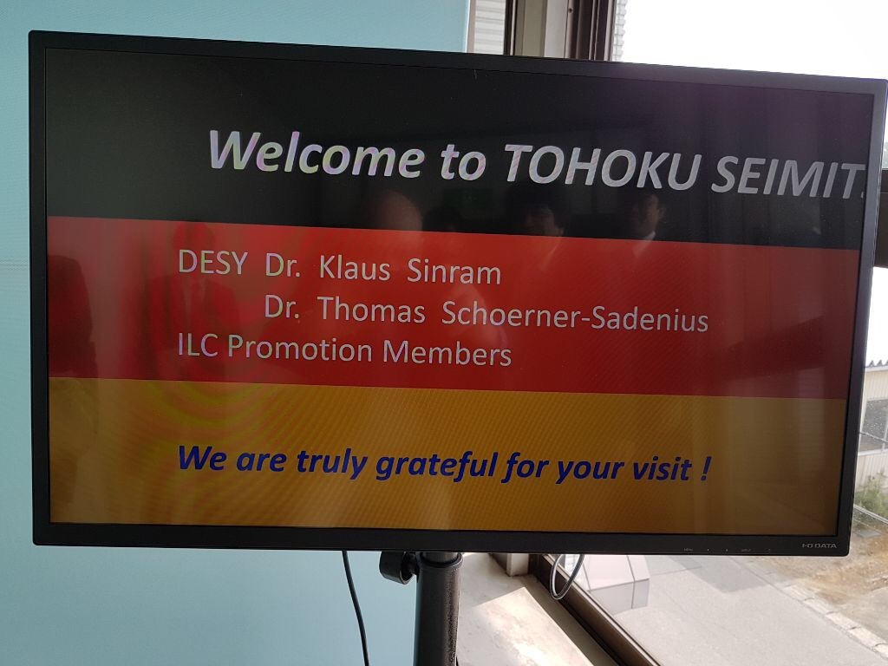
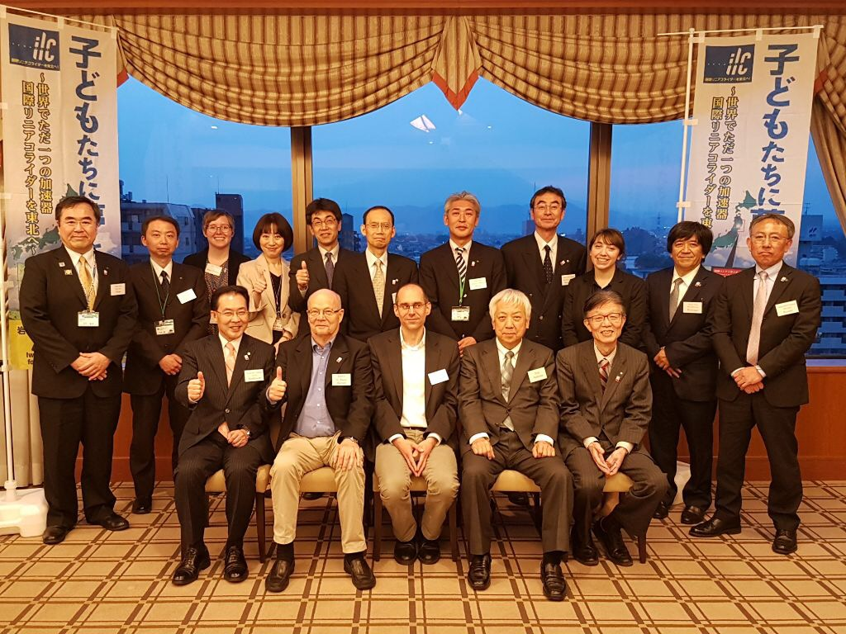
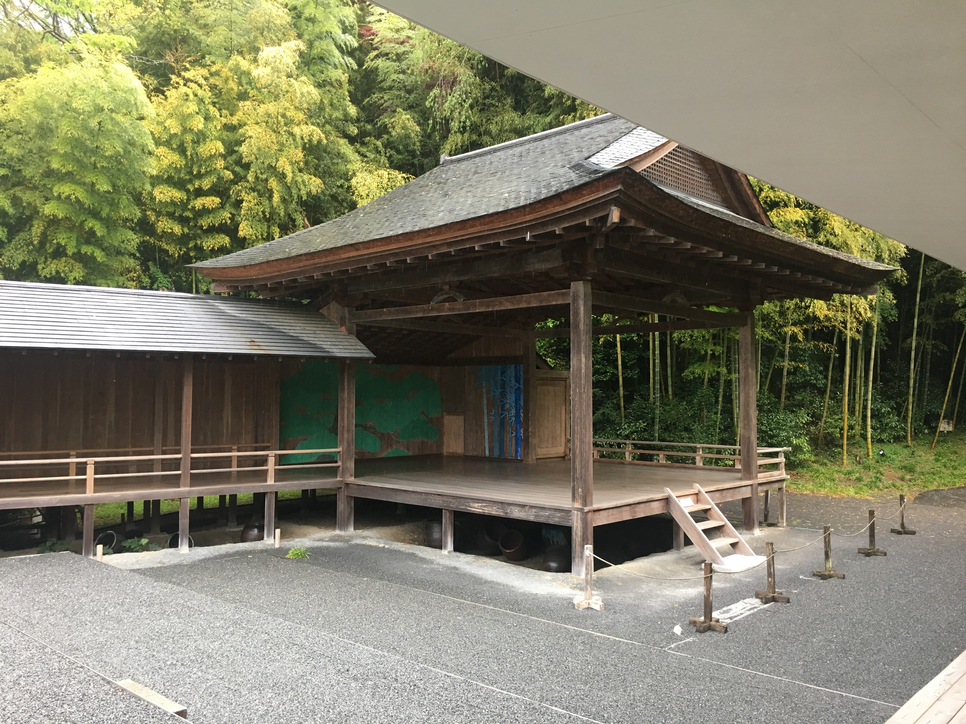
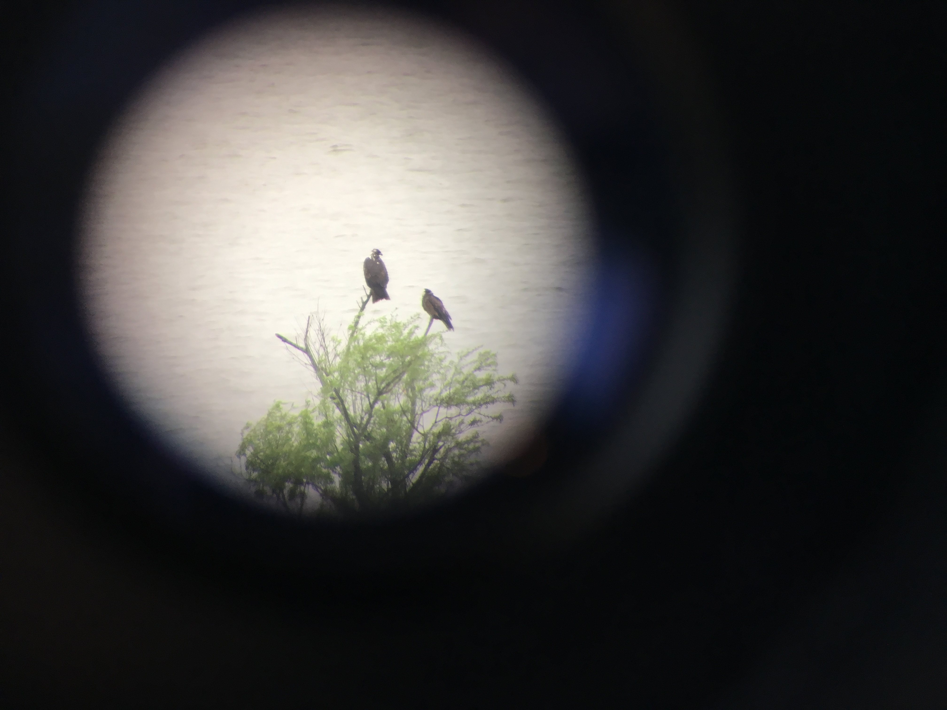
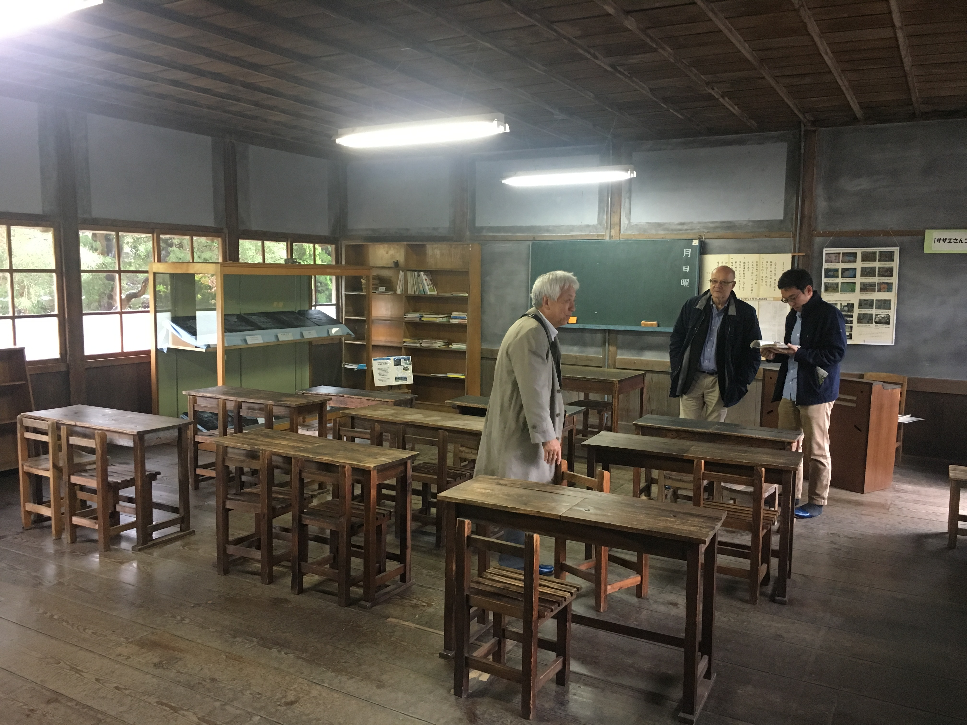
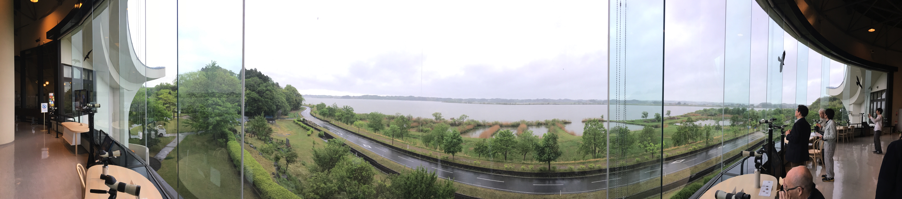
Last week

Slide 3
Contents
European XFEL
  Reminder
  Status of the machine (thanks to Nick Walker)
  Safety at the European XFEL (see separate presentation)
ILC in Europe
  Strategy processes
  European Action Plan
  …

Slide 4
Contents
European XFEL
  Reminder
  Status of the machine (thanks to Nick Walker)
  Safety at the European XFEL (see separate presentation)
ILC in Europe
  Strategy processes
  European Action Plan
  …

Slide 5

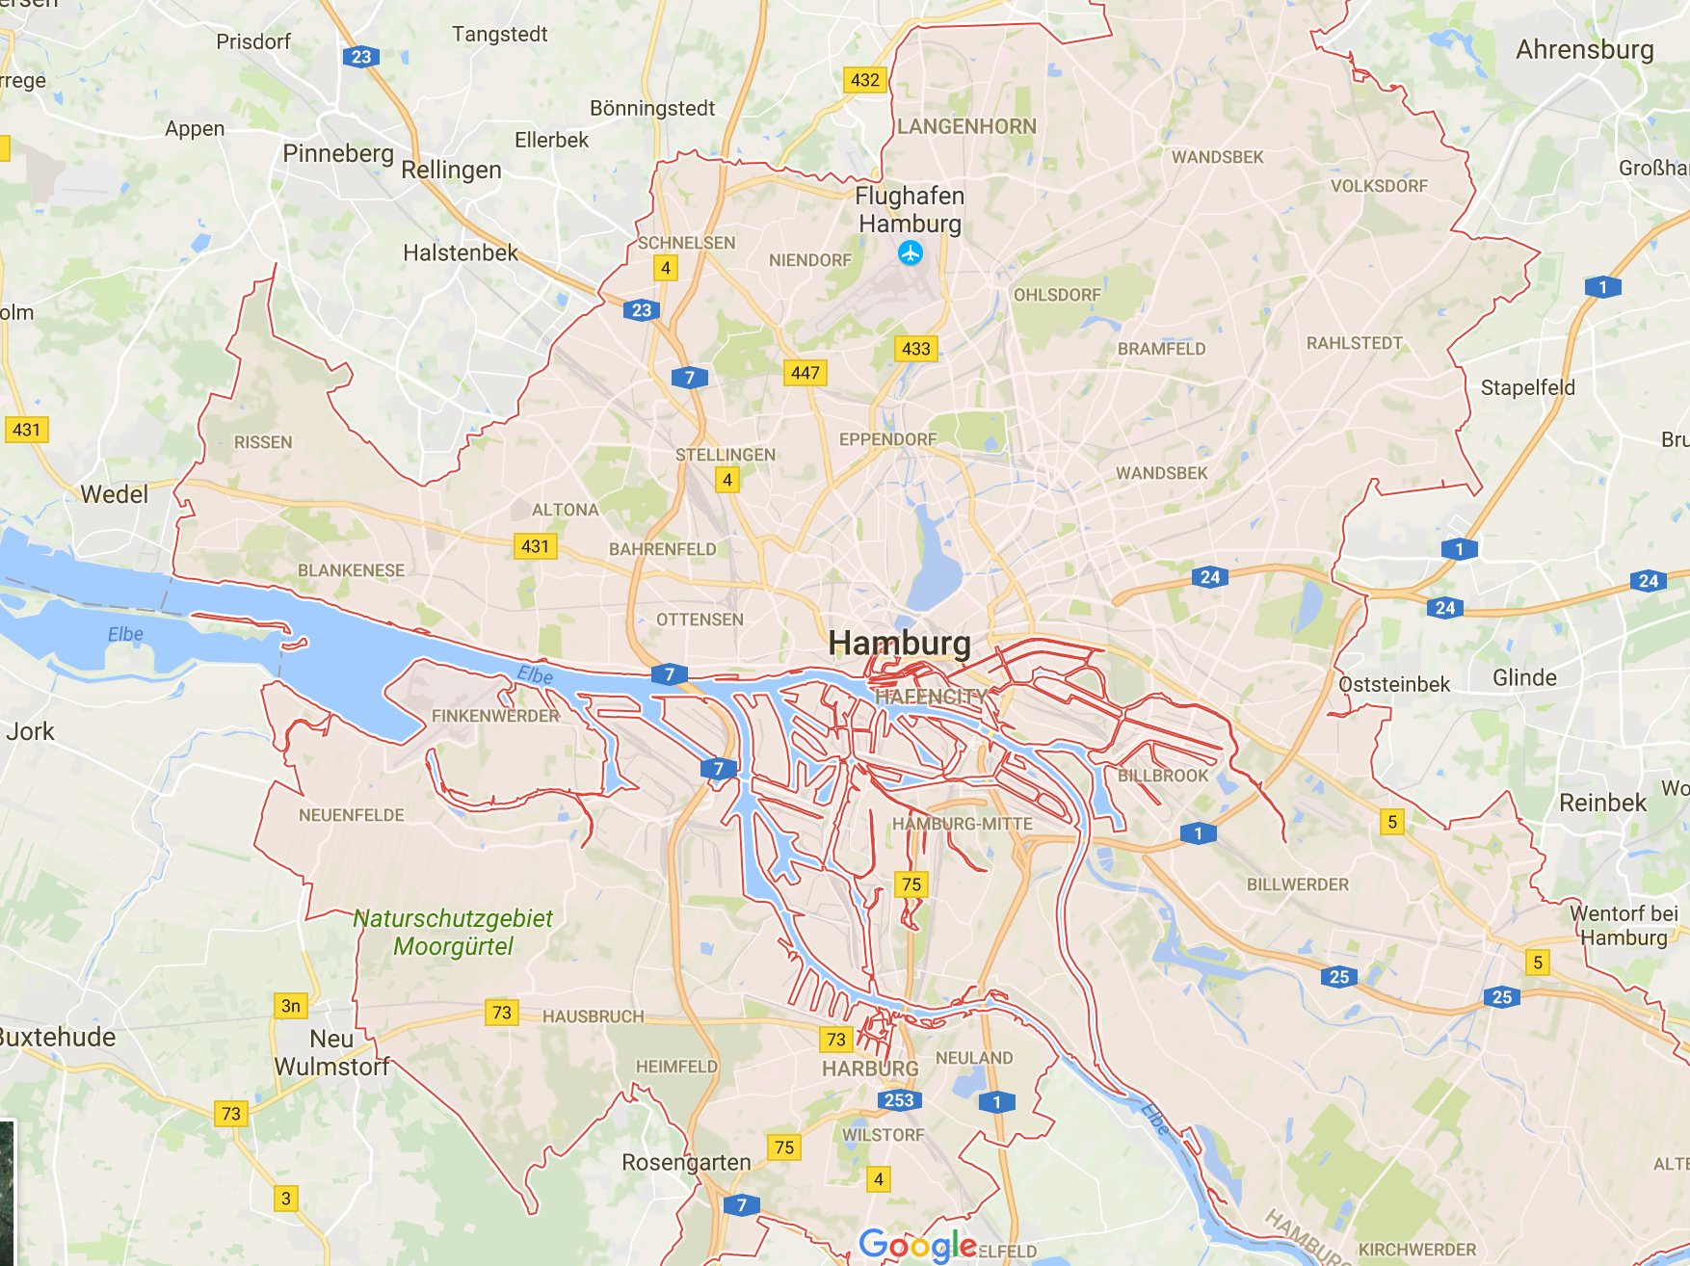

The European XFEL

Slide 6












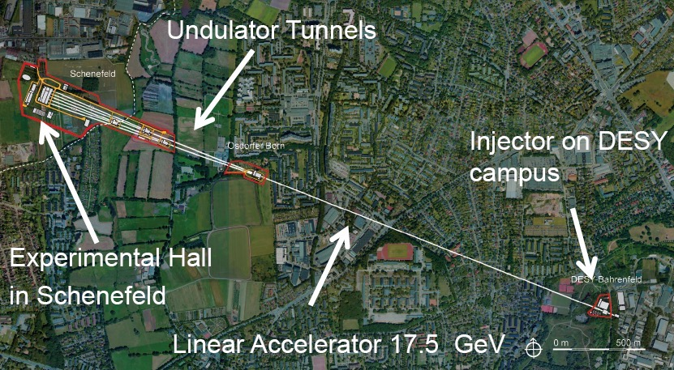
The European XFEL

Slide 7
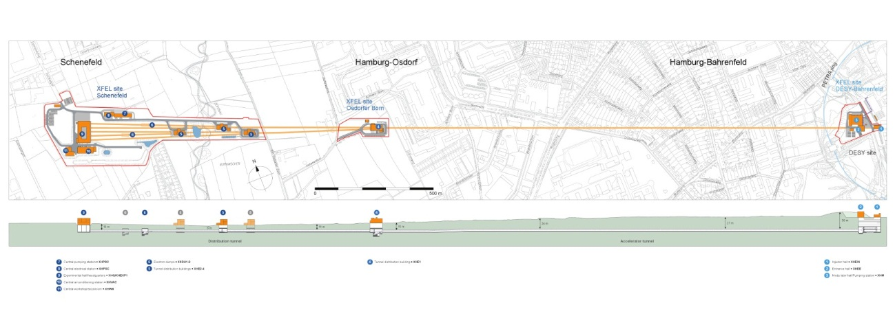
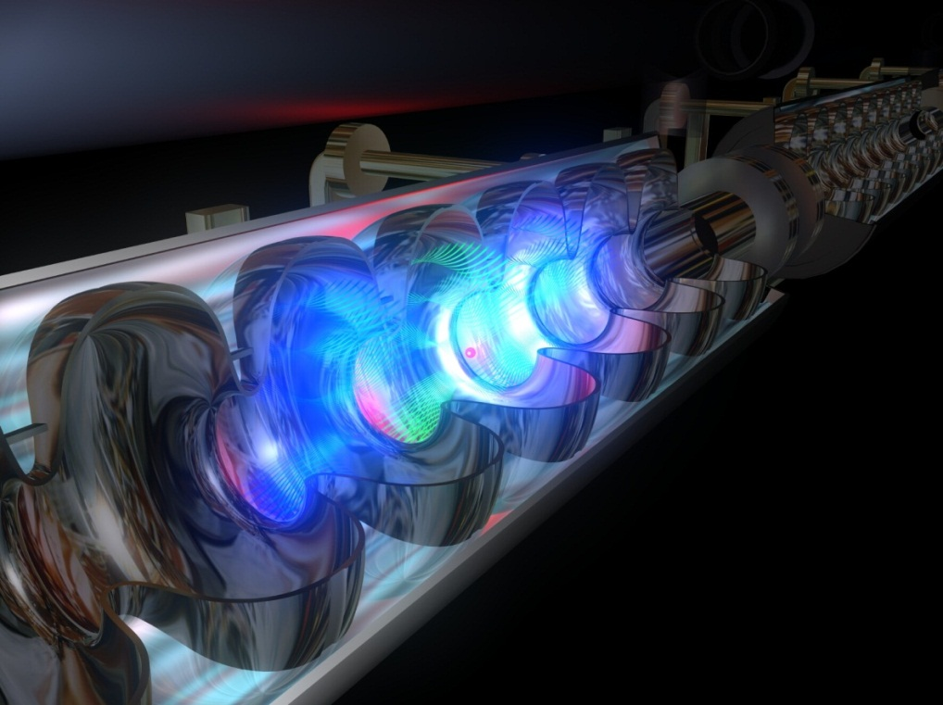
The European XFEL
Some facts:
  Overall length 3.4 km; superconducting linac
  (ILC technology) for 2.1 km
  Tunnel between 6 and 38 m underground
  Energy 17.5 GeV
  Cooled with helium to -271ºC.

Slide 8
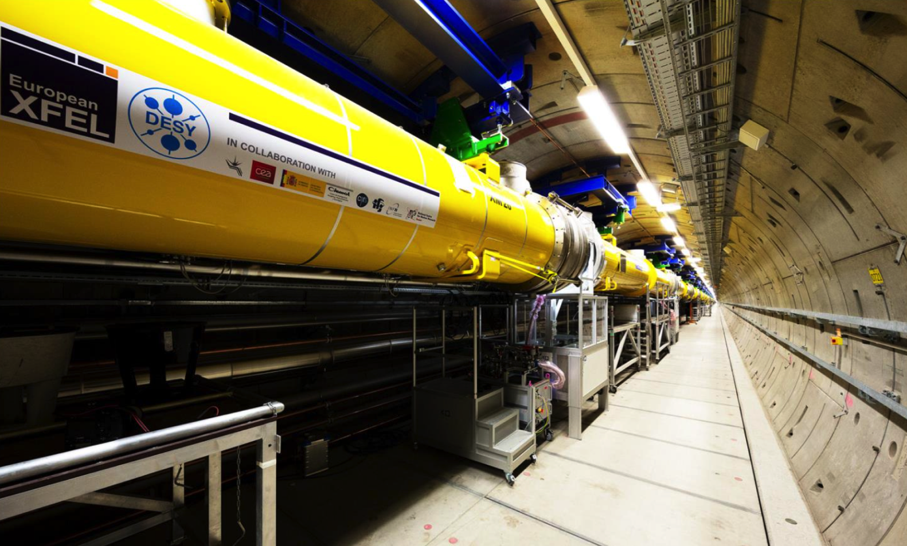
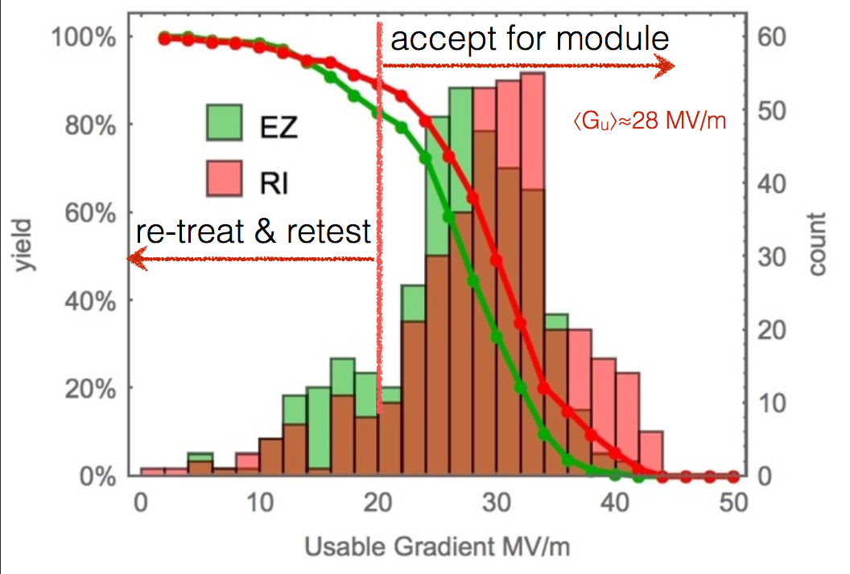
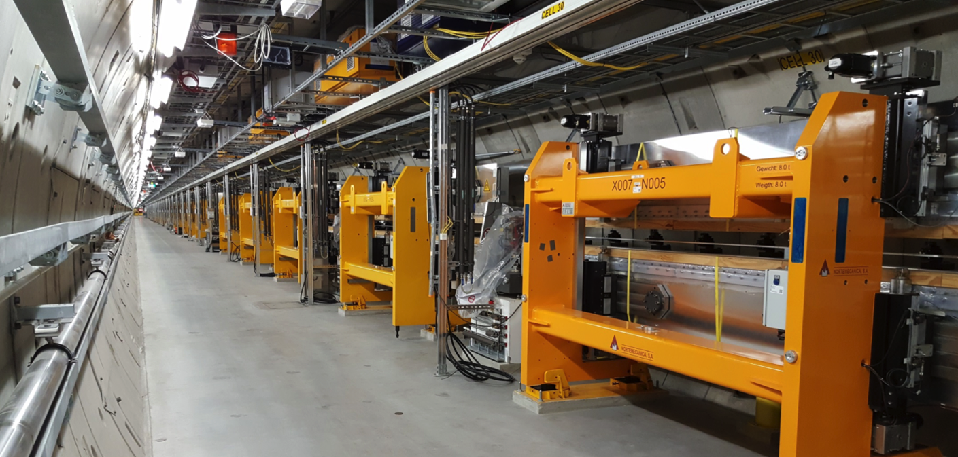
The European XFEL
A prime light source
A 10% prototype of the ILC
Industrial production of 800 SCRF cavities
Accelerating gradients close to ILC specs

Slide 9
Contents
European XFEL
  Reminder
  Status of the machine (thanks to Nick Walker)
  Safety at the European XFEL (see separate presentation)
ILC in Europe
  Strategy processes
  European Action Plan
  …

Slide 10
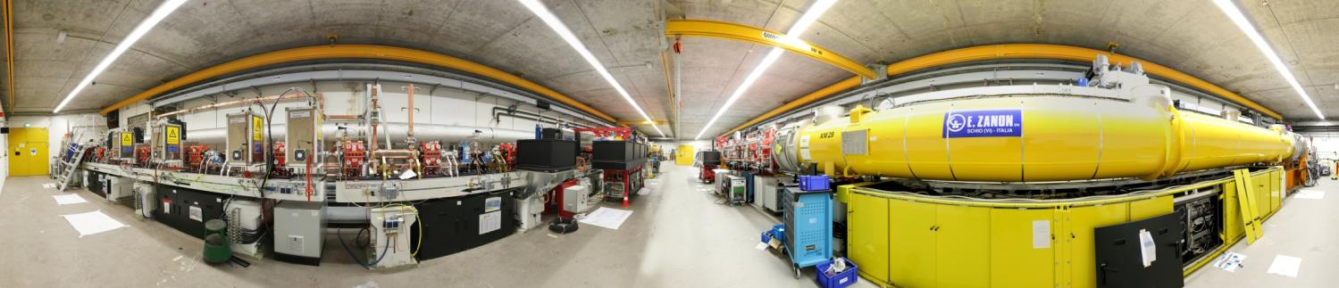
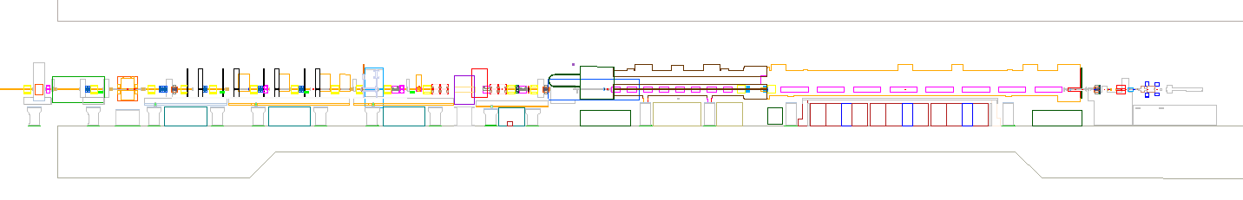
















Injector in Operation – First Beam in 12/2015
Dump Transverse Deflecting Structure
Spectrometer Diagnostic Section Laser Heater 3.9 GHz Module 1.3 GHz Module Gun

Slide 11



All Accelerator Modules Installed
CS1
L001
A2.1.L1
L002
A2.2.L1
L003
A2.3.L1
L004
A2.4.L1
CS2
L005
A3.1.L2
L006
A3.2.L2
L007
A3.3.L2
L008
A3.4.L2
L1
BC1
L2
XM 5
XM 1
XM 2
XM -1
DEMACO Cryo-connection
XM 62
XM 61
XM 71
XM 76
P
A2
P
P
A3
CS2
L009
A4.1.L2
L010
A4.2.L2
L011
A4.3.L2
L012
A4.4.L2
L013
A5.1.L2
L014
A5.2.L2
L015
A5.3.L2
L016
A5.4.L2
L2
BC2
50
XM 73
XM 57
XM59
XM 72
XM44
XM 43
XM47
XM42
DEMACO Cryo-connection
CS3
A4
32
A5
P
L017
A6.1.L3
L018
A6.2.L3
L019
A6.3.L3
L020
A6.4.L3
L021
A7.1.L3
L022
A7.2.L3
L023
A7.3.L3
L024
A7.4.L3
L025
A8.1.L3
L026
A8.2.L3
L027
A8.3.L3
L028
A8.4.L3
L3
XM 7
XM 6
XM11
XM 3
XM 13
XM 9
XM 10
XM 19
XM 27
XM 18
XM 30
XM 20
SCB 1
51
52
53
A6
54
55
56
57
A7
58
59
60
61
A8
P
62
63
L029
A9.1.L3
L030
A9.2.L3
L031
A9.3.L3
P
UV XTL-2AV
L033
A10.1.L3
P
CS4
L032
A9.4.L3
L034
A10.2.L3
L035
A10.3.L3
L036
A10.4.L3
L037
A11.1.L3
L038
A11.2.L3
L039
A11.3.L3
L040
A11.4.L3
L3
XM 31
XM 28
XM 34
XM 14
XM 39
XM 37
XM 40
XM 41
XM 26
XM 38
XM 36
XM 35
SCB 2
64
65
66
A9
67
68
69
70
A10
P
72
73
74
A11
P
75
76
CS5
L041
A12.1.L3
L042
A12.2.L3
L043
A12.3.L3
P
L044
A12.4.L3
L045
A13.1.L3
L046
A13.2.L3
L047
A13.3.L3
L048
A13.4.L3
L049
A14.1.L3
L050
A14.2.L3
L051
A14.3.L3
L052
A14.4.L3
L3
XM 56
XM 32
XM 25
XM 53
XM 17
XM 51
XM 15
XM 52
XM 45
XM 16
XM 33
XM 49
SCB 3
77
78
79
A12
80
81
82
83
A13
P
84
85
86
87
A14
88
89
CS6
L053
A15.1.L3
L054
A15.2.L3
L055
A15.3.L3
P
L056
A15.4.L3
L057
A16.1.L3
L058
A16.2.L3
L059
A16.3.L3
L060
A16.4.L3
L061
A17.1.L3
L062
A17.2.L3
L063
A17.3.L3
P
L064
A17.4.L3
L3
XM 64
XM 68
XM 70
XM 21
XM 69
XM 60
XM 63
XM 66
XM 12
XM 23
XM 58
XM 48
SCB 4
A15
A16
A17
CS7
L065
A18.1.L3
L066
A18.2.L3
L067
A18.3.L3
L068
A18.4.L3
L069
A19.1.L3
L070
A19.2.L3
L071
A19.3.L3
L072
A19.4.L3
L073
A20.1.L3
L074
A20.2.L3
L075
A20.3.L3
L076
A20.4.L3
L3
XM 77
XM 74
XM -2
XM 79
XM 4
XM 67
XM55
XM65
SCB 5
CS8
L077
A21.1.L3
L078
A21.2.L3
L079
A21.3.L3
L080
A21.4.L3
L081
A22.1.L3
L082
A22.2.L3
L083
A22.3.L3
L084
A22.4.L3
L085
A23.1.L3
L086
A23.2.L3
L087
A23.3.L3
L088
A23.4.L3
L3
CS9
L089
A24.1.L3
L090
A24.2.L3
L091
A24.3.L3
L092
A24.4.L3
L093
A25.1.L3
L094
A25.2.L3
L095
A25.3.L3
L096
A25.4.L3
L097
A26.1.L3
L098
A26.2.L3
L099
A26.3.L3
L100
A26.4.L3
1.508 m
L3

Slide 12
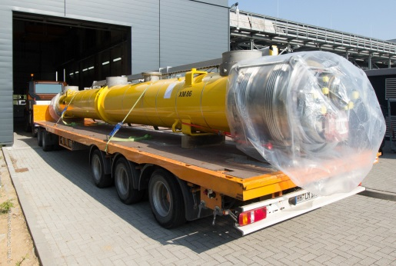
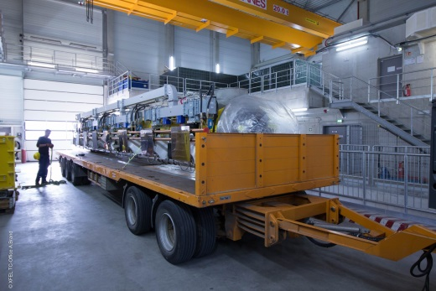
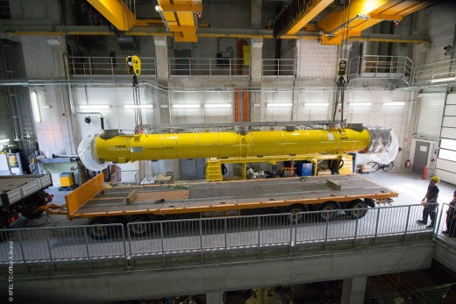
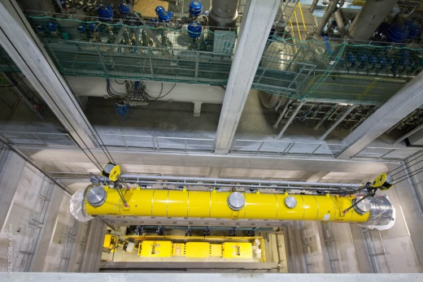
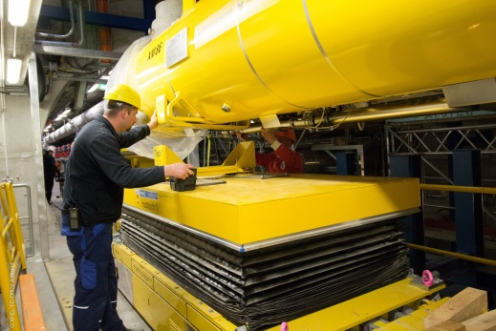
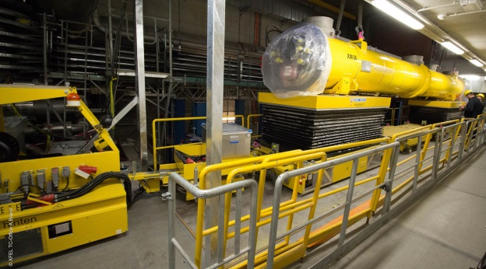
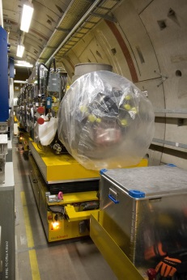
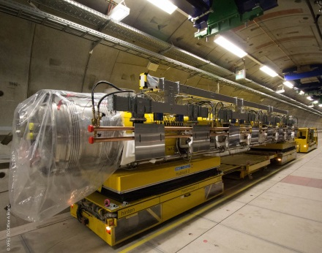
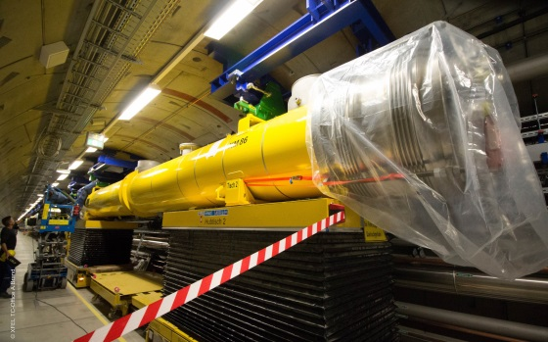
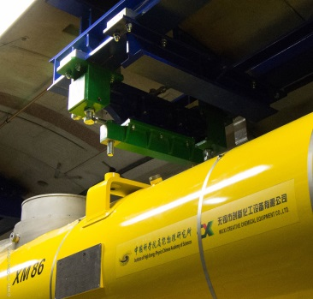
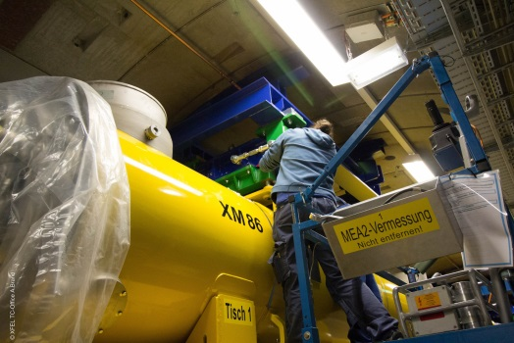
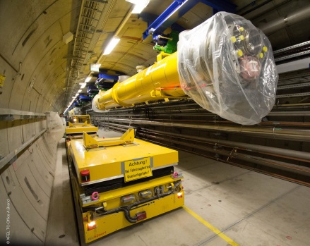
Accelerator Module on its Way to the Tunnel
1st module July 1st, 2014 – last module August 1st, 2016

Slide 13
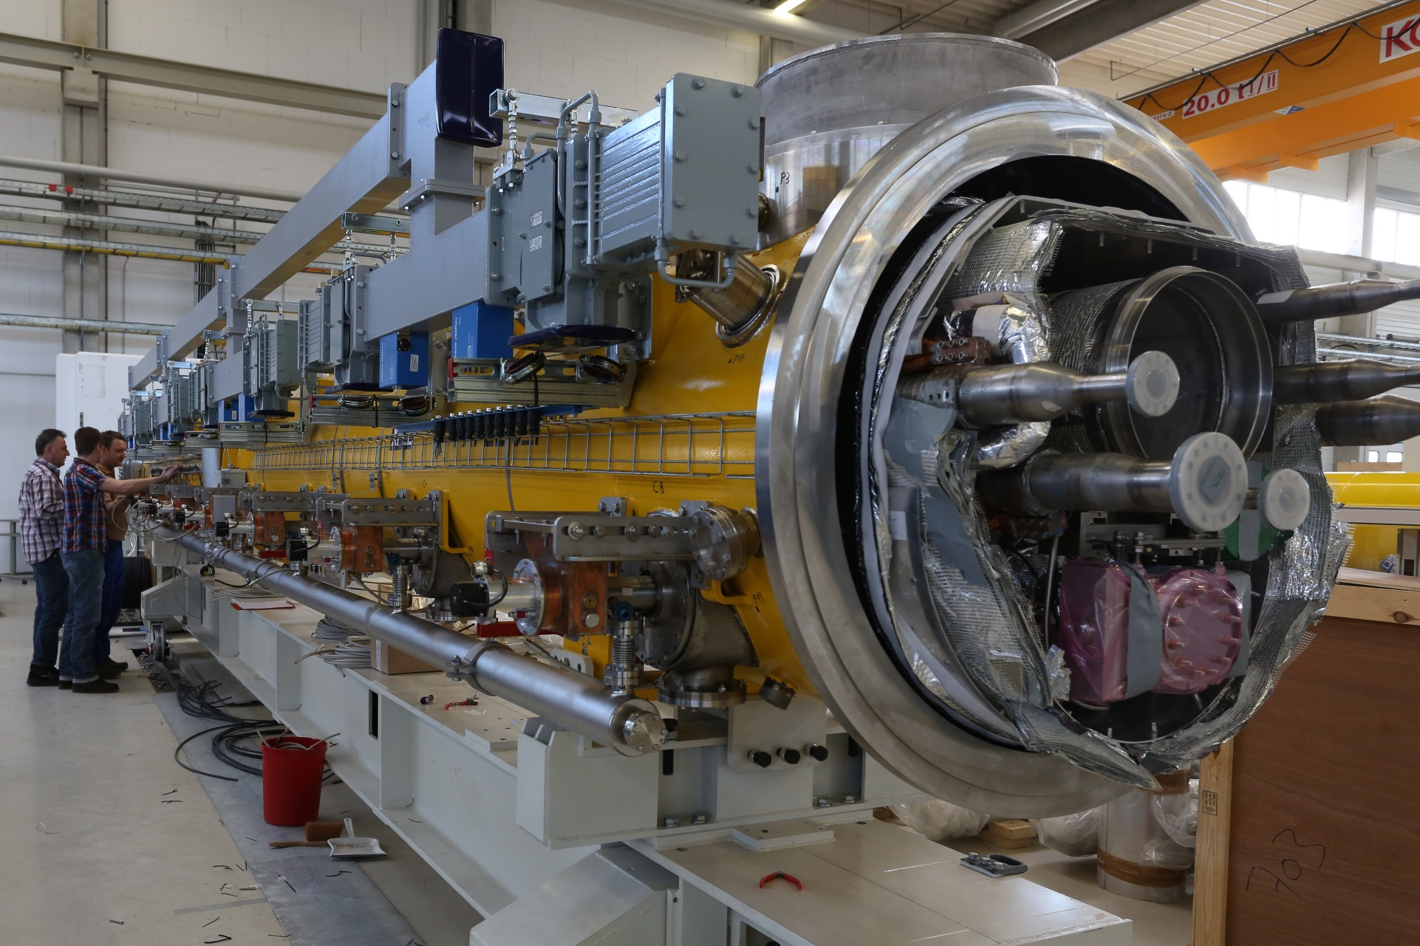
Waveguide Tailoring was done for all Modules

Slide 14
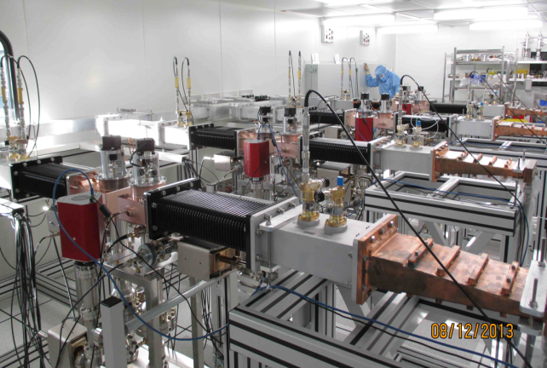
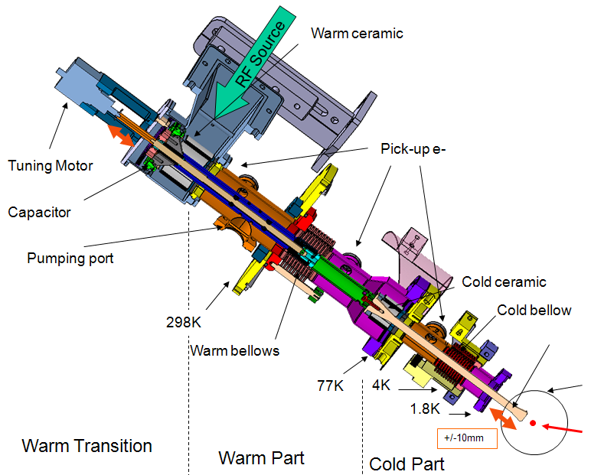

Couplers were the by far the most challenging single items in the supply chain of the modules
A total of 800 RF power couplers was produced at three different vendors
The largest fraction was procured by LAL Orsay and produced by Thales / RI
Approx. 20% were procured from CPI
RF conditioning of all couplers was done at LAL Orsay at a rate of 10+ couplers/week
Coupler delivery rate did not match the module assembly rate
Continuing quality and delivery issues needed to be addressed

Slide 15
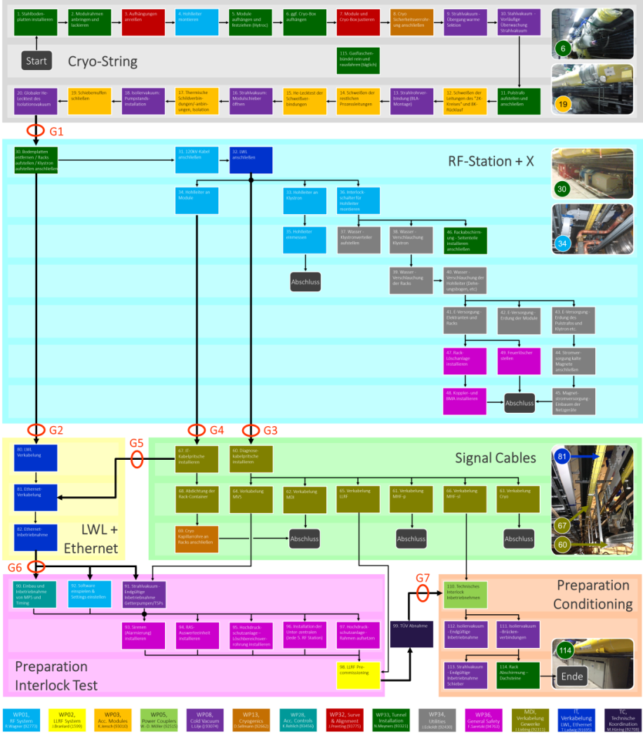
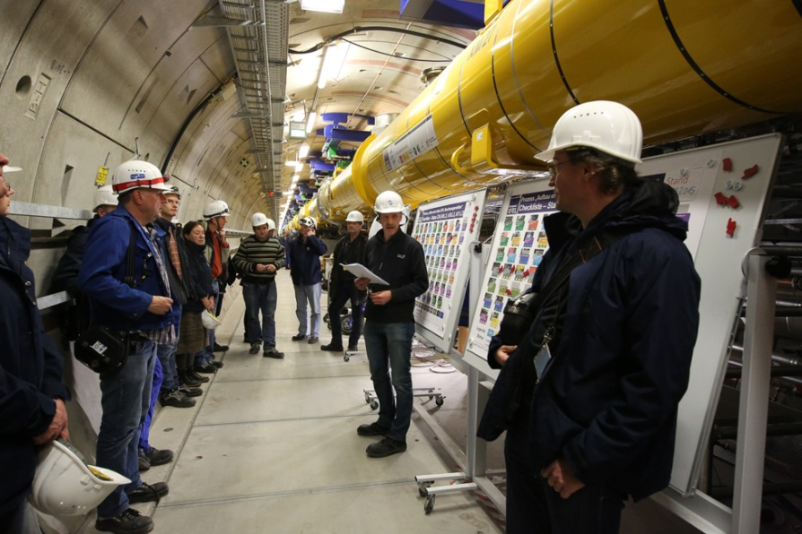
Tunnel Installation Process
Optimized global process steps and sequence & daily improvements
Cryo-String
RF
Signal Cables
LWL
Ethernet
P.I.
PrepCond
TÜV

Slide 16
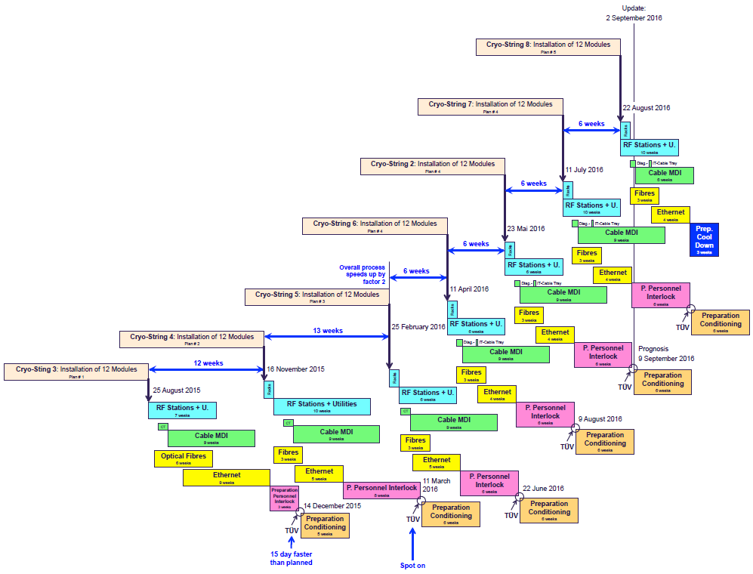
Process Management XTL Installation
Improved process management and repetitive
tasks helped to speed-up the installation.

Slide 17
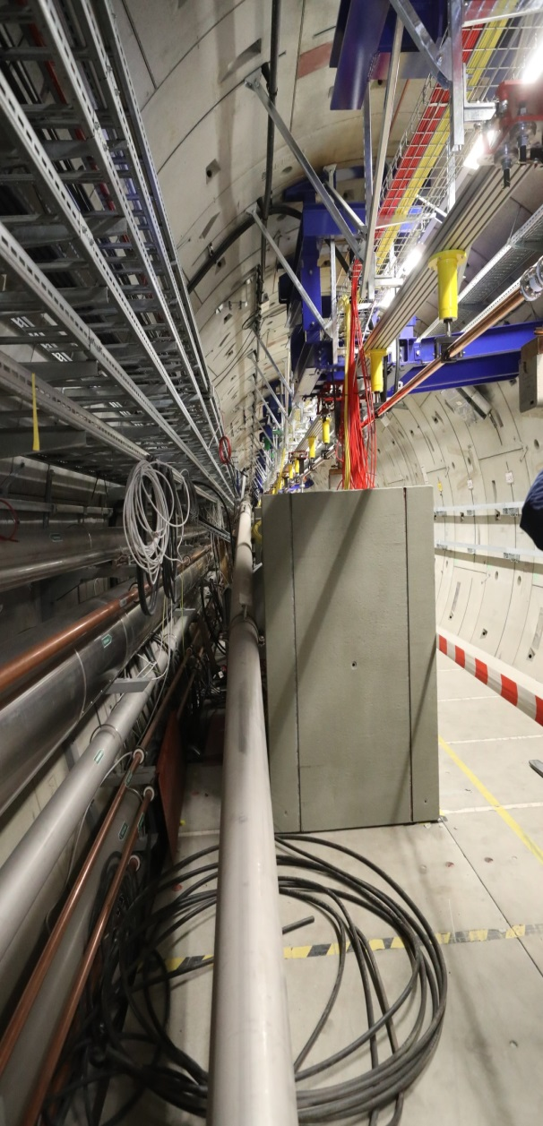
Result of a DN200 Pressure Test Preceding the first Cool Down
During the pressure test of a Helium exhaust line severe damage to accelerator infrastructure happened late night on October 11, 2016.
No people were injured since the tunnel was closed during the test.
Investigations are still ongoing but a first rough estimate of the needed repair time is about three months.
Both ends of the line have fix points to take the forces in longitudinal direction. The downstream fix point broke, and in consequence the pipe end moved by roughly 1.5 m towards Schenefeld.
The sliding fixtures along cryostrings CS8 and CS9 also broke and the line fell down.

Slide 18
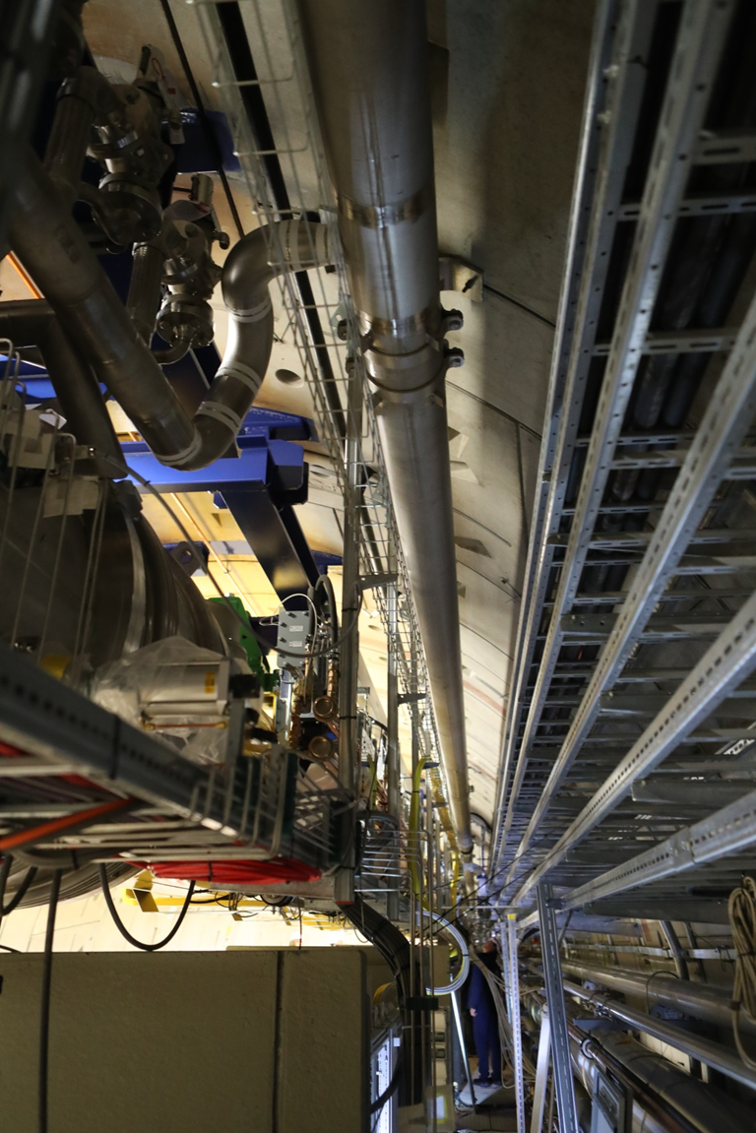
DN200 He Exhaust Line
DN200 exhaust line goes all along the linac to collect He in case of abnormal operation conditions in the process lines of the accelerator modules. Safety valves with short hoses connect the cryogenic string connection boxes to the exhaust line.
The exhaust line was designed, constructed and installed by an external company. Installation finished in 2014 with an acceptance test including full pressure check without any apparent problems.
After completion of connections to all cryogenic boxes a final pressure test was needed to prepare for the upcoming cool-down of the accelerator.
Notes:
Before you start editing the slides of your talk change to the Master Slide view:
Menu button “View”, Master, Slide Master:
Edit the following 2 items in the 1st slide:
1) 1st row in the violet header:
Delete the existent text and write the title of your talk into this text field
2) The 2 rows in the footer area: Delete the text and write the information
regarding your talk (same as on the Title Slide) into this text field.
If you want to use more partner logos position them left
beside the DESY logo in the footer area
Close Master View

Slide 19
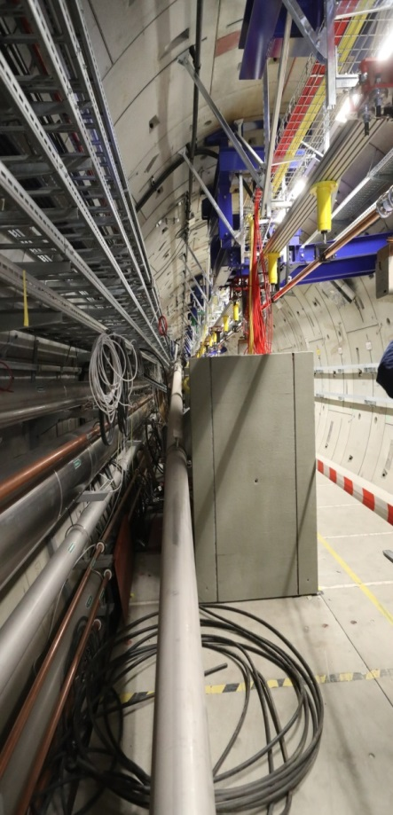
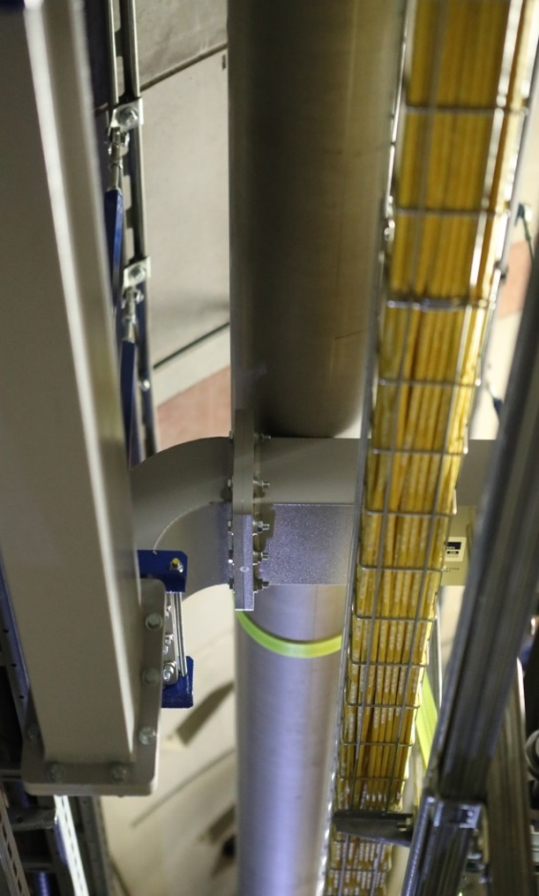
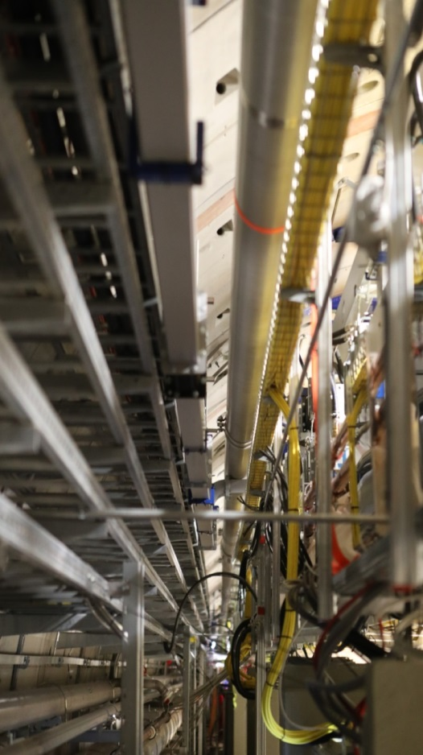
Position of DN200 Pipe right after Pressure Test
Downstream of CS9, along the replacement line, the pipe fell down to the floor, without major damage to other components.
Along CS9 and CS8 the line came to a halt on some of the wave guide sections which are 0.5 m below the original position of the pipe.

Slide 20
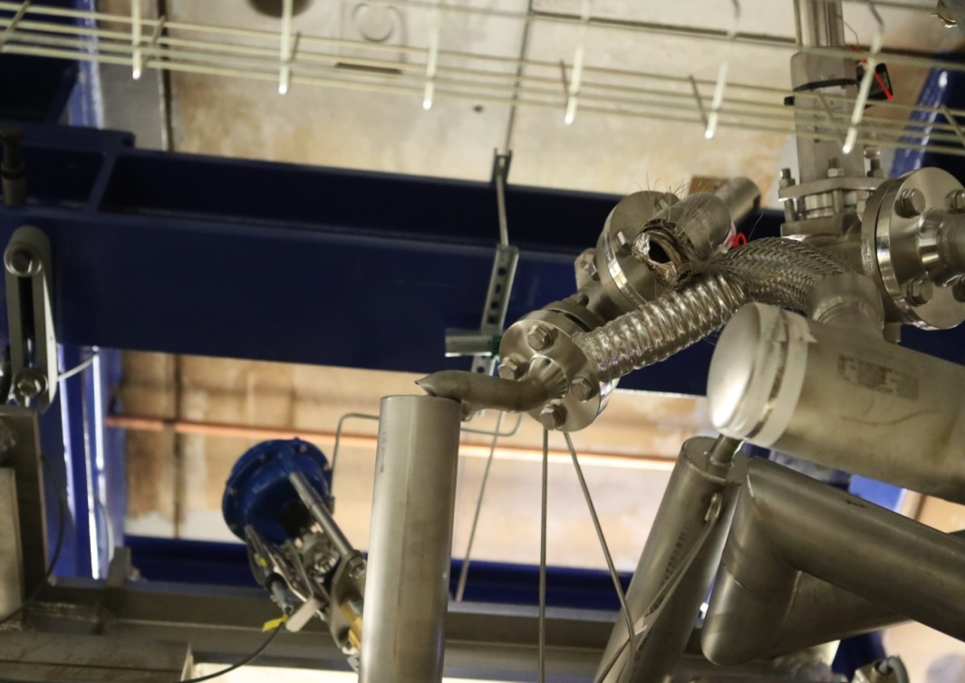
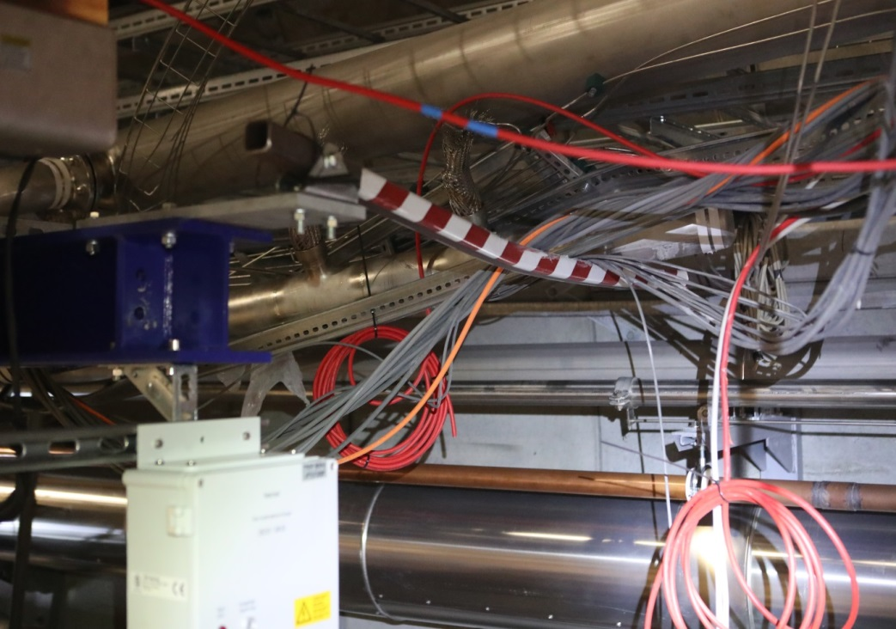
Damage close to Cryogenic End Box
At the cryo end box and also at the string connection box connecting CS8 to CS9 all connections to the DN200 pipe broke.

Slide 21
XFEL Linac Commissioning (to date)
Injector commissioning (130 MeV) 12.2016
✔︎
L2 and L3 linacs at 2K 6.01.2016
✔︎
L1 (A2) commissioning (600 MeV) 01.02.2016
✔︎
L2 (A2/3/4) commissioning (2.4 GeV) 15.02.2016
✔︎
L3 (A6-25) commissioning ongoing
→ 12 GeV achieved 10 April 2017
✔︎
→ First lasing 4.5.2017 (6.4 GeV, 7.8Å)
✔︎
21

Slide 22

European XFEL: First Laser Light on 3 May 2017

Slide 23

European XFEL: 12 GeV point (max. energy to date)
EDesign = 17.5 GeV
max. performance from cryomodule tests
12 GeV
Still work to do to achieve maximum performance
A20 waveguide issue (repaired)
A21-23 currently being commissioned with RF
CS1
CS2
CS3
CS4
CS5
CS6
CS7
CS8
CS9
cryostring
23

Slide 24
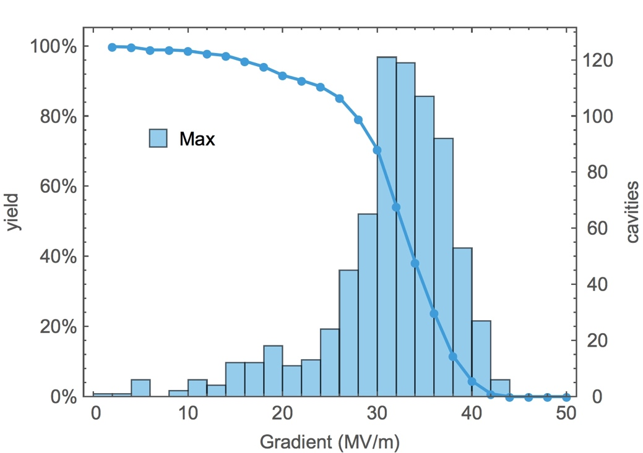
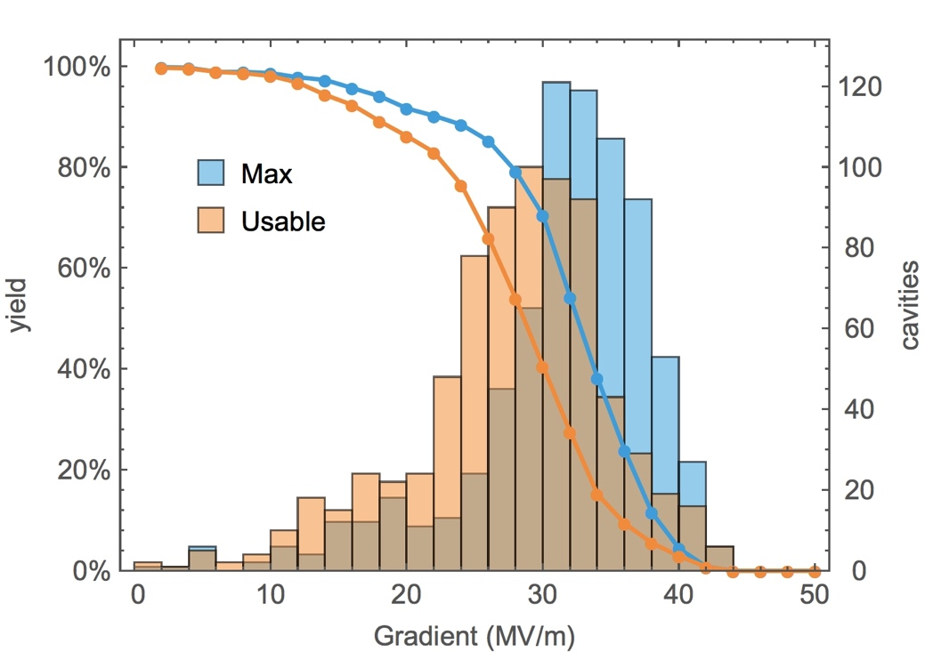
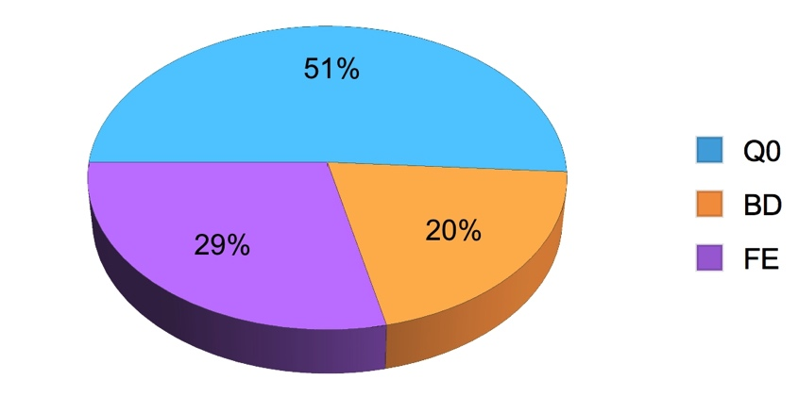
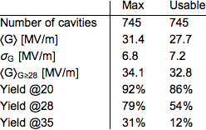
As Received Usable Gradient in the VT
typical individual error: 10%
Include operations spec
  Q₀ ≥ 1×10¹⁰
  FE threshold (X-ray)
→ Usable Gradient
Limiting factor for “as received” cavities.
24
Notes:
Pie-chart Q0-dominated because half of the cavities are aboue 30 MV/m where the so-called “negative Q-slope” kicks in.

Slide 25
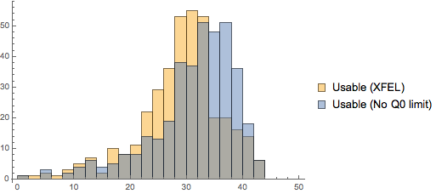
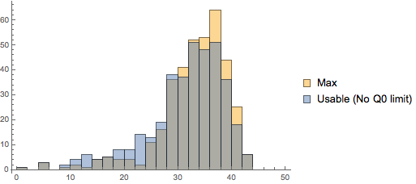
Usable field – ignore Q₀ criterion? (FE only)
RI cavities only
XFEL Q₀ limit
FE limiting

Slide 26
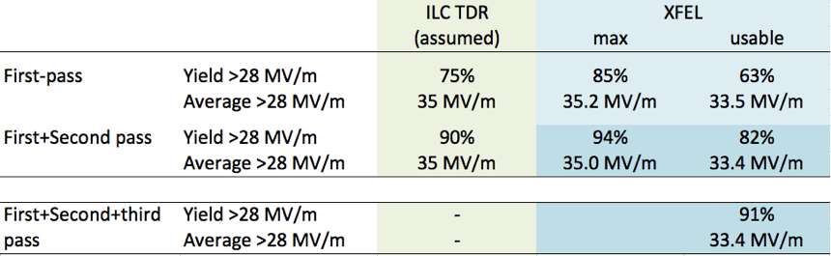
Second pass?
No direct ‘correct’ comparison possible
  Cut off for XFEL retreatment ≤20 MV/m
  ILC is ≤28 MV/m
Can try to use retreatment MC model based in XFEL results
More re-treatments - but mostly only HPR
Number of average tests/cavity increases from 1.25 to 1.55 (1st+2nd) or
20% over-production or additional re-treat/test cycles

Slide 27
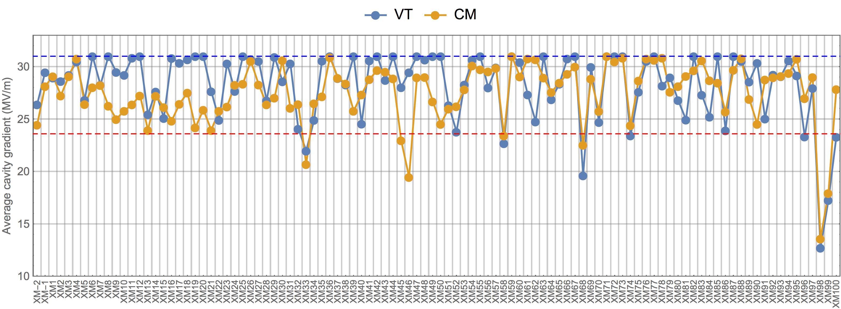
Cryomodule average gradient performance
usable gradient
VT capped at 31 MV/m for fair comparison and power considerations
 | N_{cavs} | Average | RMS
VT | 815 | 28.3 MV/m | 3.5
CM | 815 | 27.5 MV/m | 4.8
~3% difference measured this way
3% ≤ ΔG ≤ 8%
27
Notes:
VT capped – so for those who don’t fail at 31 MV/m in the test, assume 31. That pulls the average for VT tests to lower values, namely to the 28.3 – which 3% above the CM performance. However, if you assume the true uncapped VT average of 30MV/m, then you get an 8% difference. The difference in gradient between VT and CM therefore is between 3 and 8%.

Slide 28


Degradation matrix
Degradation defined as ≥20% (red)
count of ‘red’ cavities
cavities degraded
best place to be a happy cavity in a cryomodule
cavity position
cavities
degraded
cryomodule
28

Slide 29
Lessons Learnt?
TESLA technology has been successfully industrialised and can be mass produced
  No reasons why this cannot be extrapolated to ILC numbers
Success requires DILIGENCE (and attention to detail)
  Close cooperation with cavity vendors
  Constant feedback, QA and QC
Standard ‘TESLA’ recipe can almost achieve ILC specifications
  But improvement still needed
  30 MV/m average is great, but 7 MV/m RMS spread is too large (why?)
  Q₀ performance (Nitrogen anybody?)
String assembly without degradation is not impossible
  Again, requires diligence!
  Auditing, QA/QC, feedback, etc.

Slide 30
Contents
European XFEL
  Reminder
  Status of the machine (thanks to Nick Walker)
  Safety at the European XFEL (see separate presentation)
ILC in Europe
  Strategy processes
  European Action Plan
  …

Slide 31
Contents
European XFEL
  Reminder
  Status of the machine (thanks to Nick Walker)
  Safety at the European XFEL (see separate presentation)
ILC in Europe
  Strategy processes
  European Action Plan
  …

Slide 32

The European strategy process
Europe’s strategy updated last in May 2013, approved by CERN Council
(i.e. the European funding agencies). Central elements:
LHC and HL-LHC
Accelerator R&D
Strong support for ILC
Importance of theory
Role of national laboratories
Next update of strategy expected 2020
Preparations starting now European countries
Personal view: Various large contenders for European support:
  HL-LHC is clearly set
  CLIC and FCC – there can only be one future project / study?
  ILC? Interesting development: ILC European Action plan figured in September meeting with European funding agencies.
  High-energy LHC as very serious option

Slide 33

The European strategy process

Slide 34

Discussion in Germany
Various different elements of strategy development in Germany:
National roadmap: collection of large-scale research
projects (e.g. “LHC upgrades”, “European XFEL” etc.)
KET (“Committee for Elementary Particle Physics”)
drives a HEP strategy process: discussions in and
statements from the community.
Last KET workshop:
2/3 May 2016, MPI Munich: e⁺e⁻ physics
Physics case of future e⁺e⁻ machines
Presentations from e.g. CLIC, FCC-ee, CPEC, ILC, …
Trying to define the German community’s
opinion concerning the various options
Surprisingly clear outcome ...
Outcome will be fed into discussions with ministry;
but no immediate impact expected.

Slide 35

Outcome of German KET workshop

Slide 36

Outcome of German KET workshop
C. Zeitnitz

Slide 37

Other options

Slide 38


On the other hand …

Slide 39

Situation in Germany
DESY / Helmholtz:
e⁺e⁻ physics at ILC and Belle on of the
pillars of our current strategy.
May aspects of physics & detector; some
machine development (SRF)
Update of strategy soon (<1 year, clash
with European timeline)
Will probably rather speak of “future projects”
Universities:
Some federal funding secured, e.g. for physics / theory
and positron polarisation; but future not clear
Outlook:
Currently orientation / strategy building on DESY and national level
It gets harder to justify ILC as “the” future project without clear positive signs from Japan.
This statement is true for all countries.

Slide 40


DESY STRATEGY BEYOND PoF III
POF 3 (2015-19)
POF 4 idea (2020++)

Slide 41
Contents
European XFEL
  Reminder
  Status of the machine (thanks to Nick Walker)
  Safety at the European XFEL (see separate presentation)
ILC in Europe
  Strategy processes
  European Action Plan
  …

Slide 42

Towards a European Action Plan
Originally requested by Okada-san from the KEK ILC Planning Office
A report outlining Europe’s possible contribution during the four-year preparatory phase
Similar to KEK document
Discussed by Okada-san and E. Elsen
Suggestion to prepare this within E-JADE
context, with Steinar Stapnes as coordinator
Originally intended timescale: two month,
4+4 European and Japanese colleagues
Comparison to KEK document
KEK document deals with only one country
(in fact only one lab)
Europe is much more complicated:
many countries, labs, funding agencies
Scope therefore shifted to potential EU in-kind
contributions (cost if EU IKC, EU core
competencies, who might do what …) along
ILC WBS

Slide 43

Towards a European Action Plan
Purpose of document not entirely clear:
KEK says it will be useful for them? Will they show it to MEXT?
Might also be useful for European discussion (starting 2019) – input to CERN Council?
How to make it carry some weight?

Slide 44



Towards a European Action Plan
Going through three phases of ILC
Pre-preparatory phase
Preparatory phase
Construction phase
… and asking what Europe is (currently) or might be doing. “Currently” is the easiest part:
XFEL synergy always as biggest European contribution

Slide 45


Towards a European Action Plan
Construction phase even more complicated.
Possible forms of EU involvement complicated:
AKA “what is the role of CERN”?
Trying to demonstrate the ILC contribution is within CERN mandate (ILC as NGO in GDE “Project Implementation Plan”)
For preparatory phase assume MoU-based “collaborations” with annual budget of ~10MCHF/year + 20 FTE (more from non-CERN collaborators?)

Slide 46





Towards a European Action Plan

Slide 47
Conclusions
European XFEL
  Impressions
  Status
  Lessons learnt
ILC in Europe (Germany)
  Activities become harder to justify
European Action Plan
  To be finalised until end of May (Steinar Stapnes, Marcel Stanitzki)
  Impact and usefulness not yet entirely clear.

