Slide 1
Positron WG Meeting 4
Undulator scheme parameters
QWT as bottom line
Work Plan presented by Sabine

Slide 2
Undulator Scheme Parameters
Need to fix the parameters for 250GeV CM
  Basis for the design of the target wheel
Big progress by Andriy’s simulation with thin target
Started as the problem of PEDD on FC
  PEDD at the tip of FC is serious at Ee=125GeV
  is ~33J/g/pulse (1312 bunches)
  PEDD limit of Cu 7-12 J/g
  There are several possible measures
  Undulator closer to the target
    Compact dogleg designed by Okugi
    gives ~12% reduction of PEDD, ----- not enough
  Thinner target

Slide 3
Possible Measures for PEDD Problem
Possible cures
  Shorter distance from undulator to target: Done
    Andriy’s simulation showed only ~15% reduction of PEDD
  Thinner target: Done
    Less development of shower angle
    But reduces positron yield
  Larger beam hole of FC
    Compatible with 3Tesla field?
  Lower K of undulator
    smaller angle spread and higher photon energy (1/(1+K²))
    But reduces photon number (propt. K²)
  Photon collimator (originally for higher polarization)
    Scrape out low energy photons (useless for positron production and cause larger angle in target)
    But reduces positron yield
Minimum baseline
  DC QWT: how much is the luminosity reduction?

Slide 4
Andriy’s Results for Thinner Target
Expect
  Smaller angle spread of shower (hence less PEDD on FC)
  Smaller power deposit on target
  Less positron gain. Hence, longer undulator needed
But simulation shows
  surprisingly flat gain in the range 6mm < t < 14mm for fixed undulator length
  why?
    Effective distance between target and FC decreases
    Reduced multiple scattering
    Positron energy loss in target
  t < 6mm requires undulator length > 231 m

Slide 5
from figure
With fixed gain (e+/e-=1.5)
thickness | undulator length | PEDD on FC | Power on target (2625 bunches)
12 mm | 0 % | +1 % | 7.9 kW
9 mm | 0 % | -3.5 % | 5.3 kW
6 mm | +4 % | -9 % | 3.1 kW
3mm | +24 % | -19 % | 1.2

Slide 6
Conclusion
  Thinner target greatly reduce the power deposit on target. Thickness 6-7mm looks OK. Power deposit ~1.6kW with 1312 bunches (cf. 14mm → 5.4kW)
  Heat conduction Ti→Cu must be confirmed
  Undulator should be slightly longer (~4%)
    Undulator center should be shifted upstream a bit (same compact dogleg length)
  But the problem of PEDD on target is not solved yet (only 9% reduction)
  Need some more measure to reduce PEDD
Now, shall we adopt 6-7mm thick target as the standard parameterfor 250GeV?

Slide 7
A Problem of Long Pulse FC
P.Martyshkin 2014

Slide 8
QWT as Bottom Line
One of the problem of FC is the (t,z) dependence of the field
  May not be easy to solve
  Who can do this? Pavel????
What about QWT?
According to the communication Omori ←→ Wanming,
  Beam hole diameter ~2cm
  Some simulations with different solenoid length, Bmax, distance between focusing & matching, seem to have done
  But full optimization was not done
Need to know the minimum positron yield with target load fixed as the bottom line design for the case FC R&D fails

Slide 9
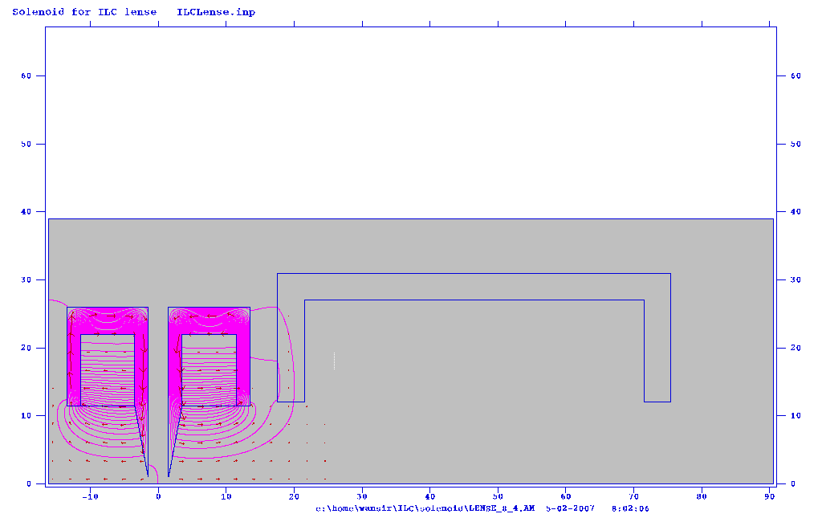
Let current in matching solenoid to be zero and solve Poisson for magnetic field map of bucking and focusing solenoid. Length of solenoid, all separation and all aperture is variable.
Matching
Bucking
Focusing

