Slide 1

Single Particle Energy Resolution
Manual Calibration
Ross McCoy and Andrew Myers
4/18/2017

Slide 2
Relevant Information
All particles used were pions, fired using single particle gun at θ=65°, for a run of 10000 events
Geometry used was SiD_o2_v02
Full simulation, including digitization and reconstruction, performed as usual
ECal: calibration_factorsMipGev increased from 6.58e-3 13.16e-3 to 9.212e-3 18.424e-3
HCal: calibration_factorsMipGev decreased from 3.0e-2 to 2.5e-2

Slide 3
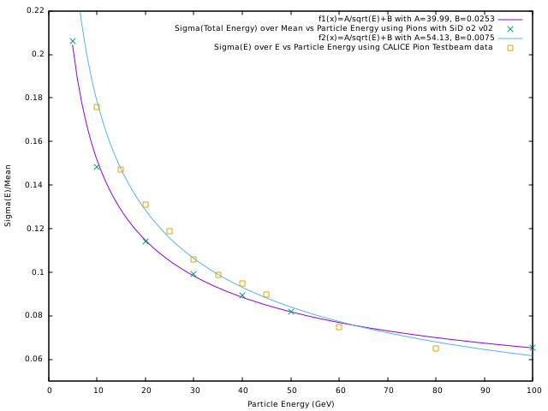
Energy Resolution using Pions (10000 Events)

Slide 4
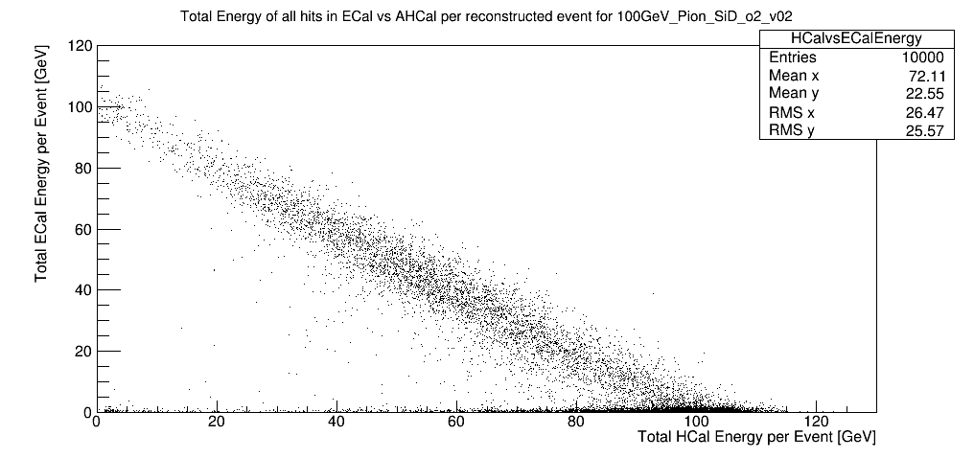

Slide 5
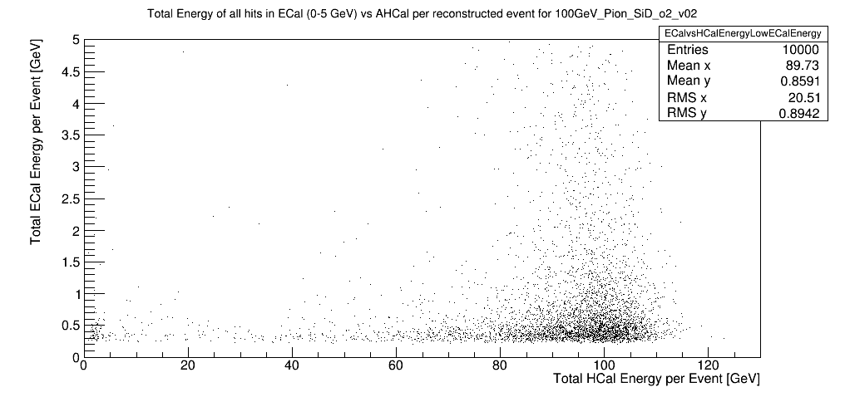

Slide 6
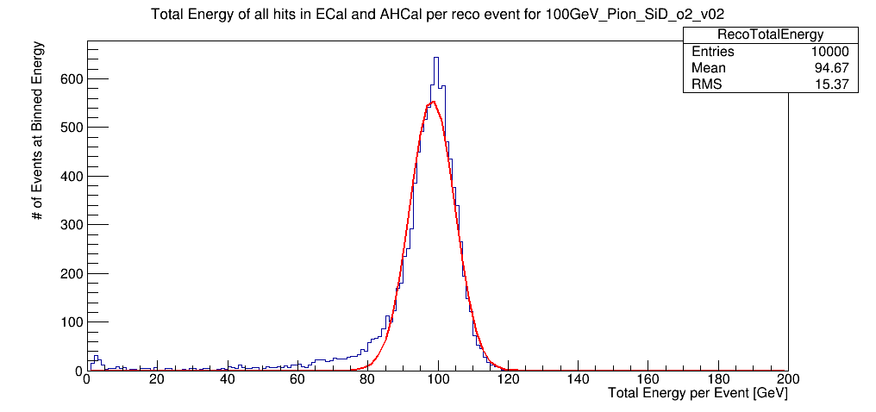
Gaussian Fit Results:
Sigma(E)=6.42717
Mean=98.3763

Slide 7
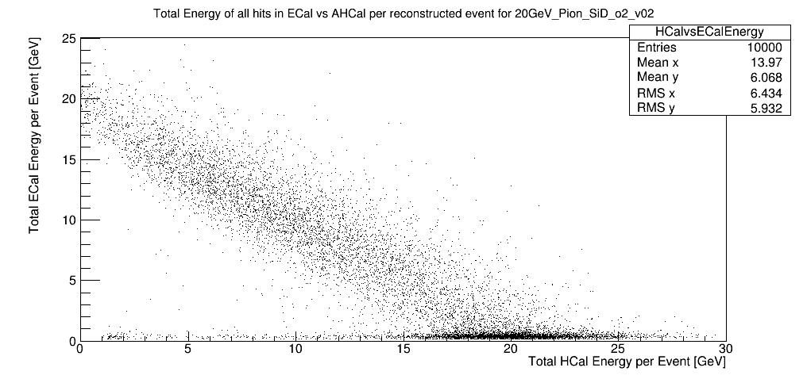

Slide 8
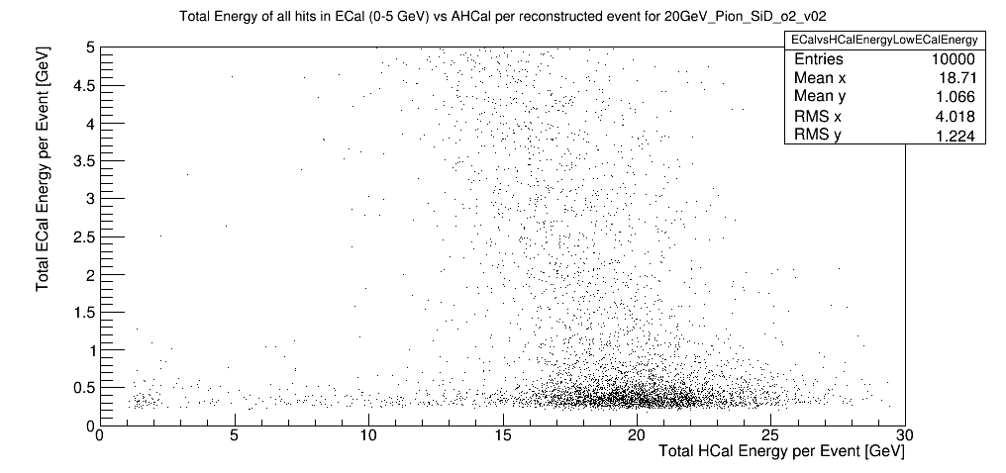

Slide 9
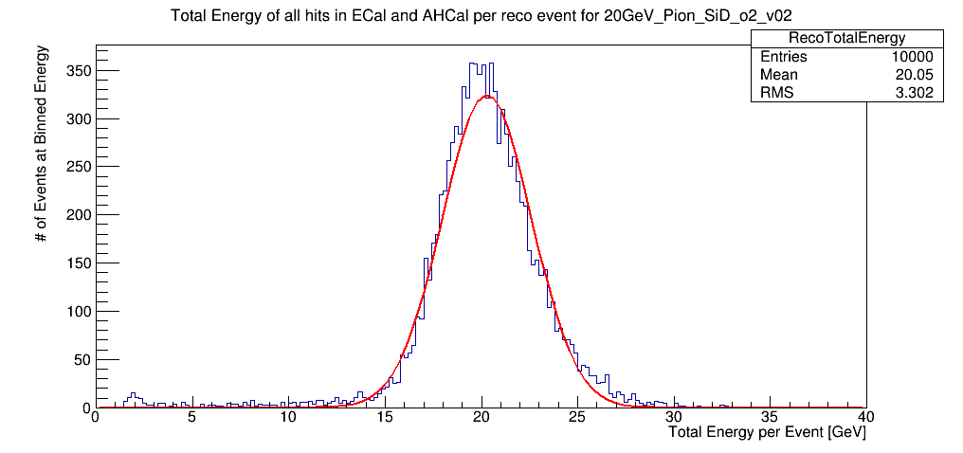
Gaussian Fit Results
Sigma(E)=2.31925
Mean=20.2818

Slide 10
Backup Slides

Slide 11
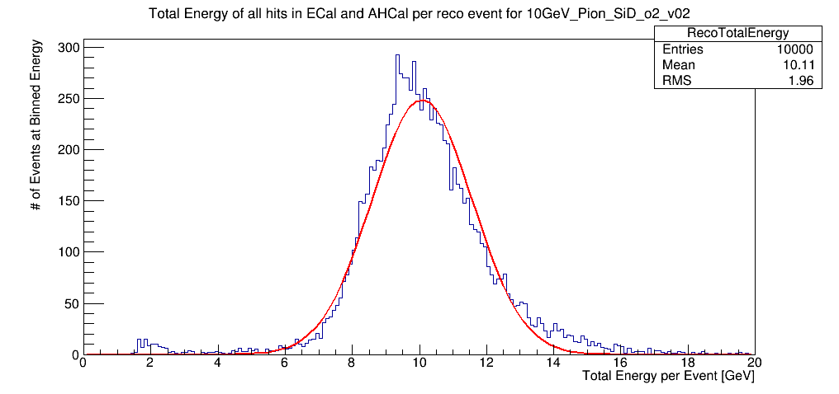
Gaussian Fit Results
Sigma(E)=1.49703
Mean=10.0782

Slide 12
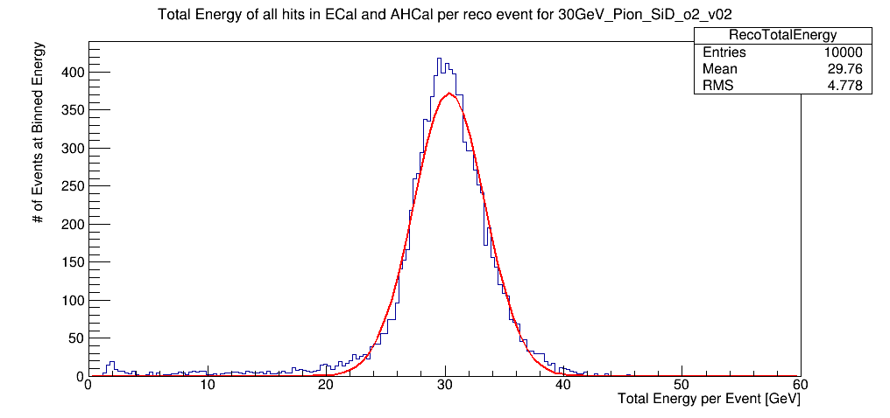
Gaussian Fit Results
Sigma(E)=3.01902
Mean=30.3792

Slide 13
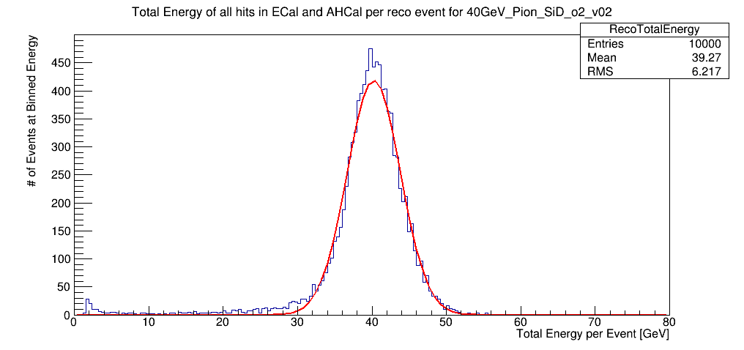
Gaussian Fit Results
Sigma(E)=3.60304
Mean=40.2568

Slide 14
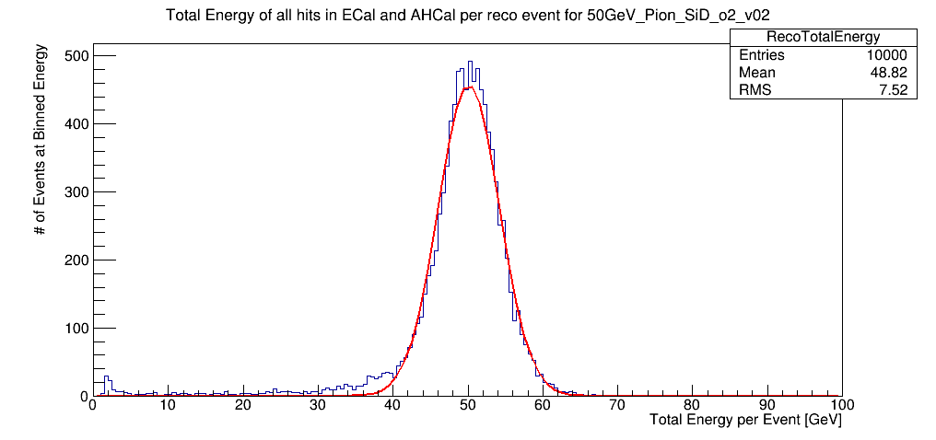
Gaussian Fit Results
Sigma(E)=4.10123
Mean=50.1213

