Slide 1
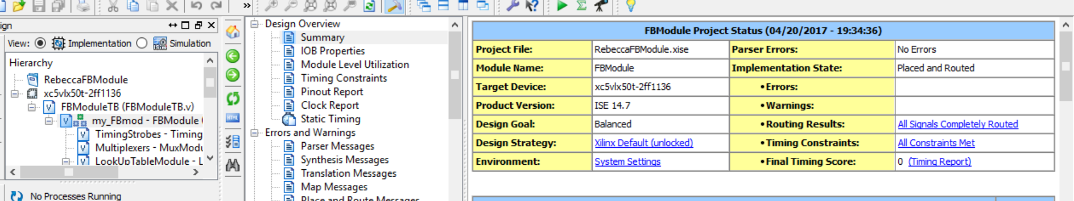
Meeting Timing
Timing constraint: TS_clk = PERIOD TIMEGRP "clk" 2.8 ns HIGH 50%;
9301 paths analyzed, 1898 endpoints analyzed, 0 failing endpoints
0 timing errors detected. (0 setup errors, 0 hold errors, 0 component switching limit errors) Minimum period is 2.780ns.
Latency at 9 clock cycles to meet timing constraints.

