Slide 1

SiD Hcal Simulation
Comparison with CALICE AHCAL Test Beam results (and simulations with various physics lists)
Ross McCoy, Andrew Myers, Andy White

Slide 2
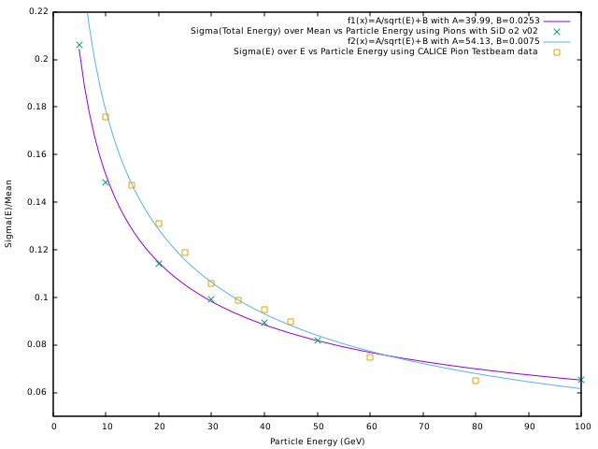
Energy Resolution using Pions (10000 Events)

Slide 3
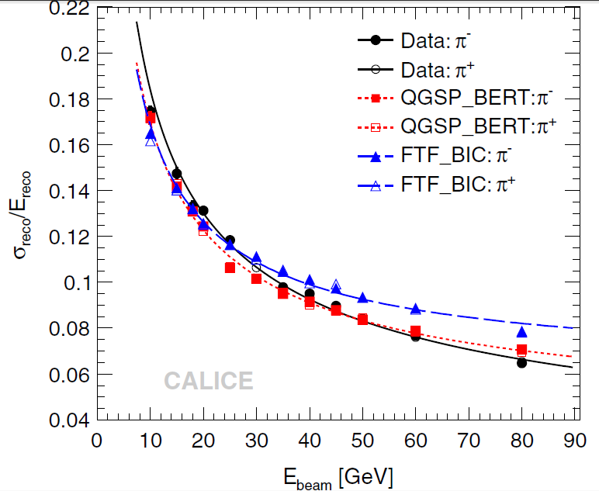
Fit to data:
Stochastic term = 57.6 ± 0.4%
Constant term =1.6 ± 0.3%
Note: simulations generally lower than test beam data

Slide 4


Features of CALICE fits to AHCAL test beam data
- The CALICE data is for events in which the pions interact in the first few layers of the ECal (so only the pion track energy deposition in the ECal is included).
The reconstructed energy is
where the e/π = 1.19 from measurements and averaged over the range of test beam energies.
The CALICE data is fitted with
so a noise term is included. The noise term c = 0.18 GeV is mainly due to the TCMT (tail-catcher). The AHCAL noise term is 0.06 GeV – measured using random triggers.

Slide 5
Next steps:
Use subset of pion simulated data that interacts early in the HCal (and so only has non-interacting tracks in the ECal).
Relate our calibration adjustments for ECal and HCal to the e/π value used by CALICE. Can also obtain e/π directly from e, π simulations in HCal.
Relate the noise put into our simulation to the “c” term used in the CALICE fit.
Re-fit our reconstructed simulated data using

