Slide 1
IP BPM alignment plan
N. Blaskovic, T. Bromwich, R. Ramjiawan
N. Blaskovic

Slide 2
Contents
IP BPM alignment measured in February
IP BPM alignment plan for May
N. Blaskovic

Slide 3
IP BPM alignment in February
IP BPMs were aligned relative to each using with high-β optics in February 2017
On-shift alignment achieved requires adjusting:
IPAB’s M3 sub-mover (close to IPA)
IPAB’s M1 and M2 sub-movers (close to IPB)
IPC mover (no mover pitch introduced)
N. Blaskovic

Slide 4
Beam-based measurements
Results presented on next slide:
Blue line: beam on 17 Feb taken as reference
Green lines: full mover dynamic range (deduced from mover setting on 17 Feb)
Red crosses: mover settings on 24 Feb
Red line: deduced beam orbit on 24 Feb (movers set so that beam is centred in BPMs)
Straight-line beam orbit reconstructed for both 17 & 24 Feb data (blue & red lines)
N. Blaskovic

Slide 5
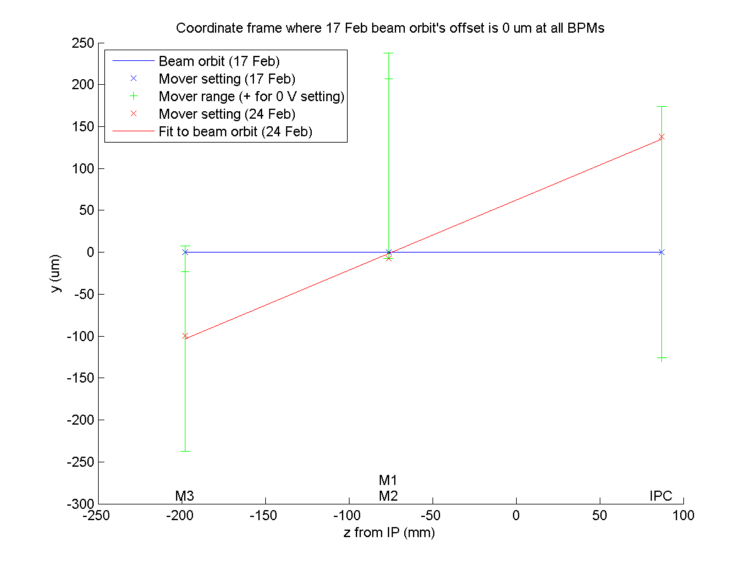
N. Blaskovic

Slide 6
Mover dynamic ranges
Next slide:
Plot IP BPM mover dynamic ranges alone
Coordinate system as on previous slide
Straight-line fit through mid-range mover settings constitutes ‘ideal’ beam orbit
N. Blaskovic

Slide 7
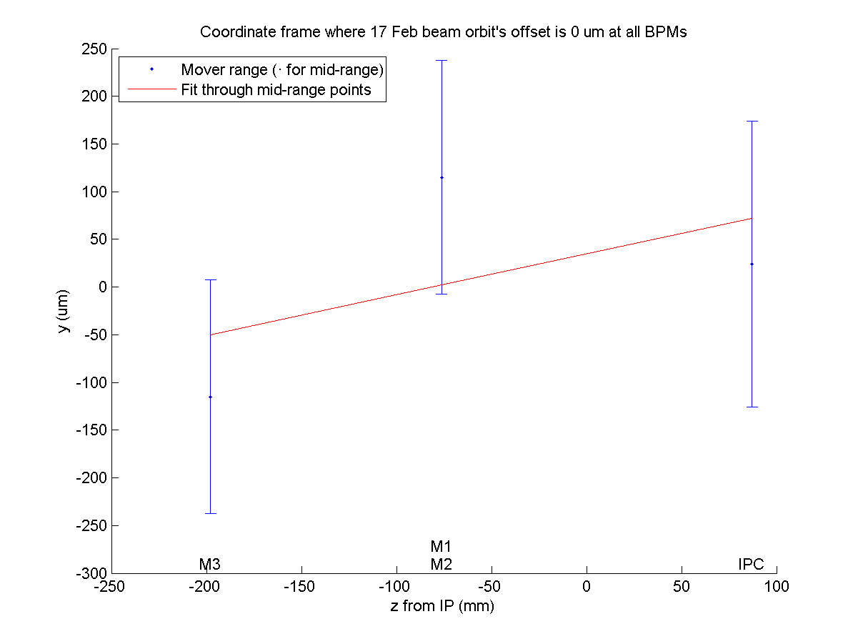
N. Blaskovic

Slide 8
Mover dynamic ranges
Next slide: rotate plot such that ‘ideal’ beam orbit is horizontal
In practice at ATF, this requires re-steering the beam or re-positioning the IP chamber
M3 and IPC movers are well aligned
M1 and M2 movers are 180 um too high
N. Blaskovic

Slide 9
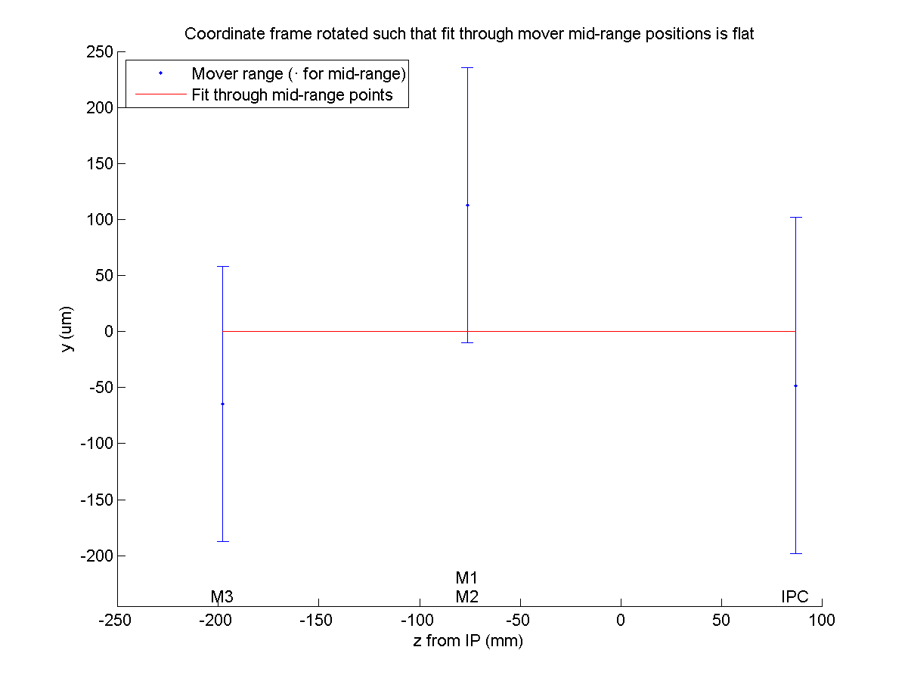
N. Blaskovic

Slide 10
IP BPM alignment plan for May
‘Internal alignment’ (alignment of IP BPMs relative to each other)
‘Global alignment’ (alignment of IP BPM system for beam size tuning operation)
N. Blaskovic

Slide 11
Internal alignment
To confirm relative alignment of the IP BPMs after their re-installation
Requires high beta optics for small beam jitter at IP BPMs
Request 1-2 dedicated shifts for this study
Results may require re-alignment inside the IP chamber
N. Blaskovic

Slide 12
Global alignment
Given larger position jitters and possible position offset, work with attenuated IP BPM signals (e.g. 40 dB attenuation)
Use nominal optics
Work with the beam-size tuning team to find a beam orbit common for both IP BSM and IP BPM operation
Results may require repositioning of the IP chamber
N. Blaskovic

Slide 13
Suggested schedule
1-2 shifts for internal alignment study
1 shift for global alignment study
Access to perform internal and global re-alignment (help from Sandry/Araki-san)
If internal re-alignment is performed, 1-2 shifts for internal alignment study
1 shift for global alignment study during a beam-size tuning shift
N. Blaskovic

Slide 14
Appendix
Settings used for IP BPM alignment study in February
N. Blaskovic

Slide 15
BPM mover settings on-shift
Mover settings to centre beam in all BPMs
BPM mover calibration (–30.65 um/V for IPA & IPB; 29.99 um/V for PI) assumes coordinate system where positive y is up
Date | Mover setting (V)
 | M1 & M2 | M3 | IPC (Y)
17 Feb | 6.75 | –0.75 | 4.20
24 Feb | 7.00 | 2.75 | 8.80
N. Blaskovic

