Slide 1
CERN Can’t Keep Up!
Simulating both interactively and through the batch system.
Ryan Bodenstein
FONT Meeting
2017/28/4

Slide 2
Preview
3 sub-projects:
ILC Offset/Angle Study for paper
ILC IP Feedback simulations for IPAC17
CLIC Single-beam traditional lattice tuning
Finished ILC Offset/Angle Study
Still working on IP Feedback and Tuning
Limited by batch system
Need a few parameters can’t find properly

Slide 3
Part I: ILC Offset/Angle Study

Slide 4
Turns out, the handle was rusty.
More than a few parameters needed to be changed to run LinSim on the ILC
Turns out, hasn’t been updated as much
Had to re-do part of the code with Jürgen
Kept failing in batch system, decided that interactive running was the best option
This kept failing too, but showed promise…eventually I got it to work
Rather than 20 iterations for each point, did 5 luminosity measurements to save time without losing much statistically

Slide 5
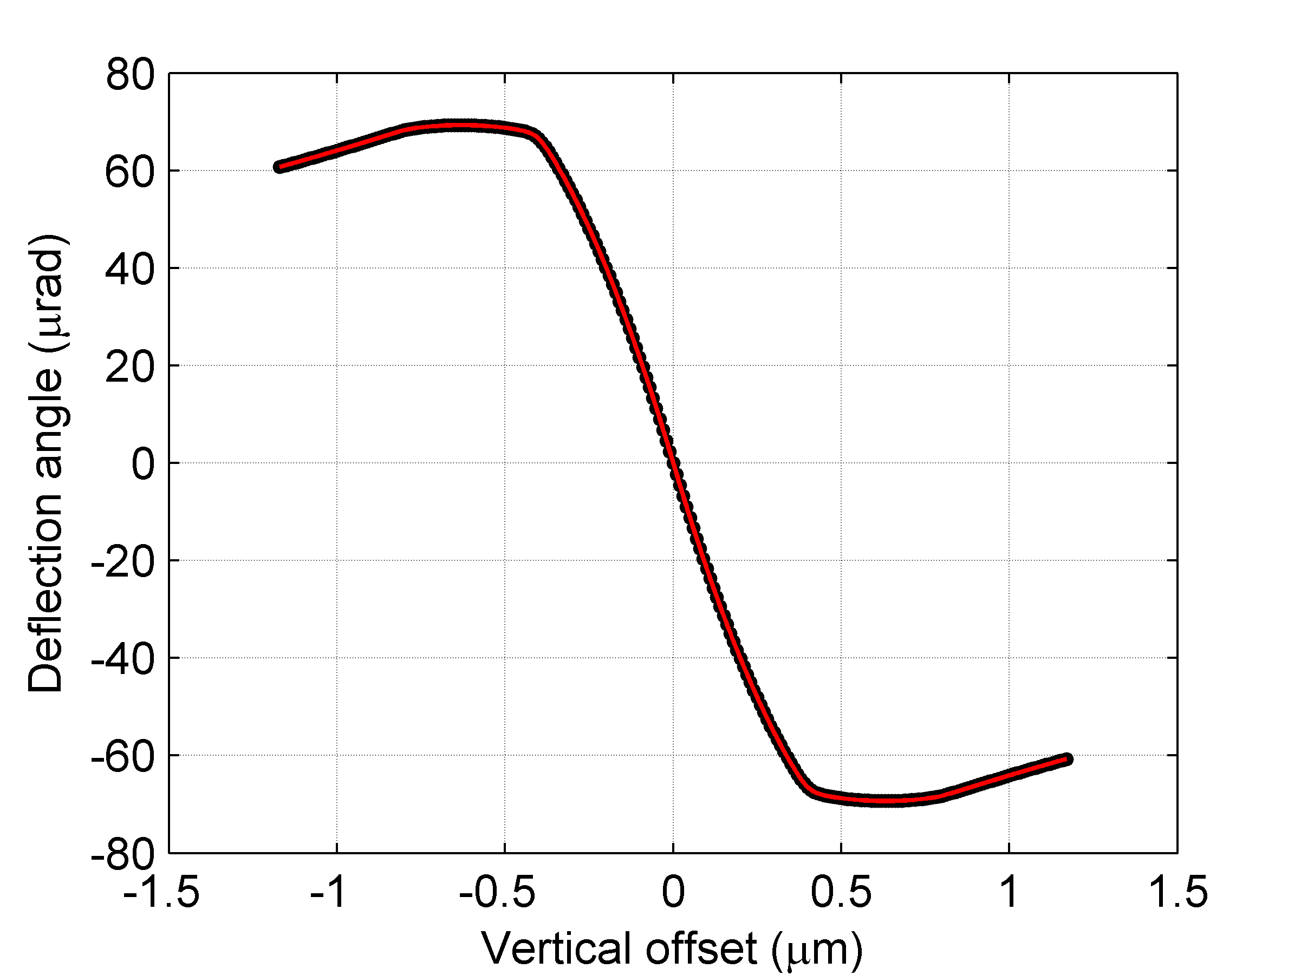
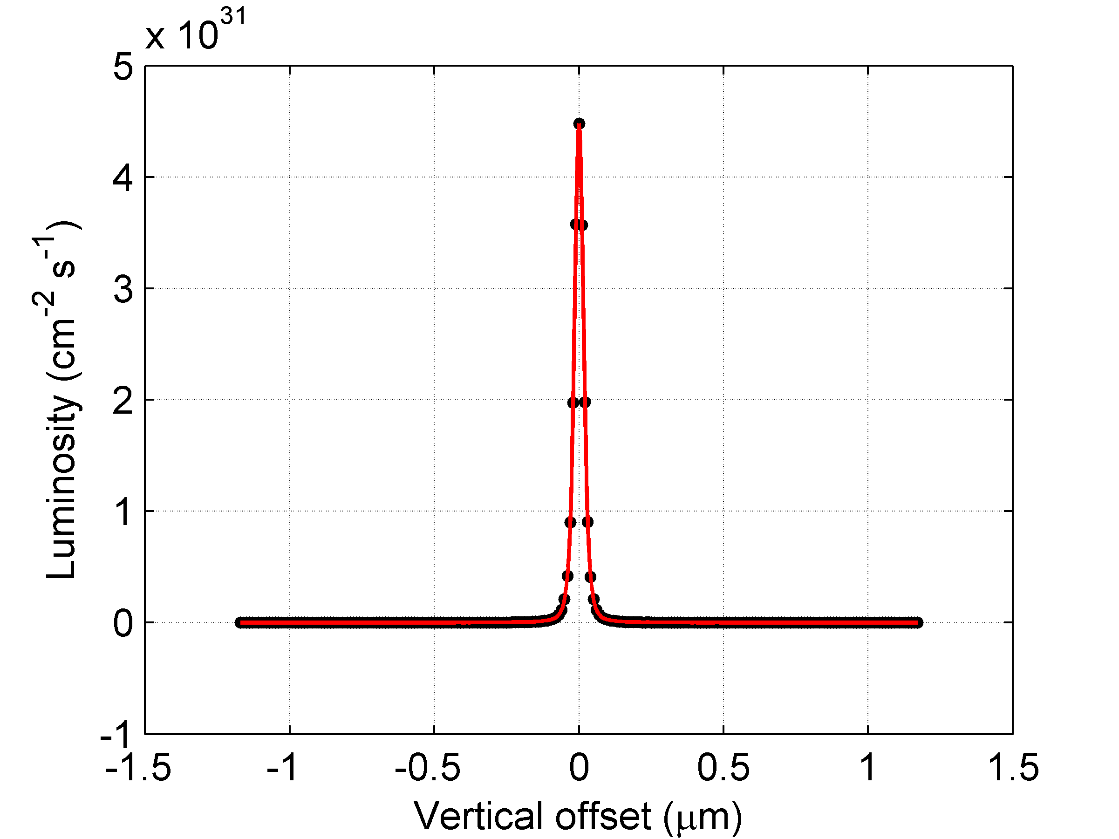
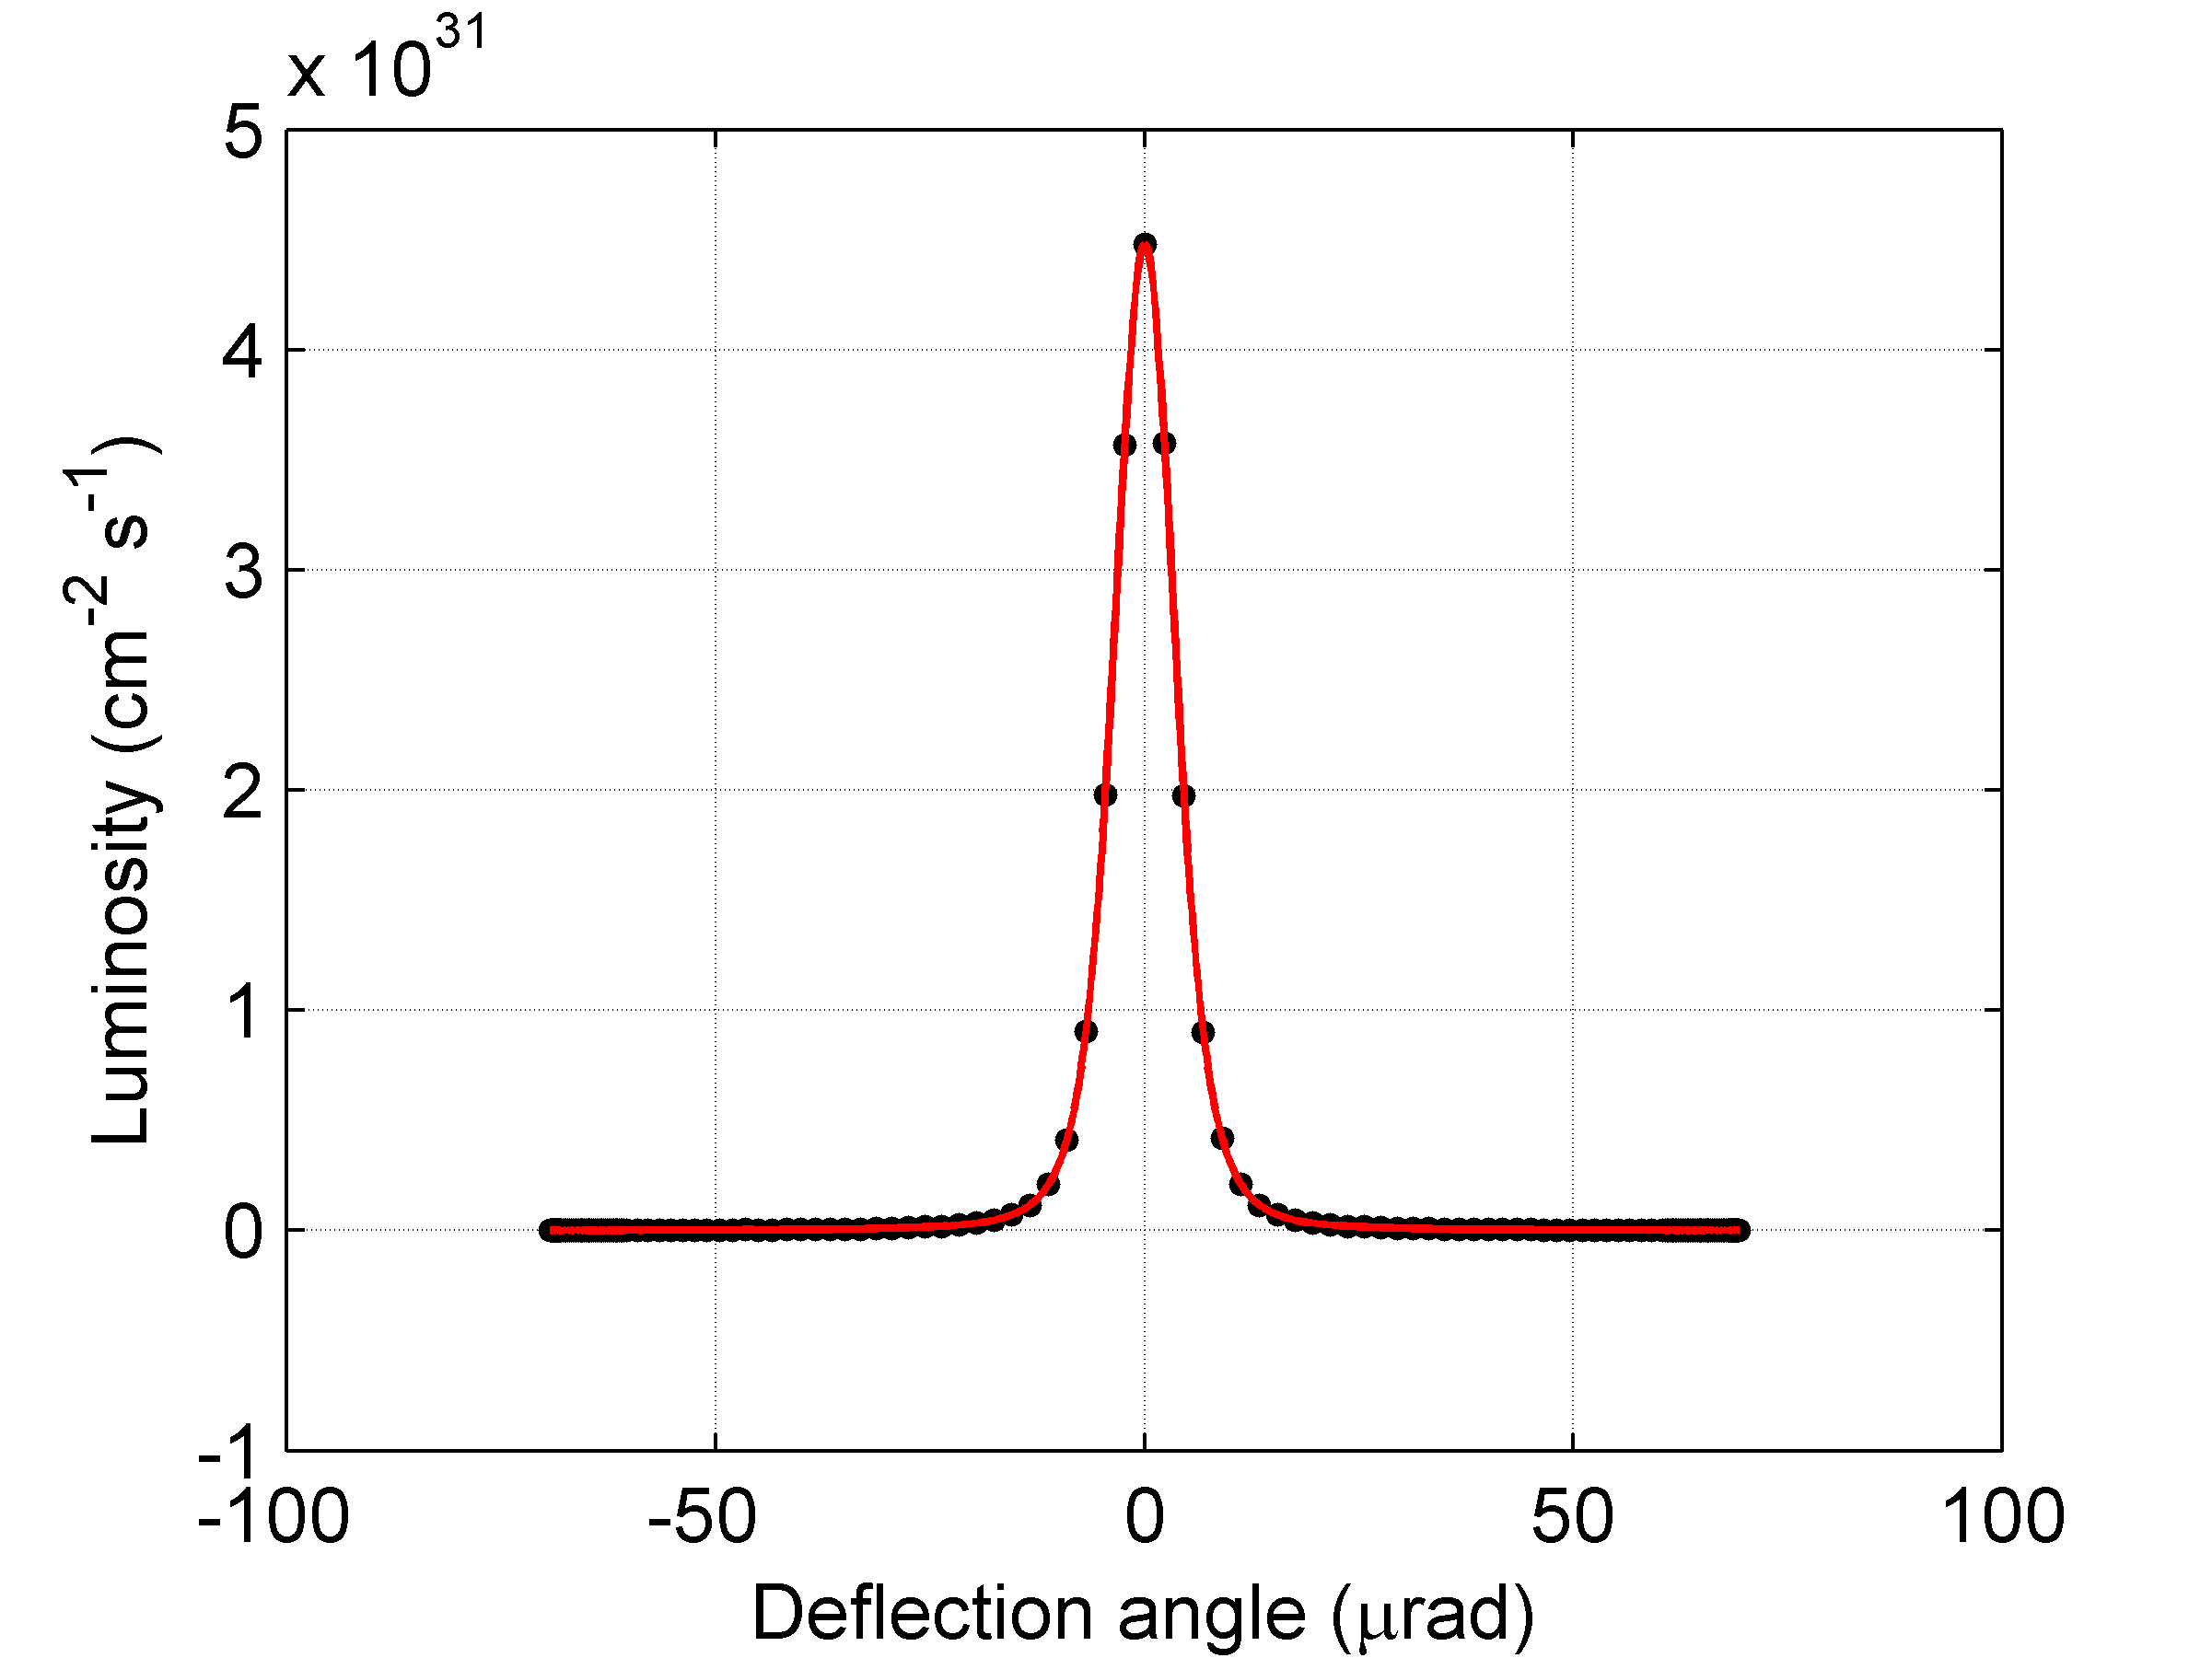
Plots courtesy of Neven:

Slide 6
Part II: IP Feedback Simulations

Slide 7
15,000 batch jobs and counting
Quite a lot of coding was required to get this going
Changed some of LinSim itself
Multiple layers of buried parameters
Without a local expert, I was required to over-examine aspects of the simulation
For example, Jochem knew roughly where the gain value would be for CLIC, but nobody knows where it should be for ILC, so I have to scan more values.
I messed up a lot before I got it right (I think)
The jobs running are:
100 seeds for each of 30 gain settings X 5 ground motion models
Once finished, should have all the data required to analyze and be done…hopefully.

Slide 8
Part III: Tuned or tone-deaf?

Slide 9
After much delay, might have new data
After my last update, where I showed a massive amount of work to demonstrate the the wrong weighting parameters were being used, it took a lot of effort to be able to run proper jobs with the new parameters
Also delayed b/c of focus on IP Feedback and Offset work
Finally submitted jobs on Thursday afternoon
Must edit analysis codes before I can be sure things are correct. This is in process.
This is likely as far as I’ll get before IPAC, but it is still new(ish) work and should be fine for a conference.
I’ll next try to scan values for W2, based on the saved machines from the current run.

Slide 10
Surviving Copenhägen
Have to find a handful of parameters which are inconsistently reported, and simulations haven’t helped:
D_bpm, Y_ip, Y’_ip
Have to edit some analysis scripts, which is mostly bookkeeping to make sure I don’t miss something small
Have to write two papers and make two posters
Flight being booked by Kim, accommodation made (AirBnB with Neven and Talitha)

