Slide 1
Tatsuya YOKOYAMA
OYO corp.
LCWS2017 Strasbourg
CFS-WG
Rock Stress Change after 2011 Earthquake and Stability of Rocks in Kitakami Mountains
25 Oct. 2017

Slide 2
Contents
1. Introduction
2. Rock stress change after Tohoku earthquake
3. Ground movement by Tohoku earthquake
4. Geology and rock states in Kitakami site
(Many figures from Tomoyuki SANUKI Tohoku Univ.)
5. Summary

Slide 3
1. Introduction
In order to evaluate the stability of the Kitakami Mountains, the stress change after the Tohoku earthquake was repeatedly measured.
As a result, a large increase of rock stress was observed immediately after the earthquake, but the stress has settled to the original stress states gradually.
Due to the Tohoku earthquake, the ground moved largely south-east, but its movement shows parallel movement as a whole, so ILC line will not be bent.
According to the Tohoku University, it is reported that the rock condition in Kitakami site is very good.
Based on these objective data, Kitakami site is judged to be suitable for ILC.

Slide 4
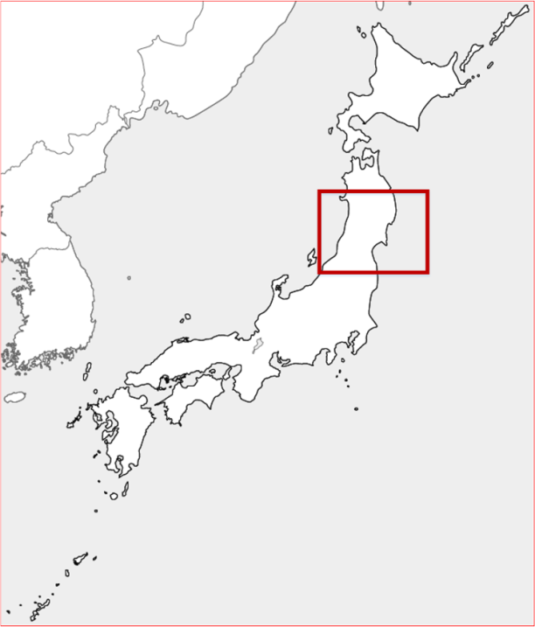
2. Rock stress change after Tohoku earthquake
(Geospatial Information Authority of Japan, 2011)
Large crustal movement was observed by Tohoku earthquake in 2011
Rock stress change was measured in a year after the earthquake.
At this time, a large magnitude of rock stress was measured.
Since then, stress measurements have been carried out every year.

Slide 5
Rock stress measurement repeatedly
(Sakaguchi et al. 2017)
(Sakaguchi et al. 2017)
Stress measurement was carried out at Kamaishi mine.
Kamaishi mine is located near the epicenter of Tohoku earthquake.
We have many data of rock stress in Kamaishi mine before Tohoku earthquake.

Slide 6
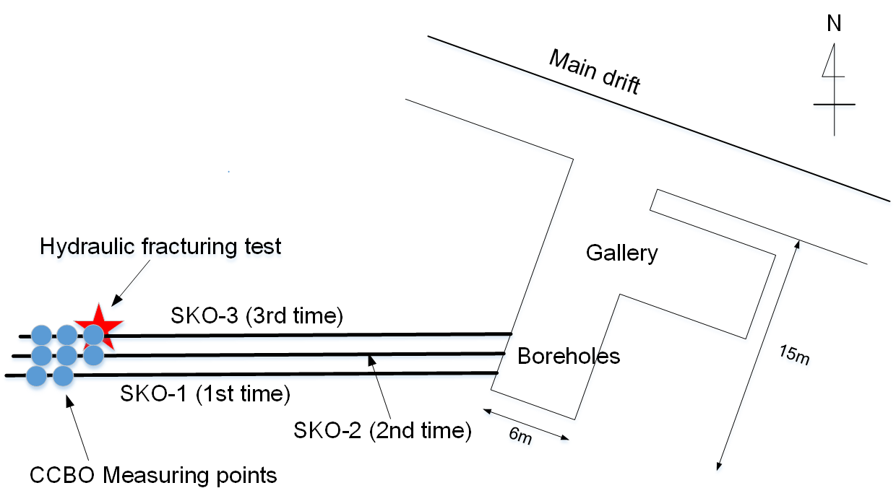
Stress measurement in Kamaishi mine at Tohoku Japan
(Sakaguchi et al. 2017)
In the same gallery we measured stress ever year after earthquake.
Three boreholes were drilled for the stress measurement.
Technique of the stress measurement is applied CCBO and HF.

Slide 7
Compact conical-ended borehole overcoring (CCBO)
Compact conical-ended borehole overcoring (CCBO) technique has been applied for the stress measurements repeatedly.
This technique is Japanese unique method classified as stress relief method.
Magnitude and direction of three dimensional stress states can be measured by this technique.

Slide 8
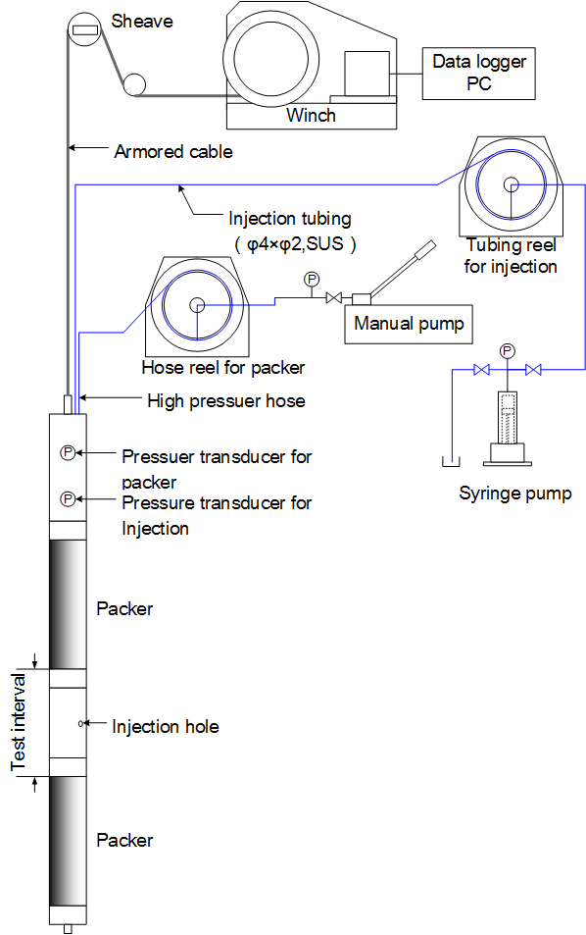
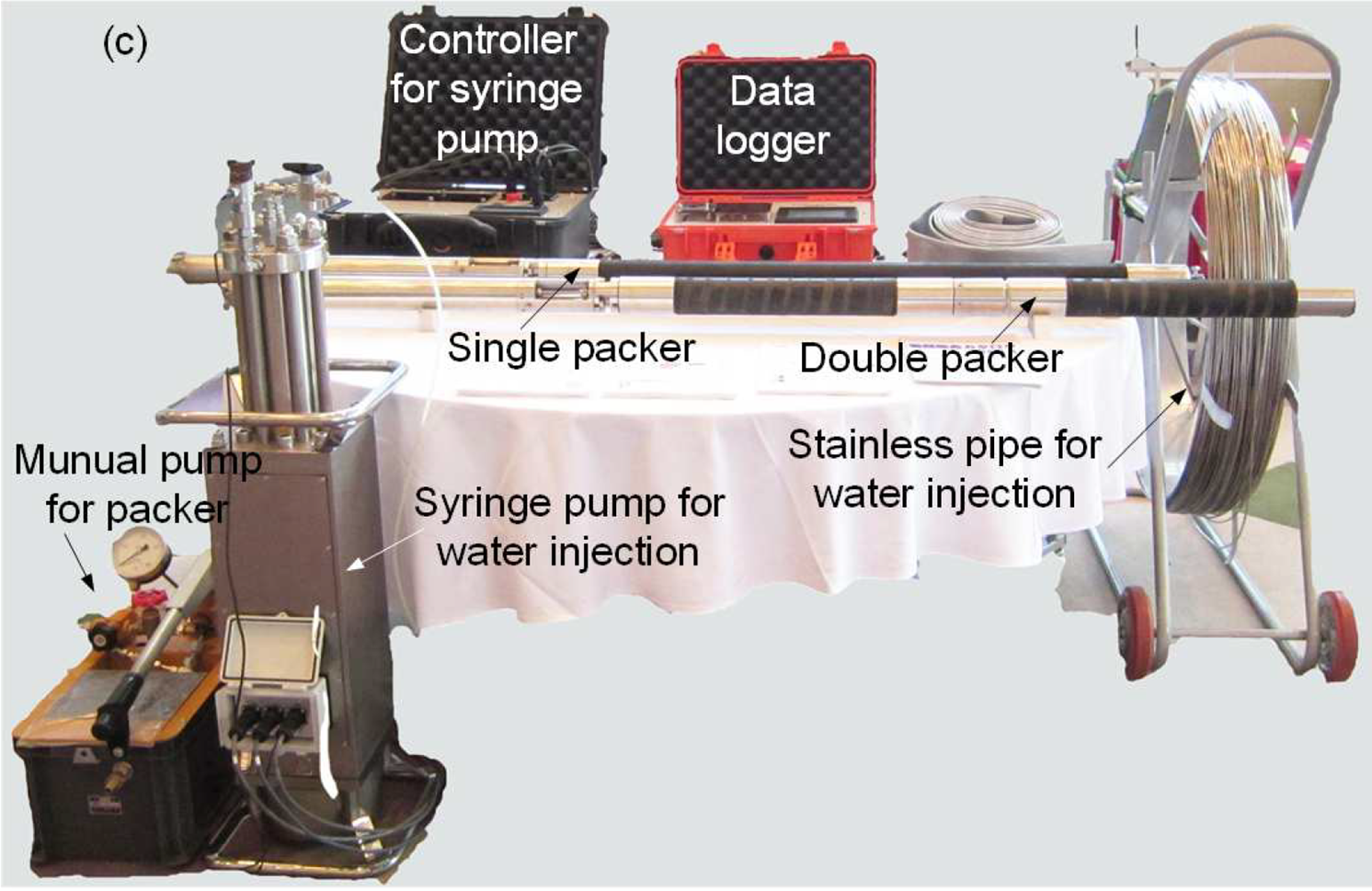
High stiffness Hydraulic Flacturing system
We developed new HF testing system with high stiffness mechanism.
Flow rate can be controlled exactly.
This system is able to measure with high accuracy.

Slide 9
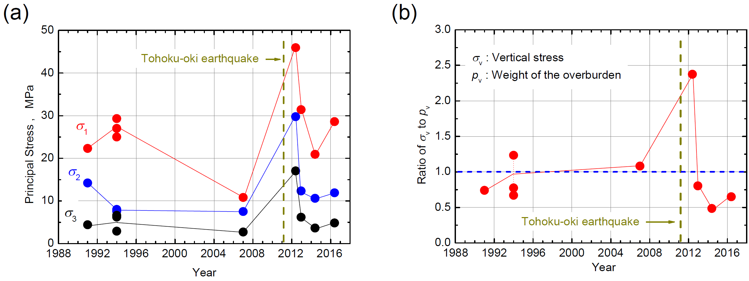
Stresses buildup and drop in 4 years after earthquake
Change of principal stresses
Change of vertical stresses
(Sakaguchi et al. 2017)
Tohoku earthquake
Tohoku earthquake
The magnitude of the stress measured one year after the earthquake was much higher than that before the earthquake.
Vertical stresses are also bigger than before the earthquake.
After 2 years and 3 years, the magnitude of stress gradually became smaller.

Slide 10
Summary of stress change after Tohoku earthquake
We considered the reason why this interesting phenomenon occurred as follows.
When the Tohoku earthquake (main shock) occurred, the fault slip stopped and the crustal strain increased at the blank area of the earthquake in the east of Kamaishi.
One year after the main shock, aftershocks frequently occurred in this blank area and the crustal strain was relieved.
It is considered that this series of changes in the crustal strain induced the stress change measured in this time.
(Sakaguchi et al. 2017)

Slide 11
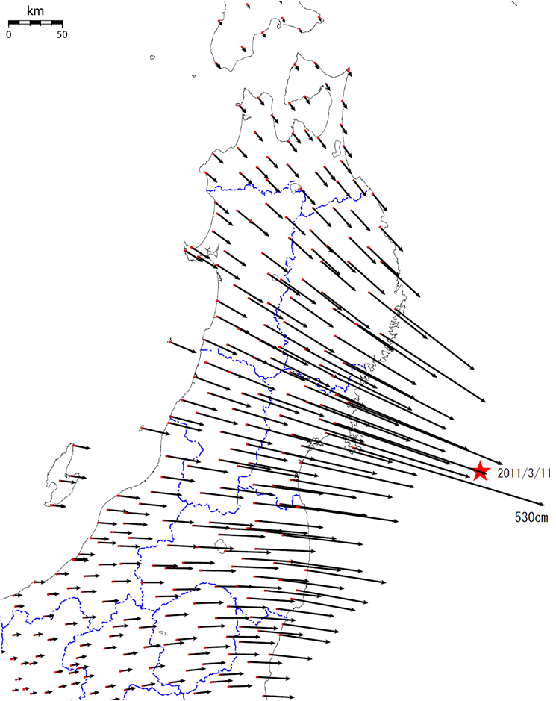
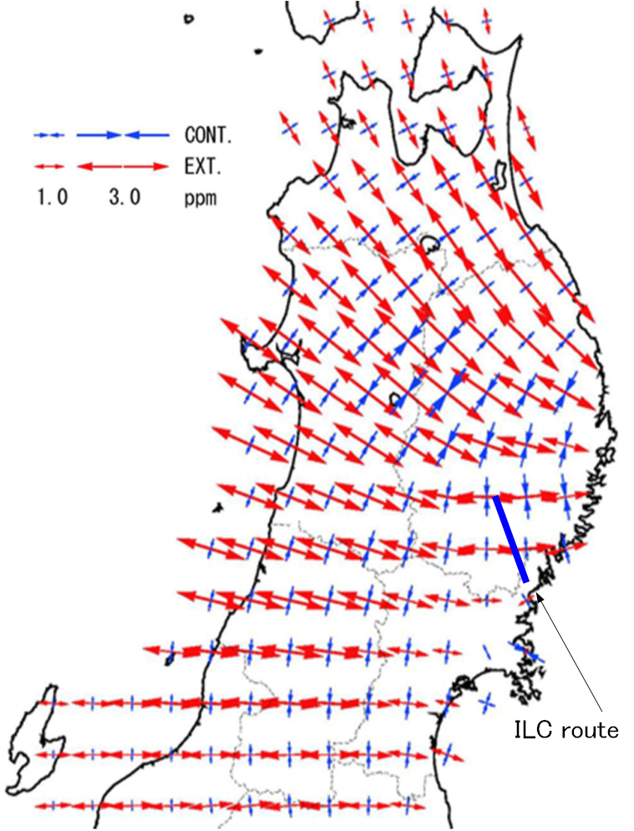
3. Ground movement by Tohoku earthquake
Crustal movement
Crustal strains
When Tohoku earthquake occurred, Tohoku Japan island moved to SE over 5.3m in maximum.
Postseismic crustal strains are distributed NW-SE or W-E direction in extension.

Slide 12
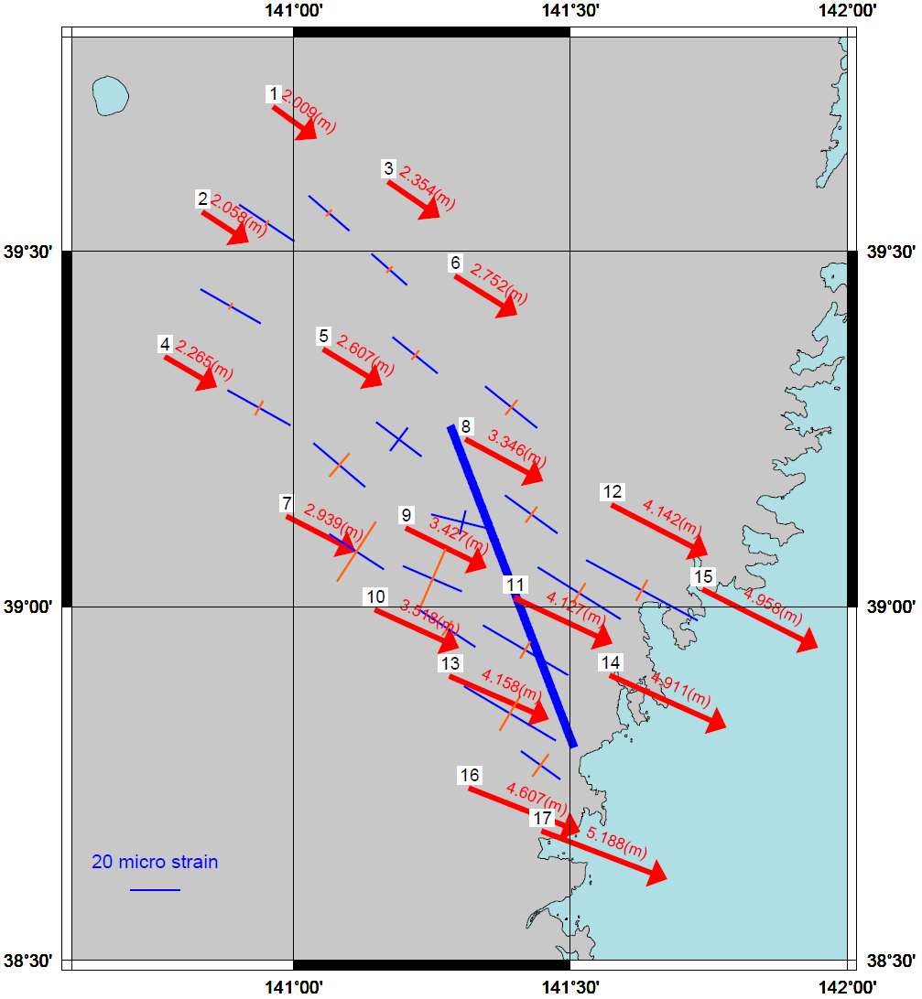
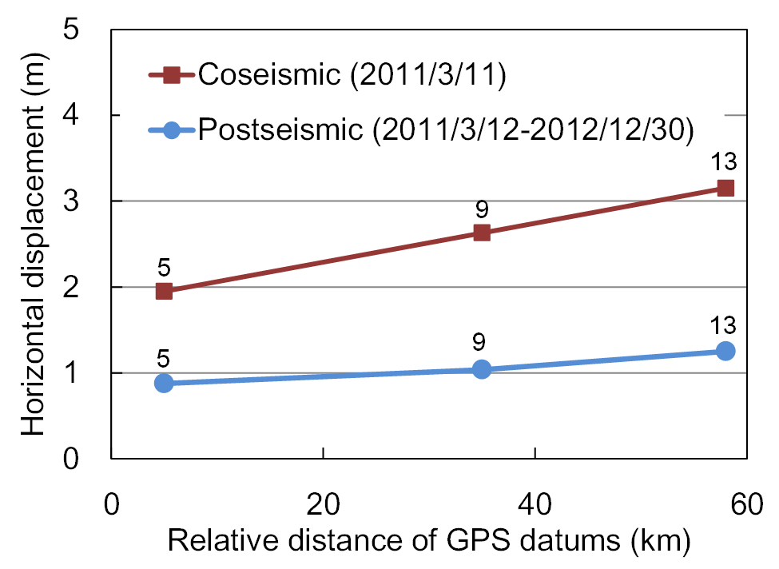
Horizontal displacement around ILC route
from Jan.2011 to Jan.2012
Horizontal displacement by GPS datums
Horizontal displacements of ground surface around ILC route are observed in 3m to 5m.
Strain distribution of ground surface around ILC route are calculated in 20 to 40 micro strains.
However, ground movement around ILC route are coherent.
Consequently, ILC linac tunnel will not adversely affected by the earthquake.

Slide 13
4. Geology and rock states in Kitakami site
Geological map and lineaments around the candidate ILC route.
Geology around the ILC route is almost consisted of granite except south edge.
The ILC route does not intersect active faults.

Slide 14
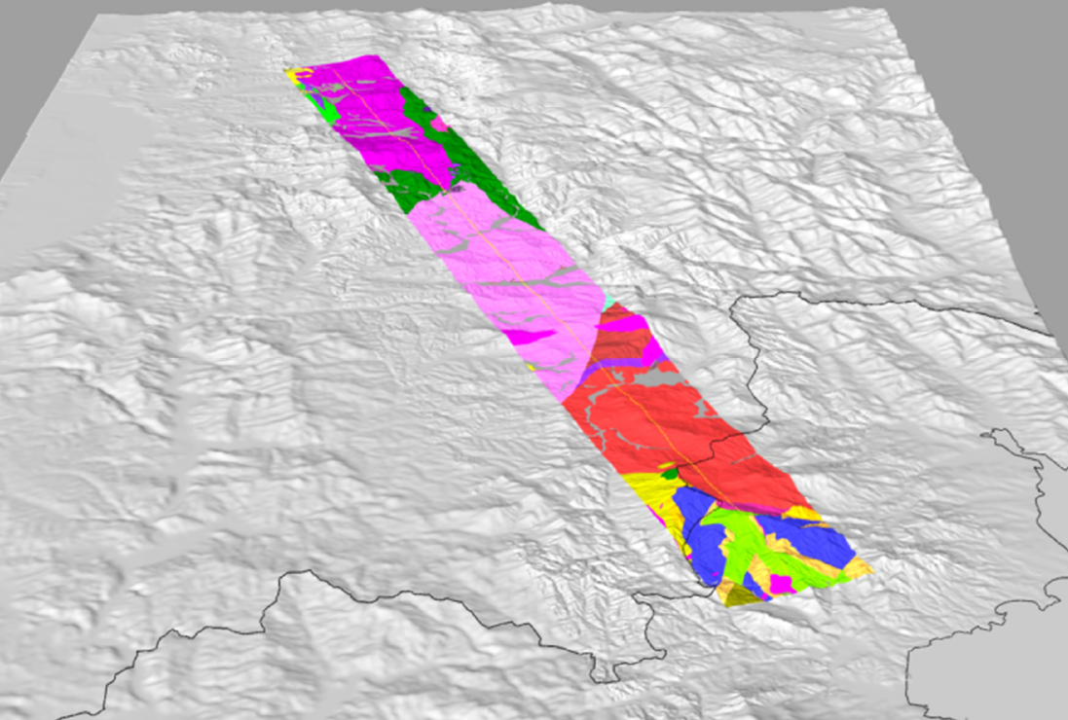

Overview of geography and geology at Kitakami site
Birds-eye view from the south side at Kitakami.
Along the ILC route, it shows a hilly area.
Geology around the ILC route is almost consisted of granite except south edge.

Slide 15
Rock status from seismic and resistivity survey
Seismic survey has been carried out several times since 2010.
Rock status along the linac tunnel is very hard and fresh.
P-wave velocity is over 4.5km/s in almost rock bodies.
(from Tomoyuki SANUKI of Tohoku Univ.)

Slide 16
Rock status from seismic and resistivity survey
Electromagnetic survey also has been carried out several times since 2010.
Electric resistivity along the linac tunnel is over 1,000 Ωm in almost rock bodies.
Even from this point of view, rock condition in Kitakami site is very good.
(from Tomoyuki SANUKI of Tohoku Univ.)

Slide 17
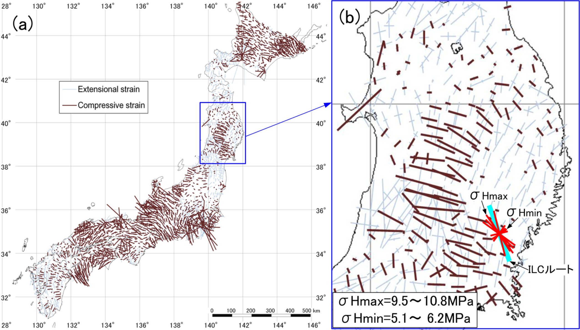
Stress states by stress measurements and crustal strains
Distribution of principal strain directions and magnitudes during last 100 years.
In right hand graph, the measured stress states by HF is overlaid.
Directions of the measured stress are close to some of the crustal strains.
Stress states of Kitakami site is close to the standard value in this region.

Slide 18
5. Summary
Geology around the ILC route is almost consisted of granite except south edge.
Granites are almost fresh an hard on the level of ILC linac tunnel.
There is no active faults intersect ILC route.
Rock status along the linac tunnel is very hard and fresh.
P-wave velocity is over 4.5km/s in almost rock bodies.
Stress states of Kitakami site is close to the standard value in this region.
After Tohoku earthquake in 2011, ground movement around ILC route are coherent.
Consequently, ILC linac tunnel will not adversely affected by the earthquake.
Kitakami is the best site for ILC.

Slide 19
Acknowledgements
Geological investigation for ILC project was carried out under the support of Professor Tomoyuki Sanuki of Tohoku University, Faculty of Sciences. We would like to express our sincere appreciation to him.
Thank you.

Slide 21
Contribution to ILC investigations in geology and rockmech.
OYO started to begin investigation for ILC project since 2010.
Items and quantities of the survey are as follows.
Geological survey : 50 km (Active fault survey)
Drilling survey : 7 places, 890 m total
Seismic refraction survey : 8 times, 18 km total
Electromagnetic survey : 8 times, 15 km
Borehole logging : 890 m total
Rock stress measurement : 1 place
Uniaxial compression test : 18 pieces

