Slide 1



CLIC QD0 Stabilization
G. Balik¹, B. Aimard, J.-P. Baud¹, L. Brunetti¹, A. Dominjon, A. Jeremie¹, M. Serluca¹
B. Caron²
Z. Buchta³
(LAViSta Team: Laboratoires d’Annecy-le-Vieux de Vibration & Stabilization)
¹: LAPP-IN2P3-CNRS, Université Savoie-Mont-Blanc, Annecy, France
²: SYMME, POLYTECH Annecy-Chambéry, Université Savoie-Mont-Blanc, Annecy France
³: ISI ASCR, Brno University of Technology, Brno, Czech Republic
26th October 2017

Slide 2
TABLE OF CONTENTS
INTRODUCTION
  Context
  CLIC Challenge vs QD0 stabilization
Vibration control for CLIC
  Beam trajectory control (IPFB)
  Mechanical stabilization
  Custom vibration sensor
FuturE prospectS
  Vibration sensor improvement
  ATF2
Conclusion

Slide 3
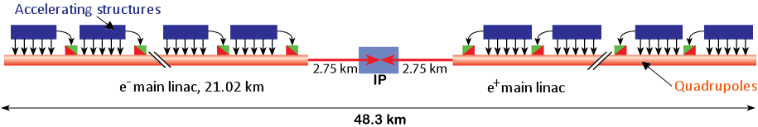
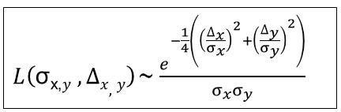
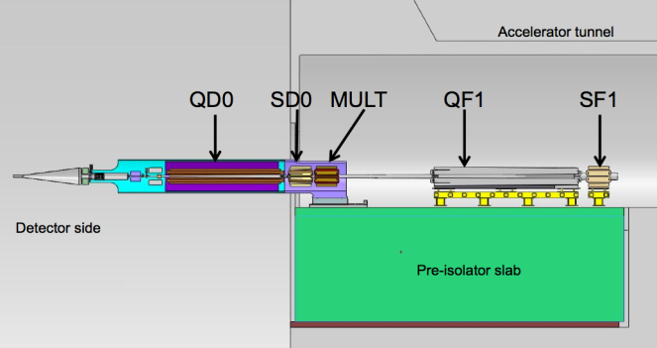
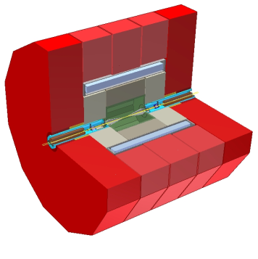
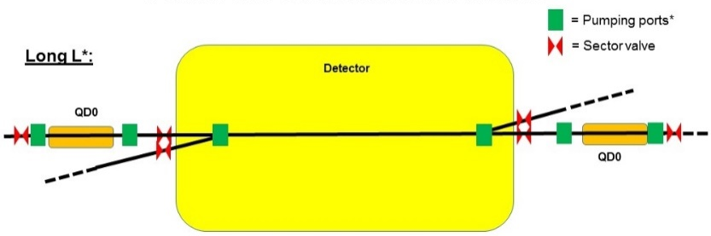
INTRODUCTION - Context
Final focus CLIC R&D:
Sub-nanometer beams
Developments of LAViSta team are dedicated to the final focus
Vertical beam offset: 0,2 nm RMS @ 0,1Hz
QD0 Cantilever
CLIC detector
QD0 L*

Slide 4
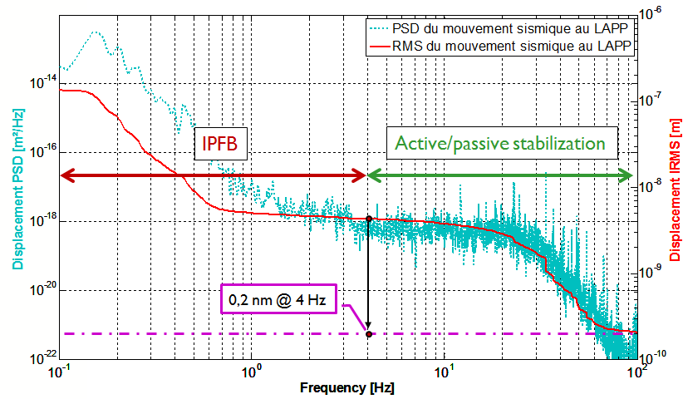
INTRODUCTION - CLIC Challenge vs QD0 stabilization
Final focus : beam stabilization strategy
At the IP (mechanical + beam feedback), we aim a vertical beam offset at 0,2nm at 0,1Hz
IPFB : Interaction Point beam based FeedBack is already developed in collaboration with CERN since 2010
Active / passive stabilization : has to be achieved (“Mechanical stabilization”)…

Slide 5
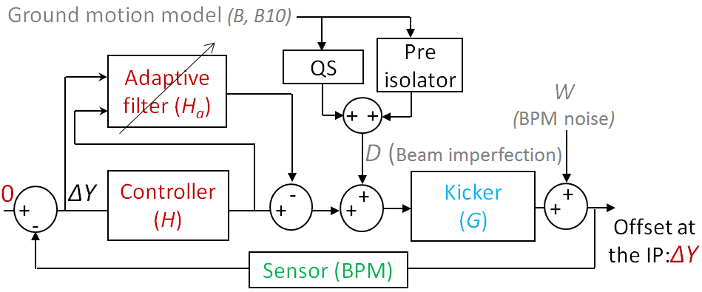
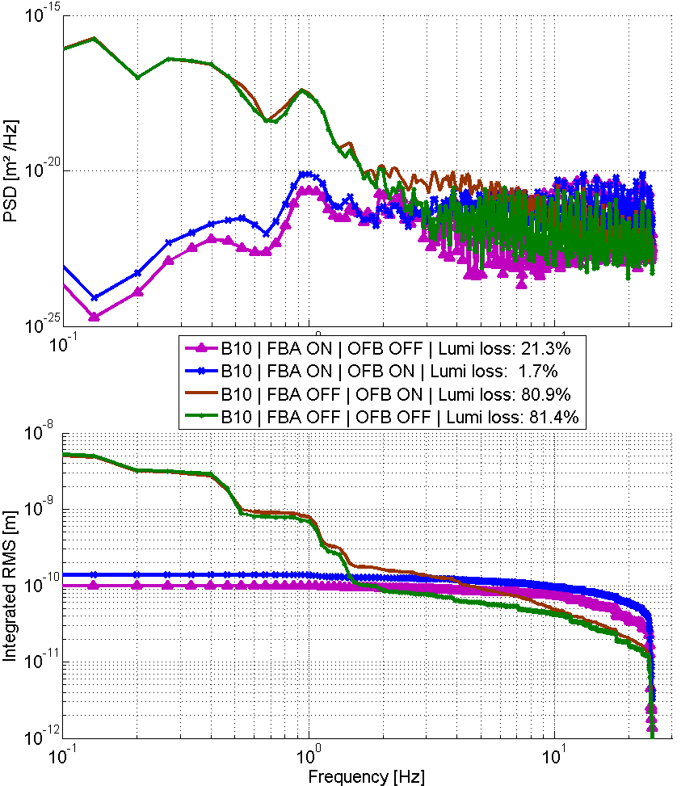
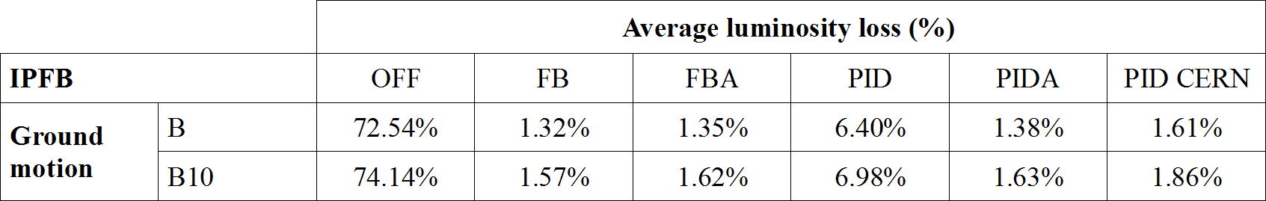
VIBRATION CONTROL FOR CLIC - Beam trajectory control (IPFB)
IPFB - simulation under PLACET
PLACET a program to simulate drive beams
- Caron B, et al, 2012, “Vibration control of the beam of the future linear collider”, Control Engineering Practice.
- Balik G. et al, 2012, “ Integrated simulation of ground motion mitigation, techniques for the future compact linear collider (CLIC) “, Nuclear Instruments and Methods in Physics Research
Controller performances
Luminosity vs control ON or OFF and vs model of seismic motion (simulation under PLACET)

Slide 6
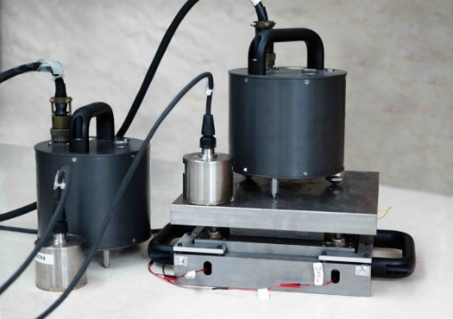
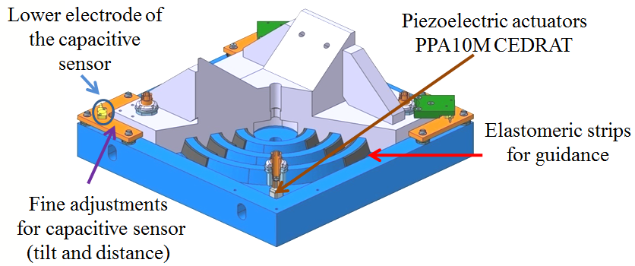
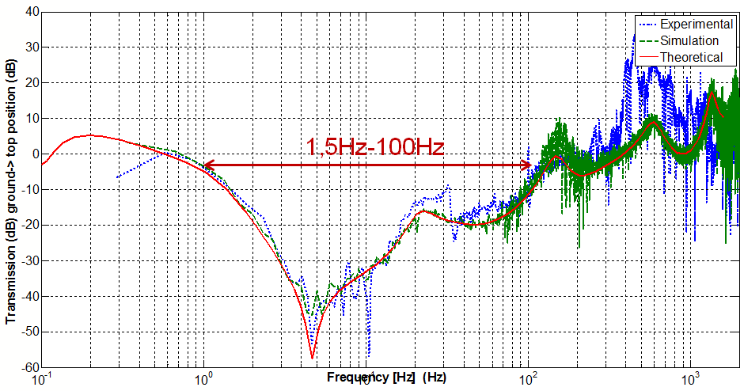
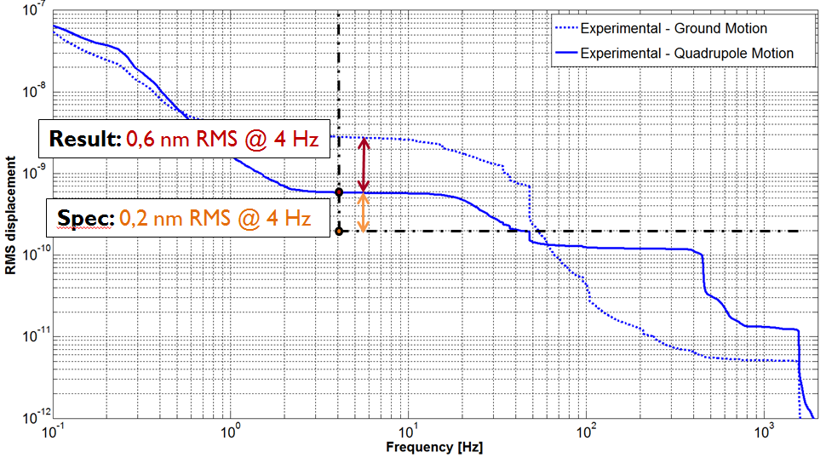
VIBRATION CONTROL FOR CLIC - Mechanical stabilization
Before 2016 : demonstration at a sub-nanometer scale
Developed active foot with commercial sensors (geophones and accelerometers)
2 sensors used in feedforward and 2 sensors used in feedback
Commercial sensors and a developed active foot
Sensors dedicated to measurement but not to control
Two needed technologies for the selected bandwidth (geophones for low frequencies and accelerometers for high frequencies)
  complexity of the control
Results with commercial sensors : 0,6 nm RMS@4Hz.
- Balik G. et al, “Active control of a sub nanometer isolator“, JIMMSS, 2013.
- Le Breton R. et al, Nanometer scale active ground motion isolator, Sensors and Actuators A: Physical, 2013.
Main limitation : SENSORS (Experimental and theoretical demonstration).

Slide 7
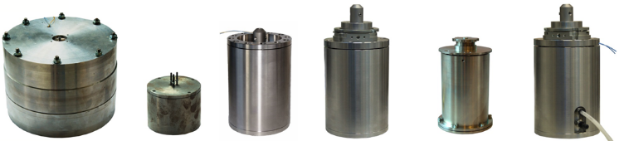
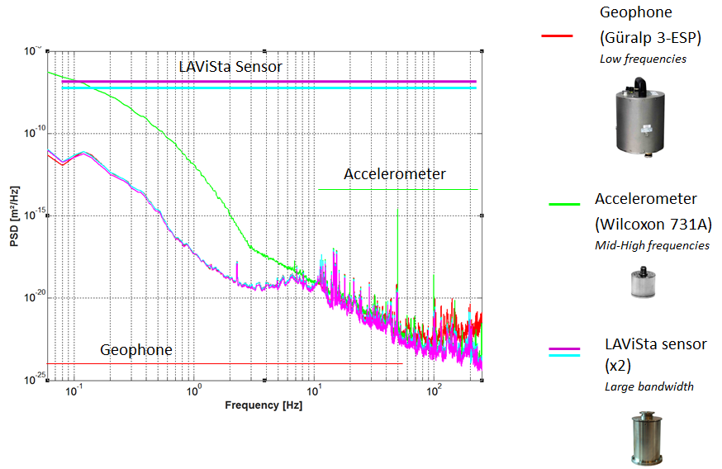
VIBRATION CONTROL FOR CLIC - Custom vibration sensor
Development of a new vibrations sensor:
Internal development at LAPP
Approach validated → Patent n° FR 13 59336
Prototypes developed since 2011
Comparison with Güralp and Wilcoxon sensors at CERN (ISR):
Promising results (similar to the best commercial sensors)

Slide 8
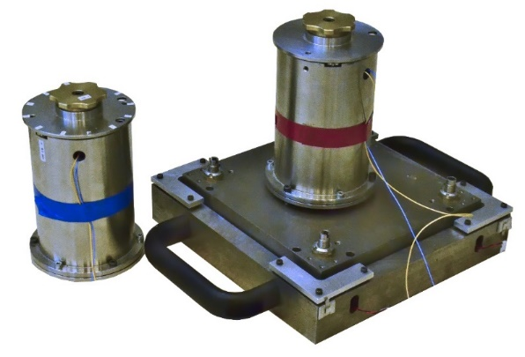
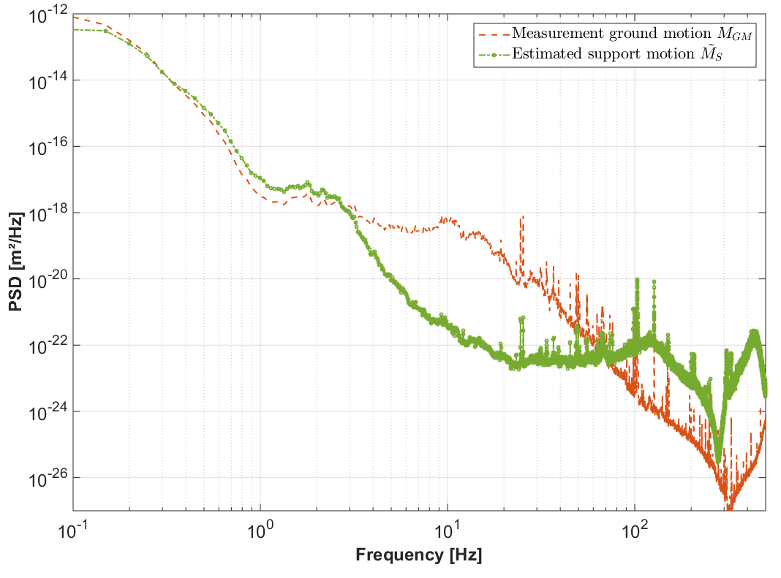
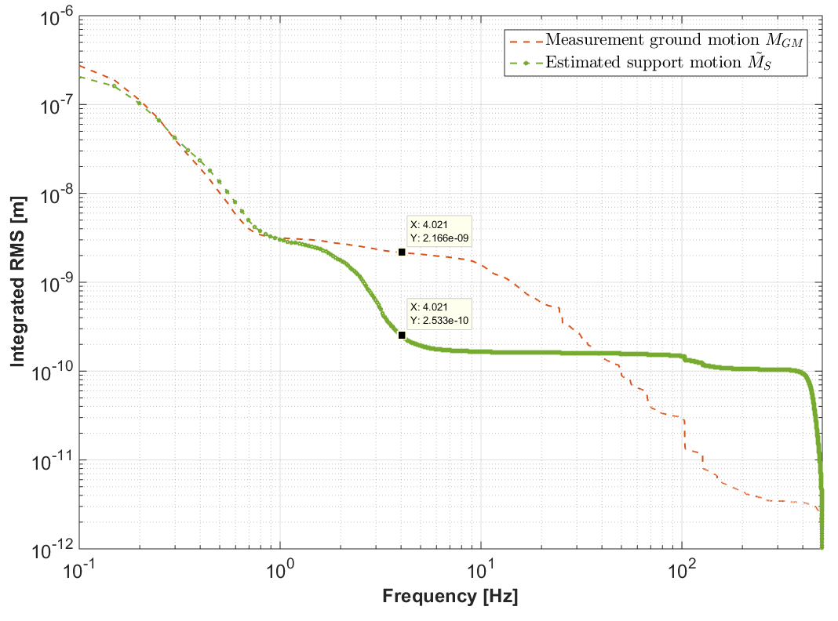
VIBRATION CONTROL FOR CLIC - Mechanical stabilization
2016 : CLIC Demonstration of feasibility at reduced scale
Active control with the custom sensor
CLIC specification (displacement of the QD0 final focus) : 0,20 nm RMS@4Hz
Previous results with LAPP active foot + 4 commercial sensors : 0,60 nm RMS@4Hz
Results of control (autumn 2016) with LAPP active foot + 1 LAPP vibrations sensor : 0,25 nm RMS@4Hz
Only 1 sensor in feedback -> control less complex and more efficient
Submitted in September 2017, in collaboration with SYMME (approval in progress)
0,25 nm@4Hz ≈ Spec
- LAPP active foot + LAPP sensors (one on ground used to monitor ground motion and 1 on top used in feedback) -
- Displacement without control / with control at LAPP -

Slide 9
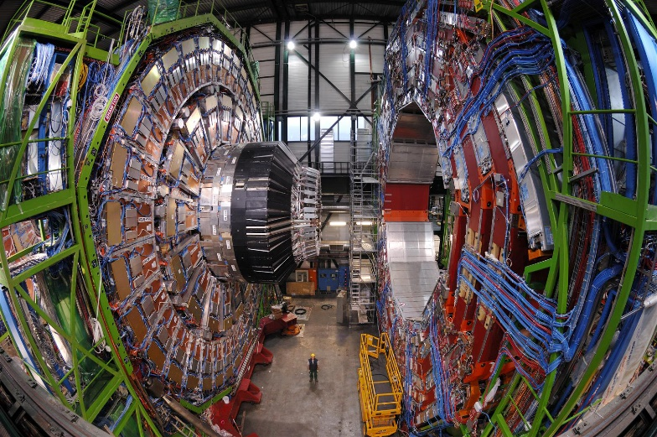
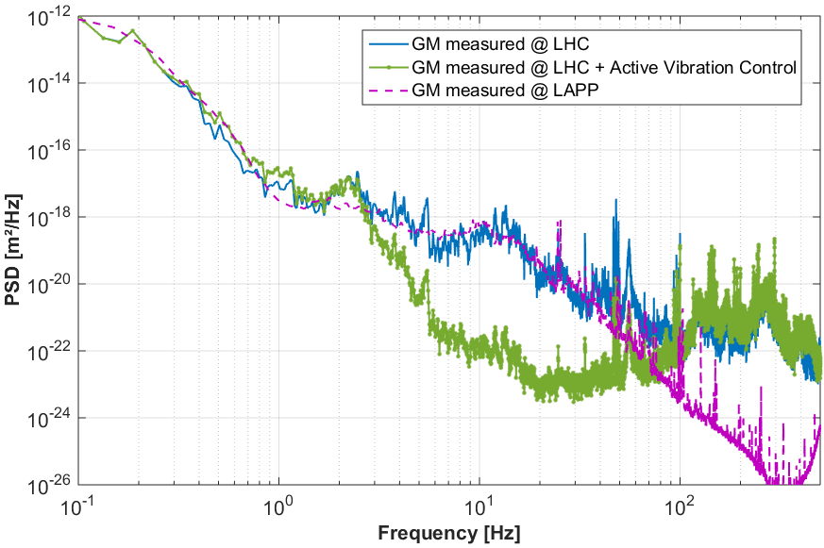
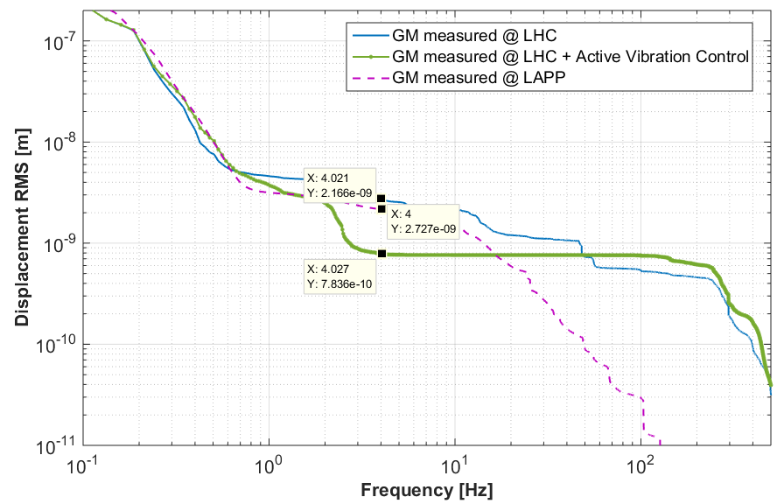
VIBRATION CONTROL FOR CLIC - Mechanical stabilization
Simulation of the active control with in a collider environment
CMS detector ground motion is taken into account (high level of cultural noise - pessimistic)
Simulation of the system (foot + sensors) with these disturbances
More cultural noise
>100 HZ
The Compact Muon Solenoid (CMS)
Control still efficient <100 HZ
0,78 nm@4Hz > Spec
Disturbances don’t reveal the same distribution (more cultural noise)
Control is not efficient enough in this case (above 100 Hz)

Slide 10
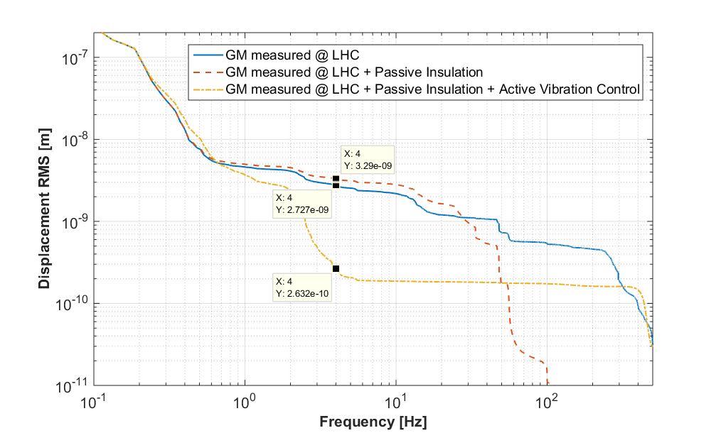
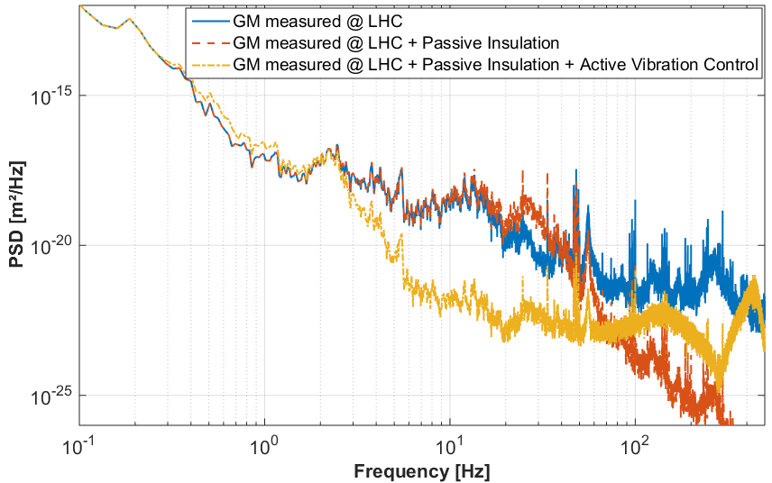
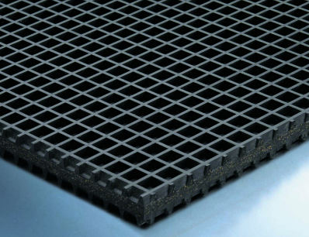
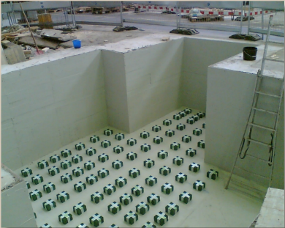
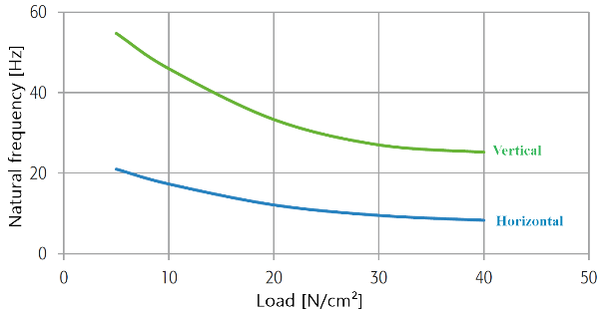
VIBRATION CONTROL FOR CLIC - Mechanical stabilization
Simulation of the active control with a collider environment
Necessity to have a passive insulation under the concrete or under the last elements
Passive isolation ≈ 25 Hz
0,26 nm@4Hz ≈ Spec
A passive insulation at about 25 Hz is common to the standard industrial solutions
Example of usable PI (Biltz® B13W- vibration isolation rubber pad).
Poster session at IPAC17: G. Balik et al, “Proof of concept of CLIC final focus quadrupoles stabilization”, in Proceedings of International Particle Accelerator Conference (IPAC 2017), Copenhagen, Denmark.

Slide 11
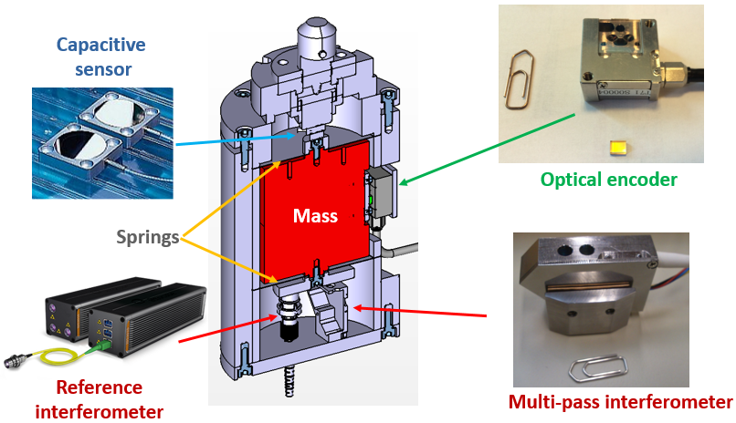


FUTURE PROSPECTS- vibration sensor improvement
Comparison of different technologies for the embedded sensitive part
PACMAN : Particle Accelerator Components’ Metrology and Alignment to the Nanometer scale (Marie Curie program at CERN)
Collaboration with several labs and industries : LAPP academic partner – SYMME co-director of a thesis
Use of the LAPP sensor with dedicated instrumentations
Capacitive sensors : PI & Lion Precision
Optical encoder : Magnescale
Interferometer : Attocube & a developed one (INRiM (It) and ISI Brno (Cz))
P. Novotny et al, “What is the best displacement transducer for a seismic sensor?”, IEEE Inertial Sensors and Systems 2017, Hawaï, USA.

Slide 12
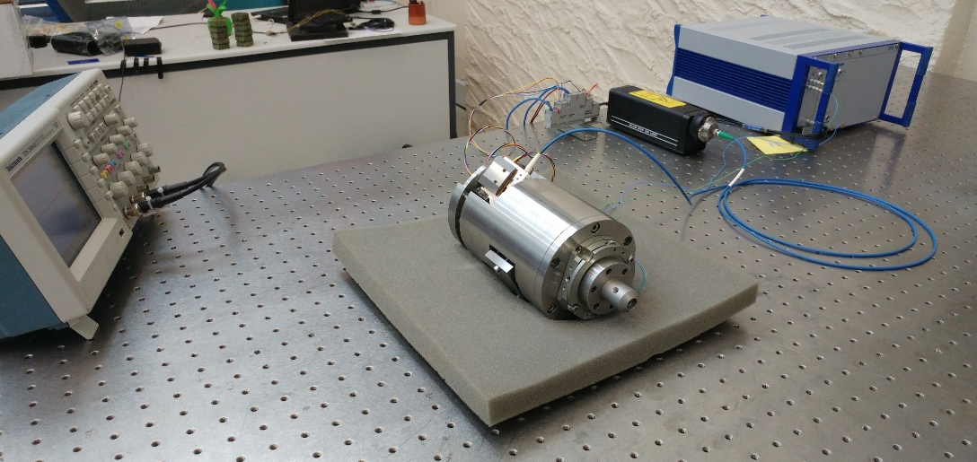
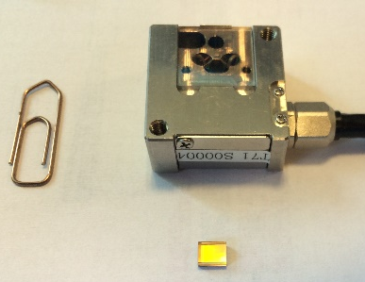
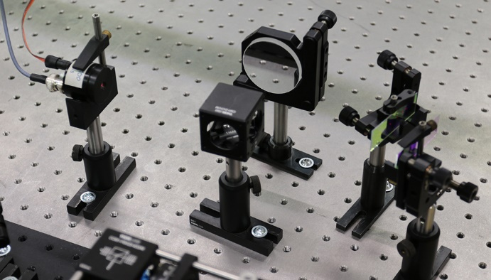
FUTURE PROSPECTS- vibration sensor improvement
Integration of a multipass-interferometer
Collaboration with ISI (Institute of scientific Instruments , The Czech Academy of Sciences)
Vibration sensor with different technologies for the embedded sensitive part
High reflectivity mirror to increase the signal-to-noise ration in the built-in interferometric sensor
New opto-mechanical components to suppress low frequency noise
Further tests ongoing and comparison with current setup (embedded capacitive sensor)
Multipass interferometer setup test

Slide 13
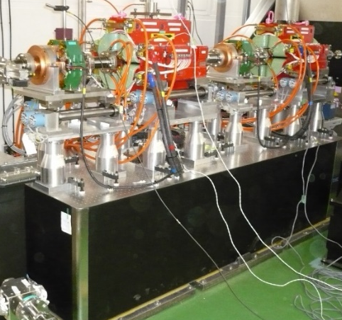
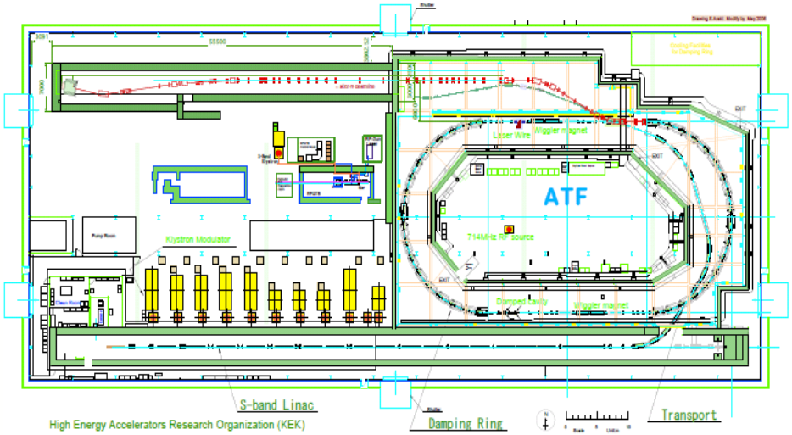
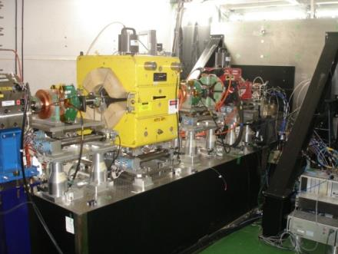
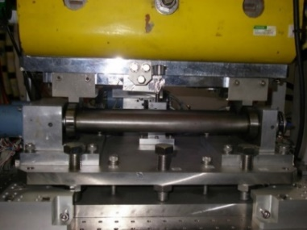
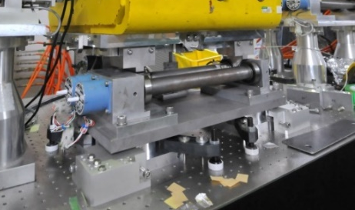
FUTURE PROSPECTS- ATF2
2008
Responsible of the final doublet relative displacement
Magnet 450kg
2012
Shintake monitor :
beam size measurement
FD : Final Doublet
  Relative motion between shintake monitor and final doublets of 6 nm RMS @ 0,1 Hz in the vertical axis.
  -> Analysis of the upgrades influences and of the drift.
Magnet 1200kg
ATF2 magnet supports upgrades
2008 by B. BOLZON | Tolerance | Measurement [SM-QD0] | Measurement [SM-QF1]
Vertical | 7 nm (for QD0) 20 nm (for QF1) | 4.8 nm | 6.3 nm
Perpendicular to the beam | ~ 500 nm | 30.7 nm | 30.6 nm
Parallel to the beam | ~ 10,000 nm | 36.5 nm | 27.1 nm
2013 by A. JEREMIE | Tolerance | Measurement [SM-QD0] | Measurement [SM-QF1]
Vertical | 7 nm (for QD0) 20 nm (for QF1) | 4.8 nm | 30 nm
Parallel to the beam | ~ 10,000 nm | 25 nm | 290 nm
feet and T-plate

Slide 14
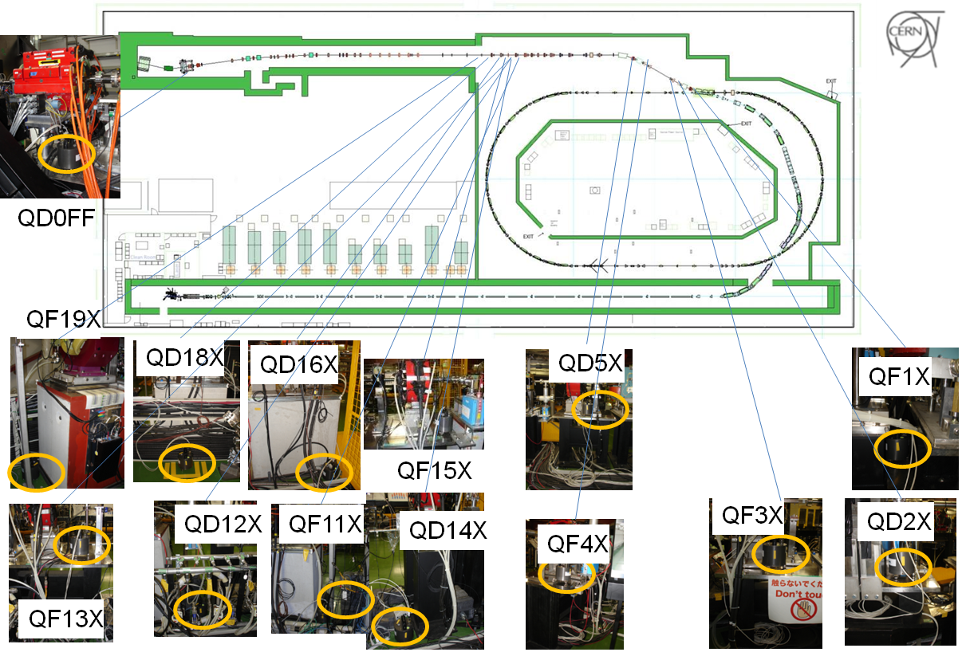
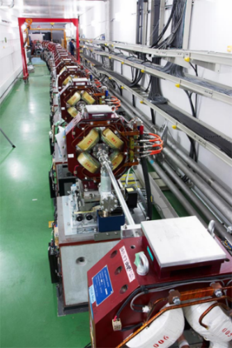
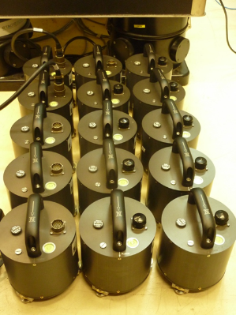
FUTURE PROSPECTS- ATF2
Involved in the assessment of the beam feed-forward control vs ground motion
Vibration sources identification
Feedforward study: correlation between the ground and the beam motions.
Processing of 14 Geophones (Guralp 6T sensors)
Collaboration with CERN, LAL & KEK
Last campaign of measurements : May 2017
Next campaign in December 2017
D. Bett et al, “Ground motion compensation using feed-forward control at ATF2, in Proceedings of International Particle Accelerator Conference (IPAC 2016), Busan, Korea.

Slide 15
Conclusion
Active control
  A sensor dedicated to this vibrations control issue is developed
  Sub-nanometer control is validated by demonstration on a small size prototype
Future prospects
  Improvements of the developed sensor (comparison of different technologies for the embedded sensitive part)
  Improvement of the embedded multipass interferometer and comparison with a original capacitive measurement
  ATF2 beam and ground motions correlation study ongoing, feedforward implication, next campaign planned in December 2017

Slide 16
Thank you for your attention

