Slide 1
Session: ILC cost reduction by new technology
Damping Ring
N.Terunuma, KEK

Slide 2
ILC Damping ring has been designed by the experiences on the past and coming rings accelerators.
Technology for the major part of DR (magnet, RF, vacuum) are well established.
The cost of DR accelerator is about 4 % of total in TDR.
The impact of cost reduction by new technology is limited for DR.

Slide 3
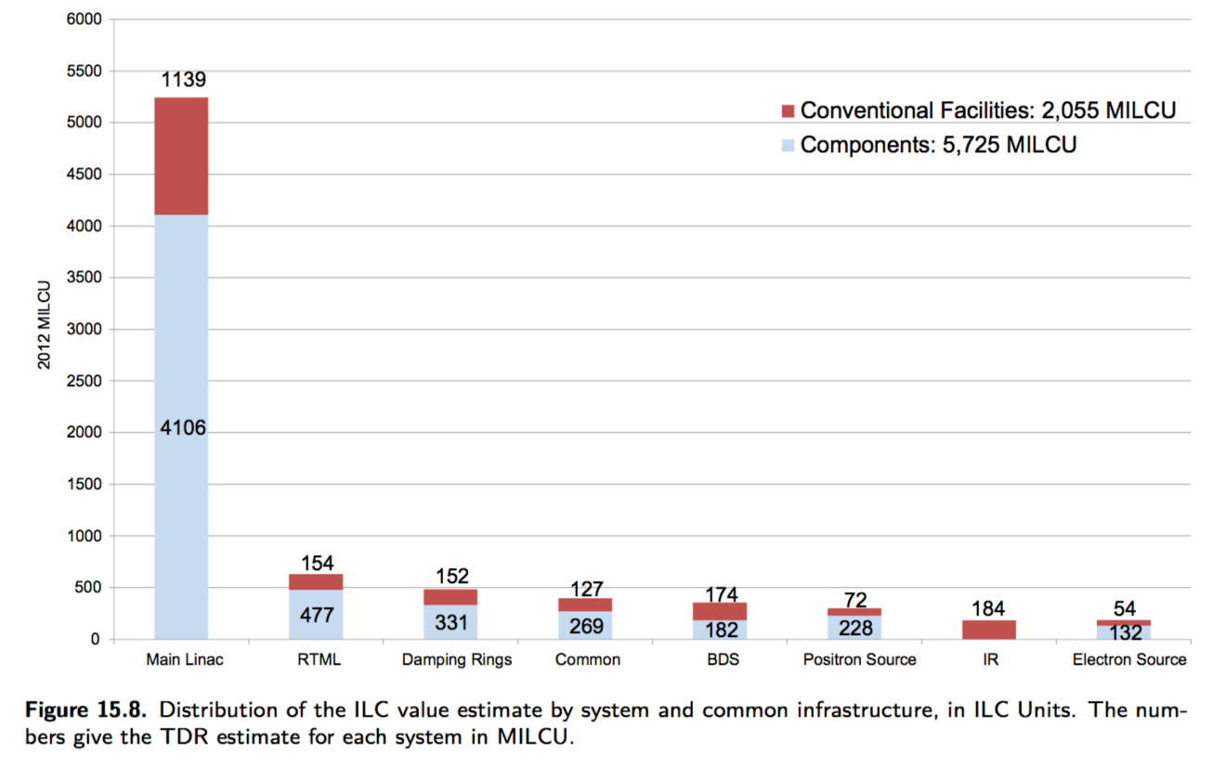
The cost of DR accelerator is about 4 % of total in TDR.

Slide 4
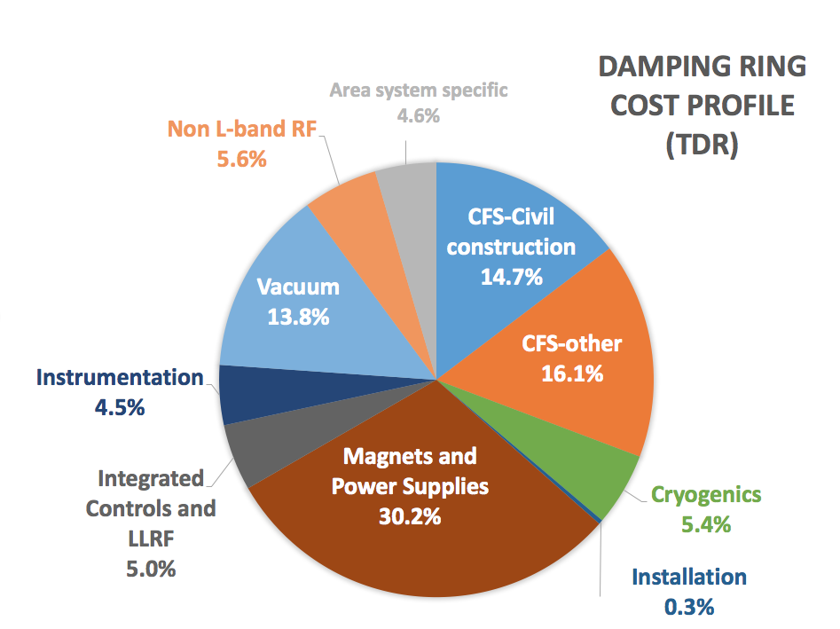
Wiggler
RF

Slide 5
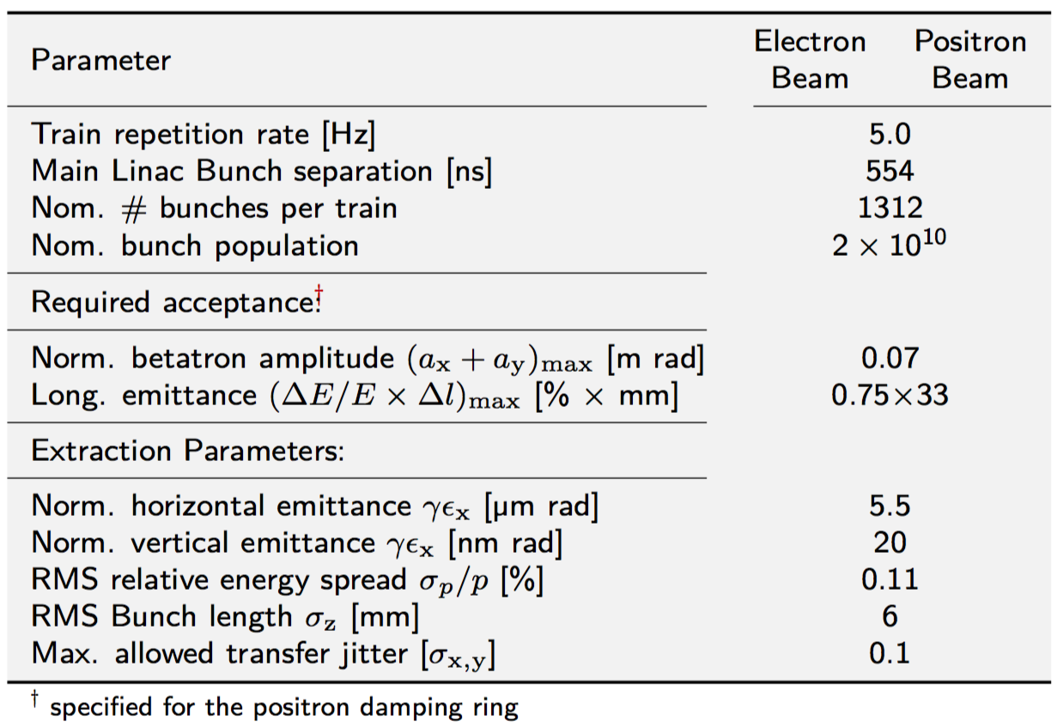

Slide 6
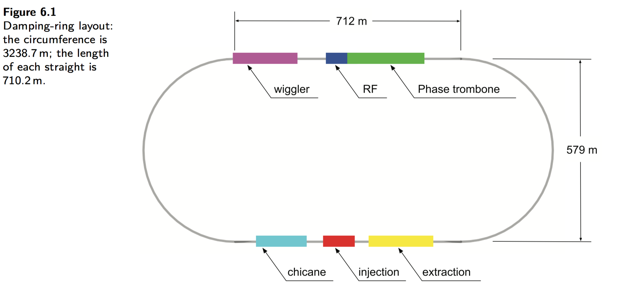

Slide 7
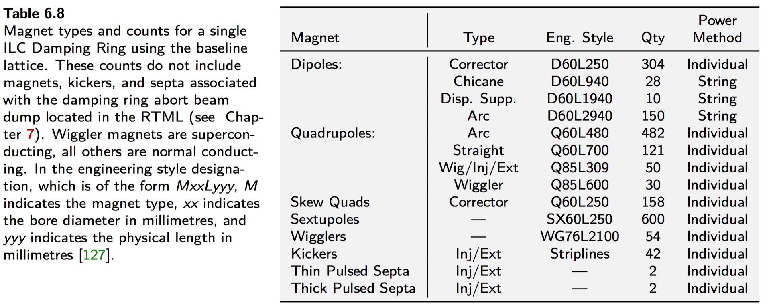

Slide 8
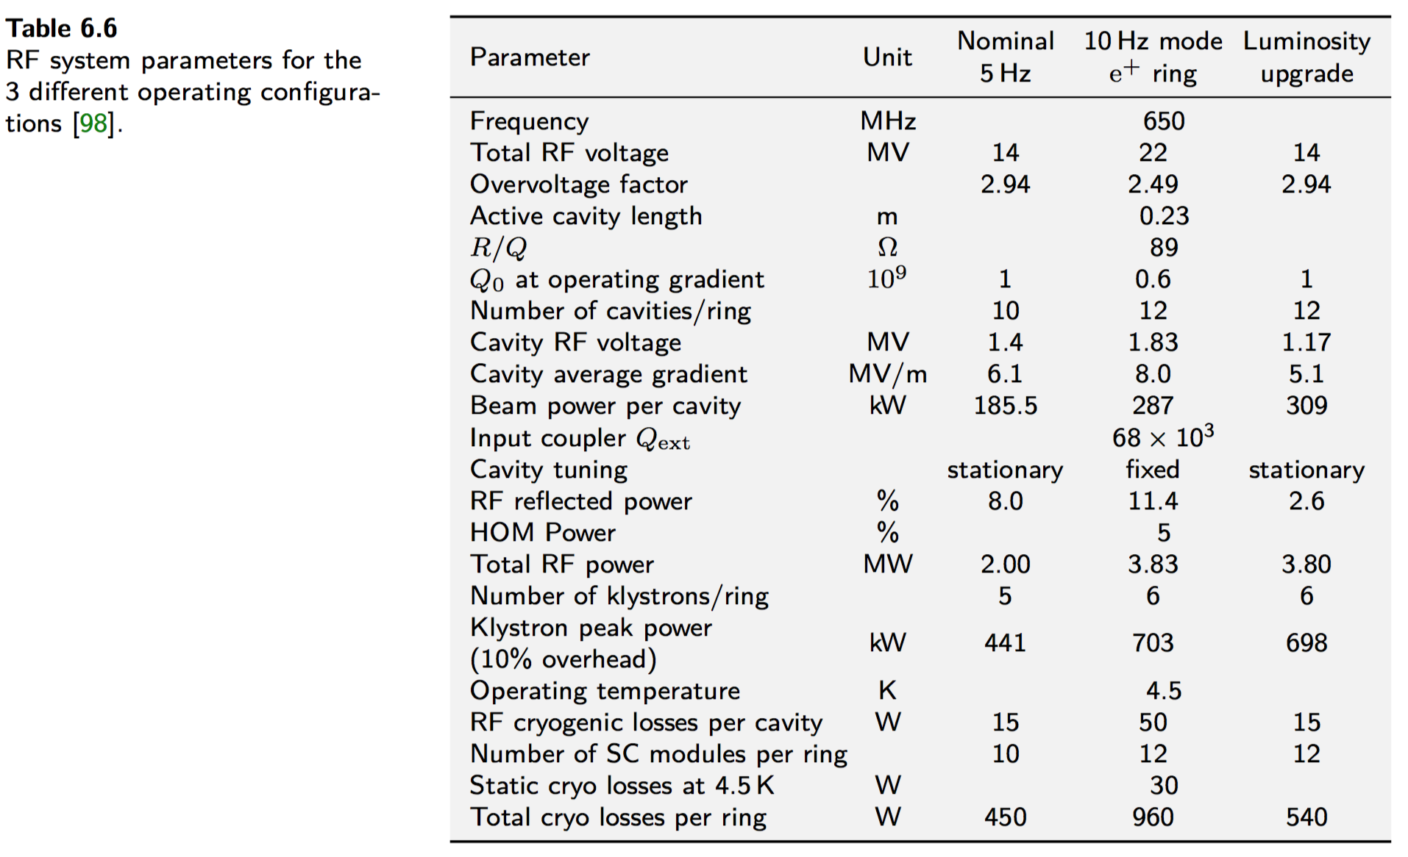

Slide 9
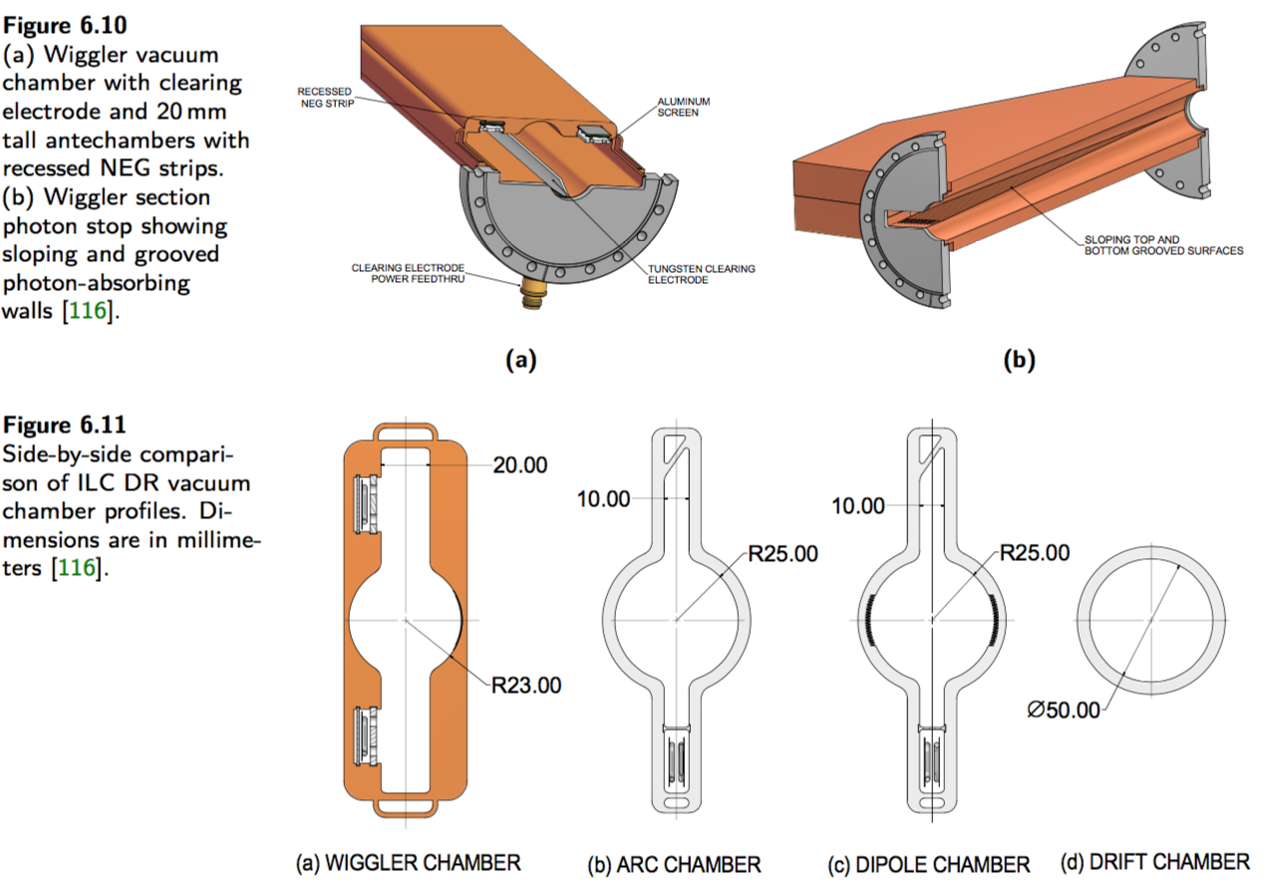

Slide 10
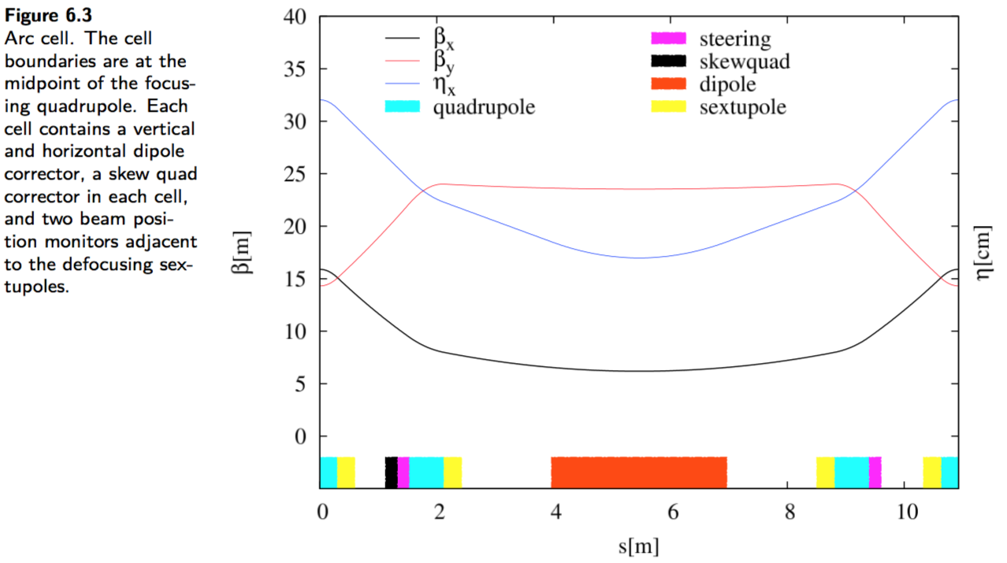

Slide 11
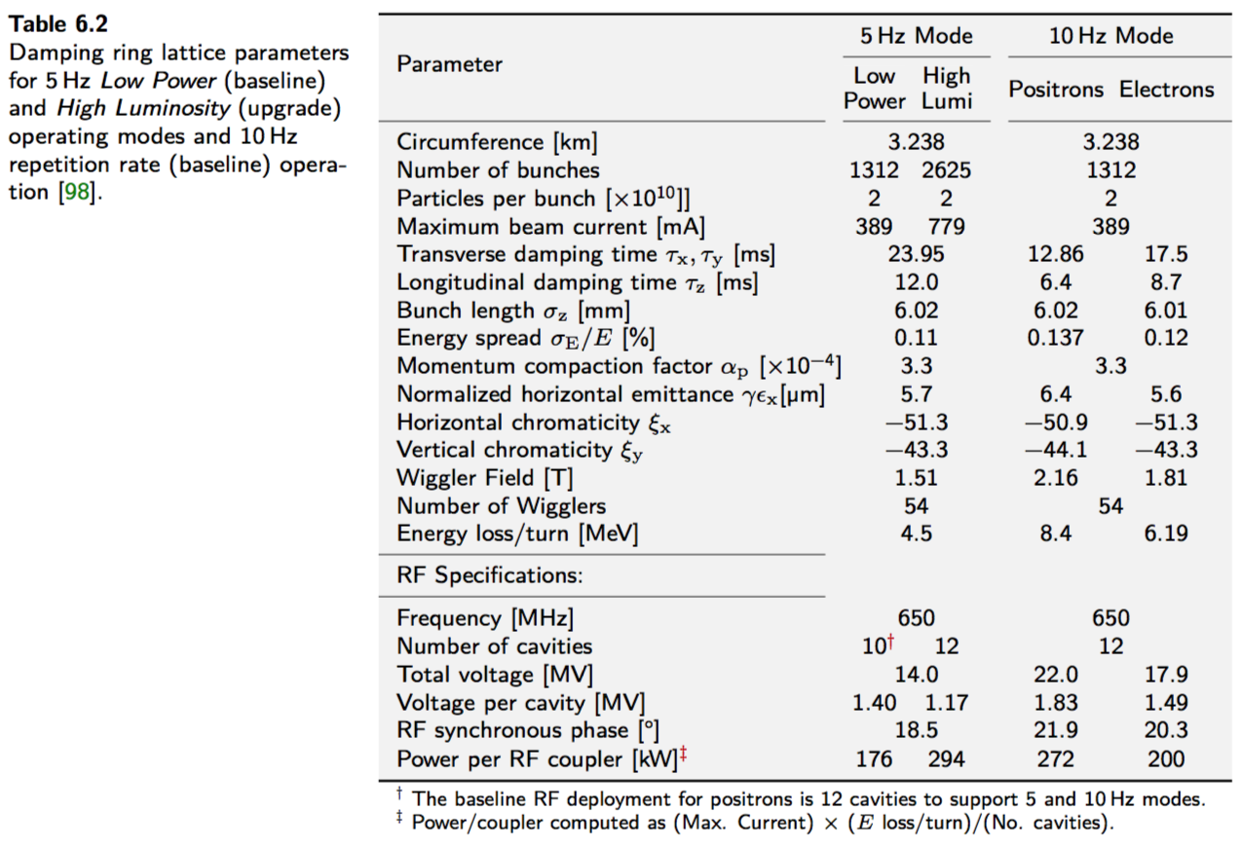

Slide 12
