Slide 1
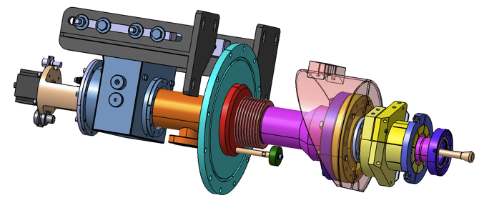


Main RF power Coupler for European-XFEL
Walid KAABI- LAL/CNRS
Notes:
How to edit the title slide
Upper area: Title of your talk, max. 2 rows of the defined size (55 pt)
Lower area (subtitle): Conference/meeting/workshop, location, date,
your name and affiliation,
max. 4 rows of the defined size (32 pt)
Change the partner logos or add others in the last row.

Slide 2
Outlines:
Introduction
Fabrication process
RF conditioning at LAL
Troubles on the track

Slide 3
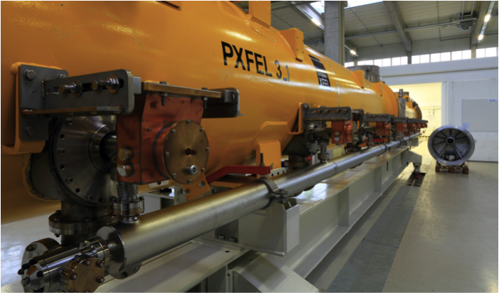
Introduction:
Linac of 101 Cryomodules, equiped with 8 couplers each → Need of 808 Couplers.

Slide 4
Introduction:
XFEL couplers are produced by 2 suppliers at 3 production sites:
Consortium Thales-RI (Thonon les bains-France and Koln-Germany): 670 units.
CPI (Beverly-Massachusetts-USA): 150 units.
Supported by DESY, LAL-Orsay has in charge:
The production monitoring and the quality control at Thales-RI sites.
The RF conditioning of all the couplers at Orsay and the weekly delivery of 8 couplers/week to IRFU-CEA (increased rate to 10 couplers/Week since January 2015) .

Slide 5
Introduction:
Challenges:
First experience in industrial monitoring at a such big scale,
Successful know-how transfer to company: The clean room processes, TiN coating process & acceptance criteria,
Rescaling the RF process at LAL to ensure the conditioning of 8 couplers per week,
Respect of the overall project schedule.

Slide 6
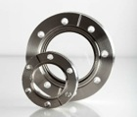
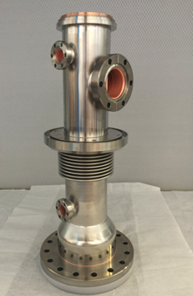

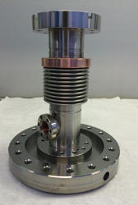
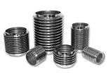
Fabrication process:
@ Thales-Thonon production site:
Step 1: Brazing of the inner and outer conductors:
Step 2: Copper plating of the inner surfaces:

Slide 7
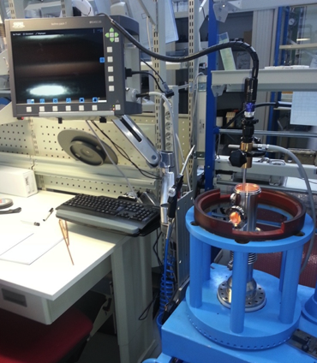
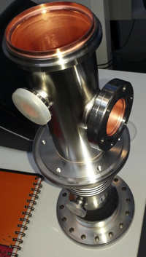
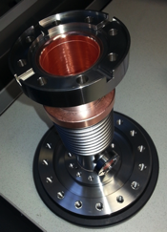
Fabrication process:
Inspection & control of all the produced parts at Thales-Thonon site.
Double check during the reception at RI site under the same inspection criteria.
Cold conductor
Warm Conductor

Slide 8
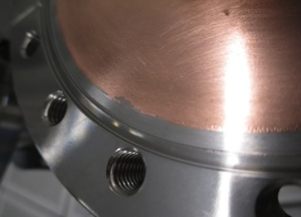
Fabrication process:
Examples of observed copper defects:
→ Qualitative & quantitative acceptance criteria definition: defects classified per types, dimensions et number. Agreement on corrective actions and validation tests.
Pitting
Blister
Copper peel off
X 20
X 30
Circular spots
X 22
Copper particle

Slide 9
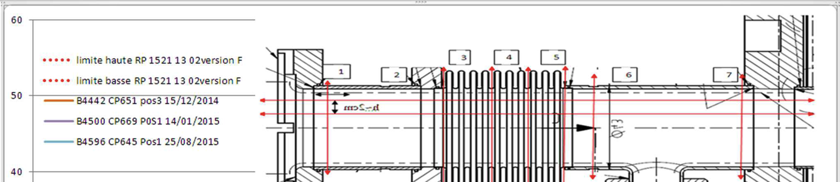
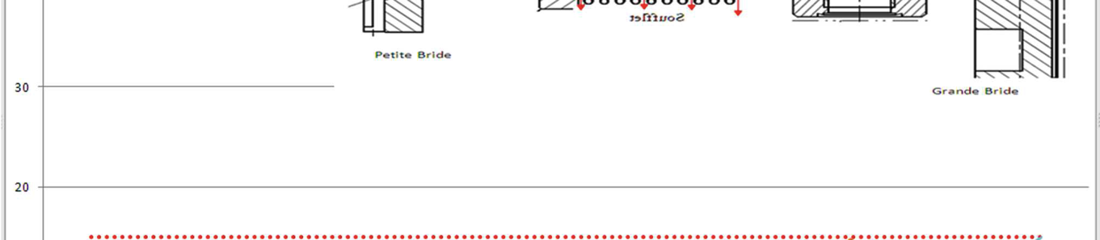
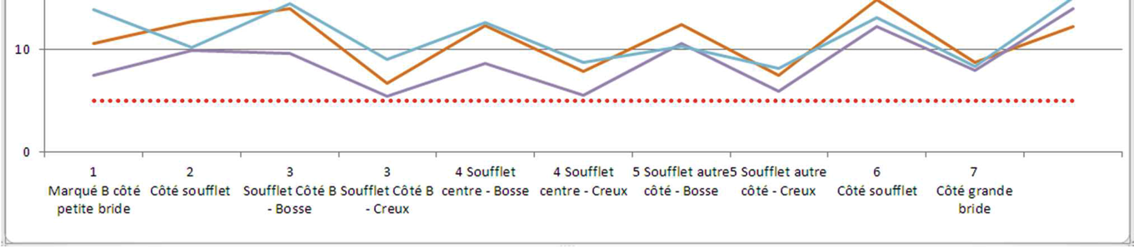
Fabrication process:
Copper thickness distribution in cold conductor (specif. 10μm ± 20% cylindrical parts & 10μm ± 30% in bellows→ relaxed to 10μm ± 50% ):

Slide 10
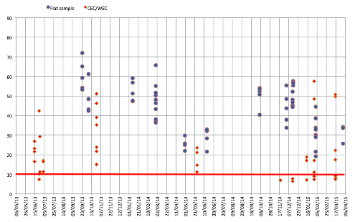
Fabrication process:
RRR measuremets (Specif. 10<RRR<80)

Slide 11
Fabrication process:
@ RI production site:

Slide 12
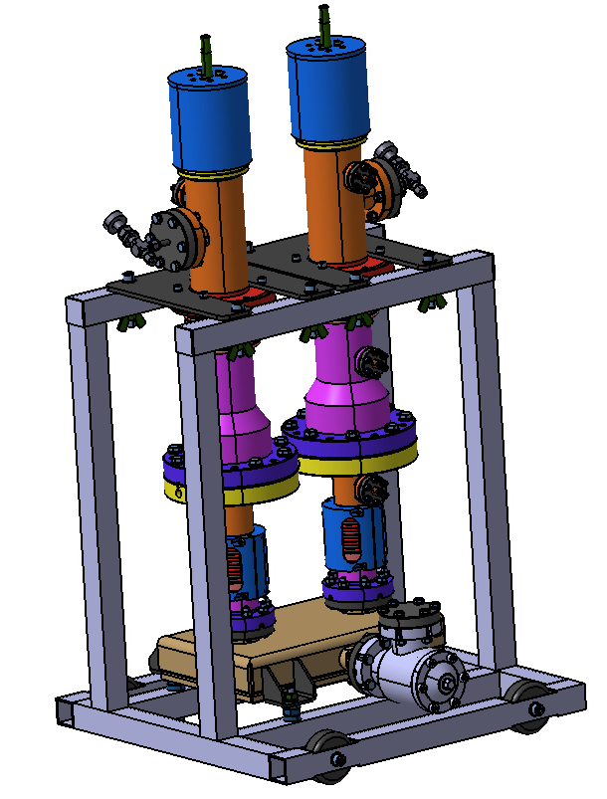
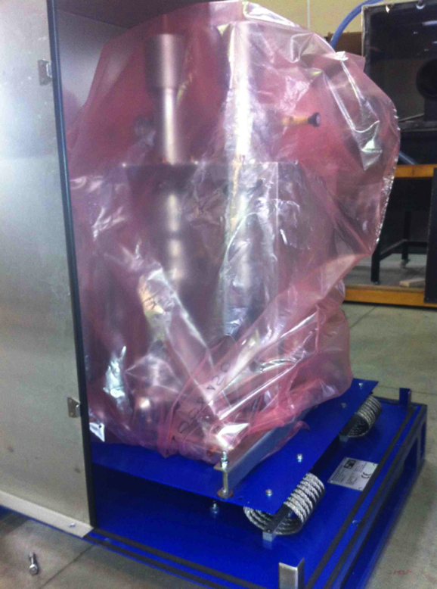
Fabrication process:
RF Conditioning
Delivery to LAL

Slide 13
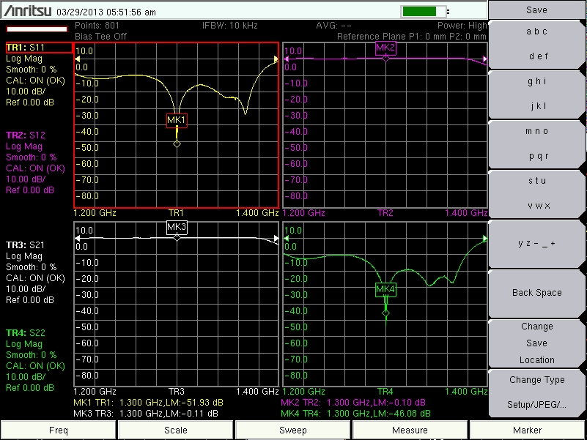
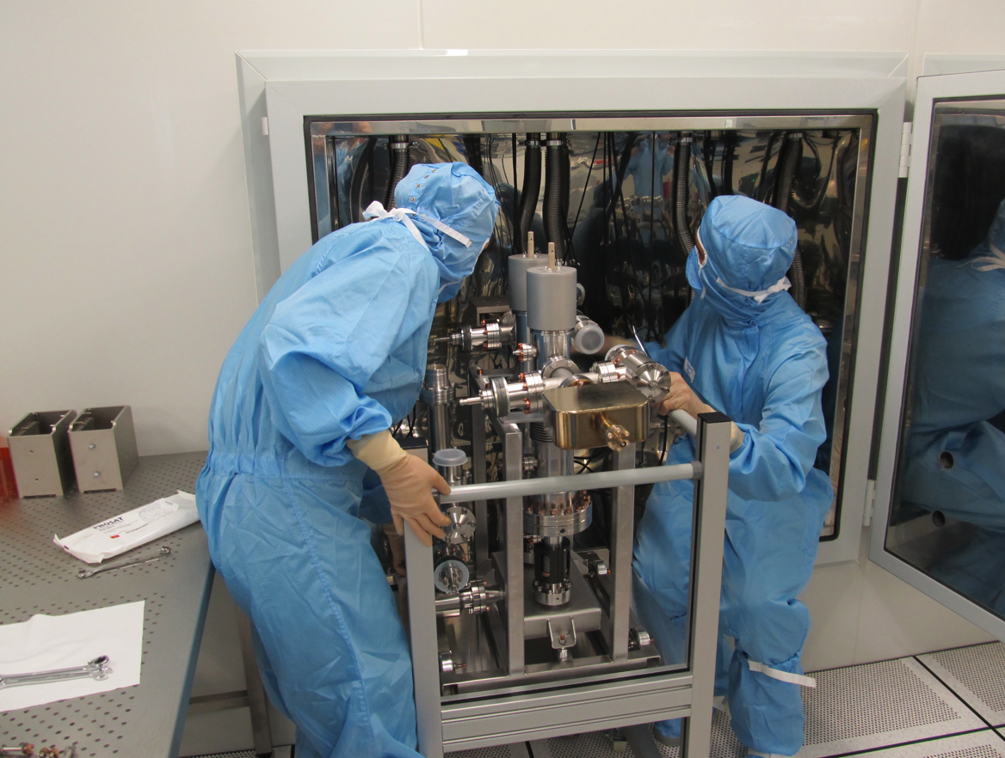
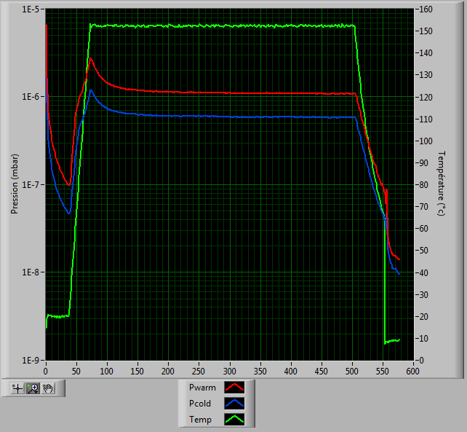
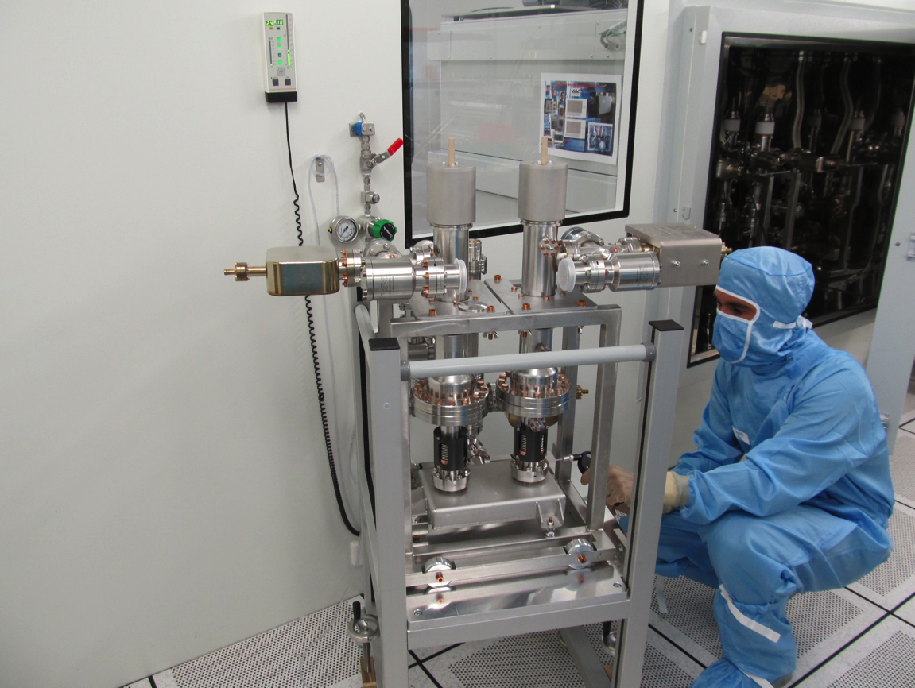
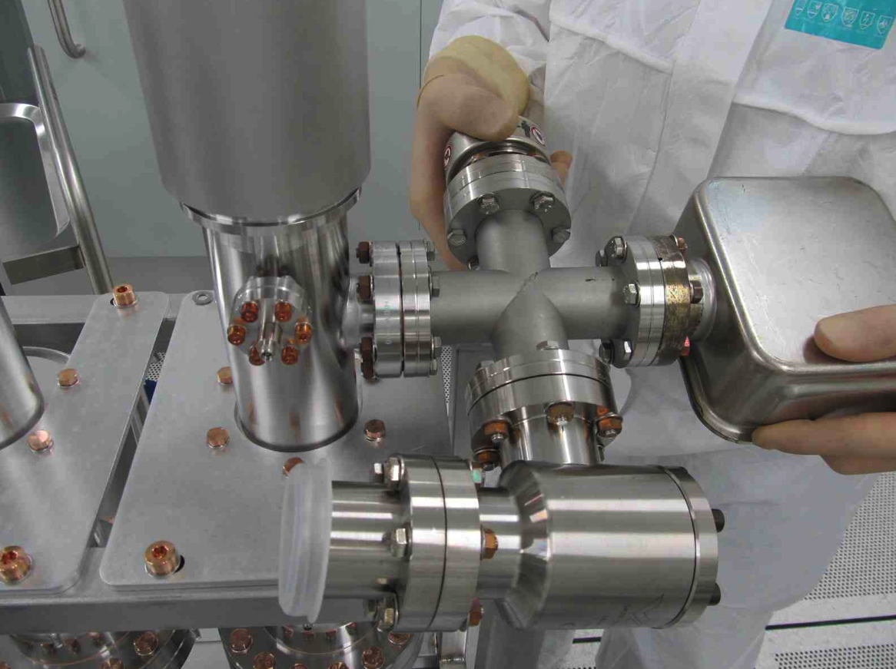
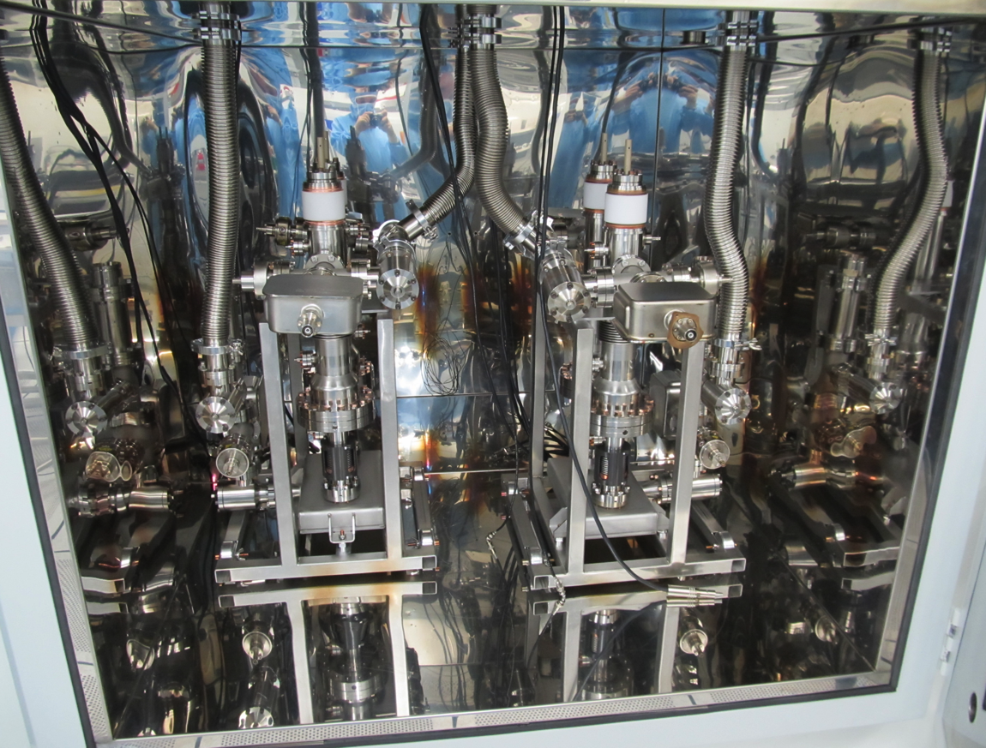
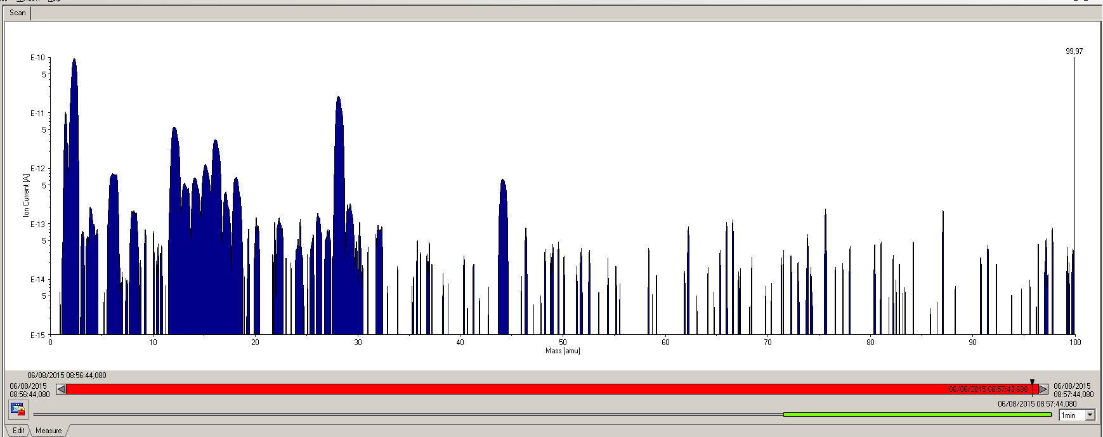
RF conditioning at LAL:
WGBs assembly
Capacitors assembly
Actuators assembly

Slide 14
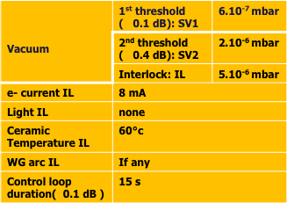
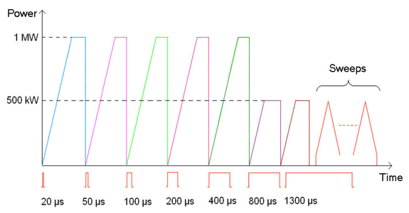
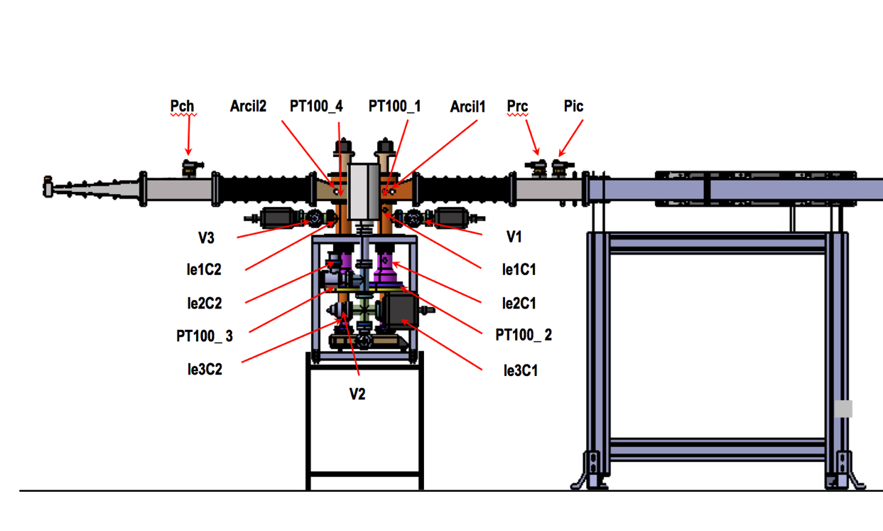
RF conditioning at LAL:
RF Conditioning

Slide 15
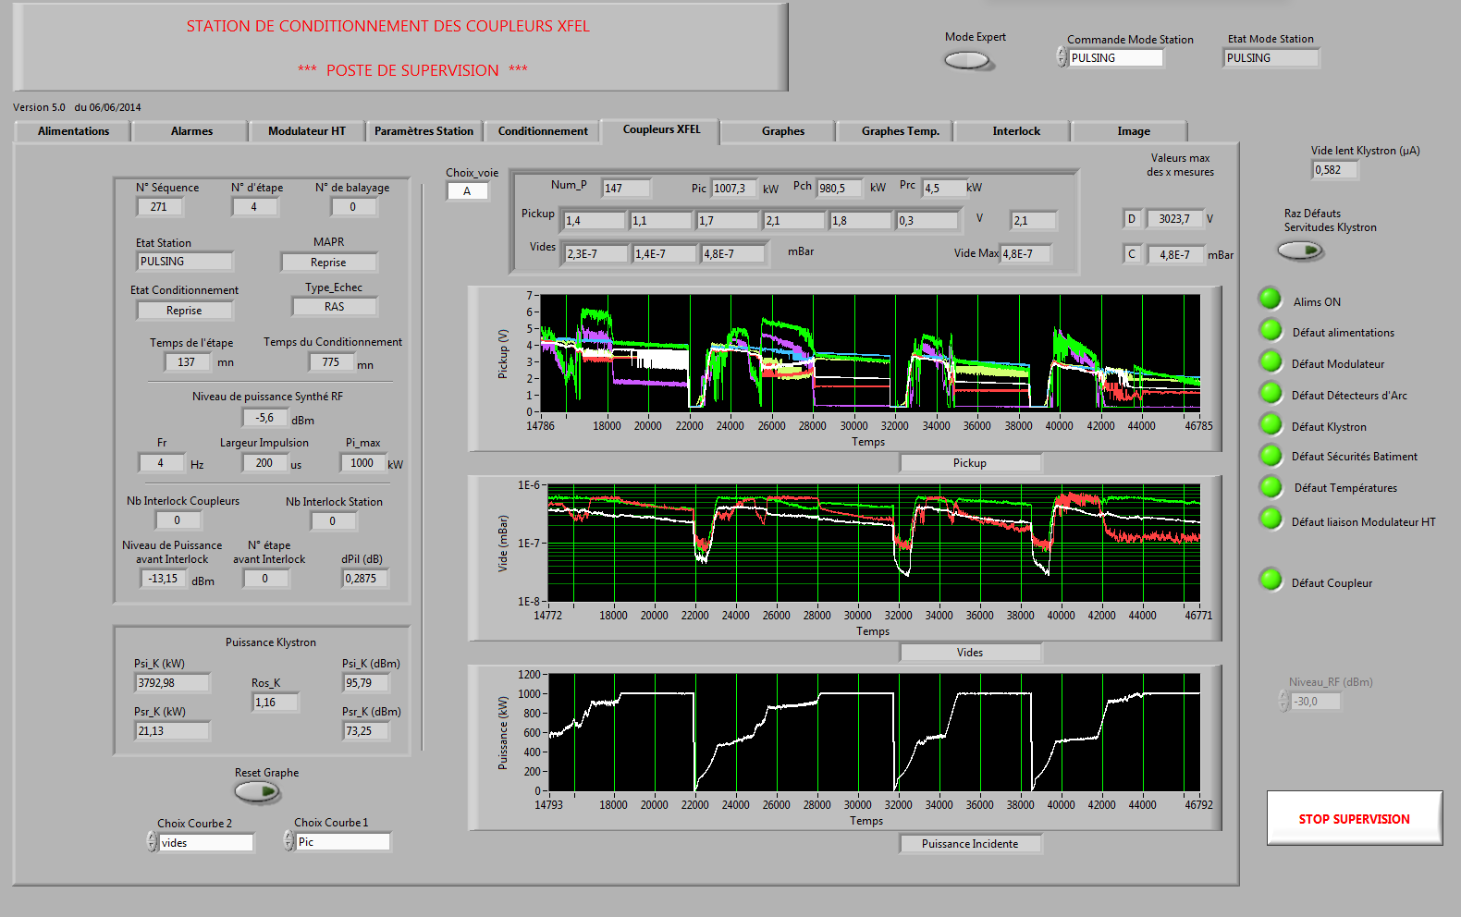
RF conditioning at LAL:
RF Conditioning

Slide 16
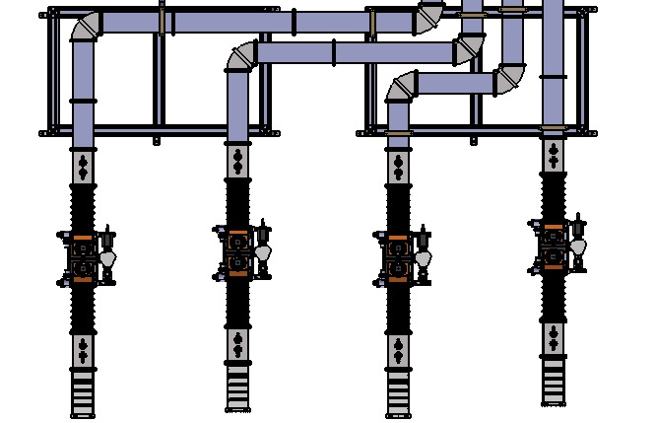
RF conditioning at LAL:
RF Conditioning
PicA
PicD
PicC
PicB
PrcD
PrcC
PrcB
PrcA
Arcil1D
Arcil1C
Arcil1B
V1A
Arcil1A
V1D
V1C
V1B
V2D
V2C
V2B
V2A
Arcil2D
V3C
Arcil2C
Arcil2B
V3A
Arcil2A
V3D
V3B
PchC
PchB
PchA
PchD
Ligne D
Ligne C
Ligne B
Ligne A

Slide 17
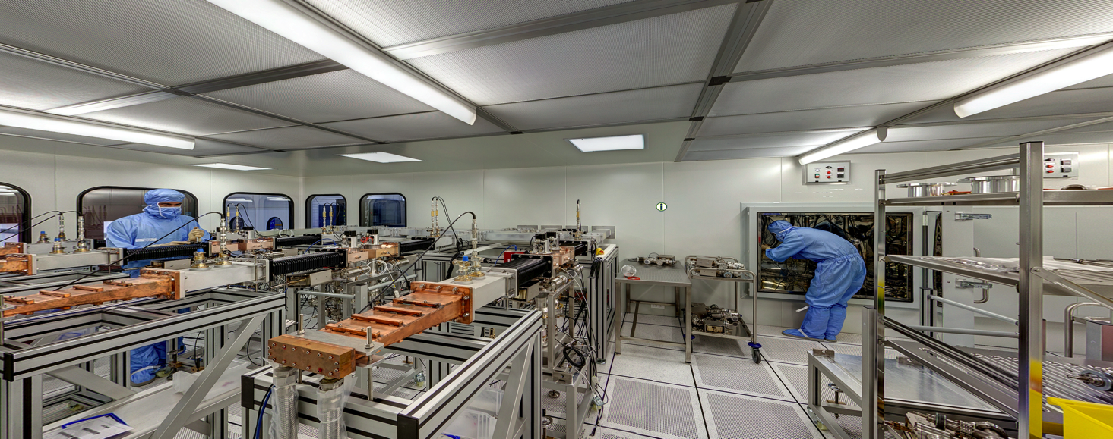
RF conditioning at LAL:

Slide 18
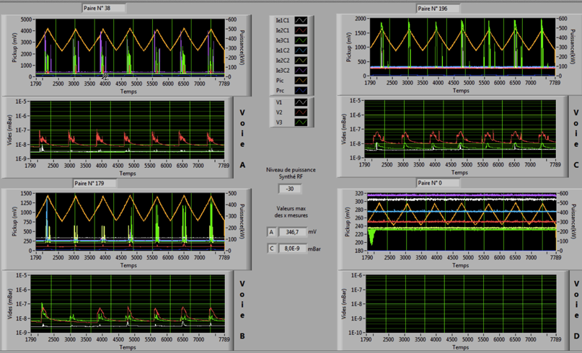
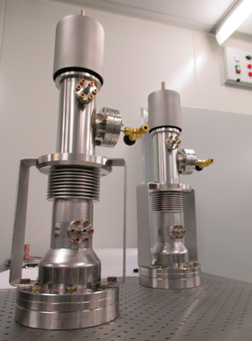
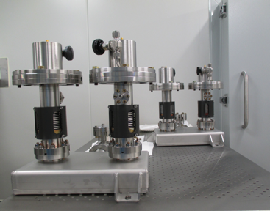
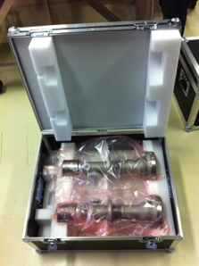
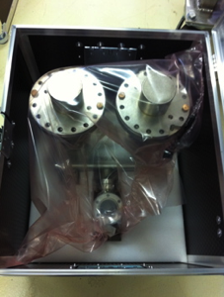
RF conditioning at LAL:
Shipment to IRFU-CEA
Coupler pair disassembly & final inspection

Slide 19
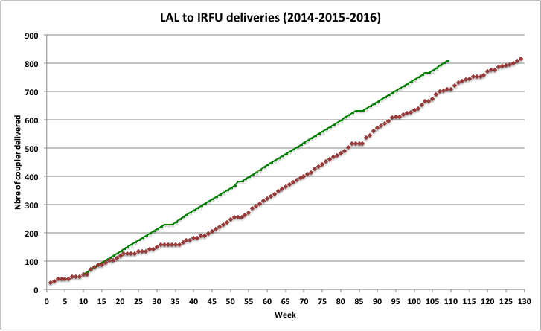
RF conditioning at LAL:
Xmas Break 2015
June 2016: The End!
-- Nominal delivery rate
-- Real rate
Summer Break 2015
Xmas Break 2014
Summer Break 2014
CPI production ( 142 units):
- Average of 4 couplers/week
Thales-RI production (670 units):
- 8 couplers/week after ramp-up,
- Delivery increase to 10 couplers/week for 10 weeks (May 2015-Sept 2015)
24 Couplers delivered in 2013

Slide 20
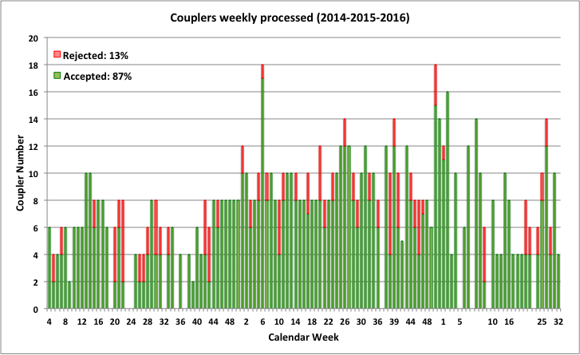
RF conditioning at LAL:

Slide 21
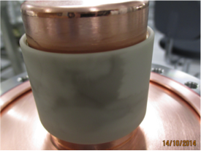
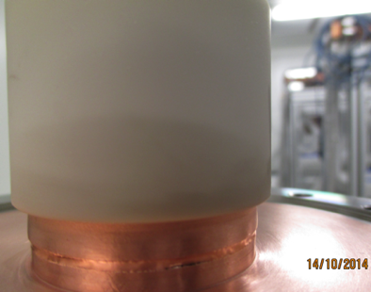
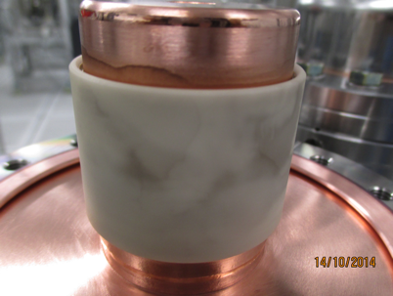
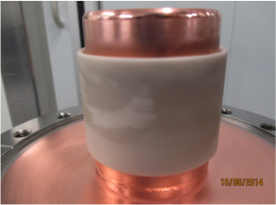
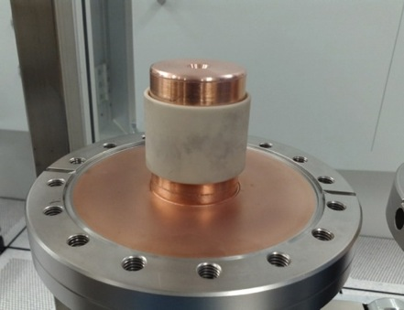
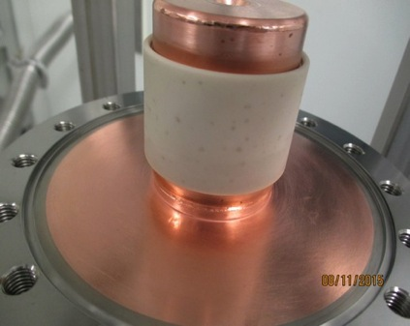
Troubles on the track: Dark layer on cold ceramic
Main defect discovered during the final inspection: Dark layer in cold ceramic window

Slide 22
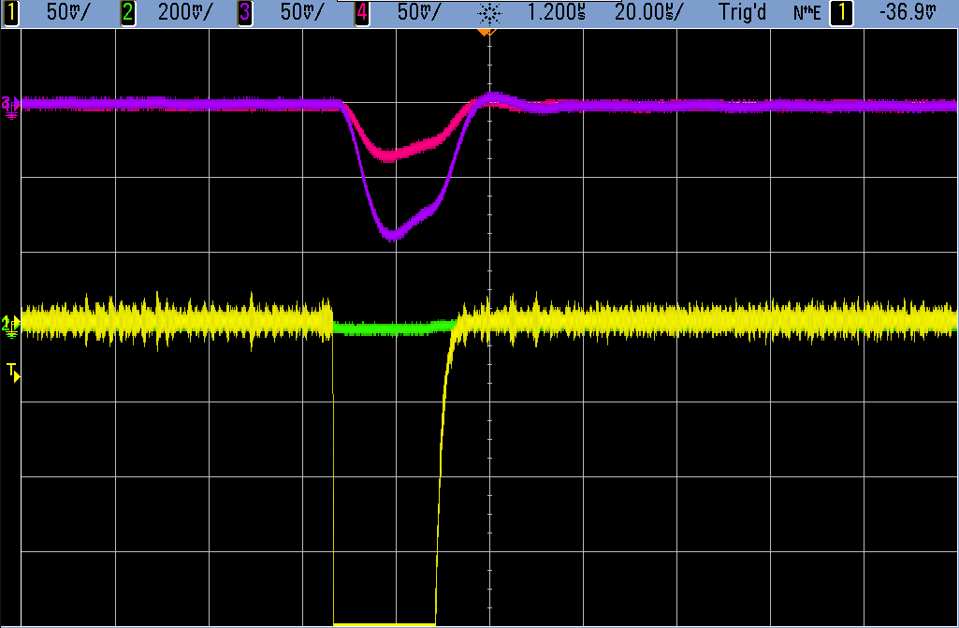
Troubles on the track: Light & arcing in the warm windows
Light C2
Light B1
Light intensity limit
Reflected power signal
Incident power signal

Slide 23
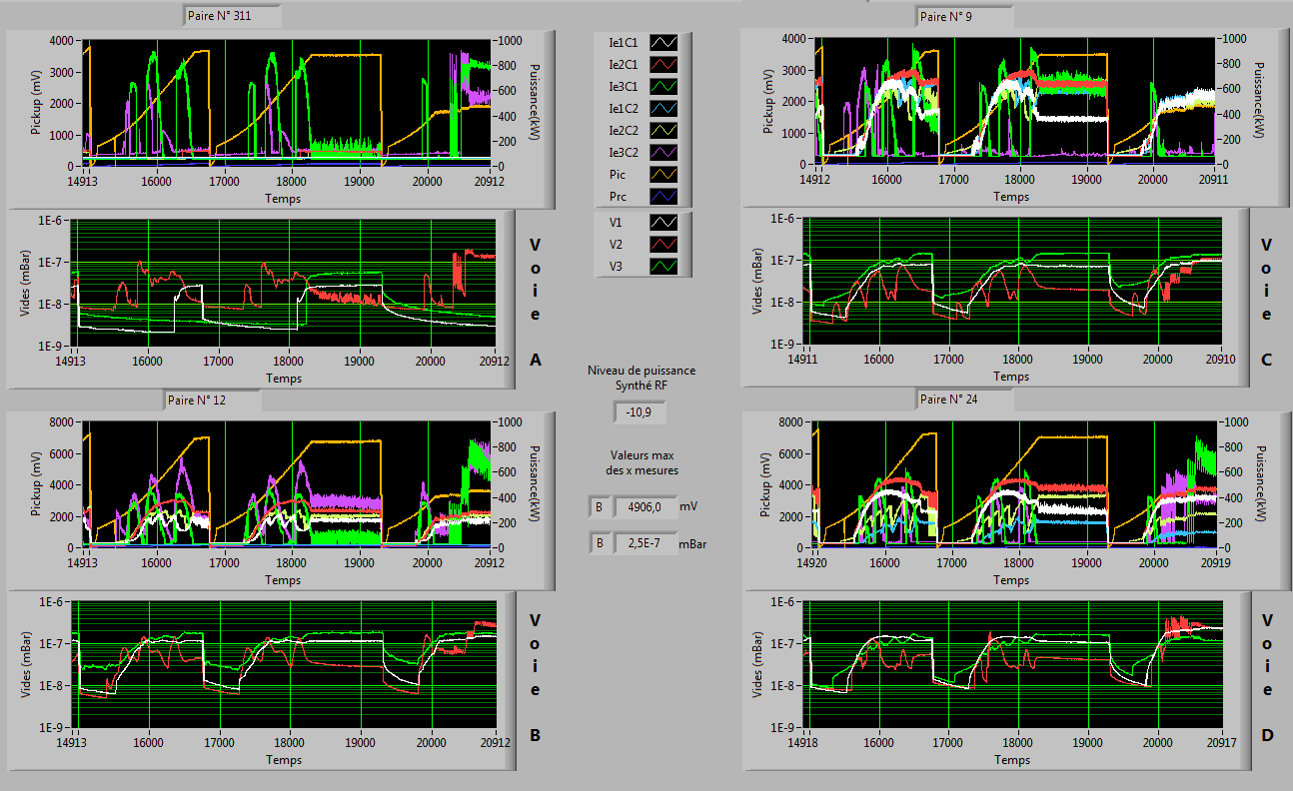
Troubles on the track: Light & arcing in the warm windows

Slide 24
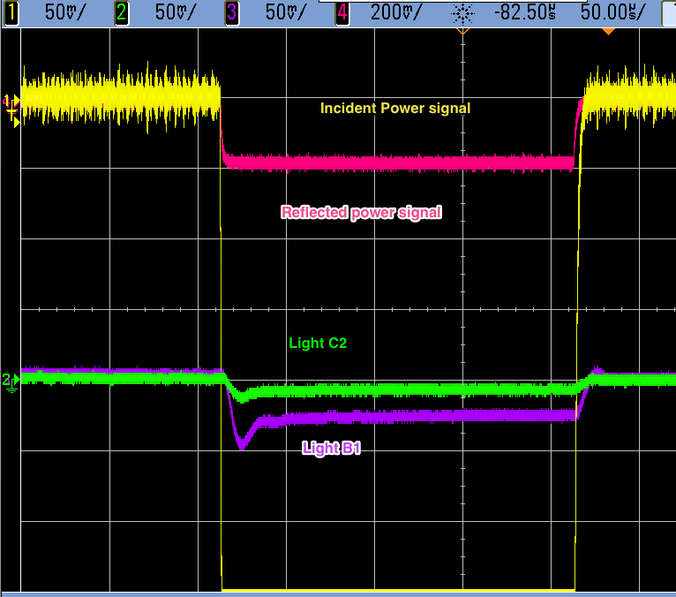
Troubles on the track: Light & arcing in the warm windows
Light intensity limit

Slide 25
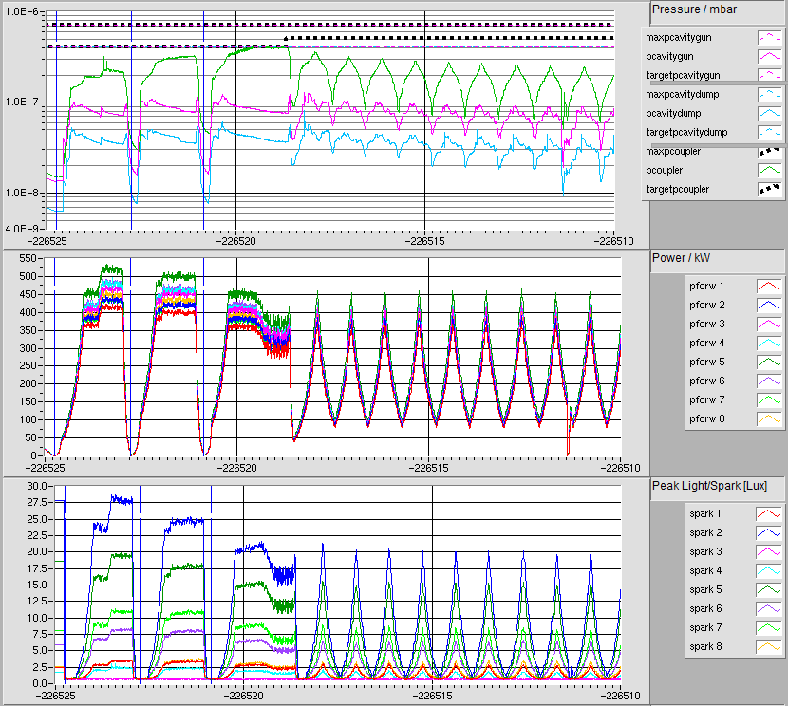
Troubles on the track: Light & arcing in the warm windows
Module XM-1 couplers conditioning:
Light signal on spark sensors
Denis Kostin, MHF-sl, DESY

Slide 26
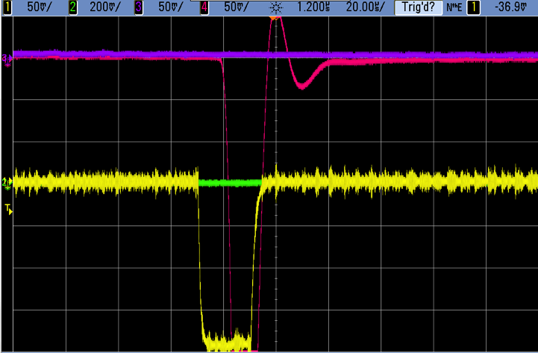
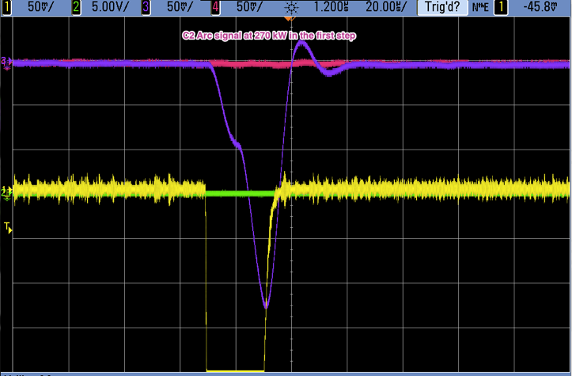
Troubles on the track: Light & arcing in the warm windows
Light intensity limit
Incident power signal
Reflected power signal
Sudden increase of the light intensity causing arc interlock: generally occurs at low power (under 250 kW) at the shortest pulse (20us) → impossible to go further: the pair is removed from the test stand.

Slide 27
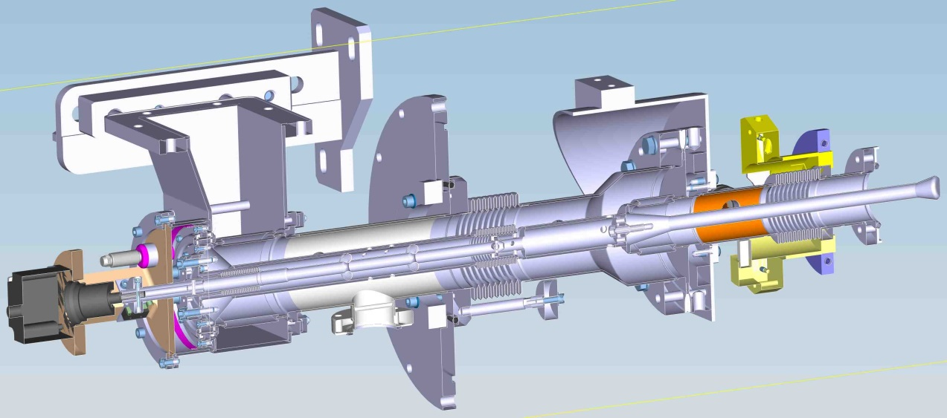
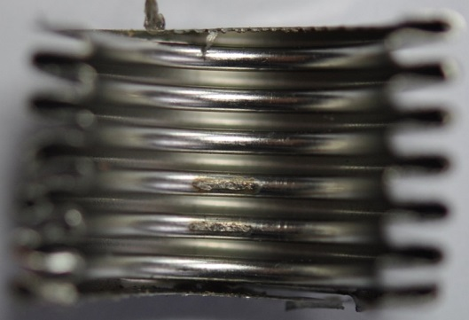


Troubles on the track: Overheating during RF test
Courtesy to Denis Kostin
All capacitors are replaced by coax gaskets: no push-rod leaks (RF is ON) since then
XM-1 Coupler 6 70K window overheating
(typical 70K window overheating case)
problem solved
FPC push-rod leak:
leak spot discovered
E-XFEL FPC
FPC coax-gasket:
capacitors are replaced
FPC simulation:
leak spot may have a contact-discharge
CST MWS simulation

Slide 28

Troubles on the track: Overheating during RF test
XM-1 Coupler 6 70K window overheating
(typical 70K window overheating case)
Denis Kostin, MHF-sl, DESY

Slide 29


Troubles on the track: Overheating during RF test
Coupler 70K window overheating due to loose connection between the WIC and the CP. Cold part must be grinded and cleaned. The WP must be changed.
Re-conditioning takes long time: cleaning is difficult, no baking, no US-wash...
Denis Kostin, MHF-sl, DESY

Slide 30


Troubles on the track: Overheating during RF test
WPs inspection after observed Overheating in module testes

Slide 31

Troubles on the track: Overheating during RF test
Same “white traces” observed after conditioning at LAL, but the thermal sensor were not plugged to observe an overheating

Slide 32
Summary:
850 power couplers were fabricated, RF conditioned and delivered to E-XFEL machine (808 assembled in modules and tested in AMTF + 42 spare units),
Coupler repair and parts replacement done in AMTF:
  35 warm parts replaced: inner screw contact problems, cold 70K window overheating and not “conditionable” discharges,
  30 push-rods replaced,
  Other repairs done (coupler movers, cables, WGs etc.);
All FPC capacitors are replaced by coax gaskets – no push-rod leaks anymore, problem well understood and fixed,
4 FPCs are shorted (not used) because of the coupler problems – cold 70K window overheating coupled with not conditionable discharge, two more couplers show T70K overheating effect – to be tested and decided.

Slide 33




Septembre 2016
Janvier 2013

