Slide 1
High-Q at high gradient at FNAL
Martina Martinello
LCWS 2017 – Strasbourg, France
24th October 2017

Slide 2
N-doping vs 120C baking
N-doping: very high Q-factors at 15-20 MV/m, quench field usually < 30 MV/m
120C baking: capability to reach high gradients 35-45 MV/m with Q < 10¹⁰
Anti-Q-slope
A. Grassellino et al., Supercond. Sci. Technol. 26, 102001 (2013) – Rapid Communications
Notes:
High Q at high gradients may reduce both capital and operational cost of the accelerators

Slide 3
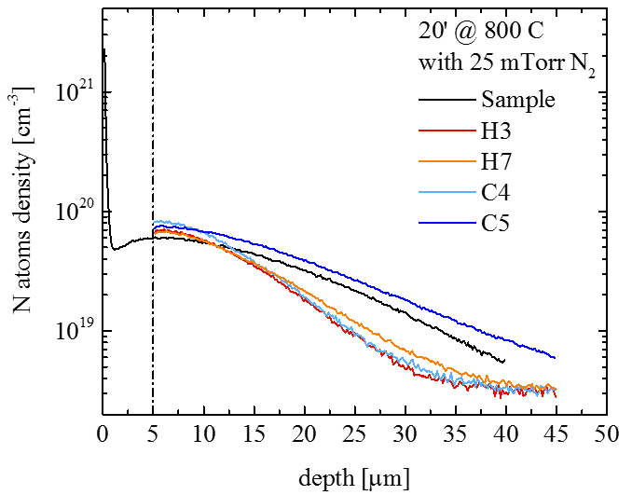
N-doping vs 120C baking
N-doping: very high Q-factors at 15-20 MV/m, quench field usually < 30 MV/m
N Doping at T> 800C manipulate mean free path constantly throughout several microns, giving the highest Q
120C baking: capability to reach high gradients 35-45 MV/m with Q < 10¹⁰
Anti-Q-slope
N doping: nitrogen throughout several microns
A. Grassellino et al., Supercond. Sci. Technol. 26, 102001 (2013) – Rapid Communications
A. Grassellino et al, Proceedings of SRF 2015
Notes:
High Q at high gradients may reduce both capital and operational cost of the accelerators

Slide 4
N-doping vs 120C baking
N-doping: very high Q-factors at 15-20 MV/m, quench field usually < 30 MV/m
120C bake known to manipulate mean free path at very near surface on clean bulk, giving the highest gradients
Anti-Q-slope
120C bake, vacancies in first ~ 60 nanometers
120C baking: capability to reach high gradients 35-45 MV/m with Q < 10¹⁰
mfp ~ 2-16 nm
mfp ~ 70 nm
A. Romanenko et al, Appl. Phys. Lett. 102, 232601 (2013)
A. Grassellino et al., Supercond. Sci. Technol. 26, 102001 (2013) – Rapid Communications
Notes:
High Q at high gradients may reduce both capital and operational cost of the accelerators

Slide 5

Motivation behind experiments
Composition and mean free path in first nanometers of cavity surface have been shown to be crucial for both Q and gradient performance
N Doping (high-Q)
+
120C baking (high gradients)
N-infusion: high-Q at high gradient
$Q=2∙{10}^{10}$at 35 MV/m

Slide 6
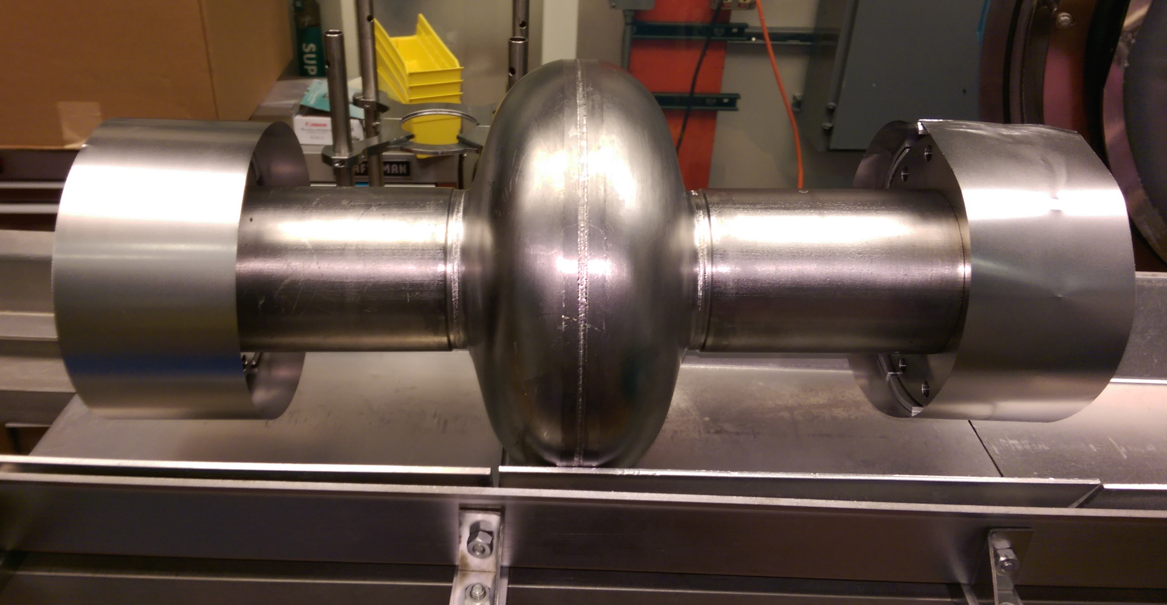
Example of N-infusion processing sequence
Bulk electro-polishing
High T furnace (with caps to avoid furnace contamination):
  800C 3 hours HV
  120C 48 hours with N₂ (25 mTorr)
NO chemistry post furnace
HPR, VT assembly
25 mTorr
10⁻⁵ mTorr
160 C
48 h
96 h
Protective caps and foils are BCP’d prior to every furnace cycle and assembled in clean room, prior to transporting cavity to furnace area
A. Grassellino et al., arXiv:1305.2182
A. Grassellino et al 2017 Supercond. Sci. Technol. 30 094004

Slide 7
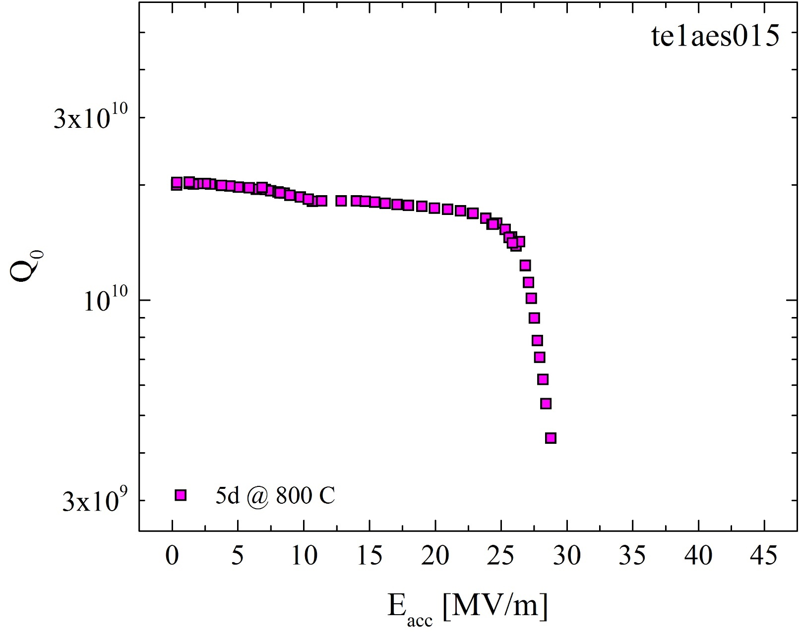
Cavity evolution- EP

Slide 8
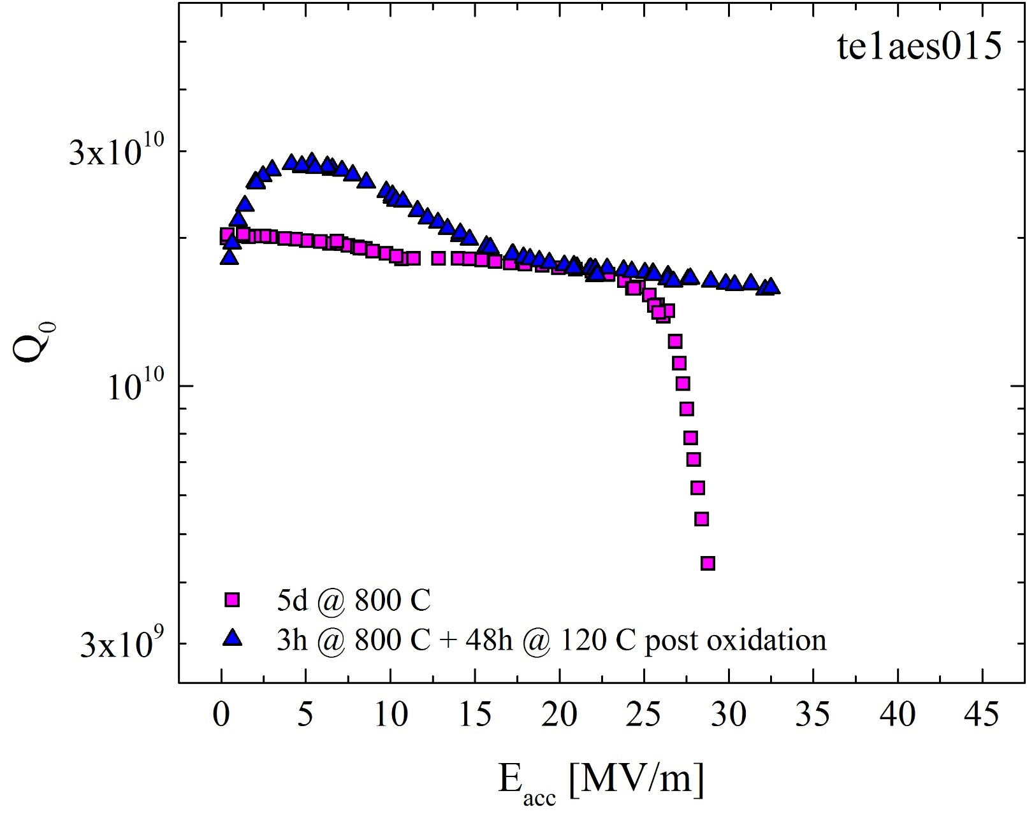
Cavity evolution – 120C baking

Slide 9
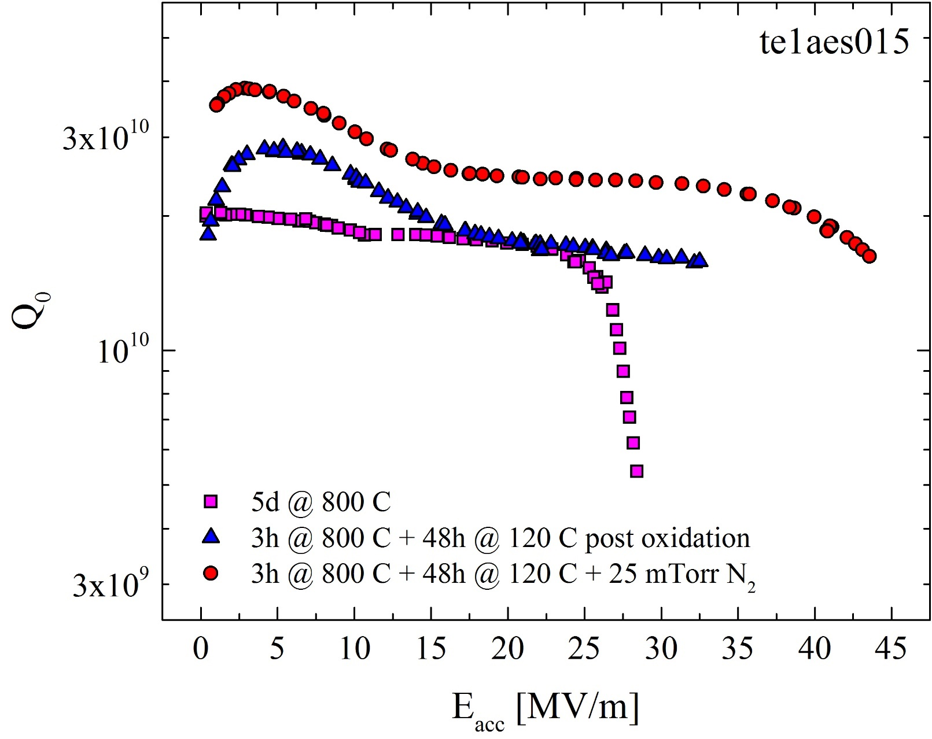
Cavity evolution – 120C N-infusion

Slide 10
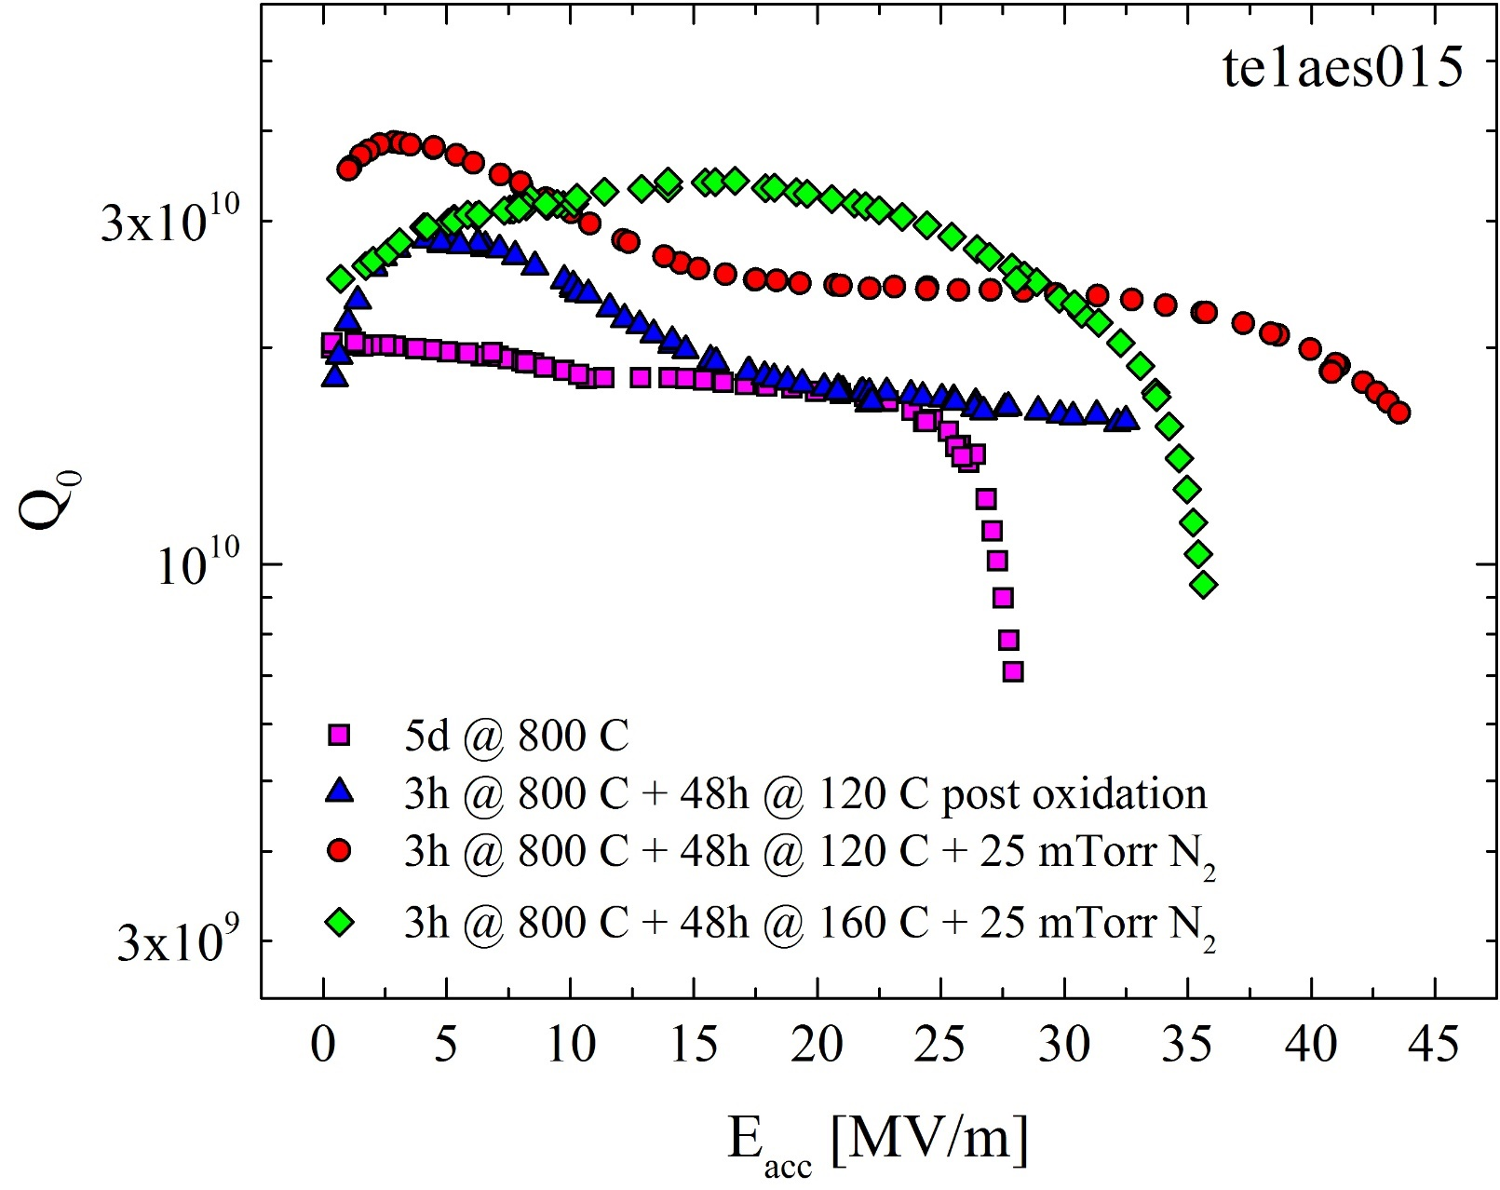
Cavity evolution – probing the parameter space
Increasing T ~40C turns cavity into “doped shape”!

Slide 11
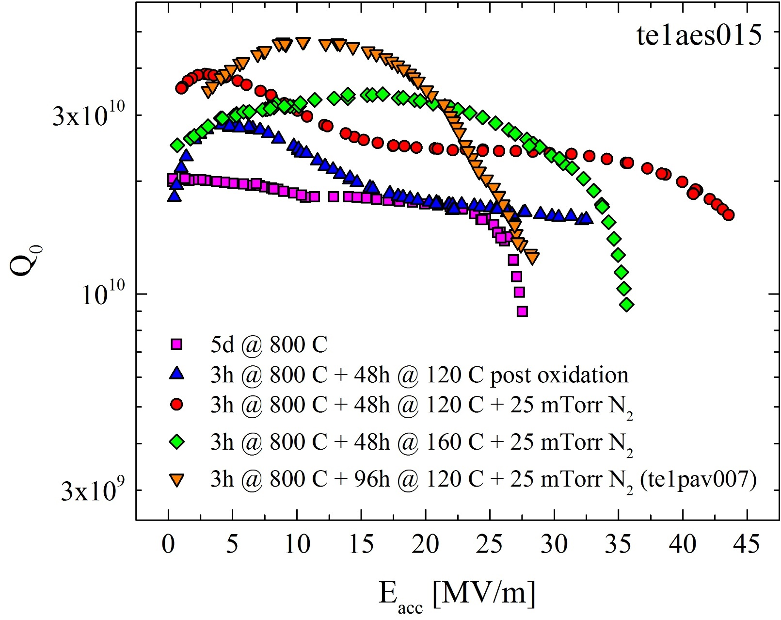
Cavity evolution – probing the parameter space
Increasing duration x 2 turns cavity into “doped shape”, even higher Q!
Increasing T ~40C turns cavity into “doped shape”!

Slide 12
Cavity evolution – 120C N-infusion
What gives the Q improvement at high field with N-infusion at 120C?

Slide 13
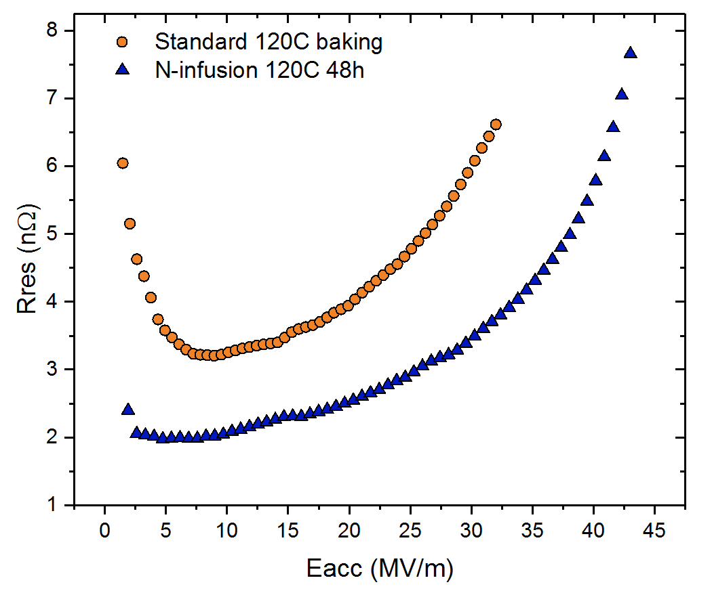
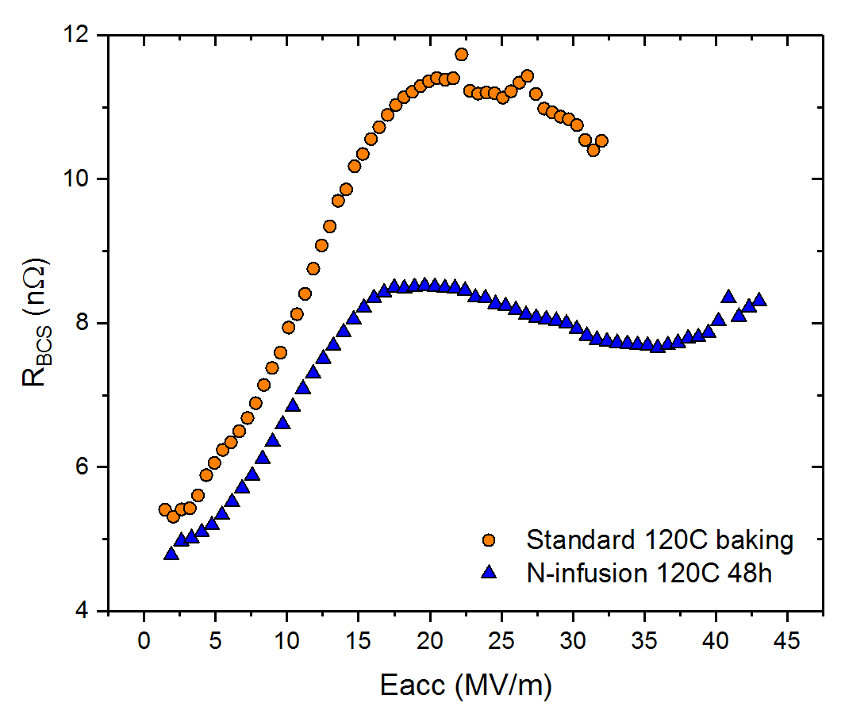
What gives the Q improvement at high field with 120C infused?
Improvement stems from both lower residual and lower BCS surface resistance
Standard
120C baking
Standard 120C baking
120C N-infusion
120C N-infusion
A. Grassellino et al 2017 Supercond. Sci. Technol. 30 094004

Slide 14
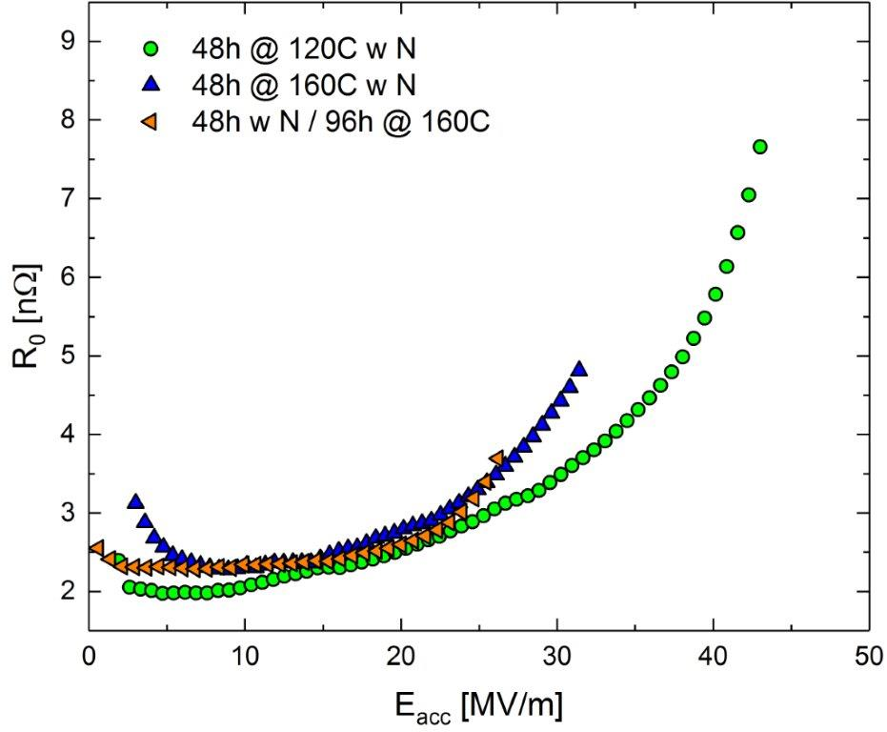
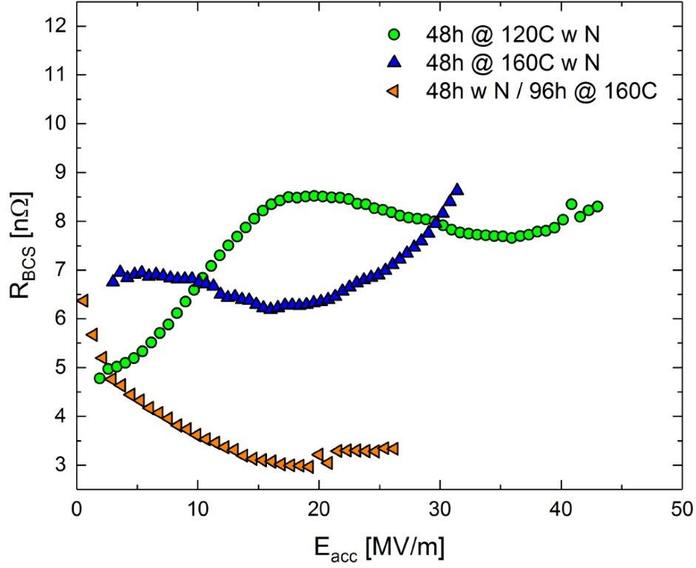
What gives the Q improvement at high field with longer duration/higher T N-infused?
Improvement stems from both lower residual and lower BCS surface resistance
120C infused 48h

Slide 15
What gives the Q improvement at high field with longer duration/higher T N-infused?
Improvement stems from both lower residual and lower BCS surface resistance
120C infused 48h
120C infused 96h

Slide 16
What gives the Q improvement at high field with longer duration/higher T N-infused?
Improvement stems from both lower residual and lower BCS surface resistance
120C infused 48h
160C infused 48h
120C infused 96h

Slide 17

What gives the Q improvement at high field with longer duration/higher T N-infused?
Improvement stems from both lower residual and lower BCS surface resistance
anti-Q-slope
The decreasing of R_{BCS} with the field allows the manifestation of the anti-Q-slope

Slide 18
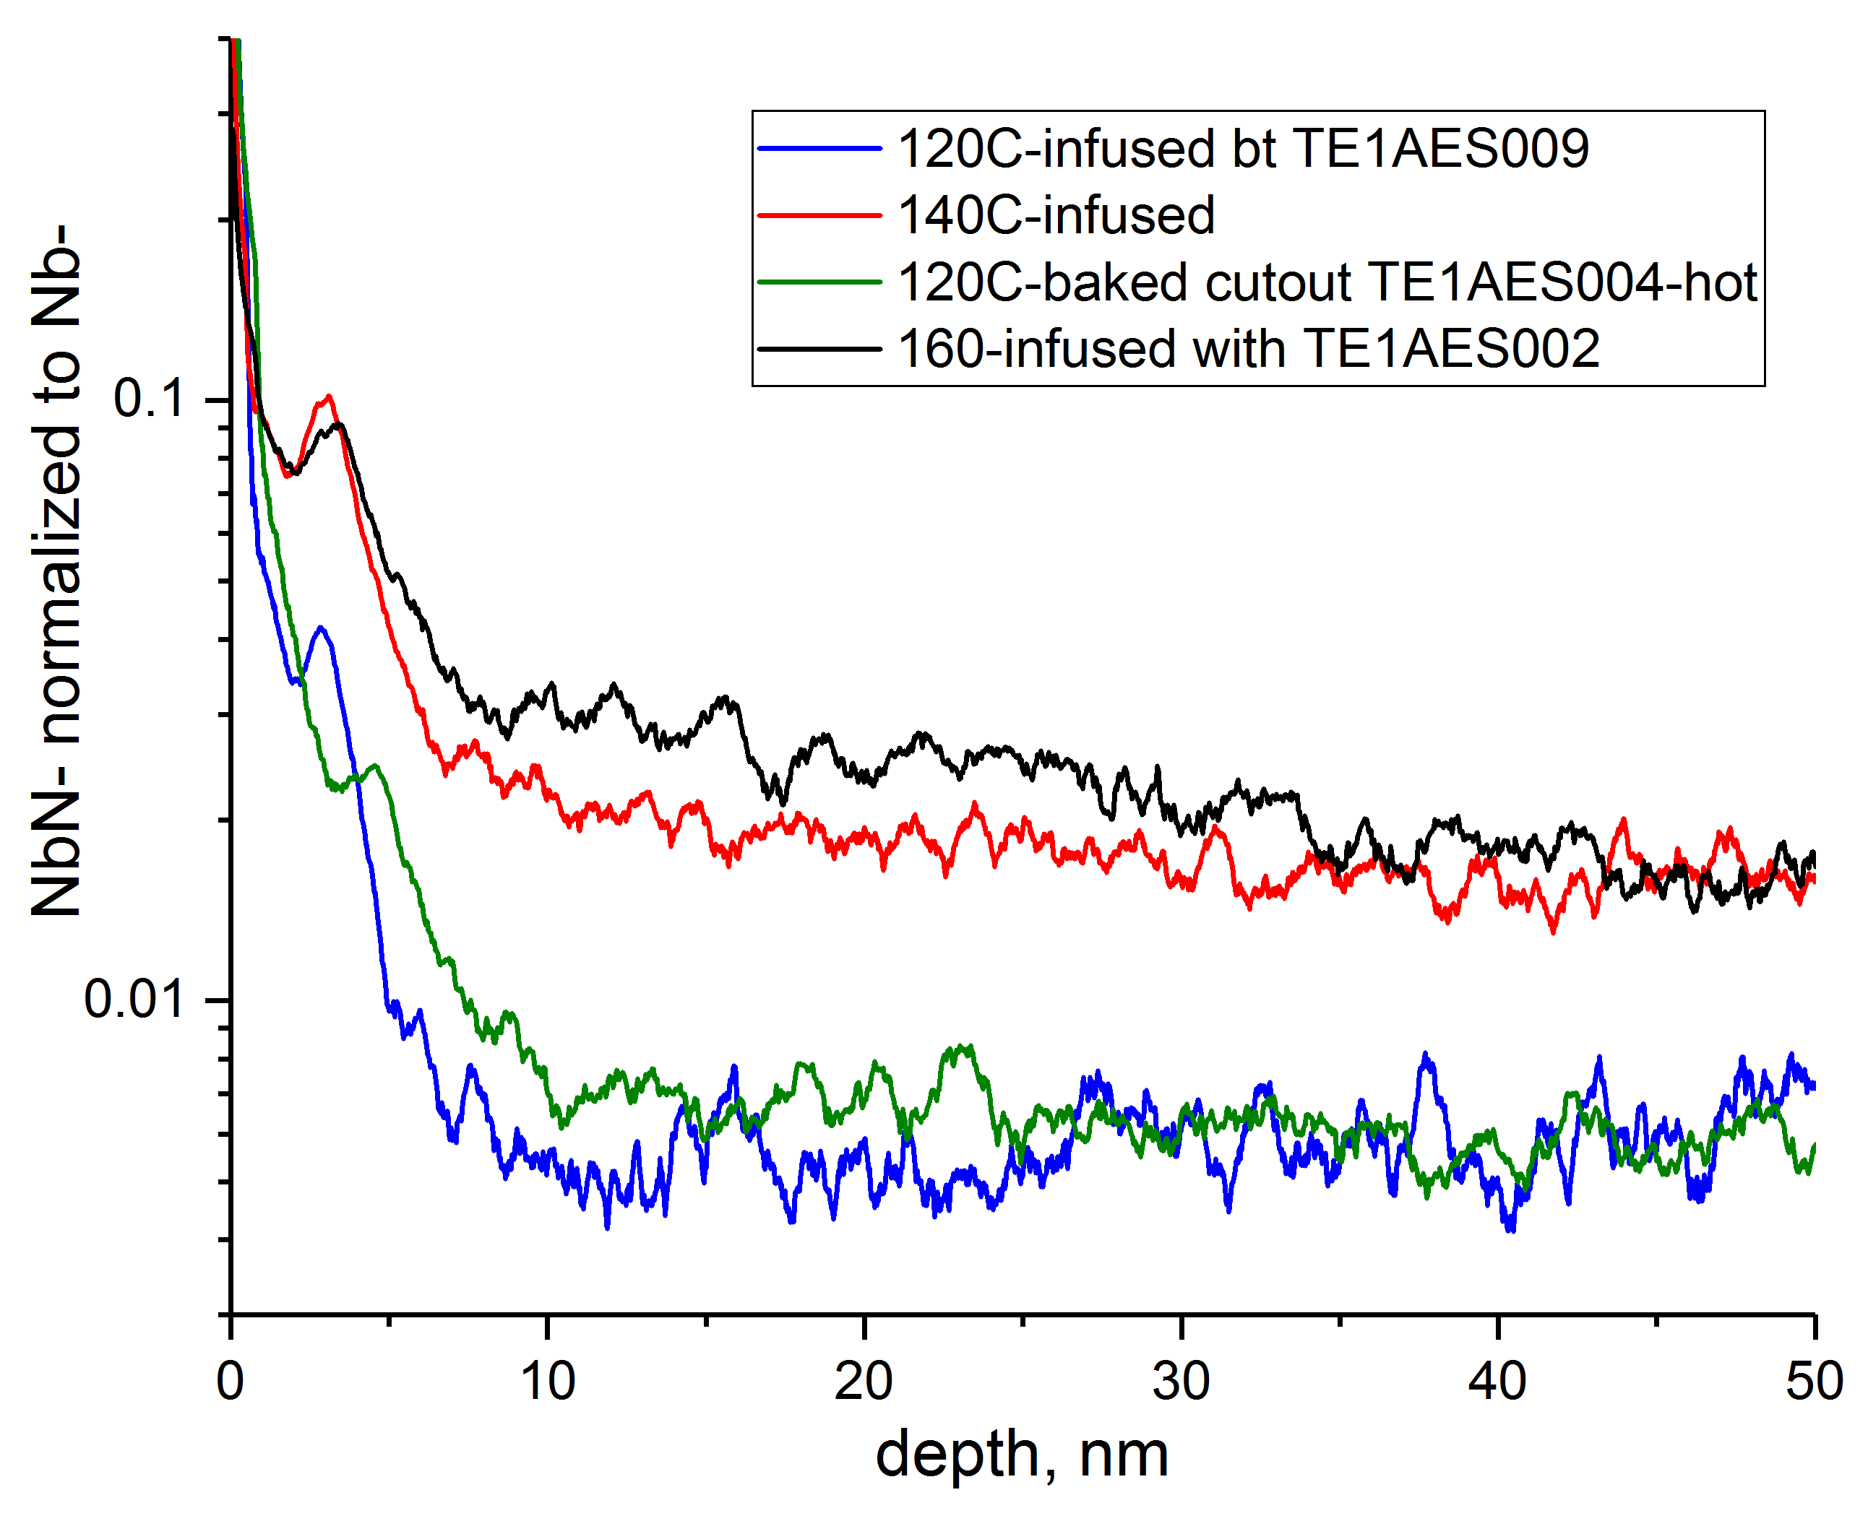
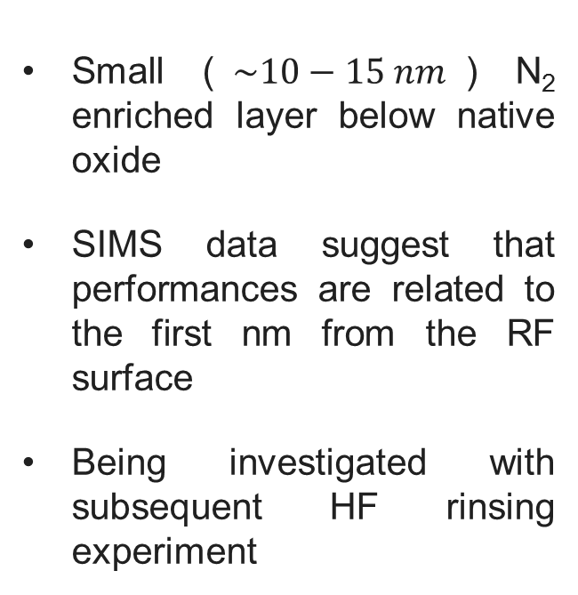
Nitrogen role in 120C N-infusion
Small ($\sim 10−15 nm$) N₂ enriched layer below native oxide
SIMS data suggest that performances are related to the first nm from the RF surface
Being investigated with subsequent HF rinsing experiment
Courtesy of Y. Trenikhina
120C infused
120C baking
SEM 120C N-infused Nb
No (clear) nitrides formation at the RF surface
Courtesy of Y. Trenikhina

Slide 19
Nitrogen role in 140/160C N-infusion
Courtesy of Y. Trenikhina
Higher N₂ background than not infused samples, through the whole penetration depth
Very similar to N₂ signal after EP in N-doped samples
No (clear!) presence of nitrides at the surface
Being investigated with subsequent HF rinsing experiment
160C infused
140C infused
120C baking
SEM 160C N-infused Nb
No (clear) nitrides formation at the RF surface
Courtesy of Y. Trenikhina

Slide 20
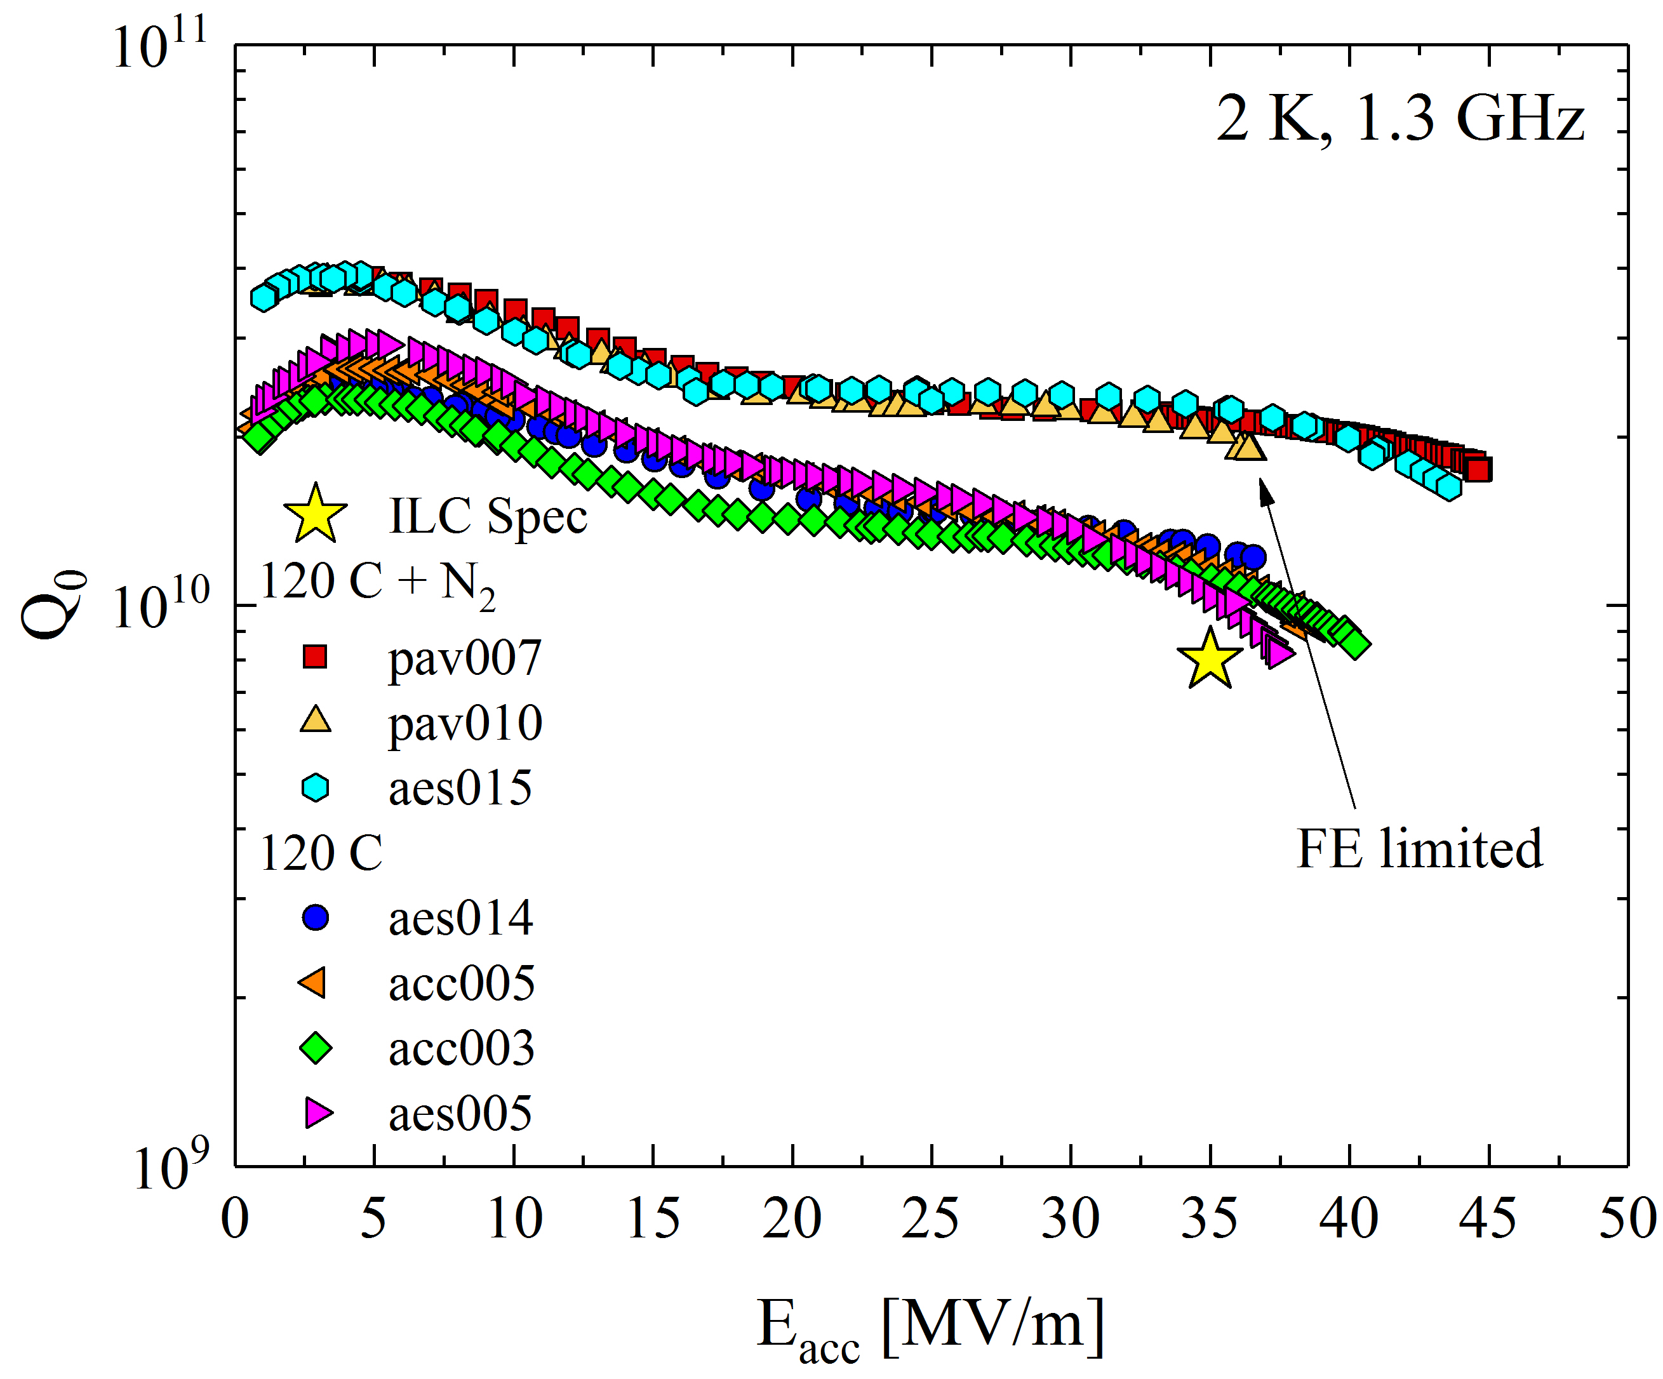
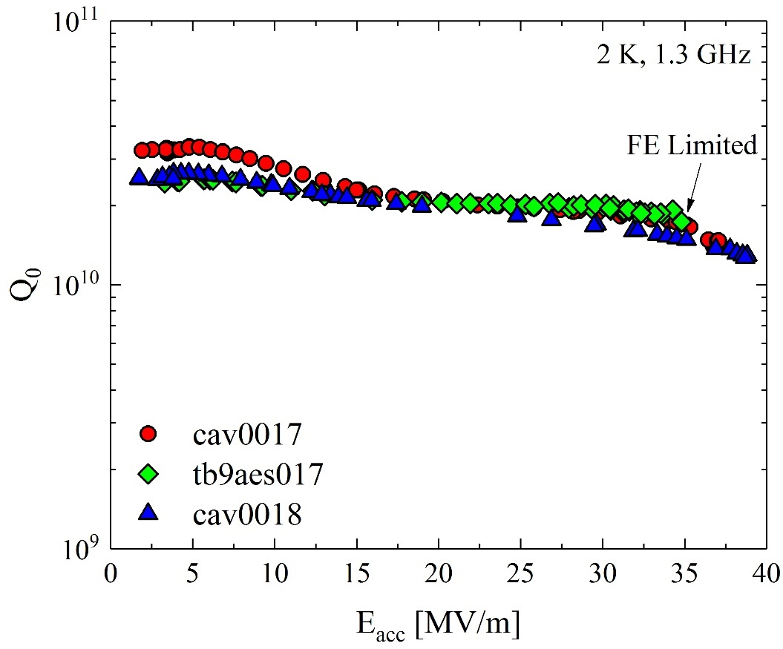
120 C N-infusion: high $Q_{0}$ at high gradients
Single-cell
9-cells
2 times higher!
N-Infusion successful also on 9-cell cavities!
A. Grassellino et al 2017 Supercond. Sci. Technol. 30 094004

Slide 21
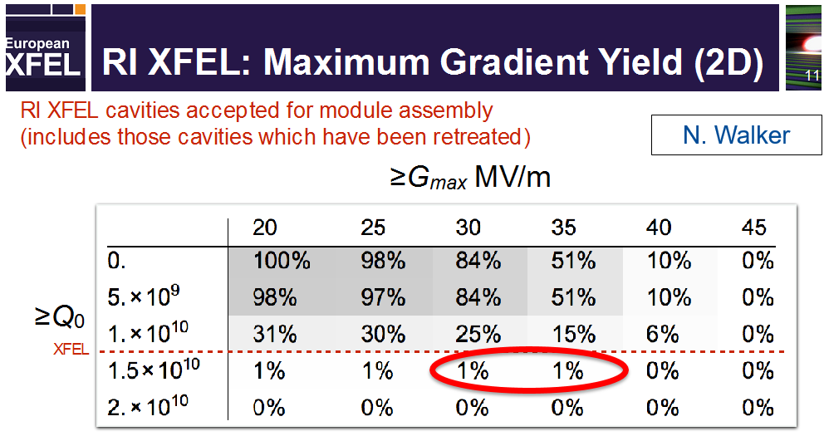
120 C N-infusion: high $Q_{0}$ at high gradients
9-cells
Compared to this table values for E-XFEL, results of 9-cell N-infused cavities would lay in top 1%

Slide 22

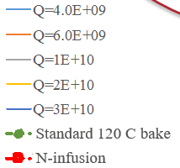
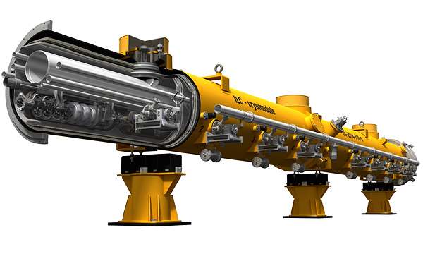
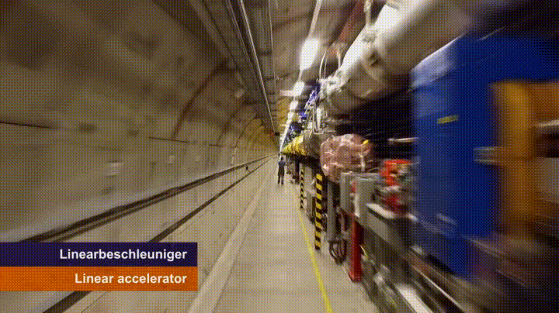
ILC possibility of cost reduction
Q₀ still very important!
Baseline design
  ILC: 16,000 cavities in 31 km linac
8 cavities
~10 m
  European XFEL
*N-infusion cost reduction takes into account also the difference cost of the processing chain
Image from linearcollider.org. Tunnelflug video by European XFEL. Cost analysis by N. Solyak
Notes:
We’re doing cost savings studies to try to make the ILC more affordable and increasing the gradient has the largest impact, but Q0 also has a strong impact

Slide 23
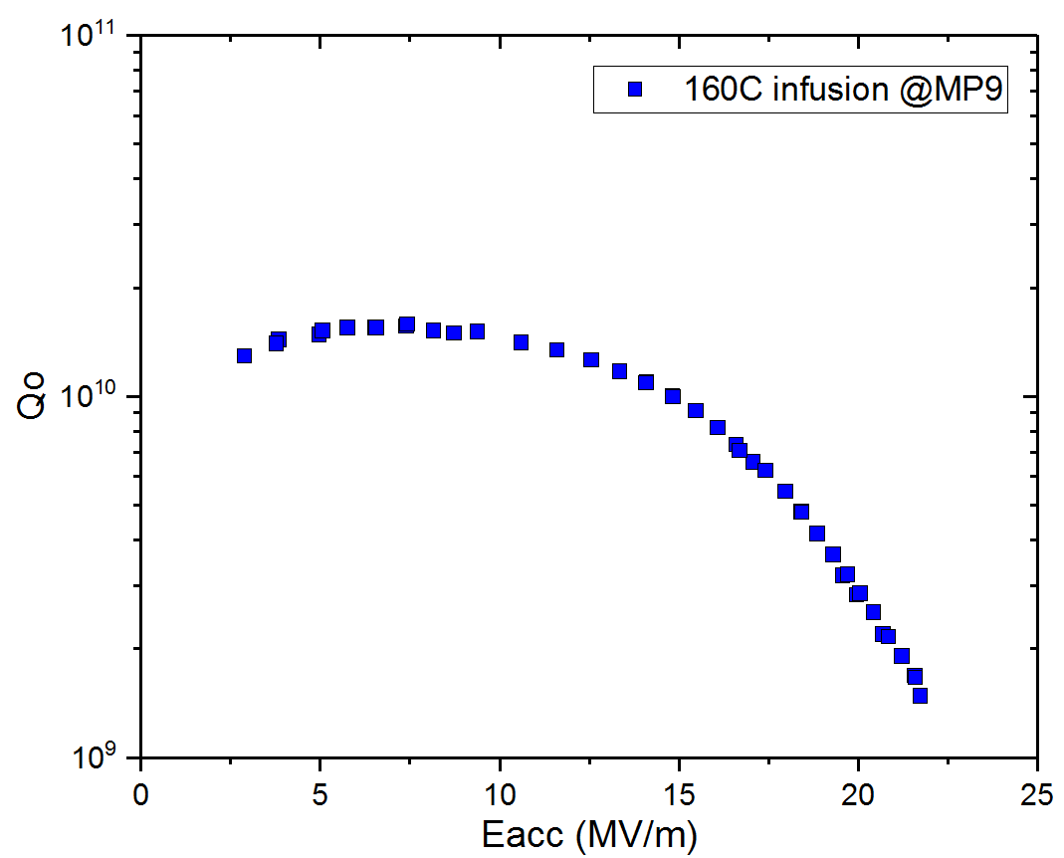
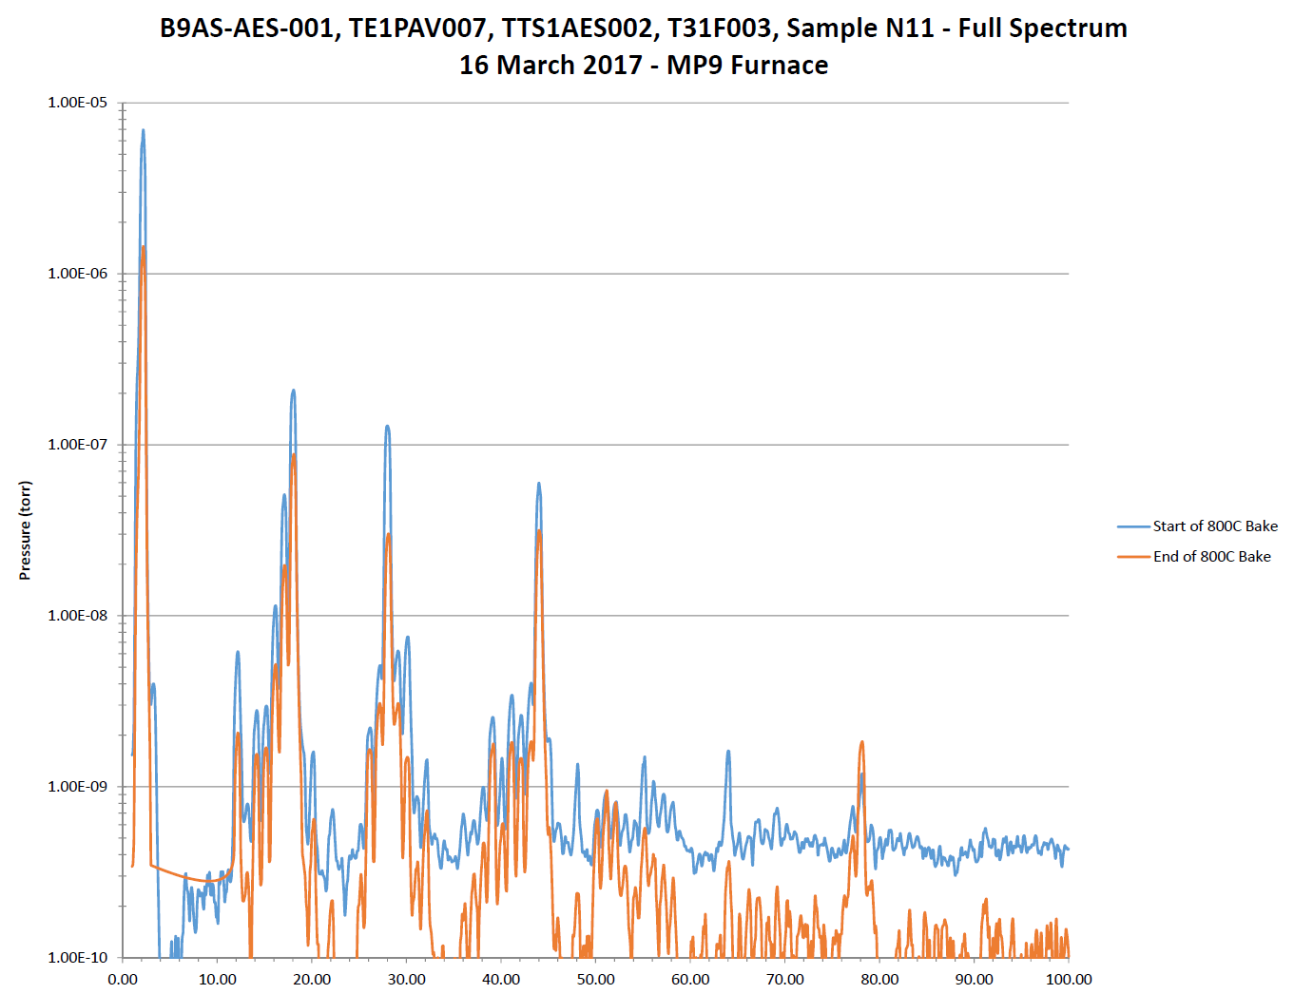
N-infusion easily affected by furnace contamination
Quite high level of hydrocarbons may be absorbed by the cavity
Example of N-infused cavity contaminated by furnace environment
Notes:
We’re doing cost savings studies to try to make the ILC more affordable and increasing the gradient has the largest impact, but Q0 also has a strong impact

Slide 24
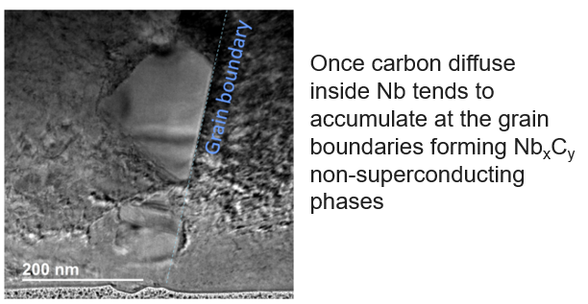
N-infusion easily affected by furnace contamination
Quite high level of hydrocarbons may be absorbed by the cavity
Example of N-infused cavity contaminated by furnace environment
Notes:
We’re doing cost savings studies to try to make the ILC more affordable and increasing the gradient has the largest impact, but Q0 also has a strong impact

Slide 25
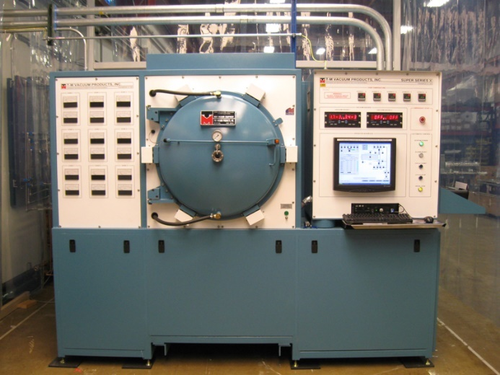
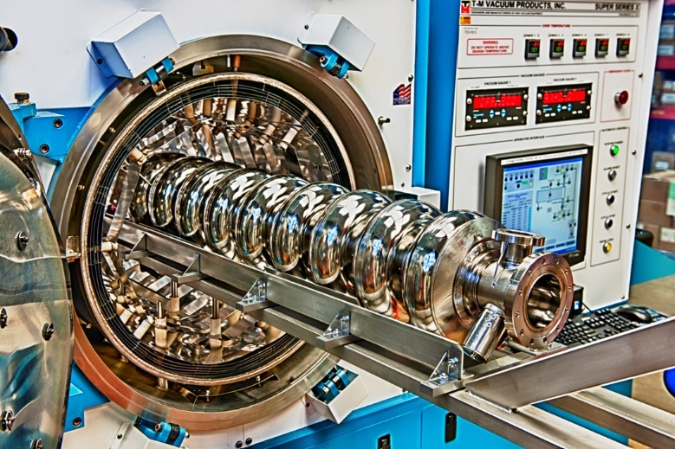
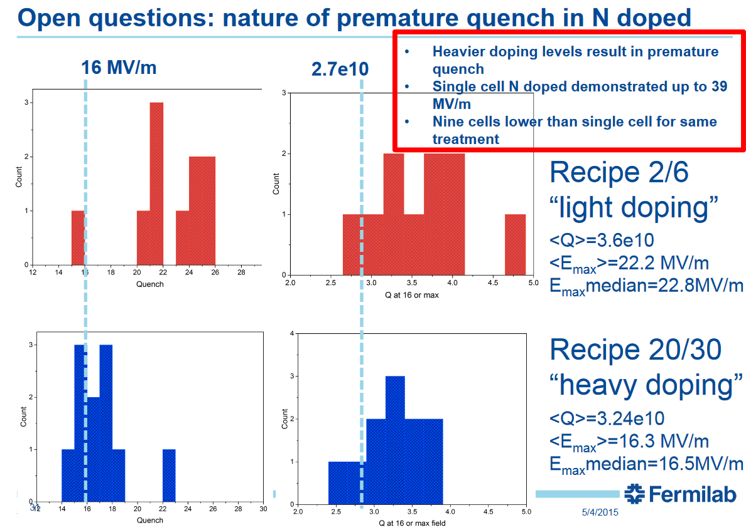
Strategies to implement the N-infusion technology
1. Very clean furnace environment
2. R&D to investigate other regime that are less affected by contamination
High-T N treatment that allows post chemistry and capable to create a thin N-enriched layer
Probe the parameter space to find an optimal spot for N diffusion rather than C
Etc..
Notes:
We’re doing cost savings studies to try to make the ILC more affordable and increasing the gradient has the largest impact, but Q0 also has a strong impact

Slide 26
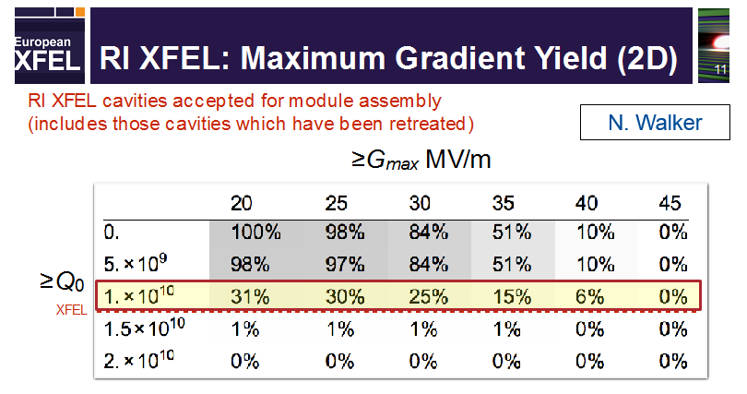

E-XFEL 120C baked cavities results
Only about 30% of the E-XFEL production cavities reach 1$∙$10¹⁰ above 20 MV/m. Why?

Slide 27

E-XFEL 120C baked cavities results
Only about 30% of the EXFEL production cavities reach 1$∙$10¹⁰ above 20 MV/m. Why?
New understanding of flux expulsion/dissipation could explain the mismatch

Slide 28
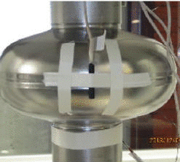
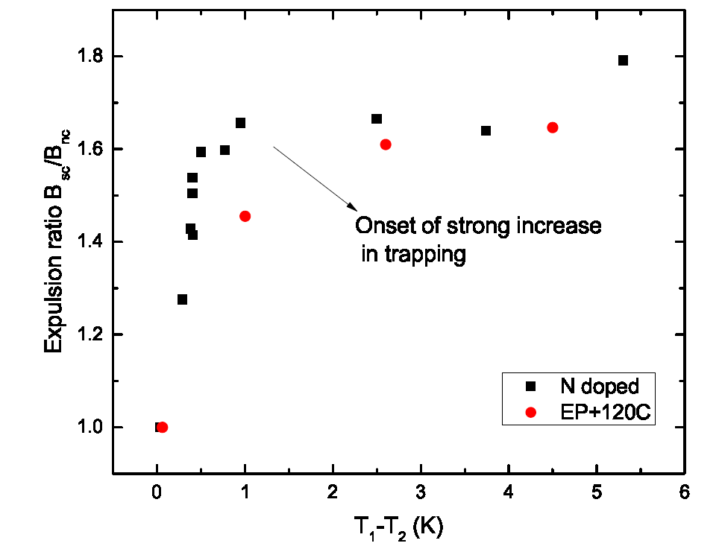
Fast Cooldown Helps Flux Expulsion
New understanding of expulsion
T₁
Fast cool-down lead to large thermal gradients which promote efficient flux expulsion
Slow cool-down → poor flux expulsion
T₂
B_{SC}/B_{NC}
Q₀
A. Romanenko et al., Appl. Phys. Lett. 105, 234103 (2014)
A. Romanenko et al., J. Appl. Phys. 115, 184903 (2014)
M. Martinello et al., J. Appl. Phys. 118, 044505 (2015)
S. Posen et al., J. Appl. Phys. 119, 213903 (2016)

Slide 29
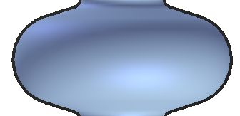
High-T Treatment to Promote Expulsion
New understanding of expulsion
Magnetic Flux
Trapping
Magnetic Flux
Expulsion
900°C furnace treatment
S. Posen et al. “Efficient expulsion of magnetic flux in SRF cavities for high Q0 applications,” Journal of Applied Physics 119, 213903 (2016)
Notes:
In addition to the development of the nitrogen infusion process, recent SRF R&D efforts have led to significant progress in understanding of magnetic flux. We knew already that practical magnetic shielding is imperfect and that when cooling a cavity in a realistic 5-10 mG background magnetic field, that the field can potentially be trapped in the superconductor, leading to Q0 degradation, but it can also be expelled from the material. We learned just in the last couple years that proper treatment of the material can promote expulsion, preventing Q0 degradation. We also learned that even if the flux is trapped, different treatments lead to different sensitivities to trapped flux.

Slide 30
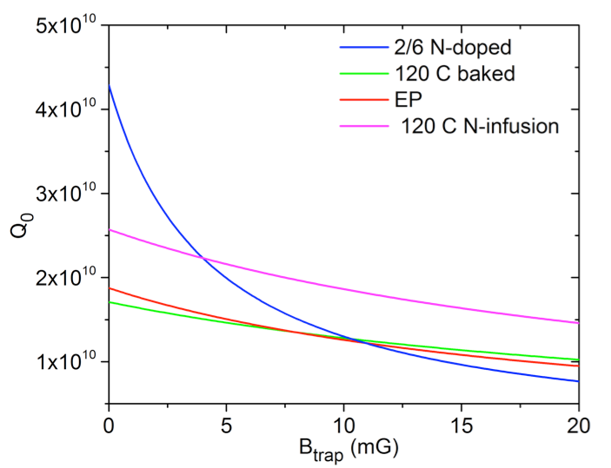
Q Degradation due to Trapped Flux
2 K, 16 MV/m, 1.3 GHz
15 mG of trapped flux can degrade performance, lowering Q below 10¹⁰
M. Martinello et al., Appl. Phys. Lett. 109, 062601 (2016)
Notes:
In addition to the development of the nitrogen infusion process, recent SRF R&D efforts have led to significant progress in understanding of magnetic flux. We knew already that practical magnetic shielding is imperfect and that when cooling a cavity in a realistic 5-10 mG background magnetic field, that the field can potentially be trapped in the superconductor, leading to Q0 degradation, but it can also be expelled from the material. We learned just in the last couple years that proper treatment of the material can promote expulsion, preventing Q0 degradation. We also learned that even if the flux is trapped, different treatments lead to different sensitivities to trapped flux.

Slide 31
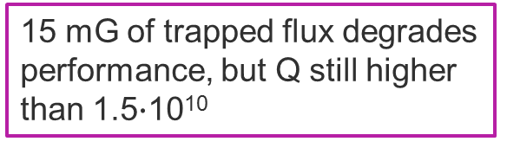
Q Degradation due to Trapped Flux
2 K, 16 MV/m, 1.3 GHz
15 mG of trapped flux degrades performance, but Q still higher than 1.5$∙$10¹⁰
M. Martinello et al., Appl. Phys. Lett. 109, 062601 (2016)
Notes:
In addition to the development of the nitrogen infusion process, recent SRF R&D efforts have led to significant progress in understanding of magnetic flux. We knew already that practical magnetic shielding is imperfect and that when cooling a cavity in a realistic 5-10 mG background magnetic field, that the field can potentially be trapped in the superconductor, leading to Q0 degradation, but it can also be expelled from the material. We learned just in the last couple years that proper treatment of the material can promote expulsion, preventing Q0 degradation. We also learned that even if the flux is trapped, different treatments lead to different sensitivities to trapped flux.

Slide 32
Magnetic Flux – Sensitivity and Expulsion
Flux expulsion
Sensitivity to trapped flux
Preservation of Q in CM environment
Magnetic Flux
Trapping
900°C furnace treatment
2 K, 16 MV/m, 1.3 GHz
Magnetic Flux
Expulsion
In order to maintain high-Q at high gradient in a cryomodule, it is extremely important to maximize flux expulsion and to minimize remnant field
M. Martinello et al. “Effect of interstitial impurities on the field dependent microwave surface resistance of niobium,” Appl. Phys. Lett. 109, 062601 (2016)
S. Posen et al. “Efficient expulsion of magnetic flux in SRF cavities for high Q0 applications,” Journal of Applied Physics 119, 213903 (2016)
Notes:
In addition to the development of the nitrogen infusion process, recent SRF R&D efforts have led to significant progress in understanding of magnetic flux. We knew already that practical magnetic shielding is imperfect and that when cooling a cavity in a realistic 5-10 mG background magnetic field, that the field can potentially be trapped in the superconductor, leading to Q0 degradation, but it can also be expelled from the material. We learned just in the last couple years that proper treatment of the material can promote expulsion, preventing Q0 degradation. We also learned that even if the flux is trapped, different treatments lead to different sensitivities to trapped flux.

Slide 33
ILC cost reduction – SRF R&D in US (FNAL, ANL, Jlab, Cornell)
Funds for ILC cost reduction for US collaboration have recently been received ($1M for one year) from DOE HEP
FNAL-lead collaboration, includes: FNAL, ANL, Jlab, Cornell
Agreed on the first year plan:
  Demonstrate increase in Q at 35 MV/m via flux expulsion
    FNAL owns about a dozen of cavities that were ILC qualified, dressed ready for cryomodule; we will undress them, re-baseline them, then apply the treatment pioneered at FNAL (and now applied to all LCLS-2 cavities) to increase magnetic flux expulsion (900C bake); re-test to demonstrate on ~10 nine cell cavities Q ~1.5e10 at 35 MV/m – Fermilab, ANL and Jlab
  In parallel continue to push single cell R&D for high Q at high gradient via doping/infusion – FNAL, ANL, Jlab, Cornell
  Apply best High Q/high gradient recipe to several nine cells – FNAL, Jlab
  Dress best nine cell cavity and demonstrate high Q at 35 MV/m in cryomodule configuration (horizontal test stand)
  Install high power klystron at FNAL Vertical test Facility to study field emission reduction via high power pulsing (HPP)

Slide 34
Conclusions
N-infusion suitable treatment to obtain high-Q at high gradient
Modification of the superficial mean-free-path at the nanometer scale
Successful results obtained also on 9-cell cavities, potentially useful for ILC cost reduction
More R&D needed to increase reliability of the process
US collaboration (FNAL, ANL, JLAB, Cornell) on SRF R&D effort for ILC cost reduction

Slide 35
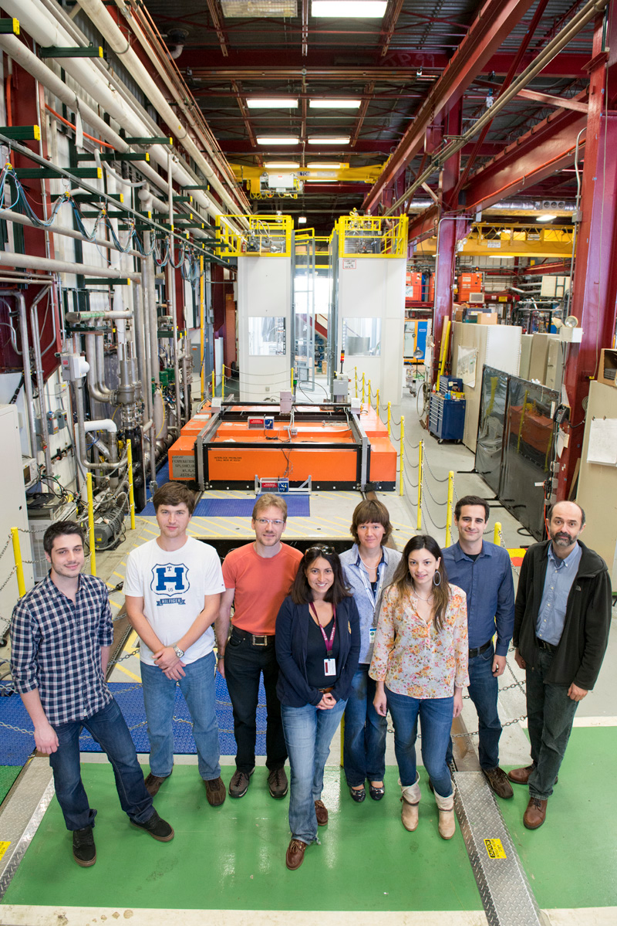
Team Effort
Results shown here are due to many hardworking people
Thanks to SRF department for contributions with graphs, slides, etc.

Slide 36


Thank you for your attention!

