Slide 1
LLRF Commissioning and Operation at the European XFEL.
An overview
Mathieu Omet
LCWS, Strasbourg, 24.10.2017

Slide 2
Contents
Introduction
LLRF commissioning
Energy Reach
LLRF performance
Summary / Outlook

Slide 3
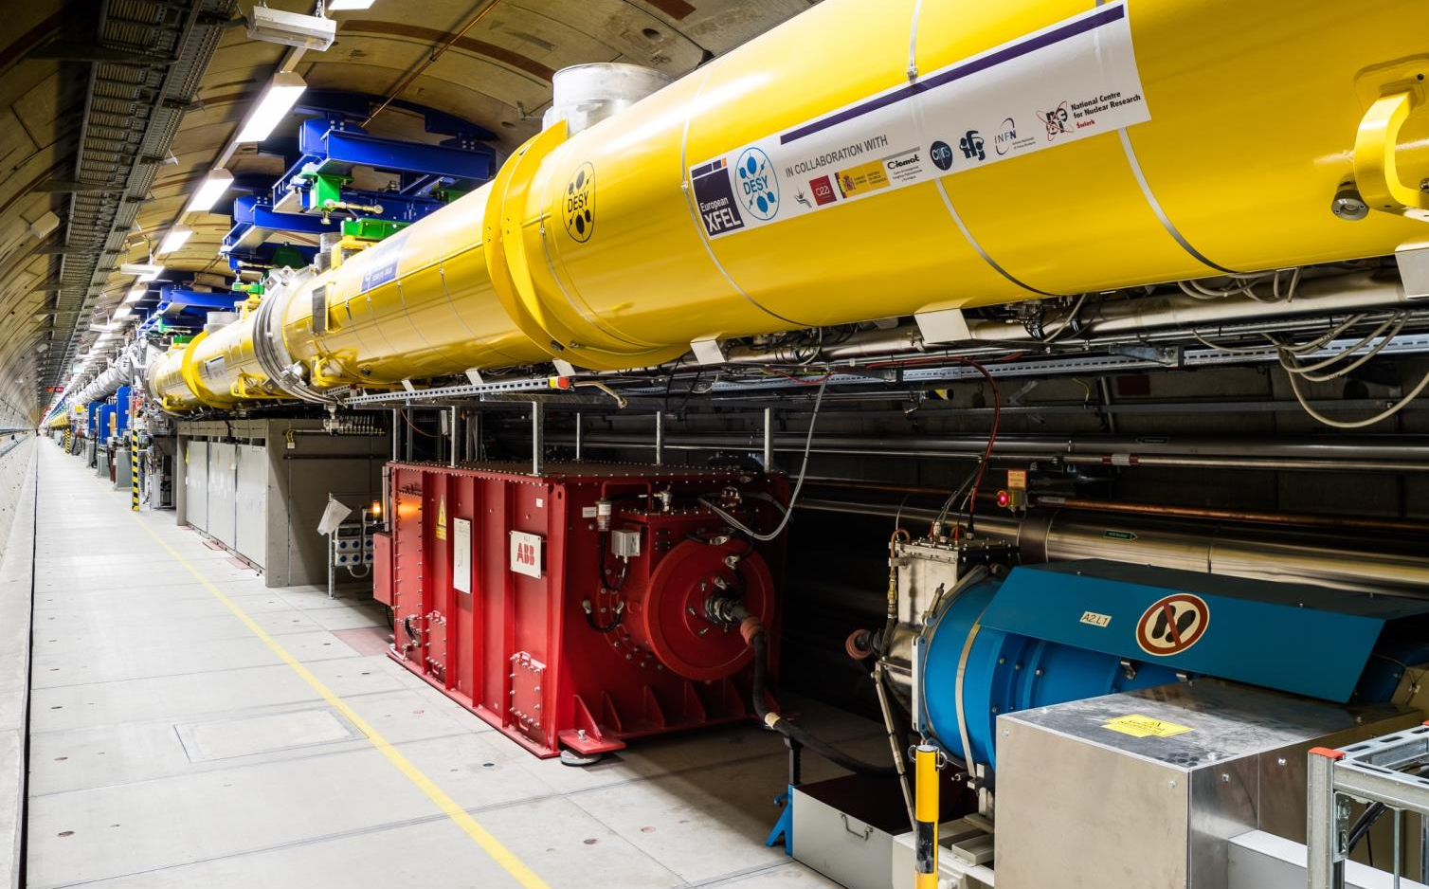
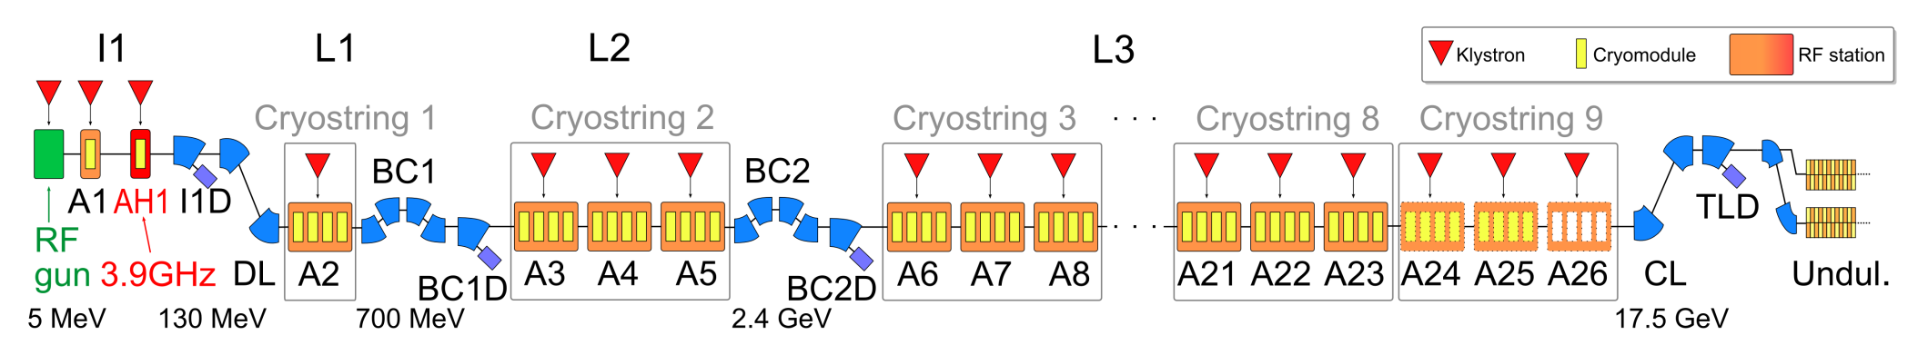
The European X-ray Free Electron Laser (XFEL)
Soft and hard X-ray light experiments
~800 TESLA-type cavities
Resonance frequency 1.3 GHz
32 cavities per XTL RF station
Design energy 17.5 GeV
Pulsed operation 10 Hz
First users September 2017
Commissioning up to cryostring (CS) 8 → 25 RF stations

Slide 4
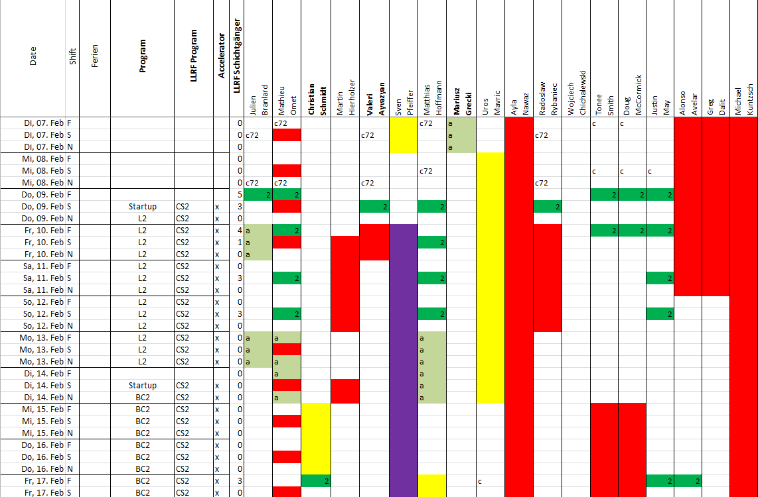
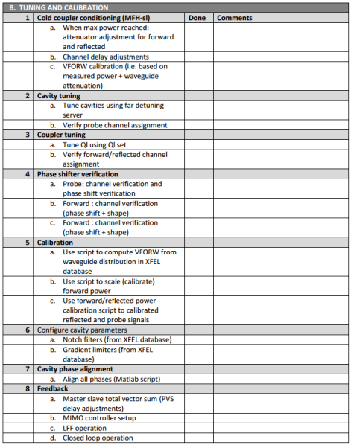
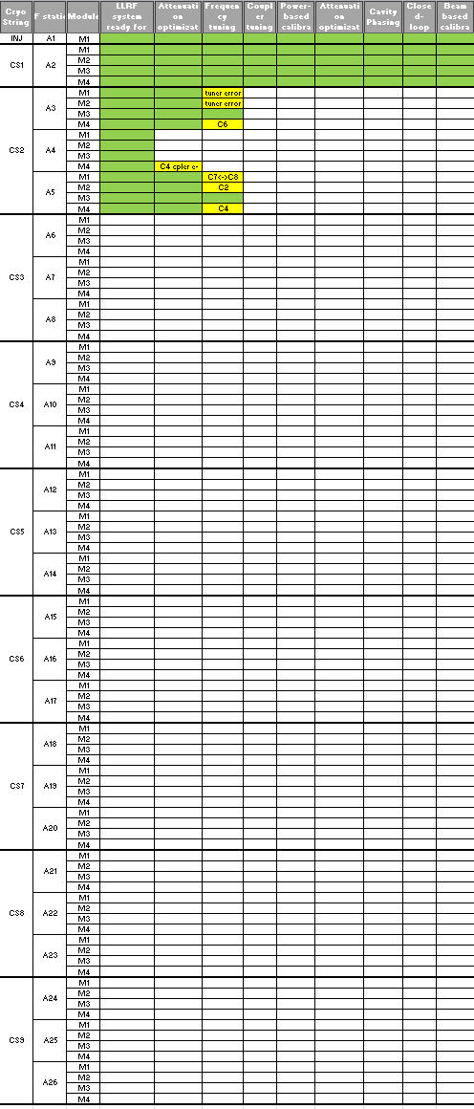
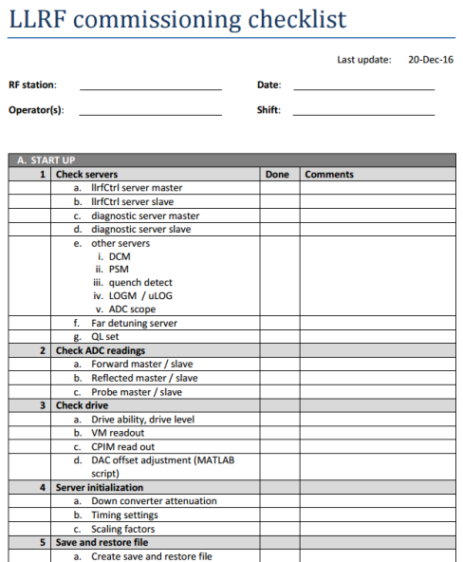
Commissioning Planning
Commissioning team of 20 people
  8 LLRF experts
  6 from DESY SRF and RF gruops
  Visitors from SLAC (5) and HZDR (1)
Commissioning shifts
  Two 8-hours shifts / day
Procedure
  Commission 1 cryo string at a time
  (3 RF stations)
  Parallel work
  Detailed check list to cover all
  commissioning tasks
  Gather issues and investigate on
  maintenance day (once a week)

Slide 5
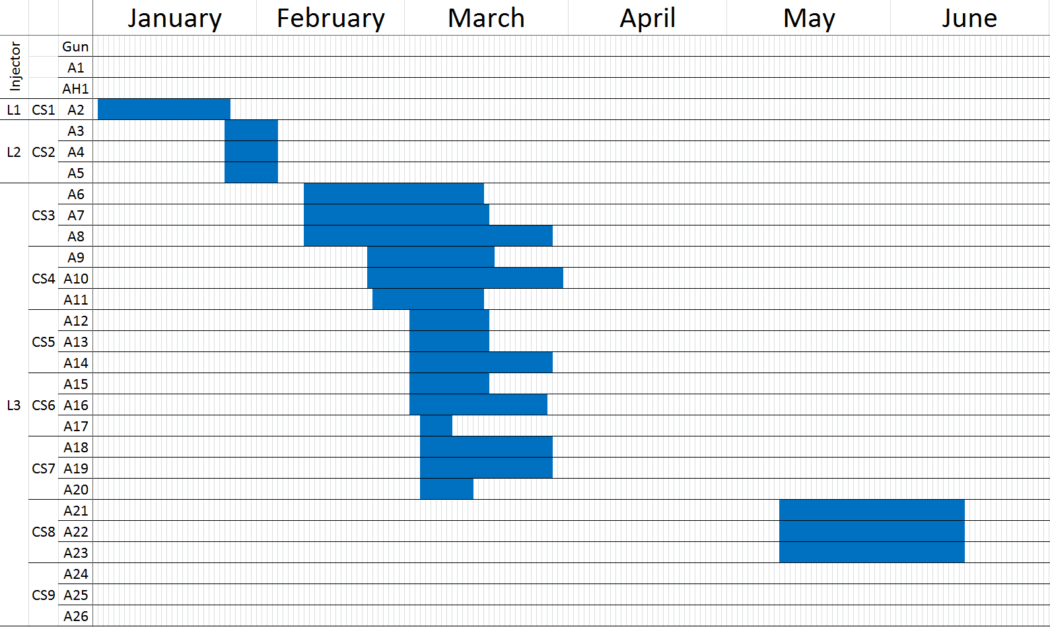
Commissioning Timeline (LLRF & General)
Estimated schedule
  Injector (gun, A1, AH1) 2 weeks
  L1 (1 RF station) 2 weeks
  L2 (3 RF stations) 2 weeks
  L3 (15 RF stations) 2 months
Actual XTL Schedule
  02.01.2017 Commissioning start
  26.01.2017 Finished basic LLRF
  commissioning of
  L1 / CS1
  15.01.2017 First beam to B1D
  04.02.2017 Finished basic LLRF
  commissioning of
  L2 / CS2
  02.02.2017 First beam to B2D
  25.05.2017 First beam to XTD
  30.03.2017 Finished basic LLRF
  commissioning of
  L3 / CS3-CS7
  02.05.2017 First SASE
  14.06.2017 Finished basic LLRF
  commissioning
  of L3 / CS8
  23.06.2017 First beam to
  experimental hutch,
  first experiment
3.4 weeks
1.4 weeks
1.6 months
1.1 months

Slide 6
Commissioning Statistics
Cabling issues (~5000 cables checked)
  15 cabling issues (outer rack) identified before cool down
  17 cabling issues (outer rack) identified after cool down
  0 cabling issues (inner rack) identified so far
Multipacting
  Observed on nearly all stations
  Start appearing around 550-600 MV (i.e. ~17-18 MV/m)
  Up to 50% of cavities / cryomodule required conditioning (worse case)
  Conditionable on all stations
  Required couple of hours per station (@10 Hz)
Further information
  SRF’17 Poster by D. Kostin: “European XFEL LINAC RF System Conditioning and Operating Test” (MOPB111)
  IPAC’17 talks by W. Decking (MOXAA1) and J. Branlard (THOAA3)

Slide 7
RF Performance as of 23.6.2017

Slide 8
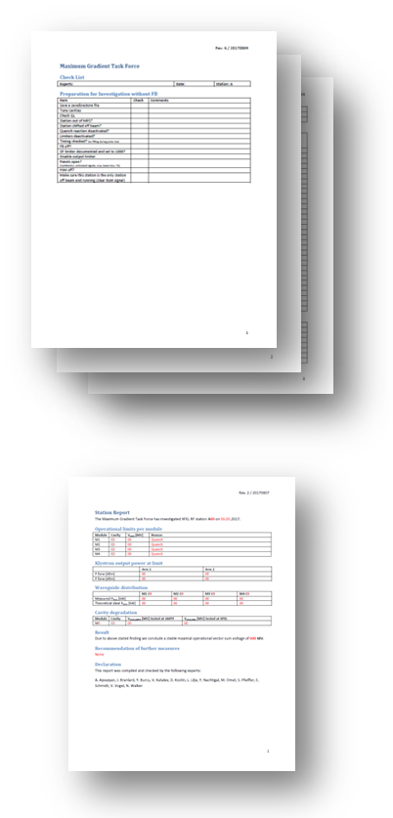
Maximum Gradient Task Force
Team of experts (12 members with a core team of 6)
Investigation of single stations in parallel to regular beam operation
Investigation on single cavity granularity
Checklist for unified testing procedure
Work out solutions for maximal possible gradient
(discussions, calculations, simulations, tests, etc.)
Retest if neccessary
Document findings in station reports

Slide 9

RF Performance as of 28.9.2017
RF station | AMTF theoretical energy gain [MeV] | XFEL max energy gain [MeV] (closed loop operation) | Performance regarding AMTF | Limitation
A10 | 860 | 770 | 89.5% | M3.C8 quenches at 19.8 MV
A11 | 939 | 800* | 85.2%* | Coupler heating*
A13 | 843 | 500* | 59.3%* | Waveguide sparking*
A14 | 748 | 620* | 82.9%* | Soft quenching and probably field emission at M3.C5 and M3.C7*
A15 | 770 | 710 | 92.2% | M4.C2 quenches at 19.4 MV
A18 | 911 | 750* | 82.3%* | Klystron interlock*
A19 | 858 | 703 | 81.9% | M3.C8 quenches at 18 MV
A20 | 920 | 620* | 67.4%* | Waveguide sparking*
A21 | 893 | 870*^{,ƚ} | 97.4%*^{,ƚ} | Missing piezo operation, otherwise M1.C5 quenching at 30.3 MV
A22 | 870 | 845 | 97.1% | M3.C5 quenches at 19.9 MV
Waveguide system not optimal
*Still under investigation, thus not final result
^{ƚ} A21: First case cavity degradation (M4.C2: > 31 MV → 22.3 MV), which would limit maximal VS voltage, thus cavity was detuned and excluded from VS
Note: The voltage calibrations at AMTF and XFEL are different
(power-based vs beam-based)
Test status:

Slide 10
RF Performance as of 28.9.2017

Slide 11
RF Performance as of 28.9.2017
Two examples of finished stations

Slide 12
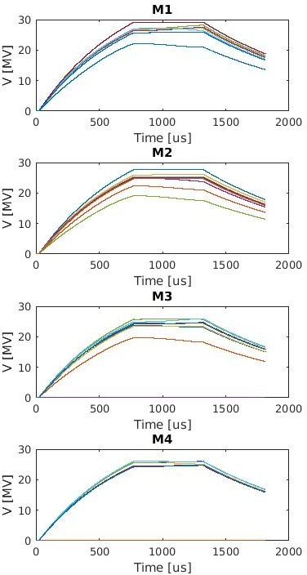
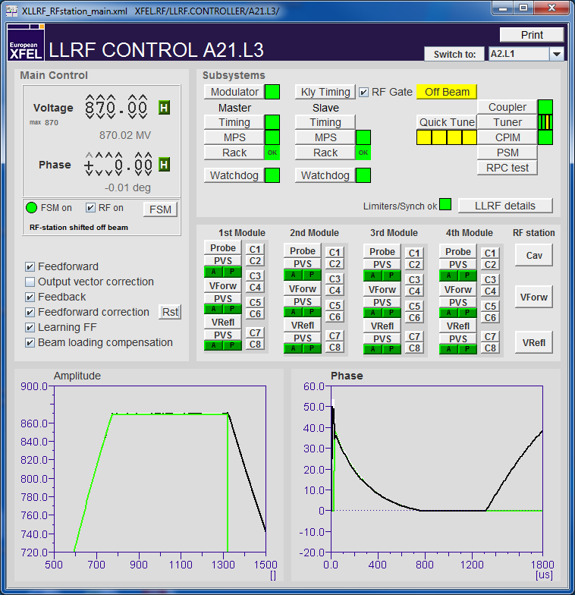
RF Performance as of 28.9.2017
A21 at 870 MV stable closed loop operation
Average voltage: 29.0 MV

Slide 13
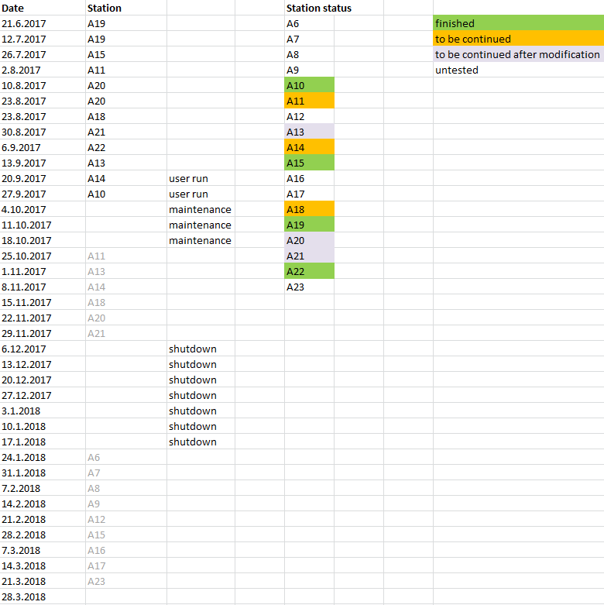
Time Schedule and Status as of 21.9.2017
10 of 18 stations in L3 investigated
4 of 18 reached final limit
  Investigations on L3
  stations will most likely
  finish in the second
  quarter of 2018

Slide 14
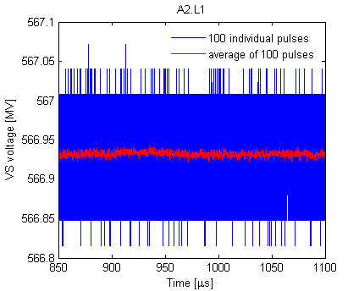
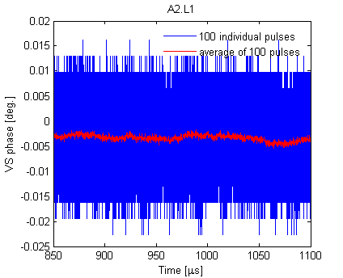
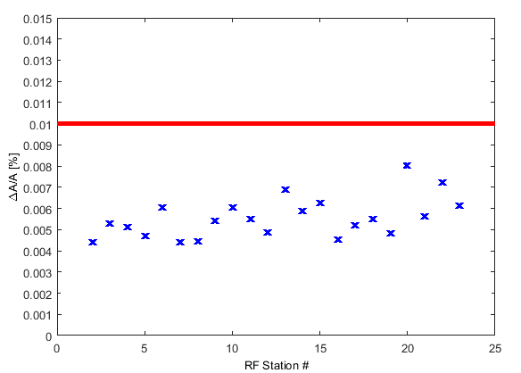
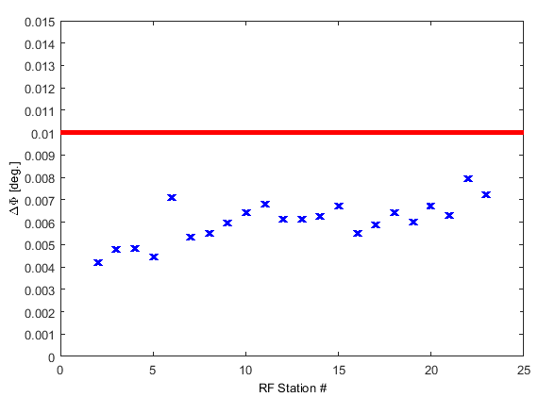
XTL Station Performance
Flattop amplitude and phase stability (RMS)
A2 as an example
All XTL Stations XFEL specifications: ΔA ≤ 0.01%, ΔΦ ≤ 0.01 deg.

Slide 15
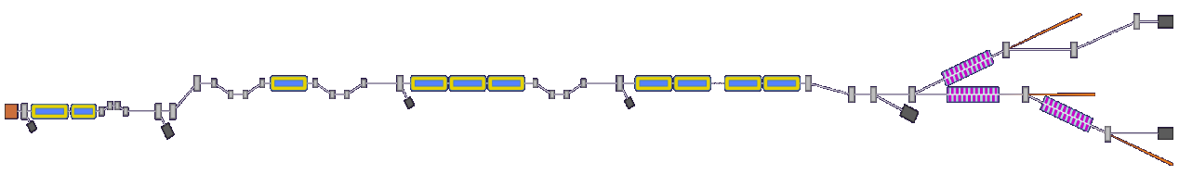
Energy Stability Measured with Energy Server
Evaluation of 1000 pulses on 22.06.2017
L1 L2 L3
Injector
Injector Laser Heater BC1 BC2 Collimation Section
 | Collimation Section
E [MeV] | 13489
σE [MeV] | 0.3104
σE/E | (0.0023 ± 0.0023)%
Requirement: 0.01%

Slide 16
Further Operation Experience
Advanced commissioning of LLRF system on-going
  E.g. drift compensation modules and optical RF resynchronization improve stability
Issues due to missing piezo drivers
  Will be installed and commissioned by the end of 2017 and the beginning of 2018
Phase jumps after reference interruption
  Solution is being developed
Few algorithms (e.g. output vector correction) had to be reworked
  Expected to be finished with the end of October maintenance
Timing issues leading to missing RF pulses
  Expected to be solved with the end of October maintenance
Calibration issues
  Under investigation
One SSD of LLRF system failed so far
Automation (FSM, etc.) and scripts (cavity tuning, etc.) key to smooth operation

Slide 17
Summary / Outlook
Basic LLRF commissioning up to CS8 done
Commissioning of CS9, when preparation work (cabling) finished
Advanced LLRF commissioning on-going (DCM, Piezo driver, REFM-OPT,
etc.)
Key to smooth commissioning and operation
  Testing all to be installed components on several levels (board level, crate level, rack level)
  Automation and scripts (cabling checking, frequency tuning, Q_{L} tuning, etc.)
  Flexible timing system allowing to shift individual RF stations on and off beam
So far maximal beam energy operated at: 15.2 GeV (goal 17.5 GeV)
Maximum Gradient Task Force
  10 of 18 stations in L3 investigated. 4 of 18 reached final limit
  Increase of maximal possible beam energy from 15.2 GeV to 16.2 GeV (to be operated at)
  Investigations on L3 stations will most likely finish in the second quarter of 2018
Intra-pulse amplitude and phase stability about factor two better than specifications
Energy stability about a factor of four below requirement

Slide 18
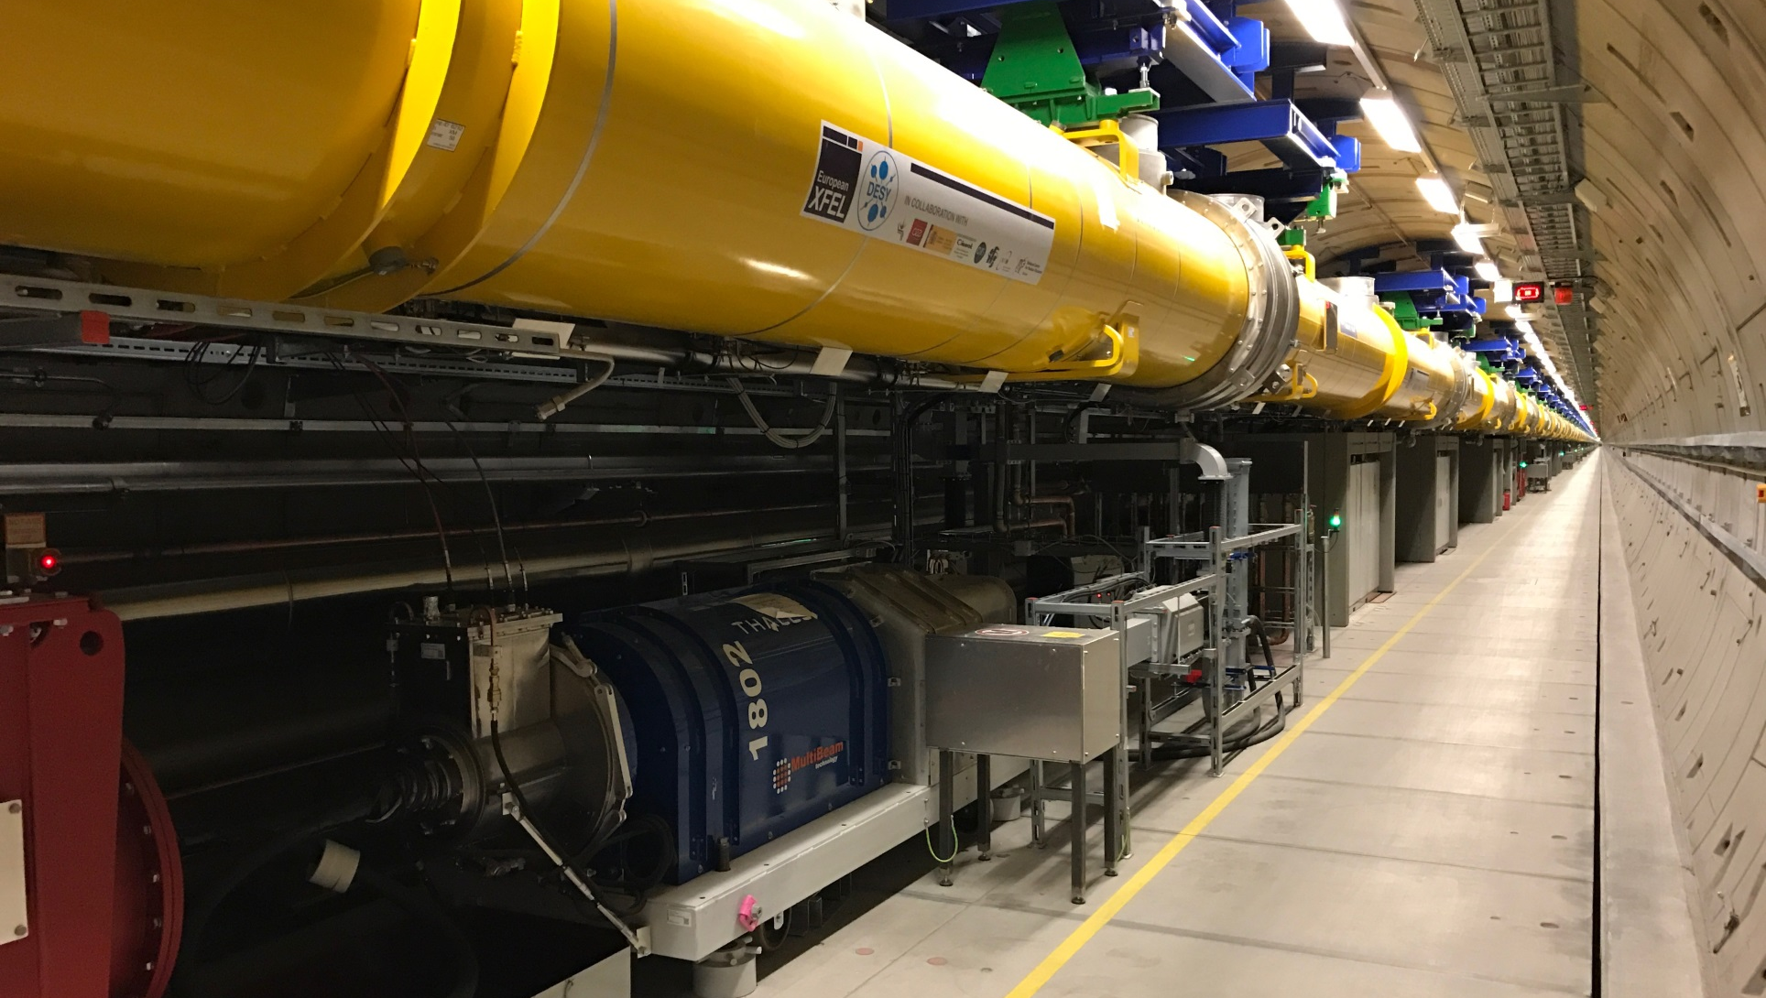
Questions?
Thank you very much for your attention!

