Slide 1
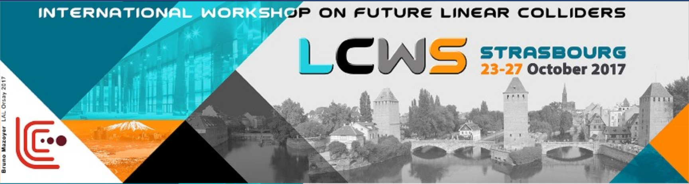

Infrastructure challenges for the CLIC Main Linac tunnel and impact on costing
Matthew Stuart – John Osborne SMB-SE-FAS

Slide 2
Introduction - Content
Who is involved and what are the objectives of the Civil Engineering, Infrastructure and Siting CEIS Working Group?
Recap the baseline design produced in the CDR.
Updates since the CDR?
  Civil Engineering – New layouts and Tunnel Optimisation Tool
  Cooling and Ventilation
  Electrical (CLIC Power Supply).
  Transport
  Survey
  Cost
Further Study – A summary of requirements for the different disciplines.

Slide 3
Representatives of the Civil Engineering, Infrastructure & Siting (CEIS) Working Group Disciplines:
Discipline | Representative
Civil Engineering & Chair | J.Osborne & M.Stuart
CLIC Link Persons | S.Stapnes/D.Schulte/C.Rossi/R.Corsini/W.Wuensch/A.Latina
Cooling and Ventilation (CV) | M.Nonis
Electricity (EL) | D.Aguglia/D.Bozini
Survey (SU) | H.Mainaud Durand
Transport & Handling (HE) | I.Ruehl/M.Czech
Interaction Region | K.Elsener
Logistics/Lab readiness | M.Tiirakari
CE Layouts & Cross-sections | SMB/CE Design Office
Health Safety & Environment (HSE) | S.Baird/S.Marsh
Schedule | K.Foraz/M.Bernardini
ILC Link Persons | J.Osborne/A.Yamamoto
Civil Engineering
Survey and Alignment
General Objective: Develop the existing layouts for the project from a civil engineering and technical infrastructure point of view, and work with the various actors towards a realistic design and project planning as needed for the ‘CLIC Implementation Plan’, due late 2018.
Transport Installation
Safety Systems
Cooling and Ventilation
Electrical

Slide 4
What are the Objectives?
Specific responsibilities:
Develop new and/or update civil engineering layouts for 380 GeV, 1.5 TeV and 3 TeV machine.
Develop new civil engineering layout for 380 GeV machine using Klystron technology.
Update the tunnel design and layout to accommodate the machine (e.g. ventilation, electrical equipment, survey, controls, safety and handling equipment).
Develop a layout for the interaction region.
Study environmental aspects of the project and siting preparation. Work together with ILC on areas of synergy.
Produce schedule and cost estimates.
Consider and update transport, installation and CERN logistics issues for the project.
Technical infrastructure and installation scheduling.

Slide 5
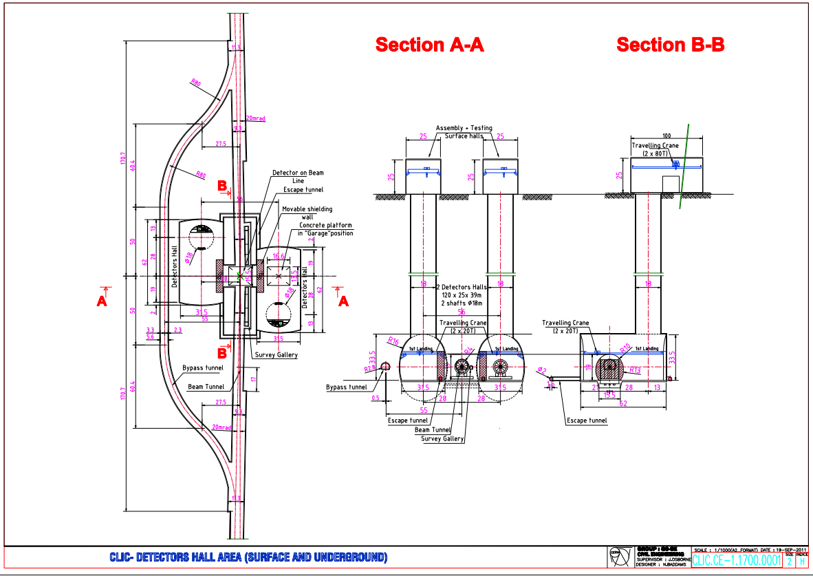
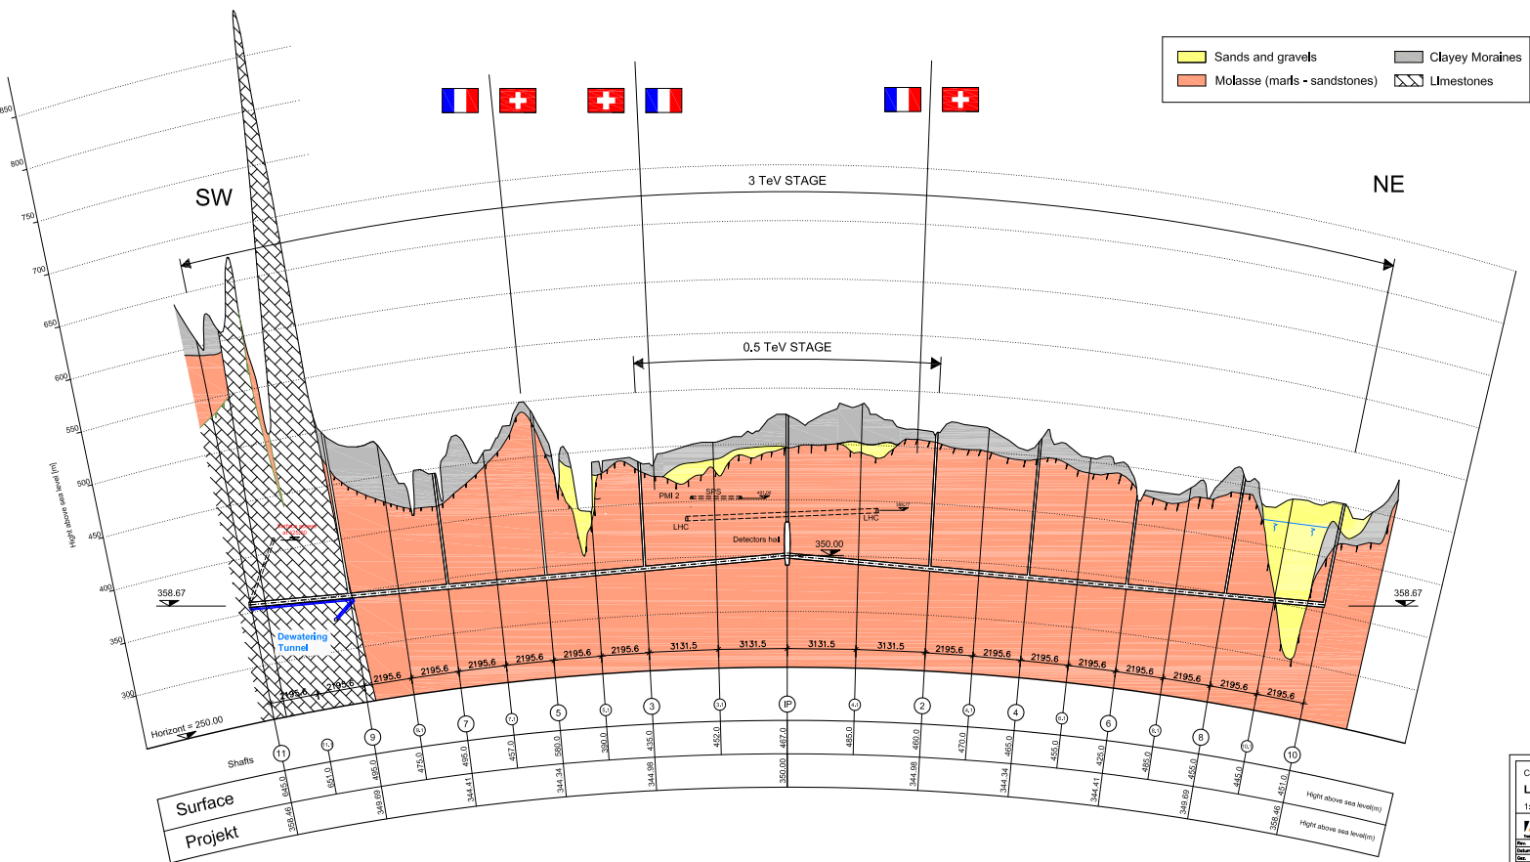
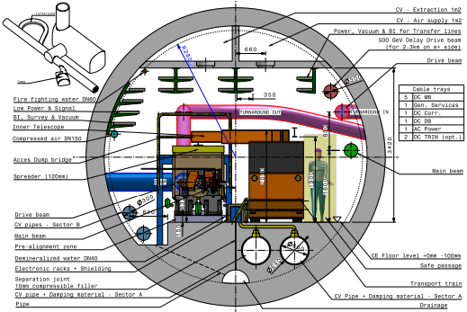
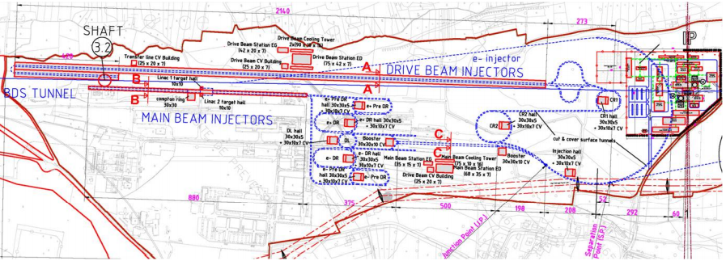
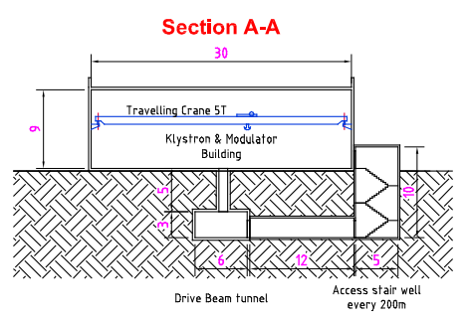
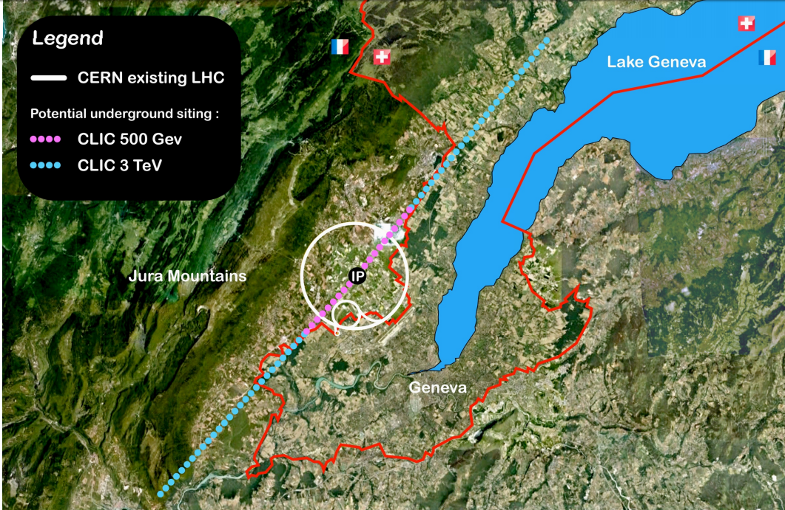
Brief History – CDR Design
Conceptual Design Report: Published in 2012.
  5.6m diameter 2 stage linear collider, an initial 500 GeV with the possibility to upgrade to 3 TeV.
  500 GeV energy stage consisted of a site length of 14km
  3 TeV energy stage consisted of a site length of 49km
  2 Independent Detector Caverns.
  Central injection complex located on CERN land.
  30m wide and 2.5km Long drive beam building.
  Depth ranging from approximately 100 – 150m below the surface along the majority of the tunnel length.
14km
49km

Slide 6
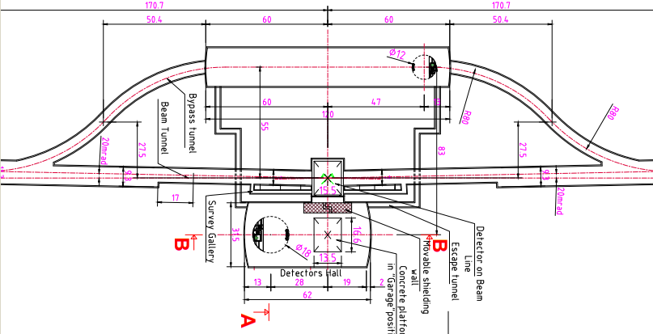
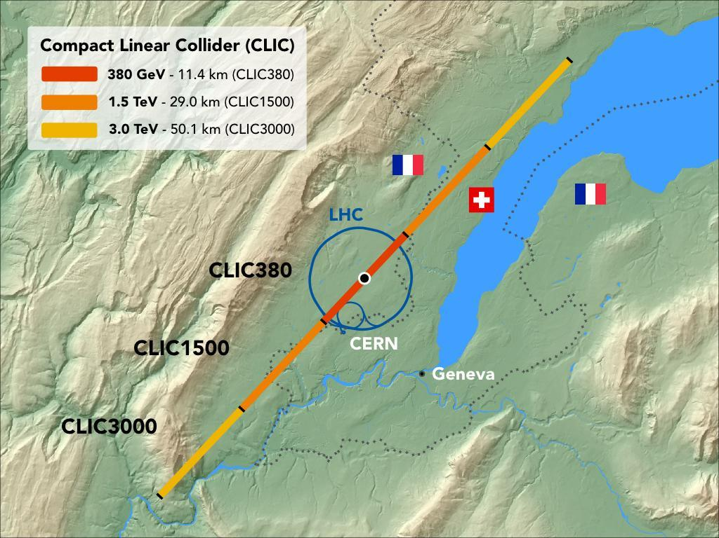
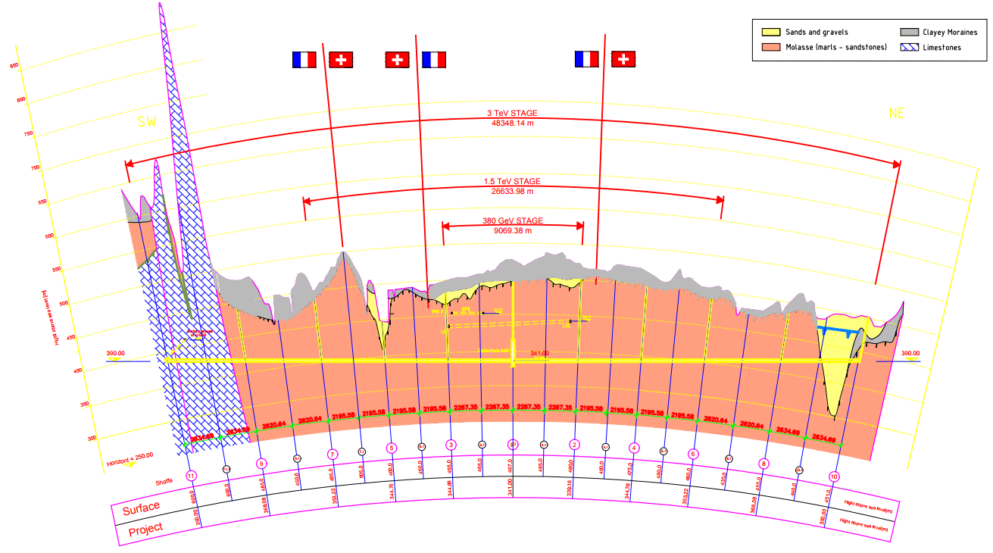
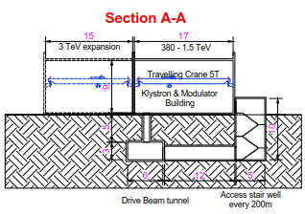
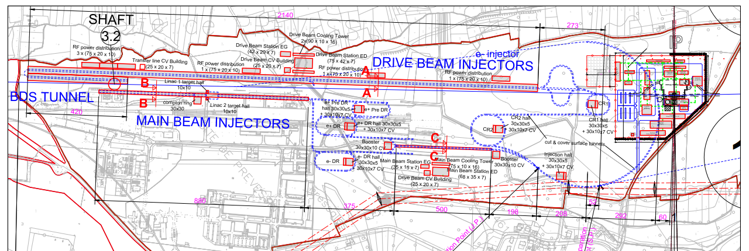
Changes Since the CDR
Civil Engineering, Infrastructure and Siting Working Group (CEIS): Kick off meeting March 2017
  3 stage linear collider, an initial 380 GeV with the possibility to upgrade to 1.5 TeV and 3 TeV.
  380 GeV energy stage consists of a site length of 11km
  1.5 TeV energy stage consists of a site length of 29km
  3 TeV energy stage consisted of a site length of 49km
  Only one detector cavern and a service cavern introduced.
  30m wide and 2.5km Long drive beam building with the possibility to reduce the size for lower energy stages.
  Depth and position of the machine to be optimised using CLIC Tunnel Optimisation Tool.
49km
29km
11km

Slide 7
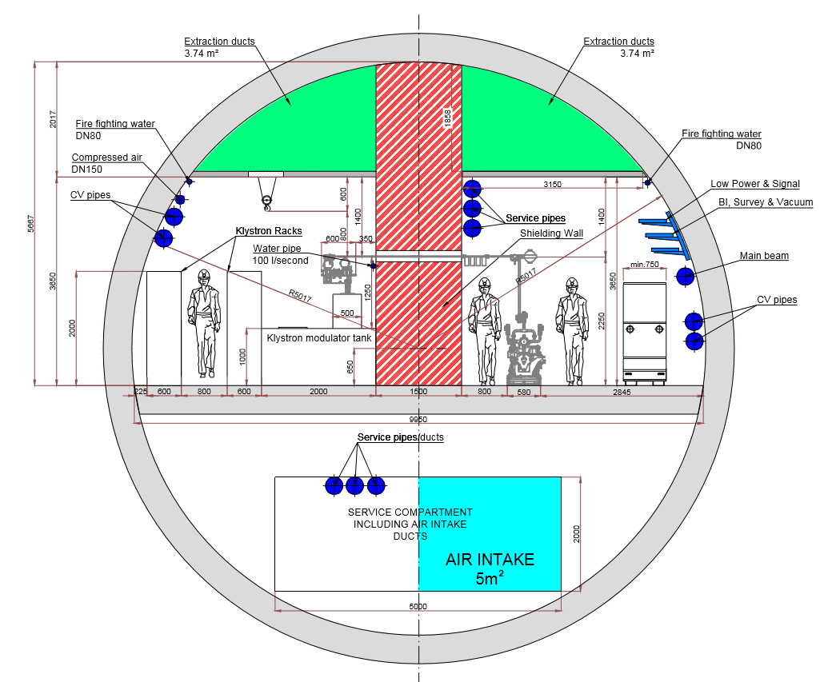
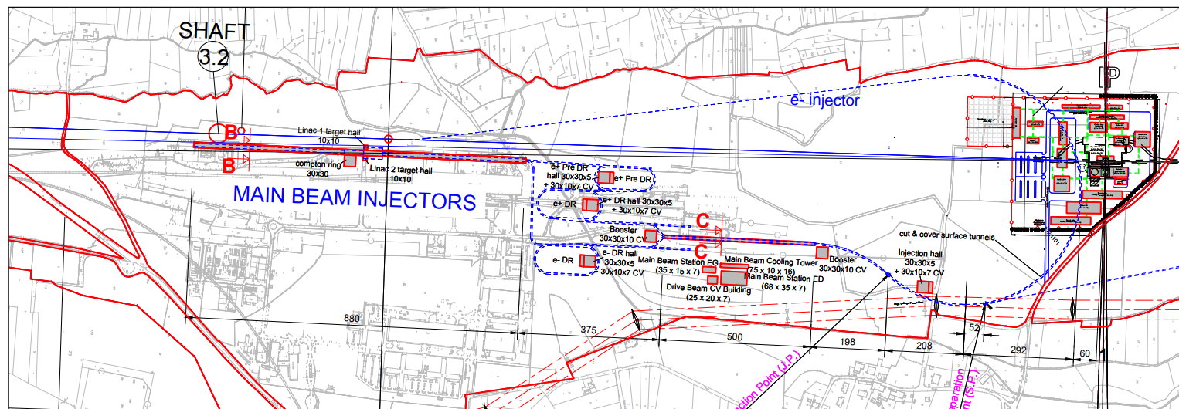
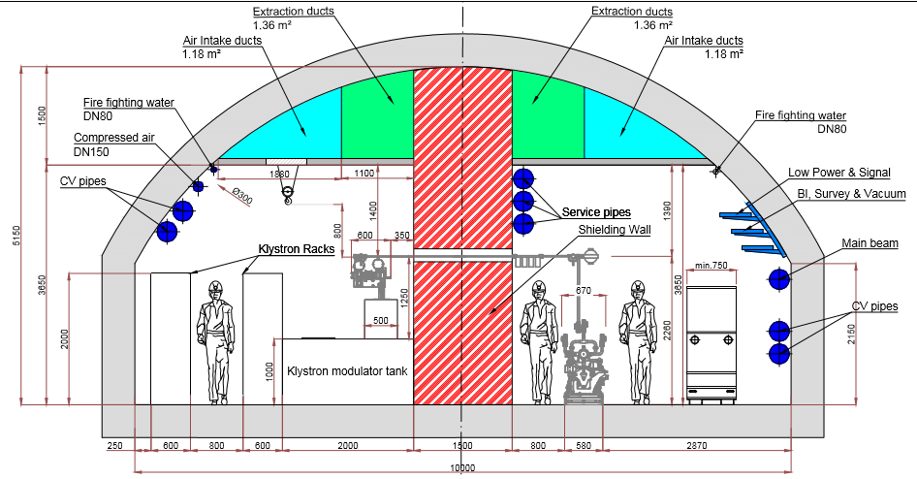
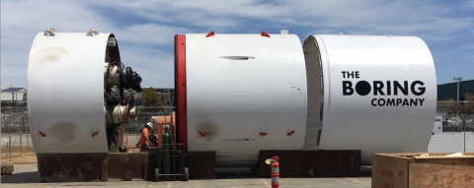
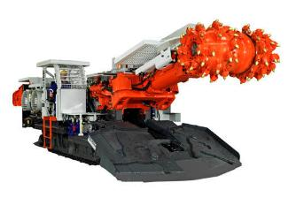
Changes Since the CDR – NEW Design
Civil Engineering, Infrastructure and Siting Working Group (CEIS): Kick off meeting March 2017
  New Klystron Design introduced for the 380 GeV energy stage
  No longer requires the Drive Beam complex.
  Larger tunnel to house the Klystron modules and the beam modules – shielding wall required. Roadheader and TBM tunnelling method considered.
Drive beam Complex Removed
TBM
Roadheader- Like ILC

Slide 8
Civil Engineering – Tunnel Optimisation Tool
1. Geology along alignment:
  Maximum proportion of tunnel in molasse.
  Avoid limestone formations wherever possible due to associate risk of water ingress and karsts.
  Avoid water bearing moraines wherever possible due to risk of water ingress and potential contamination of water sources.
  Minimise overburden.
2. Shaft length:
  Minimise total shaft length.
  Avoid very deep individual shafts – utilise inclined access tunnels where required.
3. Geology of shafts and caverns
  The greater the depth of the moraine before reaching the molasse layer, the more costly/ time consuming the construction.
  Cavern construction requires good ground conditions.
4. Environmental Constraints
  Avoid protected water sources and protected habitats.
5. Shaft Surface Locations
  Initial assessment to avoid clashes with buildings, natural features or protected zones.
  Followed by a more refined assessment of feasibility including potential access to the site.

Slide 9
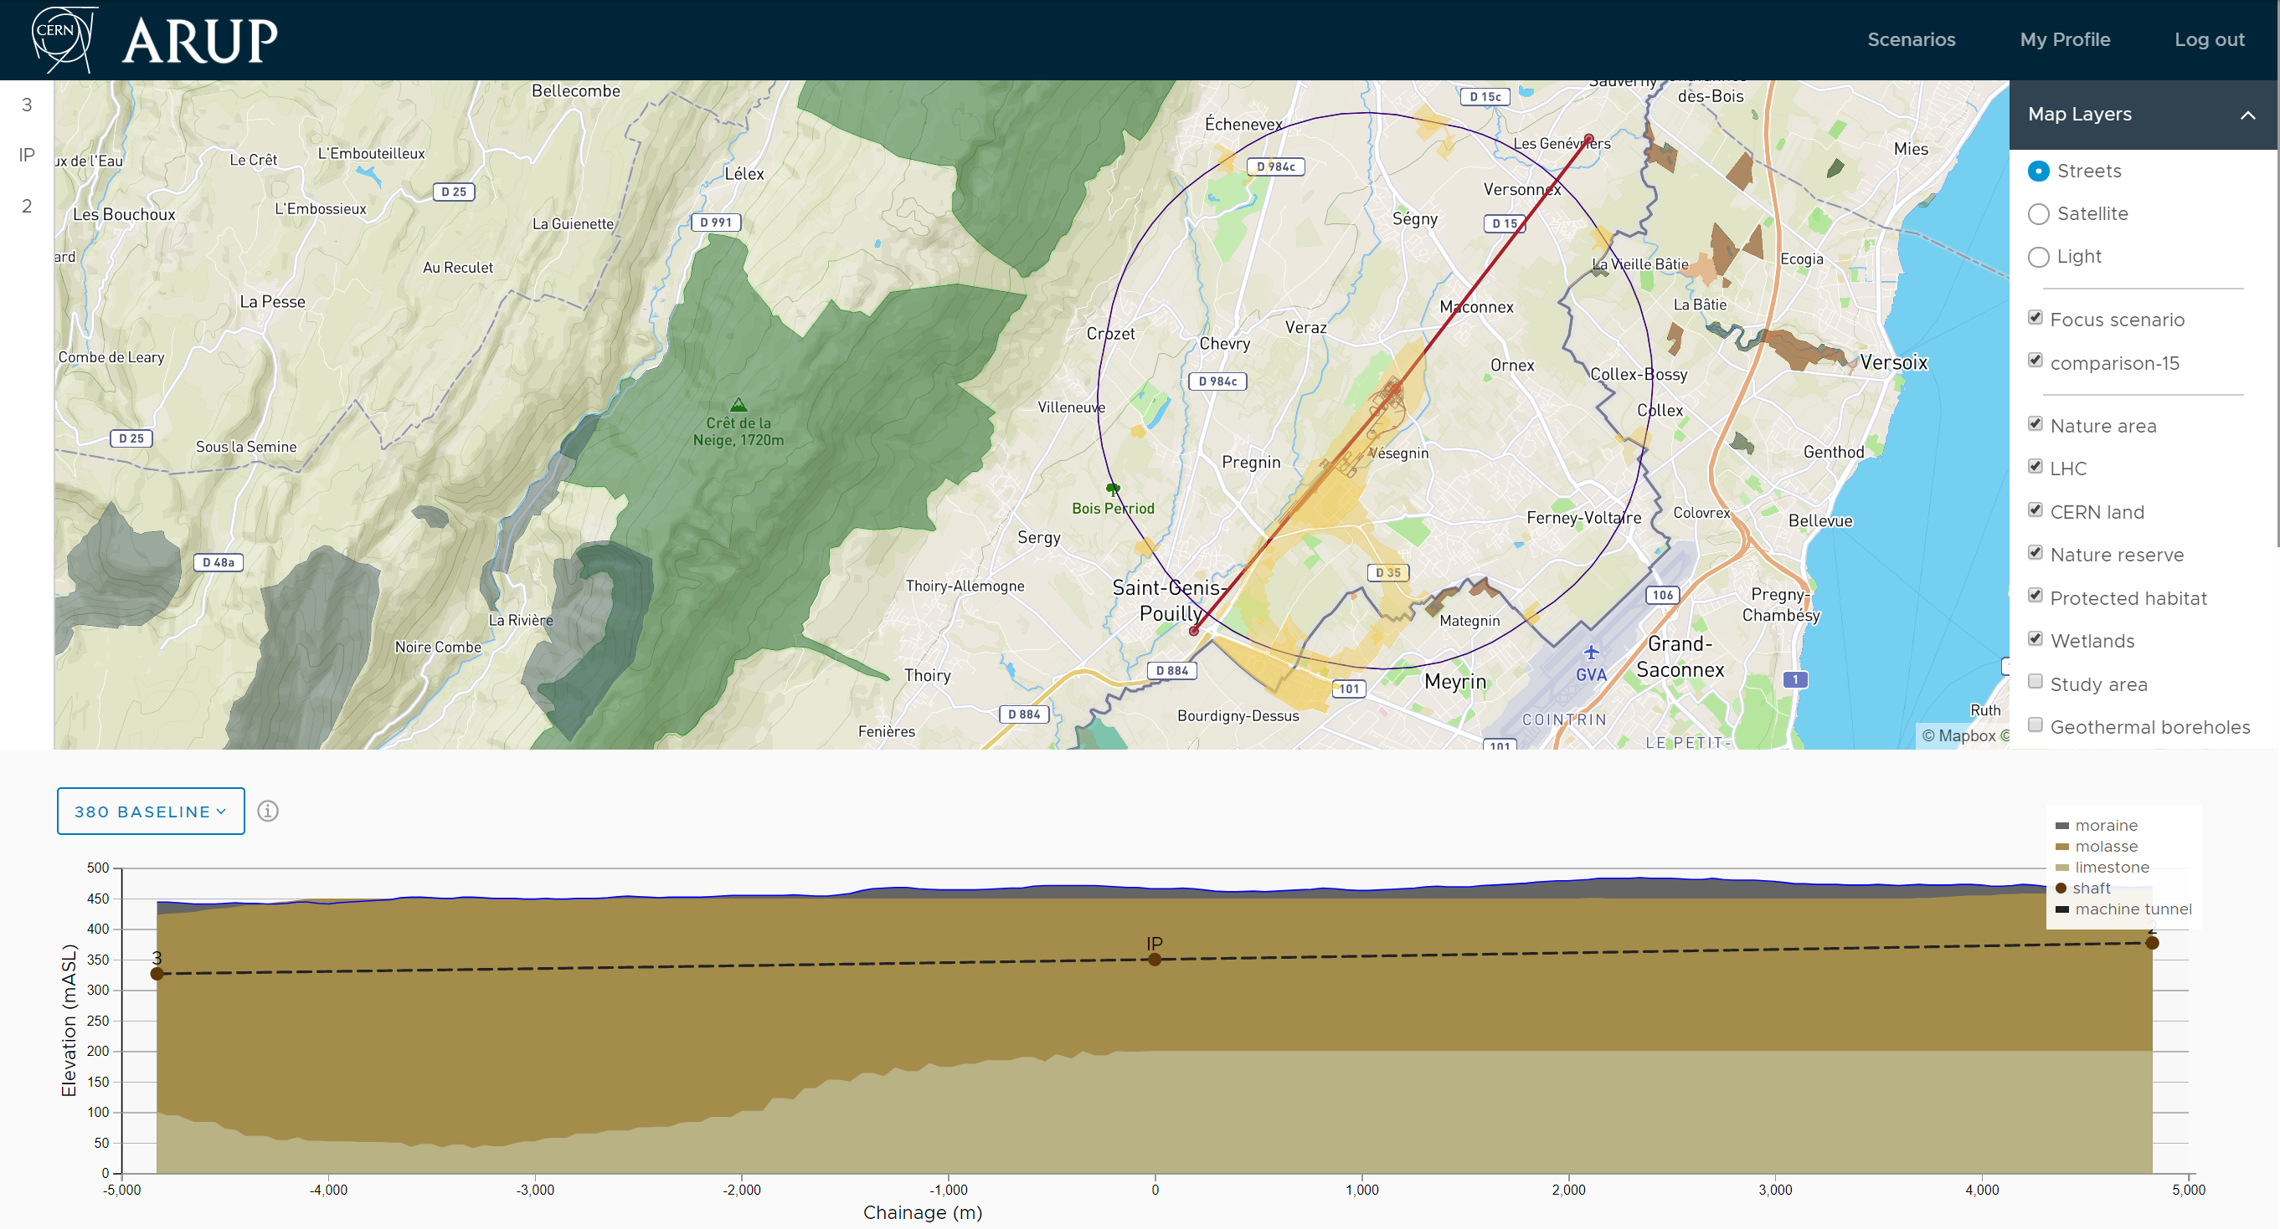
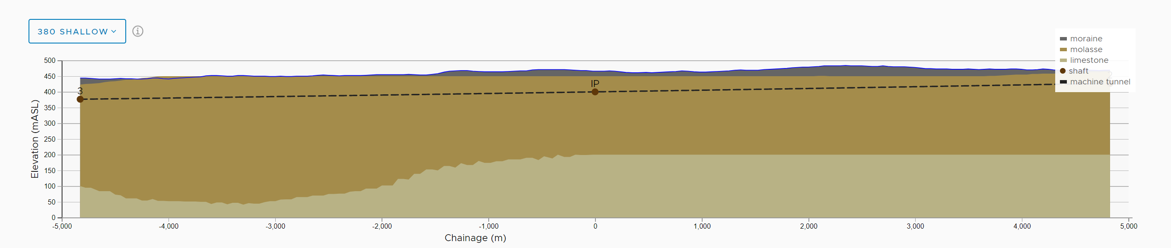
Civil Engineering – Tunnel Optimisation Tool
CLIC Advantages
Allows quick movement of the entire machine.
Easier to find optimised locations.
User can run through many positions quickly and efficiently.
Simpler to find and compare new positions.
Shallow Option
Baseline Design

Slide 10
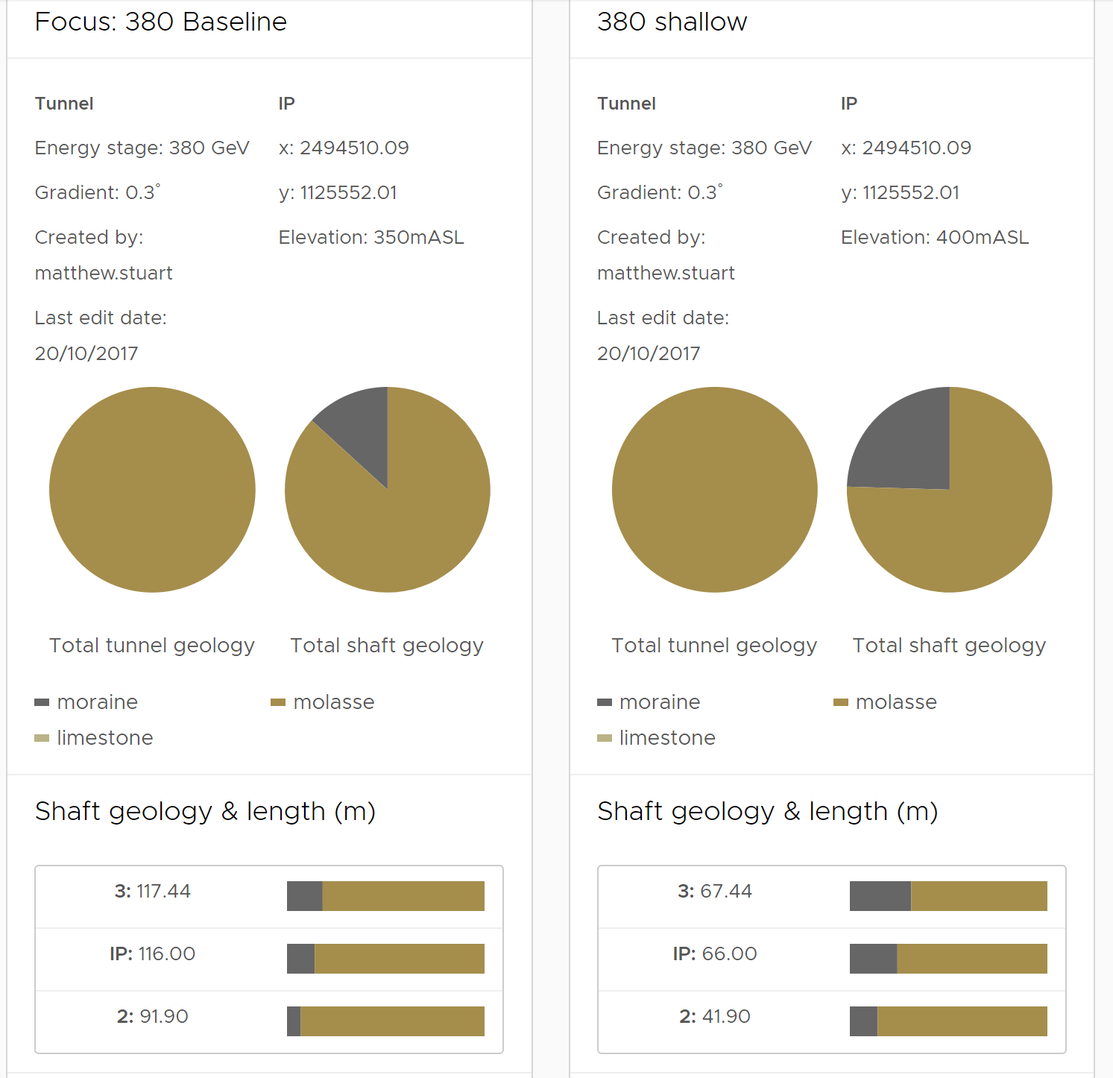
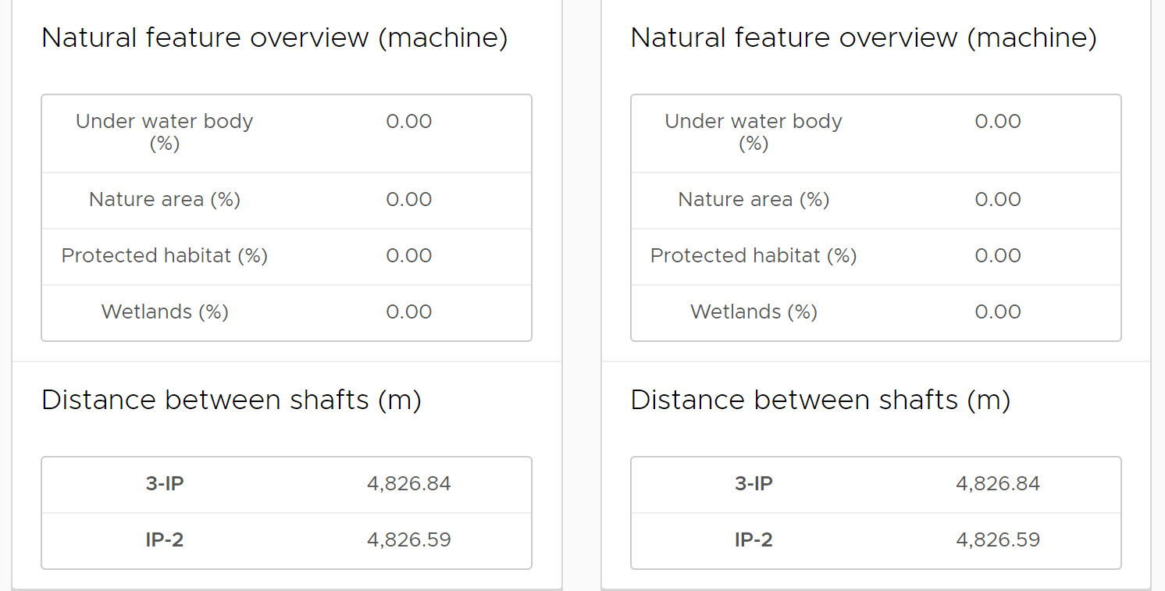
Civil Engineering – Tunnel Optimisation Tool
380 GeV “CDR” Design
Total Shaft Length: 325m
Main Tunnel entirely in Molasse
380 GeV Shallow Option
Total Shaft Length: 175m
Main Tunnel still remains in the molasse

Slide 11
What has been done – Civil Engineering
Two options for the Klystron Tunnel have been looked at:
10m wide Roadheader mined tunnel – Like ILC.
  Shape can be determined by tunnel requirements.
  No wasted space below the tunnel floor.
  Can mine through varying rock types using one machine.
10m internal Diameter TBM Bored tunnel.
  Considerably quicker rate of excavation through “good rock”.
  Cheaper per m of tunnel construction for this length of tunnel.
  Under floor space can be utilised for services to avoid wasted space.

Slide 12
What has been done – Civil Engineering
10m Internal Diameter TBM tunnelling method is proposed for the Klystron 380 GeV design:
The cost for an 11km tunnel for the TBM is an estimated 10% cheaper than a mined tunnel.
The underfloor space can be utilised and therefore reduce the amount of wasted space.
The excavation rate per m of tunnel is considerably quicker for a TBM and therefore construction time is reduced.
The geology for the 380 GeV is expected to be majority molasse and suited for a TBM.

Slide 13
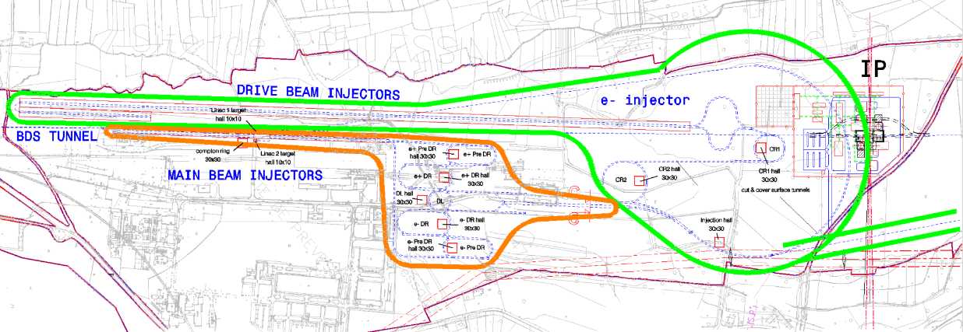
Cooling - CDR
The cooling and ventilation is a critical aspect of the tunnel integration design as it has a large effect on the required dimensions of the tunnel cross-section.
Facilities divided into 5 cooling sectors:
Drive beam and transfer lines
Main beam Injection Complex
Main Tunnel A
Main Tunnel B
IR and BDS
Sector 3
Accelerating structure
Sector 2 MB Injection Complex
Sector 5
Detector Region
Sector 1 DB + Transfer lines
Sector 4
UTR’s, dumps, loops
Notes:
Sectors:
1. Drive beam and Transfer lines
2. Main beam injection complex
3. Main Tunnel A
4. Main Tunnel B
5. IR and BDS.

Slide 14
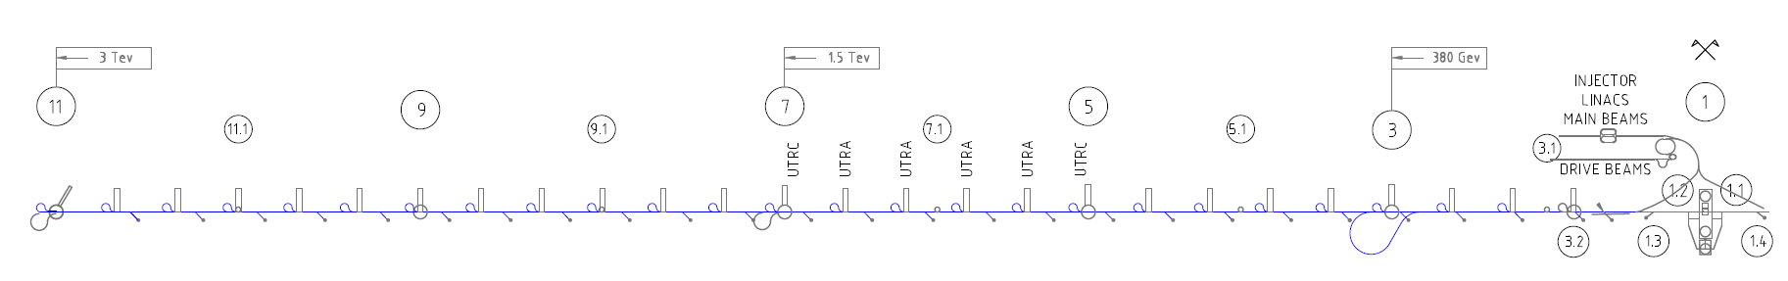
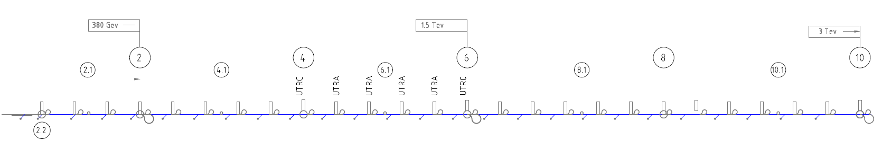
Cooling and Ventilation - CDR
The cooling and ventilation is a critical aspect of the tunnel integration design as it has a large effect on the required dimensions of the tunnel cross-section.
The CDR Design used a central cooling tower however, due to a change in policy this is no longer a requirement for CLIC.
Centralising cooling towers results in larger pipes and booster pump requirements.
Proposed Solution:
New cooling towers located at points 4, 5, 8 and 9.
Advantages:
  Smaller pipe diameters in tunnel
  Lower electrical power requested (25%)
  No need for booster pumps
  Bypass, connection to drain: simpler if still needed
  Easier operation (balancing of circuit, …)

Slide 15
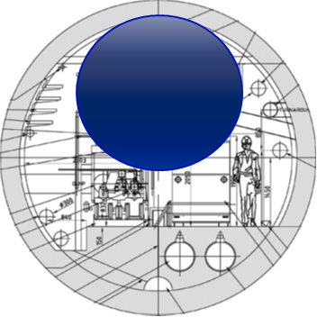
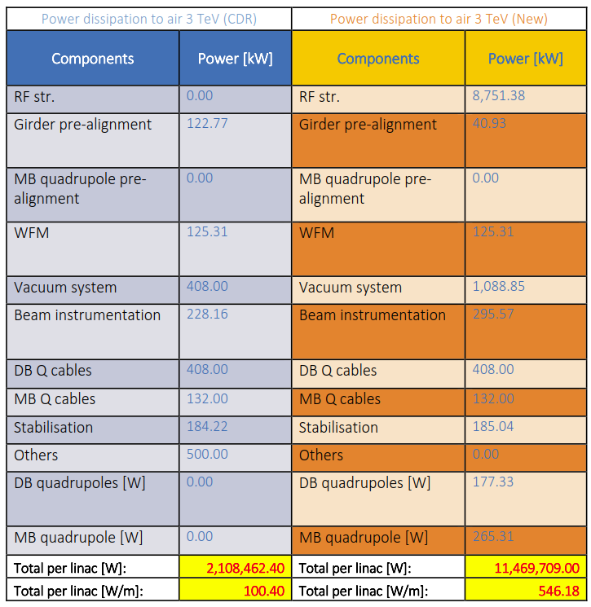
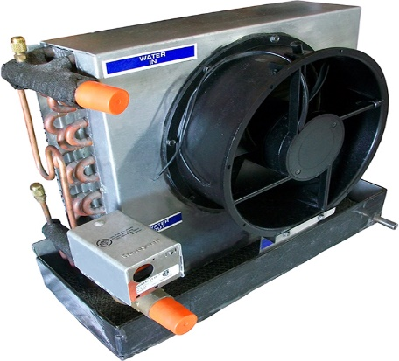
Cooling and Ventilation - CDR
The cooling and ventilation is a critical aspect of the tunnel integration design as it has a large effect on the required dimensions of the tunnel cross-section.
CDR tunnel ventilation not adapted for the increased heat load to air in the main tunnel.
Some possible solutions are shown below:
Ventilation:
Insulate/Encapsulate CLIC Modules – Install heat exchangers or fans inside the “box”.
Increase allowable temperature in the tunnel.
Install AHU machines to tackle heat load locally

Slide 16
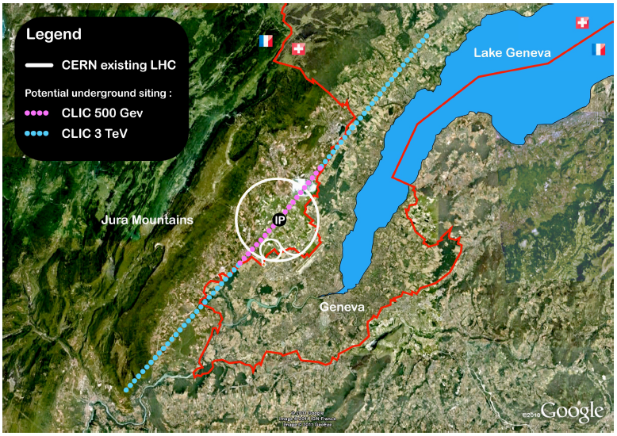
What has been done – Electrical (CLIC Powering)
CLIC Powering
Grid Design Solution: Since 2012 TE/EPC has focussed on RF powering and has made steps toward the powering grid design, this includes the proposed solution as seen here:
6 sectors for RF power distribution (3 TeV)
Each sector needs a substation/location.
One substation needs an indoor space of (very roughly): ~ 1500 m2 x 10m height
EN/EL - Availability of Power:
Power available at European level have been identified at the three locations shown.
2140m
Experimental buildings
Drive beam injector
I

Main beam injector
II

III


Slide 17
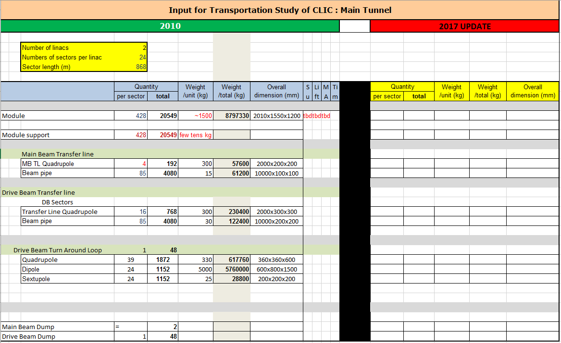
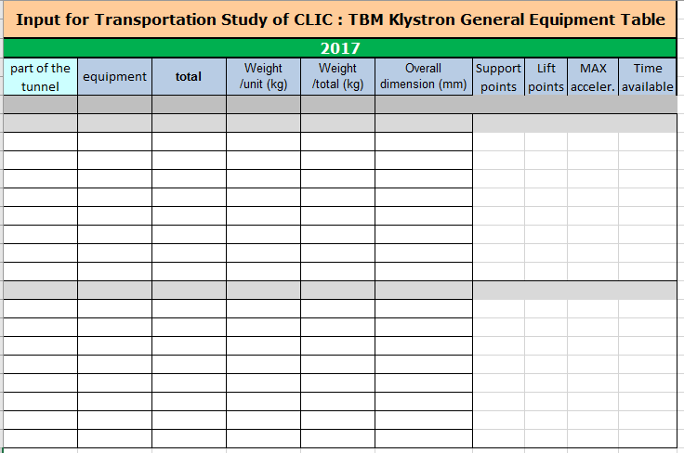
Transport – Inventory Input
List of Equipment for the CDR Design was provided in 2010:
Existing data from 2010 Must be updated and verified
New components to be added where required.
The new klystron design requires similar information to that of the CDR:
New input table created for the Klystron Design.
Will allow a transport design and study to be undertaken for the Klystron design.

Slide 18
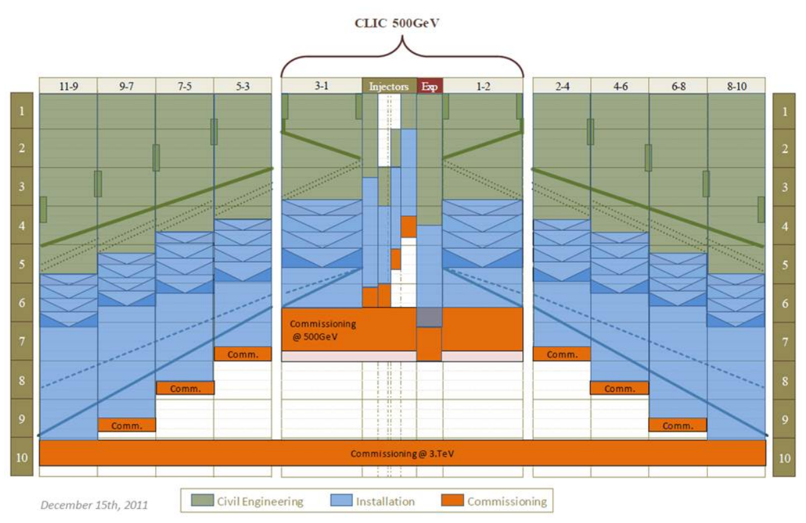
CDR 3 TeV and 500 GeV Schedule
CDR Schedule key points:
Schedule produced for 500 GeV and 3 TeV
Almost 10 years to operation of 3 TeV
7 years from construction to beginning operation for 500 GeV.
Critical path for 500 GeV is the experimental region.

Slide 19
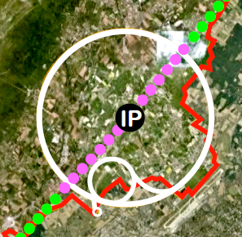
New Schedule Requirements
A new schedule is required for the 380 GeV Klystron Design, key points are:
  Larger diameter tunnel
  Reduced surface buildings
  Large shielding wall installation.
Updates will be required to produce an edited schedule for a 380 GeV CDR design:
  Tunnel lengths reduced.
  Drive Beam Building significantly reduced.
  One Pre-damping ring removed.
  One detector cavern and all associated civil works Removed.
10m Internal Diameter
Reduced drive beam building
11km

Slide 20
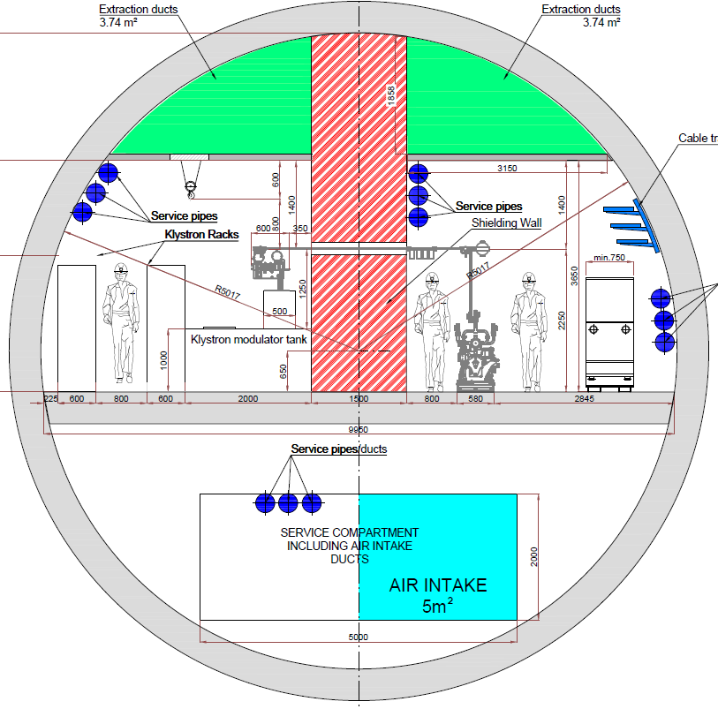
Cost Considerations
A consultant produced costing spreadsheet has been adapted to enable it to be used with CLIC parameters this allows us to:
Compare the cost of multiple scenarios depending on geology.
Analyse the cost of changing structural dimensions like tunnel width shaft depth etc…
Allow us to compare the three tunnel options shown in the table.
 | CDR 500 GeV | New 380 GeV Drive Beam | Klystron 380 GeV 10m TBM
Main Underground Site Length | 13,736 | 10,280 | 10,061
Drive Beam Complex | Full drive beam complex required | Partial drive beam complex required | No drive beam complex required
Underground structures + drive beam cost | All cut and cover tunnels required | All cut and cover tunnels required | Removal of drive beam complex associated cut and cover tunnels

Slide 21
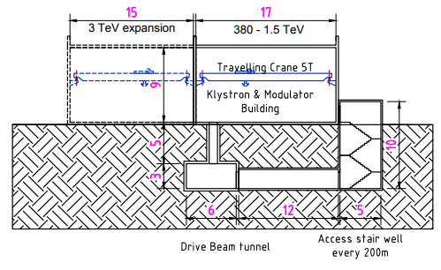
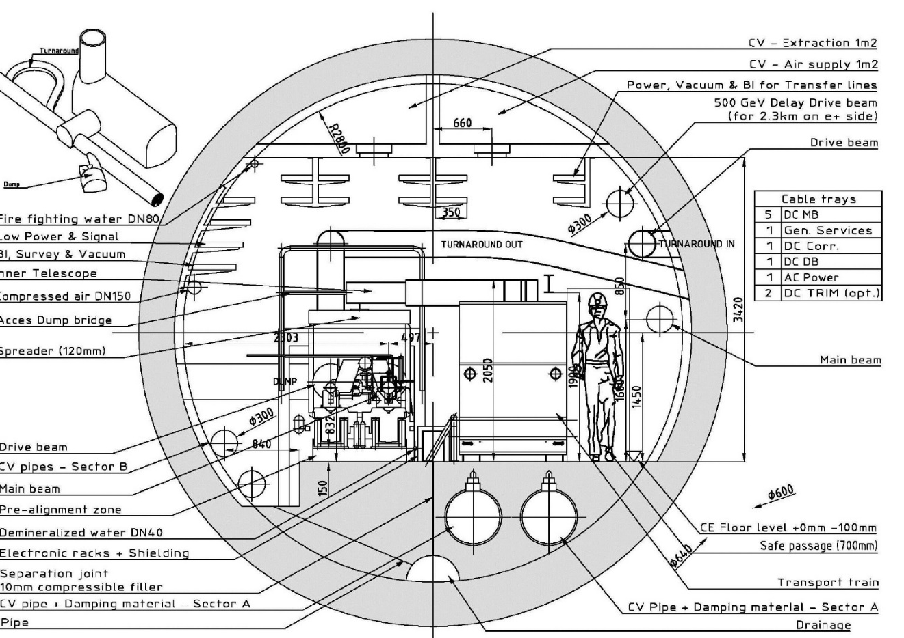
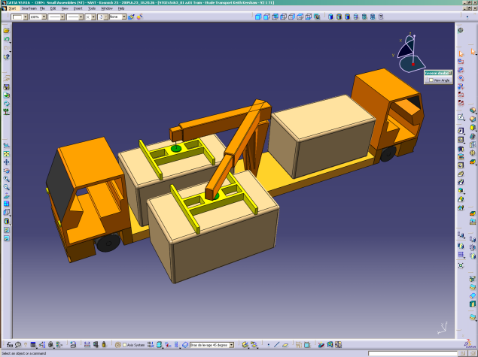
Further Study
Transport:
An updated items list for transport is required for the Klystron and the Drive beam design.
Transportation logistics need to be studied to allow a construction and installation schedule to be produced.
Cooling and Ventilation:
Update of heat loads from ALL users is required to allow a solution to be implemented properly.
Smoke extraction and radiation protection systems need to be integrated into the requirements (to be done with safety).
Finalise the solutions for both Cooling and Ventilation.
Safety:
Identification of hazards and mitigations that fall under standard procedure.
Hazard register to be produced and populated by all disciplines.

Slide 22
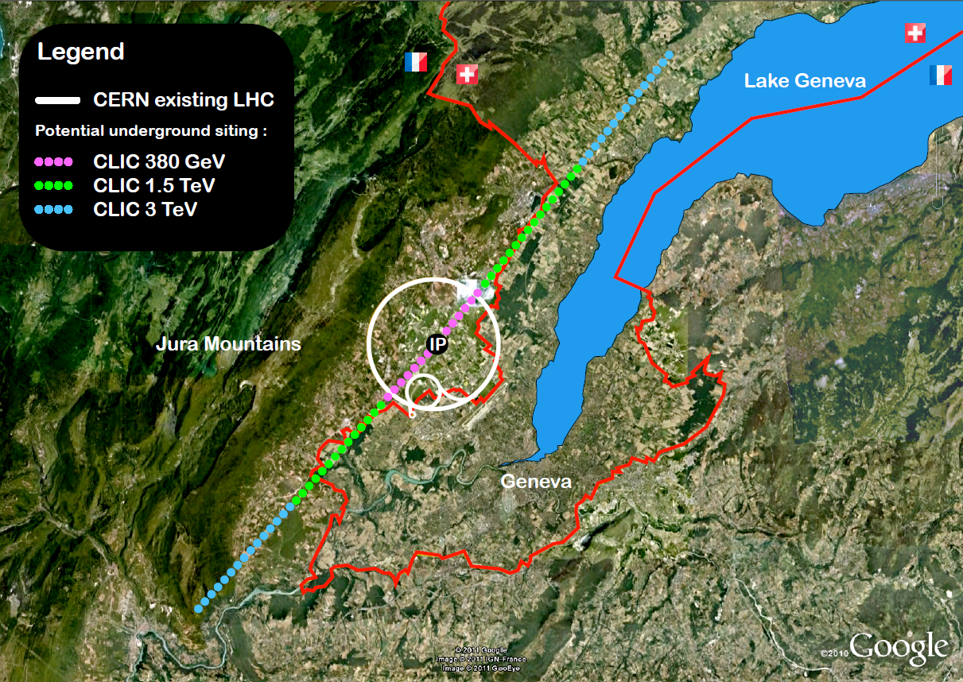
Further Study
Civil Engineering
Use CLIC TOT to optimise the position of the tunnel for the different energy stages.
Continue to update and integrate all disciplines into the surface and tunnel layouts and designs.
Electrical:
Electrical power distribution layouts and electrical infrastructure requirements for both the Drive beam and the Klystron design are to be studied and integrated into the accelerators layouts.
The availability of the required electrical power for all different CLIC machine configurations and energy levels will have to be studied and optimized.

Slide 23
Summary
CEIS Working Group:
Meetings for the CEIS Working Group are taking place every 5 weeks to ensure full integration of the work done by each discipline.
Full Activity tracker updated at each meeting outlining the tasks for each discipline.
Updates since CDR:
Civil Engineering Layouts have been updated and new Klystron layouts have been produced.
CLIC TOT has been produced and is available to start optimising the position of the CLIC tunnels and surface locations.
HVAC has been studied in more detail, the heat loads have been updated and new cooling and ventilation systems/solutions have been proposed.
CLIC Power supply requirements have been proposed with an update on the substation requirements and the connection to the European grid.
Further Study:
CLIC tunnel optimisation to be studied in detail.
Solutions proposed for the cooling and ventilation require input from all disciplines responsible for heat loading so a more detailed design can be produced.
Safety to produce and populate a hazard register for the CLIC Project.
Transport design and schedule to be completed – requires an updated list of items that are to be transported throughout the shafts and tunnel.
Survey and Alignment to provide lattice files for the 1.5 TeV and 3 TeV energy stages.

Slide 24
Thank You For Your Attention
Thank you to all contributors from the CLIC CEIS Working Group

Slide 25

Cooling CDR Baseline
Sector 3
Accelerating structure
Facilities divided into 5 cooling sectors according to:
Functional and operational requirements
Thermal loads
Dimensions & geographical distribution
    - Facilities (Drive beam injector building)
    - HVAC and cooling plants (keep reasonable size)
    - Environmental impact: no cooling towers on surface points -> centralised in Prévessin
Sector 4
UTRs, dumps, loops
Sector 2
Sector 1
Sector 5
Detector premises

Slide 26
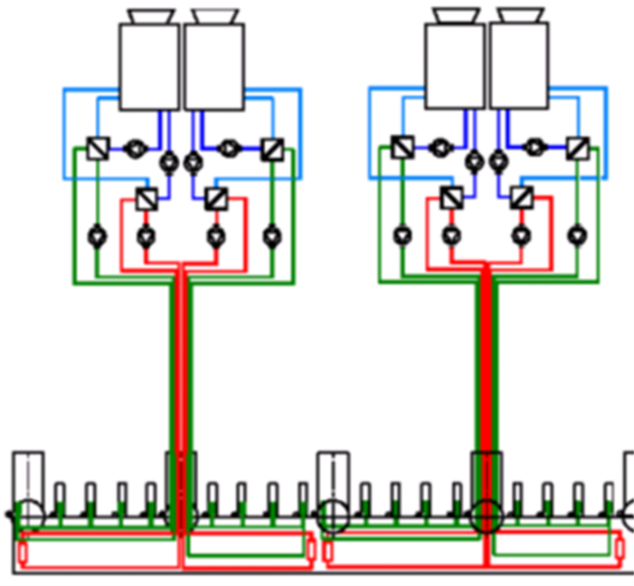
Cooling: proposed modification
Cooling towers in surface points: Pt 4, 5, 8, 9
Advantages:
  Smaller pipe diameters in tunnel
  Lower electrical power requested (25%)
  No need for booster pumps
  Bypass, connection to drain: simpler if still needed
  Easier operation (balancing of circuit, …)
Disadvantages:
  Stronger environmental impact (outside CERN)
  Bigger surface needed for installation
  Impact on shaft dimensions?
  However: manifold issue still present

Slide 27
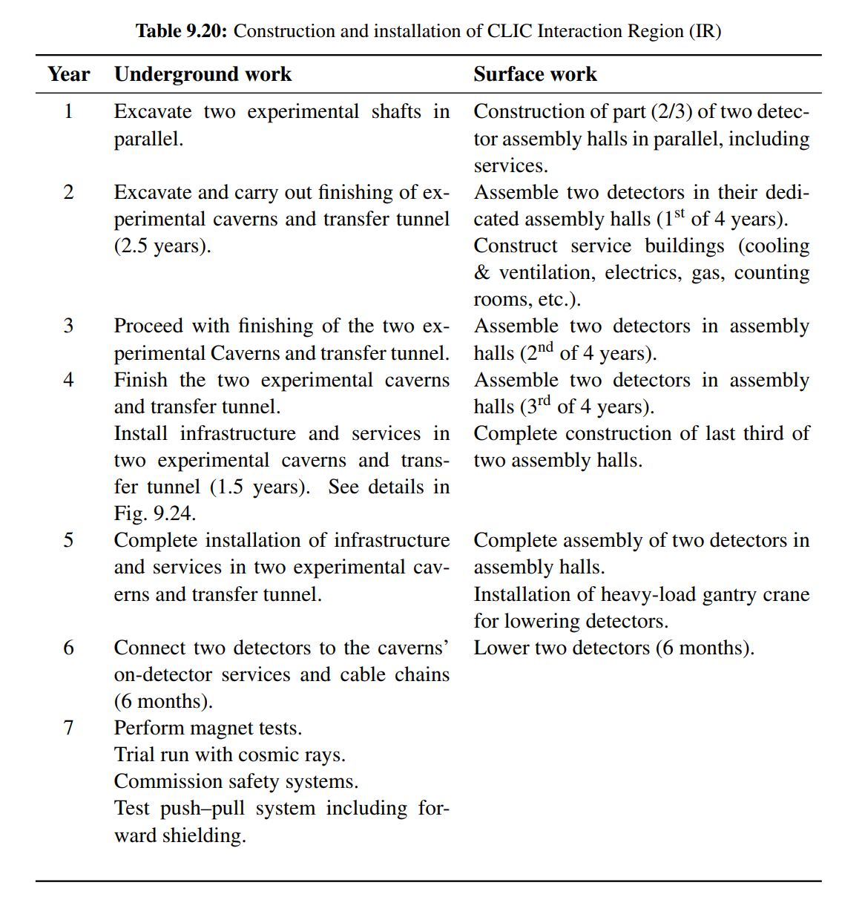
CDR Schedule Critical Path

