Slide 1
A Superconducting Solenoid applicable for
X-band Klystrons
Akira Yamamoto （KEK and CERN)
To be presented at LCWS-2017, Strasbourg, 2017-10-26

Slide 2

CLIC Staging Scenario being Studied

Slide 3
Background and Objectives
The CLIC-380 staging scenario is being studied at CERN, and the X-band (12 GHz) klystron-based accelerating scheme may be a cost-effective option.
The klystron requires a solenoid magnet field for beam focusing with
  Bc = ~ 0.6 T in a bore-diameter of 0.48 m
A Cu-based solenoid magnet, currently used, is consuming
  AC-plug power of ~20 kW per Klystron,
The superconducting magnet option will result in
  Total AC-plug power saving of > ~80 MW for ~4,500 klystron in CLIC-380.

Slide 4
Klystron-based First Stage (380 GeV)
Example RF unit design
(I. Syratchev)
With simple cost model find similar cost than drive beam-based design at 380GeV
Much improved RF unit design
More expensive at 3TeV
1076 units /beam
The pulse compressor used for parameter determination in the Baseline Report has been still a previous version
But used updated model

Slide 5
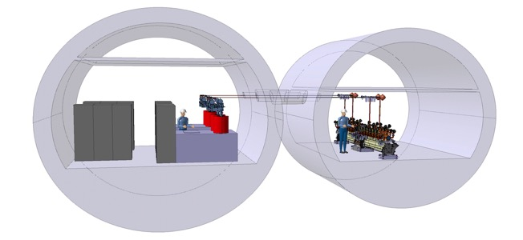
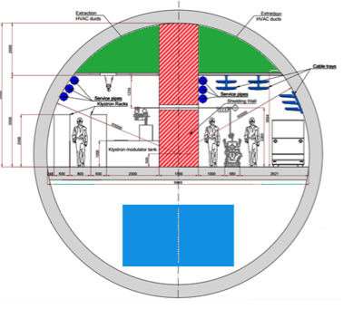
380 GeV Klystron Tunnel View
4,482 Klystron strings
(2,241 pairs) required

Slide 6
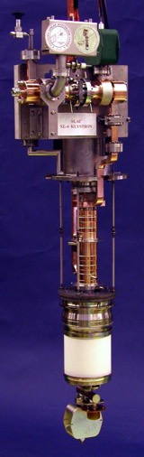
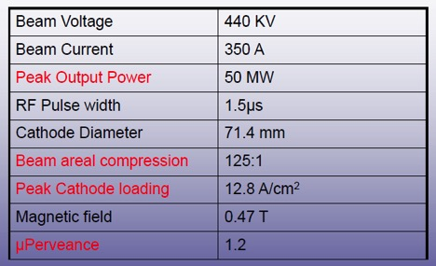
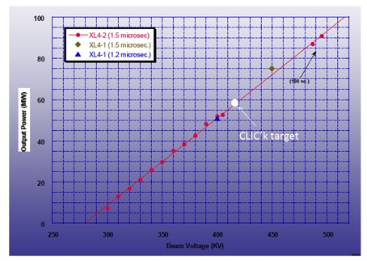
X-band klystrons (industrialized)
Courtesy: Igor.Syratchev
CLIC’k klystron:
59 MW
418 kV, 324 A (µK=1.2)
Efficiency 0.436
18 tubes built to date (not counting rebuilds)
Klystron XL4 series
(Design)
KMD and X-Band Overview,
January 5, 2011 Erik Jongewaard

Slide 7
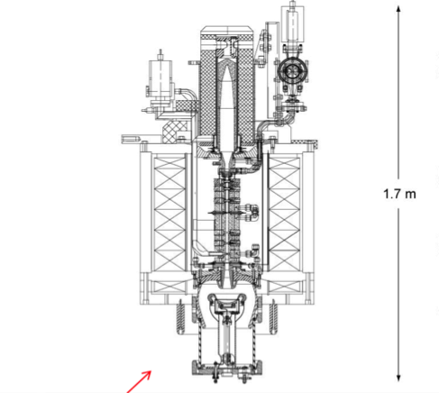
Cross Section and Photos of X-band Klystron at CERN
(~35V x 600 A )
F. Peauger et al.; A 12 GHz RF POWER SOURCE
FOR THE CLIC STUDY; Proceedings of IPAC’10
Cu solenoid: Power Consumption: ~ 20 kW

Slide 8
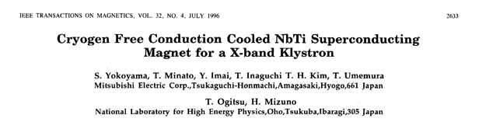
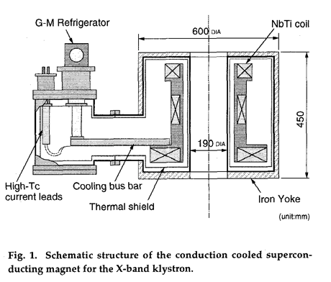
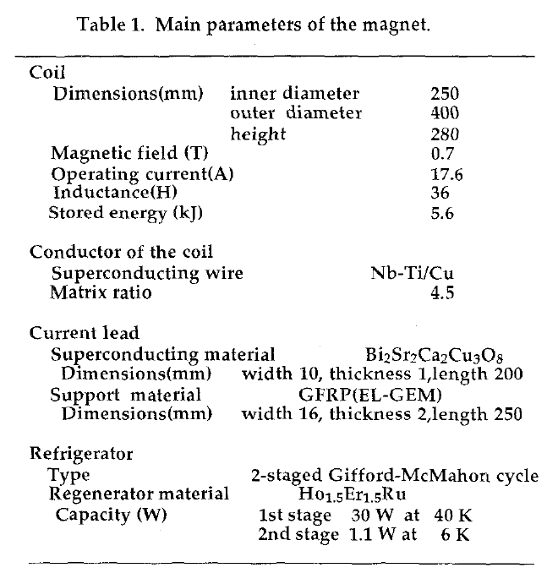
A reference

Slide 9

Possible Choices among SC Materials
Courtesy, H. Padamsee, R. Flukiger, A. Ballarino
Material | T_{c} [K] | B_{c1}(0) [T] | B_{sh}(0) [T] | B_{c}(0) [T] | B_{c2}(0) [T] | Pen. depth λ(0) [nm]
Nb | 9.2 | 0.18 | 0.21 | 0.25 | 0.28 | 40
NbTi | 9.2 ~9.5 | 0.067 | -- | -- | 11.5 ~ 14 | 60
NbN | 17.3 | (0.02) | -- | -- |  | 150-200
Nb₃Sn | 18.3 | (0.05) | 0.43 | 0.54 | 28 ~30 | 80
MgB₂ | 39 | (0.03) | 0.31 | 0.43 | 39 | 140
YBa₂Cu₃O₇ (REBCO family) | 92 | 0.01 | -- | 1.4 | 100 | 150
Bi₂Sr₂Ca₁Cu₂O₈ (BSCCO-2212) | 94 | 0.025 | -- | -- | >100/30 | 1800
Bi₂Sr₂Ca₂Cu₃O₁₀ (BSCCO-2223) | 110 | 0.0135 | -- | -- | >100/30 | 2000
Note Important for: |  | RF |  |  | Magnet

Slide 10
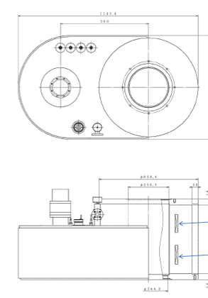
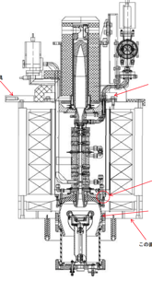
A SC Model Magnet proposed
Design Parameters
Superconductor (T-operation) | MgB₂ (@ 20 K)
Current | 50 A
Central field | 0.7 T
Stored energy | ~ 10 kJ
Cryo-cooler applied | 6.7 W @ 20 K 13.5 W @ 80 K
AC Power Consumption | ~ 3 kW (1,5 kW/Klystron in case of a pair )

Slide 11
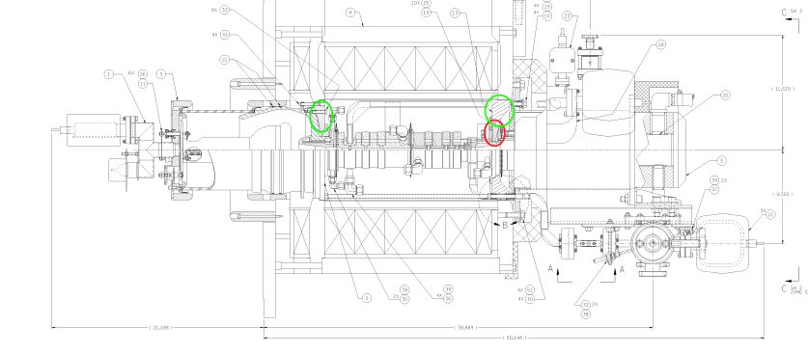

Courtesy: jeff Neilson

Slide 12
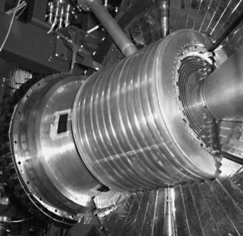
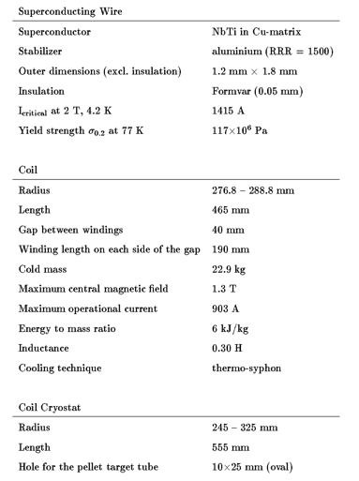
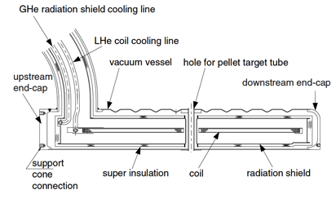
WASA Superconducting Coil

Slide 13
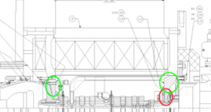
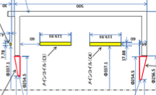
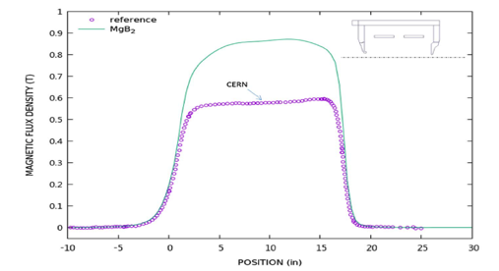
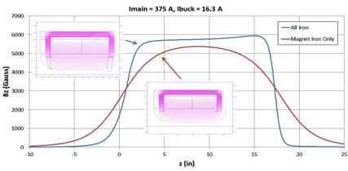
Axial Magnetic Field Profile
Comparison of Cu and SC Solenoids
←Cu Solenoid
SC Solenoid →
Courtesy: j. Neilson

Slide 14
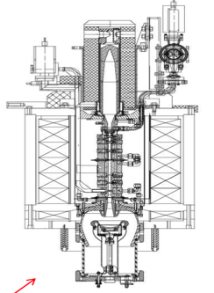
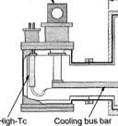
A Prototype Development proposed
R&D Objective
Demonstrate SC-mag technology to be applicable & power saving
A prototype magnet to be demonstrated:
A prototype solenoid using MgB₂
  B = > 0.7 T (central field), Coil size: ~ 0.35 m (dia.), ~ 0.35 m (L)
  Iron Yoke size: interface compatible with the current magnet yoke
  Operational Temp. 20 K, conduction cooled by using a cryo-cooler
  AC-plug power saving (to be demonstrated):
    → < 3 kW / Klystron ( corresponding < 1.5 KW/ a pair Klystron )
A goal with operation of the magnet assembled with an existing Klystron
Future:
Pairing the solenoid, for reducing # CLs and cryogenic cooling capacity
HTS solenoid (when it will become cost-effective),
Cooling by using a dedicated cryogenic system for a series of Klystron Solenoids to reach < 1 kW AC-plug power /Klystron (< 1/10 of AC power)
→ Saving expected : ~ (20-1) kW x 4,500 = > ~ 80 MW in CLIC-staging-380 .

