Slide 1
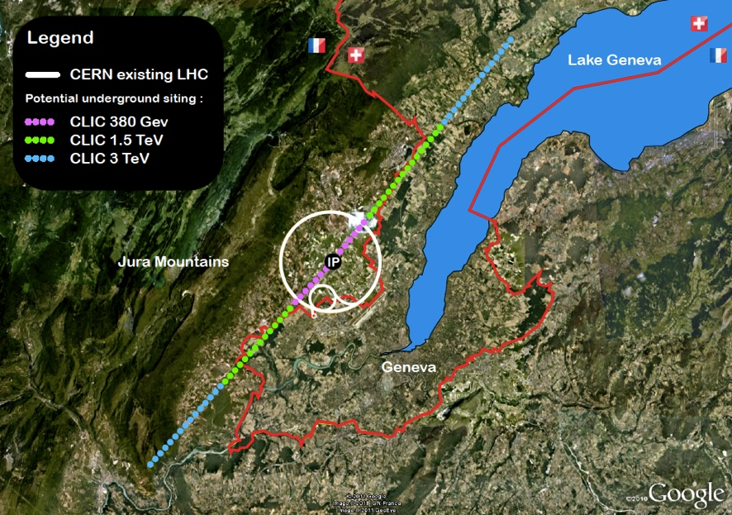
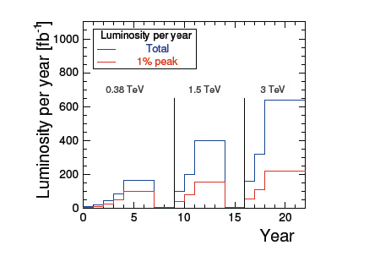
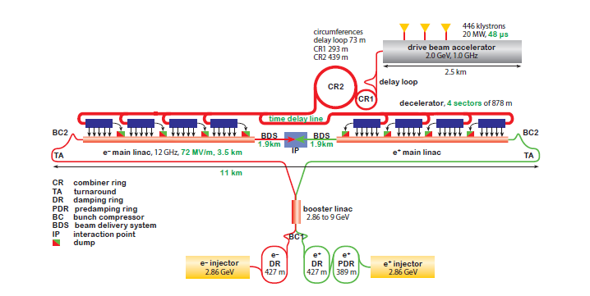
CLIC: from 380 GeV up to 3 TeV
Will also study klystron based machine for initial stage

Slide 2
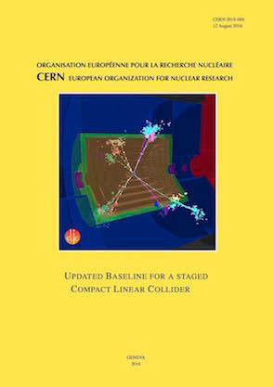
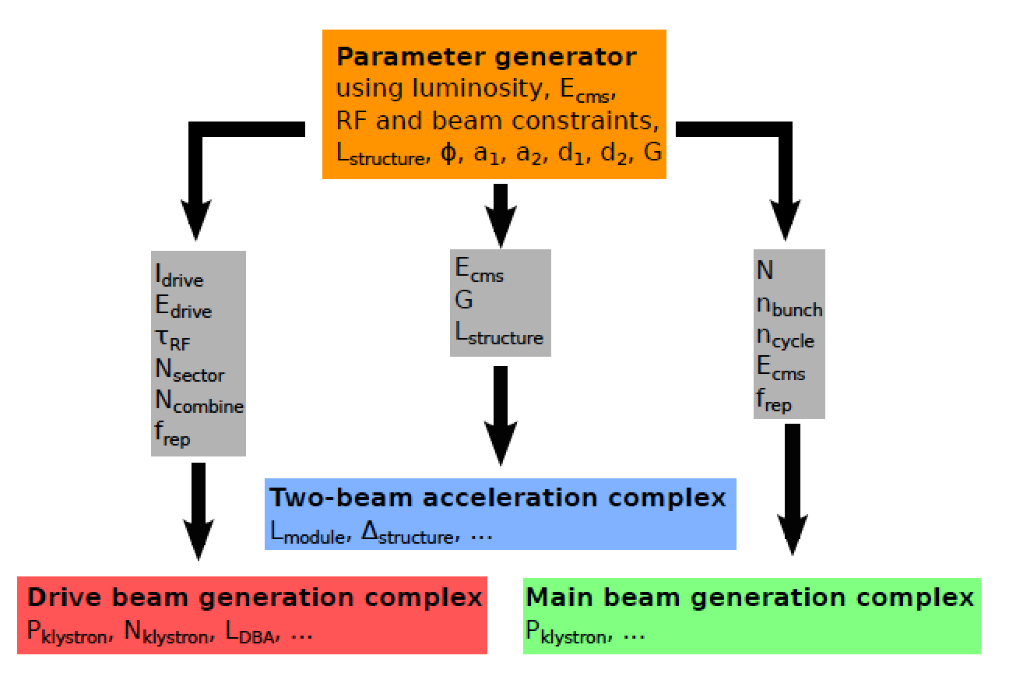
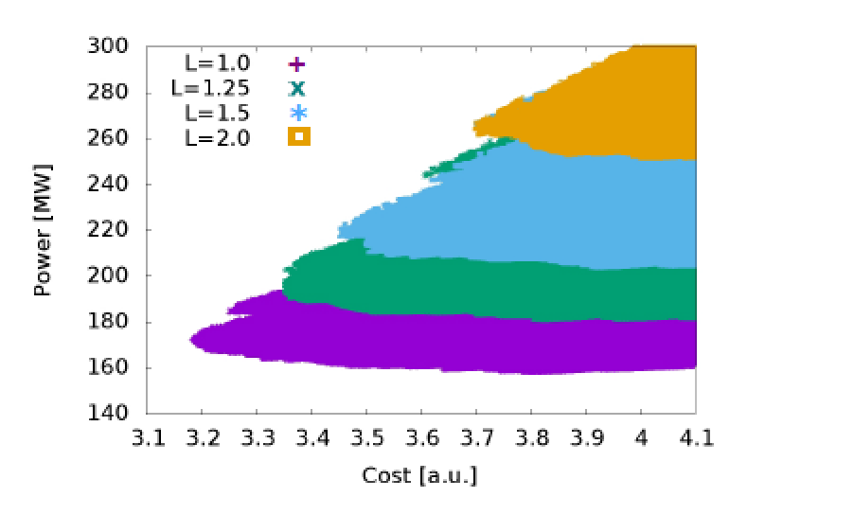
CLIC cost and power optimisation
CDR 2012: Cost and power estimated (bottom up, WBS based, reviewed – led by Lyn Evans, including ILC cost experts)
2013: Useful document comparing ILC and CLIC cost and performance (among others) (link) – still valid in most respects
2016: Cost and power update for 380 GeV drivebeam based machine made
Still a very limited exercise:
  Optimize accelerator structures, beam-parameters and RF system -> defines machine layout for 380 GeV
  Remove pre-damping ring for electrons, scale DB better, some other minor changes
  Largely scaling from 500 GeV
Yellow report: New reference plots for power, costs, luminosities, physics, etc

Slide 3
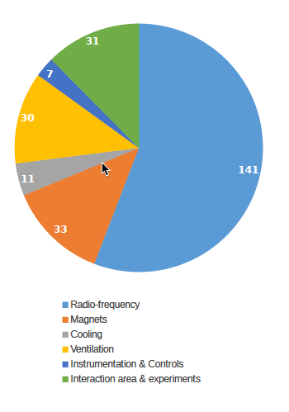
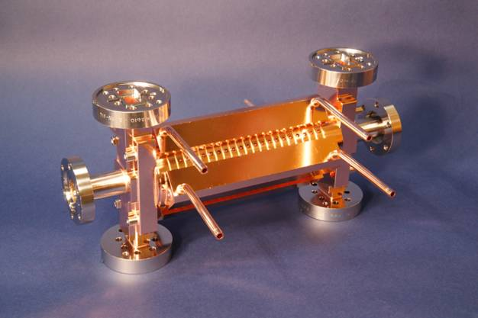
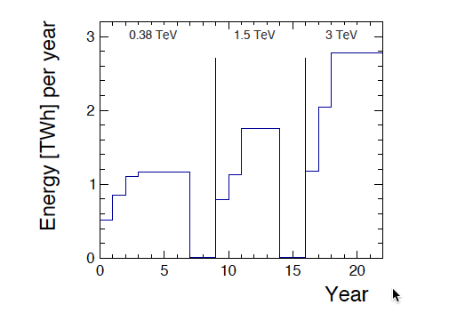
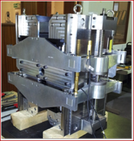
Power and energy
Power/energy reductions are being looked at:
Look at daily and yearly fluctuation – can one run in “low general demand” periods
Understand and minimize the energy (consider also standby, MD, down periods, running
Consider where the power is dissipated (distributed or central) – recoverable ?
CERN energy consumption 2012: 1.35 TWh

Slide 4

Power updates foreseen
Action (v = significant impact expected) | Cost | Pow/Energy | Comments
Structure/parameters optimisation, minor other changes | v | v | Ok for now, 380 GeV at 1.5 10^34 Defines Civ Eng parameters
Further possibility: lower inst. luminosity or initial energy (250 GeV) | v | v | Integrated lum. goal can be maintained, can re-optimise structures
Known corrections needed for injectors and Cooling/Ventilation | v | V | Partly addressed for injectors CV to be re-designed and clear up average and max estimates Check infrastructure
Structure manufacturing | v |  | Optimise, remove steps, halves
High eff. Klystrons/Modulators and RF distribution | v | V | Technical studies where gains can be large Large commercial uncertainty
Magnets | ? | V | Technical studies and costing in progress
Running scenario (daily, weekly, yearly) |  | V (energy, op. cost) | Take advantage of demand/price changes, study foreseen
Commercial studies, currencies and reference costing date | v |  | Examples: klystrons, CHF, CLIC and FCC will use similar convention, learning curves, cost-escalation
Power: To be redone from PBS (bottom up), nominal and with R&D
Distribution on water and air cooling also an issue (in tunnel)
Notes:
Green: DONE
Beige: DESIGN CHANGES possible
BLUE: Techncial studies (illustrate with following slides)
”BRAUN”: need to define approach
Most of the current CLIC studies are today driven by cost and power reduction studies
As conclusions are reached for these studies new cost and power can be estimated

Slide 5
Cost updates foreseen
Action (v = significant impact expected) | Cost | Pow/Energy | Comments
Structure/parameters optimisation, minor other changes | v | v | Ok for now, 380 GeV at 1.5 10^34 Defines Civ Eng parameters
Further possibility: lower inst. luminosity or initial energy (250 GeV) | v | v | Integrated lum. goal can be maintained, can re-optimise structures
Known corrections needed for injectors and Cooling/Ventilation | v | v | Partly addressed for injectors CV to be re-designed and clear up average and max estimates Check infrastructure
Structure manufacturing and also other module components | v |  | Optimise, remove steps, halves
High eff. Klystrons/Modulators and RF distribution | v | V | Technical studies where gains can be large Large commercial uncertainty
Magnets | ? | V | Technical studies and costing in progress
Running scenario (daily, weekly, yearly) |  | V (energy, op. cost) | Take advantage of demand/price changes, study foreseen
Commercial studies, currencies and reference costing date | v |  | Examples: klystrons, CHF, CLIC and FCC will use similar convention, learning curves, cost-escalation
Costs: Structures and modules, Klystron and modulators – in particular
important for klystron version, ”infrastructure” and CE, injectors, commercial studies
Notes:
Green: DONE
Beige: DESIGN CHANGES possible
BLUE: Techncial studies (illustrate with following slides)
”BRAUN”: need to define approach
Most of the current CLIC studies are today driven by cost and power reduction studies
As conclusions are reached for these studies new cost and power can be estimated

Slide 6
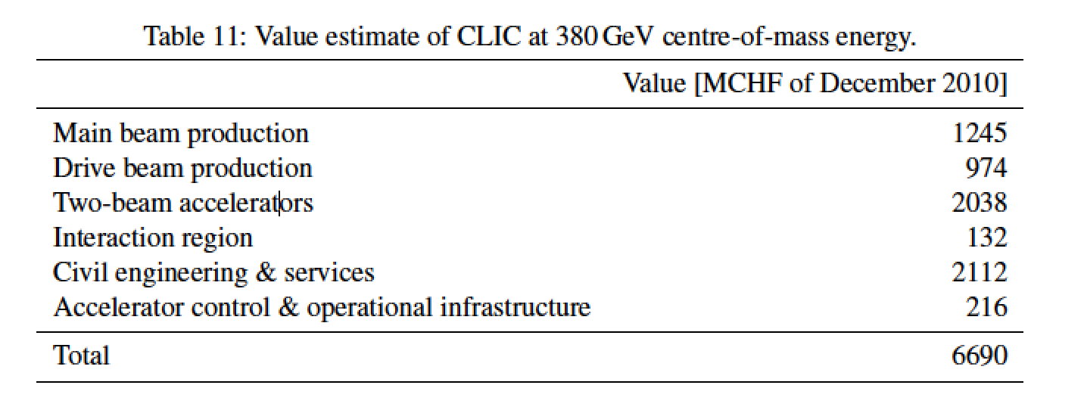
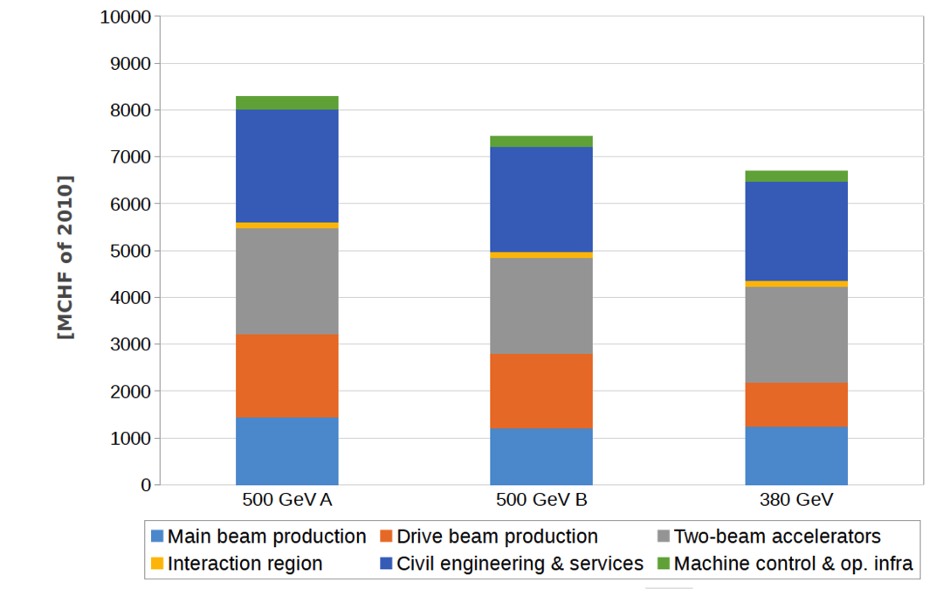
Costing status – I
Status:
Setting up new PBSs for 380 GeV DB and klystrons, 1.5 TeV and 3 TeV
Revise cost escalation factors from 2008 to 2017 (first iteration done)
Have identified responsible for all parts (~15 people from machine to infrastructure to CE - overlap with FCC/LHC-HE team where possible)
Aim for internal review mid 2018, external review Sept-October 2018
Have made some efforts to extract klystron based machine estimates (but did not have PBS for it in 2012)
Will do power bottom up as well revising all numbers

Slide 7
Costing status – II

Slide 8
Costing status – III (do not copy to other slides)
PBS top level | 500 GeV (with 4 sectors) | Baselining CLIC DB at 380 (2015) | Updated 380 DB in progress | Scale previous to 250 DB | Klystron driven 380 GeV | Scale to 250 klystron
Sum | 7438 | 6717 | 6327 | 5082 | 7125 | 5192
Main beam production | 1203 | 1245 | 1005 | 1005 | 1005 | 1005
Drive beam production | 1599 | 974 | 974 | 820 | 0 | 0
Main linac | 2038 | 2038 | 2038 | 1315 | 1400 | 1000
Klystron machine power | 0 | 0 | 0 | 0 | 2000 | 1315
Interaction region | 132 | 132 | 132 | 132 | 132 | 132
CE and infrastructure | 2250 | 2112 | 1962 | 1630 | 2372 | 1560
Control and op. infrastr. | 216 | 216 | 216 | 180 | 216 | 180
Not included possible gains: Change of CHF 2012-2017 (-7%), possible reduction of klystron tunnel (now 10m) with R^2, CV costs still ~500 MCHF, higher eff. klystrons
Not included possible additions: cryo-system for solenoids, wall (small)
To understand: RF system for klystron-option, permanent magnets, module, SC solenoids for klystrons, interaction region and cont. and op. infra. not studied, sectors for 250 GeV
Main conclusions:
We are still at an early stage of the new cost estimate, but no large surprises
For the klystron option we need to work on/optimize the RF system and tunnel size
Commercial gains possible, could be significant: production planning (specs, inside/outside lab, learning curves) – mainly for klystrons, module parts/structures and magnets
Uncertainty remains at ~25%
Goal: 380 GeV baseline for ~6 BCHF (would be ~5 BCHF for 250 GeV)
Provide estimate of further gains with concentrated effort in next phase (working with industry)

