Slide 1
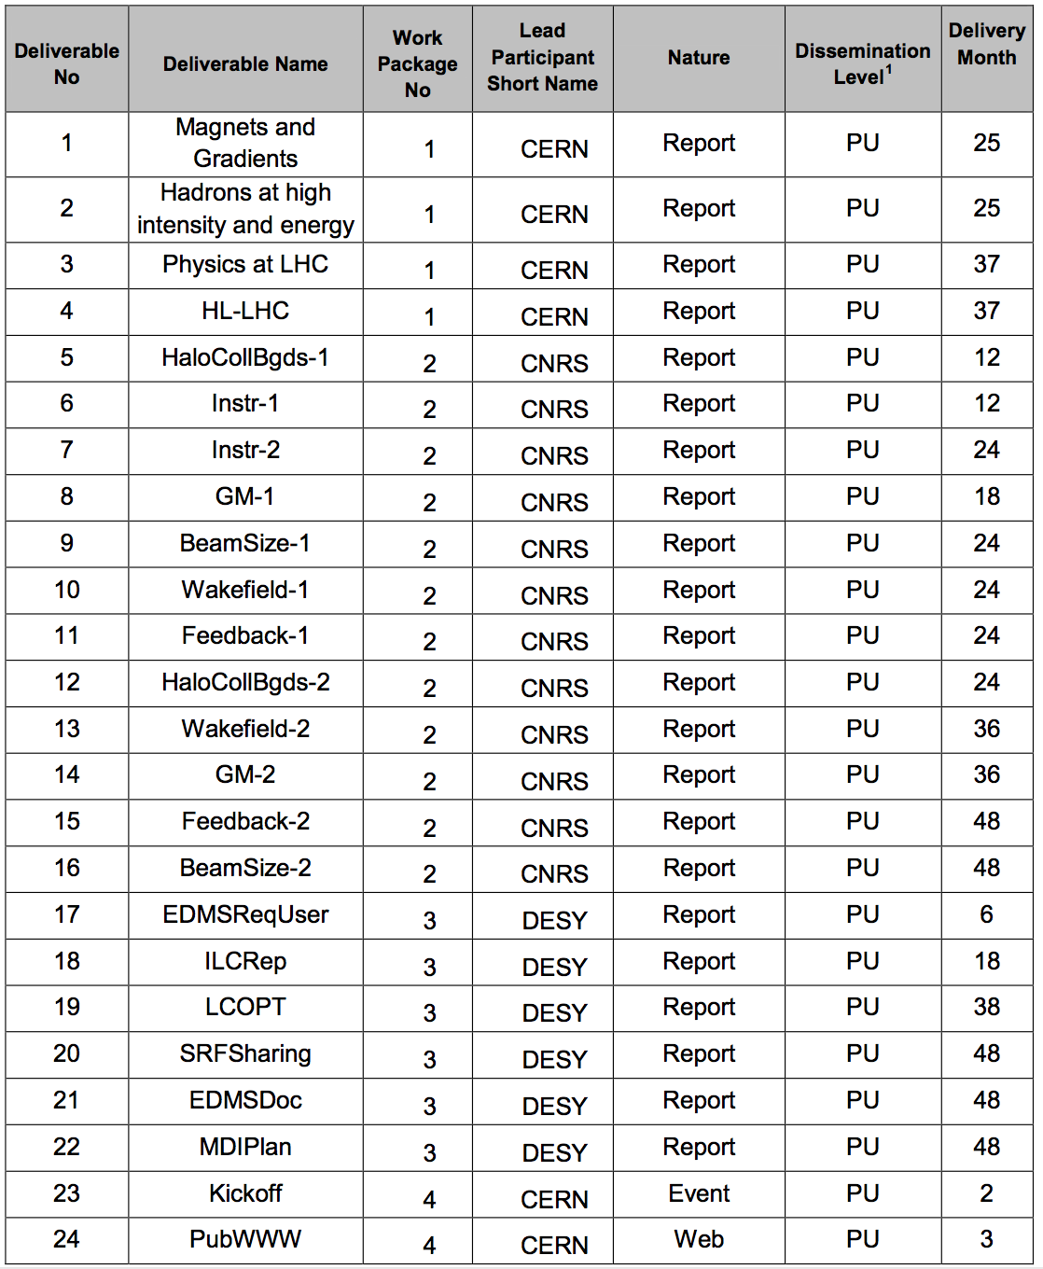
31 January 2018
31 December 2017
28 February 2018

Slide 2
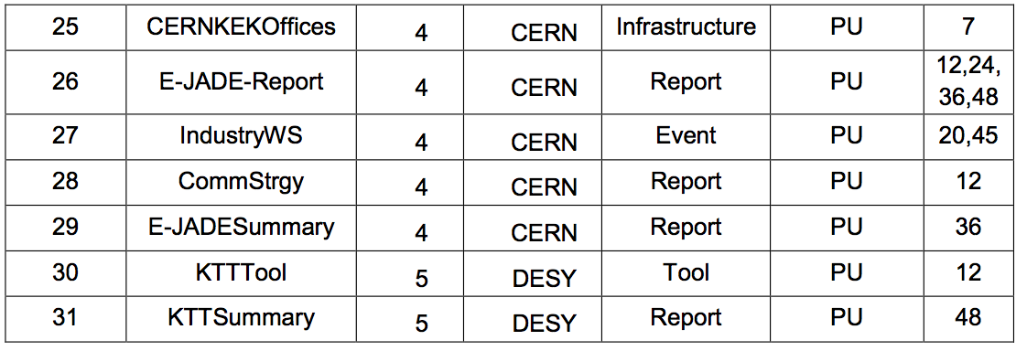
31 December 2017
31 December 2017

