Slide 1
Overview of the AAA activities
October 25, 2017
Masanori Matsuoka
Secretary General, Advance Accelerator Association
promoting science & technology
Notes:
(Tittle)
I am very honor to be here and talk about our activity in Japan.
I am Masanori Matsuoka, Secretary General of AAA.

Slide 2

Contents
Introduction
AAA activities
Toward realization of ILC
Notes:
(Contents)
Today, I would like to talk about three items.
The first item is the activities of AAA.
And then I will explain the accelerator science and industry in Japan.
Finally, I introduce the significant issue for realization of ILC.

Slide 3
Contents
Introduction
AAA activities
Toward realization of ILC
Notes:
(Contents)
Today, I would like to talk about three items.
The first item is the activities of AAA.
And then I will explain the accelerator science and industry in Japan.
Finally, I introduce the significant issue for realization of ILC.

Slide 4
Our vision
Affluent Future with Advanced Accelerator Science & Technology
Government
National Strategies
AAA
Industry
Manufacture Technologies
Academia
Basic Science
Notes:
(Outline of AAA)
AAA was established in 2008 with 76 members from the academia and the industry.
Our vision is to realize the affluent future with the advanced accelerator science and technology.
As you know, the accelerator technology has been created new products helping our society and our life such as medical diagnostics or cancer therapy machine.
We are acting to promote the science and technology related to advanced accelerators including the International Linear Collider (ILC) project in collaboration with Government, Academia and Industry.

Slide 5
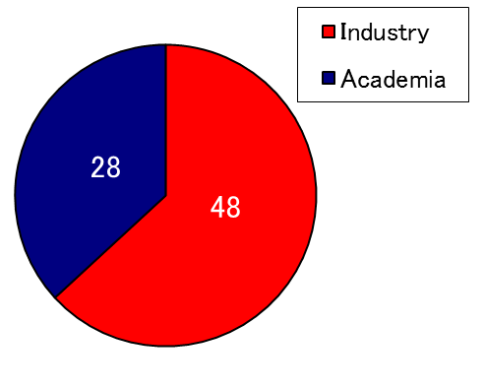
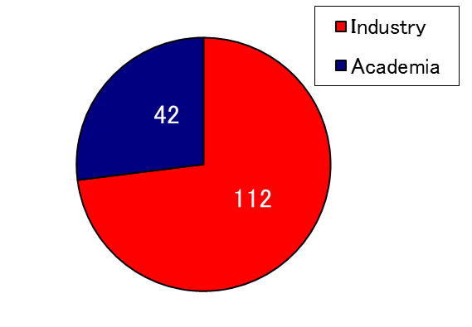
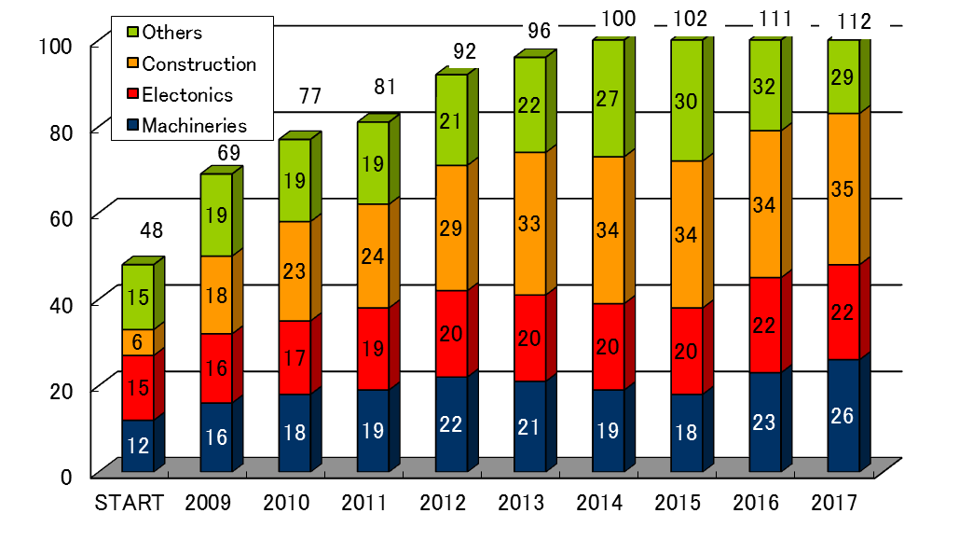
Member of AAA
76 members
154 members
Members have increased double since establishment and their business area become to diversify.
“The others” includes the material, traffic system, trading companies and so on.
Notes:
(Member of AAA)
This is a trend of the membership from the establishment until now.
From the time of establishment, the number of members increased approximately double and their business area becomes to diversify.
“The others” includes the material, traffic system, trading companies and so on.

Slide 6
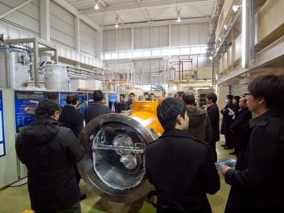
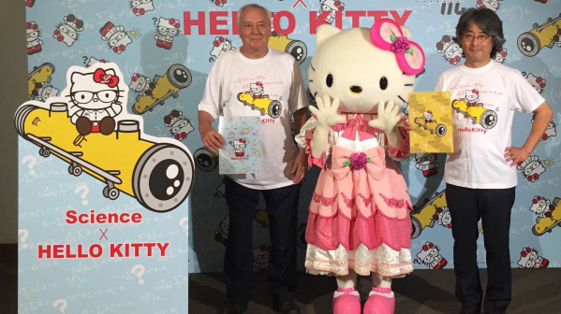
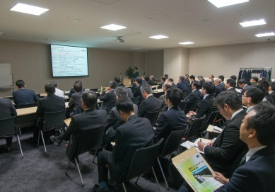
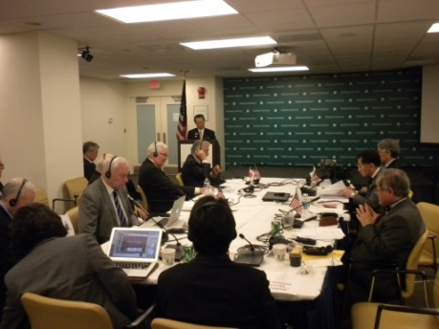
Organization
Etemity Supreme Advisor：
The late Kaoru Yosano
Honorary Chair:
Masatoshi Koshiba
Nobel prize in Physics 2002
Supreme Advisor：
Takeo Kawamura
Senior Advisors：
Yoichi Tao
Junichi Nishiyama
Hiroya Masuda
Masao Ninomiya
Chair：
Takashi Nishioka
Vice Chair:
Atsuto Suzuki
Board of Directors
Representative Director:Takashi Nishioka(MHI)
Director: Atsuto Suzuki(Iwate pref. University)
Director: Masanori Yamauchi (KEK)
Director: Yuzo Onishi (Kyoto Univ./Kansai Univ.)
Director: Mamoru Hatazawa (Toshiba)
Director: Hiroto Uozumi (Hitachi)
Director: Yasuyuki Ito (MELCO)
Director: Masahiro Inagaki (Kyocera)
Auditor: Sachio Komamiya (Univ. of Tokyo)
General Meeting
Corporate Organizations
and Institutional Organizations
Secretariat
Secretary General:
Masanori Matsuoka
Technology Study Gr.
Leader: Hitoshi Hayano
Outreach Gr.
Leader: Hiroyuki Yoshizumi
CIVIL Gr.
Leader: Yuzo Onishi
Large Project Study Gr.
Leader: Satoru Yamashita
Notes:
(Organization)
AAA have four groups of the technology study group, the outreach group, the CIVIL group and the large project study group.
At the technology study group seek directionalities on advanced accelerator with ILC. And they investigate “manufacturing technologies” from a variety of industrial field to create innovative scientific technologies.
The outreach group inform the general public about possibilities and significance of advanced accelerator and the ILC, through a variety events such as the symposium and media exposure.
The CIVIL group contribute to hosting the ILC smoothly in Japan with studying civil issue.
Finally, the large project study group seek how to reach a consensus with understanding the location issue in order to realize the ILC in Japan, and study proper organization for promoting the ILC in collaboration with law makers and government officials.

Slide 7
Contents
Introduction
AAA activities
Toward realization of ILC
Notes:
(Contents)
Then I will talk about our activities.

Slide 8
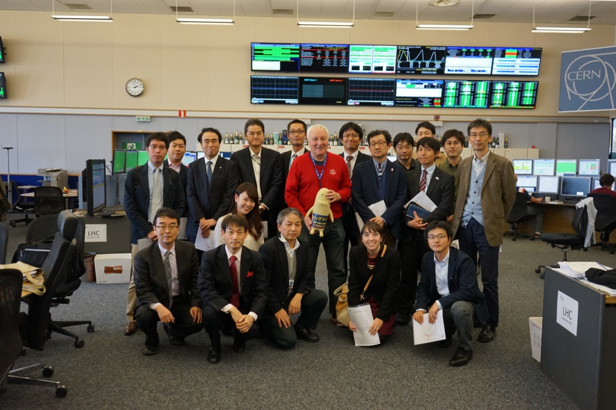
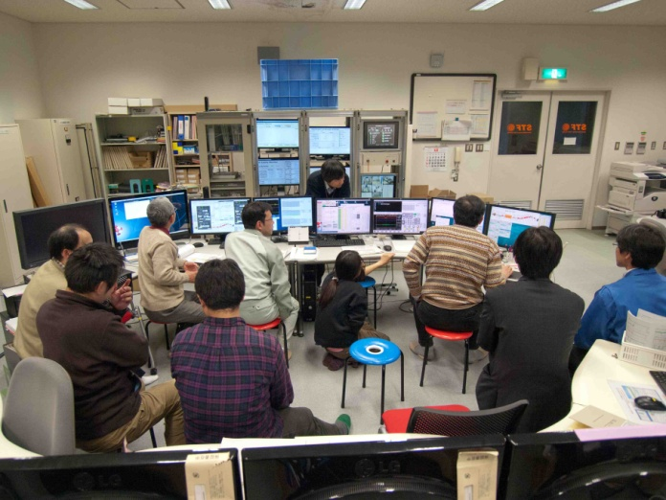
Activities for members
53 Seminars (ILC status, Accelerator technology)
Working group
  Superconducting Accelerator WG
  Green ILC WG
Visit to Accelerator Lab.(CERN, KEK)
Operation training of superconducting accelerator
Company presentation at IEEE and LCWS in 2016
Visit to CERN
Training at KEK (STF)
Notes:
(Activities of Technology Study Group)
The technology study group conducts technical seminars for the AAA members.
We have held 53 seminars and lots of working group meetings for about 9 years.
We have exchanged valuable information about the technological challenges and the possibility of advanced accelerators including the ILC with the academia and industry attending.
On the other hand, the researchers give us some information about the status of the ILC timely.
You can see a photo on the left is that of visiting CERN
A photo on the right is that of visiting KEK to see some advanced accelerators including ILC R&D.
We also experienced the operation of the superconducting accelerator to improve our knowledge and skill.
These activities may induce the innovation regarding the accelerator technology.

Slide 9
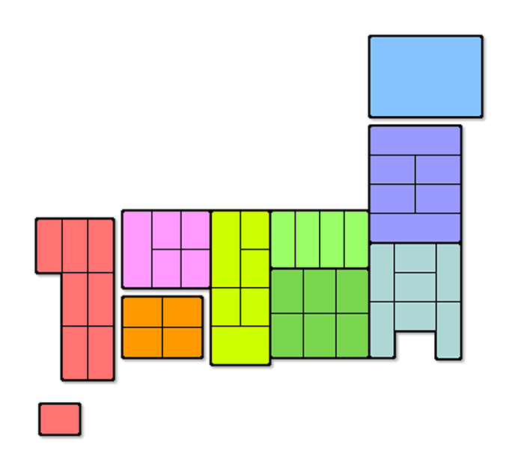
Symposiums at the various cities in Japan
No.17 Washington, D.C.
No.22 Washington, D.C.
No.26 Washington, D.C.
No.28 Washington, D.C.
No.30 Spain
No.11 Sapporo
No.8 Oushu
No.23 Oushu
No.27 Oushu
No.33 Oushu
No.4 Fukuoka
No.9 Fukuoka
No.6 Kyoto
No.18 Niigata
No.13 Fukuoka
No.3 Hiroshima
No.15 Matsumoto
Participants
No.2 Sendai
No.16 Sendai
100-199
200-299
No.21 Tsukuba
300-399
400-499
No.19 Tokyo
No.20 Tokyo
No.24 Tokyo
No.25 Tokyo
No.29 Tokyo
No.31 Tokyo
No.32 Tokyo
No.1 Tokyo
No.5 Tokyo
No.10 Tokyo
No.12 Tokyo
No.14 Tokyo
No.7 NAGOYA
500-
Notes:
(Symposiums at the various cities in Japan)
This is the slide which summarized the holding situation of the symposium which AAA sponsored.
This is a Japanese map.
From Hokkaido to Kyushu, Japan is the islands which stand in a row for a long time southwest from northeast.
As for us, the surroundings are sending the meaning of ILC or a tip accelerator for the Japan whole country through symposium.
Very much, it stated and I have obtained attendance also in 7500 persons as indicated in the upper graph.
When large, you sometimes participate also in 800 persons at once.
This thinks that the height of the Japanese's concern about Japanese attraction of ILC is told.
Moreover, we are also tackling the work and distribution of an animation or comics on the theme of ILC, and are just going to send the meaning of ILC or a tip accelerator using media.
こちらは、当協議会が主催したシンポジウムの開催状況をまとめたスライドです。
スペインの皆様にはあまり馴染みがないかも知れませんが、これは、日本の地図です。
北海道から九州まで、日本は北東から南西に長く連なる列島でございます。
我々は、日本全国を回り、ILCや先端加速器の意義をシンポジウムを通じて発信しております。上のグラフに記載してございますとおり、実に、述べ8200名もの方々にご出席を頂いております。多いときには、一度に800名もの方に参加頂くこともございます。これは、ILCの日本誘致に対する日本国民の関心の高さを物語っていると考えています。
また、我々は、ILCをテーマにした動画やマンガの制作・頒布にも取組んでおり、ILCや先端加速器の意義をメディアを使って発信しているところでございます。

Slide 10
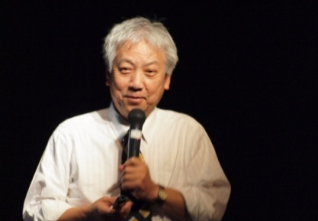
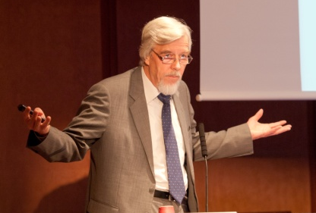
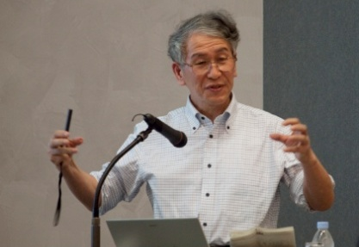
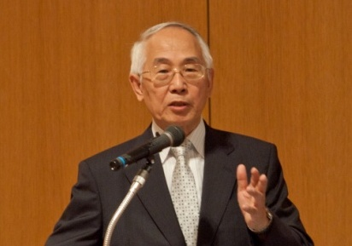
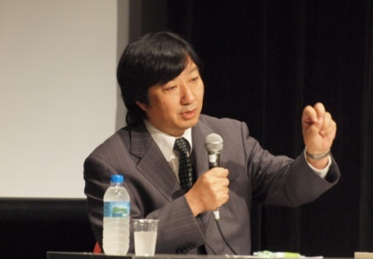
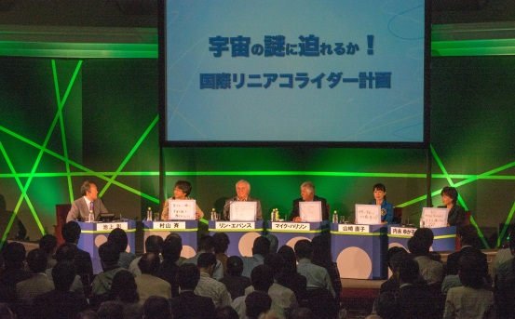
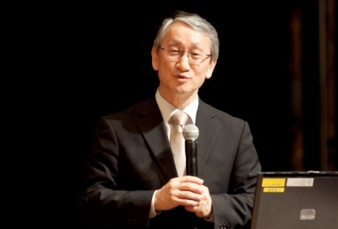
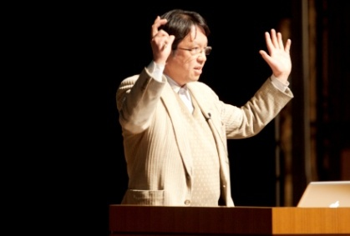
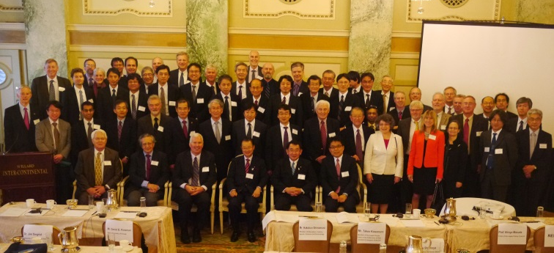
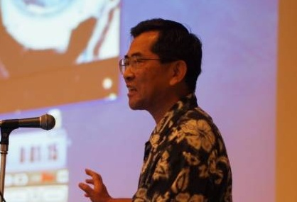
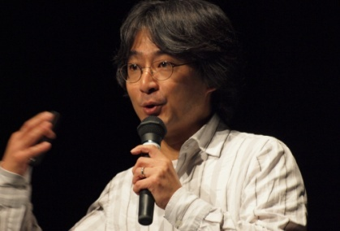
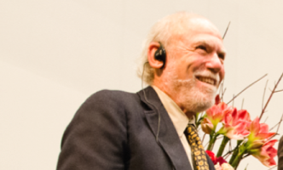
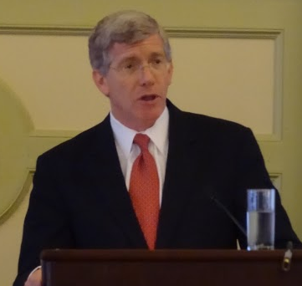
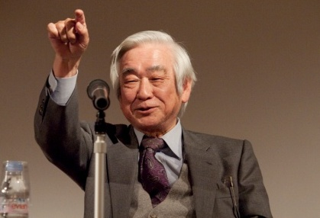
Symposiums on Advanced Accelerator
M. Yoshioka
R. D. Heuer
A. Suzuki
M. Tsujii
#20 Symposium in Tokyo
S. Komamiya
J. Kawaguchi
#17 Symposium in Washington, D.C.
H. Yamamoto
M. Ie
H. Murayama
B. Barish
D. P. Poneman
T. Masukawa
Notes:
(Symposiums on Advanced Accelerator )
This is a view of the symposium we sponsored.
We invited the top-level lecturer from domestic and abroad.
33 times of symposium were held until now.
We invited to our event famous lectures including those from oversea.
In 2012

Slide 11
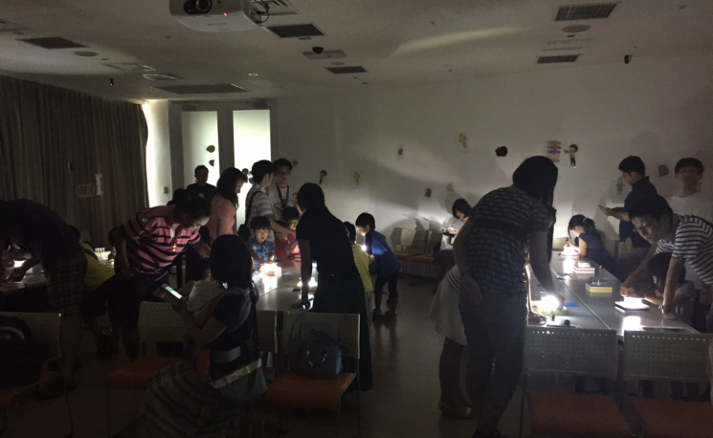
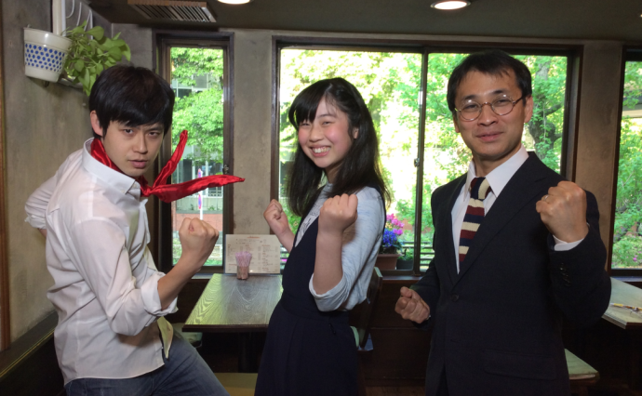
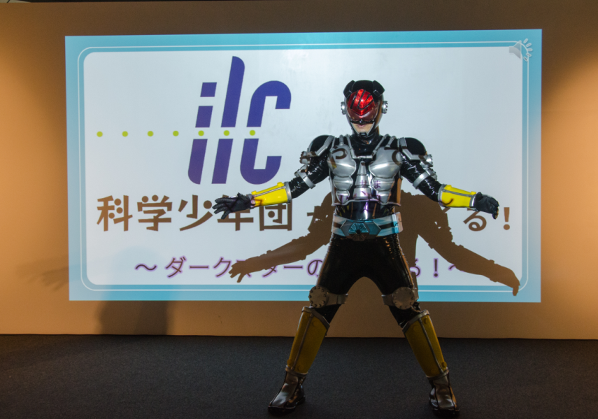
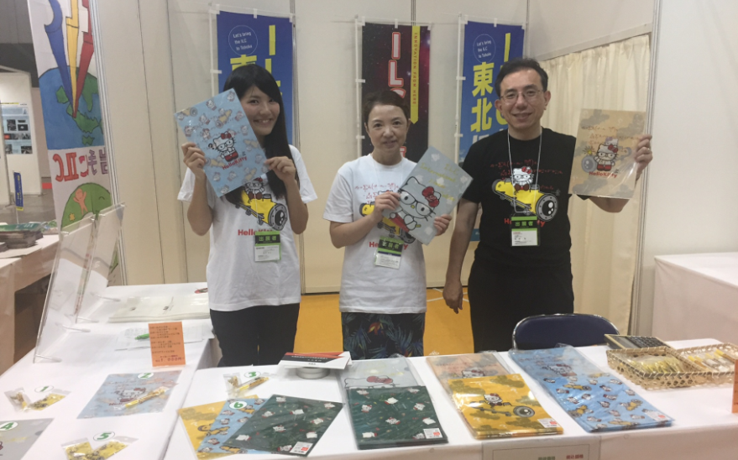
The latest event for publicity in Japan
Cloud Chamber Experiment by children with their parents.
Lineaco Rider Hero TV Character
These events were good chance to let children know the ILC.
ILC promotion at Vacuum 2017 in Japan
Notes:
We conducted some events for publicity especially children.
ILC would be supported by the people who believe in the future.

Slide 12
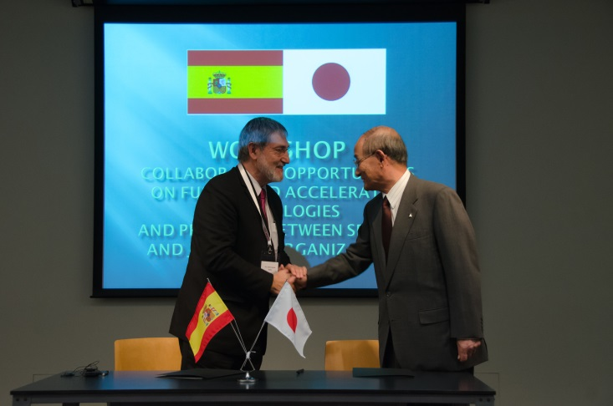
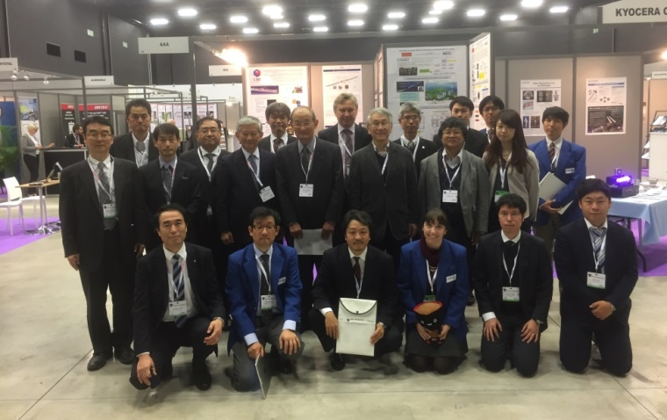
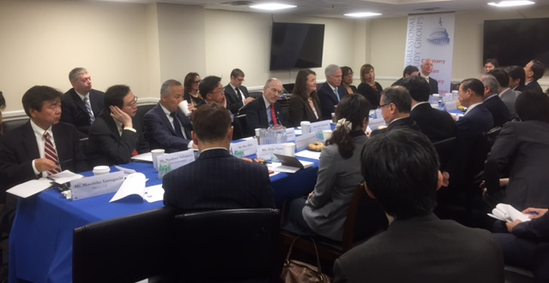
International events
Collaboration Opportunities on Fusion and Accelerator Technologies and Projects, between Spanish and Japanese Organizations in 2016
US-Japan Advanced Science and Technology Symposium in Washington DC in 2013
2016 IEEE NSS/MICRTSD in Strasbourg
The US-Japan Public and Private Partnership in Science and Technology, in Washington DC in 2017
Notes:
We concluded LOI with INEUSTAR of Spain.

Slide 13
Contents
Introduction
AAA activities
Toward realization of ILC
Notes:
(Contents)
Today, I would like to talk about three items.
The first item is the activities of AAA.
And then I will explain the accelerator science and industry in Japan.
Finally, I introduce the significant issue for realization of ILC.

Slide 14
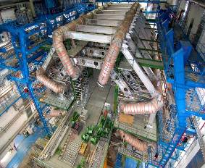
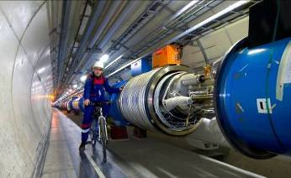
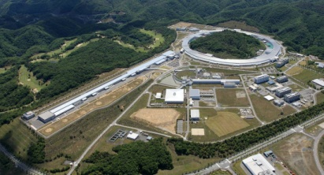
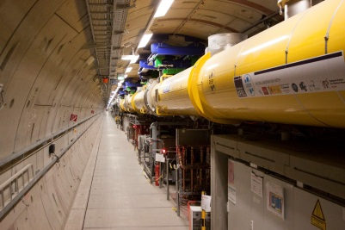
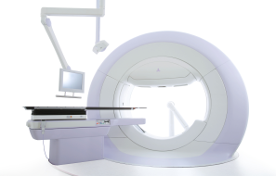

Accelerator- Pyramid
LHC（CERN）
Number in the world
1～5
High end Accelerator for particle Physics
RIKEN SACLA
European XFEL
10 ～20
Large project for science & technology
Euro XFEL
More than 100
Advanced accelerator for New usage development
Radio Therapy
Innovative technologies, New applications, ･･･
Elemental technologies, Cost reduction,
Standardization, ･･･
More than 10,000
(USD 3.5Billion*)
General purpose machine
(Medical, Industry,･･･
(USD 500Billion*)
Products derived from
accelerator technologies
*) ”Accelerators for America’s Future” , 2010, Department of Energy, USA
Notes:
(Accelerator- Pyramid)
We are calling this the accelerator pyramid.
In realizing it, an accelerator for the latest particle physics experiment which is represented by the LHC accelerator needs to establish high technology.
The broad accelerator for technology research which is the following class is realized using the technology and equipment which were obtained with the latest accelerator.
For example, X-ray-free-electron-laser institutions, such as SACLA in Japan and European XFEL which construction can be advancing in Europe, etc. are the example.
It is the feature that the sector not only basic research but called [ for example ] development of a high-performance tire and new medicine development in the accelerator of this class is also used widely.
Furthermore, the third class is an accelerator which is called the particle radiotherapy equipment for medical treatments and which was redeveloped along with the purpose.
On this class, the product never realized with old technology uses accelerator technology as a key, and there are many realized examples and there are.
Furthermore, although the principle called electron beam welding is an accelerator, it has a thing already called an accelerator no longer and a product using it.
These foot is very large, and for the property of DOE, if an annual 500 billion dollar is also attained to, the trial calculation is made.
n the Mitsubishi 重工, although manufacture of the accelerator was started 60 years or more ago, in that case, he has heard that our airplane production technology was utilized.
That is, in order to realize the latest accelerator, it is an example from which the leading-edge technology of another field is utilized, and also this evolves.
Moreover, although it became my own talk, it was engaged in development of a superconducting accelerator about 20 years ago.
Those days, electron beam welding was used for manufacture of a nuclear plant, and manufacture of the superconducting accelerator was tried using this technology.
Those days, Mr. Peter Kneisel of the Jefferson research institute in the U.S. is invited to a company, and it has the experience I had various things taught to.
I regard by all means that the technology of an accelerator has the technology of various fields, and deep relation as liking to understand.
これは、我々が加速器ピラミッドと呼んでいるものです。
LHC加速器に代表されるような最先端の素粒子物理実験用の加速器は、それを実現するに当たって、高い技術を確立する必要があります。
最先端の加速器で得られた技術や装置を使って、次の階層である、幅広い科学技術研究用加速器が実現されます。例えば、日本にあるSACLAや、欧州で建設が進めれているEuropean XFELといった、X線自由電子レーザ施設などがその例です。
このクラスの加速器は、基礎研究ばかりではなく、たとえば、高性能タイヤの開発、新薬開発といった、産業分野でも広く用いられるのが特長です。
さらに、三番目の階層は、医療用の粒子線治療装置といった、目的に沿って再開発された加速器です。この階層では、これまでの技術では決して実現できなかった製品が加速器技術をキーとして、実現できた例が多くあります。
さらに、電子ビーム溶接といった、原理は加速器だけれども、既に加速器と呼ばれなくなったもの、またそれを使った製品があります。これらの裾野は非常に広く、DOEの資産では、年間500ビリオンドルにも及ぶと試算されています。
三菱重工では、60年以上前に加速器の製造を開始しましたが、その際には、当社の飛行機製造技術が活用されたと聞いています。つまり、最先端の加速器を実現するために、別の分野の最先端技術が活用され、さらにこれが進化していく例です。
また、私自身の話になりますが、約２０年前、超伝導加速器の開発に従事しておりました。当時は、原子力プラントの製造に電子ビーム溶接を利用しており、この技術を使って、超伝導加速器の製造を試みました。当時、米国のジェファーソン研究所のピーター・クナイゼル氏を会社に招き、さまざまなことを教えて頂いた経験があります。
加速器の技術は、さまざまな分野の技術とつながりが深いことを是非、ご理解頂きたいと思います。

Slide 15
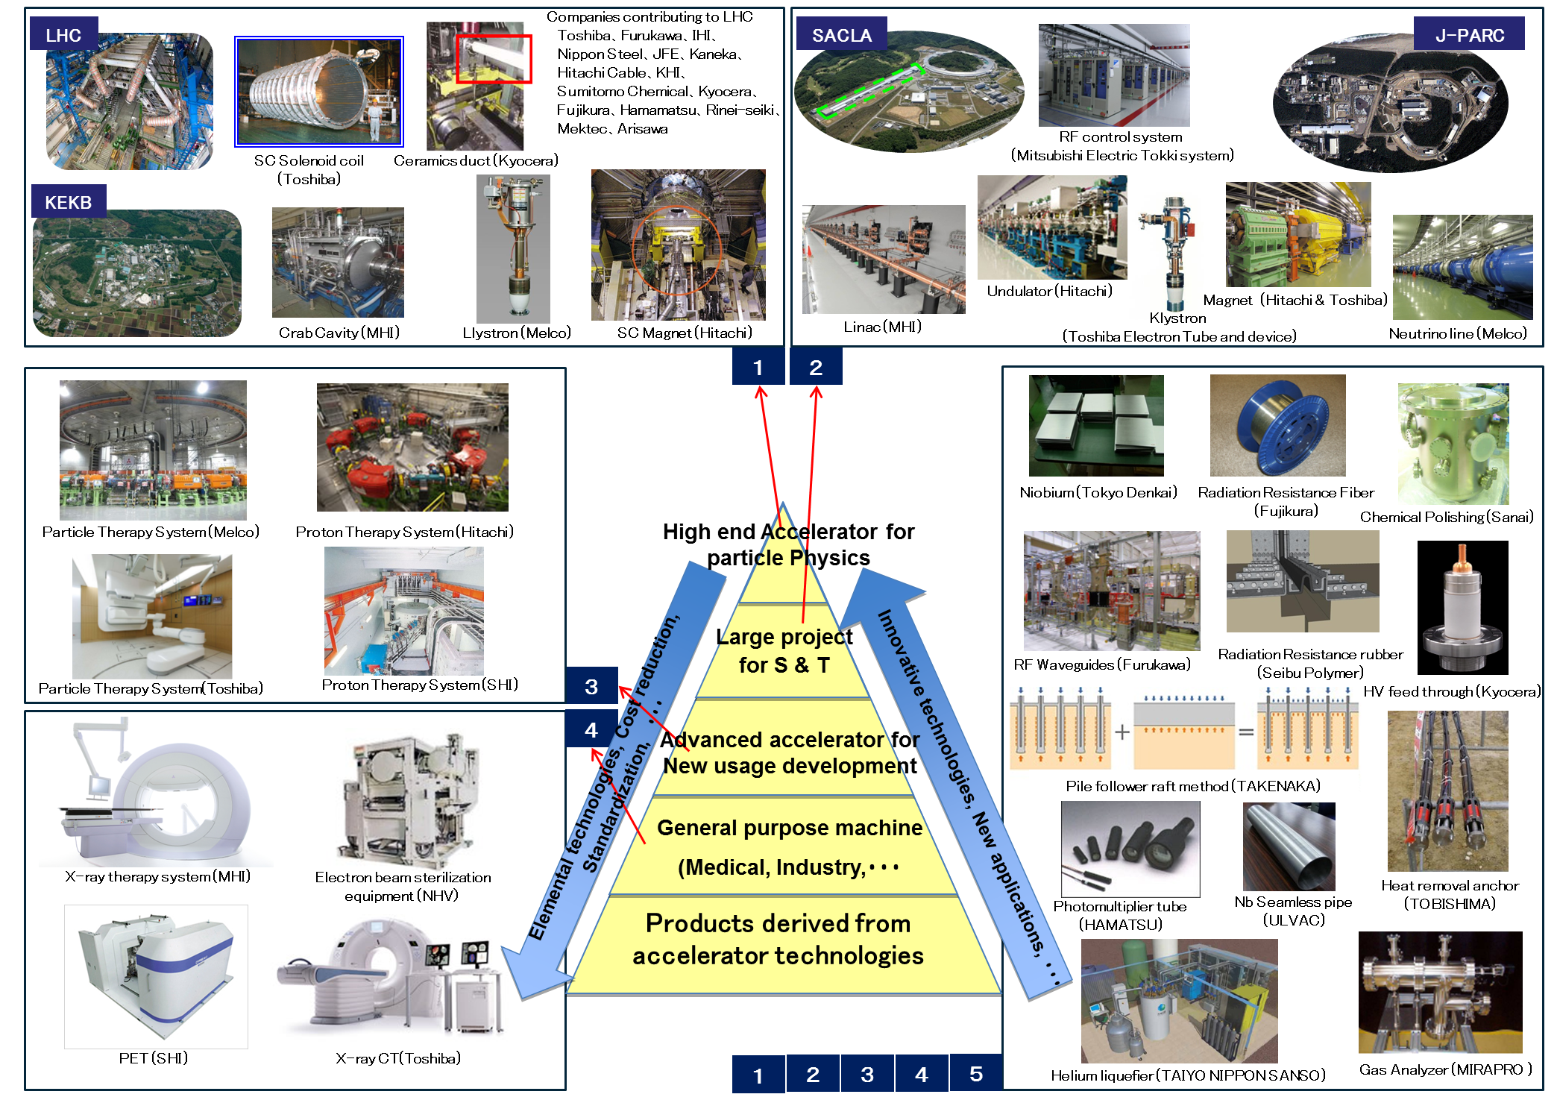
Accelerator industry in Japan
Notes:
(Accelerator industry in Japan)
Let’s put the accelerator industry of Japan on the accelerator pyramid.
Many companies in Japan are playing important roles in various fields from the latest accelerator for the particle physics to the application products.
High end accelerators push up the top of this pyramid and contribute to widen the science and the technology related with the advanced accelerators.

Slide 16
Japanese companies contribute to the advanced accelerator projects in the world
Companies which have contributed to LHC
Company | Products
Toshiba corporation | Superconducting magnet, TDC chip
Furukawa, Ltd. | Superconducting cable
IHI corporation | 1.8K refrigeration units
Nippon steel, Ltd. | Non-magnetic steel plate
JFE steel corporation | Non-magnetic steel plate
Kaneka corporation | Insulation film for SC wire
Hitachi Cable, Ltd. | Superconducting cable
Kawasaki Heavy Industries, Ltd. | Cryostat for Liquid-Ar, CMS end york
Sumitomo Chemical | Aluminum for SC Cable
Kyocera corporation | Ceramics duct
Fujikura, Ltd. | Rad-hard optical fibers
Hamamatsu photonics K. K. | Photo-tube, Silicon sensor, SCT module
Rinei Seiki, Co., Ltd. | TGC(Thin Gap Chamber) trigger chamber
Nippon Mektron, Ltd. | Cu/Polyimide flexible circuits
Arisawa Manufacturing Co., Ltd. | Polyimide film
Notes:
(Japanese companies contribute to the advanced accelerator projects in the world)
The Japanese accelerator-related company is playing an active part also overseas.
This is a company list of Japan which contributed to LHC construction.
A superconductive cable is begun and the sensor, an electromagnet, a freezer, etc. support the project with the state-of-the-art technology.
海外でも日本の加速器関連企業は活躍しています。
これは、LHC建設に貢献した日本の企業一覧でございます。
超伝導ケーブルを始め、センサーや電磁石、冷凍機など、最先端の技術でプロジェクトを支えています。

Slide 17
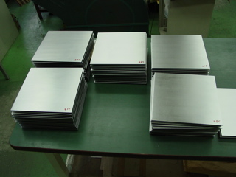
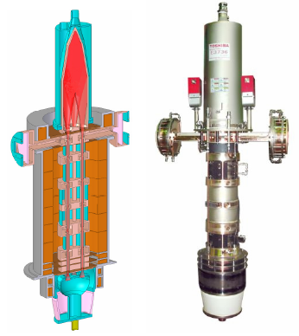
Japanese companies contribute to the advanced accelerator projects in the world
Companies which have contributed to Euro-XFEL
Company | Products
Tokyo Denkai Co., Ltd. | Pure Niobium Sheet
Toshiba Electrical Tubes and Devices Co., Ltd. | L-band Klystron
Kyocera corporation | Feed through flange
Companies which have contributed to other projects
Company | Products
Mitsubishi Heavy Industries | S-band accelerator Superconducting accelerator
Mitsubishi Electric | Superconducting accelerator Superconducting magnet
Toshiba corporation | Normal conducting cavity
Toyama | Beam line instruments
Notes:
This is an example of European XFEL.
The Japanese company supplied high purity niobium, a klystron, feed through of high-frequency power, etc. which influence the performance of a superconducting accelerator.
In addition, the Japanese company is playing an important role in overseas various accelerator projects.

Slide 18
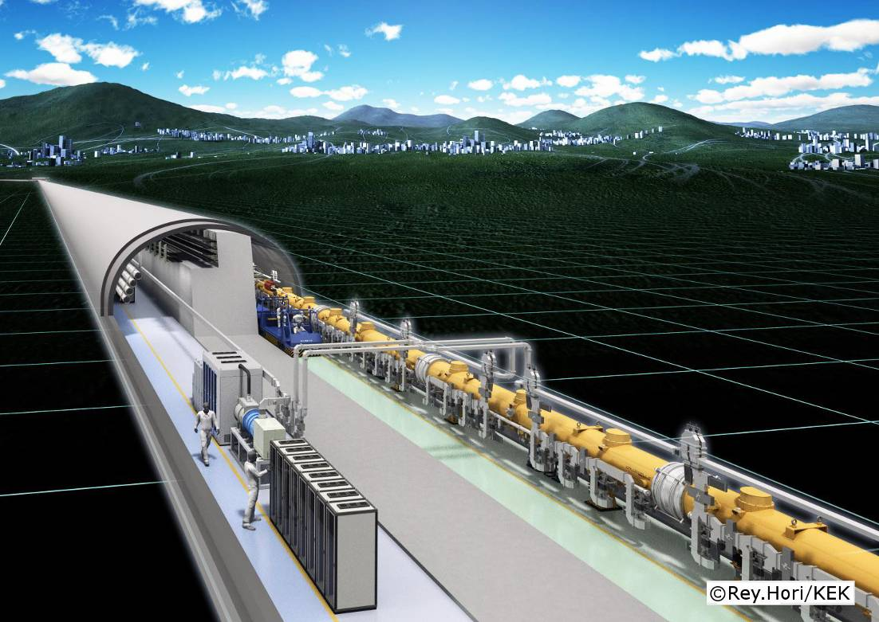
Study of technology spillover effect of ILC
Key Tech. from ILC
High reliability RF system
Energy Recovery Linac
/ Monochrome X-ray
New material
Drug discovery
Spillover Tech.
Cancer therapy
Nuclear Transmutation
New application
High power neutron source
High performance Hard disk
RF technology
Superconducting
technology
ILC
Ultra precise measurement method for magnetic material
Polarized electron
Ultra-short pulse beam
Ultra precise Lithography
High sensitivity sensor
Data analysis
High performance inspection technology
Big data analysis
Cloud computing
Information & Communication Technology
Early detection of cancer
High reliability of industrial machines
Notes:
(Study of technology spillover effect of ILC)
The construction cost of the ILC is estimated 1 trillion yen.
This investment will spend for the basic science fundamentally, but this idea may not be able to accept by the ordinary tax payer.
We are considering that the ILC is not only for the basic science but also for the innovation which will be useful for all the people.
This point of view is very important to obtain more understanding from general people.
We studied technology spillover effect of the ILC to inform general people about the impact of our life as correctly as possible.
The key technology from the ILC shows here in the red boxes.
And yellow boxes are produced by technical derivation, and blue is products using them.
For example, when superconducting accelerator technology ripens, the neutron source of large intensity and synchrotron orbital radiation equipment are miniaturized and used widely, and it can be expected that the exotic material development which is the use place, and development of a new medicine will be promoted.
Moreover, when the reliability of a superconducting accelerator develops, I think that the way to nuclear transmutation technology is also opened.

Slide 19
Economical Benefit of ILC
Local economical Impact
Technology Improvement
Economical effect from International academic city
technology improvement by tackling the cutting edge manufacturing
Creating New Market
Human Resource
New products and new market created from ILC technology
Gathering superior people from all over the world and pushing up our educational level, especially science field
Innovation
The new idea from ILC leading to innovation beyond our imagination
Notes:
(Economical Benefit of ILC)
Is any impact for Japan, as for ILC?
Chairman Nishioka of the AAA is telling as follows at the symposium in 2012.
“Two view points are significant regarding ILC. One is the cutting-edge manufacturing and the other is to make the model case to improve Japanese industry.
In this several decades, the mass production has been our strong advantage, but in the future we need to create new fields.
New Intellect should become a core competence of Japan.”
I believe that development of regional economy, accumulation of the excellent talented people from overseas, improvement in technology, development of a new market, and creation of an innovation are expectable by hosting the ILC in Japan.
I also want to realize the ILC in Japan, in that Japan would continue to contribute to the world by science and technology.

Slide 20
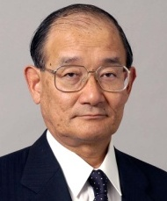
Message from our Chairman
Takashi Nishioka（Chair of AAA, former President of MHI）
Throughout history, physics has not only advanced our understanding of who we are, but also driven the advancement of innovations that have benefitted the whole of human civilization. The internet, advanced medical imaging equipment, and novel approaches to genetic engineering can all be traced to work done to unlock the mysteries of the universe. Currently physicists are working to unravel the history of the universe and discover the origin of matter. To solve these mysteries, advanced equipment will be required. The International Linear Collider, or ILC, will be a crucial facility which will allow researchers to deepen their understanding of fundamental physics. For more than two decades, a worldwide team of thousands of scientists from the Americas, Europe, and Asia have worked on the concept and design of the ILC. Stakeholders in the project are closer than ever to brining the ILC to life. As the ILC is an international effort, we believe that international cooperation is necessary to develop the technology and share the cost of the facility.
The ILC will be a milestone for Japanese physics. In 1949, Dr. Hideki Yukawa was awarded the Nobel Prize for Physics, an achievement of huge importance for a nation still recovering from the devastation of the Second World War. Japan has produced 11 Nobel Laureates in Physics, proving that Japan is a global leader in scientific advancement. We hope to continue this tradition by playing a prominent role in hosting and constructing the ILC, which will enable future contributions to the field of physics and in advancing technology that will make the world a better place. Robust international collaboration is required to realize this dream and we hope for broad and strong collaboration to bring the next generation of advanced accelerators to life.
Notes:
(Message from our Chairman)
I would like to bring you a message from our chairman who couldn’t be here.

Slide 21
Conclusion
We wish to realize the affluent future with advanced accelerators.
AAA continue to conduct or participate domestic & international events in order to publicize and promote the international cooperation for the ILC.
Notes:
(Conclusion)
Finally it is a conclusion.
The conference is promoting activity for technology development of accelerators including ILC.
The Japanese company contributes to the accelerator project in and outside the country with technology.
Towards ILC realization, a conference plans an event in and outside the country, and is sending the meaning of ILC widely.
If much more exchange about technology can be promoted between Japan and Spain by considering today's symposium as a start, I will think a very wonderful thing.
Thank you for your attention.

