Slide 1
(Selected) SRF R&D activity at CEA
Saclay
| SRF group meeting @ KEK
C. Z. Antoine (O. Napoly, F. Eozenou, T. Proslier…)

Slide 2
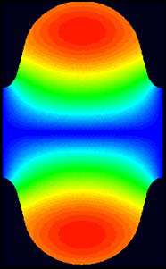


Ultimate limits in SRF-1
Niobium cavities
  Performances
    E_{acc} α H_{RF}
    Q₀ (α 1/R_{S}) α T_{C} => Nb₃Sn, MgB₂, NbN…
    Limit = magnetic transition of the SC material @ H_{peak}
  Superconductivity only needed inside :
    Thickness ~ < 1 µm => thin films
    (onto a thermally conductive, mechanically resistant material, e.g. Cu)
  Today :
    Thin films exhibit too many defects
    Only Bulk Nb has high SRF performances
  Issues : getting “defect free” superconductors (yes but not all defects are detrimental…)
H_{Peak}
H_{Max}.
0
H field mapping in an elliptical cavity

Slide 3
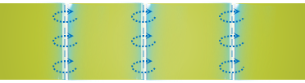

Ultimate limits in SRF-2
Mixed state w.Vortex
(i.e. N. cond. flux line + screening currents)
  SC phase diagram
    All SC applications except SRF: mixed state w. vortex
    Vortices dissipate in RF !
    SRF => Meissner state mandatory !
    H_{C1} = limit Meissner/mixed state
    Nb: highest H_{C1} (180 mT)
    “Superheating field”(?) :
  Metastable state favored by H // to surface
    Difficult to get in real life !
H
H_{C2}
H_{C1}
Meissner state
T_{C}
T
Screening current over λ, no magnetic field deeper

Slide 4
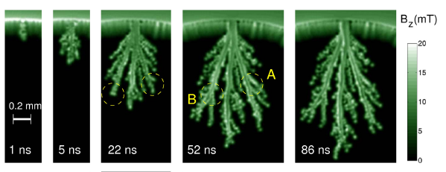



What is the limit (H_{p}/H_{C1}/H_{SH}) ?
  Real world cavities behavior is dominated by a few number of defects
  It is very important to measure the penetration field of samples in realistic conditions
H
$$\vec{HRF}$$
$$\vec{HRF}$$
H
H_{SH}
H//
H//
H_{SH}
H_{C1}
H_{C1}
H⊥
H⊥
T²_{C}
T²
T²_{C}
T²
$$\vec{Happl}$$
  ~100 µm in 1 ns (~RF period)
  Compare with λ (field penetration depth)
    Nb : ~ 40 nm
    MgB₂ ~ 200 nm
  Avalanche : high RF dissipation
MgB_{2:} http://www.nature.com/srep/2012/121126/srep00886/full/srep00886.html?message-global=remove&WT.ec_id=SREP-20121127

Slide 5
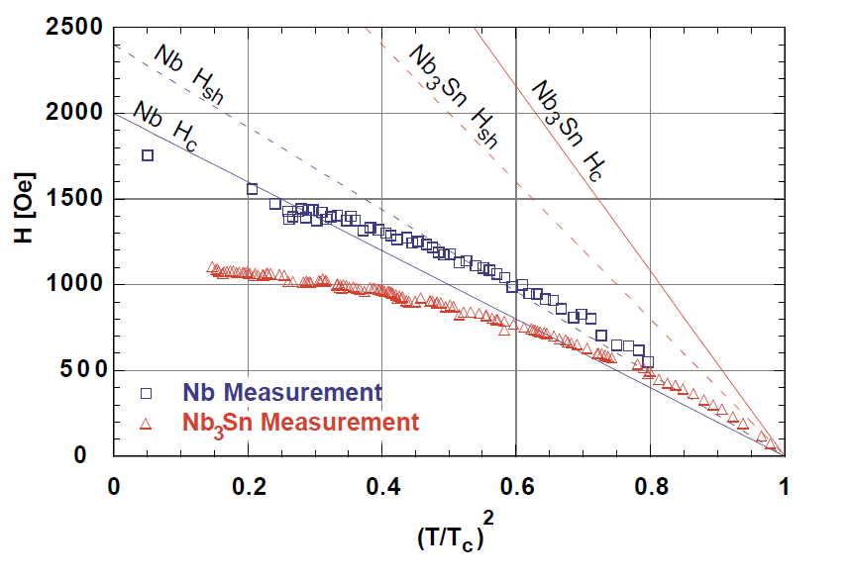
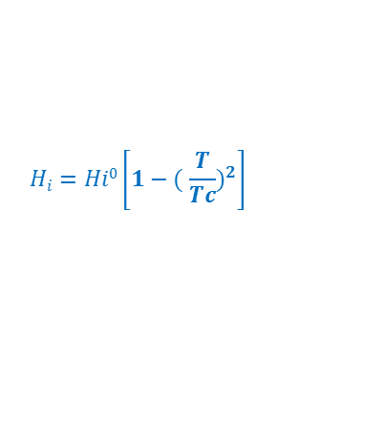
EFFECTs of local defects
H_{SH}^{Nb3Sn}
(~ 400 mT @ 0 K)
Hays. "Measuring the RF critical field of Pb, Nb, NbSn". in SRF 97. 1997.
Nb H_{C1}
(170 à 200 mT)
Nb₃Sn
Cornell, 1997
pulsed
Recent results from Cornell CW (Posen, 2015 (17 MV/m))
$$Hi=Hi0\left.\left[1−( \frac{T}{Tc}\right.)^{2}\right]$$
H_{C1}^{Nb3Sn} (~27mT)
(50 mT pour le bulk)
Dissipations :
~ 2K
  Vortices enter more easily at lower temperature (counter intuitive !)?
    @ T~T_{C} : H is low => low dissipations => easy to thermally stabilize
    @ T<<T_{C} : H is high=> even if small defect => high dissipations => Favors flux jumps
=> We have to reduce defect density (yes but which ones?)

Slide 6
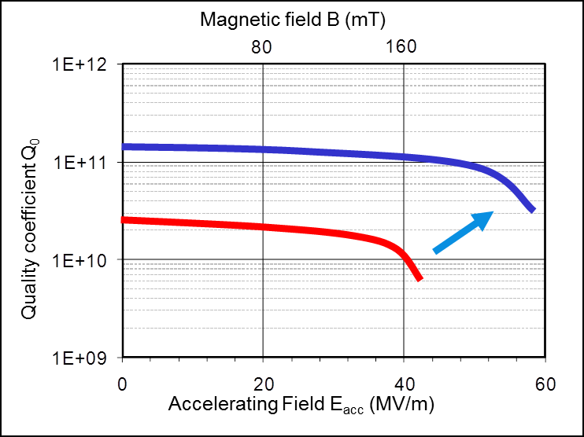


After niobium : nanocomposites multilayers
$$\vec{HRF}$$
$$\vec{HRF}$$
Structures proposed by A. Gurevich in 2006, SRF tailored
  Dielectric layer
    Small ⊥ vortex (short -> low dissipation)
    Quickly coalesce (w. RF)
    Blocks avalanche penetration
    => Multilayer concept for RF application
  Nanometric I/S/I/ layers deposited on Nb
    SC nanometric layers (≤ 100 nm) => H_{C1}↑ => Vortex enter at higher field
    Nb surface screening => allows high magnetic field inside the cavity => higher E_{acc}
    SC w. high T_{C} than Nb (e.g. NbN): => Q₀^{multi} >> Q₀^{Nb}
H_{Nb}
H_{applied //}
d_{sc}
Cavity's internal surface
→
S-I-S
Notes:
A. Gurevich, "Enhancement of RF breakdown field of SC by multilayer coating". Appl. Phys.Lett., 2006. 88: p. 12511.
Couche fine : pas favorable énergétiquement à la nucléation d’un vortex => augmentation artificielle du HC1.
Couches trop fines pour écranter totalement le champ, seulement atténuation : il en faut plusieurs => structures à optimiser

Slide 7
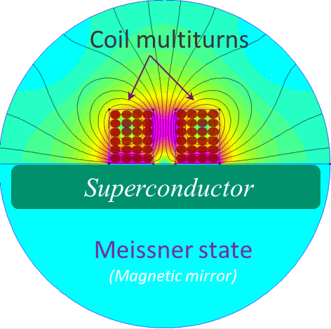
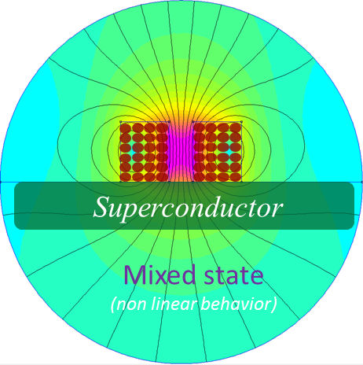

What is the limit (H_{p}/H_{C1}/H_{SH}) ?
  Real world cavities behavior is dominated by a few number of defects
  It is very important to measure the penetration field of samples in realistic conditions
H
$$\vec{HRF}$$
$$\vec{HRF}$$
H
H_{SH}
H//
H//
H_{SH}
H_{C1}
H_{C1}
H⊥
H⊥
T²_{C}
T²
T²_{C}
T²
  Local magnetometry
    ~ Same geometry as cavities
    No shape/edge effect (vs DC/ Squid magnetometry)
    No demagnetization effect
    Measures actual penetration field wherever it is H_{P}/H_{C1}/H_{SH}

Slide 8
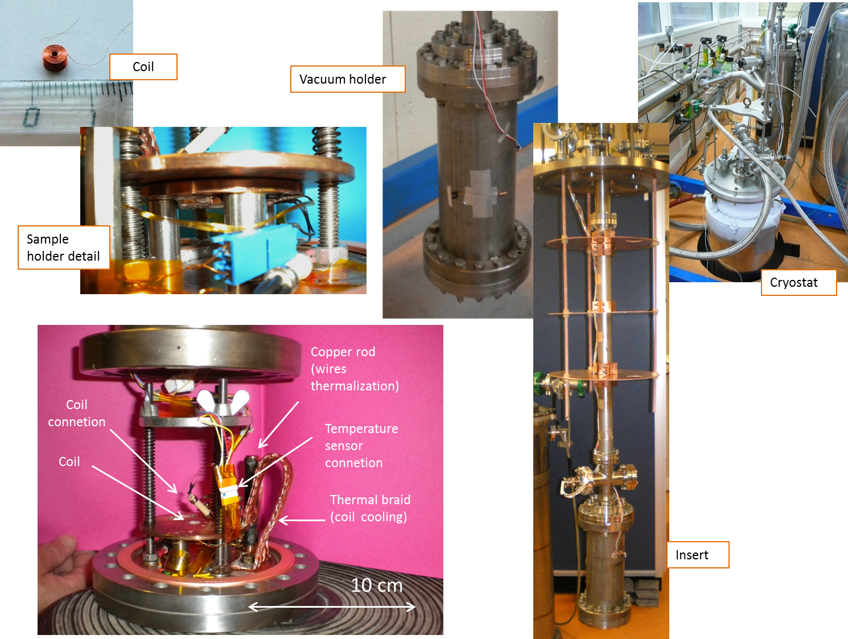
Experimental Details
H
H_{C2}
maximum field without Vx (max E_{acc})
maximum pinning
Vx ~ liquid
H_{Melting}
H_{C1}
Vx lattice
I_{a}/H_{a}
Meissner state
T_{C}
T
  Low frequency ≡ DC :
    0 < H_{a}< H_{C1} => R=O, Meissner state
    H_{C1}< H_{a}< H_{M} =>Vx are trapped, R=O, Campbell regime
    H_{M}< H_{a}< H_{C2} =>Vx are moving liquid like, R≠O, Flux flow regime
    Third harmonic signal arise from flux line tension (affects the e- inside the Cu coil),
    It does not depend on dissipation inside Nb, BUT depends on # of Vx trapped there (and length).
flux line moving in AC field
Vx pinned in the SC

Slide 9
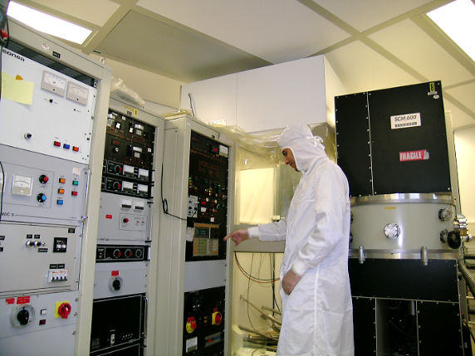
Nb – Insulator – NbN model
  NbN coating by Magnetron Sputtering
  NbN single layers series
    NbN SL / “thick” Nb layer
      Magnetron sputtered
      MgO as dielectric layer
    Far from perfect…
Nb (nm) | MgO (nm) Calc(actual) | NbN (nm) Calc(actual) | T_{C} (K)
250† | 14 | 0 | 8.9
250† | 14 | 25 | 15.5
500 | 10 (10.3) | 50 (65) | 15*
500 | 10 (8.4) | 75 (72) | 14.1*
500 | 10 (9.8) | 100 (94) | 14*
500 | 10 | 125 | 14.3*
500 | 10 (6.7) | 150 (132) | 15.9*
500 | 10 (10.4) | 200 (164) | 15*
† Not same batch, deposited on the same conditions, but substrate = sapphire
*As determined with magnetometry, see below.

Slide 10
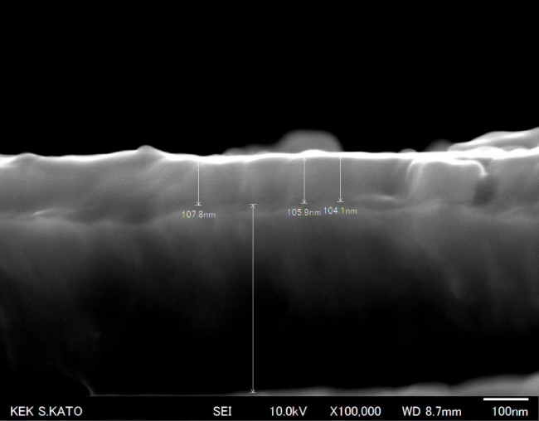
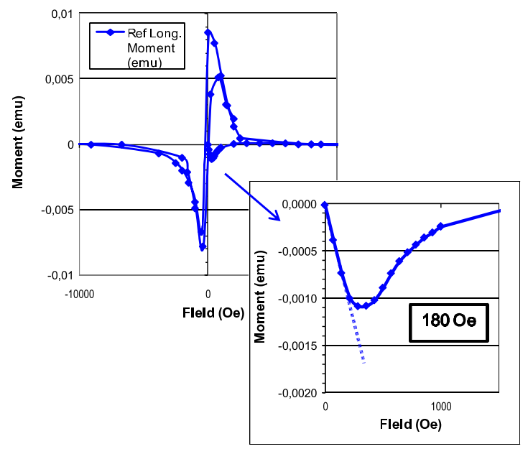
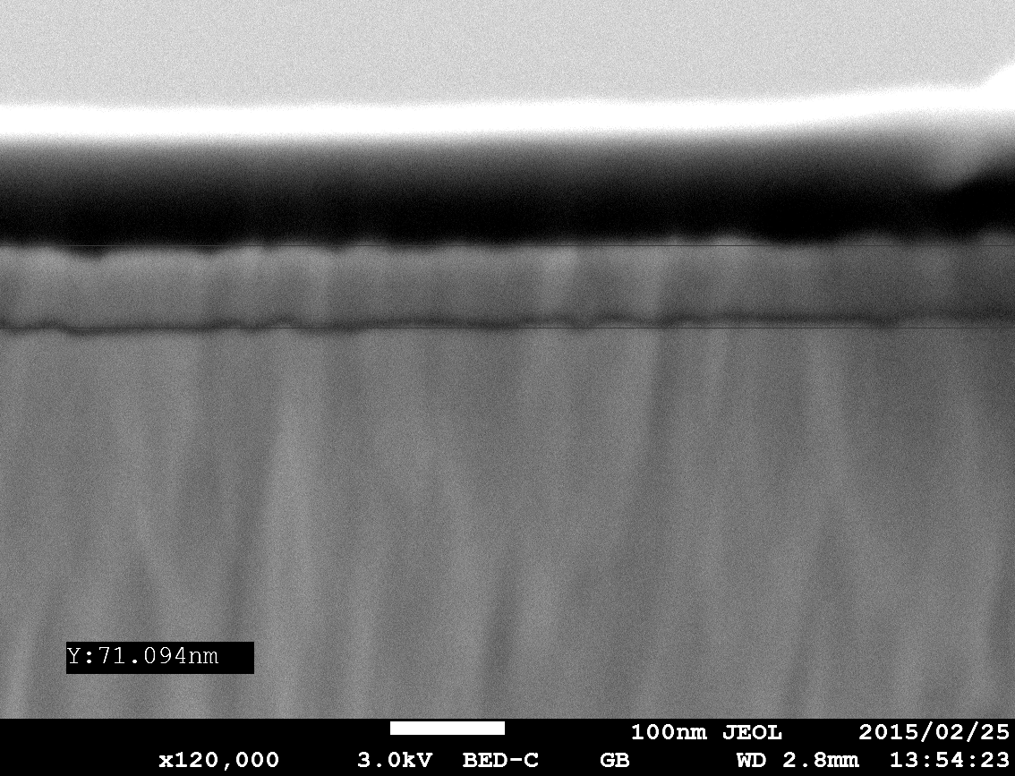
Sputtered (defective) materials…
  Typical defects…
    Low H_{C1}
    Thickness ≠ uniform
    …
    NbN 100nm
NbN Thickness ~ 105nm
250 nm Nb on saphire
DC Squid magnetometry @ 4.5 K
Nb Thickness ~ 425nm
Rippled interfaces
~ 18 mT
As expected for MS samples
    NbN 50nm
| PAGE 10

Slide 11
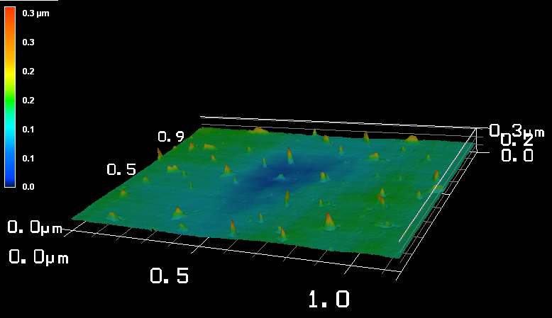
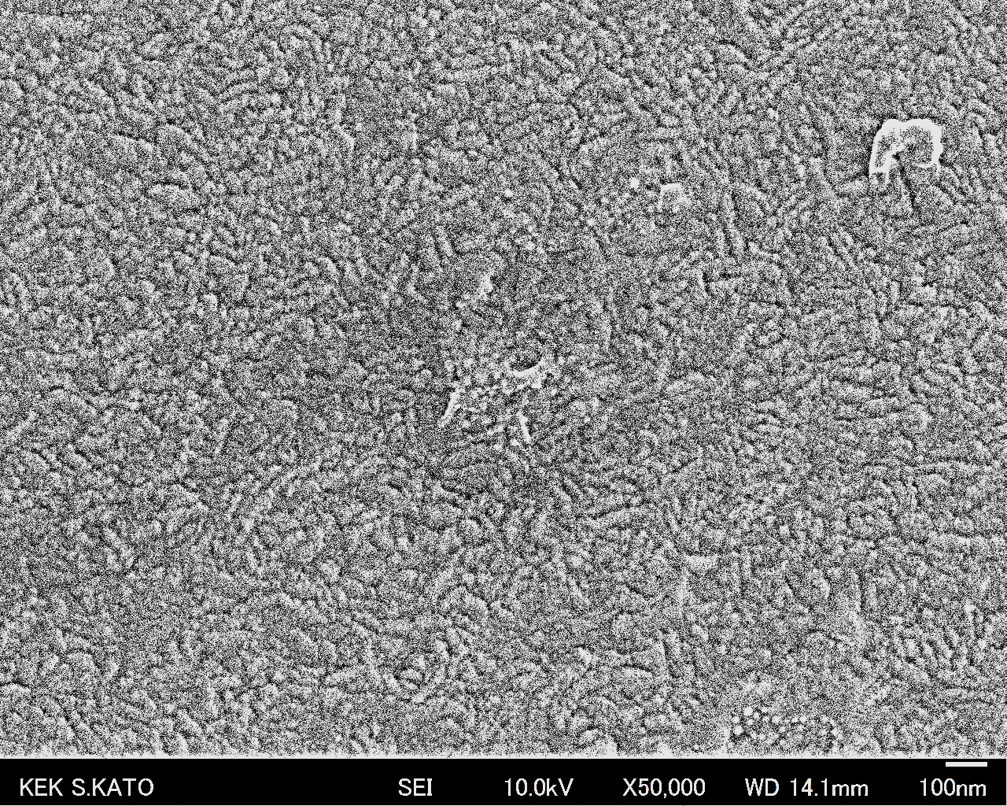
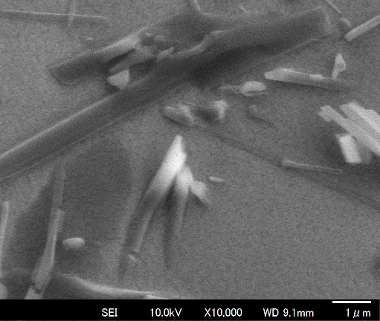
Far from perfect….
  Morphology
    Rough surface
    NbN 50 nm
    NbN 100 nm
    NbN 200 nm
    MgO needle ? (capping material)

Slide 12
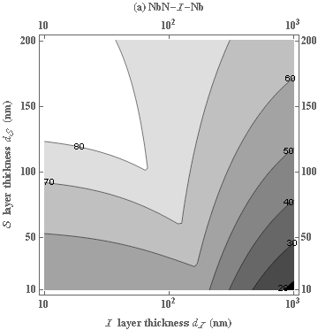
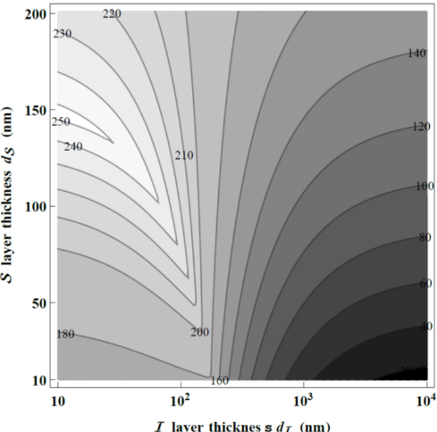
Comparaison with theory
  Theoritical predictions from T. Kubo (KEK)
x
x
Ideal Nb substrate with B_{C1}=170 mT
x
x
Nb with defects*, with B_{C1}=50 mT
* e.g. morphologic defects that allow earlier vortex penetration See SST paper cited earlier
x
x
x
x
x
x
x
x
  The enhancement of the field penetration increases with thickness of NbN
  It reaches a saturation at thicknesses > 100 nm

Slide 13
Comparaison with theory
  Theoritical predictions from T. Kubo (KEK)
x
x
Ideal Nb substrate with B_{C1}=170 mT
x
x
Nb with defects*, with B_{C1}=50 mT
* e.g. morphologic defects that allow earlier vortex penetration See SST paper cited earlier
x
x
x
x
x
x
x
x
  The enhancement of the field penetration increases with thickness of NbN
  It reaches a saturation at thicknesses > 100 nm

Slide 14
CLOSEUP OF 3rd HARMONIC SIGNAL
  For a given H_{appl}, we observe 3 ≠ transition temperatures
Phase signal
1
T~T
T >>T
3
    T~T: within noise level
    T >>T: dramatic transition
2
Voltage signal

Slide 15
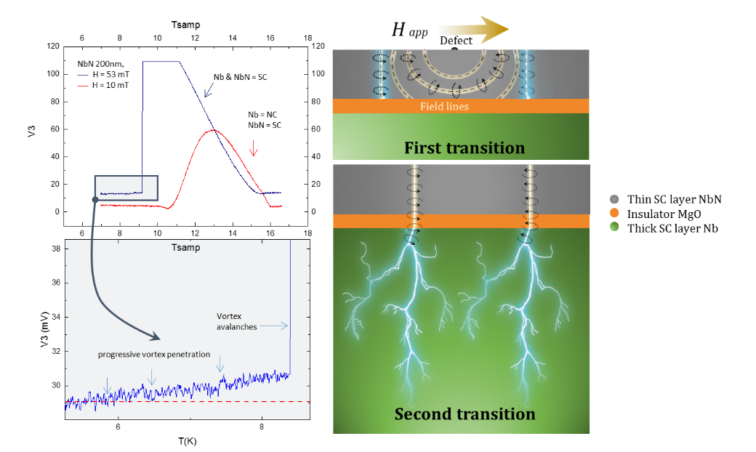
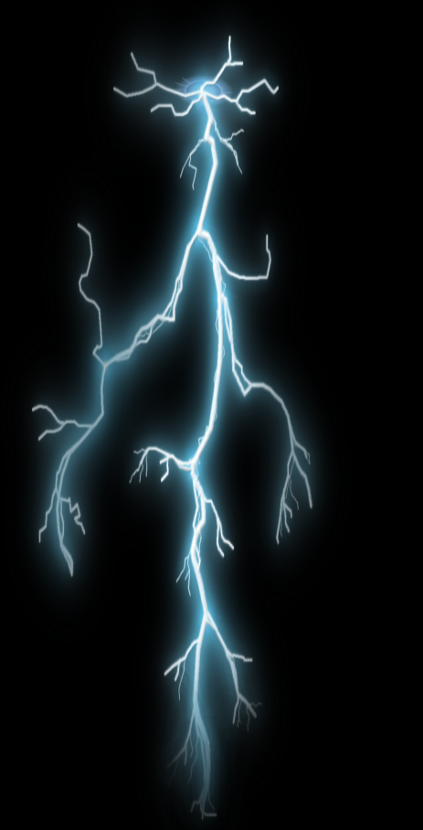
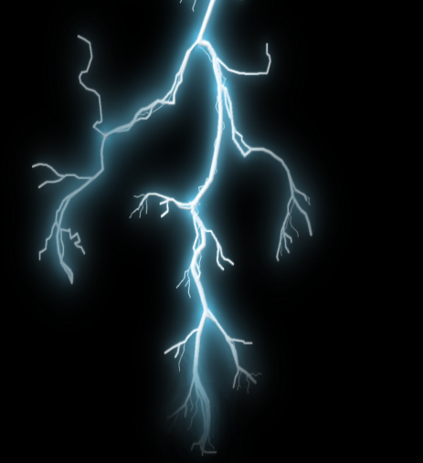
ROLE OF THE DIELECTRIC LAYER !
  Why do we have two transitions ?
H app
Defect
Thin SC layer NbN
Insulator MgO
Thick SC layer Nb
Field lines
First transition
      H // surface => surface barrier†
      A defect locally weakens the surface barrier
      1st transition, vortex blocked by the insulator ~100 nm => low dissipation.
      2nd transition, propagation of vortex avalanches (~100 µm) => high dissipation.
      Dielectric layer = efficient protection !!!
Second transition
†B. Bean and J. D. Livingston, Phys. Rev. Lett. 12, 14 (1964).

Slide 16
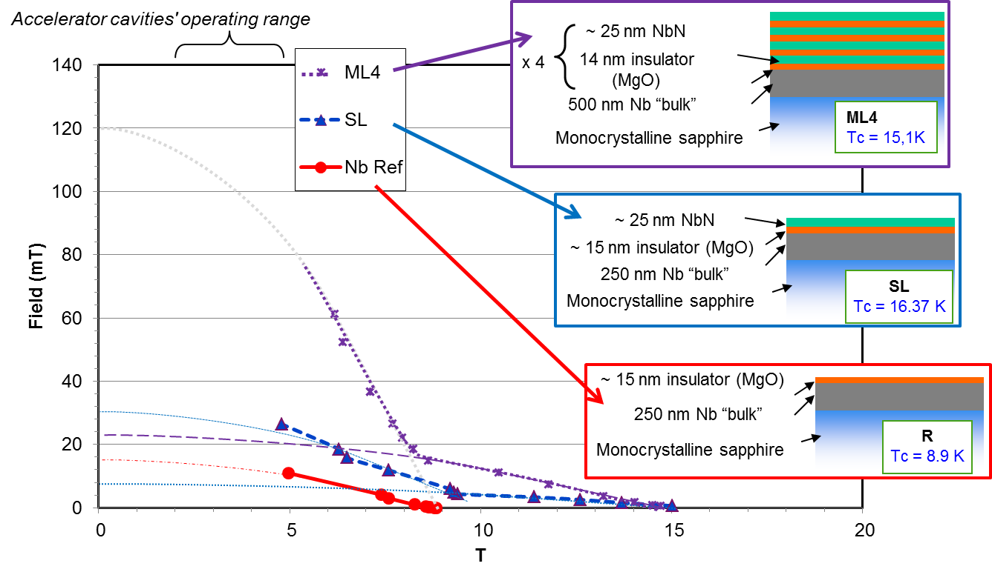
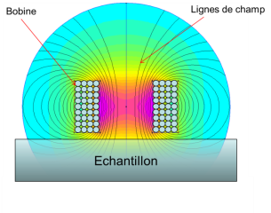
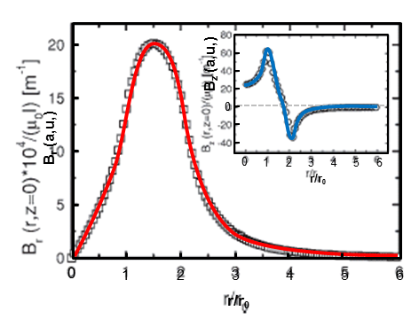
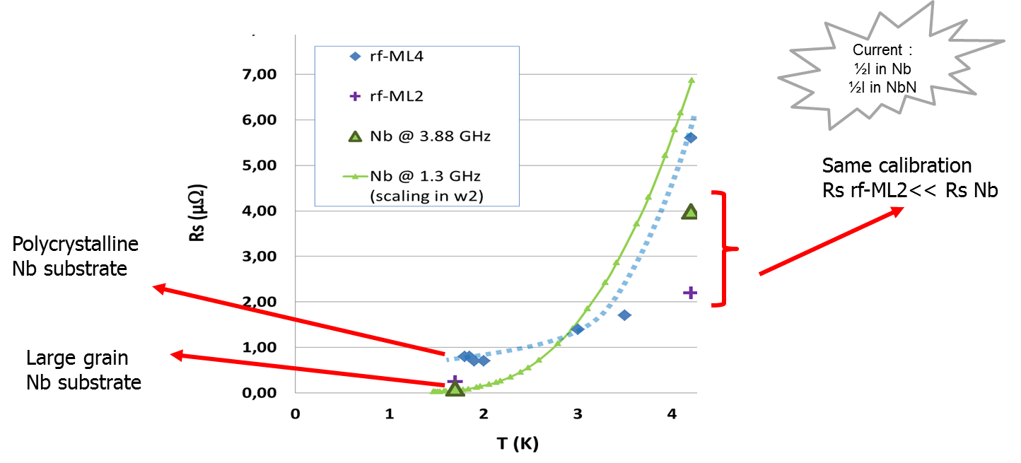
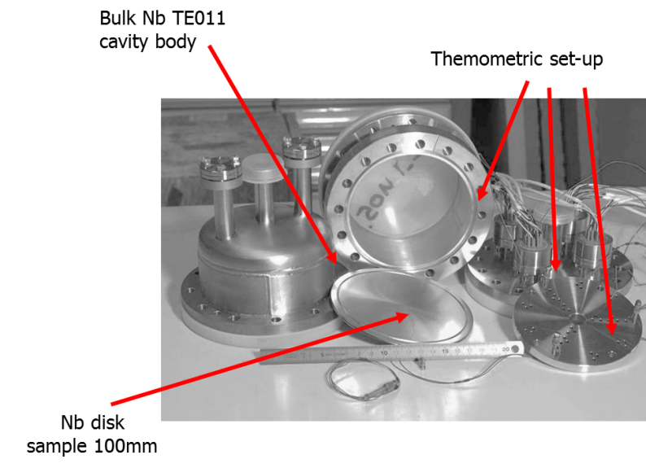
H_{C1} (E_{acc}^{max}) and R_{S} (Q₀^{max}) estimation
  Local magnetometry:
  RF test (collaboration IPNO)
Notes:
Pas possible de mesurer direct sur une cavité (on ne sait pas encore déposer de telles structures sur des formes complexes)
On mesure indirectement
Par magnétométrie : le champ de transition limite (donne une estimation du champ acc maximum)
Par cavité TE011 (5,88 GHz) : la Rs à bas champ (donne une estimation du Q0)
Magnétométrie : Les résultats au dessus de la ligne orange sont à prendre avec des précautions. On espère les confirmer avec les développements prévus cette année (bobine + petite ou échantillons plus grands)
RF La grande inconnue de ces multi couche c’était la résistance résiduelle qui aurait pu s’avérer monstrueuse et mettre tout par terre. Le premier échantillon, très rugueux présentait une résistance résiduelle seulement 5 fois plus grande que celle du Nb, le deuxième beaucoup + lisse est quasiment identique à celle du Nb . Dans ces échantillons la moitié du courant seulement passe dans les couches, l’autre moitié dans le Nb… on a donc bon espoir de faire beaucoup mieux

Slide 17
Conclusion and outlook
  Scientifically:
    Very challenging upstream, discovery, R&D
    Efficiency of multilayer concept demonstrated
    Field enhancement => higher SRF performances
    Protection against “avalanches” => can accommodate defective (real) material
    Results close from theory => will help optimization
  Future :
    Developing deposition techniques e.g. ALD, ECR, HPIMS….
    Up-grade of existing Nb cavities
  Change of paradigm in SRF technology at hand

Slide 18
THANK YOU FOR YOUR ATTENTION

Slide 19
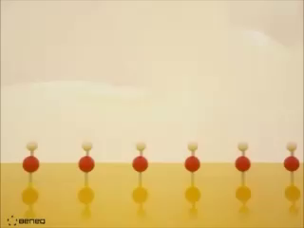
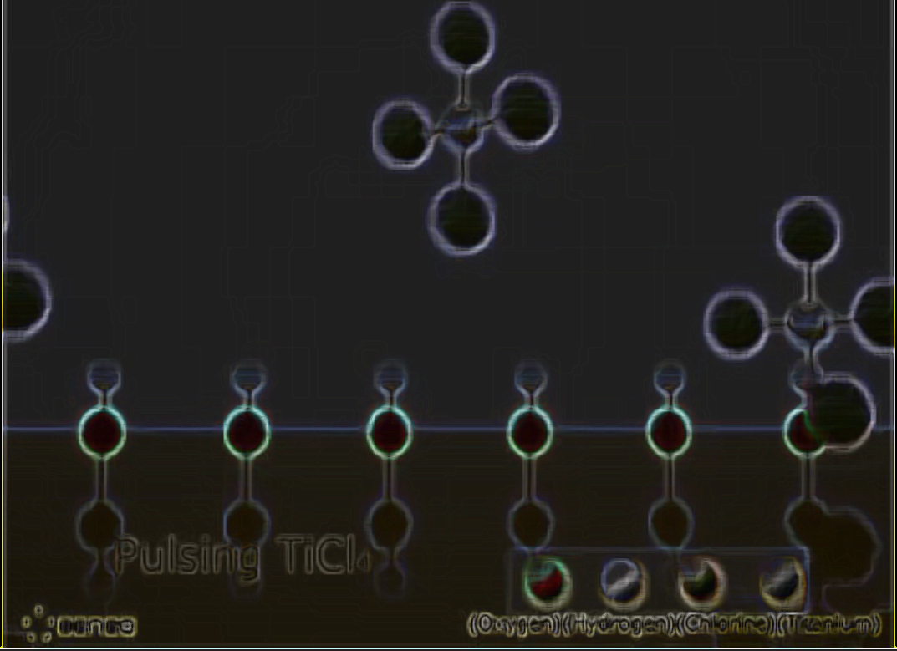
TiO₂ .Atomic layer deposition
Extract from http://www.youtube.com/watch?feature=player_detailpage&v=XMda8TXLIFk

Slide 20
What do we measure ?
H = 7 mT
Determination of Hc1
  Low field => one transition
  High field => two transitions
    1st transition with low dissipation
    2nd transition very strong dissipation
Why do we have two transitions ?
H = 25 mT
1st transition
2nd transition
NbN 200nm

Slide 21
What kind of defects ?
Morphologic defects (pores, steps, facets…)
Site with depressed superconductivity (NC, SC but local change of κ, ξ...)
~1 nm
~1 µm
Micro- to nano-roughness (go to fractal approach ?)
.
⊥
Early penetration / Flux trapping => same battle!!!
⊥
⊥
⊥
°
⊥
Crystalline defects :
Interfaces (inclusions) > GB >⊥ cells > ⊥(=dislocations) > vacancies or interstitials
3D
2D
1D
0D
Strain on the crystalline lattice
Plays on l, κ...

Slide 22
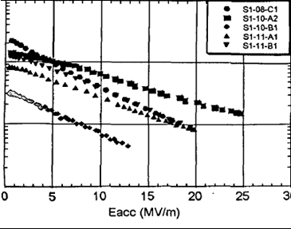

Why bulk niobium ?
  Bulk Niobium:
      grains ∅>~ 50 µm to mms, good crystallographic quality
  Niobium ~1-5 µm/Copper :
      ∅ <~ 100 nm, many crystallographic defects, grain boundaries…
      sometimes better low field performance (thermal configuration and/or cost)
  It is changing !!!: New emerging thin films techniques
Typical sputtered Nb cavities
1.5 GHz
Typical Good bulk Nb cavity
1.3 GHz

Slide 23
Nb-MgO-NbN trilayers
  Transition field (H_{SH} here ?)
  NbN single layers series
    NbN SL / “thick” Nb layer
      Magnetron sputtered
      MgO as dielectric layer
Saturation ?
Maybe it is still worth trying to go to thicker samples
  The enhancement of the field penetration increases with thickness of NbN
  It reaches a saturation at thicknesses > 100 nm
Maybe this sample quality is not good !

Slide 24
SRF R&D @ CEA Saclay:
Layout
Polishing
  Chemical polishing / Electropolishing
  Damage layer / Mechanical polishing
Characterization tools
  Local magnetometry
  Point contact Tunneling
  Cp measurement
Future superconductors
  ALD/Doping studies
  Multilayers
Miscealenous
  Quench location
  Flux trapping studies
Notes:
Longueurs caractéristiques ξ₀, λ₀, l
$ℓ$<< ξ : GL Linéarisées
éléments de la théorie BCS
Comportement résistif en AC/RF

