Slide 1
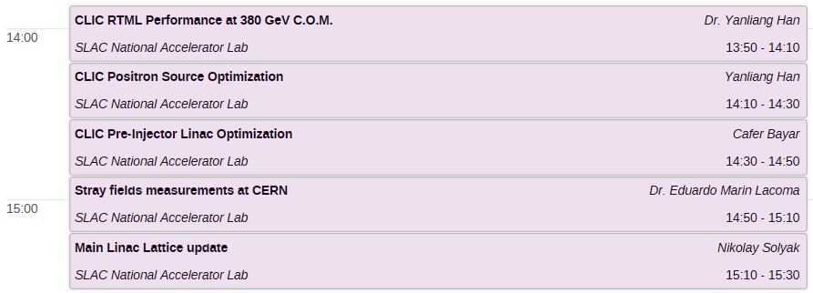
Beam Dynamic session: Tuesday 27 June
Conveners: A.Latina, K.Kubo, N.Solyak

