Slide 1
Comparison of Undulator and e-Driven Schemes
K. Yokoya
2017/6/6
5-rank evaluation
A: Complete model or some prototype exists. Can be finalized if tried.
B: Basic partial tests done or known to work. No whole prototype.
C: Calculation study only. But no show stopper seen yet.
D: Break through needed
E: Fatal (of course there is no E)

Slide 2
Recent Progresses (1)
Problem of heating FC (Flux Concentrator) by photons was found for 250GeV CM.
  More than factor 3 higher than PEDD (Peak Energy Deposit Density) limit of Copper
  Seems to be mainly large angle from low energy photons
  Several cures studied
    Move undulator closer to the target
    Estimate the effect of masks (already in TDR., to protect undulators)
    Thinner target
    Collimator just before the target (similar to that for higher polarization but aperture larger)
    Larger iris of FC (not yet)
  The first 3 will reduce PEDD by factor 2/3, but not sufficient yet

Slide 3
Ushakov. 2017.5.18

Slide 4
Recent Progresses (2)
Positron yield with thinner target
  14mm in TDR
  Thinner target seems to be better for 125GeV electron
  No yield reduction down to ~7-8 mm
  Reduction of the energy deposit in the target is quite significant
  5.4kW@15mm, 5kW@14mm
  → 2.7kW@9mm, 1.5kW@6mm (same e+ yield)
  Reduction of PEDD on FC is not too large (~10%)
Now, revising the undulator scheme parameters with thinner target (~7mm) for 250GeV staging

Slide 6
Comparison of Technical Feasibility of Undulator/e-Driven Schemes
There are many pros and cons for both schemes such as polarization, timing constraints, coupling of operation of e+ and e-, etc.
However, these are well known by now. At this moment the primary issue is the technical feasibility.
  How far from realization?
  What is the expected status after couple of years?
Other issues such as upgradeability (more bunches, higher energy), cost, power consumption, etc. are only of secondary/tertiary concern.
Here, we summarize the technical status and future prospects for establishing the plans for the near future.

Slide 7
Driver Beam
 | Undulator |  | e-Driven
Input beam | Undulator photons |  | S-band NC Electron Linac
 | 231m undulator for 125GeV electron |  | 3 GeV electron
Issues | field accuracy | B | 300 Hz | B
 | alignment | B
 | (better if the undulator pitch is reduced, but for now assume no improvements)
xx

Slide 8
Alignment/Field accuracy of Undulators
The photon beam must hit the target with an accuracy better than ~1mm. If this is routinely satisfied, we need not worry about the case that the beam misses the dump window.
Since the photons are emitted forward of electron, an alignment algorithm of minimizing the electron angle (not position) must be developed.
Once aligned, a feedback system can keep the photon spot.
The undulator field must be accurate such that integral B(s) ds / integral |B(s)| < ~10⁻⁴ . Otherwise, the electron would be bent by more than 1/γ in an undulator. I think the first prototype at Cockcroft did not satisfy this.

Slide 9
Target
 |  | Undulator |  | e-Driven
Specification | Rotation speed | 100m/s |  | 5m/s
 | Material | Ti alloy |  | W or W/Re
 | thickness | 0.4X₀ |  | ~4X₀
 | Cooling | radiation |  | water
 | rotation axis | non-penerate |  | penetrate
Status/issues | Wheel | Specification not determined yet (coming soon) | C | Durability of Magnetic fluid under radiation confirmed | A
 |  | magnetic bearing under study | C | Rotation test ongoing in vacuum | B
 | Cooling | calculation only | C
 |  | Lab test plan proposed
 |  | Ti-Cu joint | B | W-Cu joint. Lab tests still to be done with a 50 cm wheel. | B
xx

Slide 10
Life Time of the Wheel
Right now the only criterion is PEDD 30J/g which came from SLC experience
It can be questioned how general this criterion is.
  Average power, average temperature, dpa,…..,
Further tests seem to be non-realistic at least for the time scale of ILC
Must prepare for frequent target replacement

Slide 11
Matching Device
 | Undulator |  | e-Driven
 | FC (Flux Concentrator) (or QWT as bottom line) |  | Flux Concentrator
beam pulse length | ~1ms |  | ~1μs
peak field | 3.2T |  | ~5T
Status | no design yet |  | Close to SuperKEKB design, but larger aperture & 2 coils. Design of the body exists
Issues | t-dependence of F(z) of FC. Break through needed. | D | water cooling not yet considered | B
 | PEDD on FC iris (factor >2 above the Cu limit) | B | Power supply design needed | B
 | QWT may be a substitute of FC, but need to study positron yield for QWT (1/1.6 in TDR but not well studied). Also, QWT hardware. | B
xx

Slide 12
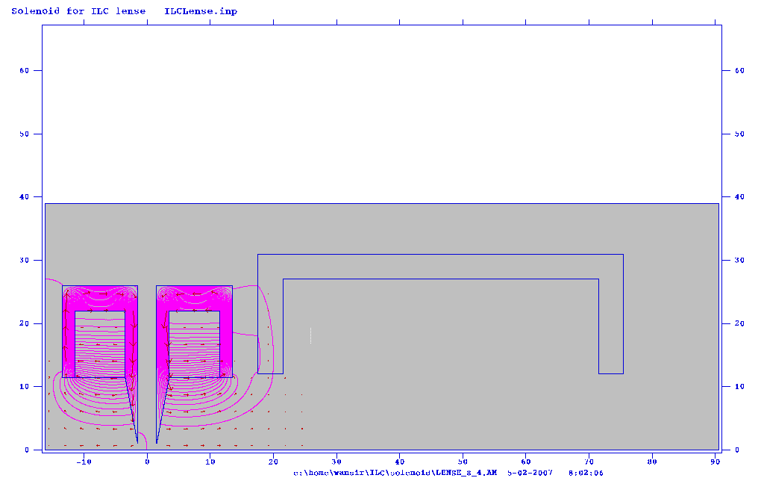
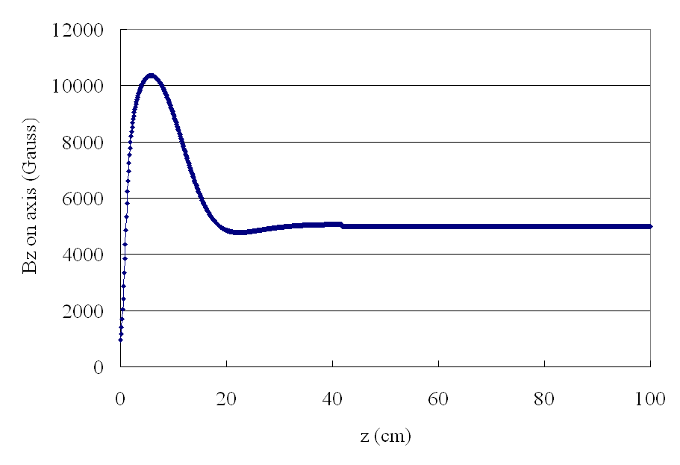
QWT
Bucking
Focusing
Matching
Wanming Liu

Slide 13
Ushakov. 2017.4.5
QWT not the same as in previous page

Slide 14
Capture Cavity
 | Undulator |  | e-Driven
Specification | L-band NC |  | L-band NC
Issues | long pulse NC | A | cavity deformation by heating | B
 |  |  | transient loading compensation | B
 |  |  | cooling not yet designed | B
 |  |  | durability under radiation | B
xx

Slide 15
Beam Dump
 | Undulator |  | e-Driven
photon dump | TDR scheme does not work. A few candidates. No.1 candidate is water curtain dump with tumbling window | C | Necessary but not a big issue because only a small fraction of the energy deposit comes to photon/electron dump (This means radiation shielding is important) | A
 | Simple illustration only | C
electron dump |  | A | must also consider the case of target absence (accident or commissioning) | A
xx

Slide 16
Shielding and Target Replacement
Definitely needed but not urgent now
Can be done later
For both, the civil engineering has to be fixed soon? Access, safety, tunnel size, cranes, transport vehicles, lifts,….
 | Undulator |  | e-Driven

Slide 17
Upgrade to 2625 Bunches
 | Undulator |  | e-Driven
Issues | Larger/heavier wheel needed because of doubled average power. The weight of the wheel will be > 100kg. The life may be short. | B | loading compensation difficult if the bunch interval is 3ns (i.e., in case 2nd DR is not built). | D
 |  |  | If the bunch interval is 6ns (i.e., build 2nd positron DR), there is still a possibility to accept 2625 bunches, but various studies are needed | B
xx

Slide 18
2625 Bunches with Undulator
The average power deposit on the target with 1312 bunches for the yield e+/e-=1.5 (decelerating capture)
Beam energy (GeV) | 125 | 150 | 175 | 250
kW | 5.4 | 3.9 | 3.3 | 2.3
Ushakov. Posipol 2016.
These must be doubled for 2625 bunches
But recent study showed 5.4kW for 125GeV can be decreased to 1/3-1/2.
Then, doubled bunch number may still be possible at 125GeV, also at 250GeV.
Further study needed. The main issue seems to be the required weight of the target wheel. Sabine suggests possible reduction of the weight (thinner body for thinner target, lighter central part)

Slide 19
Overall
 | Undulator |  | e-Driven
Positron pol. | Yes | A | No
Timing constraint | Needed |  | No needed (but will be taken into account)
2625 bunches | May be OK but more heating | B | Presumably no unless 2nd positron DR is added | D
 |  |  | May be OK if 2nd DR | B
Target |  | C |  | B
Matching device | FC t-dependence of field | D | Improvement from superKEKB | B
 | QWT | B
Capture cavity |  | A |  | B
Beam dump |  | C | (beam dump is not an issue but radiation shielding must be studied instead) | B
Cost |  | A | No serious evaluation. May be slightly more expensive. | B
xx

Slide 20
R&D Plan (Undulator)
JFY2017: mainly simulations & specifications
  Undulator parameters
  Temparature/stress distribution (Cu-Ti contact)
  Wheel design based on new parameters
  Revisit FC
JFY 2018-19
  Wheel
    Lab test of radiative cooling and Ti-Cu contact, made with a small subsector of the wheel (<100k$)
    Feasibility study for rotating wheel (~300k$, should be more))
  FC
  JFY 2020-
    prototyping of target wheel & FC

Slide 21
S. Riemann
 | issues | action | resources
Undulator | Optimize λ, K, L for E_{cm}=250GeV | Sim. | 0.5MY
 | Realistic B field |  | ??
 | Collimators in undul. (vacuum), … |  | ??
Target wheel | Realistic temperature/stress distribution | Sim | 1Y(Eng+Phys)
 | Cyclic load resistance of material | MAMI tests | 1MY
 | Target-radiator contact design | sim
 | Realistic test of radiation cooling | Lab test | 1Y, 1-2 Eng+Techn, ≤100k$
 | Rotating wheel design Dyn. Respons Vibrations, imbalances, eddy currents,… | Sim, preparation of construction | 1.-2MY, + Ext., ≤2.5 MY, 100k$
 | Magnetic bearings (performance specification,…)+ ext. study | Feasibility study | 2x(0.5-1MY), 2x50k$
 | Final Lab test, validation of a small sector of the wheel | Design, built, test a mockup | ~1MY+ Eng.+ Techn ~100k$
FC | Studies to reduce energy deposition, optimization of FC | sim | 1-1.5MY
 | Prototype (design+manufacture+test) | Constr+test | 2MY+test time+Techn ~1mio$
FC+wheel | Fully assembled mock-up (wheel+FC) | Ultimate Tests
QWT ? | reoptimize wheel for QWT ?????? | Sim ???

Slide 22
R&D Plan (e-Driven)
(Assume 1$=100yen)
JPY 2017
  Vacuum seal test on-going at 225rpm
  Target: full-size prototype (50cmφ, but no water circuit, no tungsten) 150k$
  Simulation studies. Re-optimization for 1st stage. Radiation issues (to be continued to 2018)
Following items are needed before construction. May be after JFY2019?
  Target :
    Cu-W braizing test, back up solution with bolts is a robust option.
    prototype (water circuit, W, vacuum, heating test) desired. 600k$?
  FC
    Prototype
  Capture cavity
  Remote handling

Slide 23
Conclusions
e-Driven scheme seems to be closer to reality but we cannot down-select now
  When can we decide? In 2019 after 2-3 year R&D?
  Tentative decision in April was
    Continue the on-going works for e-driven in JFY2017
    Concentrate more on undulator in JFY2018-19
Main R&D issue for the undulator scheme is the mechanical performance of the target wheel.
Flux Concentrator for undulator seems very difficult. A possibility when FC fails is the QWT. TDR says the positron yield with QWT is 1/1.6 times FC (this number must be confirmed). Are we satisfied with a lower luminosity?

