Slide 2
Summary of Staging Consideration
ステージングの検討は最終段階。TCMBのレビュー中。８月にLCBに報告する予定
CFS Conditions & cryomodule distribution
H. Hayano, 07212017

Slide 3
staging option name （given ｂｙ S. Michizono, 02052017）
350GeV option were added
500GeV
TDR:
250 GeV e+
33.5km tunnel
collision timing considered
250 GeV e-
250 GeV
125GeV e-
125GeV e+
20.5km tunnel
Option C:
Option D:
125GeV e-
125GeV e+
33.5km tunnel
Simple tunnel
(no center wall, no facilities)
Simple tunnel (no center wall, no facilities)
350GeV Option D’:
125GeV e-
125GeV e+
27.0km tunnel
Simple tunnel
(no center wall, no facilities)
Simple tunnel (no center wall, no facilities)
Option E:
125GeV e-
125GeV e+
350GeV Option E’:
less important
for staging,
cost reduction
effect are less.
Option F:
125GeV e- sparse linac
125GeV e+ sparse linac
350GeV Option F’:

Slide 4
How to estimate the cost of each option
TDR cost
WG2
Subtract cost reduction of
2014-2016 TDR cost reduction and design change
TDR-updated cost
Decide working assumptions,
and cryomodule configuration,
tunnel configuration.
cost estimation conditions.
Subtract cost reduction of each staging option
each option cost
Estimation of cost for each staging option
in case of 31.5MV/m
Subtract cost reduction by change of 31.5MV/m to 35MV/m, assuming success of 35MV/m Q₀=1.6x10¹⁰ SRF HG,HQ
WG3
decrease of RF unit,
Nb material cost reduction,
surface process cost-reduction,
cryogenics cost reduction,
HLRF cost-increase, etc
each option cost with HG HQ success
35MV/m
Estimation of cost for each staging option
in case of 35MV/m

Slide 5
Working assumption (1)
(1) Considering collision timing adjustment, condition must keep in any option,
option C = remove length between PM+10 and PM+12,
and remove TDR timing adjustment,
and adjust to n=6
option D = adjust to n=10, it is option C + simple tunnel of 6477m (total).
option D’ =adjust to n=8, it is option C + simple tunnel of 3238m (total).
In TDR(Ecm=500GeV), this equation is not satisfied as follows ( additional 294m exist);
collision condition
C_{DR}=3238.68m
Change Request is to adopt n=10;
( L₁ + L₂ + L₃ ) – L₄ = n x C_{DR}
(L₁ + L₂ + L₃’) - L₄ = 10 x C_{DR}
n=integer
with putting 1473m space
in both LINAC (updated TDR)
e⁺

Slide 6
ダンピングリングへのビーム入射・出射
ILCのビーム加速のシーケンス
5GeV 電子ダンピングリング(3.2km)
5GeV 陽電子ダンピングリング(3.2km)
ターン部
ターン部
バンチ圧縮部
final focus
バンチ圧縮部
電子加速部
陽電子加速部
陽電子生成部
偏極電子源
衝突点
1msのビームトレインの中は
1312 bunch (220km length)
ー＞実に長いバンチトレイン！
beam generation （560 ns bunch spacing）
バンチトレイン圧縮
injection with compressed bunch spacing
In damping ring （6ns bunch spacing） : 2.3km length
バンチトレイン拡張
extraction with long bunch spacing
beam acceleration in Linac
（560 ns bunch spacing）
1312 bunch (220km length)

Slide 7
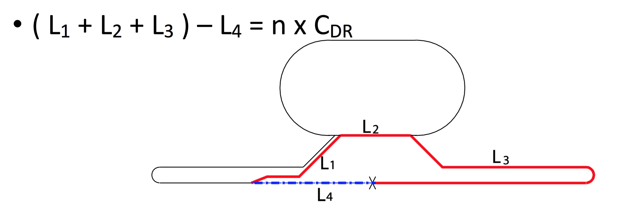
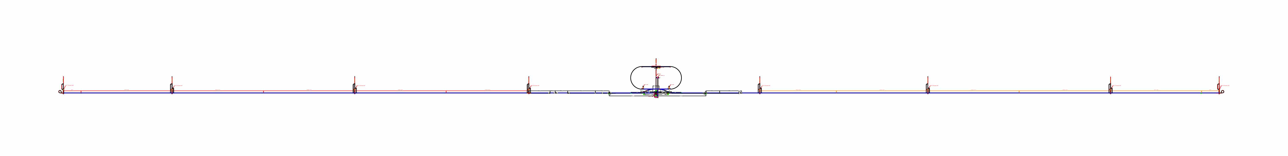
In Option-C(Ecm=250GeV), required Linac length become half, then we can adopt n=6
Shortning the e⁺ LINAC length is possible
as a unit of C_{DR} /2 = 1619.34m.
Keep the same length of e⁻ LINAC
for the symmetric collision energy.
remove 1367.74m
at BDS entrance
(timing adjustment)
remove 202.02m at end of Linac area.
remove L _{(PM+10 – PM+12)} = 4907.8m
( -1367.74m - 4907.8m - 202.02m) x 2 = -12955.12m = - 4 x C_{DR}
L₃ is shortened by 4 x C_{DR} , it means LINAC length is shortened by 6477.56m
1264m
1375m
4907.8m
4911.6m
3413.8m
2334.9m
4795.2m
4907.8m
1375m
1264m
PM-13
PM-12
PM-10
PM-8
PM+8
PM+10
PM+12
PM+13
put 1473m
by change Request
TDR
put 1473m
by change Request
n=10

Slide 8
Working assumption (2)
(2) Keep Energy Reach Margin enough safe to reach target energy (250GeV).
for enough positron production and meaningful energy reach of Higgs physics
(1) Module margin : margin to reach the target energy of the target experiment (0% in TDR)
2.5% module margin(3.1GeV each) for Ecm=250GeV
(2) Availability margin : margin to compensate cryomodule trip (1.5% in TDR, ~3 RF unit trip )
3 RF unit margin correspond to 3% for Ecm=250GeV
(3) Space margin : cryomodule space to be installed more cryomodule in future.
*Anytime 0.5% is required in the operation with cavity phase offset.
Total margin: 1.5%+ 0.5% = 2% for TDR Ecm=500GeV
2.5% + 3% + 0.5% = 6% for Ecm=250GeV, Option C
(3) In case of HG,HQ R&D success;
HG HQ upgrade :from 31.5MV/m Q0=1E10 → 35MV/m Q0=1.6E10 by N-infusion.
Same RF unit configuration, but increase of klystron output to 11MW, 1.75ms.
Consider decrease of number of RF unit for 35MV/m.
The length of tunnel is kept the same as 31.5MV/m.

Slide 9
Working assumption (3)
(4) Only 5Hz Linac operation is considered (not 10Hz).
(5) Maximum cryo-line length of one cryogenics is 2.5km+/-10%, the same as TDR.
This determines the interval of the access point, such as PM+/-8, PM+/-10, PM+/-12
(6) Adopt CR0009 and CR0014 for cryogenics. The access hall is re-considered
with this design change. Angle cross with Linac tunnel and access tunnel
for cryomodule carry in, is considered.
(7) Linac central shield wall is 1.5m thick. Total width of Linac tunnel is 9.5m.
(8) Two Vertical shaft access to detector hall is assumed.
(9) Design change of positron side BDS tunnel and injector-linac position are adopted.
(10) Number of beam dump and power of them proposed by Yokoya are adopted.

Slide 10
Working assumption (4)
(11) TDR-undulator-based positron is kept in this study.
The length of undulator is streched to 231m from 147m with 125GeV beam.
This determines energy sensitivity of positron production
(12) Remove access tunnels at turn-around (PM-13 and PM+13) of TDR tunnel,
not for staging tunnel.
(13) One water-drain-tunnel is considered in the collision point, not at PM-13/PM+13.
(14) Simple tunnel means: normal wall finish, but no central shield wall,
no AC power line, no cooling water line,
however air-condition, lighting and water drain are installed.
(15) Digging tunnel during accelerator operation without serious interference.
(16) Keep the Damping Ring circumference. No design change for DR.
This determines the requirement of collision timing condition.

Slide 11
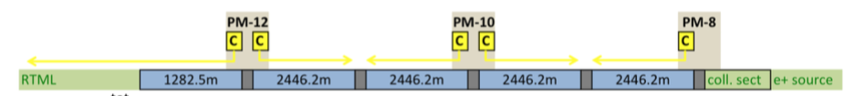
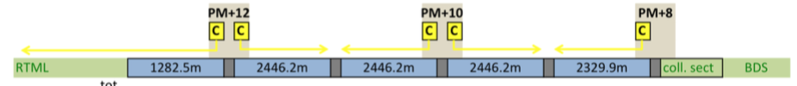
TDR Cryomodule configuration
TDR
put 1473m
by change Request
Ecm = 500GeV
put 1473m
by change Request
SRF 31.5MV/m
129.3m
2509.7m
4907.8m
4911.6m
3413.8m
2334.9m
4795.2m
4907.8m
2509.7m
129.3m
PM-13
PM-12
PM-10
PM-8
PM+8
PM+10
PM+12
PM+13
1264m
1375m
1375m
1264m
IR
BC
Ecm=500GeV
BC
e+inj
e-inj
51
99
189
189
189
189
24
cryomodules
24
180
189
189
189
99
51
17
22
42
42
42
42
8
RF unit
8
40
42
42
42
22
17
10.0
28.1
53.6
53.6
53.6
53.6
5.0
E gain (GeV)
5.0
51.0
53.6
53.6
53.6
28.1
10.0
Total length of tunnel = 15872.2m+14676.9m+1473m+1473m=33495m
Cavity active length = 1.0385m
Energy gain by 1 cavity = 31.5*1.0385 = 32.7 MeV
Energy gain by 1 RF unit = 32.7 MeV * 39 =1.2753 GeV
length of 1 RF unit = 58.3m

Slide 12
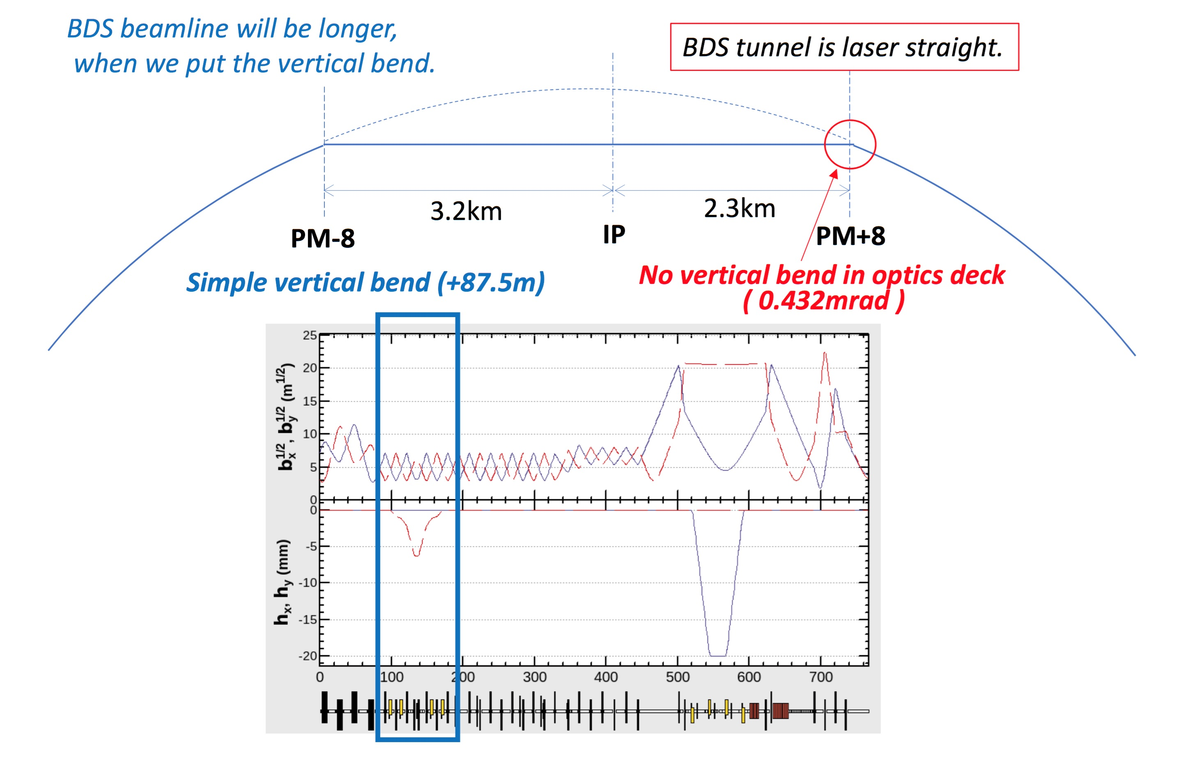
Keep BDS tunnel length as TDR, but put verical bend 87.5m on both entrance of BDS
There is no vertical bend in the optics deck.
ML tunnel should be along geoid
ML tunnel should be along geoid

Slide 13
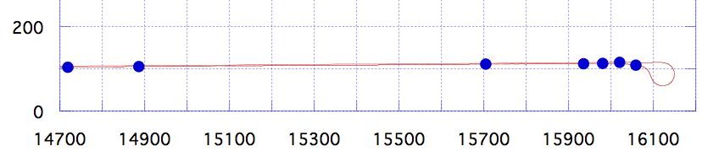
e+ Main Linac end region details
turn-around and bunch compressor
PM+12
TURN
←ML
LAUNCH
BC2
BC1
EMIT
SPIN
e+ ML
LAUNCH
BC2
BC1
^{emit}
spin rotator
turn around
167.6m
818.6m
230.6m
77.8m
45.1m
~92m
1454m
1264m
This is the same length for e- side and e+ side,
We keep this section same in option C,
except EMIT part.
We will touch the ML length for staging.
We will touch this length for staging, too.

Slide 14
Parameters for staging RF unit count
SRF 31.5MV/m
SRF 35MV/m
Cavity active length = 1.0385m
Energy gain by 1 cavity = 31.5*1.0385 = 32.7 MeV
Energy gain by 1 RF unit = 32.7 MeV * 39 =1.2753 GeV
length of 1 RF unit = 58.3m
Cavity active length = 1.0385m
Energy gain by 1 cavity = 35.0*1.0385 = 36.3 MeV
Energy gain by 1 RF unit = 36.3 MeV * 39 =1.418 GeV
length of 1 RF unit = 58.3m
“a Pair of RF units” is the fundamental unit of Main Linac Accelerator
RF unit
58.3m
58.3m
RF unit

Slide 15
manipulation details for option C CFS configuration
TDR Recent Optics Deck (M. Woodley)
Ecm = 500GeV
Total length of tunnel = 17266.9m+16149.9m=33417m
timing path length is matched with n=10
2639.6m
4907.8m
6318m
3401.5m
3729.2m
4795.1m
4907.6m
2718m
PM-13
PM-12
PM-10
PM-X
PM+8
PM+10
PM+12
PM+13
1264m
1375.6m
IP
1454m
1264m
remove this length
for option-C
delta-L = -4907.6m
Option C with n=6
2718m – 404.04m/2
=2516m
3401.5m + 87.5m = 3489m
(2015 Okugi BDS) + 87.5m = 2361.46m
2639.6m
– 404.04m/2
=2437.48m
remove timing adjust
6318m – 1367.74m = 4950.26m
remove this length for option-C
delta-L = -4907.6m
delta-L = -1367.74m
collision condition
( L₁ + L₂ + L₃ ) – L₄ =(L₁’+87.5)+L₂+(L₃’-1367.74x2-4907.6x2 -X) – (L₄’+87.5)
=(L₁’+L₂+L₃’)-L₄’ -( 12550.68m +X)
=10 x C_{DR} - 4 x C_{DR}
= 6 x C_{DR}
( L₁ + L₂ + L₃ ) – L₄ = n x C_{DR}
C_{DR}=3238.68m
4 x C_{DR}=4 x 3238.68m = 12550.68m + X
X = 404.04 m

Slide 16
LINAC configurations for each staging option
(number of RF unit, length of tunnel are considered for each option.)

Slide 17
Option C

Slide 18
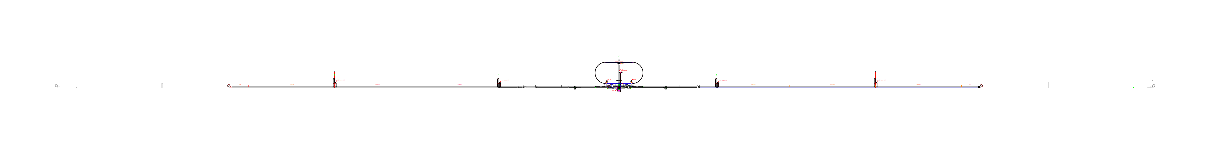
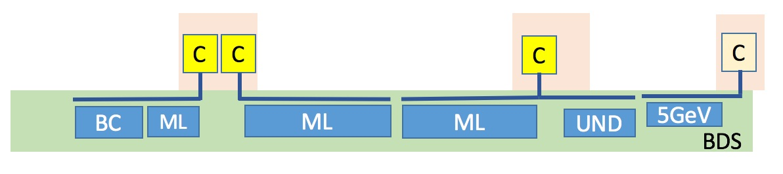
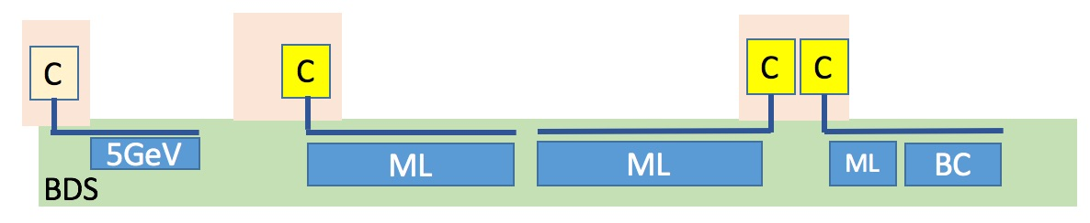
Option C
ECM=250GeV
SRF 31.5MV/m
2437.58m
4950.26m
3489.0m
2361.46m
4795.2m
2516m
PM-12
PM-10
PM-8
PM+8
PM+10
PM+12
(PM-0)drain tunnel
583m space
583m space
IR
BC
Ecm=250GeV
BC
e+inj
e-inj
module space margin
for option C, 31.5MV/m
module space margin
for option C, 31.5MV/m
51
90
189
189
24
module space
24
180
189
90
51
51
45
189
189
24
cryomodules
24
180
189
45
51
17
10
42
42
8
RF unit
8
40
42
10
17
e⁻ 134.8GeV =
10.0
12.8
53.5
53.5
5.0
E gain (GeV)
5.0
51.0
53.5
12.8
10.0
= e⁺ 132.3GeV
+5.8%margin
Total tunnel length = 20549.5m
(20.5km)

Slide 19
Option D

Slide 20
SRF 31.5MV/m
Option D
Ecm = 250GeV tunnel=500GeV length, accelerator at downstream
6477m
2437.58m
4950.26m
3489.0m
2361.46m
4795.2m
2516m
6477m
PM-13
PM-12
PM-10
PM-8
PM+8
PM+10
PM+12
PM+13
4907.8m
4907.8m
4006.8m
2470.22m
2391.8m
4085.2m
IR
Simple tunnel
583m space
583m space
simple tunnel
Ecm=250GeV
Ecm=250GeV
BC
e+inj
e-inj
BC
51
90
189
189
24
module space
24
180
189
90
51
module space margin
for option C, 31.5MV/m
51
45
189
189
cryomodules
180
189
45
51
module space margin
for option C, 31.5MV/m
24
24
17
10
42
42
8
RF unit
8
40
42
10
17
e⁻ 134.8GeV =
10.0
12.8
53.5
53.5
5.0
E gain (GeV)
5.0
51.0
53.5
12.8
10.0
= e⁺ 132.3GeV
+5.8%margin
tunnel total length = 17353.8m+16149.7m=33503.5m
(33.5km)
simple tunnel length = 6477m+6477m=12954m
(n=4 extension on both end)
(12.9km)

Slide 21
Option D’ 350GeV tunnel

Slide 22
SRF 31.5MV/m
Option D’
Ecm = 250GeV tunnel=350GeV length, accelerator at downstream
3238m
2437.58m
4950.26m
3489.0m
2361.46m
4795.2m
2516m
3238m
PM-12
PM-10
PM-8
PM+8
PM+10
PM+12
4907.8m
4907.8m
583m space
583m space
IR
Simple tunnel
simple tunnel
Ecm=250GeV
BC
Ecm=250GeV
BC
e+inj
e-inj
module space margin
for option C, 31.5MV/m
51
90
189
189
24
module space
24
180
189
90
51
module space margin
for option C, 31.5MV/m
51
45
189
189
24
cryomodules
24
180
189
45
51
17
10
42
42
8
RF unit
8
40
42
10
17
e⁻ 134.8GeV =
10.0
12.8
53.5
53.5
5.0
E gain (GeV)
5.0
51.0
53.5
12.8
10.0
= e⁺ 132.3GeV
+5.8%margin
tunnel length = 14114.8m+12910.7m=27025.5m
(27.0km)
simple tunnel length = 3238m+3238m=6476m
(n=2 extension on both end)
(6.5km)

Slide 23
Option E
less important
for staging; cost reduction effect is small
TDR updated tunnel & place SC-ML accelerator upstream

Slide 24
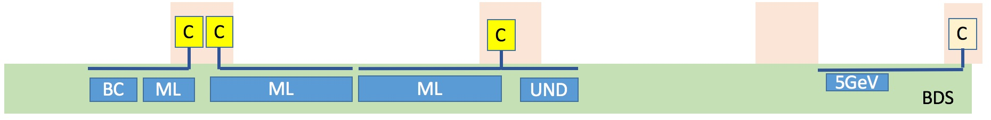
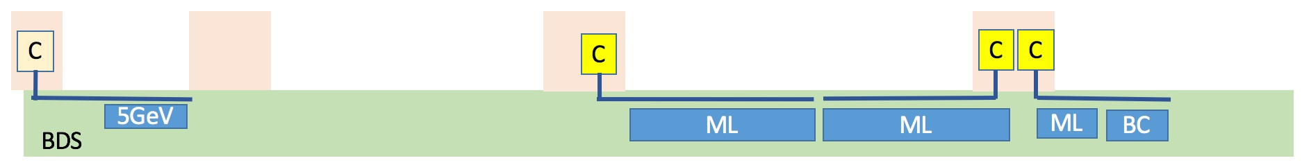
put 1473m
by change Request
put 1473m
by change Request
SRF 31.5MV/m
Option E
Ecm = 250GeV tunnel=500GeV length accelerator upstream
129.3m
2509.7m
4907.8m
4911.6m
3413.8m
2334.9m
4795.2m
4907.8m
2509.7m
129.3m
PM-12
PM-10
PM-8
PM+8
PM+10
PM+12
932.7m
4897.2m
4897.2m
932.7m
IR
BC
Ecm=250GeV
BC
e+inj
e-inj
51
45
189
189
24
cryomodules
24
180
189
45
51
17
10
42
42
8
RF unit
8
40
42
10
17
10.0
12.8
53.6
53.6
5.0
E gain (GeV)
5.0
51.0
53.6
12.8
10.0
e⁻ 135.0GeV =
= e⁺ 132.4GeV
Total length of tunnel = 15872.2m+14676.9m+1473m+1473m=33495m
place SC-ML accelerator upstream

Slide 25
Option F
less important
for staging; cost reduction effect is small
TDR updated tunnel & place SC-ML accelerator sparse cut

Slide 26
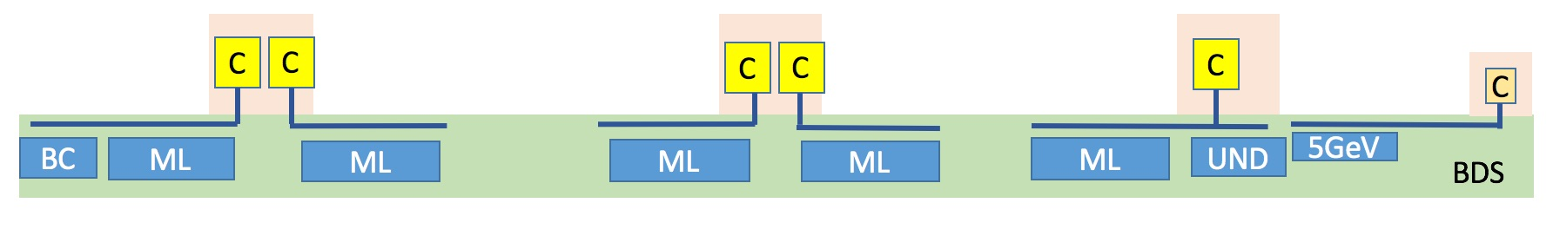
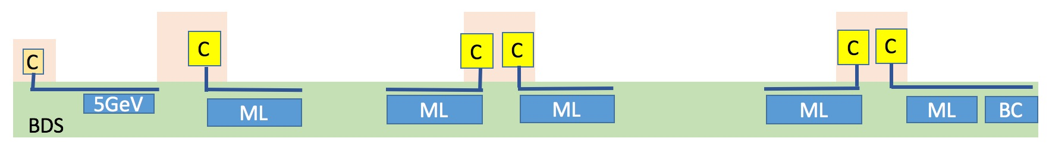
put 1473m
by change Request
put 1473m
by change Request
SRF 31.5MV/m
Option F
Ecm = 250GeV tunnel=500GeV length accelerator sparse
129.3m
2509.7m
4907.8m
4911.6m
3413.8m
2334.9m
4795.2m
4907.8m
2509.7m
129.3m
PM-13
PM-12
PM-10
PM-8
PM+8
PM+10
PM+12
PM+13
IR
BC
Ecm=250GeV
BC
99
90
99
e+inj
e-inj
51
45
90
24
cryomodules
24
90
90
90
99
45
51
17
10
22
20
22
20
8
RF unit
8
20
20
20
22
10
17
10.0
12.8
28.1
25.5
5.0
E gain (GeV)
5.0
25.5
25.5
25.5
28.1
12.8
10.0
28.1
25.5
e⁻ 135.0GeV =
= e⁺ 132.4GeV
Total length of tunnel = 15872.2m+14676.9m+1473m+1473m=33495m
Place SC-ML accelerator sparse cut, for 10Hz operation possible

Slide 27
ILC staging Cost estimation Conditions

Slide 28
Conditions
(1) Estimate cost with ILCU unit for;
TDR-updated, staging option each with 31.5MV/m gradient
(2) Estimate cost for accelerator part;
using RF unit cost and other unit cost calculated from TDR,
decrease TDR cost by subtracting decreased number of units.
( ignor mass-production effect
which will be different for number of production.)
(3) Consideration items for accelerator part;
Decrease number of RF unit (cavity&cryomodule, klystron, modulator,
waveguide,LLRF, installation)
Decrease number of cryogenics (cooling power is the same as TDR)
Add simple beam line for open space of cryomodules
Decrease of RTML-return line length
Increase number of positron undulator
Decrease of beam dump power for BDS tune-up

Slide 29
(4) Estimate cost for CFS part;
Because of TDR estimation method is not relevant to decomposition,
calculate the CFS cost option by option.
ignore the cost difference depending on the length.
(5) Consideration items for CFS part;
Decrease of number of access-hall cavern
Decrease of number of access-tunnel
Decrease of number of surface access-station
Decrease of utility devices in the surface access-station and cavern
Decrease of Main Linac Tunnel length
Decrease of Utility device, AC power cable, water pipes
of cut Main Linac Tunnel
Increase of simple tunnel
(6) Estimate cost for High-Q High-G R&D success;
If the R&D success, consider cost reduction effect
on the change of RF unit cost and decrease number of RF unit.
No change for CFS part.

Slide 30
ILC staging Unit Cost

Slide 31
ILC staging Unit Cost
Details of calculations
“TDR_Value_Matrix-ay170119” = cost reference
geometry of RTML beam line = from “geom-pLET-tape.csv”
consider “eLET”, the same as “pLET”
pLET=positron :DR exit - RTML - turn around - BC - Main Linac - BDS
eLET=electron :DR exit - RTML - turn around - BC - Main Linac - BDS

Slide 32
すみません。コスト情報は開示できません。

Slide 33
すみません。コスト情報は開示できません。

Slide 34
すみません。コスト情報は開示できません。

Slide 35
すみません。コスト情報は開示できません。

Slide 36
すみません。コスト情報は開示できません。

Slide 37
すみません。コスト情報は開示できません。

Slide 38
すみません。コスト情報は開示できません。

Slide 39
Summary of WG2 : CFS staging

Slide 40
(1) We examined the conditions to be considered for the staging,
such as, collision timing condition, energy margin,
cryoline length, undulator length, access point intervals,
RF unit arrangement, etc.
(2) CFS configurations for option C, option D and D’ are proposed.
option E and F configurations are also proposed.
(3) Cost estimation conditions are examined.
(4) Unit Cost estimation & cost reductions are examined.
The calculation is under cross-checking.
Reduction of common part is under discussion.

Slide 41
End of Slide

