Slide 1
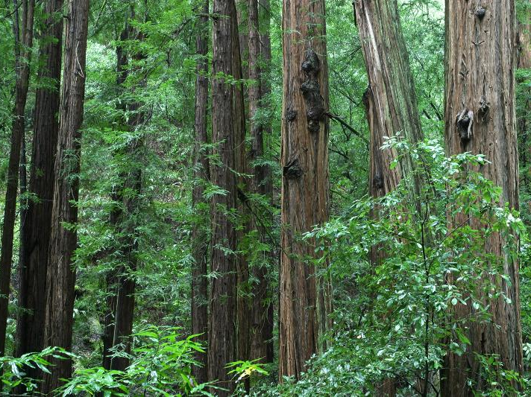
A FLUKA Model of the ILC BeamCal
SiD Simulation Meeting
Benjamin Smithers
UC Santa Cruz
June 21 2017
Notes:
Hi everybody. My name is Ben Smithers, and today I’ll be talking a bit about what I’ve been working on lately with Bruce. Specifically, a FLUKA model for predicting the leakage current in the SiD’s Beamline Calorimeter, or Beamcal.

Slide 2
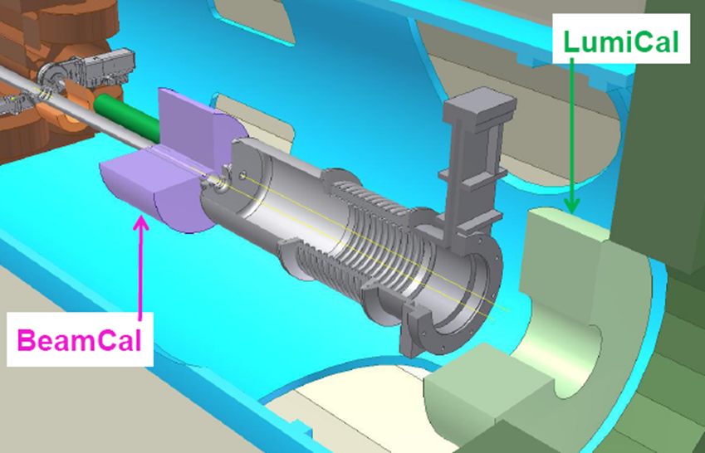
The ILC BeamCal
Accepts E+&E- scattered between 5 and 50 mRads
Notes:
Just as a quick reminder, the BeamCal is one of the SiD’s forward detectors. It’s just aftet the LumiCal, and rests about three meters away from the interaction point. It accepts lightly scattered em particles.
It’s fifty layers of Tungsten with electronic detectors sandwiched between each tungsten chunk.

Slide 3
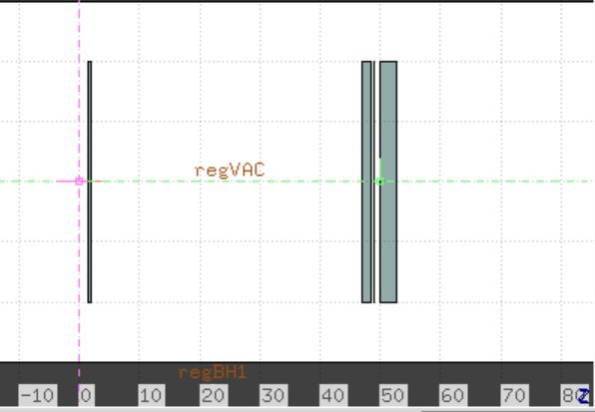
T506 Experiment
Irradiated p-type Silicon Detector to 270 MRad
Realistic mix of leptons, hadrons, and photons
13.3 GeV beam scanned over 1cm² area
Charge collection remained high
Measured current draw as a function of bias and temperature
7.008 mm
14.016 mm
28.032 mm
0.3 mm Si slice
between these
45.0034 mm
Pre to Post
14.22 mm
Post to Backstop
Combine with FLUKA Simulation to estimate BeamCal Power Draw
Notes:
The bulk of what I’ve been doing is based around the T506 experiment run at SLAC. The experiment comprised of firing a 13.3 GeV electron beam at a Tungsten Apparatus. Two tungsten plates were arranged such that a scoring plane (or p-type Silicon Detector) would sustain 270MRads of radiation, in addition to a mix of leptons, hadrons, and photons that would be realistically expected in the BeamCal. This gives an accurate environment to see how the detectors will be damaged in the BeamCal, and by combininb FLUKA simulations into the mix we can make estimates of the BeamCal power draw.

Slide 4
T506 Leakage Current Results
After 270Mrad electromagnetic radiation, the current at 600V bias is given by
Temperature ( C ) | Current (uA) @ 600V
-15 | 1.15
-7.5 | 2.05
0 | 5.21
7 | 14.7
14 | 25.7
Notes:
Those simulations are only useful though since afterwards the current draw (or leakage current) of the detector was measured as a function of the operating temperature.

Slide 5
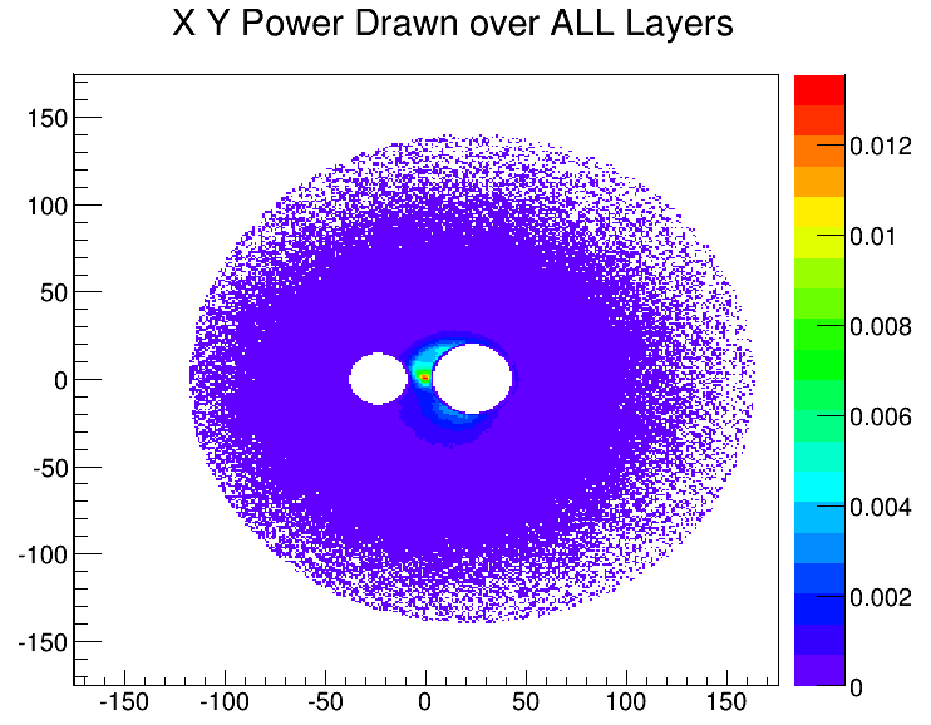
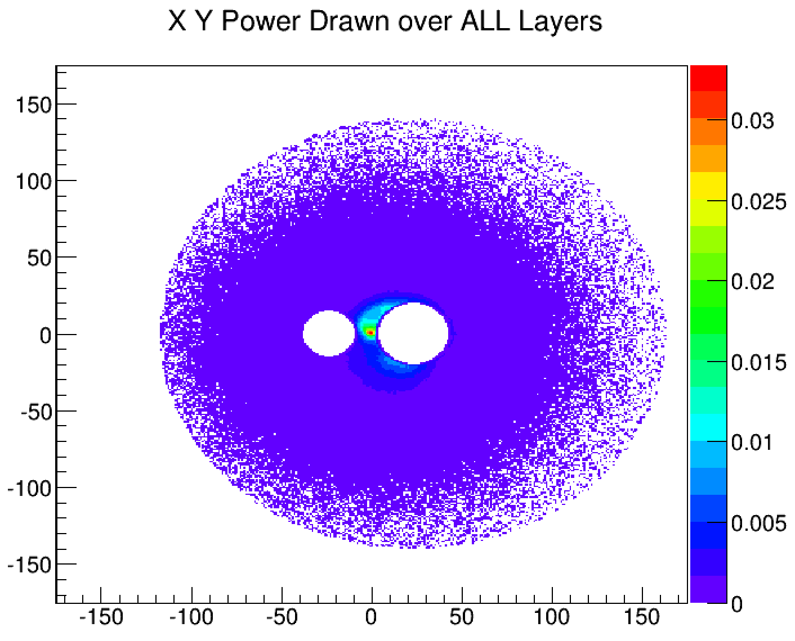
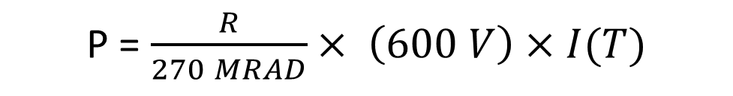
Prior studies (Luc d’Hauthuille) assumed e+&e- ionization responsible for damage (10 Snow Mass Yrs)
P = $\frac{R}{270 MRAD}× \left(600 V\right)×I(T)$
T = -7 ˚C
T = 0 ˚C
P_total = 4.467 W
P_total = 11.01 W
P_max = 1.86 mW
(for single 1mm² pixel)
P_max = 4.59 mW
(for single 1mm² pixel)
Notes:
A Prior study by Luc d’Hauthuille (dohtwheel) assumed that it was e+e- ionization that was responsible for detector damage. Although we now realize that this is an unrealistic prediction, a lot of groundwork was already laid for us.
Dohtwheel used that the power draw of a BeamCal pixel would be proportional to the dosage said pixel sustained. Then, by using the T506 benchmark power draw, as well as the bias voltage and operating temperature, could predict the power draw.

Slide 6
Operating Temperature (⁰C) | Total Power Draw (W) | Maximum for 1mm² Pixel (mW)
15 | 56 | 23
7 | 25 | 10
0 | 11 | 4.6
-7 | 4.5 | 1.9
Likely unrealistic due to production of neutrons scattering off of atomic sites.
Notes:
After 10 snow mass years, these are the power draws for both the BeamCal as a whole and most damaged pixels. Again though, this is likely an unrealistic model due to the interactions of neutrons in the Si detector. We now realize that the neutrons are more likely to be the cause of damage in the detector.

Slide 7
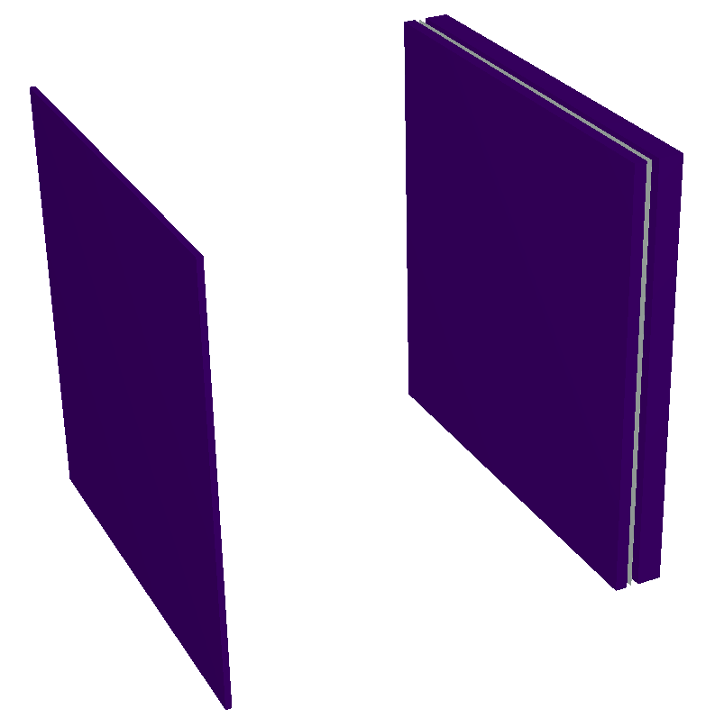
FLUKA Simulations (T506)
Needed for neutron production and transport
Using T506 to develop neutron damage factor that will scale FLUKA model of BeamCal
NIEL Scaling (1MeV Equiv)
Path length
Neutrons scored, two way
Binned wrt dE (GeV), dΩ (SR)
E+&E- scored ballistically
Binned in Energy
Notes:
To simulate the effects of the neutrons we need FLUKA for its support of neutron production and transport. Especially in the 20MeV range that is the result of giant dipole resonance evaporation that produces the field.
First things first though, we need a way to quantify neutron damage. Since high energy neutrons cause different amounts of damage than low ones, we scale fluences into equivalent 1 MeV fluences using non ionizing energy loss of neutrons in silicon. Additionally we account for the extra distance of detector neutrons will pass through when approaching the detector from varying angles of incidence.
During simulations, the neutrons must then be binned in terms of energy and solid angle.
The electrons are also binned, just in Energy, as a sanity check.

Slide 8
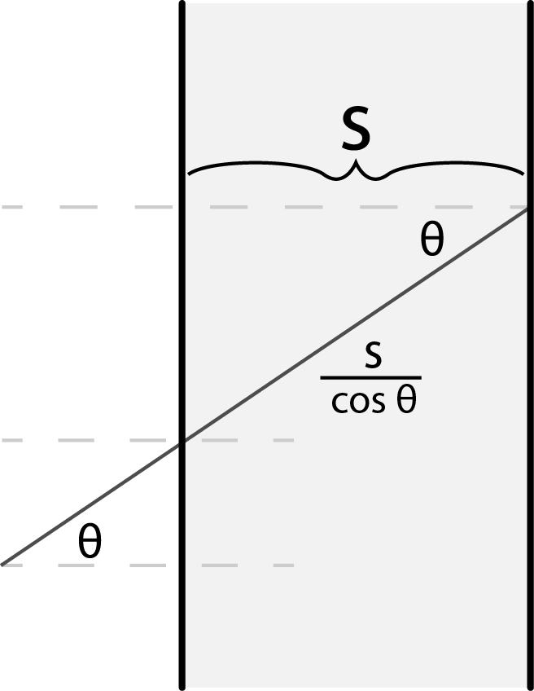
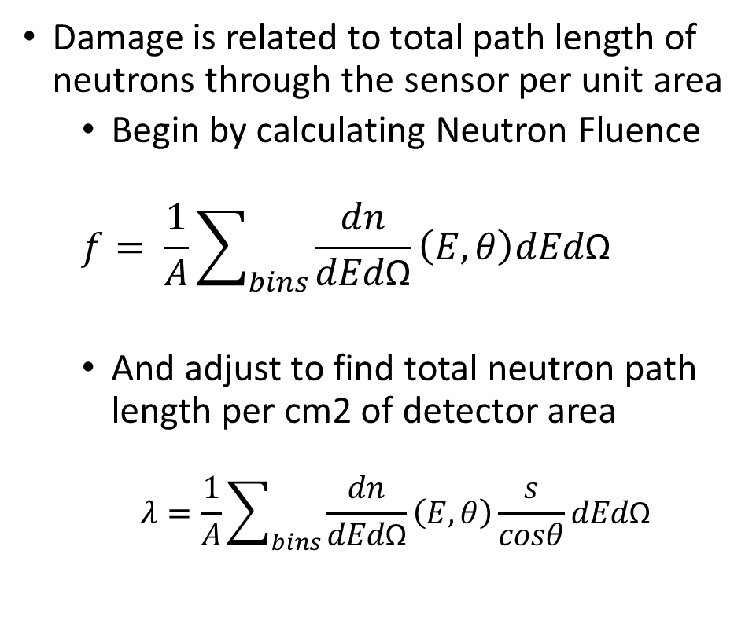
Calculating Damage Factor - Step 1
Damage is related to total path length of neutrons through the sensor per unit area
Begin by calculating Neutron Fluence
$$f= \frac{1}{A}\sum_{bins}{\frac{dn}{dEd\text{Ω}}\left(E, θ\right)dEd\text{Ω}}$$
And adjust to find total neutron path length per cm2 of detector area
$$λ=\frac{1}{A}\sum_{bins}{\frac{dn}{dEd\text{Ω}}\left(E, θ\right)\frac{s}{cosθ}dEd\text{Ω}}$$
Notes:
To actually calculate the neutron damage, we start with our equation for the sum total fluence through the detector. This is the double differential fluence at each energy-angle bin, multiplied by the size of those bins, and then summed over all bins and normalized by the area A of the scoring plane in FLUKA.
Then we add a term to adjust for path length. A neutron approaching a detector of width (s) at an angle of incidence theta will have travel a distance of (s//costheat) through the detector.

Slide 9
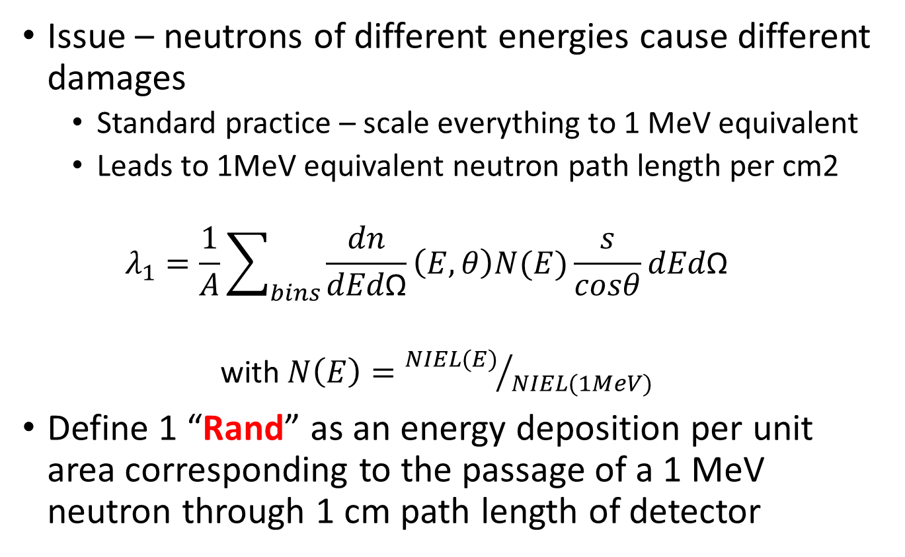
Calculating Damage Factor – Step 2
Issue – neutrons of different energies cause different damages
Standard practice – scale everything to 1 MeV equivalent
Leads to 1MeV equivalent neutron path length per cm2
$$λ_{1}=\frac{1}{A}\sum_{bins}{\frac{dn}{dEd\text{Ω}}\left(E, θ\right)N(E)\frac{s}{cosθ}dEd\text{Ω}}$$
with $N\left(E\right)={NIEL(E)}/{NIEL(1MeV)}$
Define 1 “Rand” as an energy deposition per unit area corresponding to the passage of a 1 MeV neutron through 1 cm path length of detector
Notes:
The last, and most important step is to account for the difference in damage of neutrons of different energies. This is done by scaling each term by a ratio between a neutron of that energy’s NIEL and a 1MeV neutron’s NIEL. The result is a quantity of damage in units that we call “Rands.” A rand is defined as the energy deposition per unit area corresponding to the passage of a 1 MeV neutron through a 1 cm path length of detector.
Or put another way, 1 MeV Neutron –cm’s of damage /cm^2

Slide 10
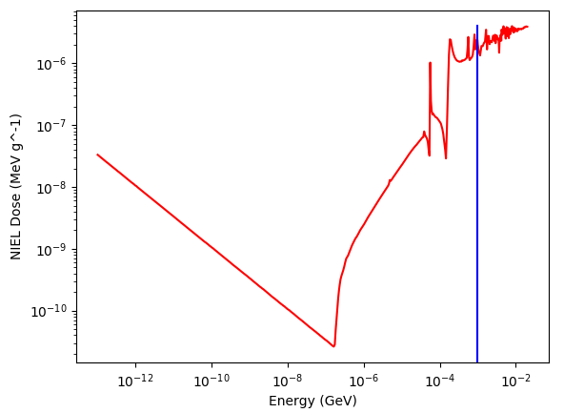
Neutron NIEL in Si
www.sr-niel.org
Notes:
This is the NIEL spectrum, covering everything from absolutely miniscule energies up to 20 MeV.

Slide 11
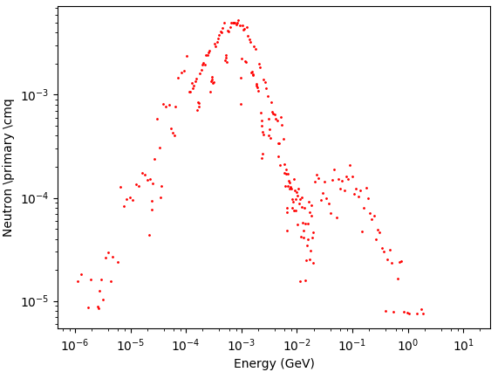
T506 Rand Calculation
T506 Neutron Fluence (Integrated over Sold Angle)
For 0.03cm scoring plane in T506 Aparatus
After taking path length and NIEL scaling into account, T506 simulation yields 4.63 mRand per 13.3 GeV primary.
Notes:
And here is the energy distribution of neutrons in the T506 detector. The vast majority of neutrons are right within the range covered by the NIEL data. It’s sharply peaked at around 1 MeV.
For a 3 micron thick detector, we calculated the total number of Rands per primary coming through the detector in the simulation. It came out to be 4.63 milli Rands per primary.

Slide 12
T506 – 270 Mrad Run
The T506 run was characterized by 270 Mrad of electromagnetically induced radiation
This dose was accumulated by directing 50.9 μC of 13.3 GeV electrons into the T506 apparatus
We calculate no. of primaries from the charge collected
By the described method, we then calculate Rands from the Neutron Fluence
Quantiy |  | Units
Primaries | 50.9 (3.181 x 10¹⁴ ) | μC (particles)
Neutron Fluence | 7.4 x 10¹³ | Neutrons/cm2
Rand Calculation | 4.63 | milli Rand/pr
Total Rands | 1.47 | Tera-Rand
Notes:
In the experiment, a total of 50.9 micro coulombs were deposited on the detector. Working backwards, we find this to be the result of ten to the fourteenth primaries. Meaning, the total dosage the detector sustained would be 1.47 Tera Rands.

Slide 13
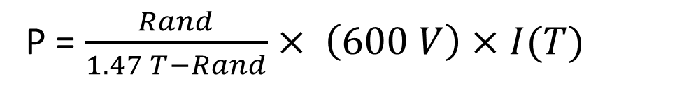
T506 Power Draw – 600 V bias
T506 Measurement
Under assumption of linearly dependent current upon dose
P = $\frac{Rand}{1.47 T−Rand}× \left(600 V\right)×I(T)$
Notes:
By using the same methods as prior studies, we got a model to predict the power draw in the BeamCal- assuming that the current is linearly dependent on dose and by using the T506 again as a benchmark for the power draw.

Slide 14
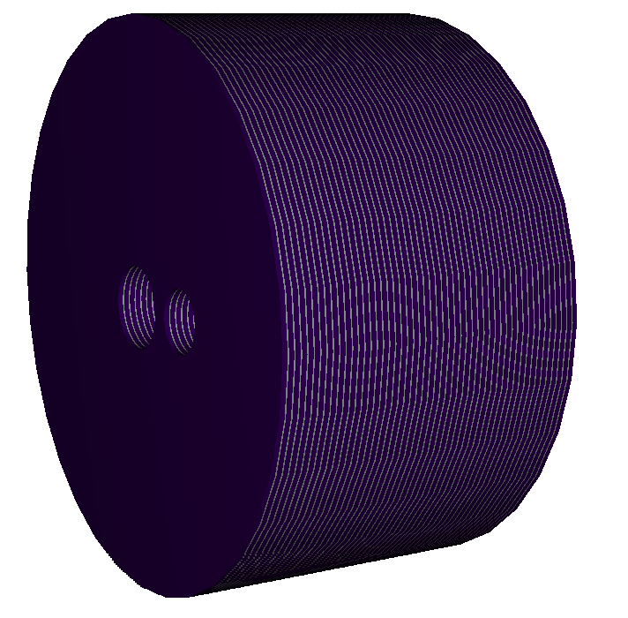
BeamCal Simulation in Fluka
Design parameters from detailed baseline description (DBD)
Primaries sourced from single Guinea Pig bunch crossing
Notes:
Proceeding into the simulations of the Beamcal, I would like to note that the geometric parameters of the beamcal were acquired from the ILC detailed baseline description. Additionally, we sourced our primaries from a Guinea Pig simulation of a bunch crossing.
After running the FLUKA simulations, I produced several cutouts of the resulting fluences of electrons and positrons, and neutrons, at various layers in the BeamCal. It gives a good idea of what is going on inside the BeamCal. I also used the raw data to find the layers of highest fluence. Layer 8 saw the highest electron positron fluence and 12 saw the highest neutron fluence.

Slide 15
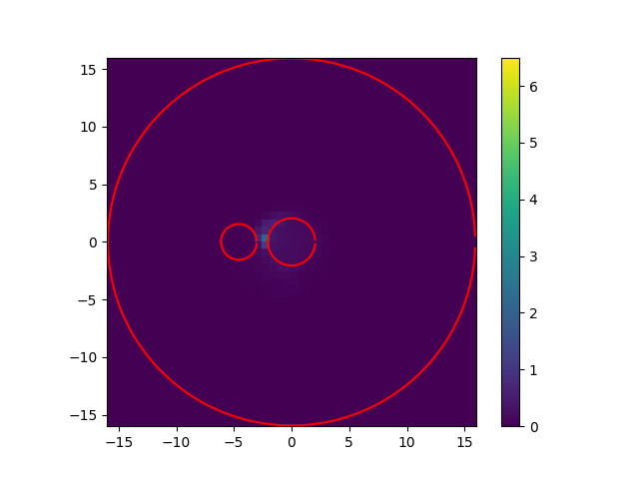
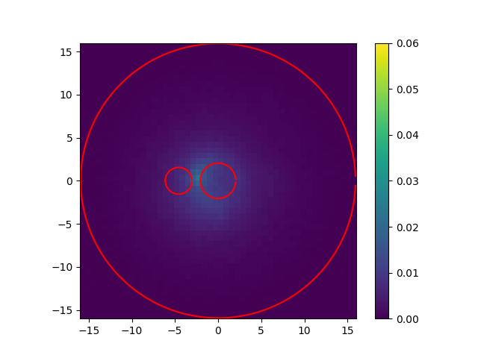
Layer 2 Detector - Fluence
E+&E-
Neutrons

Slide 16


Layer 4 Detector - Fluence
E+&E-
Neutrons

Slide 17
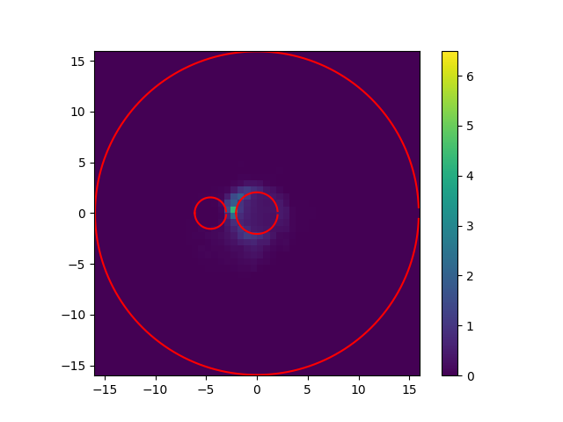
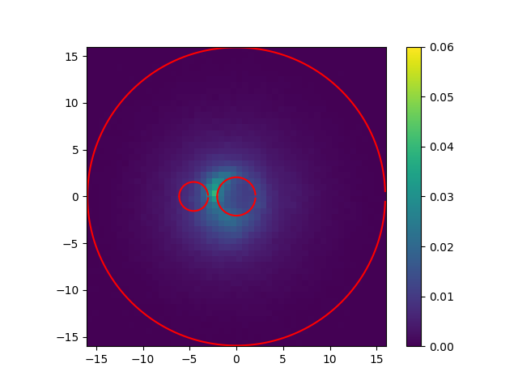
Layer 6 Detector - Fluence
E+&E-
Neutrons

Slide 18

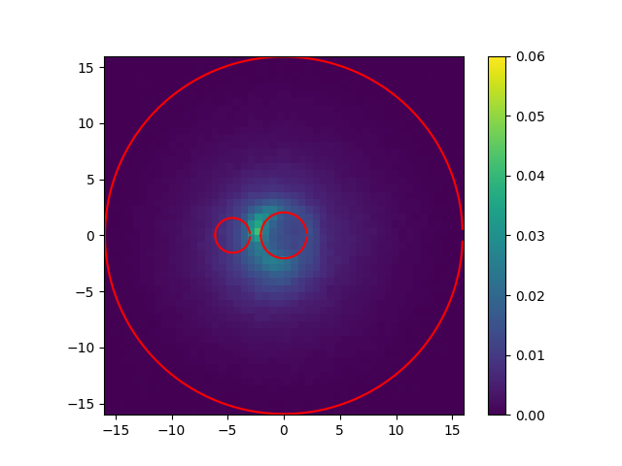
Layer 8 Detector - Fluence
E+&E-
Neutrons

Slide 19


Layer 10 Detector - Fluence
E+&E-
Neutrons

Slide 20

Layer 12 Detector - Fluence
Neutrons

Slide 21

Layer 14 Detector - Fluence
Neutrons

Slide 22
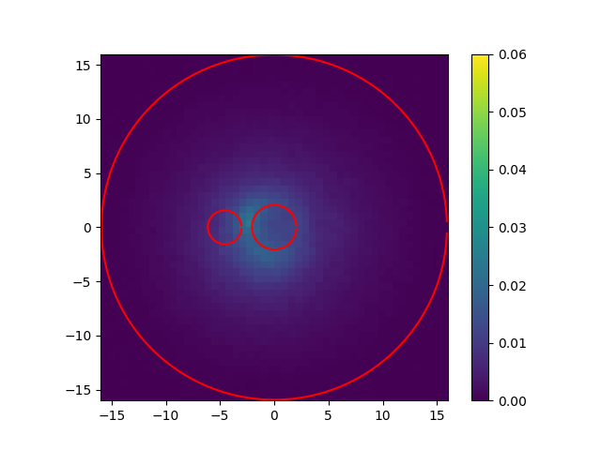
Layer 16 Detector - Fluence
Neutrons

Slide 23
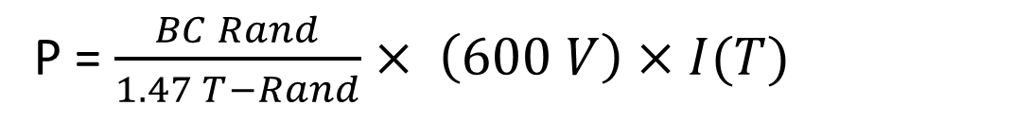
Beamcal – Maximum Power Draw
Picked the pixel maximizing neutron fluence
Layer 12 |  | Units
Neutron Fluence | 0.0136 | /pr/cm2
Bunch Crossing | 46868 | E+&E-
Quantiy |  | Units
Rand Calculation | 0.001025 | Rand/pr
Total Rands | 48.0619 | Rand
Rand Rate | 315.3 | kRand/s
Yearly Rand Rate | 3.153 | TRand/yr
One bunch crossing
P = $\frac{BC Rand}{1.47 T−Rand}× \left(600 V\right)×I(T)$
Notes:
At the moment I’ve mainly been focusing on the region maximizing neutron fluence. There, I calculated 1.025 milli Rands per primary. By multiplying this by the number of primaries in a bunch and then the bunch crossing rate, I got the Rand rate. And from there is a short step to the number of Rands in a Snow Mass year, or 3.153 Terra Rands.

Slide 24
BeamCal
Snow Mass year of usage results in 3.153 Tera-Rands
At -7.5C, the power draw by a 1mm² pixel is given by
Temperature ( C ) | Current (uA)
-15 | 1.15
-7.5 | 2.05
0 | 5.21
7 | 14.7
14 | 25.7
P = $\frac{3.153 TRand}{1.47 TRand}× \left(600 V\right)×\left(2.05μA\right)=2.63 mW$
Notes:
By comparing this dosage to the T506 benchmark, I can predict the power draw expected by pixels in the area scored in FLUKA. Which, at an operating temperature of -7.5 Celcius, would be 2.63 milli Watts.

Slide 25
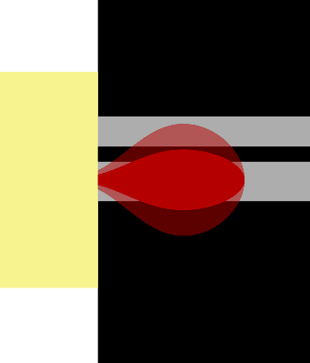
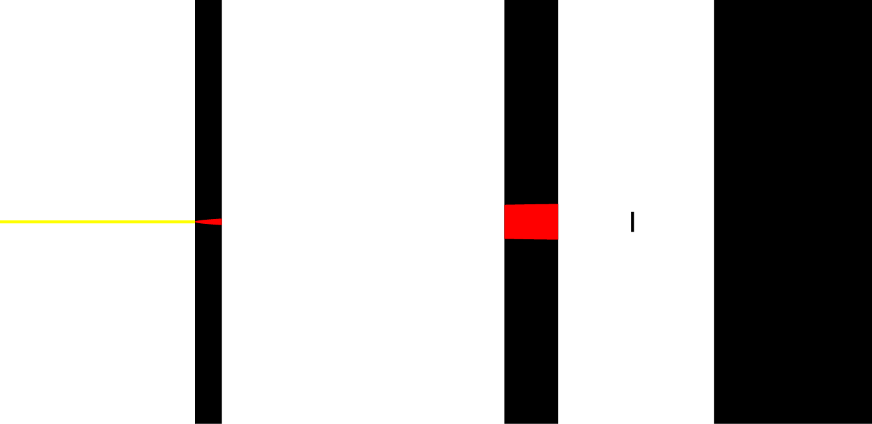
Overall
Most Damaged Pixel draws
Previous predictions: ~ 0.20 mW
If neutrons responsible : 2.63 mW
Culprit? The Rand to rad ratio is found to be a factor of 10 higher for the Beamcal than the T506.
Predicts ten times the wattage
Presently being investigated
Why?
T506 neutron field more ballistic
T506 scoring plane may not be at neutron maximum
Notes:
This is a significant quantity though. After 10 Snow Mass years, Dohtwheel predicted that if we attribute damage to electro magnetic ionization there would only be a 1.9 milli Watt power draw at that temperature. Consqequently, after only one such year there should only be a 0.2 milli Watt power draw.
This significant difference between the wattages ( or really the rand-to-rad ratios ) is actively being investigated.
At the moment, we think that one possible cause is the difference in the shapes of the neutron sources of the T506 and Beamcal. In the t506 arrangement, all of the neutrons scored come from the narrow region beam in front of the beam and beam resultant showers. As a result the T506 neutron field would be more ballistic at the scoring plane, and so the neutron path lengths would be shorter.
Another possibility is that the T506 scoring plane is not at neutron maximum.

Slide 27

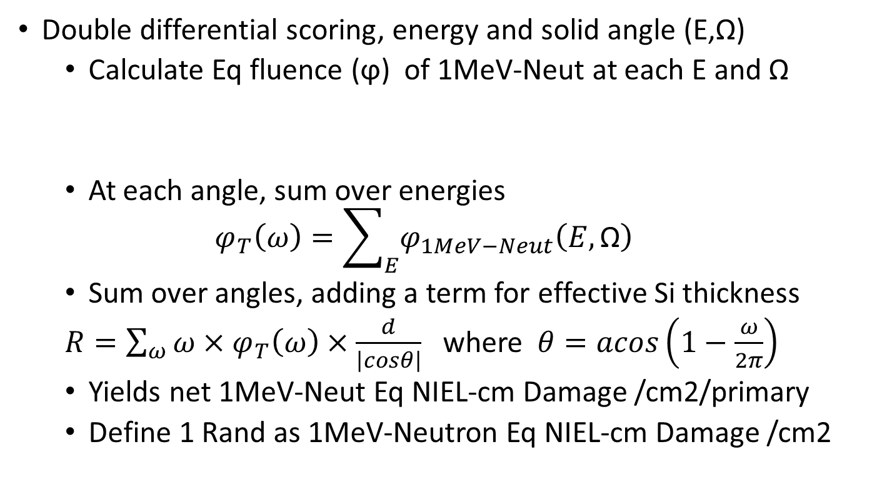
BACKUP
Double differential scoring, energy and solid angle (E,Ω)
Calculate Eq fluence (ϕ) of 1MeV-Neut at each E and Ω
At each angle, sum over energies
$$φ_{T}\left(ω\right)=\sum_{E}{φ_{1MeV−Neut}\left(E,\text{Ω}\right)}$$
Sum over angles, adding a term for effective Si thickness
$R=\sum_{ω}{{ω×φ}_{T}\left(ω\right)×\frac{d}{\left|cosθ\right|}}$ where $θ=acos\left(1−\frac{ω}{2π}\right)$
Yields net 1MeV-Neut Eq NIEL-cm Damage /cm2/primary
Define 1 Rand as 1MeV-Neutron Eq NIEL-cm Damage /cm2
$φ_{1MeV−Neut}(E,\text{Ω})$= $\frac{NIEL(E)}{1MeV NIEL}×\text{ϕ}\left(E,\text{Ω}\right)×E$

