Slide 1
Overview of the FCAL detectors
Yan Benhammou
On behalf of the FCAL Collaboration

Slide 2
outlook
Simulation
Hardware
Electronics
conclusion

Slide 3
Simulation
Hardware
Electronics
conclusion

Slide 4
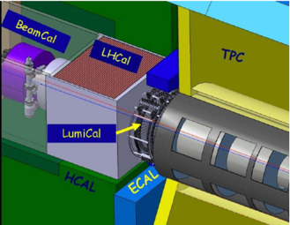
FCAL detector purposes in future e+e- linear accelerators
LumiCal :
  Precise integrated luminosity measurements (Bhabha events)
  Extend calorimetric coverage to small polar angles. Important for physics analysis
LHCal :
  Extend the hadronic calorimeter coverage
BeamCal :
  Measure instant luminosity
  tagging of high energy electrons to suppress backgrounds to potential BSM process
  shielding of the accelerator components from the beam-induced background
  providing supplementary beam diagnostics information extracted from the pattern of incoherent-pair energy depositions

Slide 5
FCAL detector designs in future e+e- linear accelerators
LumiCal :
  Electromagnetic sampling calorimeter
  layers of 3.5 mm thick tungsten plates with 1 mm gap for silicon sensors (30 for ILC, 40 for CLIC)
LHCal :
  Sampling Calorimeter
  29 layers of 16mm thickness. Absorber : tungsten or iron
BeamCal:
  Sampling calorimeter based on tungsten plates (30layers for ILC, 40 layers for CLIC)
  Due to large dose, rad hard sensors (GaAs, Diamond, Sapphire)

Slide 6
FCAL detector simulation in future e+e- linear accelerators
ILC
  Geometry model of FCAL ( positions, internal structure) is implemented, updated according to new L*
  Reconstruction software for LumiCal and BeamCal present (FcalClusterer Marlin module) adopted for DD4HEP
  Simulations within DD4hep environment and validation started
CLIC
  LumiCal and BeamCal reconstruction working with DD4hep geometry
  LumiCal and BeamCal reconstruction performance since moving code shows decent results.

Slide 7
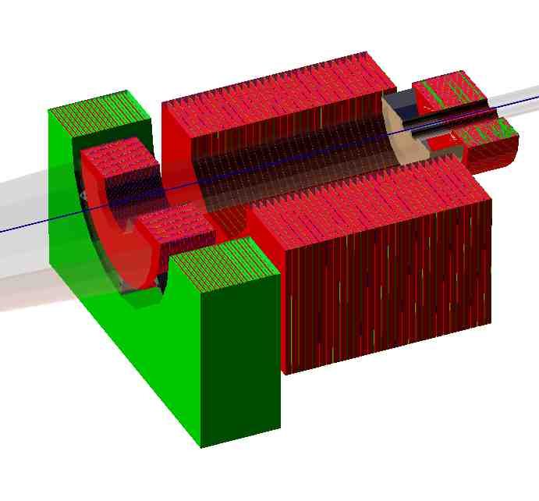
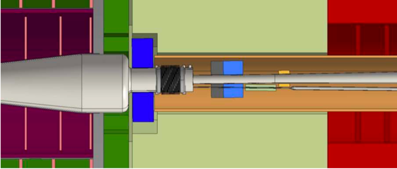
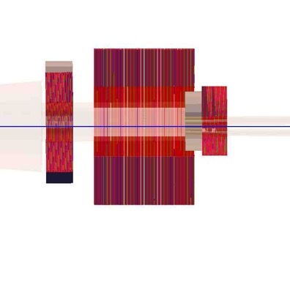
FCAL detector simulation in future e+e- linear accelerators
LHCal
BeamCal
LumiCal
ILC
LumiCal LHCal BeamCal
CLIC
LumiCal
BeamCal
Ecal EndCup Plug
+Z
2450 2680 3195

Slide 8
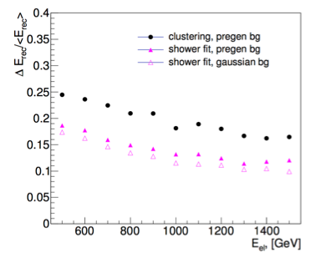
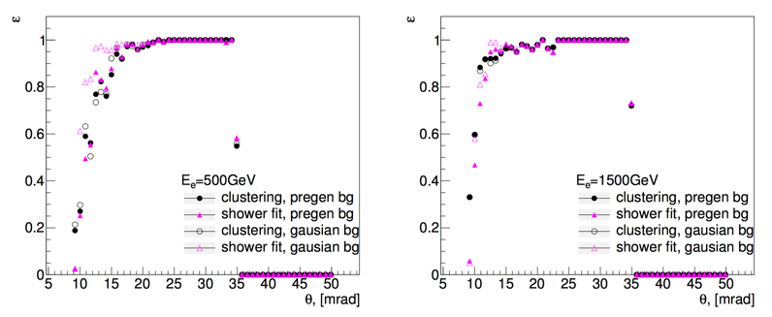
BeamCal simulation in future e+e- linear accelerators
Cover the angles between 10 mrad to 43 mrad
Different methods of background generated :
  “Pregenerated” based on MC event
  “Gaussian” based on estimation of the energy deposition in each pad
Reconstruction :
  Cluster algorithm : pad clustering
  after subtraction of average
  background
  Shower fitting algorithm :
  estimation of the profile of the
  shower from electron
CLIC simulations

Slide 9
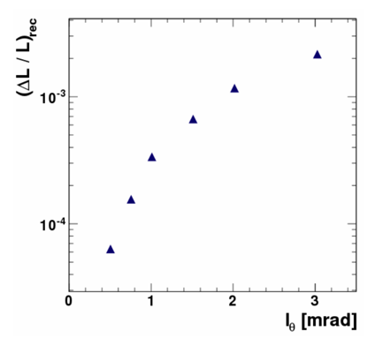
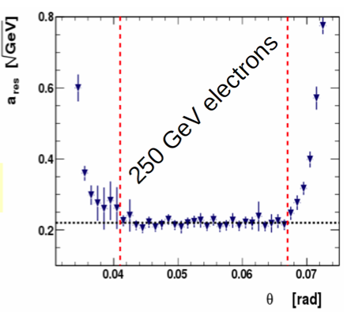
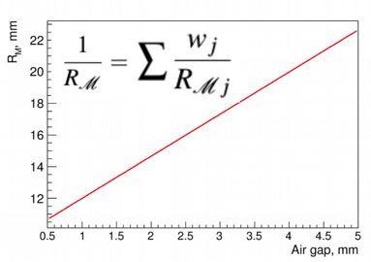

LumiCal simulation in future e+e- linear accelerators
Cover the angles between 41 mrad to 67 mrad
Polar angular pad size calculated to obtain the given precision of luminosity measurement
Simulation of the
energy resolution
Moliere radius estimation
for compactness study
ILC
For I_{θ} =0.8 mrad, ΔL/L = 1.6 10⁻⁴

Slide 10
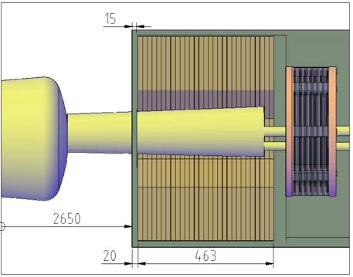
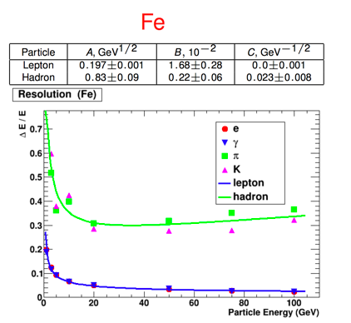
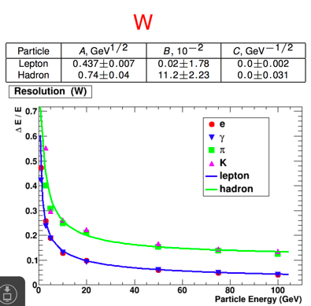

LHCal simulation in future e+e- linear accelerators
Located between the LumiCal and BeamCal
Total thickness : 463 mm
Simulation of tungsten-Si and iron-Si with different incident particles

Slide 11
Simulation
Hardware
Electronics
conclusion

Slide 12
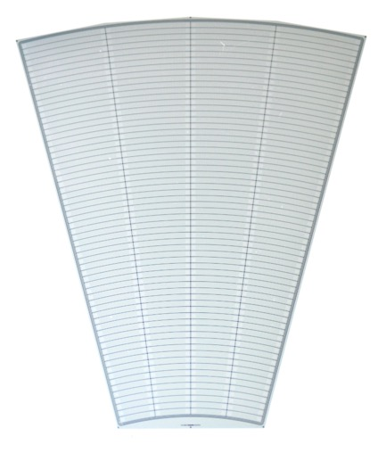
LumiCal sensor
4 sectors:
L1
R1
L2
R2
Outer active radius R = 195.2 mm
Silicon senor, 320 μm thickness
DC coupled with read-out electronics
p+ implants in n-type bulk
64 radial pads, pitch 1.8 mm
4 azimuthal sectors in one tile, each 7.5 degrees
12 tiles makes full azimuthal coverage
40 modules were produced by Hamamatsu
channels: 1 - 64
3 x 100 μm guard rings
Inner active radius R = 80.0 mm

Slide 13
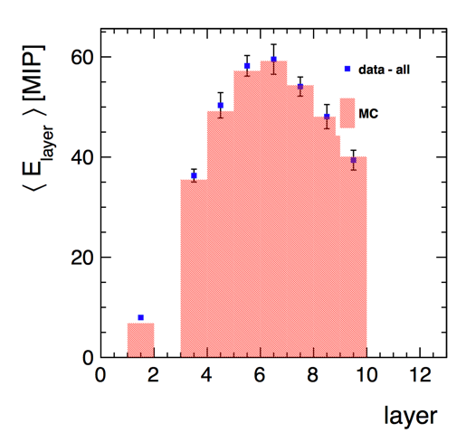
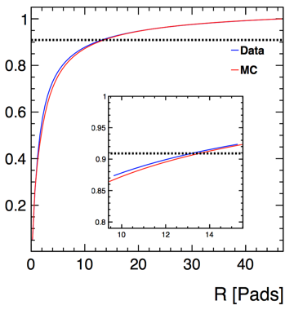
LumiCal test at CERN in 2014
4 LumiCal modules equipped with dedicated electronics (32 channels) glued on a 2.5 mm PCB
3.5 mm between tungsten plates
Tested in test beam at PS with 5 GeV e-/μ
Energy fraction
Moliere radius :
24.0 ± 0.6 (stat.) ± 1.5 (syst.) mm

Slide 14
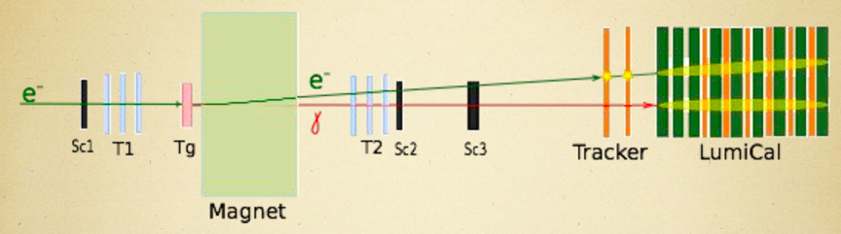
LumiCal test at DESY in 2016
New LumiCal module design : 750 um thickness. 1mm between tungsten planes
Eight modules fully equipped with generic read out (256 channels)
Two modules were installed without tungsten planes : test of a tracker in front of LumiCal for electron/photon identification
Six modules formed the LumiCal
Test at DESY with 1 to 6 GeV electrons. Creation of a e⁻γ beam

Slide 15
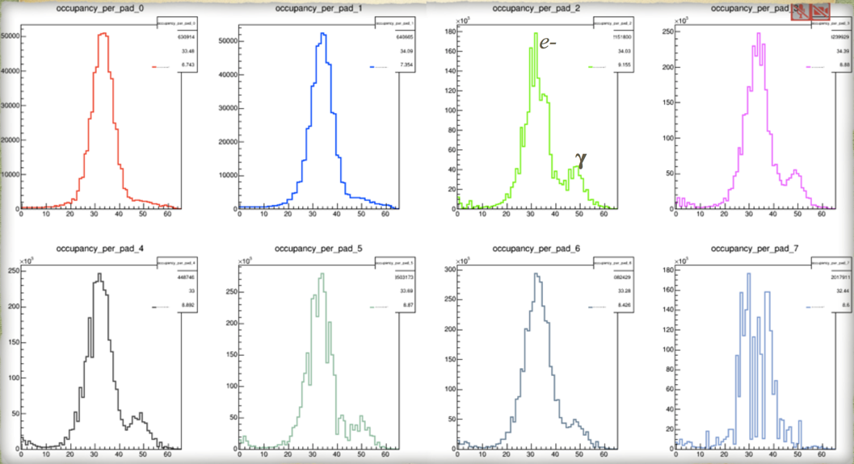
LumiCal in 2016
Tracker 1
Tracker 2
LumiCal 1
LumiCal 2
e⁻
e⁻
e⁻
γ
pad
pad
pad
pad
LumiCal 3
LumiCal 4
LumiCal 5
e⁻
e⁻
e⁻
γ
γ
γ
pad
pad
pad

Slide 16
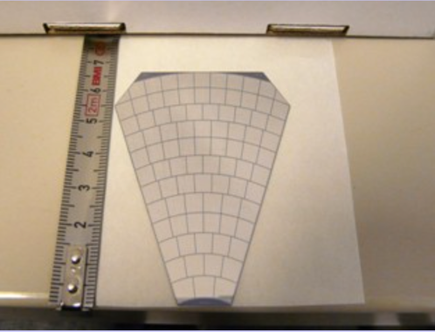
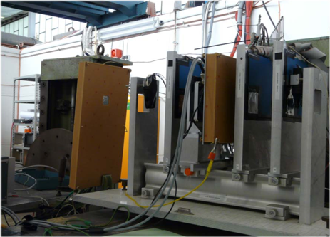
BeamCal test at DESY in 2010
GaAs plate with Al metallization: 500 μm thick
45 deg tiles, segmented into 12 rings, 5x5mm² pads
S/N ratio and CCE are good: CCE ~33% at 60V, S/N ~19 for all channels.
4 independent pad areas show identical charge collection
Homogeneous response of the pad signal
Edges loss of about 10% of the signal

Slide 17
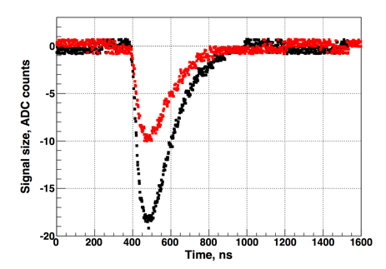
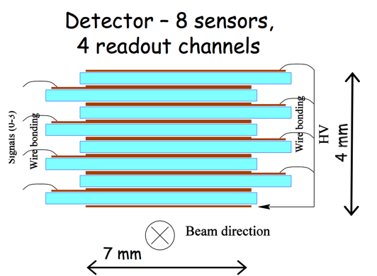
BeamCal test at DESY in 2013
Idea to test sapphire sensors parallel to the beam line
Red : 550V
Black 950V
Sapphire is a very promising wide-bandgap material for HEP applications
Produced in large quantities for industrial purposes, not expensive
Perfect electrical properties, excellent radiation hardness, but presently low charge collection efficiency

Slide 18
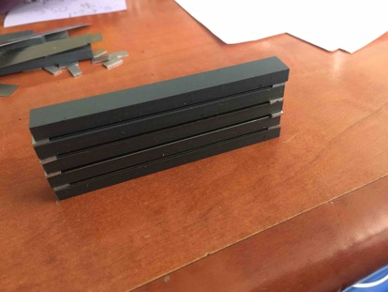
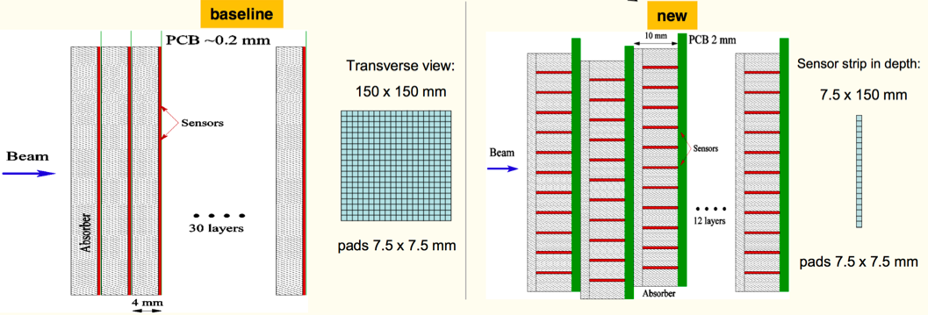
BeamCal in 2017
New design of the detector
Serious study has started

Slide 19
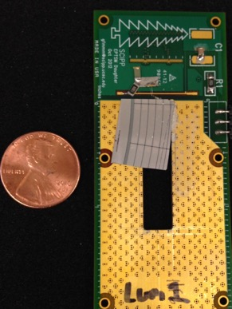
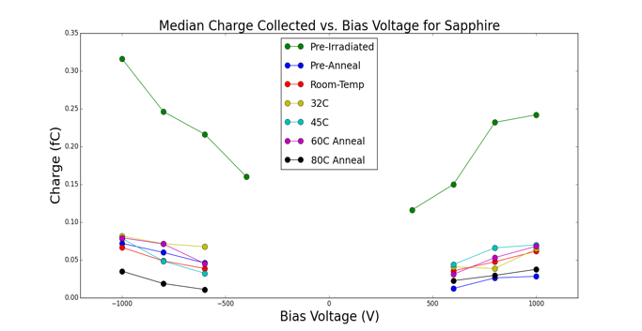
Radiation damage in electromagnetic shower
BeamCal maximum dose ~100 MRad/yr
Study is performed at California University of Santa Cruz
Exposition of Si, GaAs, Sapphire, Silicone carbide
Dark current remain low for Sapphire
300 Mrad Exposure
500 μm thick Al₂O₃
300 Mrad Exposure

Slide 20
Simulation
Hardware
Electronics
conclusion

Slide 21
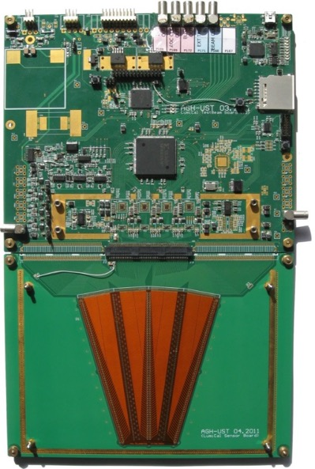
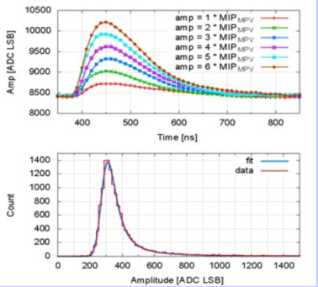
LumiCal readout in 2014
Development of an ASIC for the 2014 test beam
Charge amplifier shaper with different gain (MIP/electron)
8 front end channels
Development of an 8 channel 10 bit ADC
Signal to noise ratio ~19
Cross Talk < 1%

Slide 22
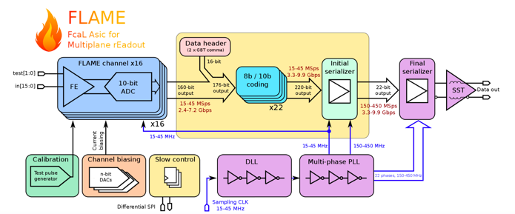
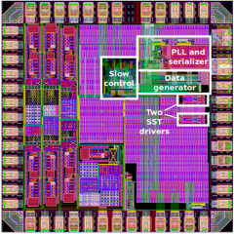
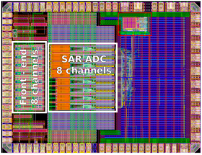
New readout : FLAME
FLAME: project of 16-channel readout ASIC in CMOS 130nm, front-end&ADC in each channel, fast serialization and data transmission, all functionalities in a single ASIC
FLAME prototype :
  Prototype 8-channel FE+ADC ASIC
  Prototype serializer ASIC
First tests are encouraging : FE ok, ADC ok, basic functionality of serializer are ok

Slide 23

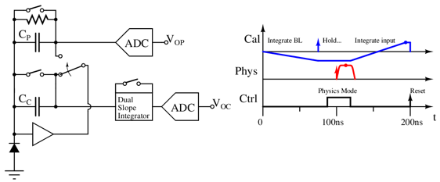
BeamCal readout
Firstly, BeamCal is hit by beam halo (muons)
  MIP deposition, low noise electronics
  Clean environment
  Good for calibration
~25ns later, BeamCal is hit by collision scattering
  Large deposit energy
  Physics readout
Dual slope integrator for calibration signal
  Integrate baseline (negative gain)
  Calibration halo signal is deposited and held
  Switch to physics mode, process and digitize Vop
  Then integrate calibration signal and digitize Voc

Slide 24
Conclusion
The precise and complete geometry of the FCAL detectors has been implemented in the mainframe of ILD and CLIC software. Simulations and reconstructions have been realized or are ongoing.
A ultra compact LumiCal has been tested and the preliminary results look encouraging
Different BeamCal options have been tested and a real prototype in under study
LumiCal prototypes of key blocks readout fabricated and first promising results obtained. BeamCal readout chip is under intensive study

