Slide 1
An Electro-Optical Wakefield Monitor for High Gradient Measurements at CLEAR
Jan Paszkiewicz

Slide 2
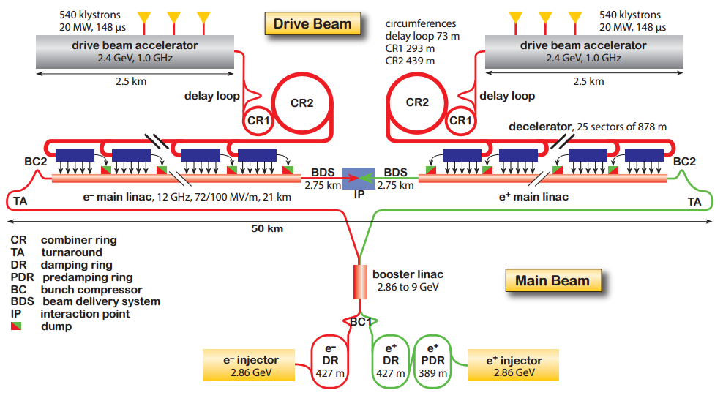
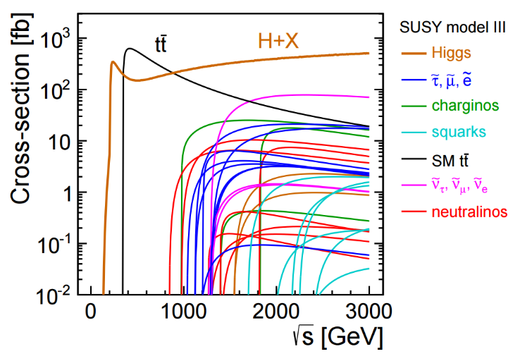
Compact Linear Collider
Linear e+e- collider
Staged implementation up to 3 TeV
100 MV/m gradient
Cross-sections for possible new interactions. [1]
Overview of the CLIC layout for 3 TeV. [1]

Slide 3
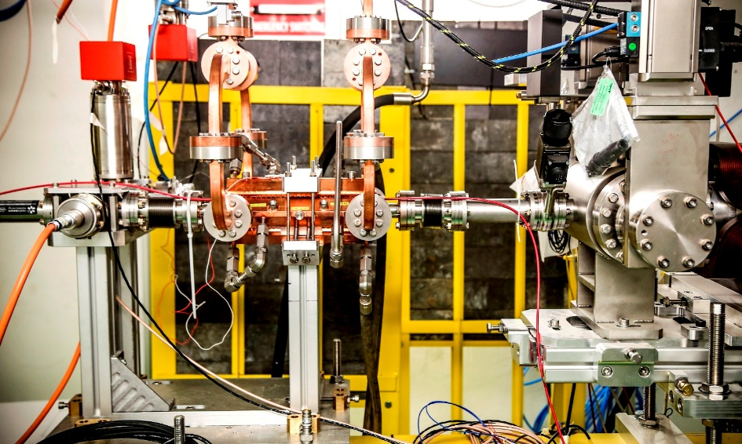

High Gradient Accelerating Structures
100 MV/m
Cu normal conducting
X-band (11.994 GHz)
50 MW peak RF power
Breakdown rate limit of 3x10⁻⁷ – impact on CLIC luminosity
$$BDR ∝ {E_{0}}^{30}τ^{5}$$
Accelerating structure under test in Xbox 2. Photo courtesy of Matteo Volpi.

Slide 4
Field Emission and Breakdown
Incident RF Pulse
Transmitted RF Pulse
Electron or Positron Beam

Slide 5
Field Emission and Breakdown
Incident RF Pulse
Reflected RF Pulse
Breakdown
Electron or Positron Beam

Slide 6
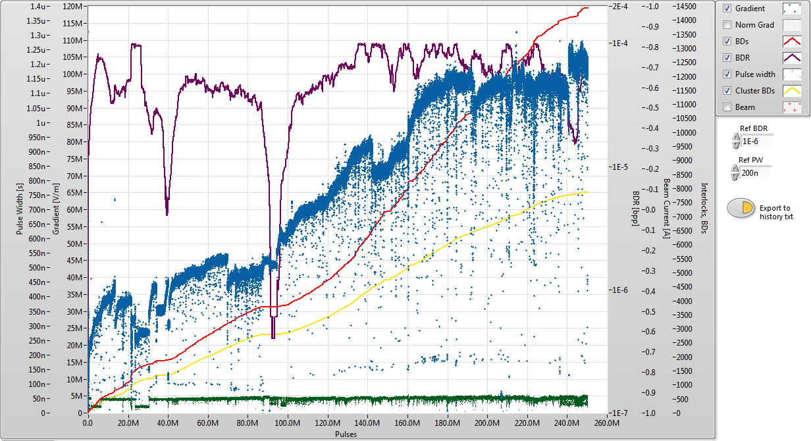
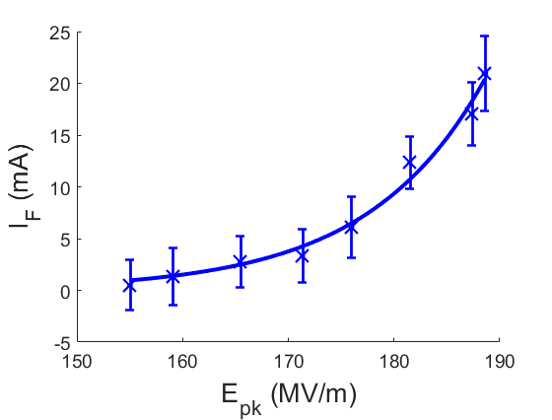
Field Emission and Breakdown
Conditioning curve for an X-band accelerating structure.
Measured field emitted current as a function of peak field.

Slide 7
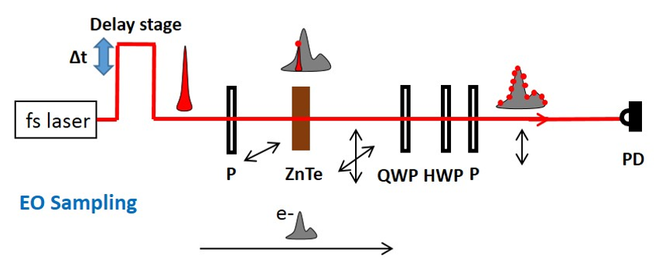
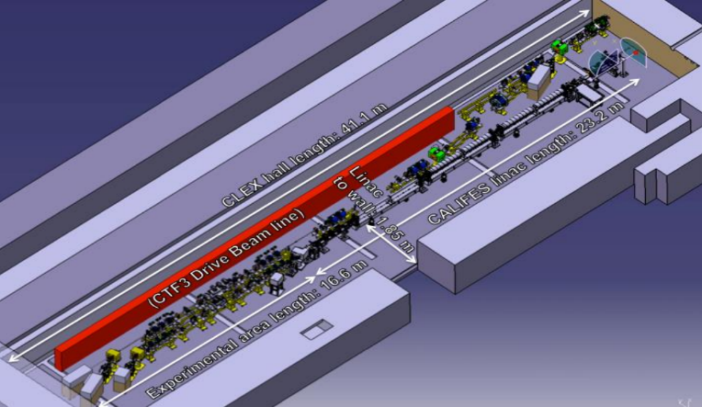
Electro-Optical Wakefield Measurements
Laser pulse
Vacuum window
Electron bunch
Electro-optical sampling principle. [2]
TM₀₁₀ E-field
ZnTe crystal
Proposal for a wakefield monitor cavity for CLEAR.
Layout of the CLEAR facility. [3]

Slide 8
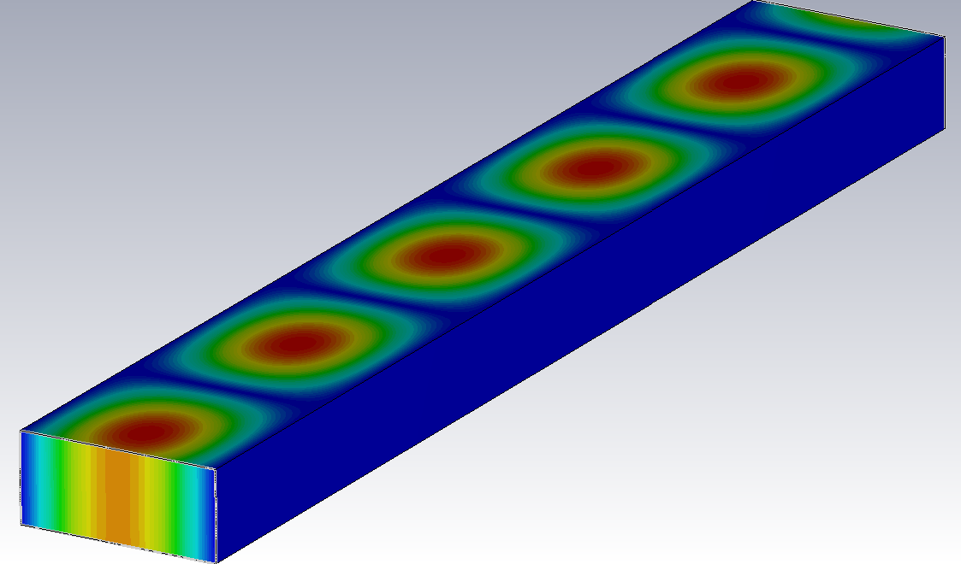
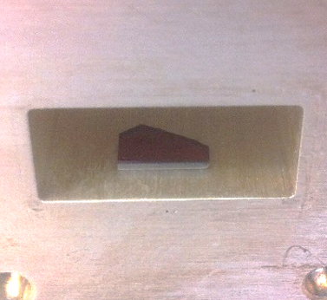
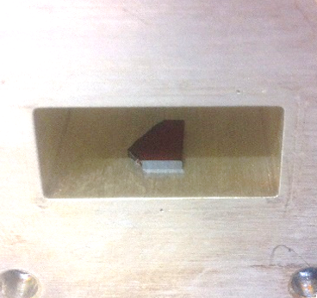
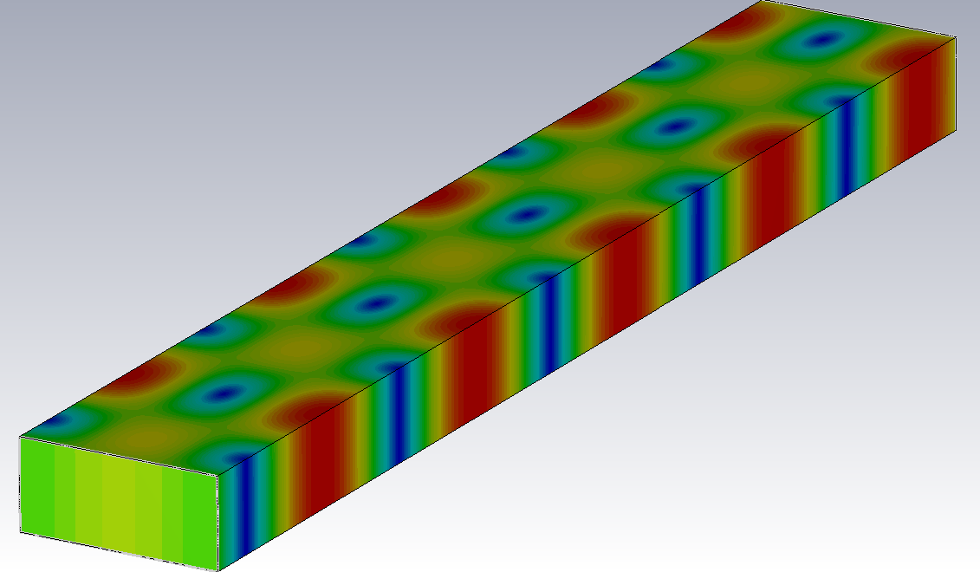
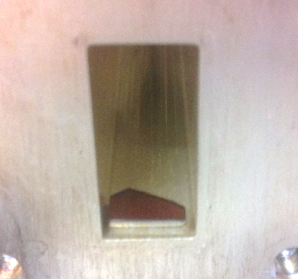
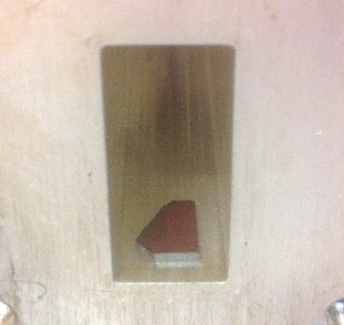
ZnTe RF Characterisation - Setup
Position 1
Position 2
E-field in TE10 mode.
Position 3
Position 4
H-field in TE10 mode.

Slide 9
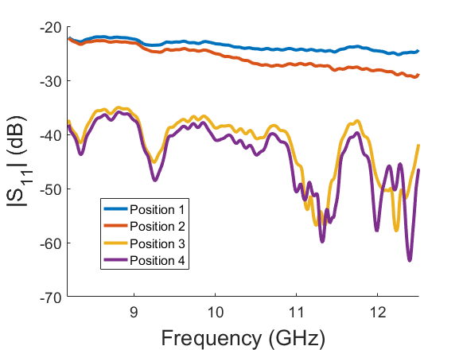
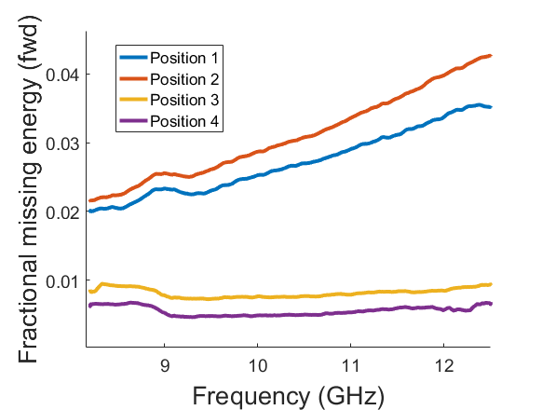
ZnTe RF Characterisation – Data
Missing energy as a function of frequency.
Magnitude of reflected signal.

Slide 10
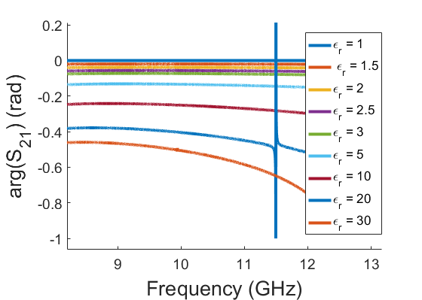
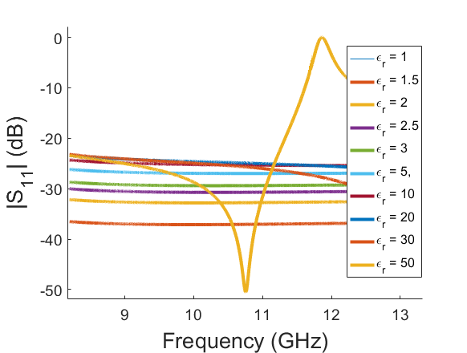
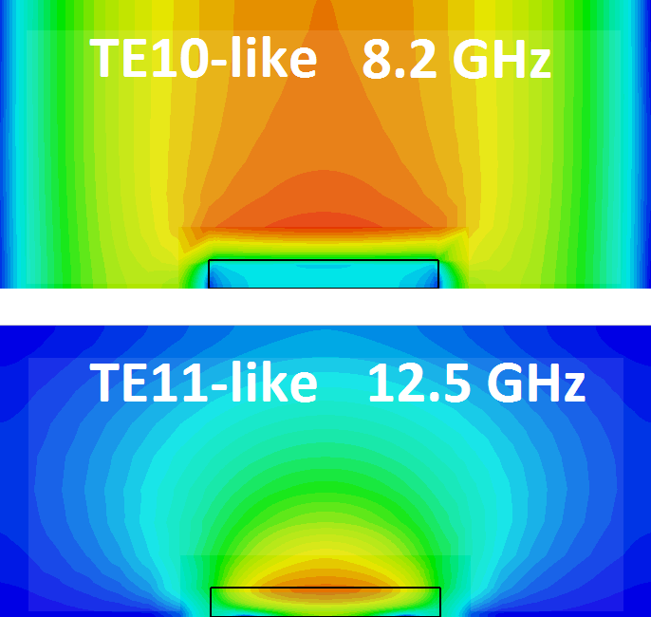
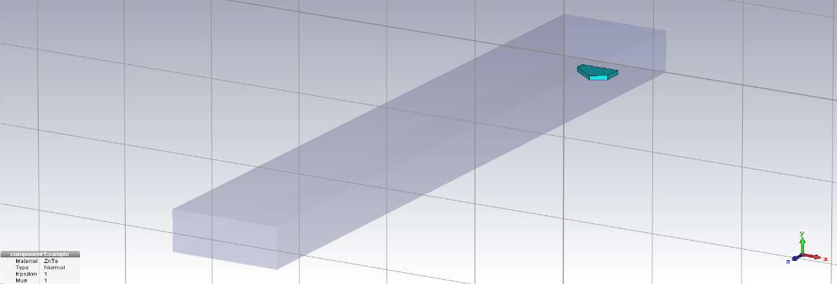
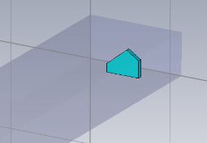
ZnTe RF Characterisation – Simulations
Phase shift of transmitted signal at various simulated values of ε_{r}.
(Vertical position)
Magnitude of reflection at various simulated values of ε_{r}.
(Position 1)
E-field distribution showing overmoding near resonant peak.

Slide 11
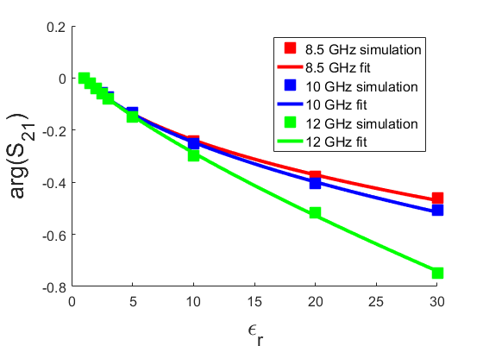
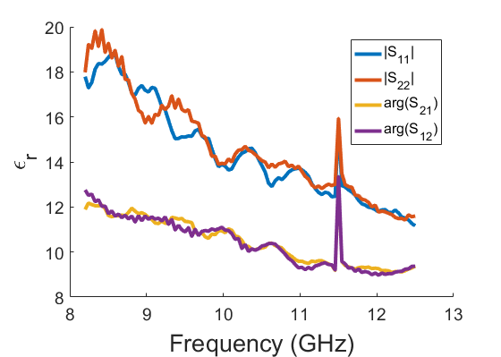
ZnTe RF Characterisation – Current Results
Simulated phase shift as a function of ε_{r}.
(Vertical position)
Extracted ε_{r} using different measured data.
(Vertical position)

Slide 12
Plans for Further Work
Design of wakefield monitor cavity
Calibration of cavity using RF sources
Integration into laser sampling system at CLEAR
Studies of high gradient phenomena in accelerating structures
Measurement of high gradient effects on beam

Slide 13
References
[1] The CLIC Programme: towards a staged e +e − Linear Collider exploring the Terascale, CLIC Conceptual Design Report, edited by P. Lebrun, L. Linssen, A. Lucaci-Timoce, D. Schulte, F. Simon, S. Stapnes, N. Toge, H. Weerts, J. Wells, CERN-2012-005.
[2] R. Pan, Electro-Optic Diagnostic Tehcniques for the CLIC Linear Collider, PhD thesis, University of Dundee, 2015.
[3] M. Brugger, R. Corsini, T. Lefevre, B. Salvant, S. Stapnes, W. Wuensch, M. Petrarca, S. Reiche, C. Welsch, E. Adli, P. N. Burrows, The CLEAR facility at CERN, 2016.

