Slide 1

SiD Optimization
Pandora Update
Andy White, Andrew Myers, Ross McCoy

Slide 2

Data File Specifics
Detector Version: SiD_o2_v02
Physics list: FTFP_BERT
Particles: Pions and Photons
Sample Size: 10,000 events (pions) and 100 events (photons)
Reconstruction with Pandora File:
Clean rebuild of lcgeo using latest ilcsoft (v04) and updated PandoraSettingsDefault.xml (Courtsey Elijah)
  https://github.com/PandoraPFA/MarlinPandora/blob/master/scripts/PandoraSettingsDefault.xml
  https://github.com/PandoraPFA/MarlinPandora/blob/master/scripts/PandoraLikelihoodData9EBin.xml

Slide 3
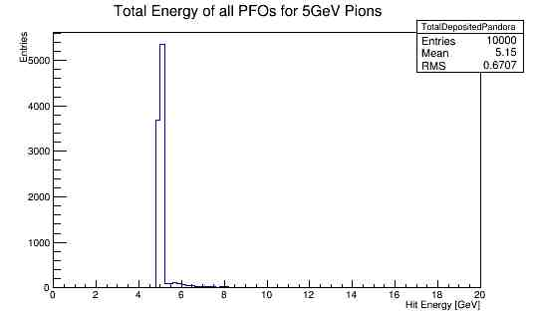
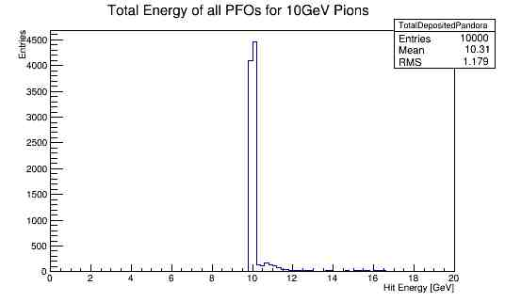

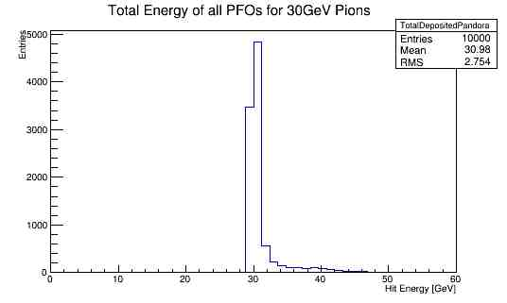
Results

Slide 4
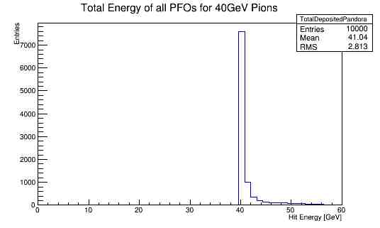
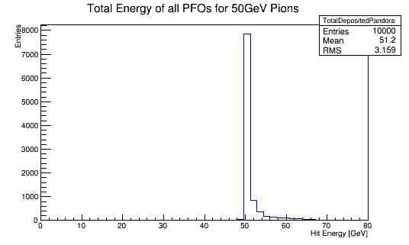
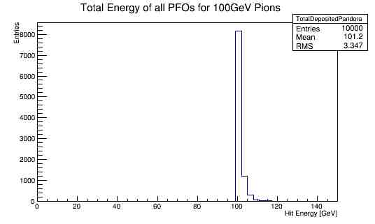
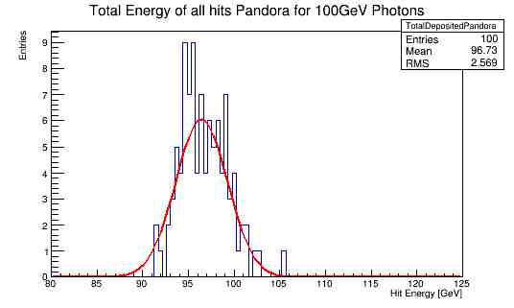

Slide 5
Errors/Warnings within Pandora
[ VERBOSE "MyDDMarlinPandora"] PhotonReconstructionAlgorithm::CreatePhotons: StatusCodeException caught during fragmentation process.
[ ERROR "MyTruthTrackFinder"] **** MarlinTrk::finaliseLCIOTrack: could not add inner hit to track !!!
[ VERBOSE "MyDDMarlinPandora"] PhotonReconstructionAlgorithm::CreateRegionsOfInterests no photon candidates avaiable, no regions of interests are created
[ VERBOSE "MyDDMarlinPandora"] this->CreateClustersOfInterest(clusterVector) return STATUS_CODE_INVALID_PARAMETER
[ VERBOSE "MyDDMarlinPandora"] in function: Run
[ VERBOSE "MyDDMarlinPandora"] in file: /cvmfs/ilc.desy.de/sw/x86_64_gcc49_sl6/v01-19-04/PandoraPFANew/v03-01-02/LCContent-v03-00-02/src/LCParticleId/PhotonReconstructionAlgorithm.cc line#: 90
[ VERBOSE "MyDDMarlinPandora"] iter->second->Run() throw STATUS_CODE_INVALID_PARAMETER
[ VERBOSE "MyDDMarlinPandora"] in function: RunAlgorithm
[ VERBOSE "MyDDMarlinPandora"] in file: /cvmfs/ilc.desy.de/sw/x86_64_gcc49_sl6/v01-19-04/PandoraPFANew/v03-01-02/PandoraSDK-v03-00-00/src/Api/PandoraContentApiImpl.cc line#: 229
[ VERBOSE "MyDDMarlinPandora"] Failure in algorithm Alg0005, PhotonReconstruction, STATUS_CODE_INVALID_PARAMETER
[ VERBOSE "MyDDMarlinPandora"] HighEnergyPhotonRecoveryAlgorithm: Failed to obtain cluster list PhotonClusters
[ VERBOSE "MyDDMarlinPandora"] SoftClusterMergingAlgorithm: Failed to obtain cluster list PhotonClusters
[ VERBOSE "MyDDMarlinPandora"] IsolatedHitMergingAlgorithm: Failed to obtain cluster list PhotonClusters
[ VERBOSE "MyDDMarlinPandora"] ClusterPreparationAlgorithm: empty cluster list for subsequent pfo construction.

Slide 6
Next Steps
Energy distributions
Collison events e⁺e⁻ qq
Examine track momentum of events with higher energies toward the low tail
Examine events with errors/warnings
Fix any calibration constants (i.e. photon energy)

Slide 7


