Slide 1
ILD Computing needs
Akiya Miyamoto
ILD Ichinoseki Meeting
21 Feburary 2018

Slide 2
Introduction
ILD LOI and DBD did not describe the computing cost, because
  Hardware performance would improve
  Software evolution would require more resources
TDR
  A building for the data analysis was included.
  Base on the estimation in LOI era. FNAL LHC facility as a bases.
  Computing hardware itself, human resources for operation, network
  were not included
After DBD, LCC “Yamada” committee made a request
  ILD Study: presented at ILD Workshop 2014. H20 Scenario, DBD experience
  LCC Software and Computing WG report
  http://www.linearcollider.org/P-D/Working-groups
Last fall, a request by LCC and KEK
  Preparation for a query about cost and infrastructure required.
  250 GeV staging in mind.

Slide 3
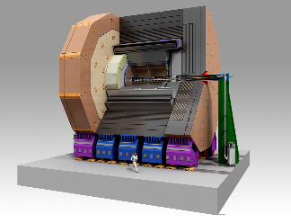

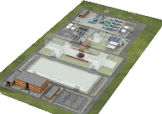
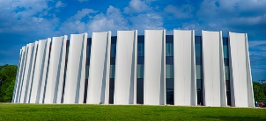
Computing concept
ILC Lab.
Detector
IP Campus
Main Campus
GRID World
Role of each computing facility:
  IP Campus : Event building, Fast Data Monitor
  Main Campus : Data storage, Event(BX) selection, Quick data analysis
  GRID Computing: Secondary Data Analysis, User Analysis, Simulation
Computing at IP Campus: DAQ of the experimental group
Role of the computing in ILC Lab. Main Campus
  Trigger less readout. Remove background data at early stage of analysis
  Share among ILD and SiD. Lab. wide uniform support of mail, security, …
  Follows the past tradition, basic resource being supported by the lab.
  as a part of running cost.

Slide 4
Bases of estimation: ILD raw data size in TDR ( @500 GeV)
raw data size per train estimated @ 500 GeV
2014
VXD : ~ 100MB
BeamCal : 126 MB→
reduced to 5% = 6MB
Others < 40MB
Dominated by lowE
e+/e- background
due to beamstrahlung
130
Total data size : ~180 MB/Train, ~0.9GB/sec, ~7.1 PB/year(0.8x10⁷sec)
~277MB/Train, ~1.4GB/sec, ~11.1 PB/year

Slide 5
Storage estimation (ILD)
Running scenario: 1st stage 250 GeV. Total int. lumi H20
Raw data size:
  TDR 500 GeV with AHCAL corr. : ~ 11PB/year
  250 GeV nominal : Same as 500 GeV (bkg would be similar )
  Run with x2 luminosity: x2 of nominal
  2 raw data set: one set at Lab, another set somewhere in the world.
Filtered/analyzed data.
  A fraction of signal BX ( DBD signal samples + ) : ~ 1%.
  Assume 3% of BXs remains after filtering.
  Event size per BX would be x2 after filtering and initial analysis
  ( REC/SIM ratio of DBD samples )
  After reanalysis on GRID, event size would be x3 of raw event.
  DST files would be replicated to 10 sites world side.
Simulation data
  Produce x10 luminosity than real data on GRID
  Event data size : adapt DBD data size.

Slide 6
CPU needs
MC Simulation (on GRID)
  x10 real data statistics
  CPU time: DBD signal + bhabha etc + Reconstruction
  Assume bhabha etc = DBD signal
  reconstruction = 0.5 x DBD signal sim.
Real data processing:
  Data filtering: all BXs, same CPU time as data reconstruction
  ➔ Major part of CPU demands
  Reconstruction : Filtered event ( 3 % of all BXs ). Same CPU time as Sim.
  CPU capacity enough to analyze 1 year of data in 240 days.
  Another reconstruction after re-calibration, on GRID
User analysis, detector calibration, are not counted.

Slide 7
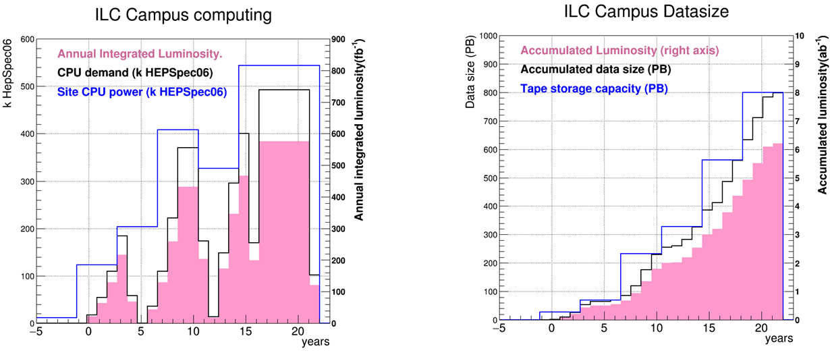
Year by Year evolution
Assume SiD = ILD
Luminosity ramp up scenario is included.
Only on site estimation is shown below.
Annual Integrated Luminosity (fb⁻¹)
Annual Integrated Luminosity (ab⁻¹)
250GeV
250GeV
2xLumi
500GeV
500GeV
2xLumi
350GeV

Slide 8
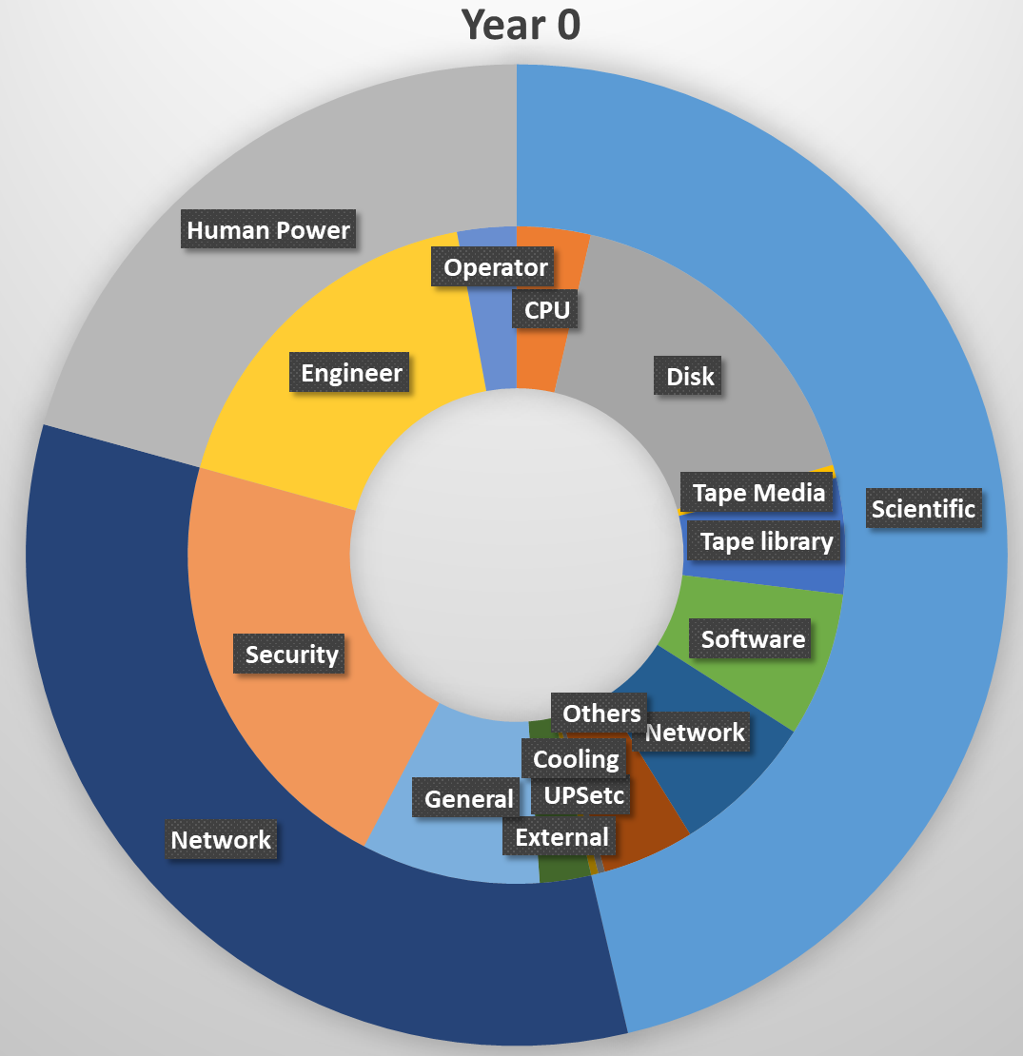
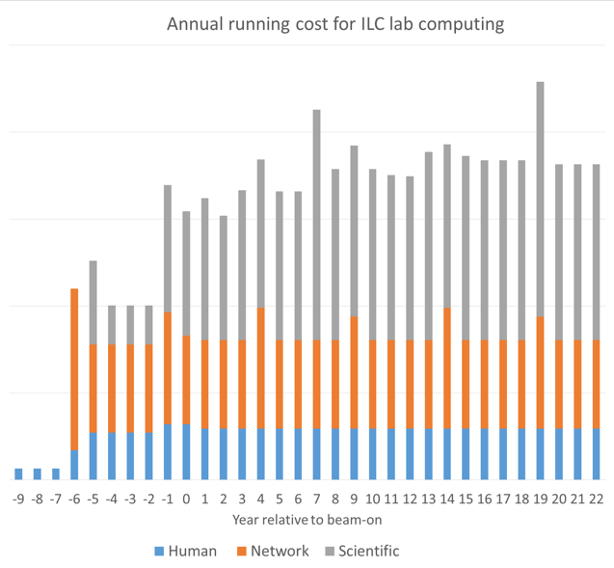
Computing cost in Lab
Assumption
  Rental. 4 year service + 0.5 year for replacement
  10% of year0 system, before year 0
Additional cost to be added to the TDR value would be
  Hardware to support ILD and SiD needs at Lab.
    Includes CPU, Tape robot, disk, software, UPS, cooling. Tape media not included.
    Base on KEKCC 2017, assume cost reduction of CPU(2%/y), Storage(10%/y)
  Network and human resources for operation of scientific system
  Support by running cost
A building space for the computing system ~ a space in TDR.

Slide 9
Summary
Computing resources for ILD data analysis was revised.
The estimated resources at the lab was used to estimate a building space and an operational cost for the lab.
The estimation is based on many assumptions.
- Raw data size with the latest beam parameters ?
- Efficiency to remove backgrounds ?
- CPU time for background removal ?
➔ Timely update of these estimation is desirable.

Slide 10
B A C K U P

Slide 11
A model of ILD data processing
ILD
Online
Computer
@ control room
F.E.
build a train data
send data to Main Computer and monitor processes
Data sample and
reconstruction for monitoring
Temporary data storage
for emergency
Temp.
Storage
DAQ/
Online
Main Computer
@ main campus
~1GB/sec
Offline

Slide 12
DAQ/
Online
Main Computer
@ main campus
~1GB/sec
Offline
Online reconstruction chain
Write data
sub-detector based preliminary reconstruction
identify bunches of interest
calibration and alignment
background hit rejection
full event reconstruction
event classification
Raw
Data (RD)
Online Processed Data (OPD)
Fast Physics
Data (FPD)
Calibration
Data (CD)
GRID based
Offline computing
JOB-A
Re-processing
with better
constants
JOB-B
Produce
condensed
data sample
JOB-C
MC-Production
Raw Data
Copy
Offline
ReconstructedData (ORD)
DST
MC data

