Slide 1



Progress and Actions for the ILC
in Tohoku District
Atsuto Suzuki
Tohoku ILC Planning Office
Iwate Prefectural
University

Slide 2
Outline
Report from Academic Expert Committee in MEXT (2015)
Tohoku ILC Planning Office (2016)
Activities in Planning Office
  3.1 Underground Facility
  3.2 Underground Facility & Engineering
  3.3 Engineering
  3.4 Regional Master Plan
  3.5 Public Relation
  3.6 All
Summary

Slide 3
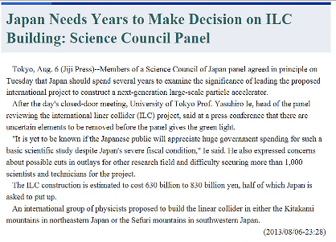


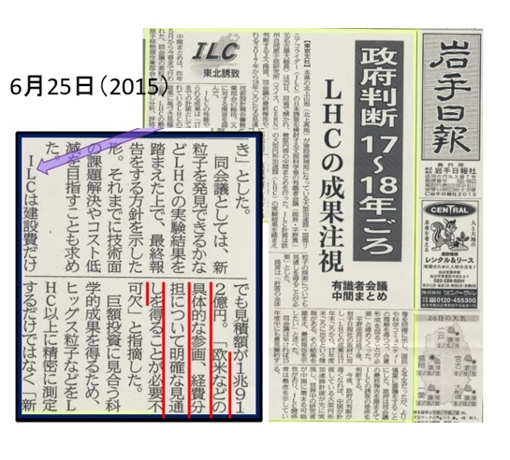
1. Report from Academic Expert Committee in MEXT
(2014-2015)
Review by
Science Council of Japan
Government Decision in 2017～2018
after finalizing the cost sharing
MEXT
Task Force
February 6, 2014
Academic Experts Committee
Particle・Nuclear Physics WG
TDR Validation WG
May 8, 2014
Tohoku ILC Planning Office

Slide 4
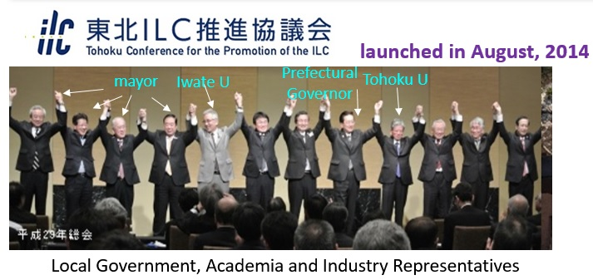
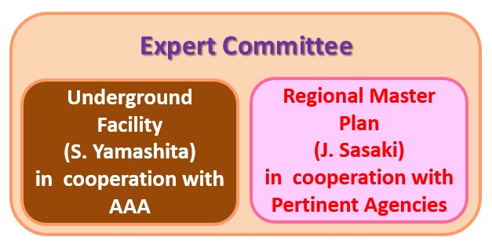
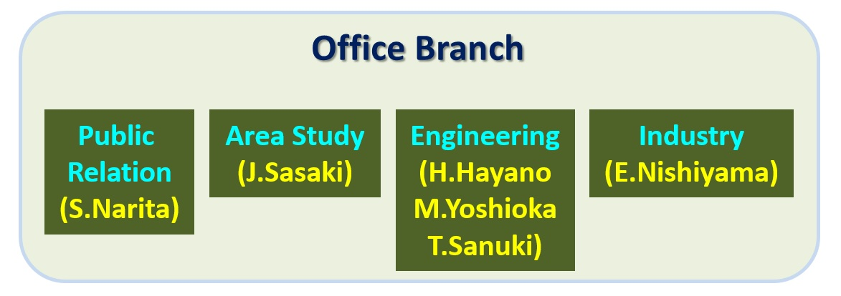
2. Tohoku ILC Planning Office (2016)
June 14th, 2016
Mission :
to complete key-issues required in the local district before the government decision for hosting the ILC in Japan
ILC Tohoku Planning Office
(Chair: A. Suzuki)
F. Ube
H. Odaira
O. Oe
S. Yamashita (Tokyo)
H. Yamamoto (Tohoku)
Steering Committee
T. Onuki, T. Sarukawa, H. Musya, Y. Shiraiwa, T. Yajima, Y. Kamata, I. Kumagai, Y. Fujita, K. Shige, A. Wayama, K. Kon, Y. Takano, K. Norita, Y. Abe, H. Ohuchi, T. Shiraiwa, T. Takahashi, Y. Inomata, Y. Ejiri, Y. Kumazawa

Slide 5
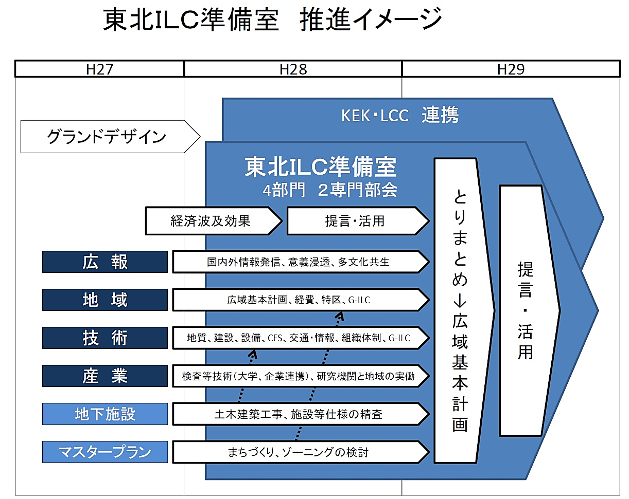
Timeline of Work-Items
Government Decision
２０１5
２０１６
２０１7
in cooperation with KEK and LCC
Tohoku Conference for the Promotion of the ILC
Public Relation
Area Study
Finalize
Proposal
Recommendation
Engineering
Industry
Underground Facility
We support the ILC Project
Regional Master Plan

Slide 6

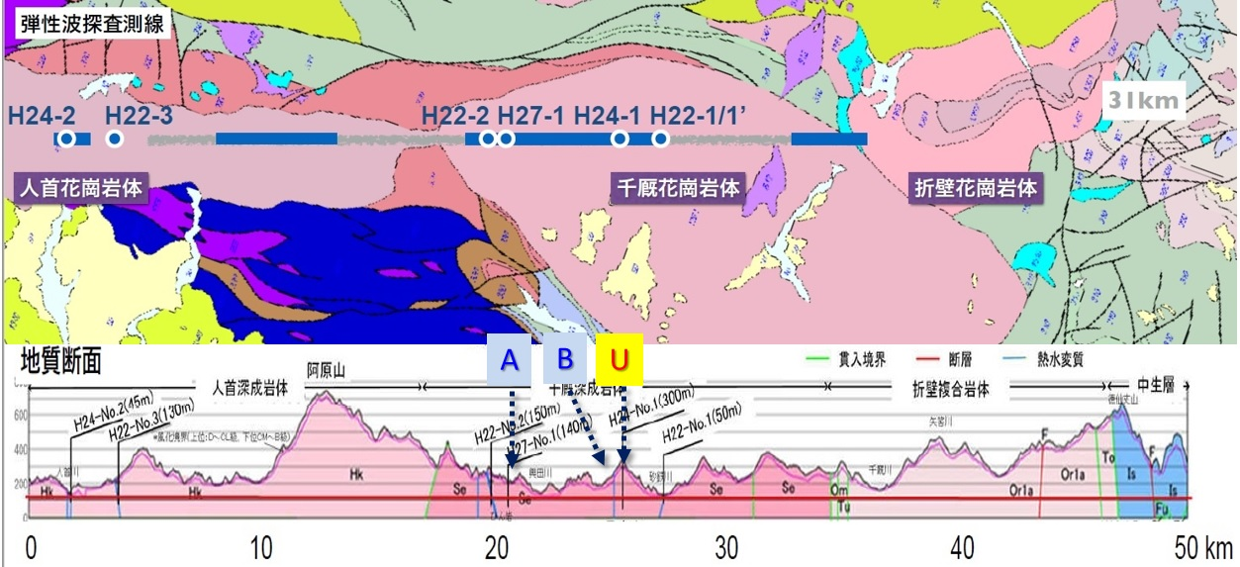
3. Activities in Planning Office
3.1
＊ Settling the most suitable collision position
No freedom for East-West shift from constraints of geological/geographical features and existing objects
U : TDR point ← sloped access
A, B : new assign points ← vertical-shaft access ← convenient installation & construction, and cost-saving
B : the most suitable point

Slide 7
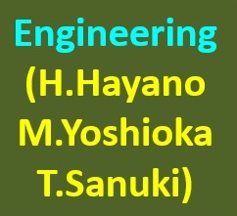
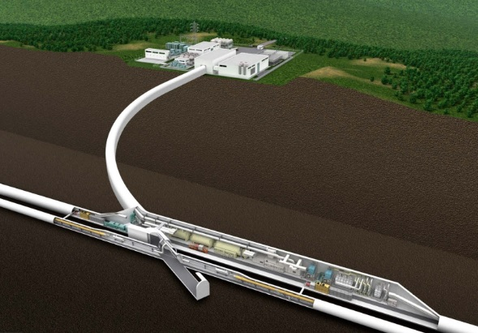
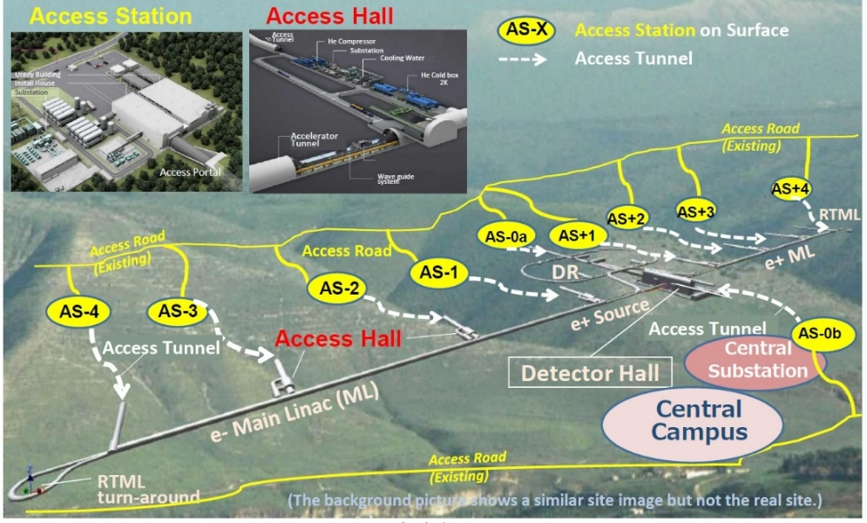
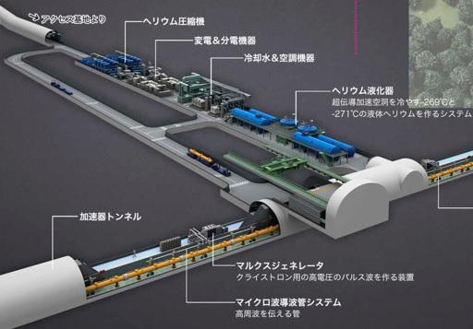
3.2
＊Developing the CFS specification and cost estimation
for staging (250 GeV～20km) scenario
Access Station
Access Hall

Slide 8
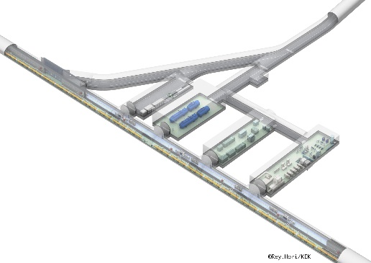
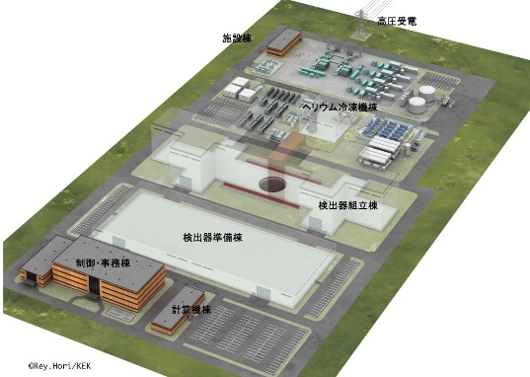
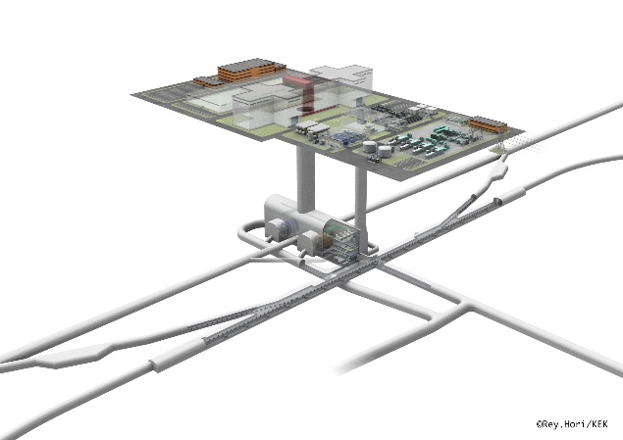

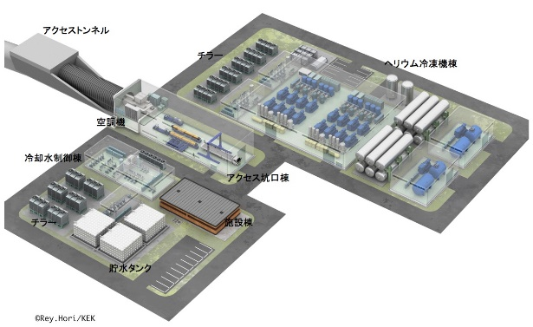
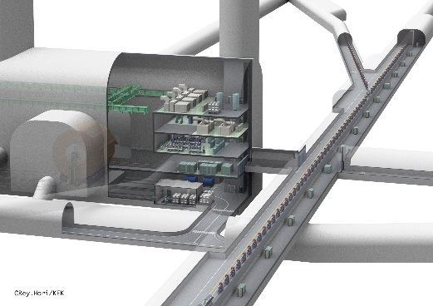
Kitakami-site-specific ILC CFS Design & Cost Studies including the Staging Scenario (H. Hayano)
turnaround
underground facility of
access tunnel
surface facility of collision point
ターンアラウンド
アクセストンネル
クライオモジュール搬入路
PM-10
ヘリウム冷凍機設備
AT-10：1503m
電気設備
（アクセストンネル長）
空調・冷却水設備
電子リニアック
主リニアックトンネル
衝突点地上部
PM-8
トンネル全長
= 20,549.5m
(20.5km)
AT-8：691m
垂直シャフト
AT・DR (坑口から DRまで)：763m
AT・DH (分岐点から 検出器ホールまで)：693m
衝突点エリア
衝突点地下部
underground facility of
collision point
collision area
自然排水トンネル（0.13%勾配）：4335m
ダンピング
リング
AT+8：283m
PM+8
検出器ホール組込の
電気・機械設備
陽電子リニアック
AT+10：943m
坑口
PM+10
アクセス
トンネル（斜坑）
ターンアラウンド
surface facility of access tunnel
turnaround
アクセス坑口地上部設備

Slide 9

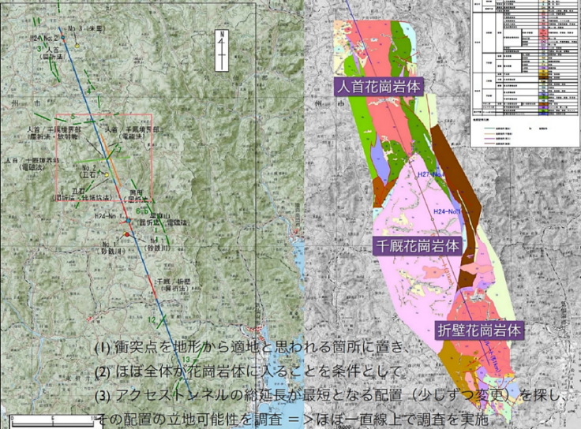
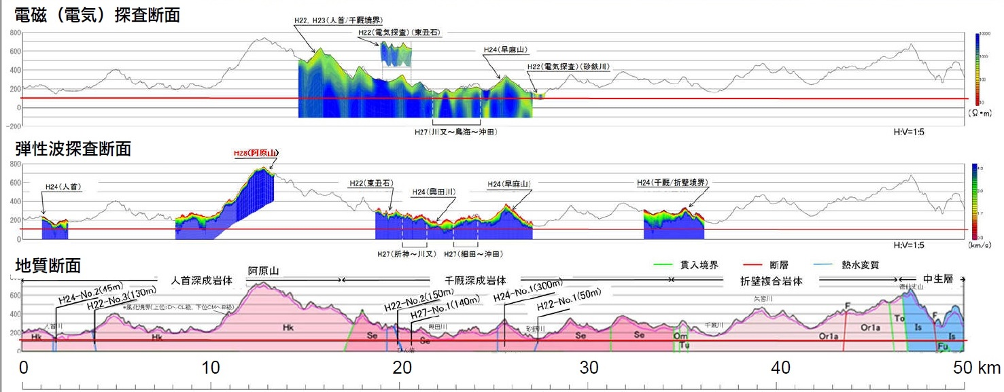
3.3
A. Survey: Geological Condition along the ILC Tunnel
・ Rock Crack : Electromagnetic Prospecting
・ Rock Stiffness : Seismic Prospecting
・ Springwater : Hydrologic Study
・ Boring Survey
crack
more
less
～1/2 of Area (～30 km long) : done
soft
hard
Electromagnetic Prospecting
stiffness
Seismic Prospecting
A
B
U

Slide 10
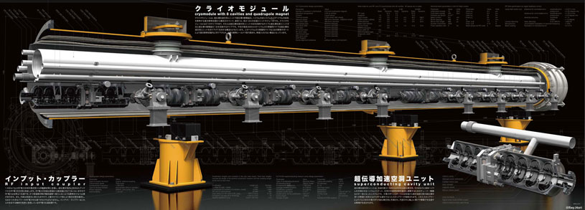
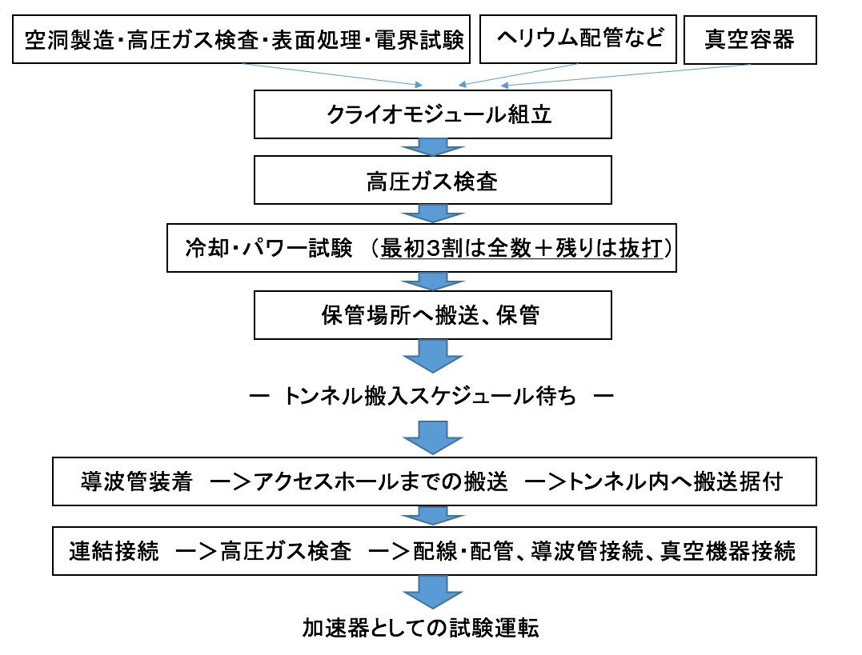
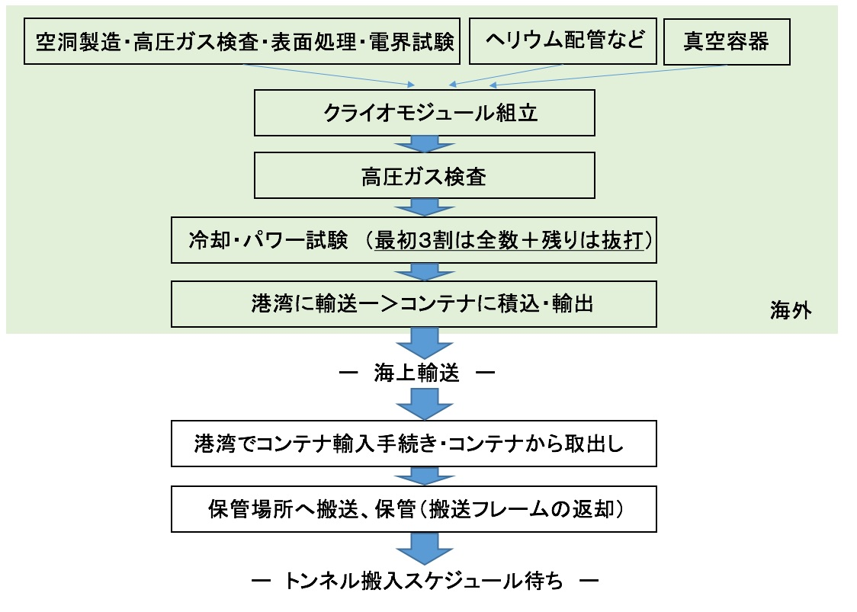
B. Visualizing the process of construction, maintenance
and storage for accelerator components
Cryomodule-processes from manufacturing to installing inside the ILC tunnel
Production in Japan
Production in Overseas
日本の場合
海外の場合
manufacturing, composition, inspection・・・
assembling
high-pressure-gas inspection
cooling & power test
ILC campus
packaging into container
overseas
ILCキャンパス
shipping
import procedure & unpacking
Port
Facility
港湾施設
inspection, assembling & storage
installation

Slide 11
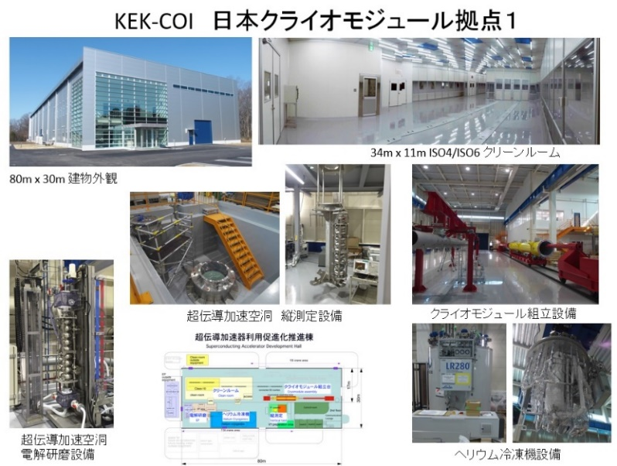

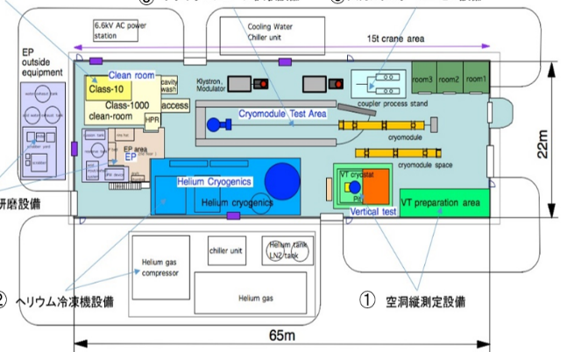
Example of Port-Facility
Euro-XFEL

Slide 12
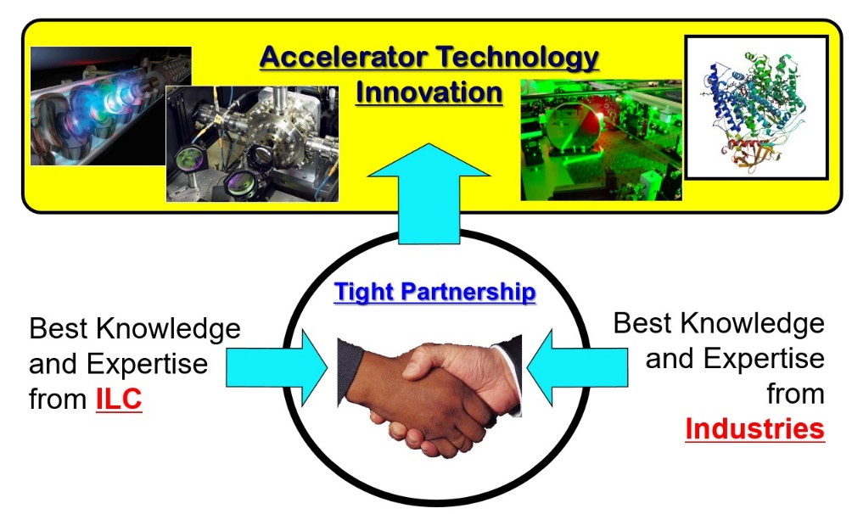
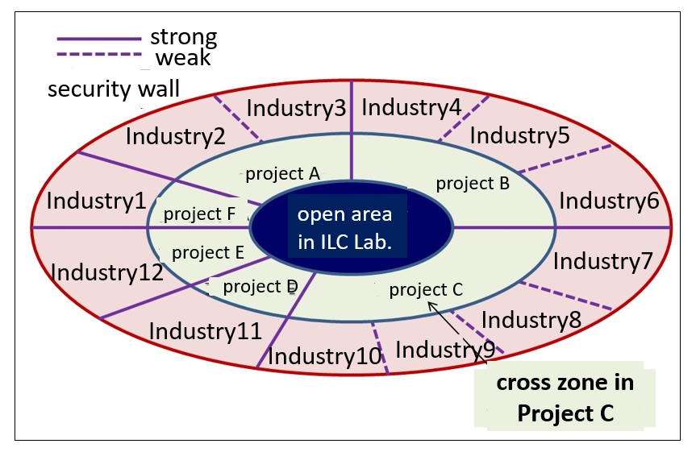
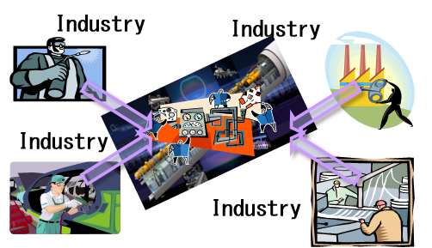
How to Encourage Technology Innovation in ILC
Port
Facility
Technology R&D and Innovation Center
for Advanced Accelerator/Detector
Possible Scheme of Industry-Academia Collaboration

Slide 13
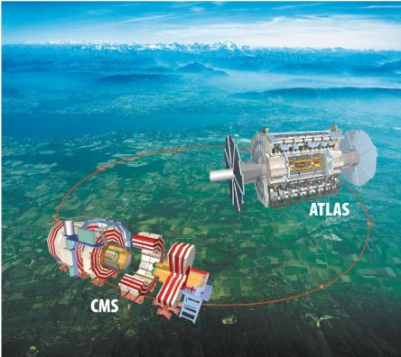

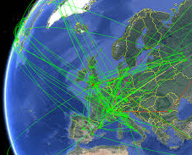
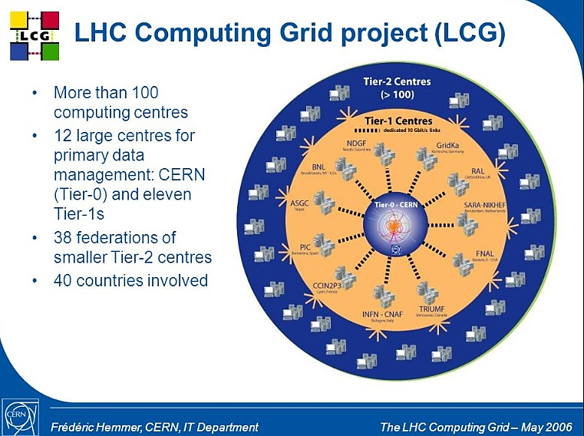
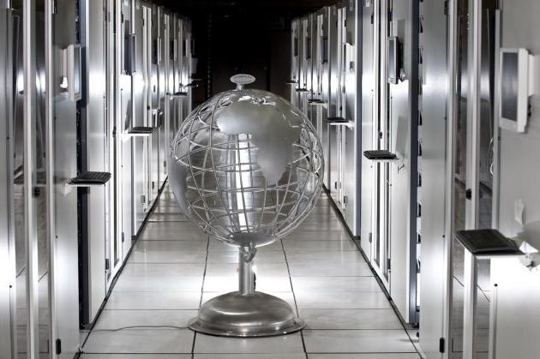
C. Data-Analysis Network
CERN Computer Looks to Future
ILC

Slide 14
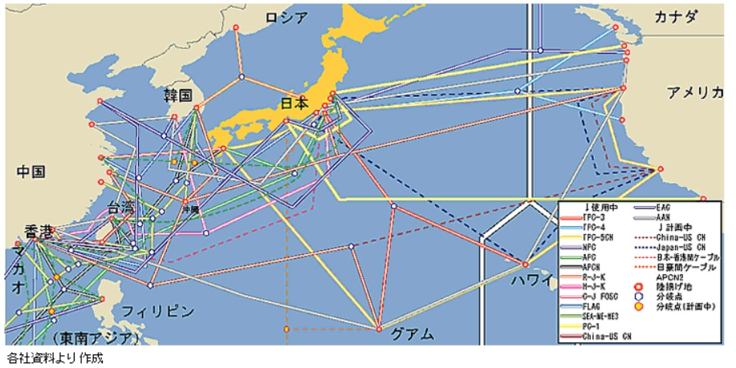
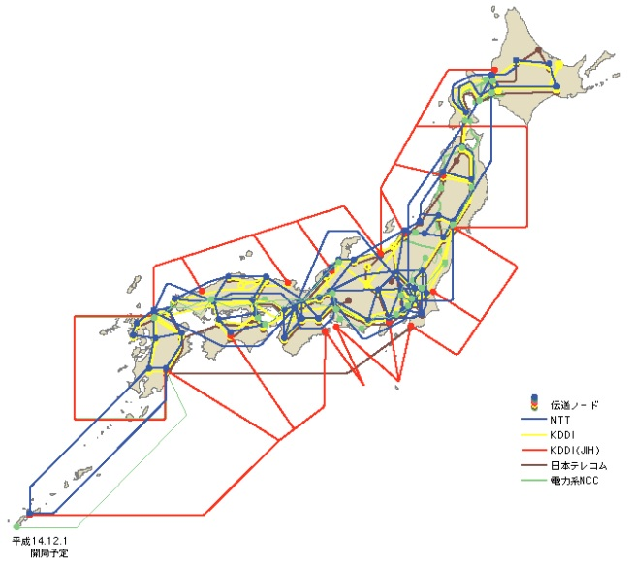
Improving Data Communication-Line
Russia
Canada
ILC
Korea
US
Kyusyu
China
Taiwan
Hawaii
Guam
ILC
Require New Submarine-Cables
from US/Canada to the ILC Site
and
from Kyusyu to Taiwan (Tier-1 : LHC)

Slide 15
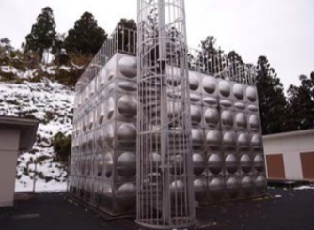
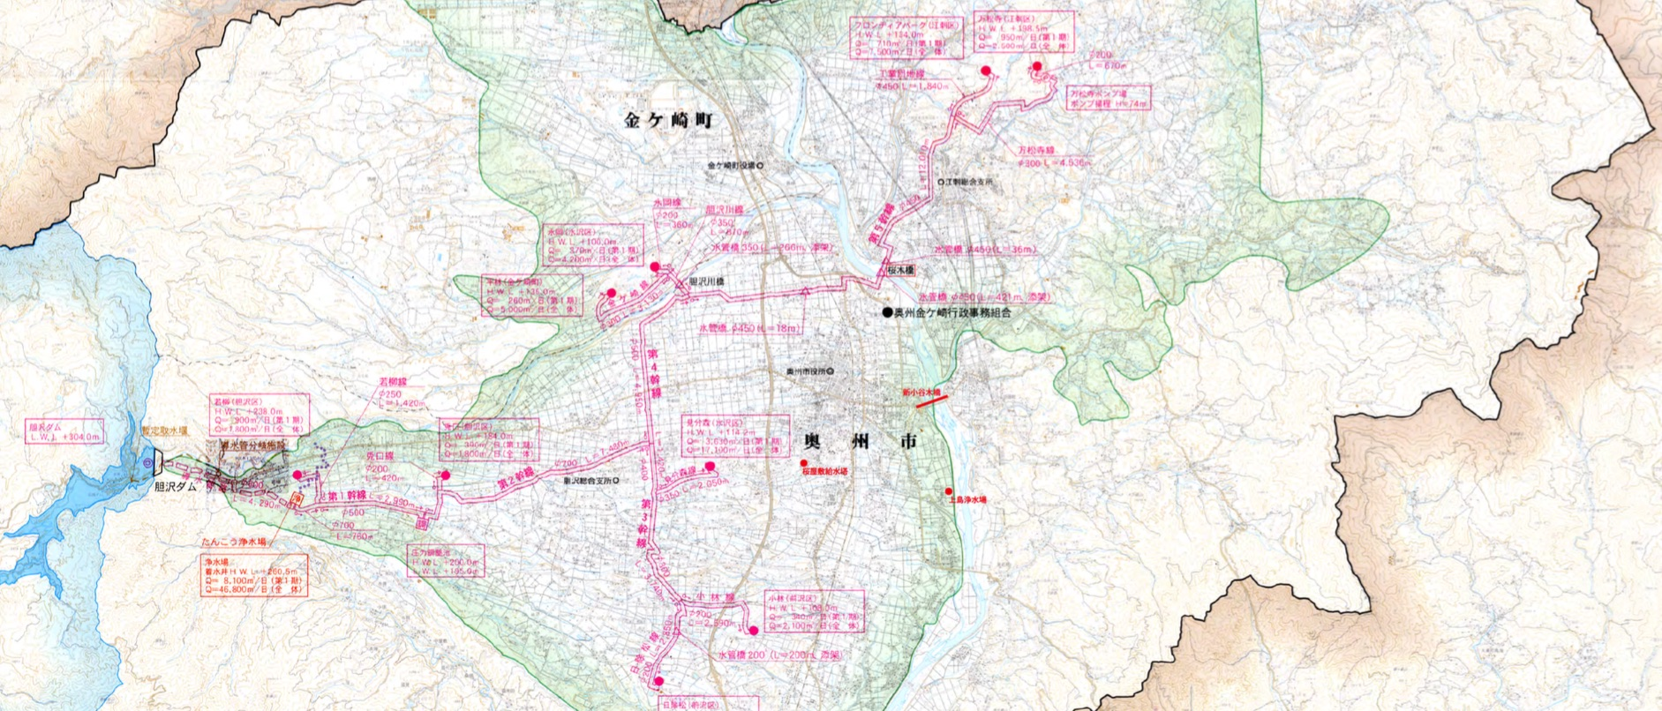
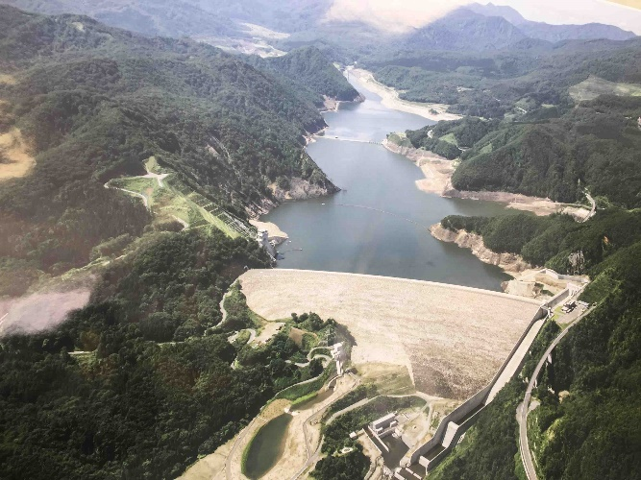
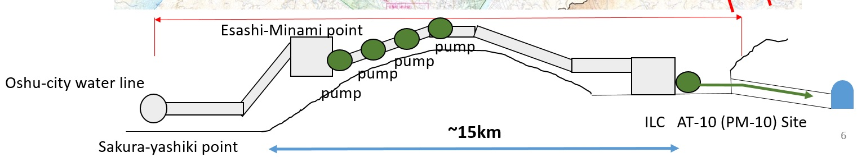
D. Possible Cooling Water Supply
Banshouji point
Frontier Park point
~13km
Isawa Dam
Sakura-yashiki point
Option-C
Pipe-line : enough capacity for 10,000m³/day
ILC

Slide 16
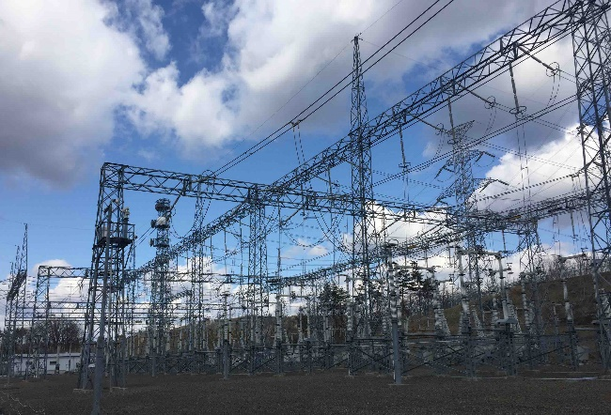

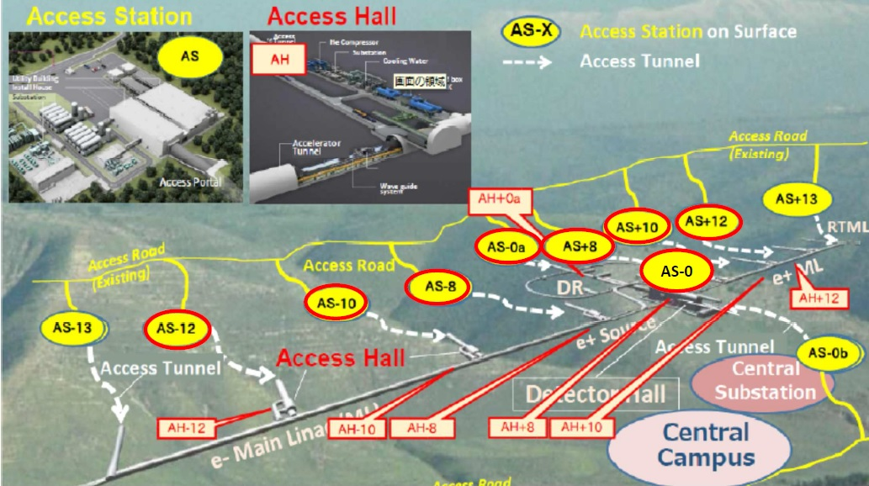
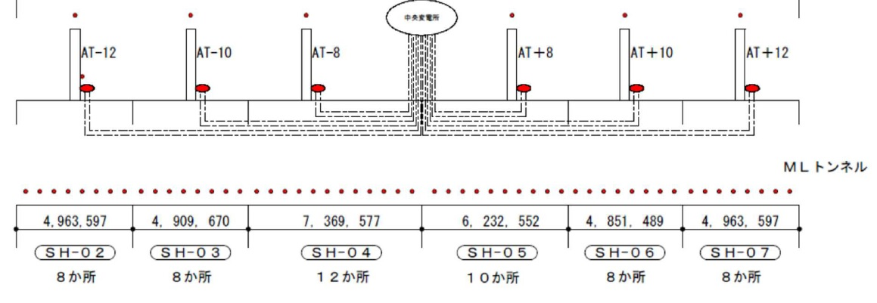
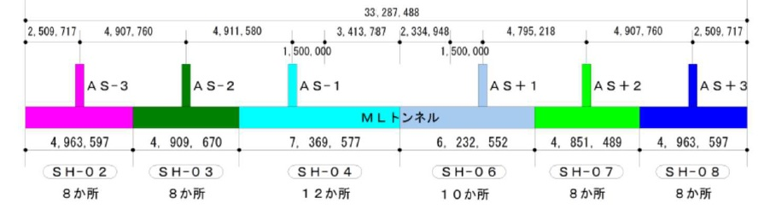
E. Design Study of Electric Power Flow
1. Surface Facility
Mizusawa Station
(～15 km)
Input : Tohoku Electric Co., Mizusawa Station (154 kV)
Receiving : ILC Extra-high Voltage Substation
(→ 66kV) identical design with J-PARC
Generation : Cogeneration System (LNG)
～3% of 164 MW (ILC peak power)
identical design with RIKEN-CGS
J-PARC
RIKEN CGS
2. Underground Facility
Receiving : 7 Access Hall Voltage Substations (→ 6.6 kV)
Receiving : 60 Local Voltage Substation (→ 400 V)
Access Station
中央変電所
Access Hall

Slide 17
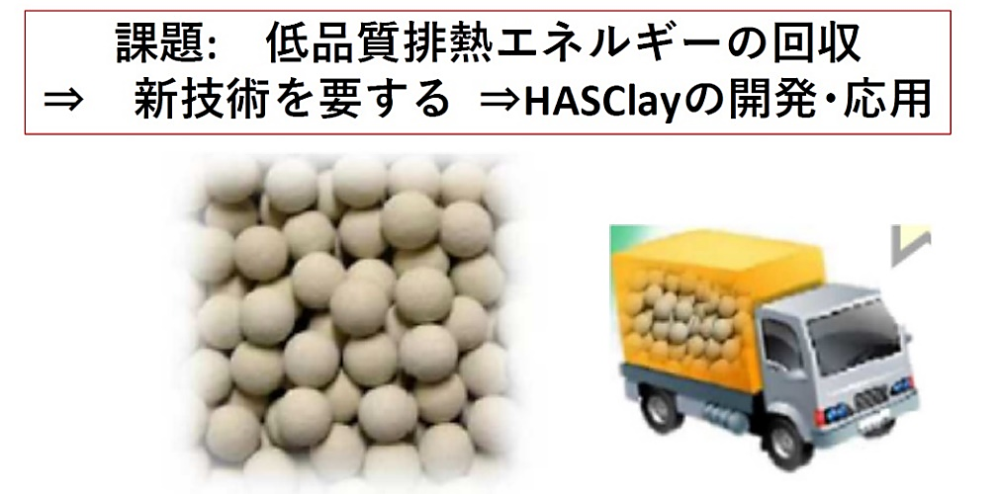
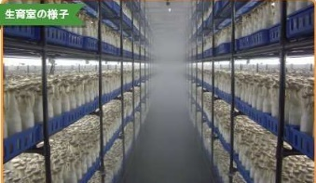
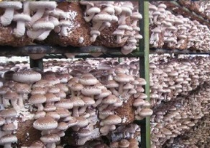
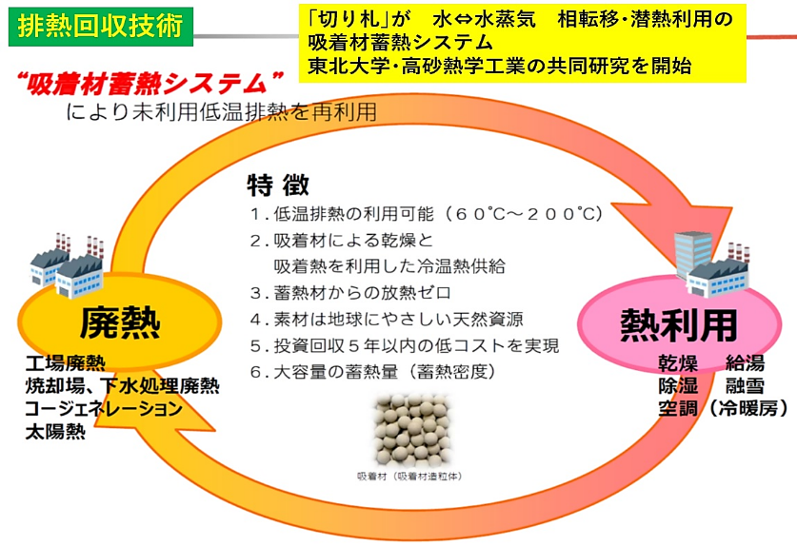
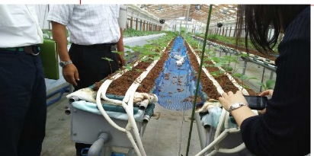
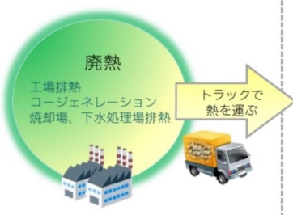
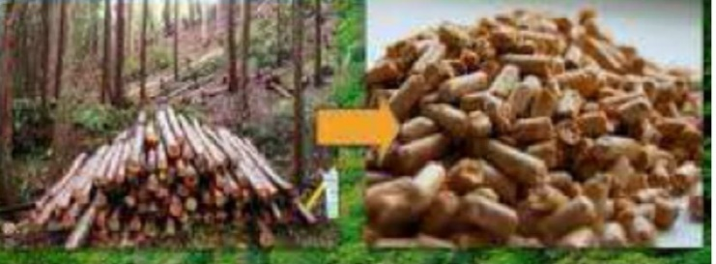
F. Encouraging Green-ILC : Waste Heat Recovery and Utilization
Back-end Energy Flow
Cooling Water → Cooling Tower
Heat Recovery → Cooling Tower
Heat Recovery
HASClay : inorganic porous material for low grade heat source
some projects in alliance with
local companies
Waste Heat
Heat
Utilization
Agriculture, Forestry
& Fisheries

Slide 18
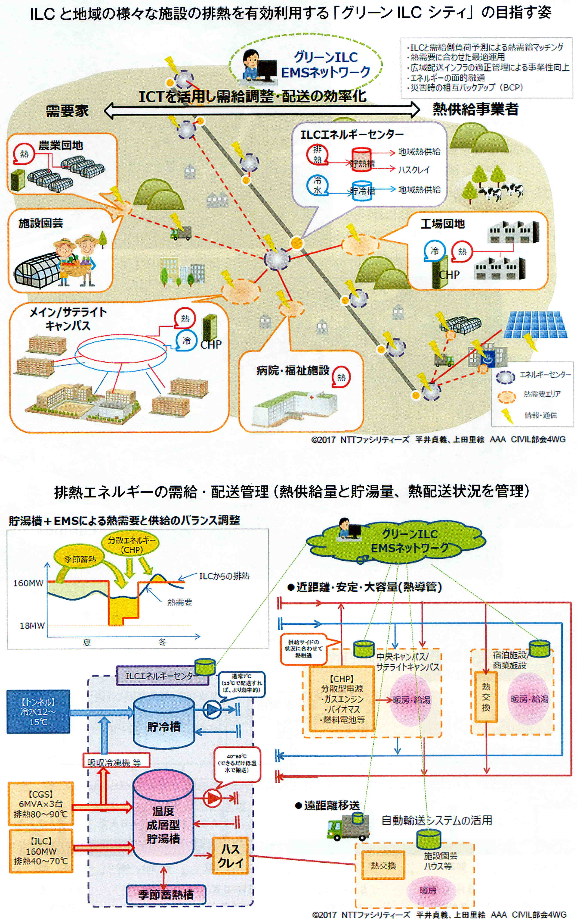
Green ILC City Plan, utilizing ILC Waste Heat
Green ILC
EMS Network
Consumer
Heat Provider
ILC energy center
collective farms
gardening facilities
Industry park
main/satellite campuses
hospital/welfare facilities
EMS: element management system
(ICT)

Slide 19
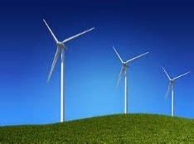
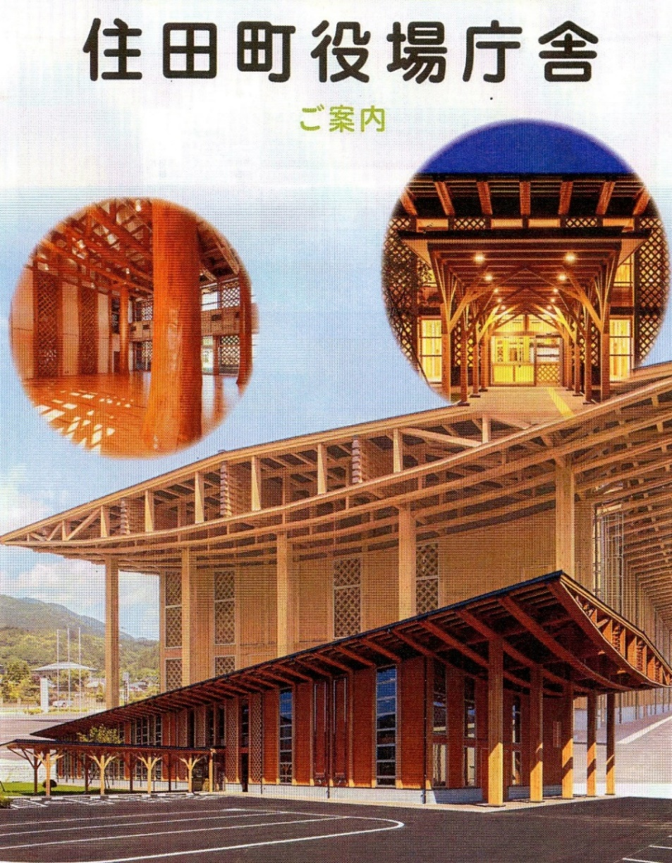

More Green ILC
5 Wind-Power-Generation
Plans near the ILC site
Sumita Town Office

Slide 20



More Green ILC
How to Recover Beam Dump Energy
(～10 MW)
Recover Beam Energy
Reduce Radio-Activation

Slide 21


The basic concepts of plasma acceleration and its possibilities were originally conceived by Toshiki Tajima and Prof. John M. Dawson of UCLA in 1979.^{[1}
Plasma Deceleration Dumping
T. Tajima : originally conceived the basic concept of plasma acceleration with J. Dawson
Use Collective Fields of Plasmas for Deceleration
10 cm for 100 GeV
The deceleration distance in the underdense plasma is 3 orders of magnitude smaller than the stopping in condensed matter.
The muon fluence is highly peaked in the forward direction.

Slide 22




Collective Stopping Power for ILC
here
&
(electron bunch)
ILC
σ_{T} ≈ 50 μm, σ_{L} ≈ 3 σ_{T} ≈ 150 μm
→ L = 10 m for Li gas
Next Trials
Experiment of Proof-of-Principle
Deposit mechanism of Wake-Field energy

Slide 23





3.4
Masterplan : ILC Area → Tohoku → Throughout-Japan
Key Concept：
Area-creation opened to the world, based on local resources & ILC technologies
Cultivating Human Resources Responsible for the Next Generation
Capital
Investment
Brain
Primary Industry
Tourism
Foodstuff
Traditional Industry
Education
New & Venture Businesses
Existing Companies
Human
Resource
Technology
Increasing Export and Inbound

Slide 24













3.5
Public Relation
(S.Narita, E.Nishiyama)
A. Information Transmission of Tohoku ILC Activities
Tohoku ILC Booth & Presentation at IEEE (Strasbourg, Oct. 2016)
～1000 for 3 days
LCWS2016 (Morioka)

Slide 25







Members of Tohoku ILC and AAA
at Tohoku Booth

Slide 26




B. System to Realize Comfortable Multicultural Society
Foreigners
Learn about JPN culture through interactions with local people
One-Stop
Total
Service
Support with
starting life here,
daily life,
Info. distribution
Meet locals
prefecture/
city/town/
village office
Daily Life
Support
Insurance
(fire/car/life/etc.)
hospitals
外国人
家族
Finding place to live, rental insurance, furniture rental
Foreign
Researchers
Other emergency,
medical services
Living
Risks
Living
Environment
Support
companies
schools

Slide 27








Realizing Multicultural Coexistence Society in On-Site Region
by Iwate foreign resident supporters

Slide 28








3.6
Government-Special Feature-Budget :
Comprehensive Special Zones
Concentration of National and Regional Policy Resources in Special Zones with High Potential for Realizing Pioneering Initiatives
International Competitiveness
Local Revitalization

Slide 29




Booklet of Tohoku ILC Activities
Brief reports on the ILC Tohoku activities for non-experts are summarized as a form of ILC Guideline-Series.
Governance Model of ILC Lab.
One-Stop Facility for Accelerator Components
Flows of Electricity and Water in ILC
Green ILC
[Masterplan], [ILC Economic Domino Effect], [ILC Q&A], [Kitakami-Site Specific CFS Design], [Realizing Multicultural Society] ・・・・・

Slide 30



Slide 31




6. Summary
ILC in Kitakami
Scientific World by K. M
Atom・Molecule
and
Iwate Prefecture
Kenji Miyazawa
(1896-1933)
Writer for Children’s
Story & Poem

Slide 32


Night on the Galactic Railway
The Galactic Railway Again!
Cosmic Journey to the Birth of Our Universe by the ILC in Kitakami
http://yamaoyazi.asablo.jp/blog/2015/05/21/7638582

Slide 33







Staging ILC
Mt. Iwate

Slide 34

ILC： Global Initiatives at the Local Level （ILC：地域からの開国）
① ILC : Paving the way of the future of Japan （ILCが拓く日本の未来）

