Slide 1
Resolution Study cont.
T. Bromwich

Slide 2
Outline
Look at different files from the May/June run and attempt to identify common conditions for achieving good resolution results.
Study 1: Look at stray waveforms
Check timing of data sets.
Plot how position changes with time.
Plot position residual changing with time.
How theta changes with jitRuns.
Study 2: Try removing outliers from Q/I plot.
How theta changes within jitRuns + differences from calibration file.

Slide 3
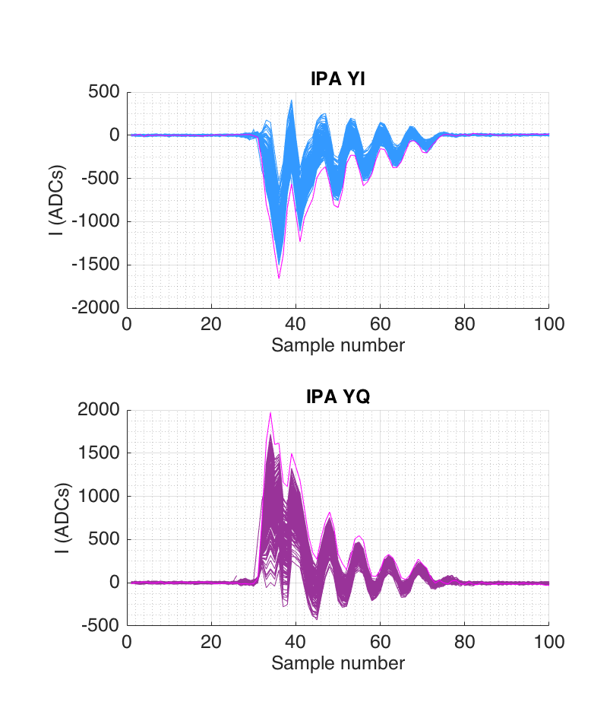
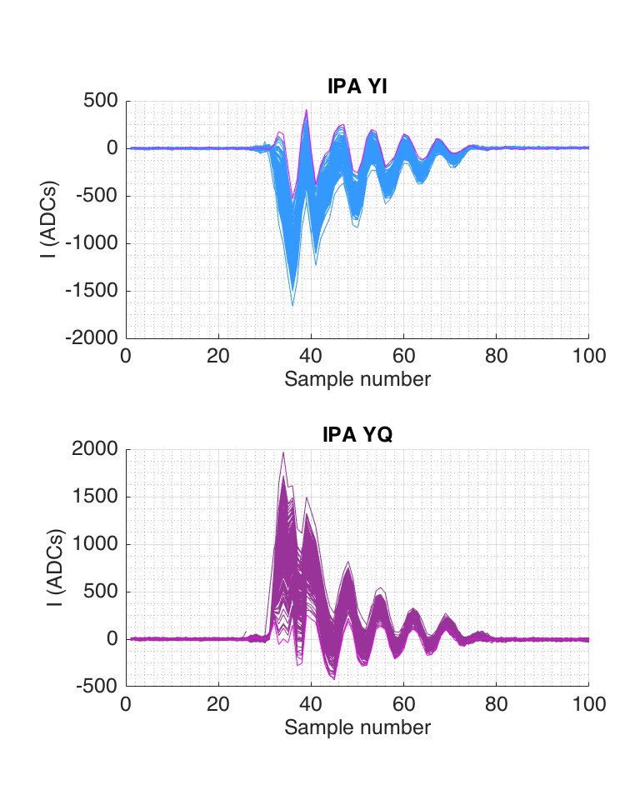
Check stray waveforms
jitRun14(601:800) → 33nm

Slide 4
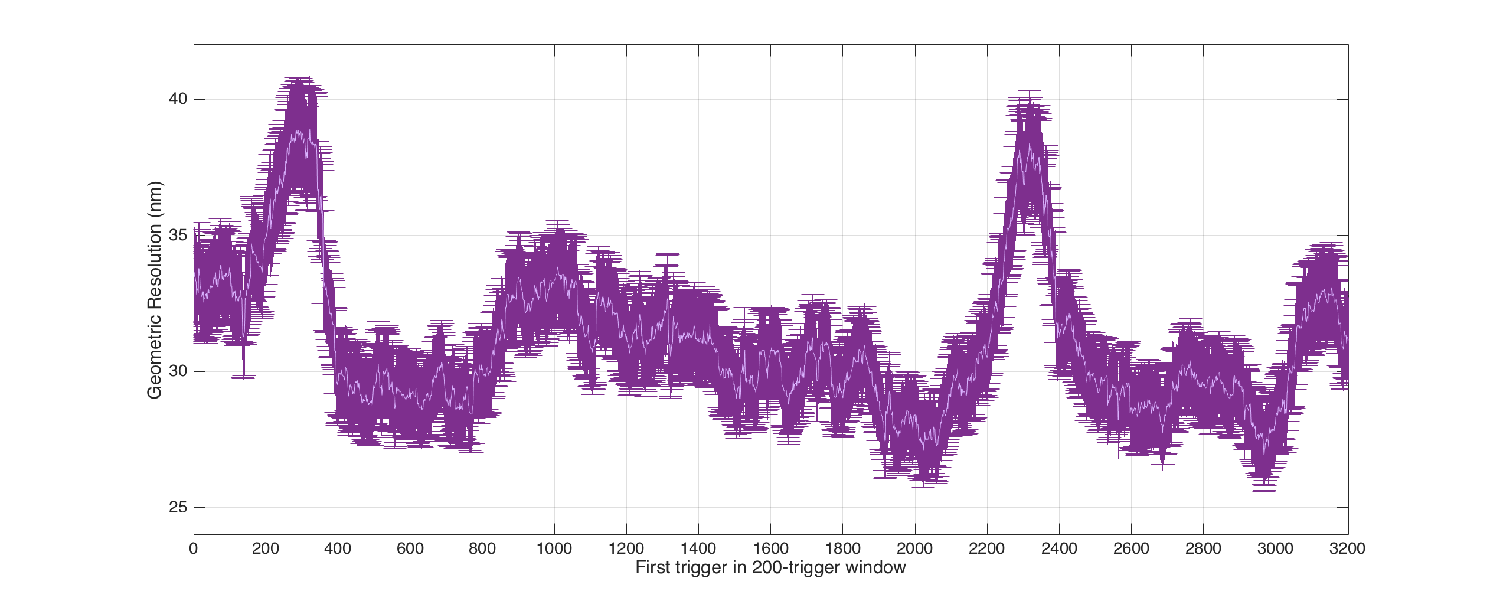
Study 1: Rolling resolution
jitRun13: triggers 1:400
jitRun14: triggers 401 to 2400
jitRun15: triggers 2401 to 3400
Time gap: 67 seconds
Time gap: 8 minutes and 7 seconds

Slide 5
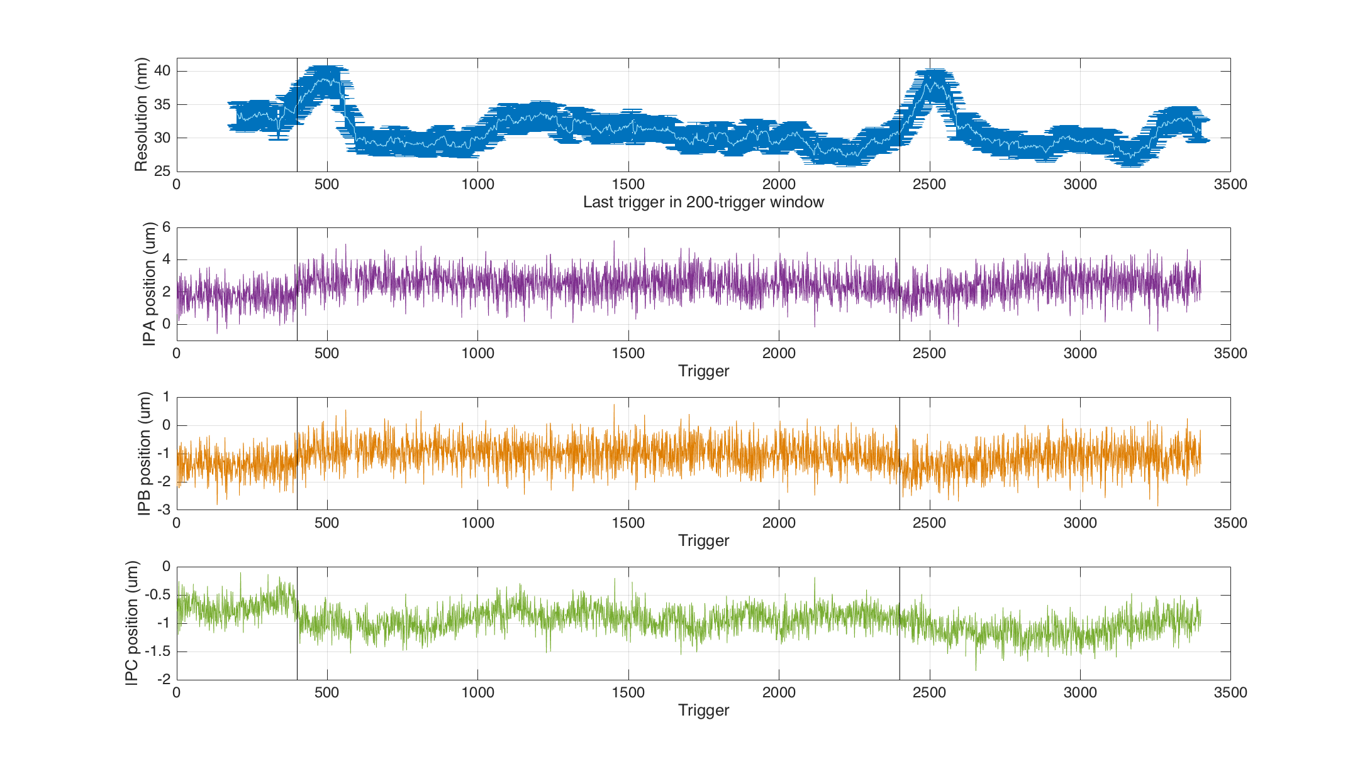
Study 1: Res & position
200-trigger resolution against same axes as the position trigger by trigger at IPA,B, C.

Slide 6
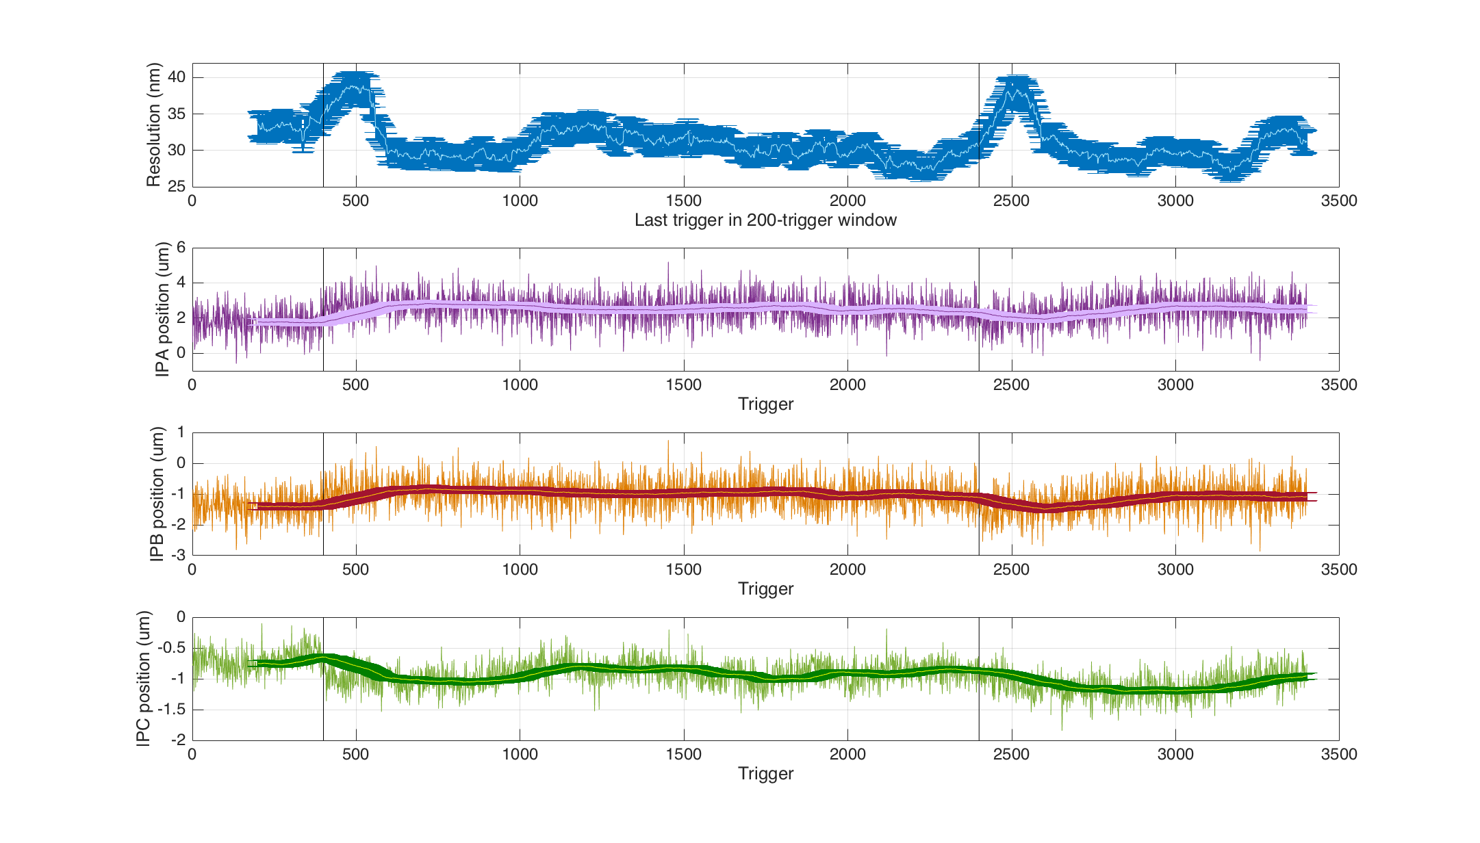
Study 1: Res & position
Superimposed mean position for each 200-window block.

Slide 7
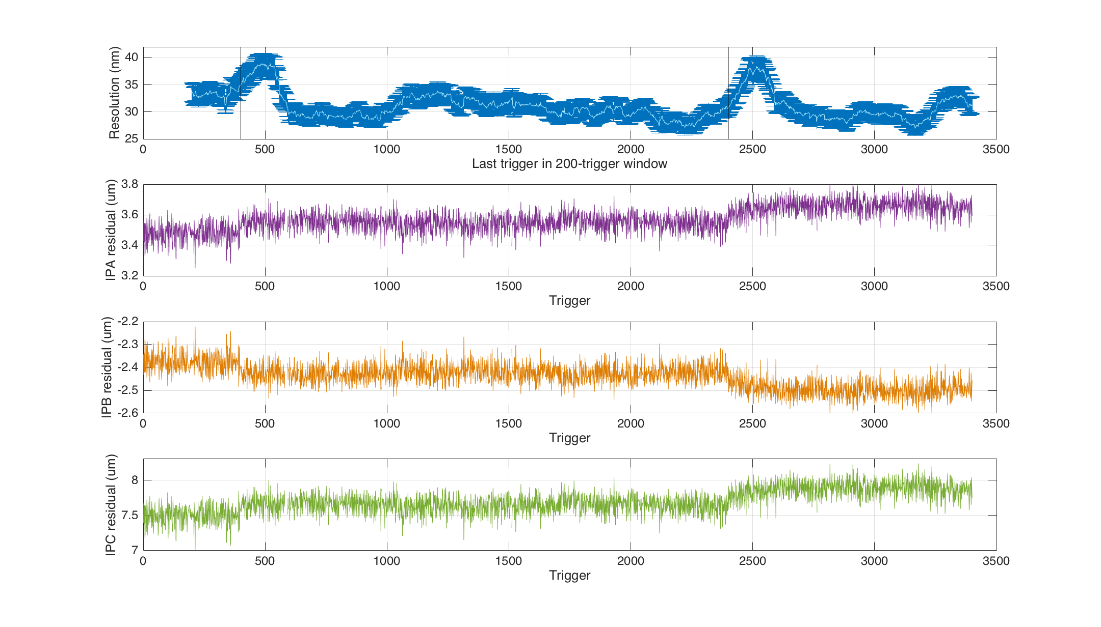
Study 1: Res & residual
How the position residual varies with time as compared to the 200-trigger resolution window.

Slide 8
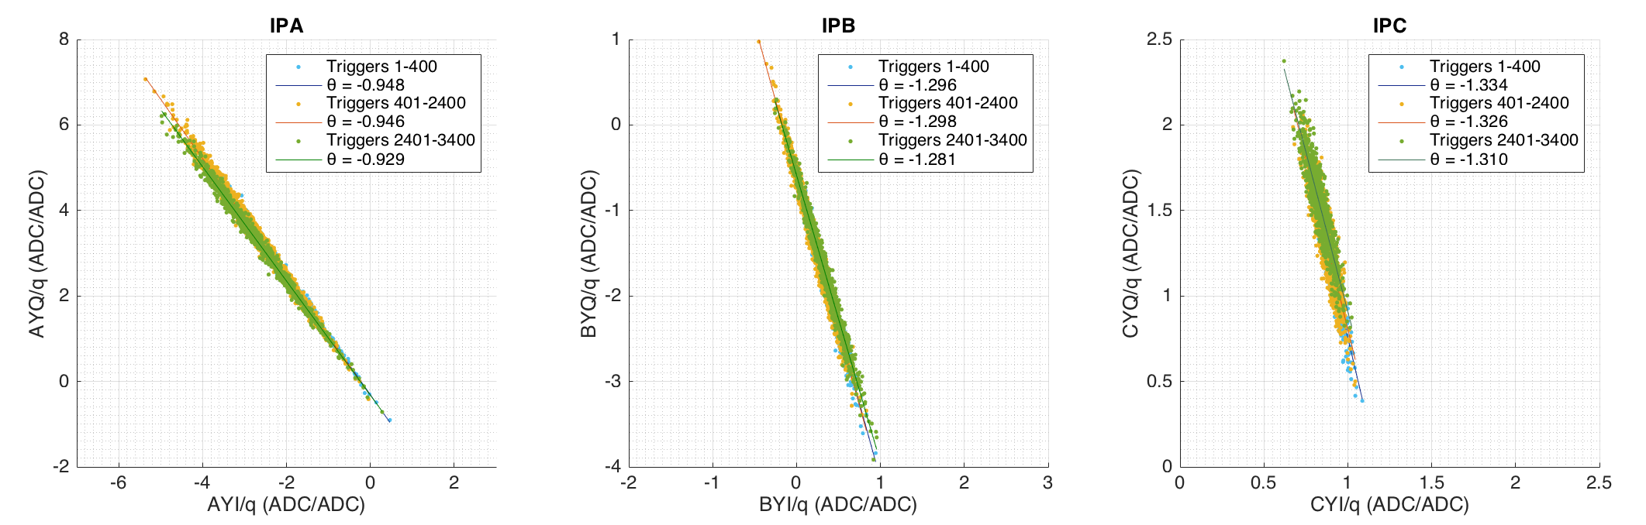
Study 1: Theta for different files
Fit to the I and Q values from the separate jitter runs to see how theta changes with time at the three BPMs.
Time gap: 67 seconds
jitRun13: triggers 1:400
jitRun14: triggers 401 to 2400
jitRun15: triggers 2401 to 3400
Time gap: 8 minutes and 7 seconds

Slide 9
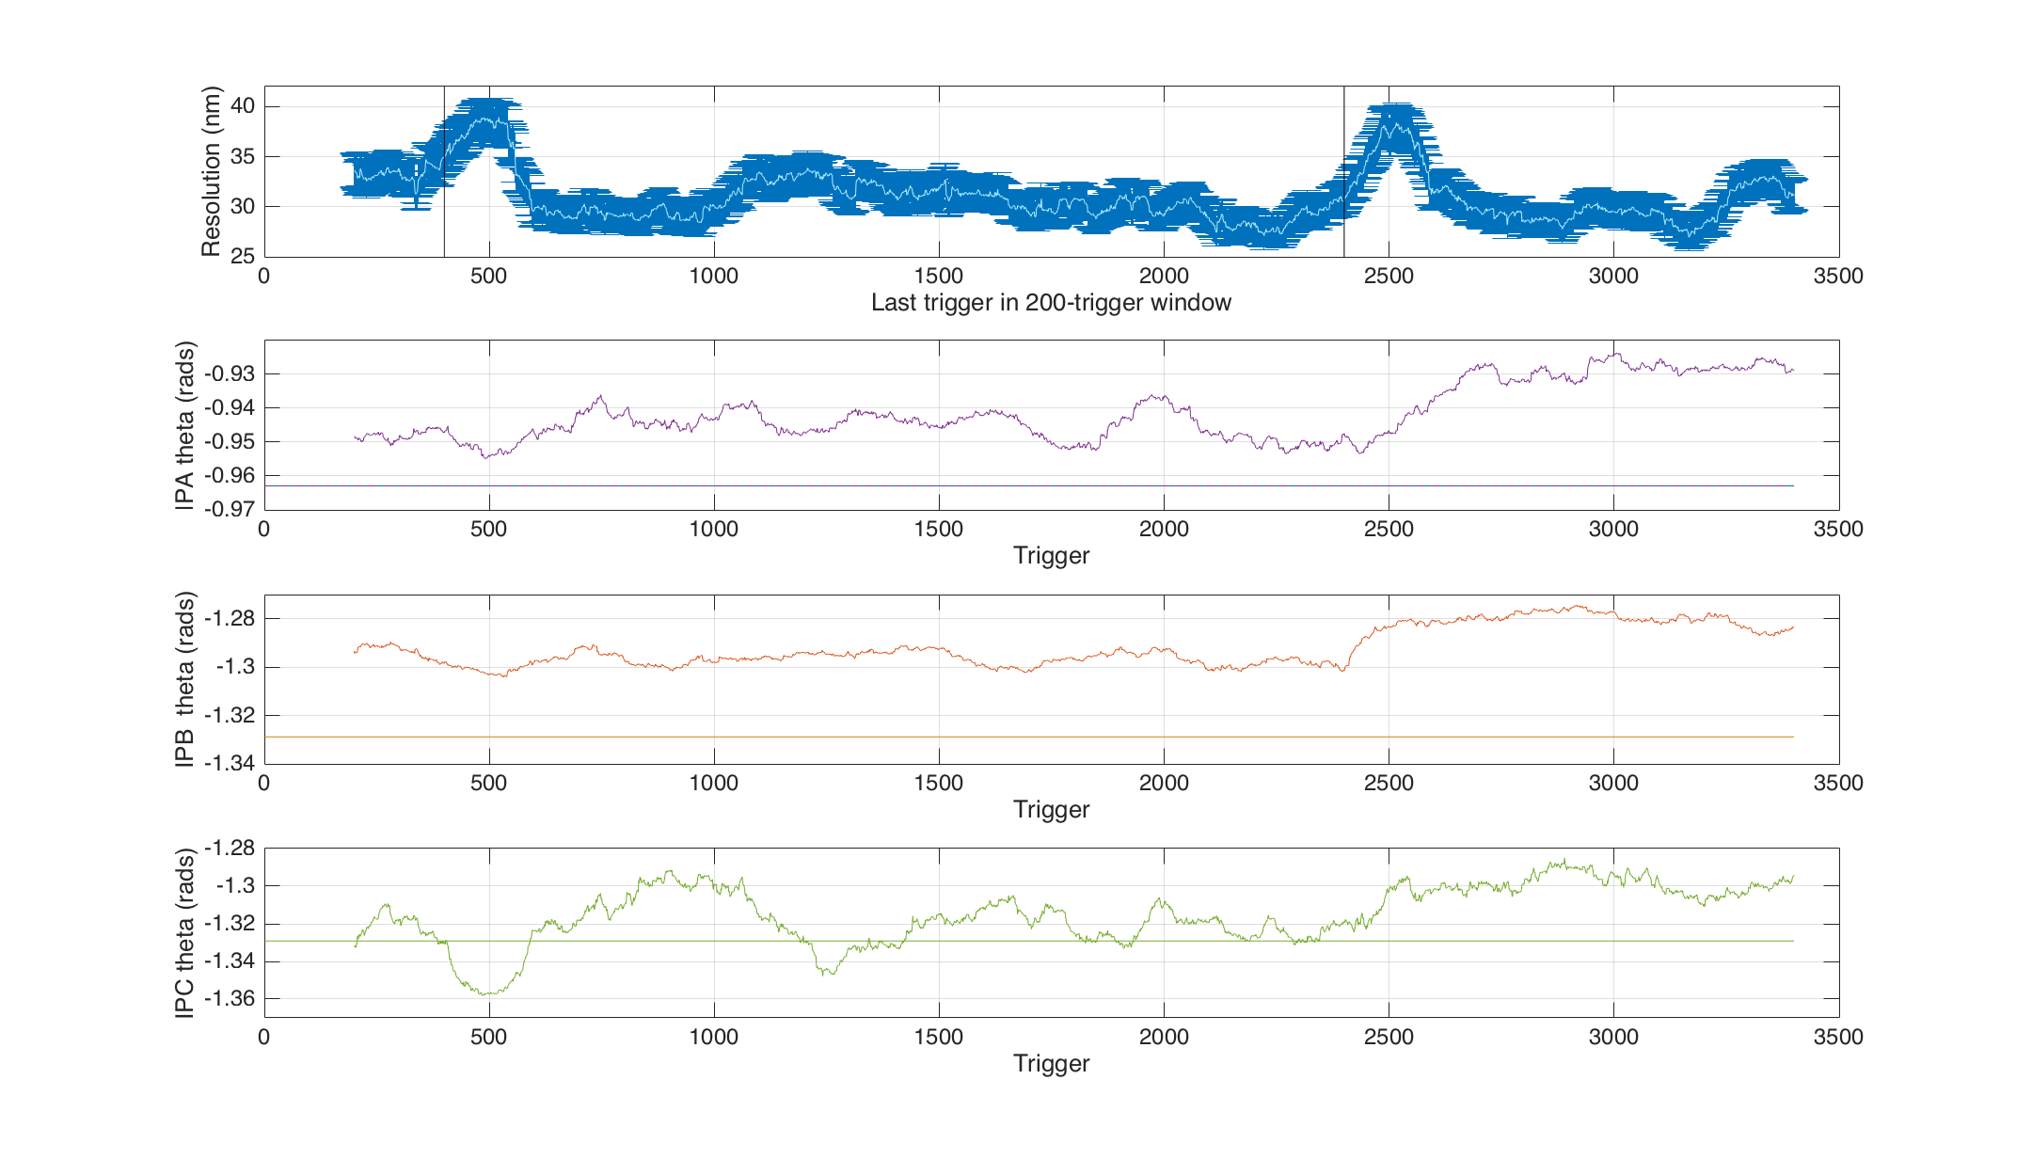
Study 1: theta with time
How theta for 200 triggers varies with time as compared to the 200-trigger resolution window.
Also plotted as solid straight line is the theta value from the corresponding calibration file.

Slide 10
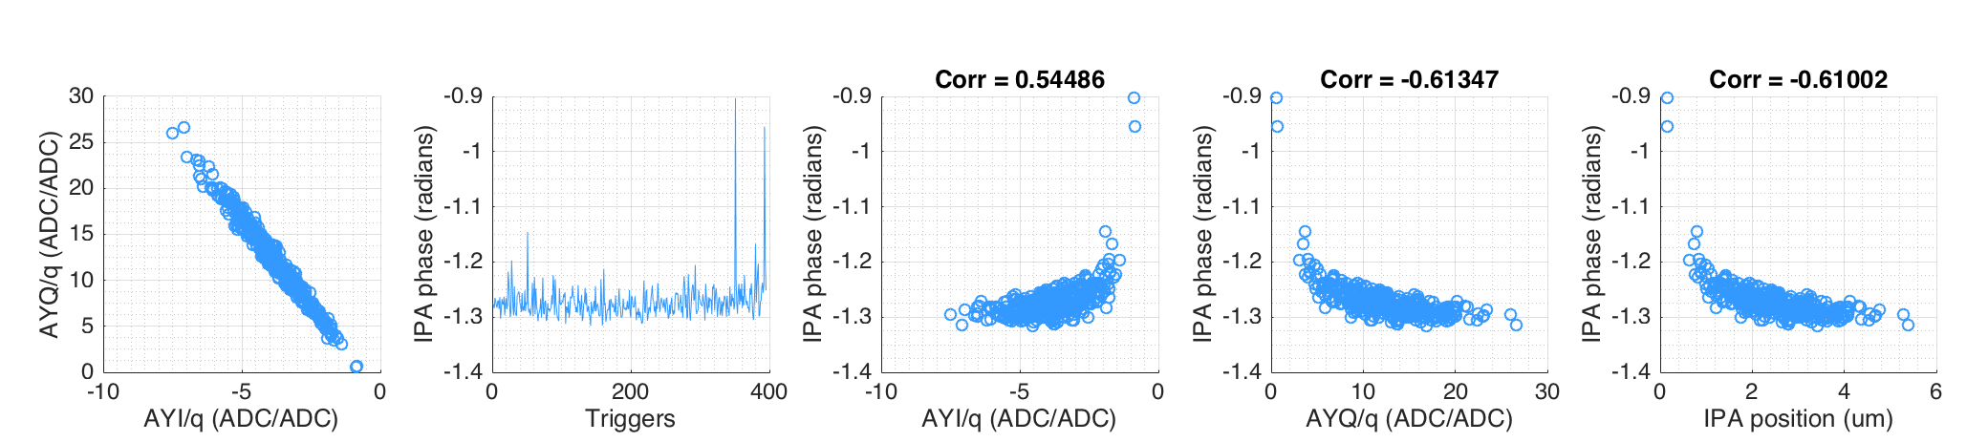
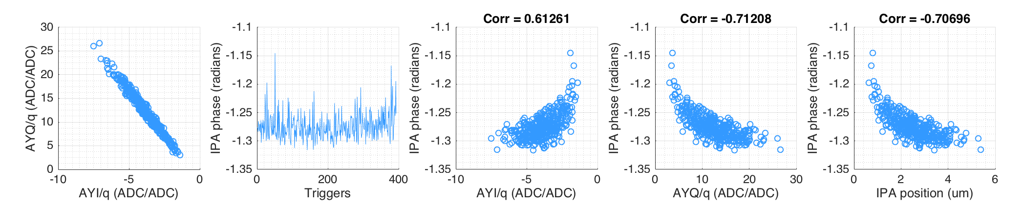
Study 2: jitRun9 (~40nm)
Study of the phase trigger by trigger shows a few clear outliers.
Try removing these from jitRun9 and see the impact on the resultant resolution.
Resolution only changes from 40.8 to 40.5 nm.

Slide 11
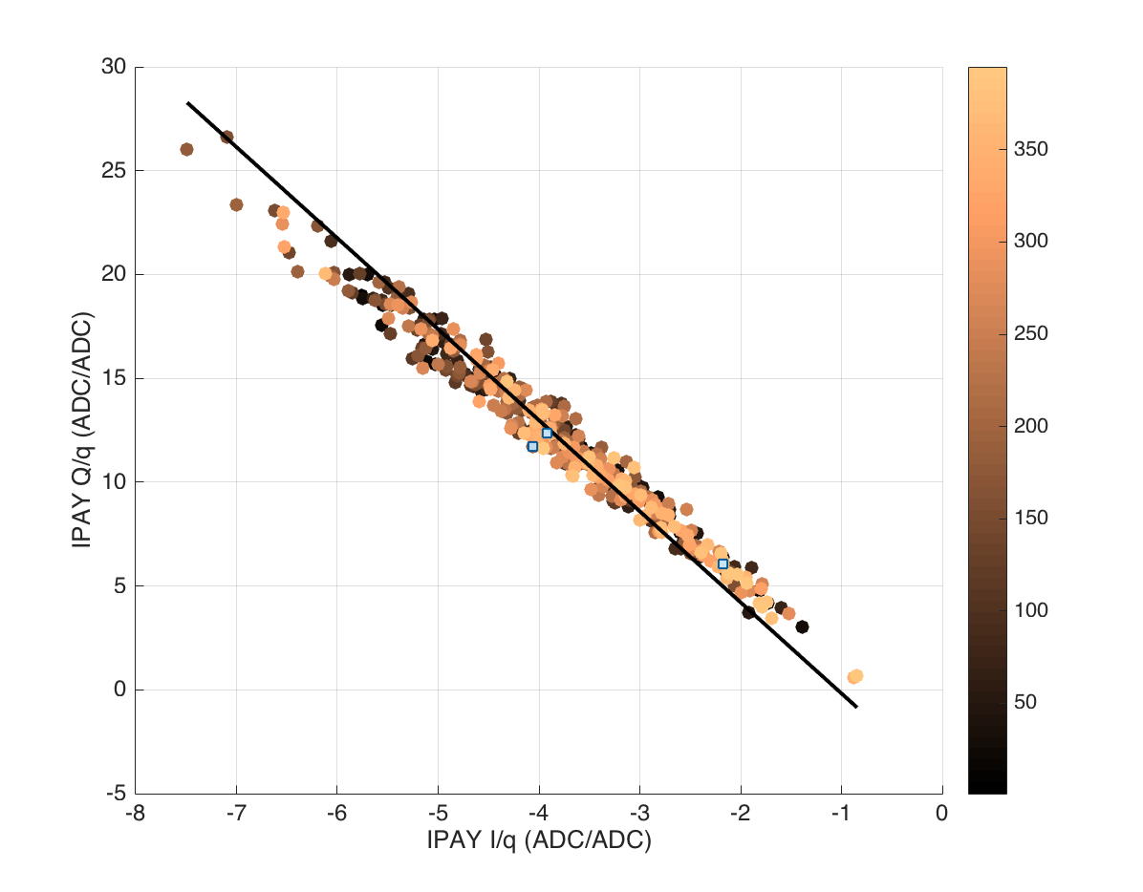
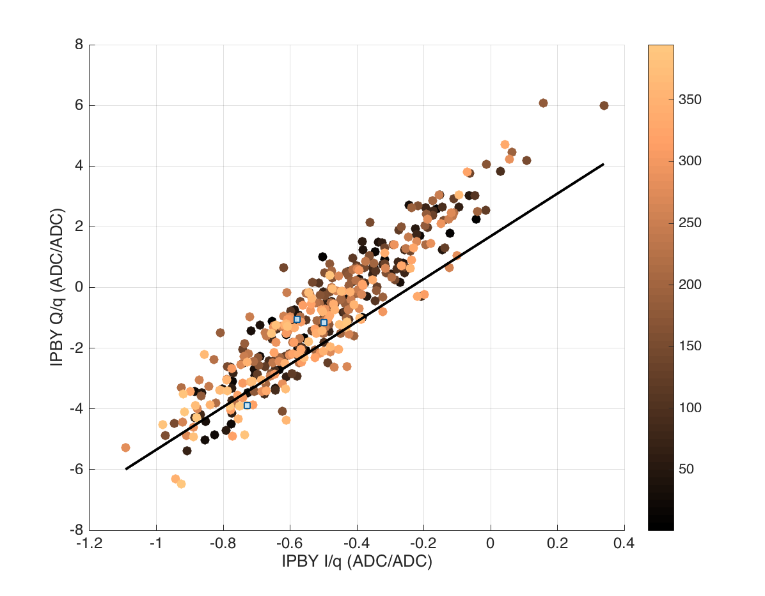
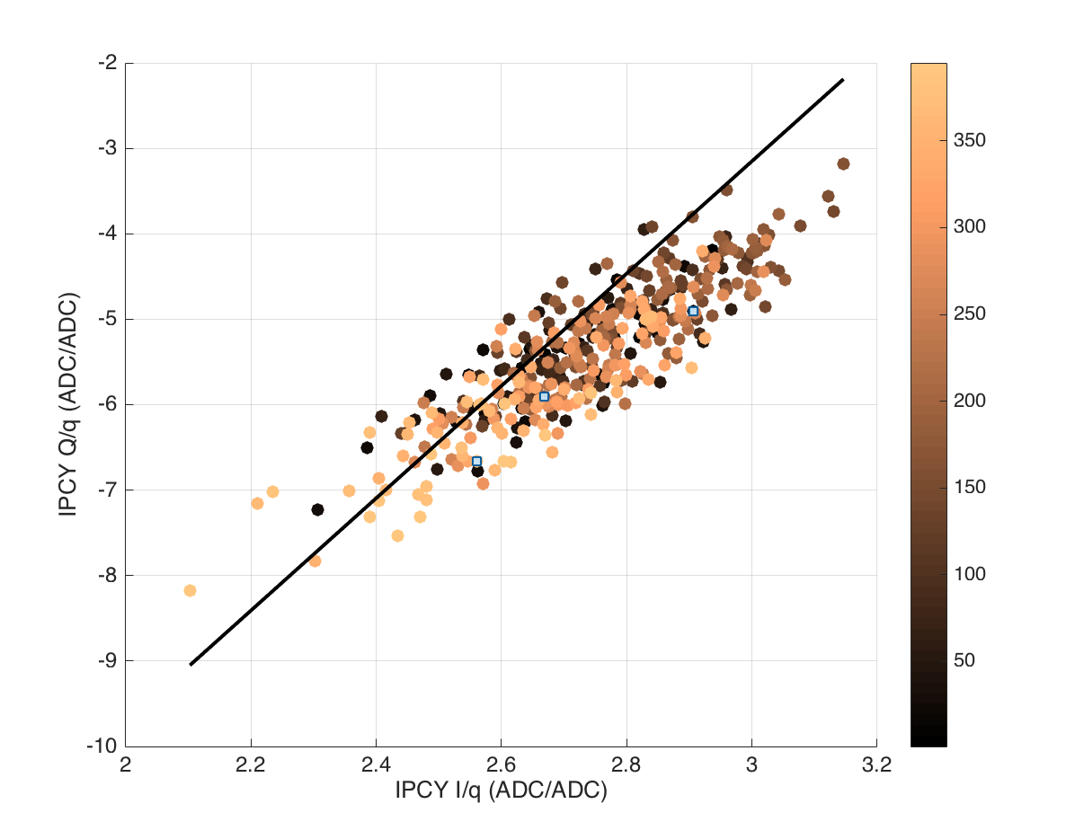
Study 2: jitRun9 (~40nm)
Try looking at the spread of Q/I with time. Colour coded with triggers 1:400.
Compare to the calibration for calculating theta – fit to calibration plotted in black.
IPA
Calibration theta: -1.347 rads
JitRun theta: -1.312 rads
Delta theta: 0.035 rads
IPB
Calibration theta: 1.430 rads
JitRun theta: 1.456 rads
Delta theta: 0.026 rads
IPC
Calibration theta: 1.420 rads
JitRun theta: 1.335 rads
Delta theta: 0.085 rads

Slide 12
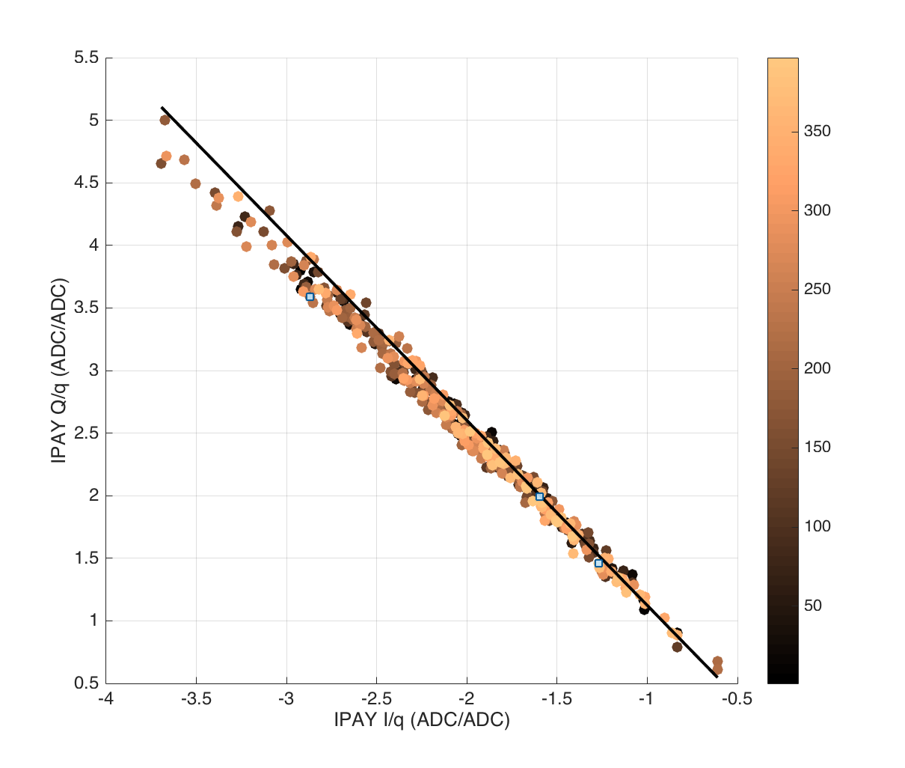
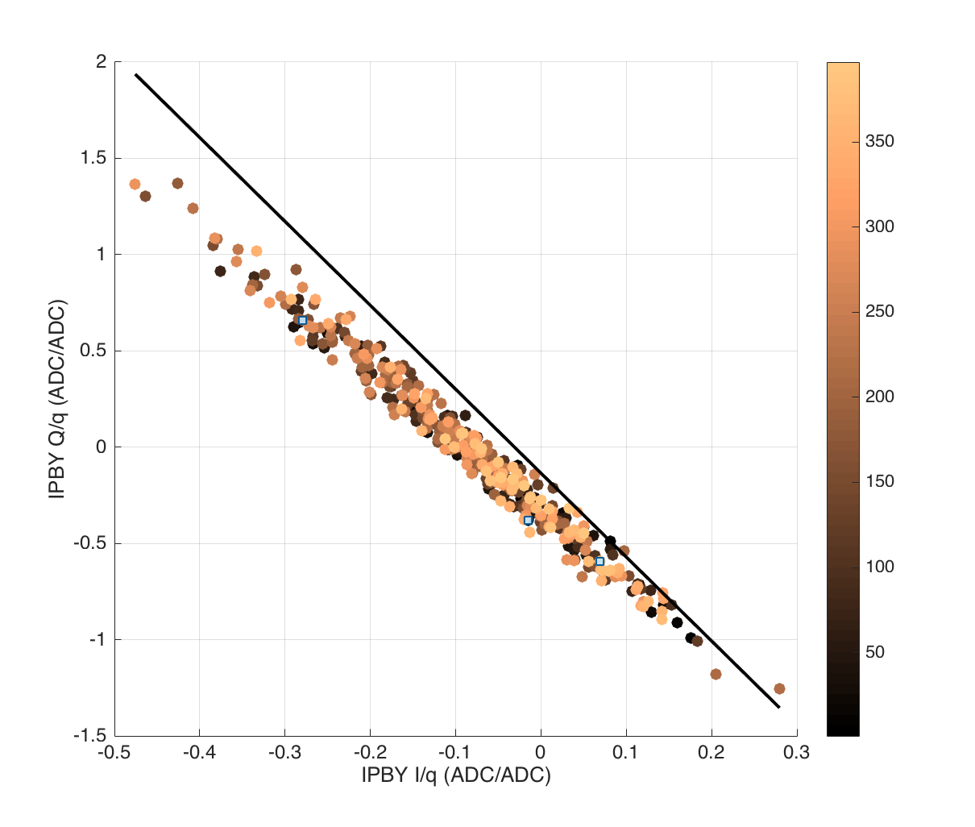
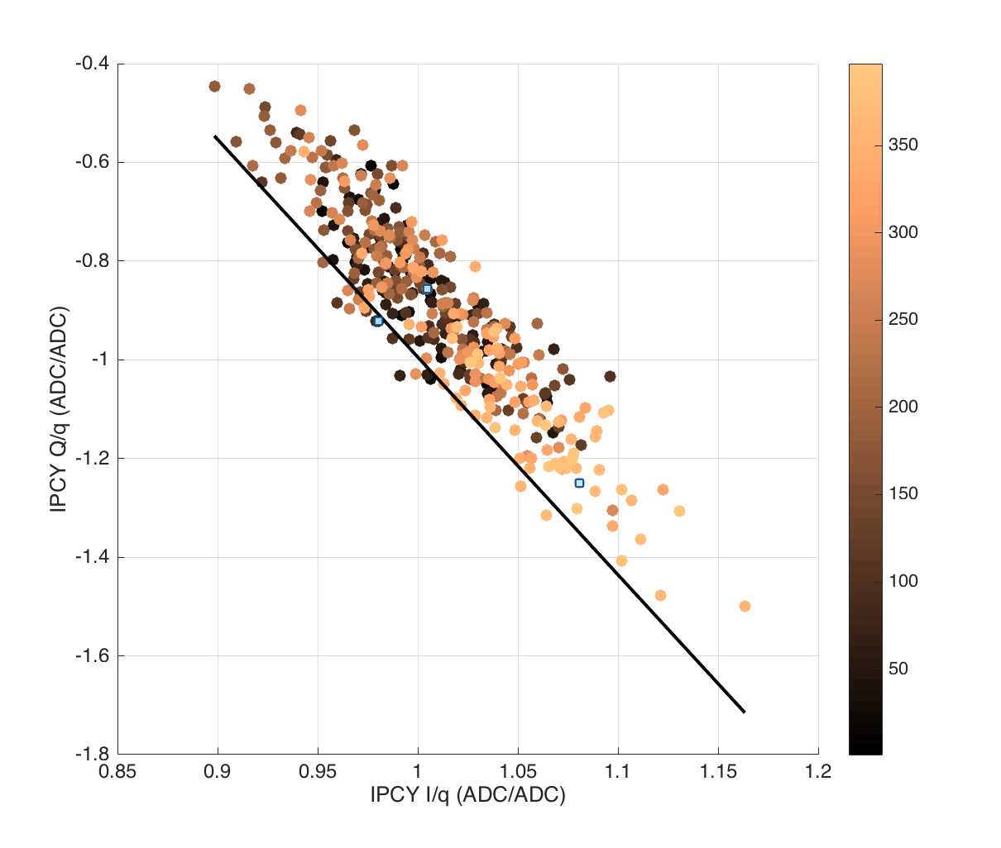
Study 2: jitRun8 (~20nm)
Try looking at the spread of Q/I with time. Colour coded with triggers 1:400.
Compare to the calibration for calculating theta – fit to calibration plotted in black.
IPA
Calibration theta: -0.976 rads
JitRun theta: -0.943 rads
Delta theta: 0.033 rads
IPB
Calibration theta: -1.345 rads
JitRun theta:-1.306 rads
Delta theta: 0.039 rads
IPC
Calibration theta: -1.348 rads
JitRun theta: -1.3296 rads
Delta theta: 0.018 rads

