Slide 1
Resolution Study cont.
T. Bromwich

Slide 2
Outline
Look at different files from the May/June run and attempt to identify common conditions for achieving good resolution results.
Study 1: Look at stray waveforms
Check timing of data sets.
Plot how position changes with time.
Plot position residual changing with time.
How theta changes with jitRuns.
Study 2: Try removing outliers from Q/I plot.
How theta changes within jitRuns + differences from calibration file.

Slide 3
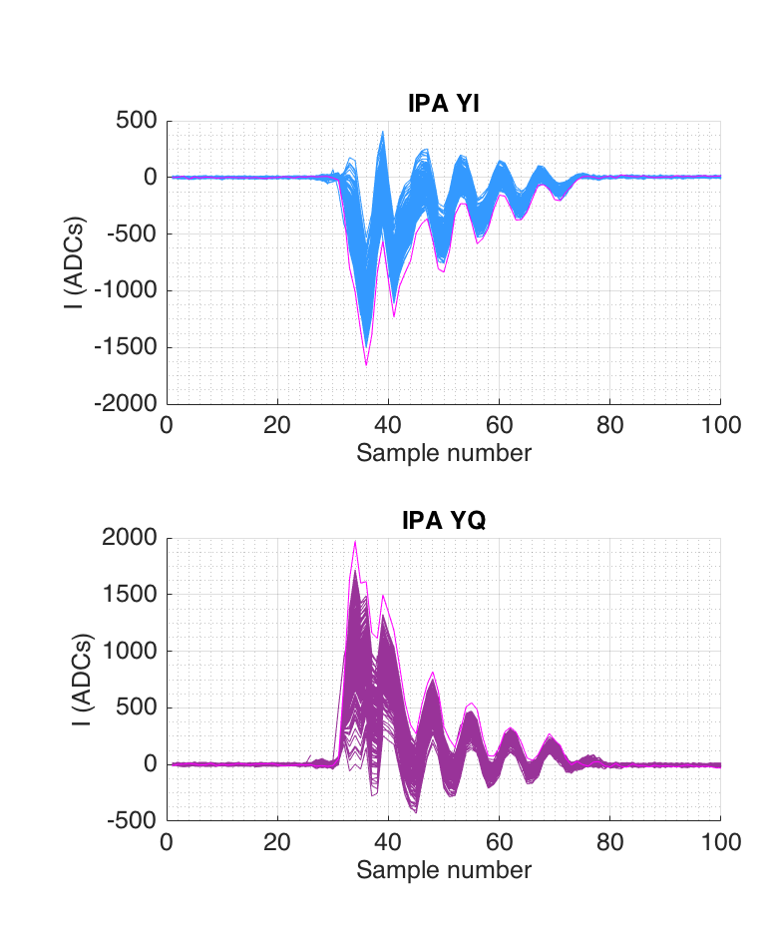
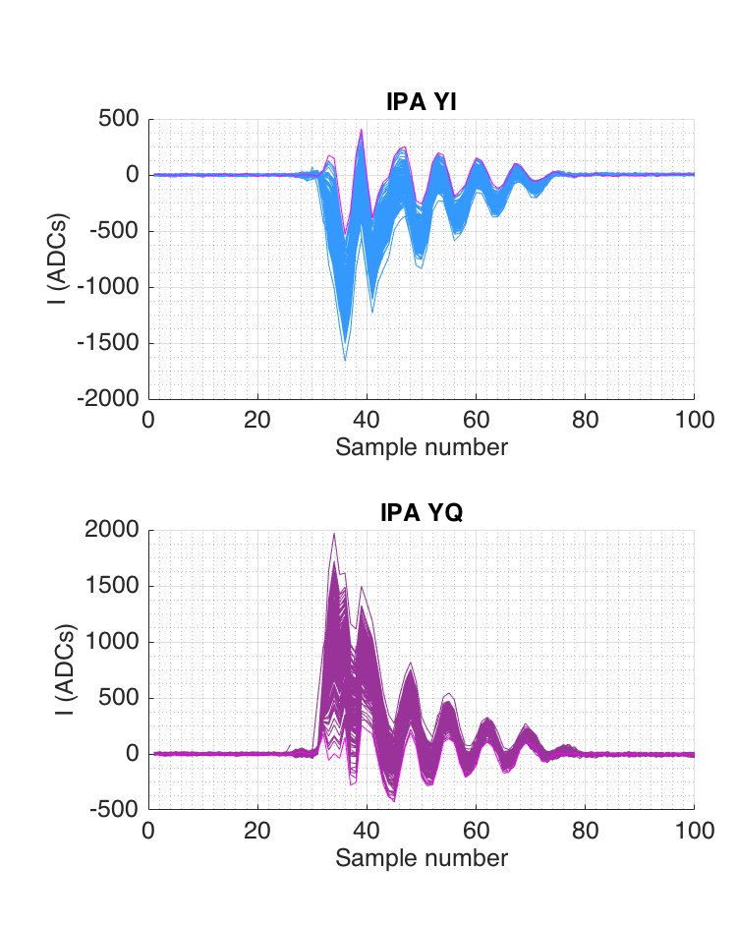
Check stray waveforms
jitRun14(601:800) → 33nm

Slide 4
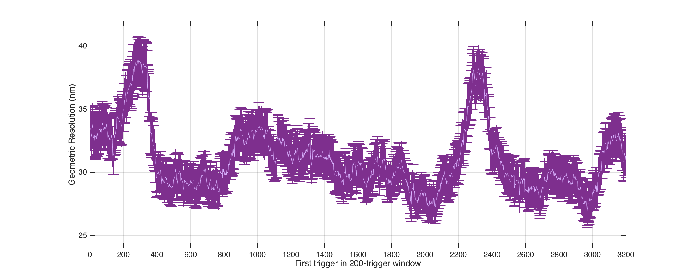
Study 1: Rolling resolution
jitRun13: triggers 1:400
jitRun14: triggers 401 to 2400
jitRun15: triggers 2401 to 3400
Time gap: 67 seconds
Time gap: 8 minutes and 7 seconds

Slide 5
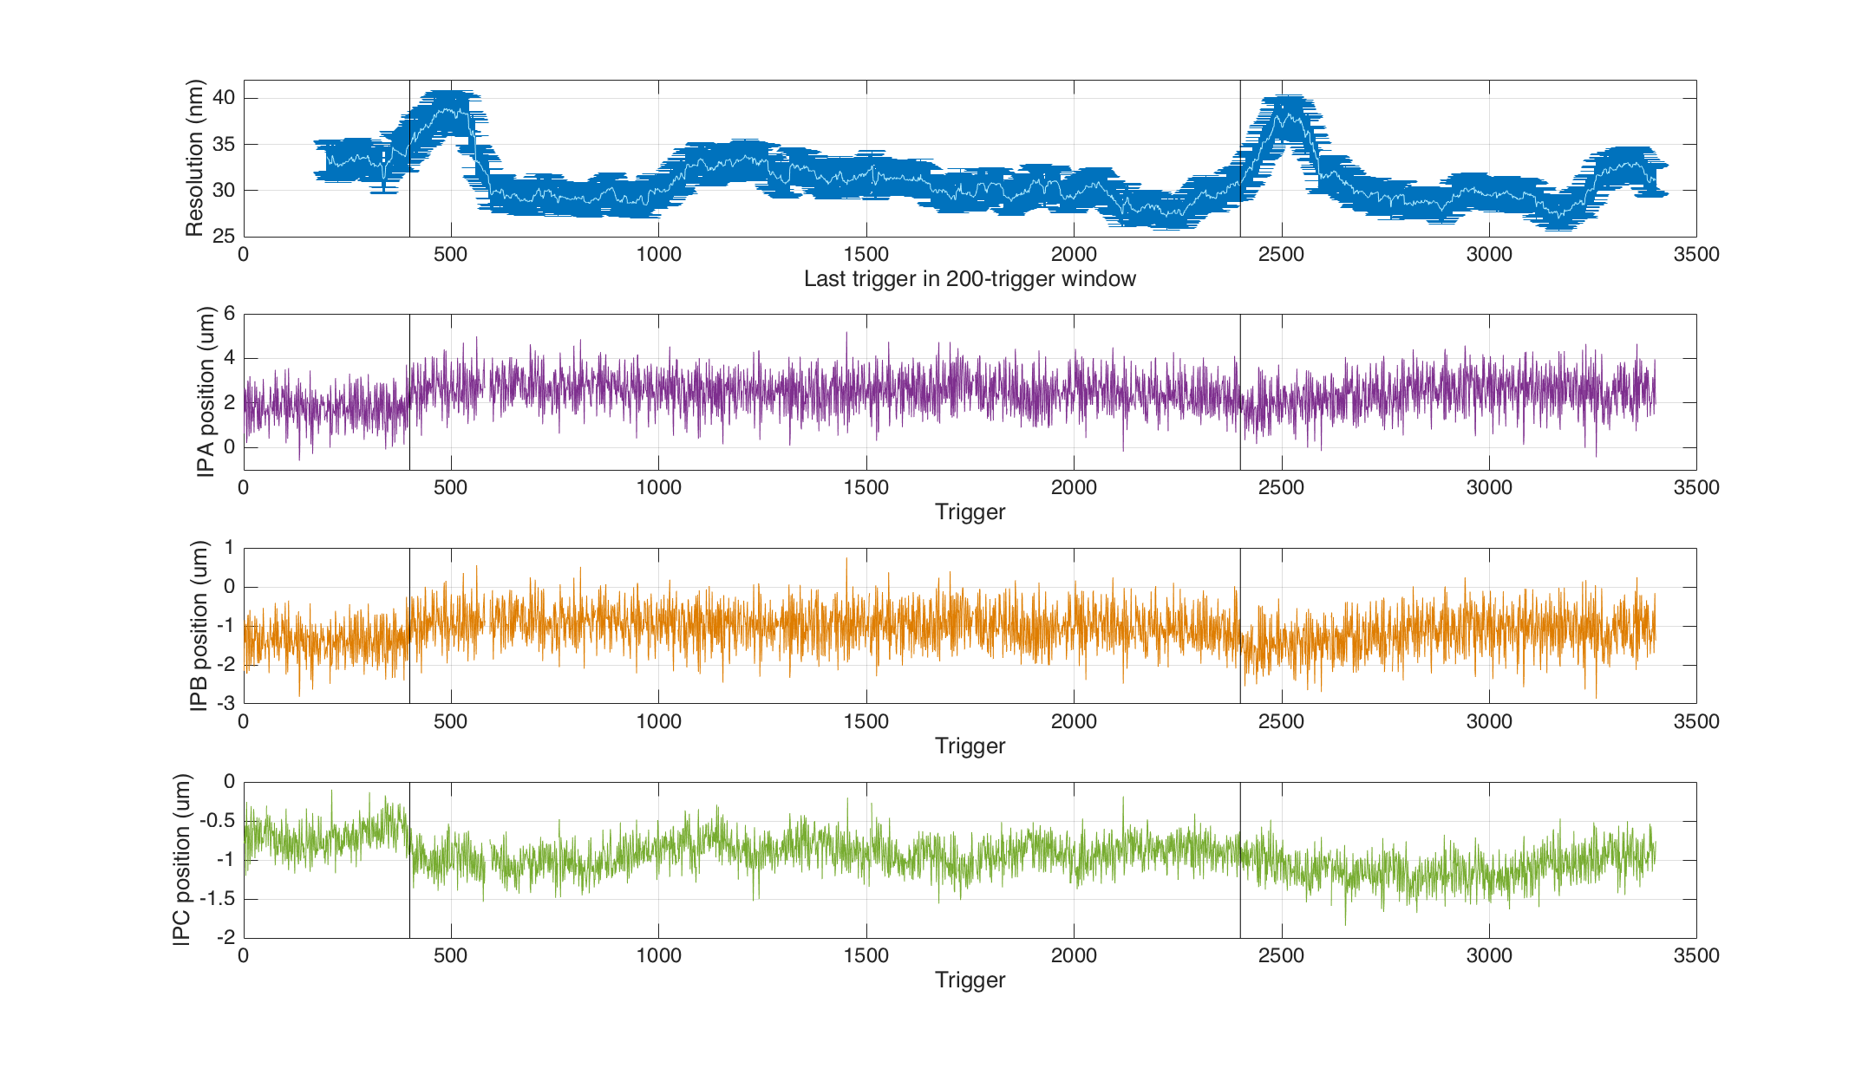
Study 1: Res & position
200-trigger resolution against same axes as the position trigger by trigger at IPA,B, C.

Slide 6
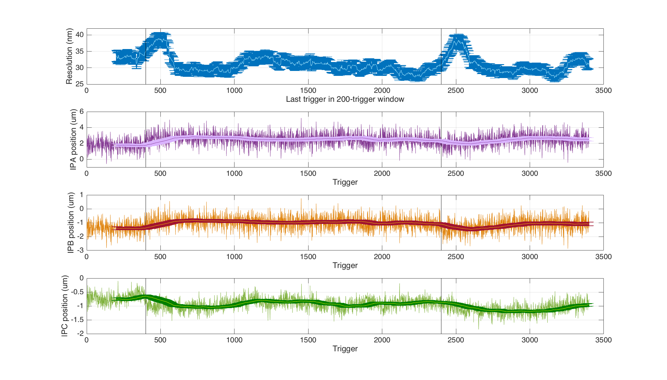
Study 1: Res & position
Superimposed mean position for each 200-window block.

Slide 7
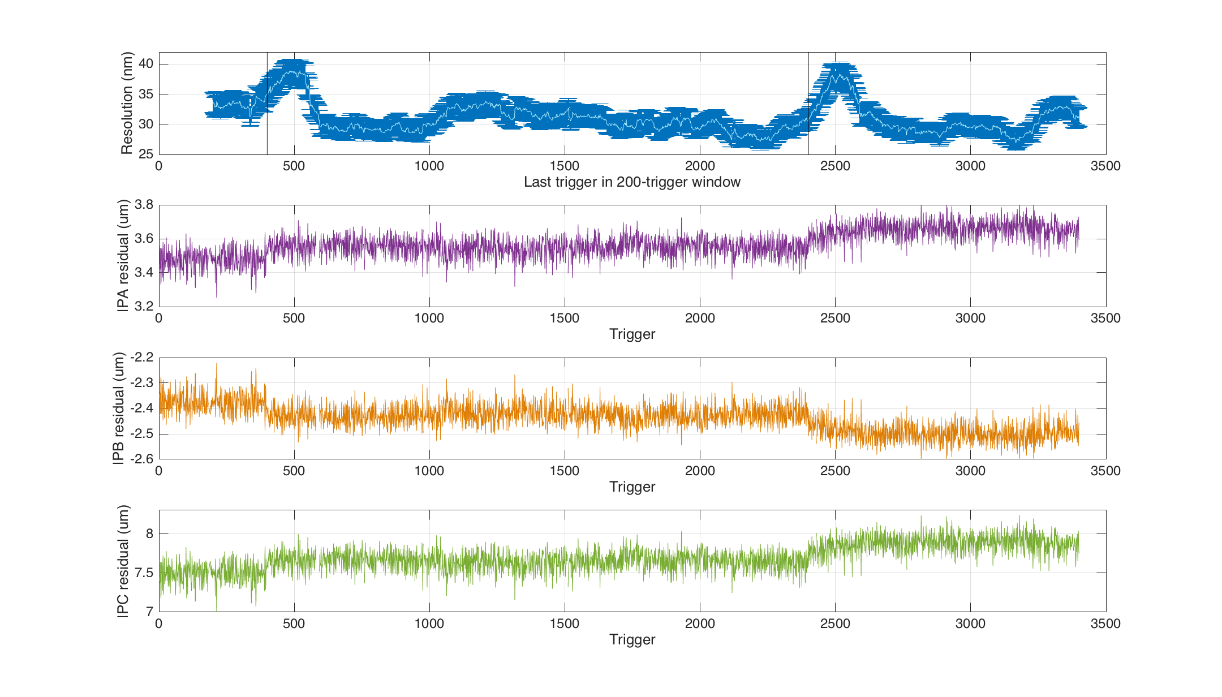
Study 1: Res & residual
How the position residual varies with time as compared to the 200-trigger resolution window.

Slide 8
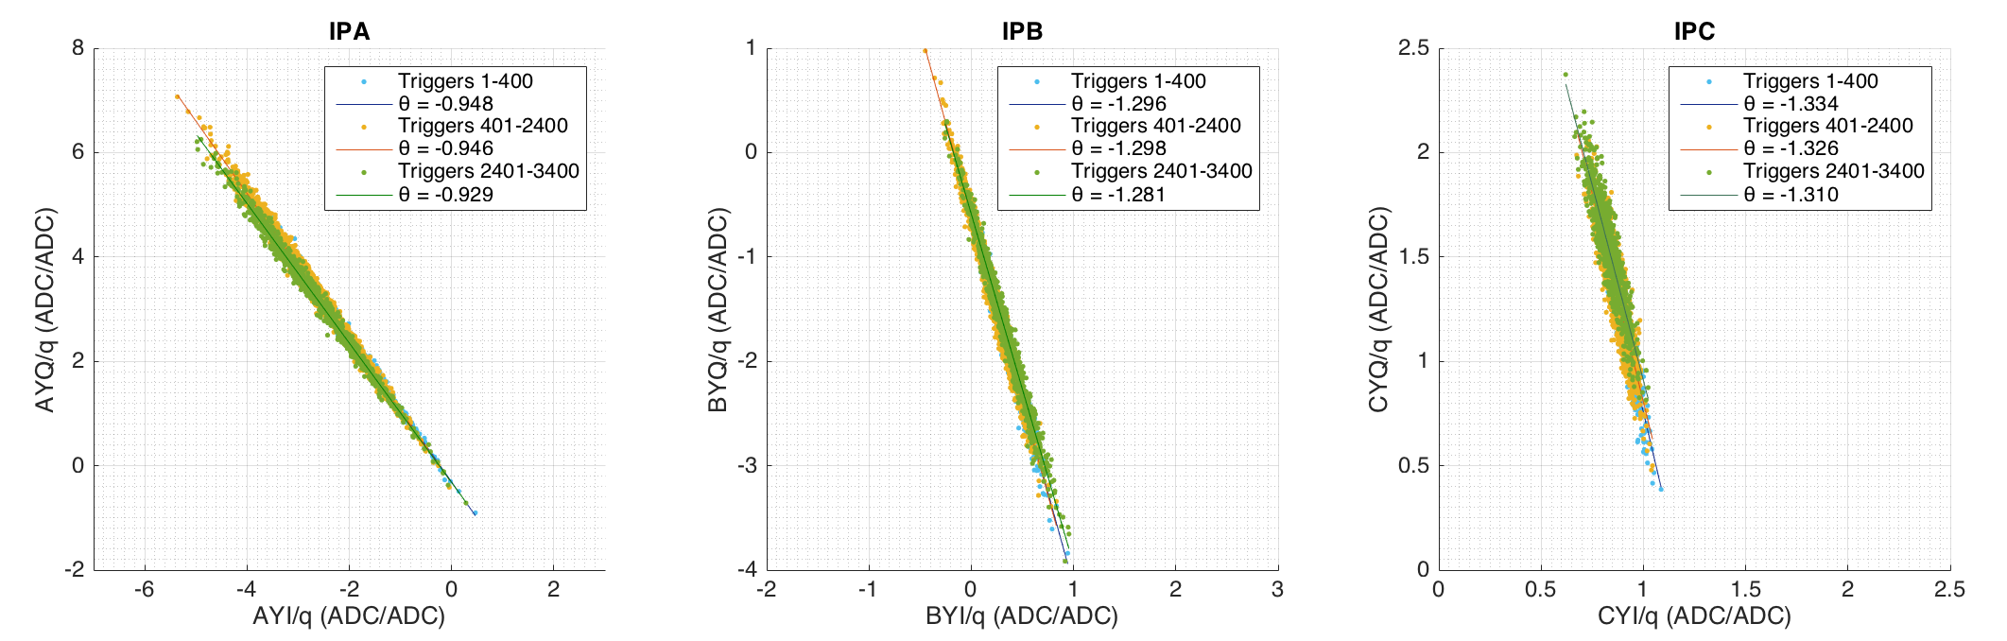
Study 1: Theta for different files
Fit to the I and Q values from the separate jitter runs to see how theta changes with time at the three BPMs.
Time gap: 67 seconds
jitRun13: triggers 1:400
jitRun14: triggers 401 to 2400
jitRun15: triggers 2401 to 3400
Time gap: 8 minutes and 7 seconds

Slide 9
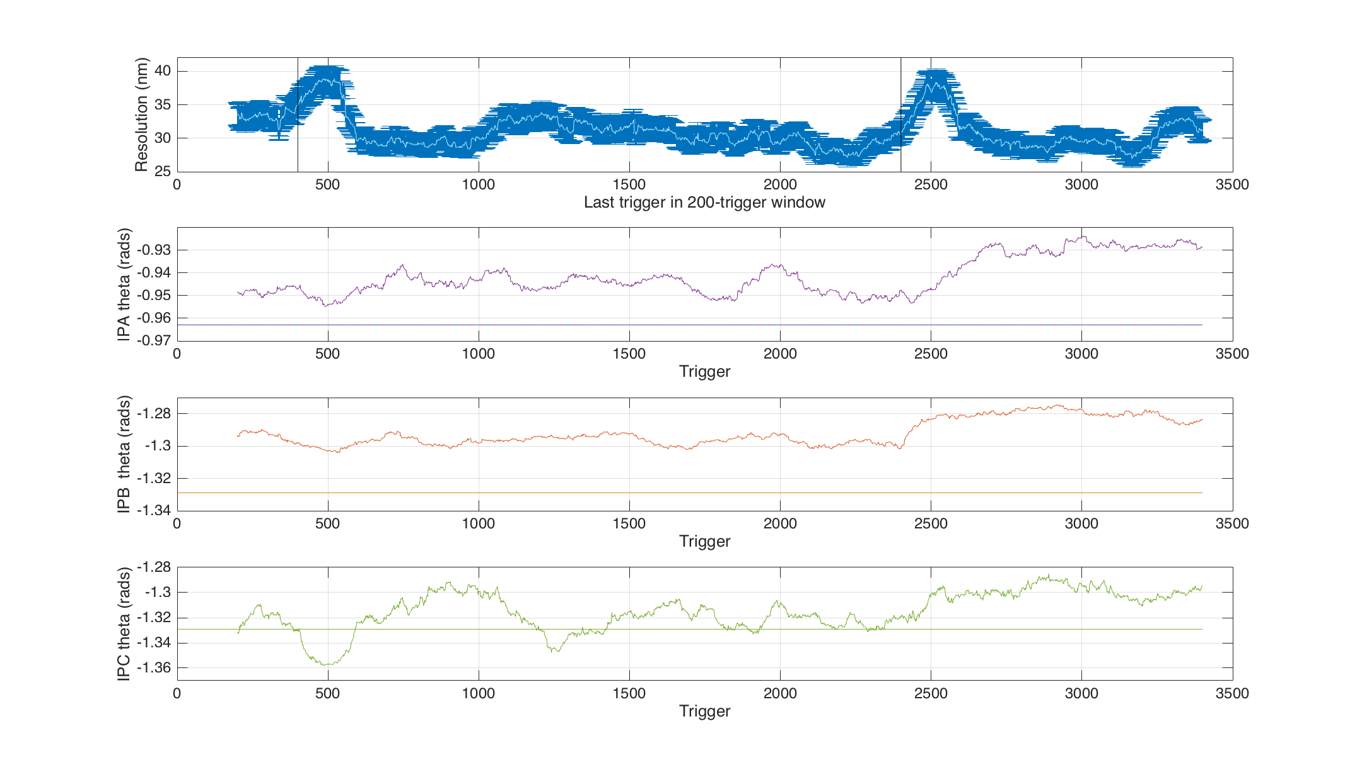
Study 1: theta with time
How theta for 200 triggers varies with time as compared to the 200-trigger resolution window.
Also plotted as solid straight line is the theta value from the corresponding calibration file.

Slide 10
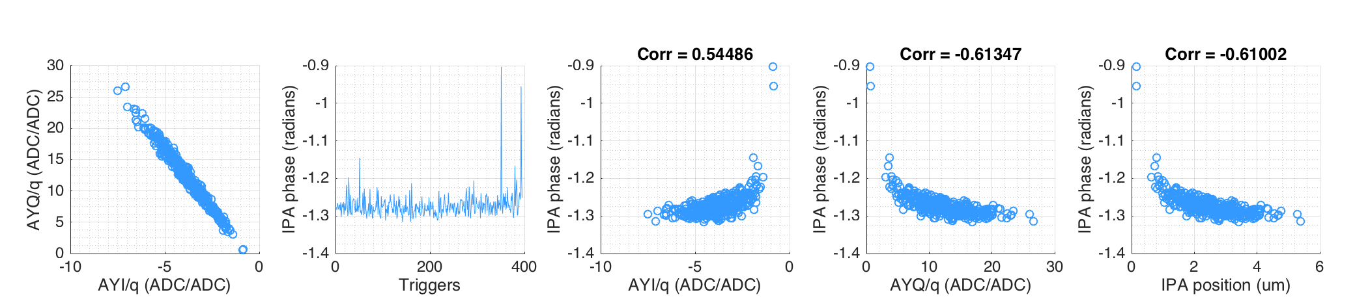
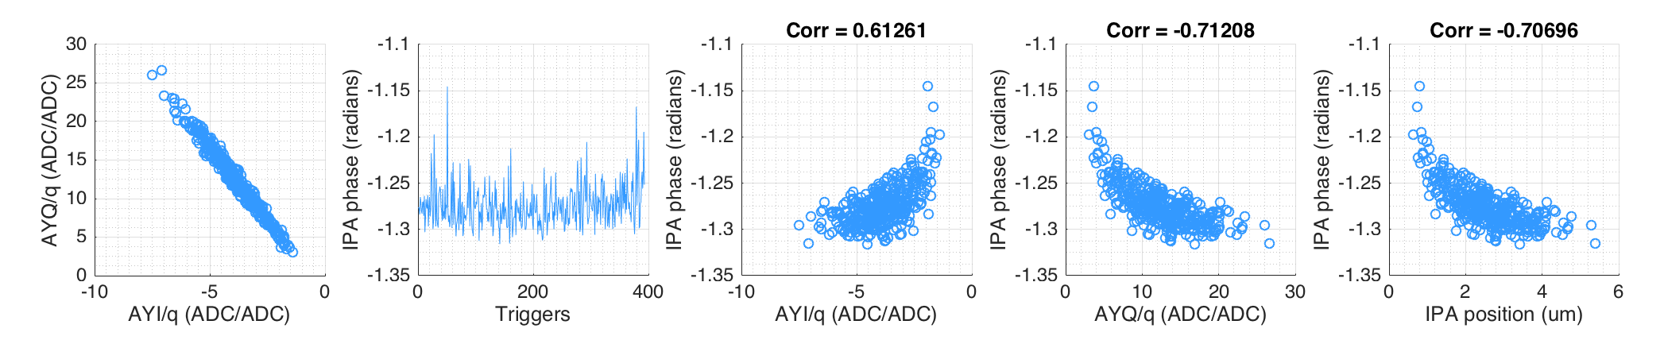
Study 2: jitRun9 (~40nm)
Study of the phase trigger by trigger shows a few clear outliers.
Try removing these from jitRun9 and see the impact on the resultant resolution.
Resolution only changes from 40.8 to 40.5 nm.

Slide 11
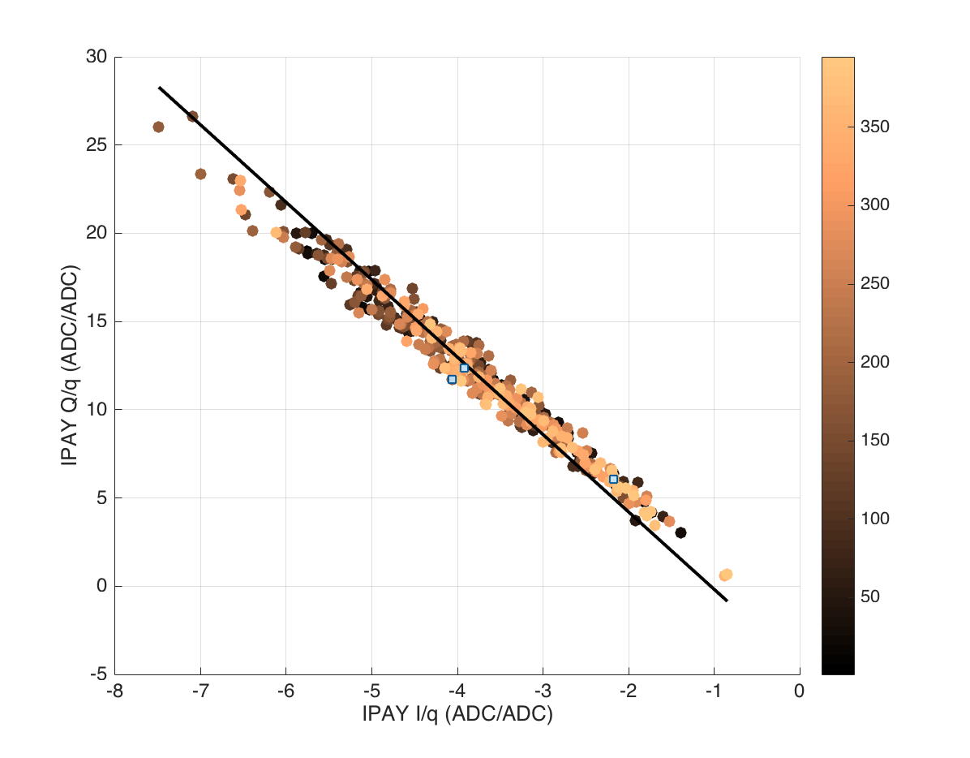
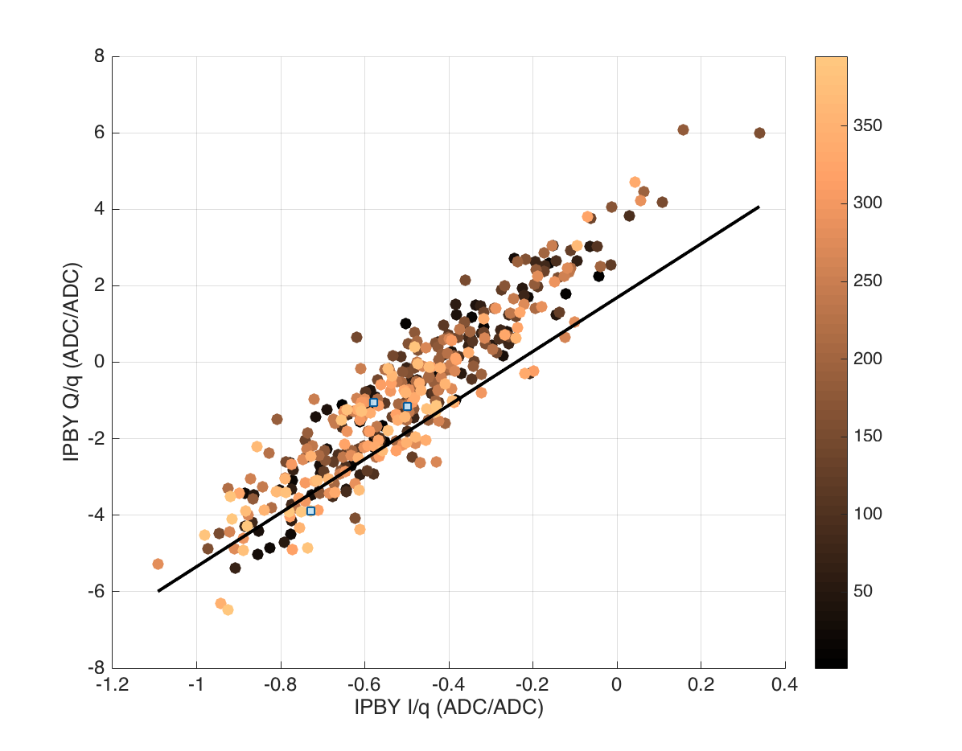
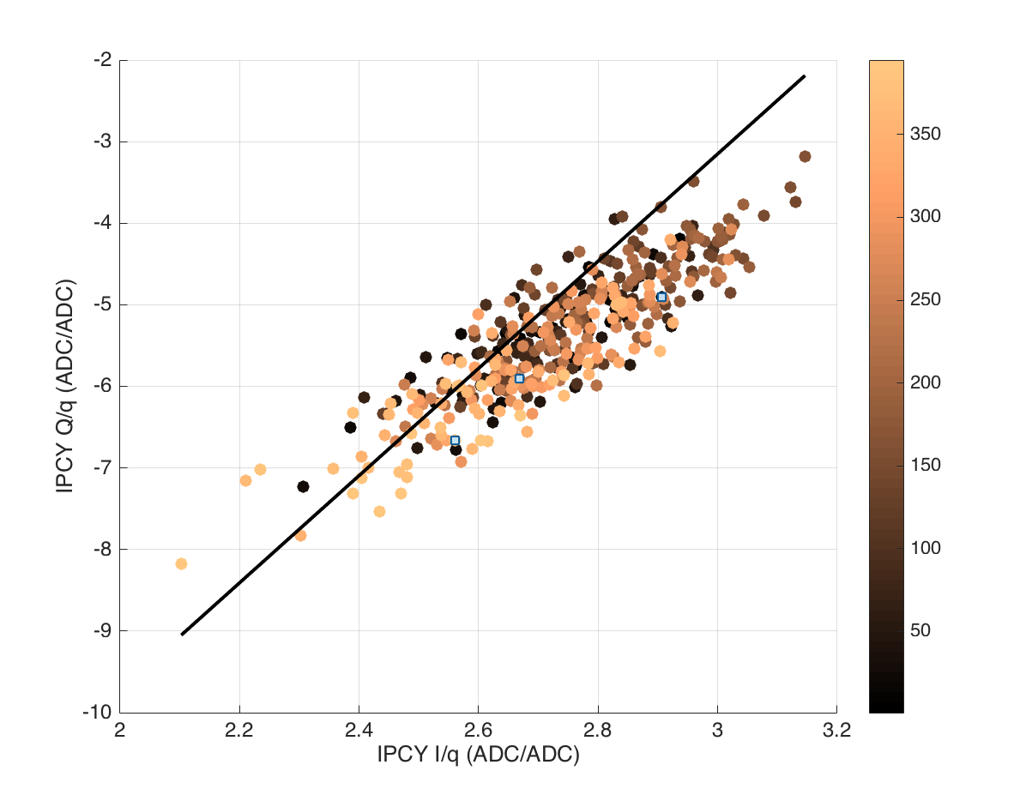
Study 2: jitRun9 (~40nm)
Try looking at the spread of Q/I with time. Colour coded with triggers 1:400.
Compare to the calibration for calculating theta – fit to calibration plotted in black.
IPA
Calibration theta: -1.347 rads
JitRun theta: -1.312 rads
Delta theta: 0.035 rads
IPB
Calibration theta: 1.430 rads
JitRun theta: 1.456 rads
Delta theta: 0.026 rads
IPC
Calibration theta: 1.420 rads
JitRun theta: 1.335 rads
Delta theta: 0.085 rads

Slide 12
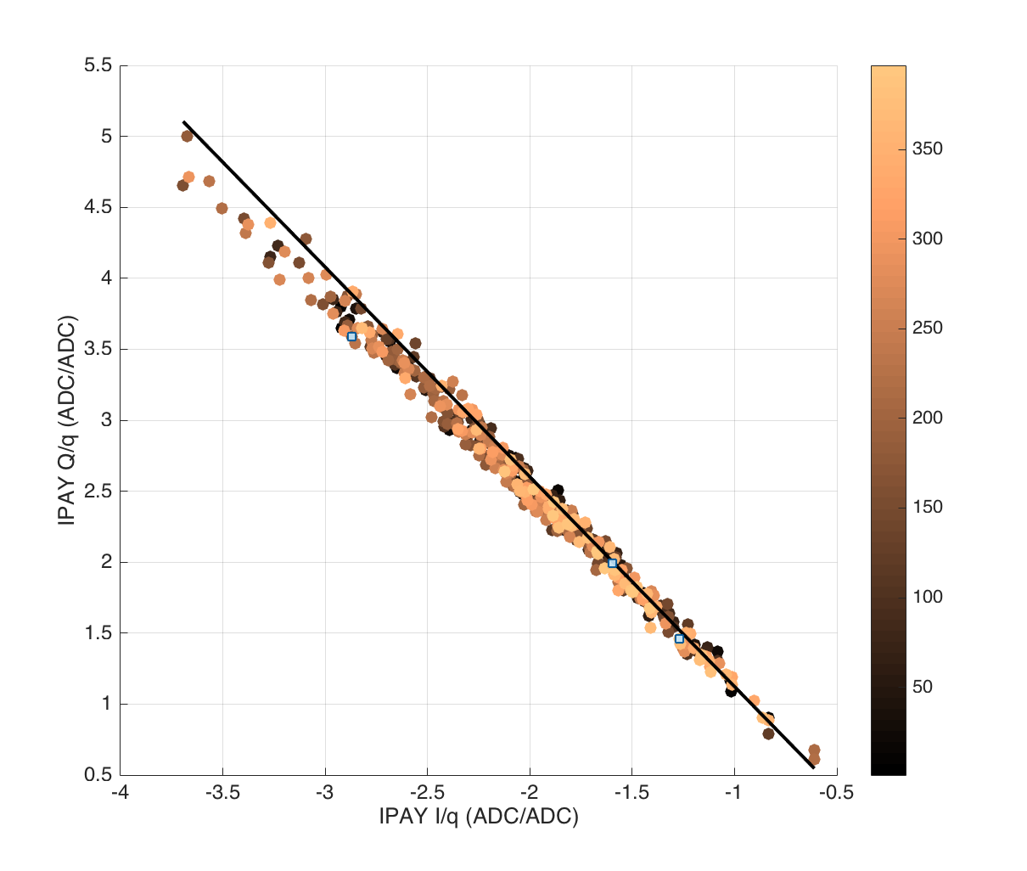
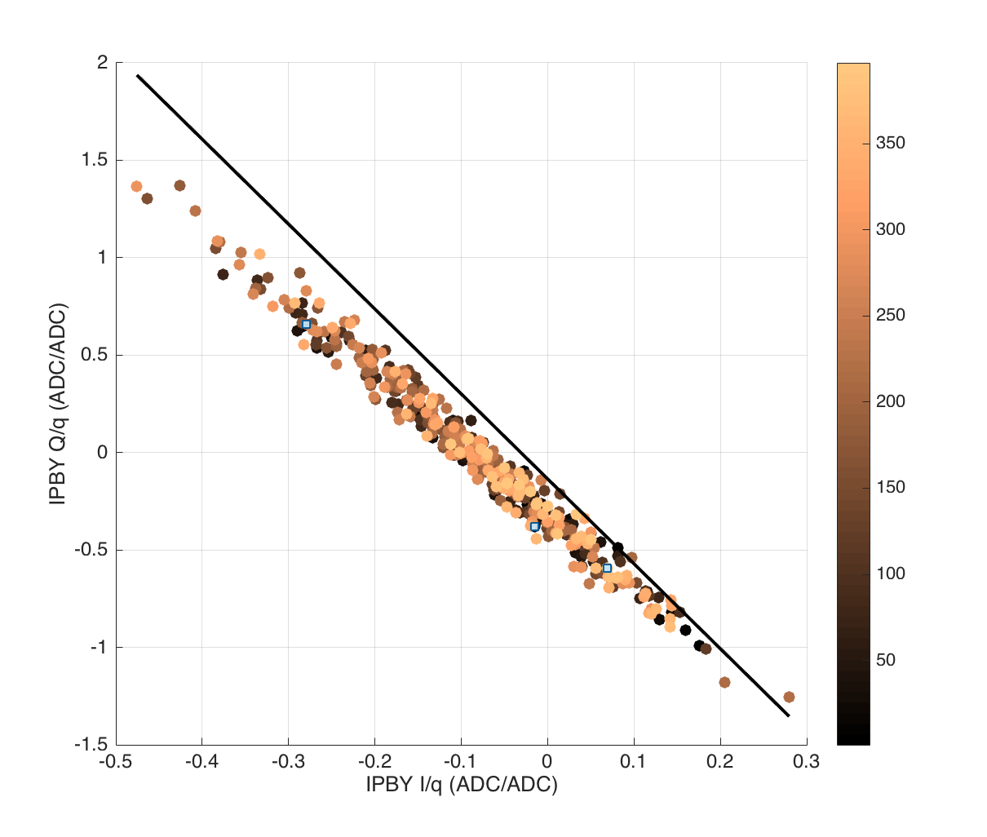
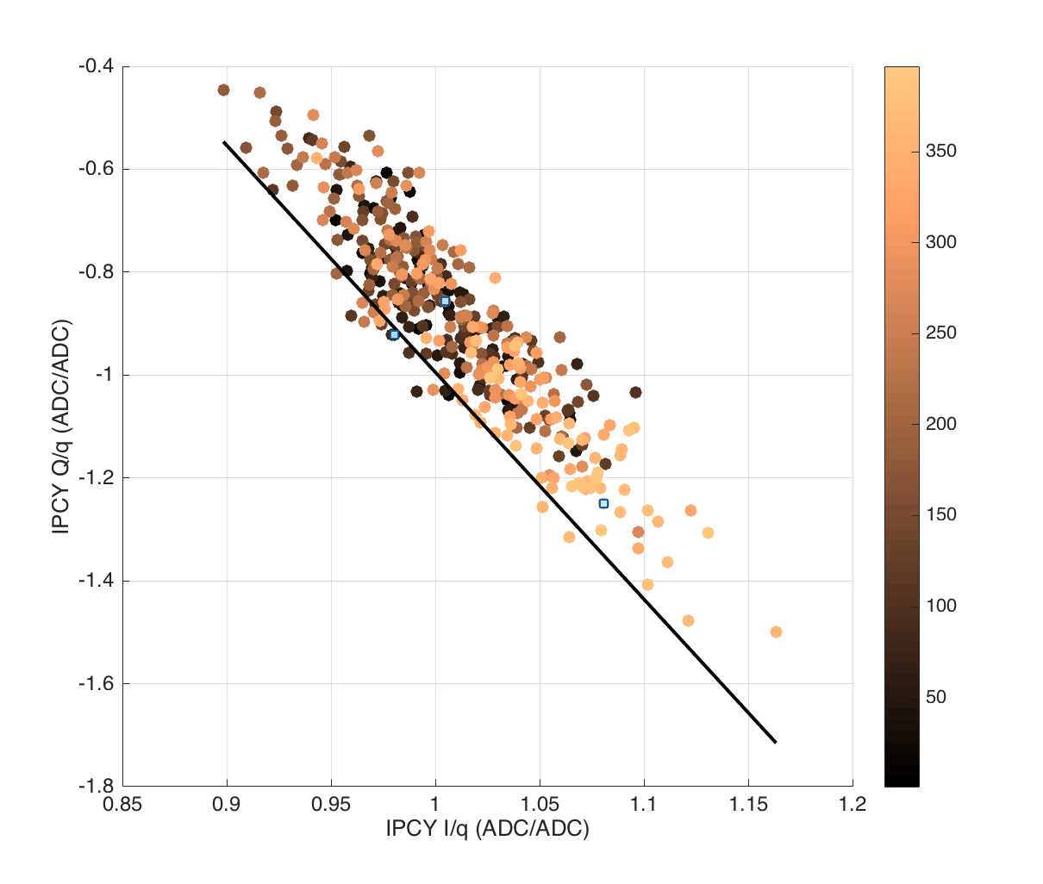
Study 2: jitRun8 (~20nm)
Try looking at the spread of Q/I with time. Colour coded with triggers 1:400.
Compare to the calibration for calculating theta – fit to calibration plotted in black.
IPA
Calibration theta: -0.976 rads
JitRun theta: -0.943 rads
Delta theta: 0.033 rads
IPB
Calibration theta: -1.345 rads
JitRun theta:-1.306 rads
Delta theta: 0.039 rads
IPC
Calibration theta: -1.348 rads
JitRun theta: -1.3296 rads
Delta theta: 0.018 rads

Slide 13
Study 2: Fitting improvements
jitRun8
IPA
Coefficient | Geometric | Fit(3) | I'(3) | I'Q'(5) | I'Q'q(6)
I | 1.464 | 1.438 | 1.849 | 1.852 | 1.852
I | -0.464 | -0.467 | 0.794 | 0.783 | 0.782
const | 0.000 | 0.003 | -0.004 | -0.004 | -0.004
Q | 0.000 | 0.000 | 0.000 | -0.065 | -0.062
Q | 0.000 | 0.000 | 0.000 | -0.464 | -0.452
q | 0.000 | 0.000 | 0.000 | 0.000 | 0.000
Res | 20.662 | 19.870 | 19.656 | 19.368 | 19.365
Res_s | 0.733 | 0.705 | 0.710 | 0.699 | 0.699
IPB
Coefficient | Geometric | Fit(3) | I'(3) | I'Q'(5) | I'Q'q(6)
I | 0.683 | 0.692 | 0.538 | 0.540 | 0.540
I | 0.317 | 0.318 | -0.421 | -0.418 | -0.418
const | 0.000 | -0.002 | 0.002 | 0.002 | 0.002
Q | 0.000 | 0.000 | 0.000 | -0.035 | -0.034
Q | 0.000 | 0.000 | 0.000 | 0.209 | 0.205
q | 0.000 | 0.000 | 0.000 | 0.000 | 0.000
Res | 20.662 | 19.879 | 19.963 | 19.642 | 19.640
Res_s | 0.733 | 0.705 | 0.713 | 0.702 | 0.702
IPC
Coefficient | Geometric | Fit(3) | I'(3) | I'Q'(5) | I'Q'q(6)
I | -2.156 | -1.859 | 1.093 | 1.091 | 1.088
I | 3.156 | 2.631 | -1.989 | -1.972 | -1.967
const | 0.000 | 0.006 | 0.005 | 0.005 | 0.004
Q | 0.000 | 0.000 | 0.000 | -0.252 | -0.262
Q | 0.000 | 0.000 | 0.000 | 0.111 | 0.124
q | 0.000 | 0.000 | 0.000 | 0.000 | 0.000
Res | 20.662 | 21.310 | 18.195 | 17.820 | 17.808
Res_s | 0.733 | 0.756 | 0.646 | 0.633 | 0.633
jitRun9
IPA
Coefficient | Geometric | Fit(3) | I'(3) | I'Q'(5) | I'Q'q(6)
I | 1.464 | 1.539 | -1.871 | -1.876 | -1.874
I | -0.464 | -0.562 | -0.830 | -0.789 | -0.797
const | 0.000 | 0.004 | -0.019 | -0.015 | -0.020
Q | 0.000 | 0.000 | 0.000 | -0.037 | -0.036
Q | 0.000 | 0.000 | 0.000 | 1.021 | 0.671
q | 0.000 | 0.000 | 0.000 | 0.000 | 0.006
Res | 40.829 | 26.149 | 27.385 | 25.966 | 25.072
Res_s | 1.453 | 0.930 | 0.996 | 0.944 | 0.912
IPB
Coefficient | Geometric | Fit(3) | I'(3) | I'Q'(5) | I'Q'q(6)
I | 0.683 | 0.646 | -0.531 | -0.527 | -0.527
I | 0.317 | 0.353 | -0.429 | -0.401 | -0.405
const | 0.000 | -0.002 | -0.010 | -0.008 | -0.010
Q | 0.000 | 0.000 | 0.000 | -0.067 | -0.080
Q | 0.000 | 0.000 | 0.000 | 0.625 | 0.452
q | 0.000 | 0.000 | 0.000 | 0.000 | 0.003
Res | 40.829 | 26.180 | 25.967 | 24.475 | 23.623
Res_s | 1.453 | 0.931 | 0.931 | 0.878 | 0.847
IPC
Coefficient | Geometric | Fit(3) | I'(3) | I'Q'(5) | I'Q'q(6)
I | -2.156 | -1.430 | -0.968 | -0.969 | -0.996
I | 3.156 | 2.143 | -1.764 | -1.753 | -1.812
const | 0.000 | 0.006 | -0.019 | -0.019 | -0.024
Q | 0.000 | 0.000 | 0.000 | 0.259 | 0.142
Q | 0.000 | 0.000 | 0.000 | 0.038 | -0.014
q | 0.000 | 0.000 | 0.000 | 0.000 | 0.006
Res | 40.829 | 28.964 | 20.258 | 19.991 | 19.258
Res_s | 1.453 | 1.030 | 0.722 | 0.712 | 0.686

