Slide 1
Micromegas modules
LCTPC collaboration meeting, Nov. 29,2017
P. Colas, D. Attié, S. Ganjour
(contribution from M. Zito and S. Suvorov

Slide 2
dE/dx analysis
With MM test beam data from 2015 by S. Suvorov a Russian student (from T2K)

Slide 3
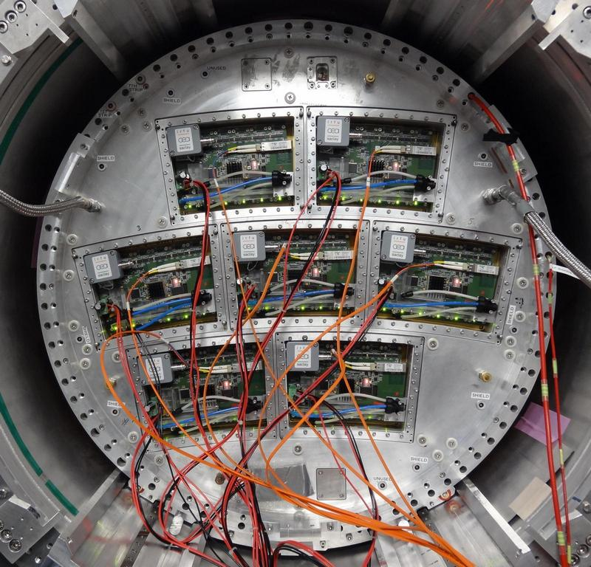
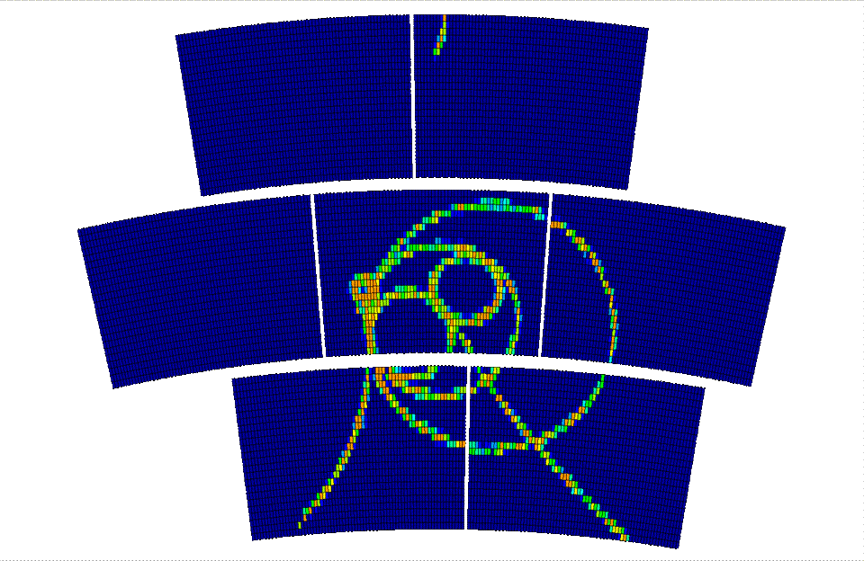
Micromegas Large Prototype overview
Endplate with 7 modules
each module has 24 rows x 72 columns

Slide 4
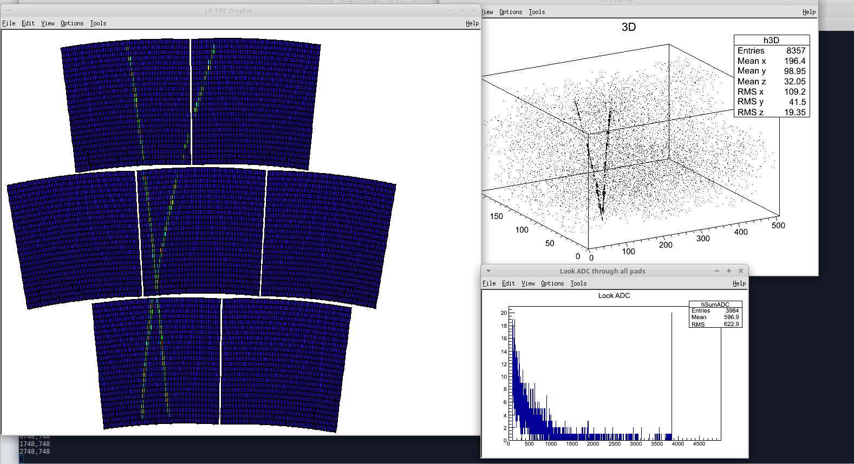
ILC-TPC raw data
Event display

Slide 5
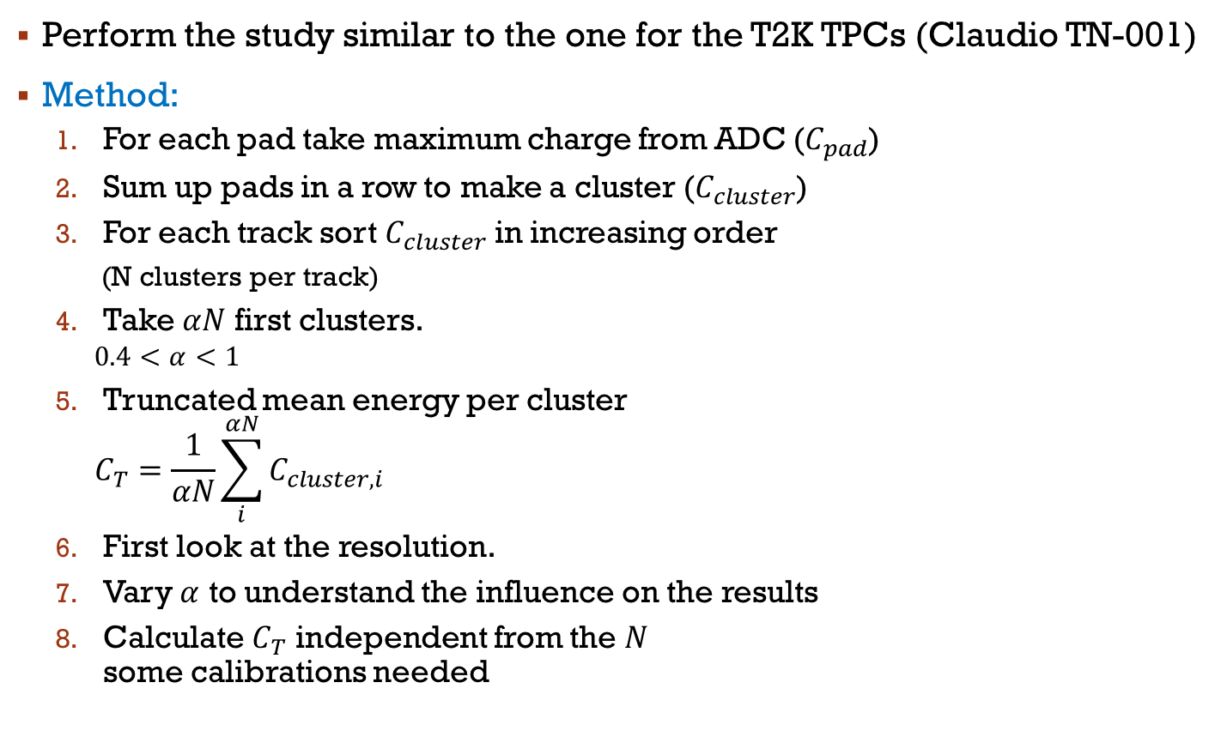
dE/dx study
Perform the study similar to the one for the T2K TPCs (Claudio TN-001)
Method:
  For each pad take maximum charge from ADC ($C_{pad}$)
  Sum up pads in a row to make a cluster ($C_{cluster}$)
  For each track sort $C_{cluster}$ in increasing order
    (N clusters per track)
  Take $αN$ first clusters.
    $$0.4<α<1$$
  Truncated mean energy per cluster
    $$C_{T}=\frac{1}{αN}\sum_{i}^{αN}{C_{cluster, i}}$$
  First look at the resolution.
  Vary $α$ to understand the influence on the results
  Calculate $C_{T}$ independent from the $N$
  some calibrations needed

Slide 6
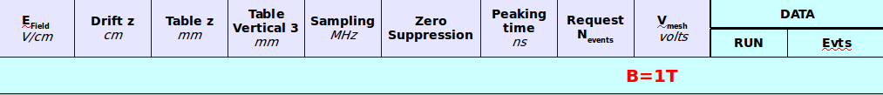
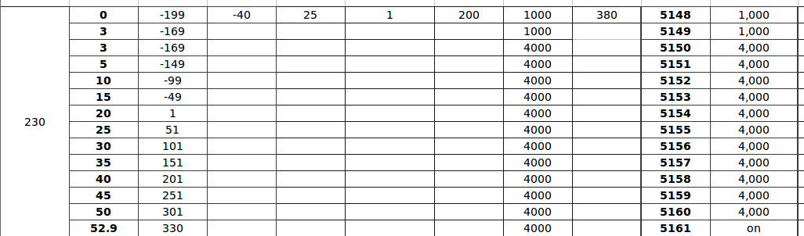
2015 LP TPC Micromegas samples
Lots of different configuration tested with beam
For the 1st look use a scan over drift length
plots in this talk are mainly for module 0

Slide 7
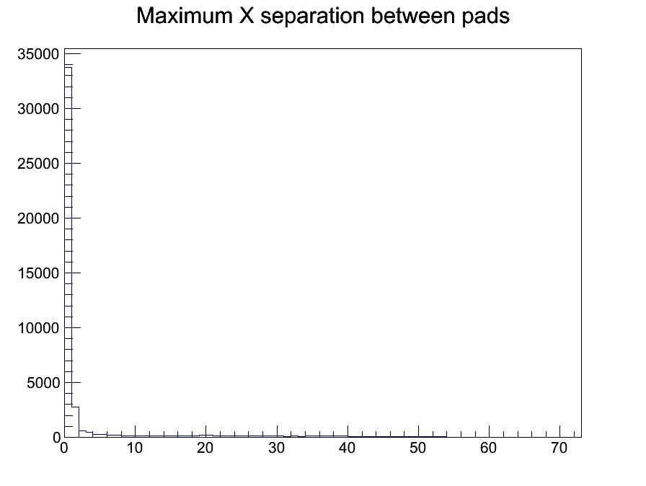
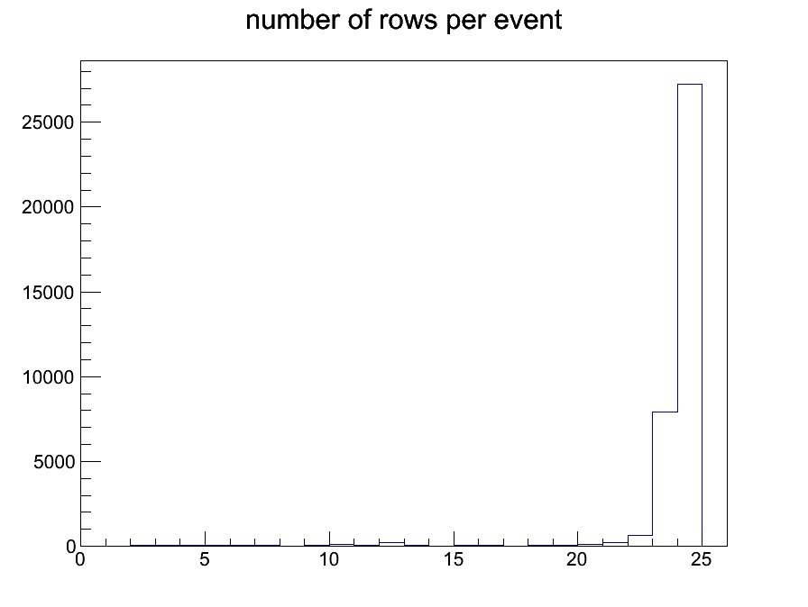


ILC-TPC event selection
FEM 0 selection results:
Events in sample: 46000
Not empty fem0: 44224
< 2 tracks : 37151
> 20 rows: 36146
For first look PID study need:
  one track per event (per FEM)
  long enough track
Selection:
  Look at maximum gap
  between pads hit in a row
  Look at track length (number of rows)
  $$N_{gap}<2$$
  $$N_{row}>20$$

Slide 8
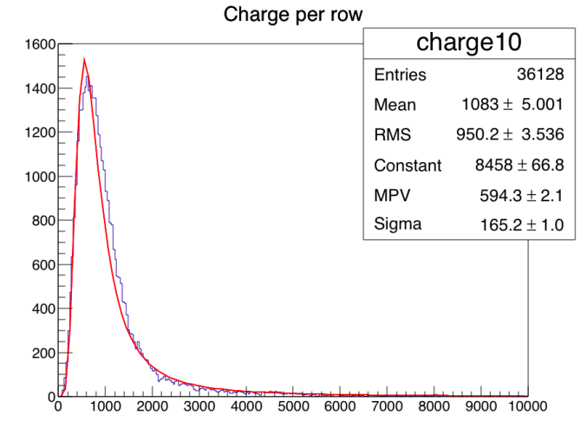
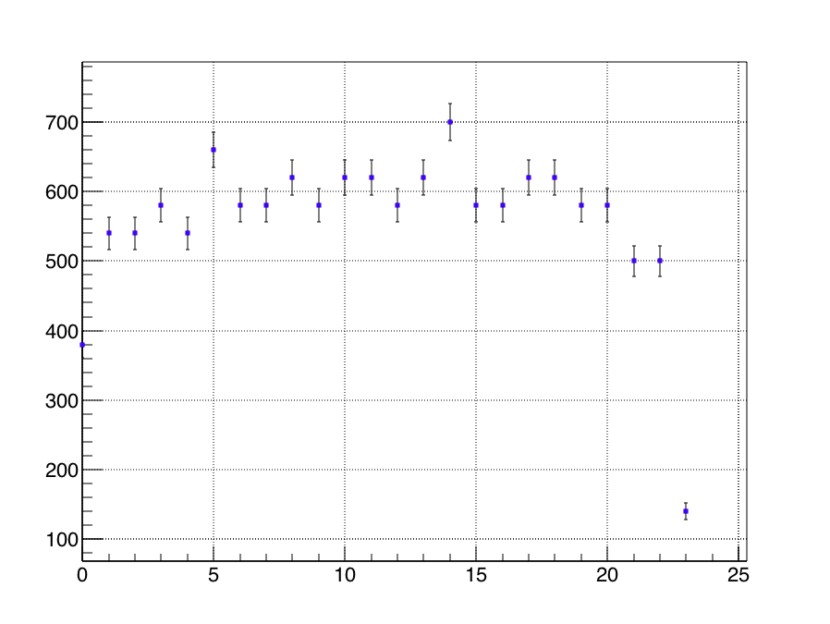
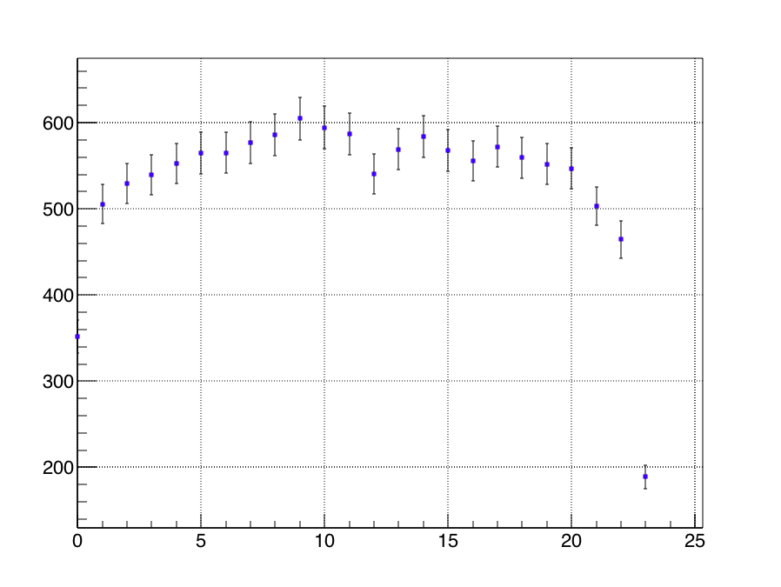
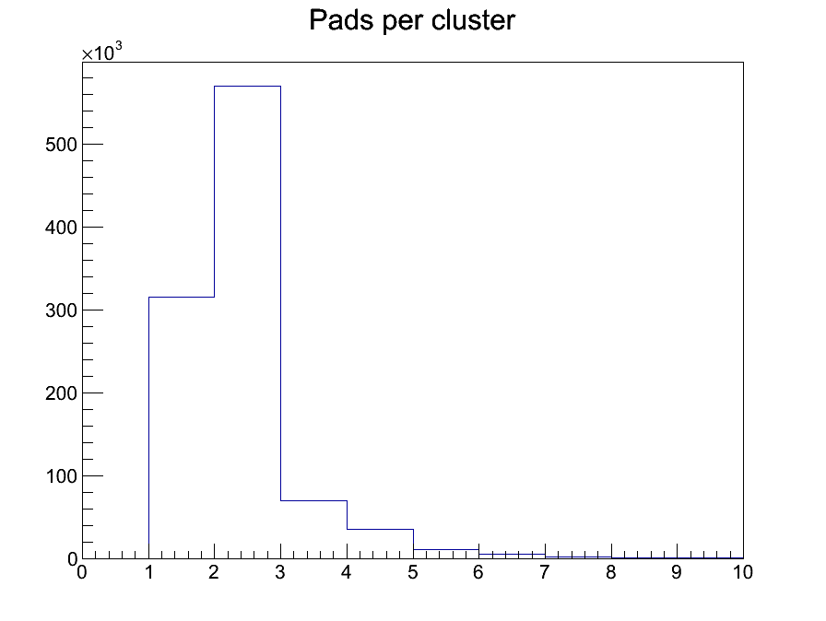
Charge per row (cluster)
Look at the most probable charge per cluster in a row
Edges of module demonstrate lack of charge (Electric field inhomogeneity)
pads at edges collect ~half of charge compared to center
Exclude 1st and last row for dE/dx estimations
MPV from landau
maximum bin
charge per cluster (row 10)
row number
row number
Typically 1-4 pad per cluster

Slide 9
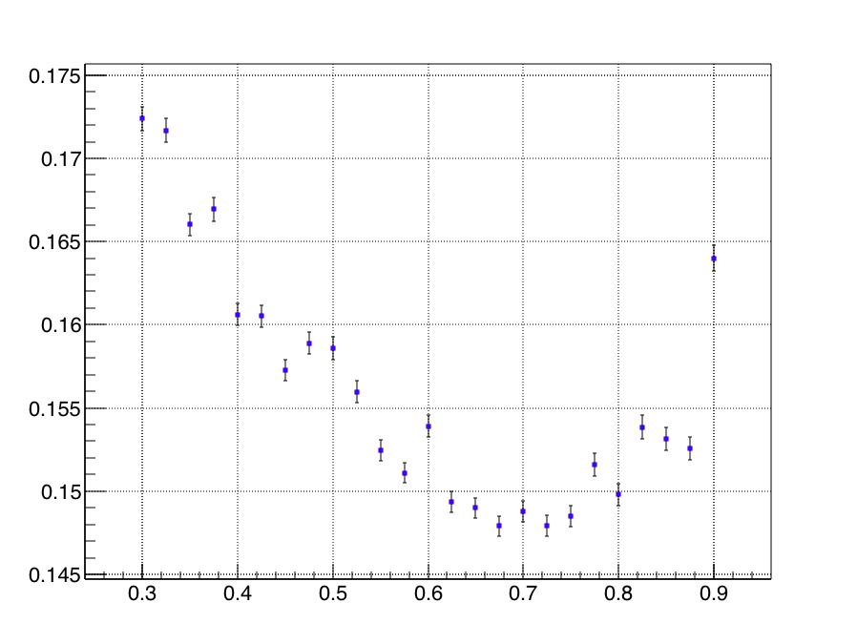



Charge cut
Reminder about dE/dx study plan:
  Take $αN$ first clusters.
  $0.4<α<1$
  Truncated mean energy per cluster
    $$C_{T}=\frac{1}{αN}\sum_{i}^{αN}{C_{cluster, i}}$$
Need to define $α$
Resolution from
Gaussian fit
T2K value is 0.7
Still make sense!
$$α$$

Slide 10
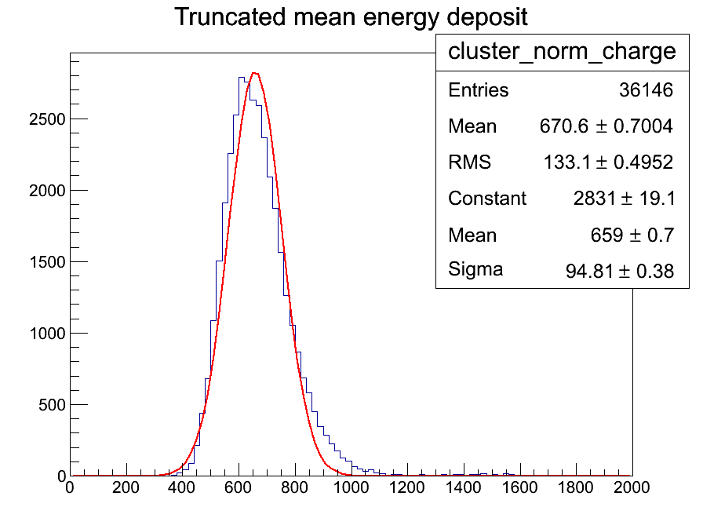

First results
Applying $C_{T}$ calculation method to the selected events
$α=0.7$ gives the best resolution
Gaussian and FWHM calculations give
~same results
~14% for 24 rows FEM (~17 cm)
for T2K TPCs 72 pads (~80 cm) have ~6.5%
For ILD TPC track length ~120 cm : ~5.0%
Truncated charge
Truncated charge per cluster

Slide 11
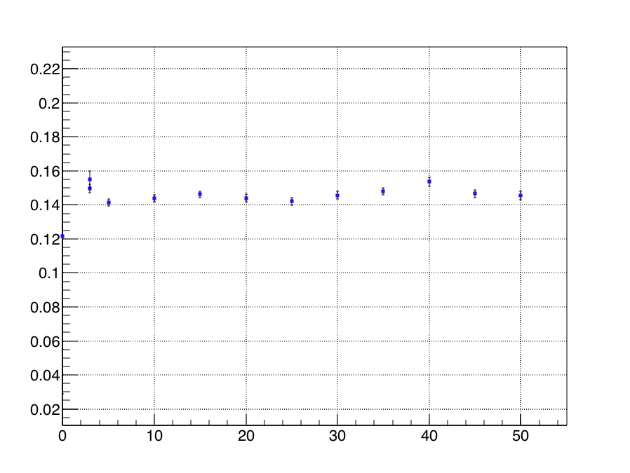

First results
Charge per pad is calculated as maximum ADC
Maximum ADC can depend on drift distance → can effect PID resolution
No dependence observed → $C_{pad}=\max{(ADC)}$ is good enough
PID resolution
Drift distance, cm

Slide 12
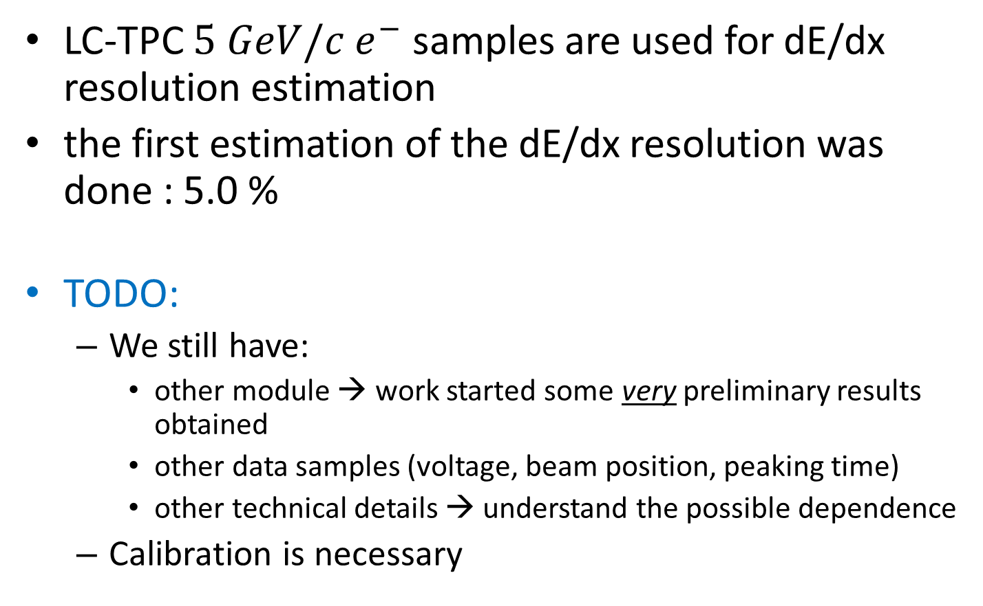
Summary
LC-TPC $5 GeV/c$ $e^{−}$ samples are used for dE/dx resolution estimation
the first estimation of the dE/dx resolution was done : 5.0 %
TODO:
  We still have:
    other module → work started some very preliminary results obtained
    other data samples (voltage, beam position, peaking time)
    other technical details → understand the possible dependence
  Calibration is necessary

Slide 13
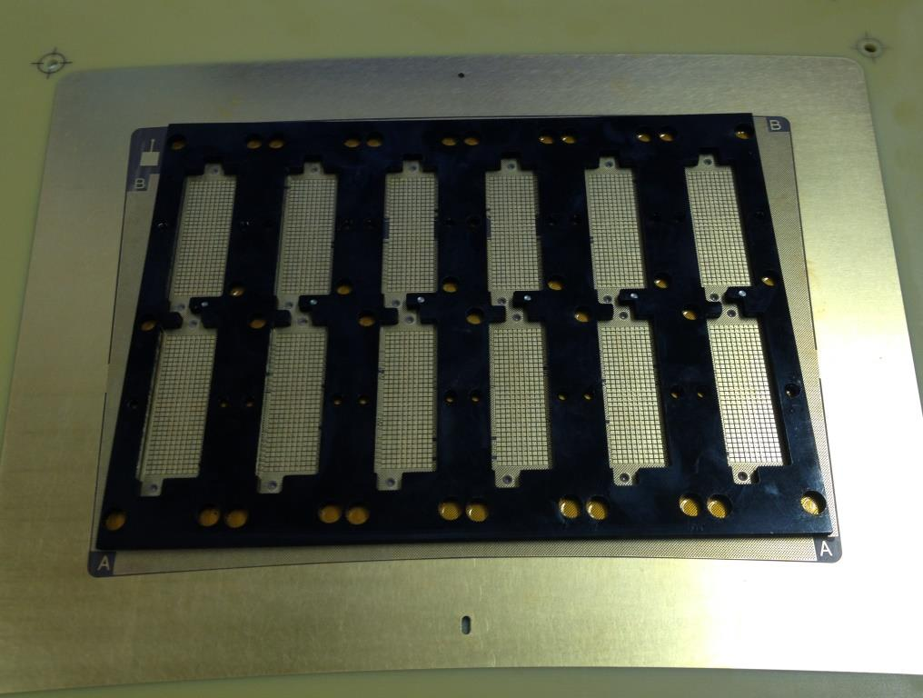
Encapsulated resistive foil Micromegas with reverse polarization
Reserved a test beam period at DESY to test 3 to 4 modules with several improvements:
  Better pad connections (threaded stiffener glued on PCB, under mechanical test, electronic test in 1 or 2 weeks)
  Grounded mesh, anode at +400 V
  (should give less noise and less
  distortions)
  -- DLC delivered (2.5 Mohm/sq)
  -- same test going on for T2K
  upgrade with cosmic rays (2
  modules ordered, one with
  annealing at 210 °C to reach 500 KOhm

Slide 14
Cosmic-ray setup (Boris Tuchming)
There is a cosmic test permanently going on in Saclay (so-called FCC test)
We hope to be able to test 4 new modules there before going to the test beam.

