Slide 1
News from Saclay
LCTPC phone meeting, Nov. 16,2017
P. Colas, D. Attié, S. Ganjour

Slide 2
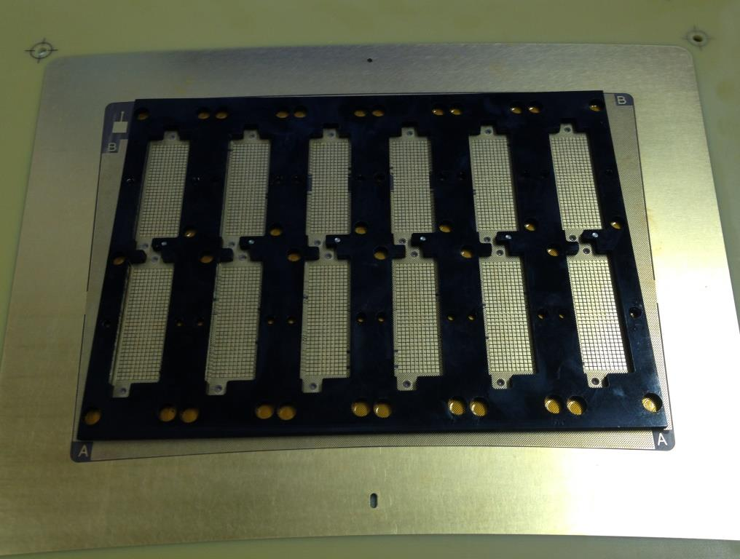
Encapsulated resistive foil Micromegas with reverse polarization
Reserved a test beam period at DESY to test 3 to 4 modules with several improvements:
  Better pad connections (threaded stiffener glued on PCB, under mechanical test, electronic test in 1 or 2 weeks)
  Grounded mesh, anode at +400 V
  (should give less noise and less
  distortions)
  -- DLC just delivered (2 Mohm/sq)
  -- same test going on for T2K
  upgrade with cosmic-rays

Slide 3
dE/dx analysis
With MM data from 2015 by a Russian student (from T2K)
Will combine 170 padrows to estimate resolution with a track length of 1.2 m

Slide 4
TPC interface document
P. Colas, A. Sugiyama

Slide 5
Integration Task Force
An integration Task Force is set up in ILD
Finalize membership early December
(one engineer + one or two physicists per subdetector)
Face-to-face meeting at DESY or LAL early 2018 (2nd half of January)
Paul and Serguei @KEK for 2 weeks, with Keisuke, Yumi, Aiko, Tomohisa,Akira,….
Discussed with Sugimoto the space and location issues for the ancillaries

Slide 6
Locations
  platform (no vibration, space reduced),
  cavern,
  gallery (facilitated accessibility for maintenance,
  surface (less space limitation nor safety constraints but long distance to the detector)
LV has to be close to the detector: platform
Gas analyse system : same
HV : Cavern
Backend and DAQ computers : gallery

Slide 7
SURFACE
Gas slow control computer
UNDERGROUND
Repeated Side A and Side B
EXTERNAL DEVICES
INTERFACE REGION
ON-DETECTOR DEVICES
3V/8A power supply for ASICS per module
6 patch panels
Module
(x240)
In 6 sectors
0.4 to few kV power
Supply for gas amplification
Or supermodule (x80)
Few V power supply
For gating
Optical fibre
DAQ computer (farm?)
(data and DACs,clock)

Slide 8
Europe-Japan matters
E-Jade now running well, with WP3.3 for ILC-related physics and detector R&D.
TPC: Paul and Serguei passing the 1st month of secondments
Central integration : Roman and Karsten are in and travel often
Next events:
  ILD meeting in Kitakami : Feb. 20 to 22
  FJPPL à Nara : May 9 to 11
  Asian LCWS in Kyushu : May 28 to June 1.

