Slide 1
KLauS: Updates on HBU Integration
KIP, Heidelberg University
Wei Shen
2018.09.19

Slide 2
Overview
Status of the KLauS ASIC
  Temperature measurements
  Timing measurements
  The next KLauS version 6
Status of the KLauS HBU integration

Slide 3
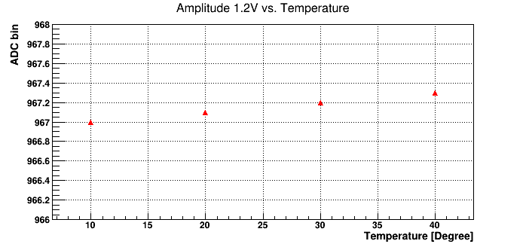
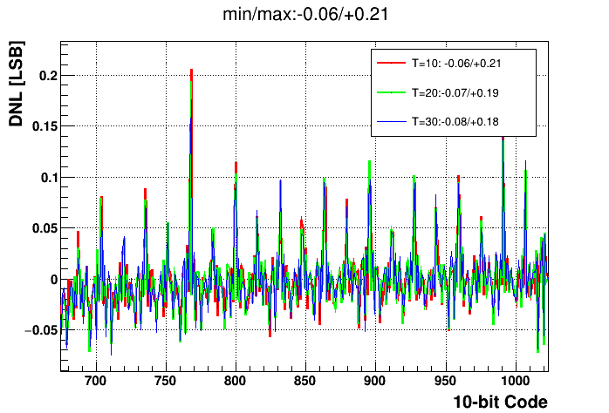
ADC @ different temperature
AD conversion @ fixed DC input
Differential Non-Linearity (ROI)
No big changes in ADC alone.
Expected: performance determined by the mismatches between capacitors.

Slide 4
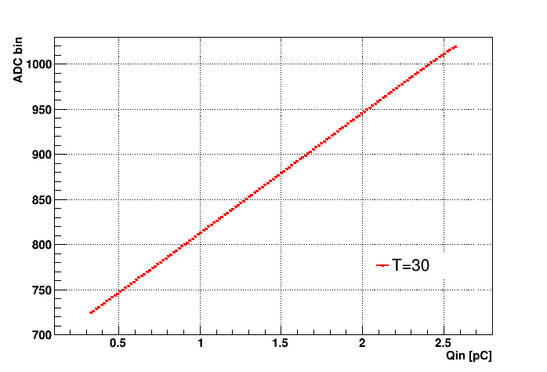
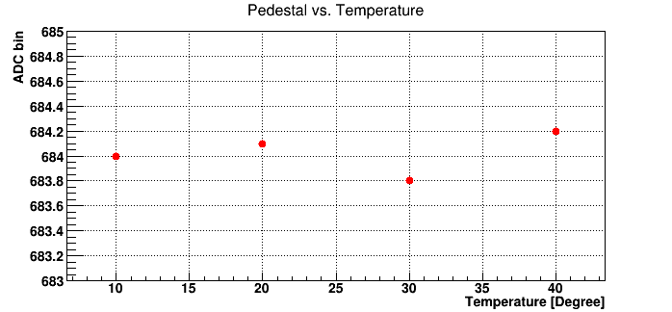
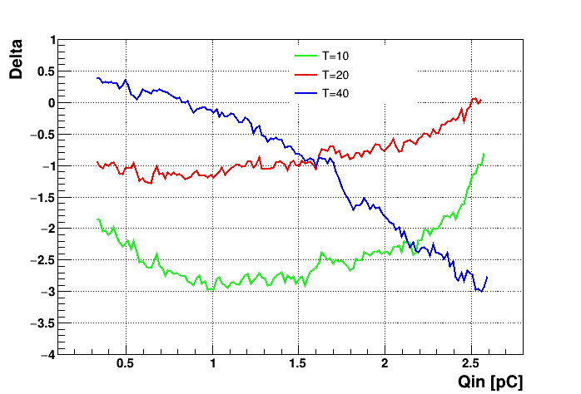
Fullchain charge injection @ different temperature
Input SiPM bias: doesn‘t change
Front-end Pedestal: no big change
Charge injection:
  For the working range 20-40°C, delta < 3 bin, within 1% FSR.

Slide 5
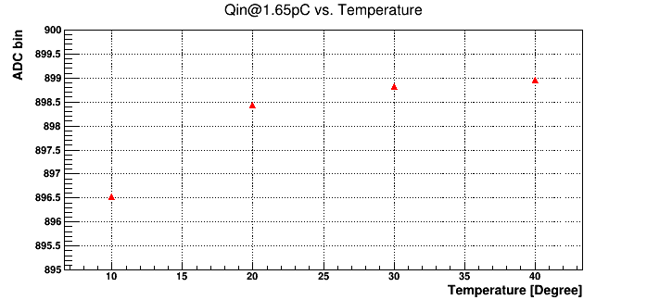
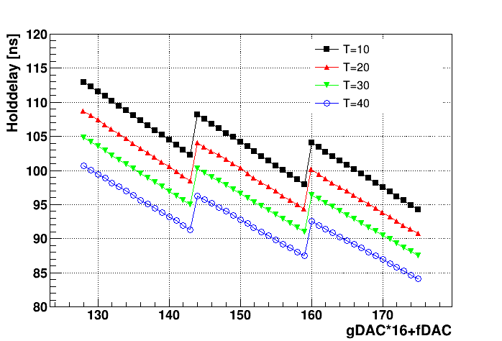
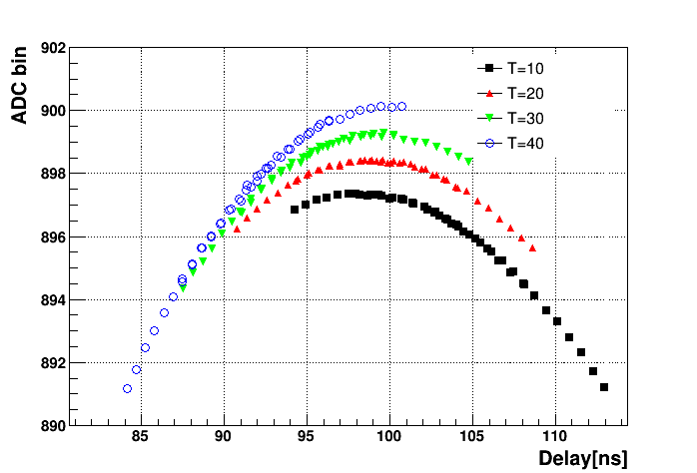
Fullchain @ fixed charge injection
Close look at fixed charge injection with pulse reconstruction
  Hold-delay contributes: 0.4ns/°C
  Peak time no changes, but peak height changes around 1bin/°C
Fixed gDAC and fDAC

Slide 6
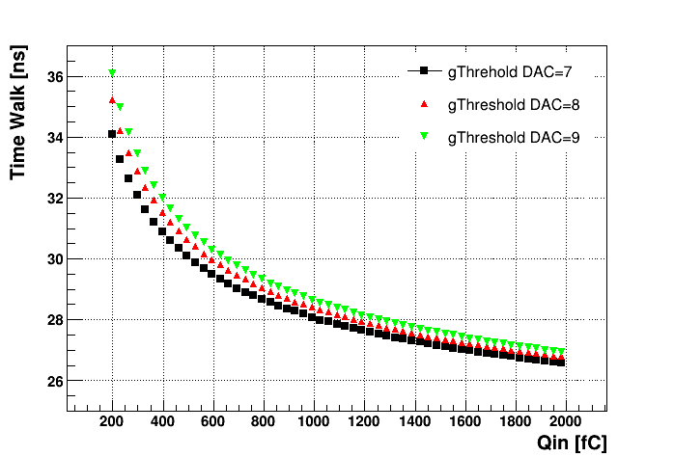
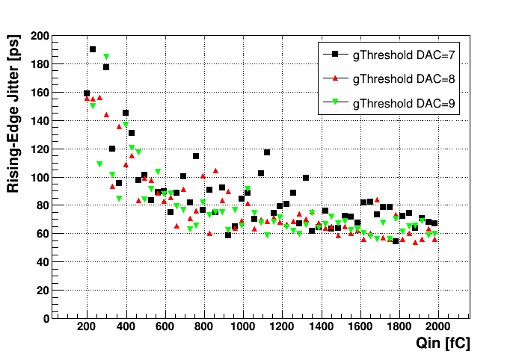

Timing measurements
Time walk and rising edge jitter of the front-end trigger signal
Jitter around 50-100ps(σ) for the front-end
  No reason to pursue a TDC with binsize smaller than 180ps($50×\sqrt{12}$)

Slide 7
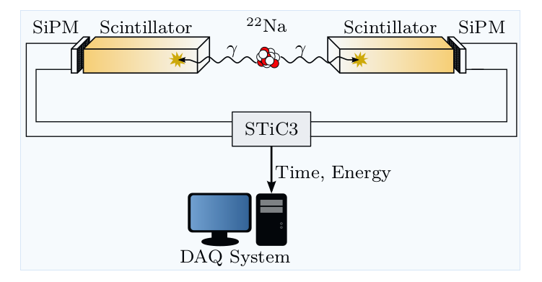
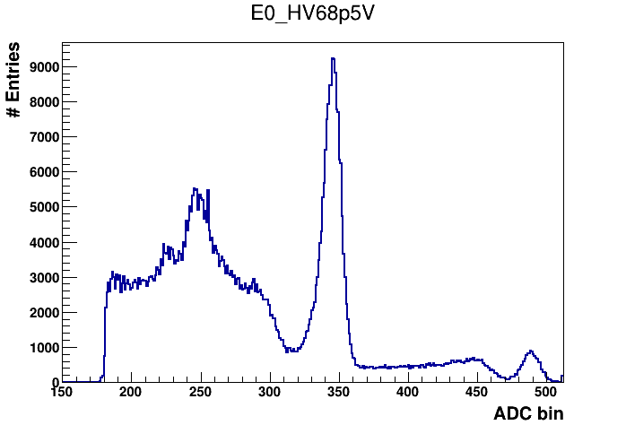


CTR Measurement Setup
Scintillator: LYSO:Ce, $3.1×3.1×15{mm}^{2}$
Energy resolution: 11.5%
Hamamatsu MPPC S12643-050CN(X)
Two peaks (511keV, 1275keV) are used to do the calibration
Temperature: 15$℃$
Two ASIC used. Scope to get the amplitude/timing information
Energy measuremets with KLauS internal ADC
KLauS5
Same as EndoToFPET setup with STiC3

Slide 8
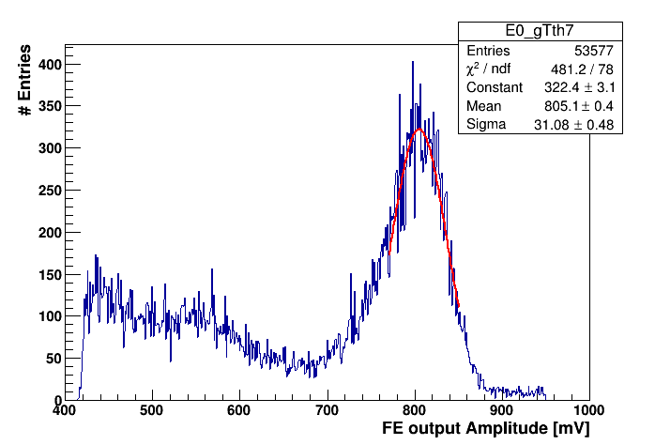
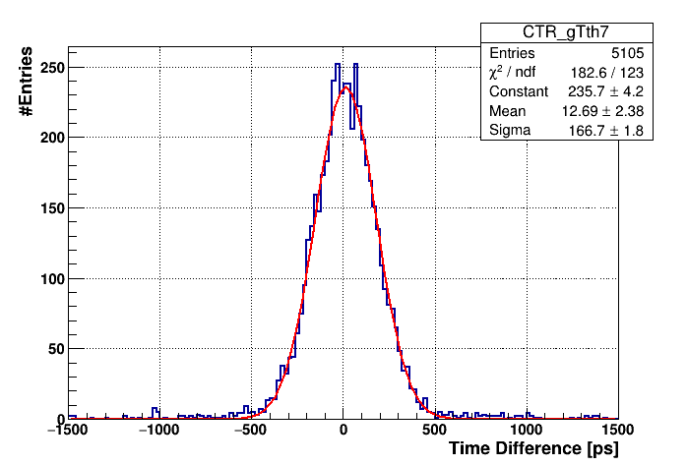
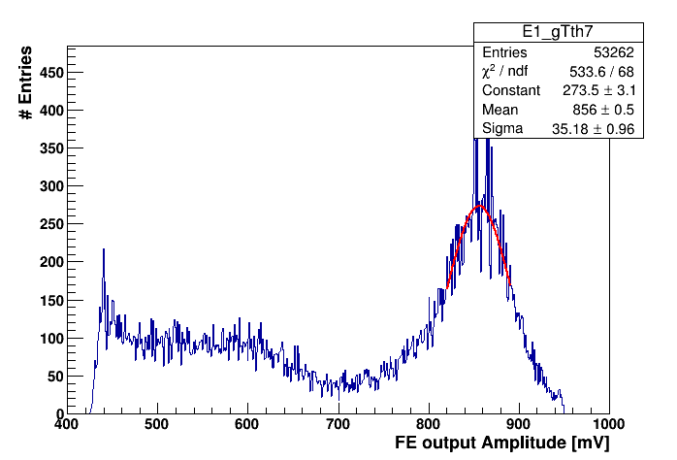
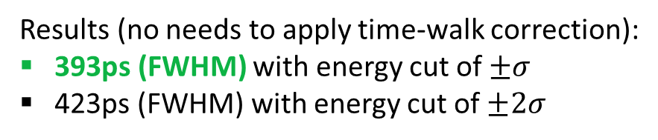
Coincidence Timing Resolution
Results (no needs to apply time-walk correction):
393ps (FWHM) with energy cut of $±σ$
423ps (FWHM) with energy cut of $±2σ$

Slide 9
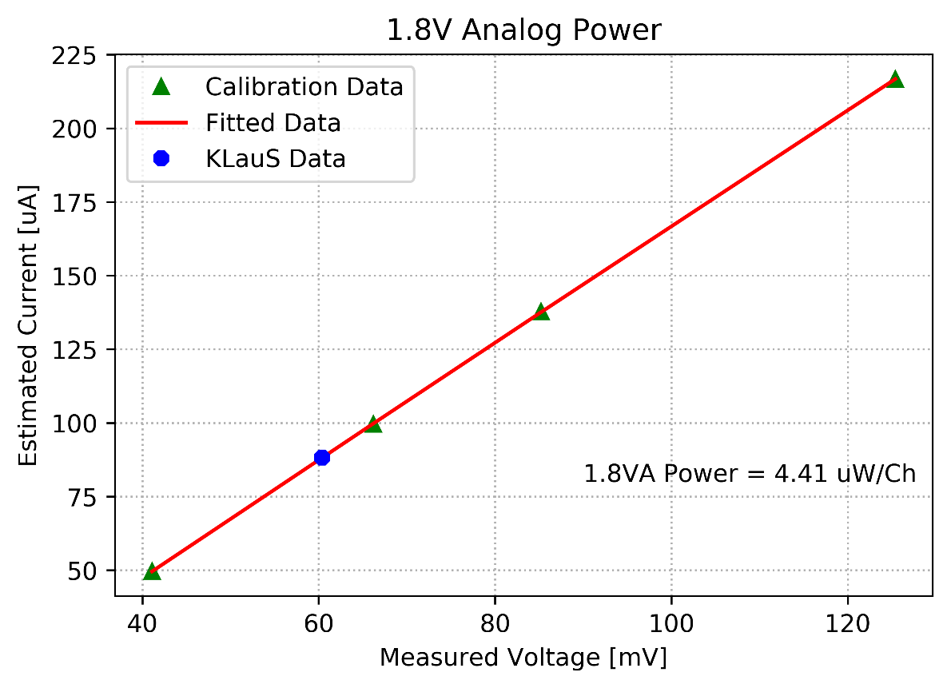
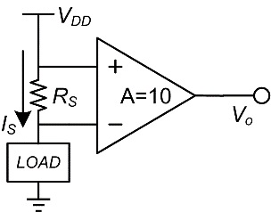
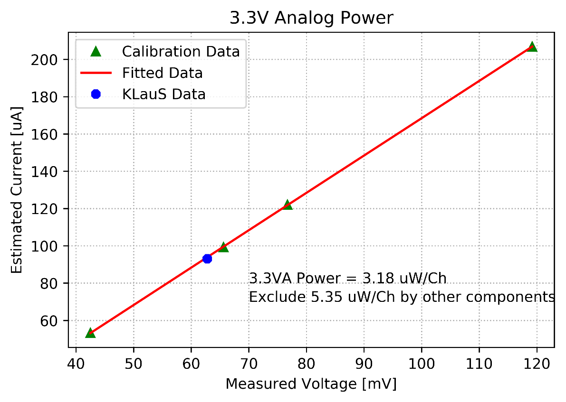
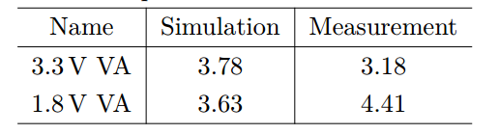
TDC Design Considerations: power constraints
Re-measure the power consumption under acquisition-off state
  Same setup as before
  Setup calibrated: resistor, gain, offset
  Exclude power from other active components
Results:
  Same for results under acquisition-on state
    2.5 mW/Ch (VA3.3 → 0.93, VA1.8 → 1.53 )
  New results for acquisition-off state
  Power-consumption under 0.5% PP duty-cycle:
    20 uW/Ch (for analog power only)
    5 uW/Ch budget left for TDC and digital parts (challenging)

Slide 10
KLauS6 Design Status
TDC Design Specfications:
  Bin-size: 200ps(depending on the actual power consumption)
  Time range: 16ms for test-beam mode (1.6ms for ILC mode)
  Fast lock time: < 10us (smaller than the front-end settling time)
  Power consumption: < 18mW (for all channels, scaled to 2.5uW/Ch with 0.5% duty cycle)
Design Implementations:
  Data structure: BXID + CC(16bits, 1.6ms) + FC(7bits, 25ns)
  Byte number of hit data 5 bytes unchanged; T0 channel stores the BXID
  Discard the T0 channel data if no event hit
  TDC strucutre: PLL-based TDC, PLL clock multiply factor of 4, slightly different from STiC
The KLauS6 will be submitted at Q1 2019

Slide 11
Updates on the HBU integration
KLauS5 packaging
  52 naked chips will be sent and expect get 47 chips back
  Purchase Order from DESY received by Novapack
  Expected submit the substrate order before the end of this month (guess it‘s delayed)
  Expected get the packaged chip by the end of Oct.
Test-board for the packaged chip
  Design on-going, expected ready by the end of Oct.
HBU integration
  HBU_HD Schematic design already finished by Mathias. Waiting for the PCB layout design......
  Also POWER board finished
  Firmware and software design will start once we get the HBU board ready

