Slide 1
TCMB face-to-face on Oct.26
Shin MICHIZONO
LCC-ILC/KEK
LCB on August
Internal cost review on Sep.26 at KEK
Machine Staging Report (for Ottawa IFCA seminar)
Recent topics
  MEXT survey
  KEK’s re-estimate for staging 2017 base

Slide 2
Tentative conclusions at LCB on Aug.

Slide 5
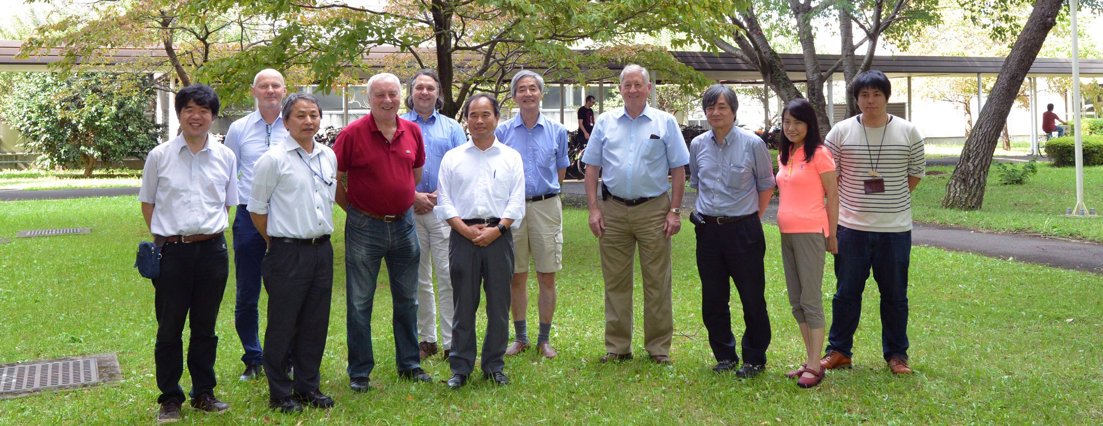
Internal Cost Review with Lyn at KEK

Slide 8
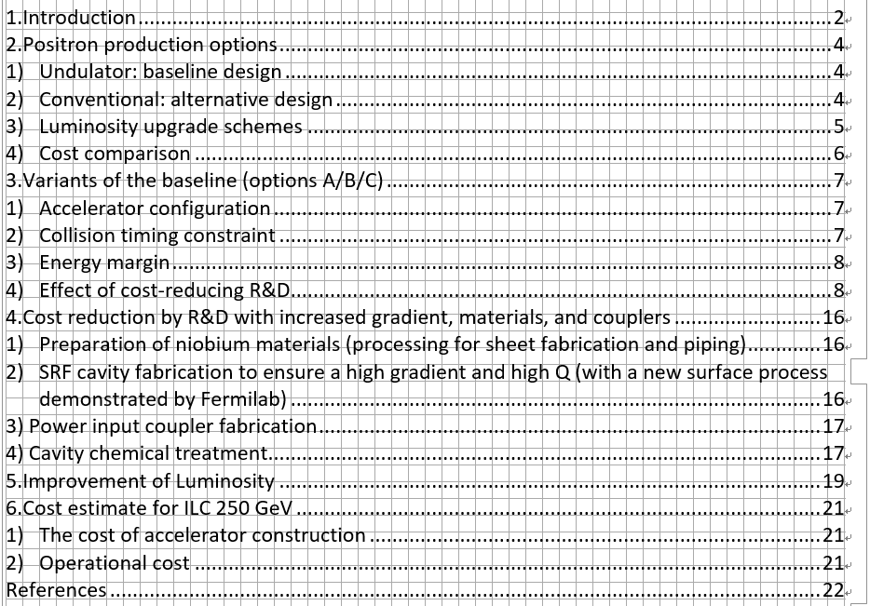
Machine Staging Report
(for Ottawa IFCA seminar)
~20 pages report for machine ILC250GeV edited by Lyn and myself.
~40 pages physics report was also prepared by physics group.
These two documents were submitted to ICFA/LCB.
(Now small revise is ongoing and revised one will be re-submitted in this week.)

Slide 9
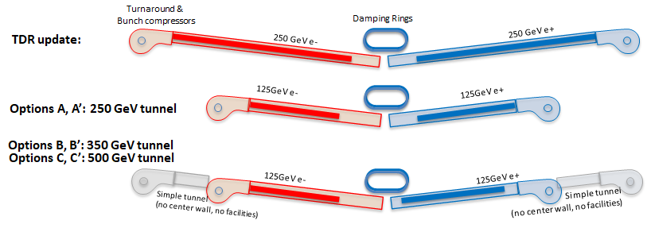
250 GeV
Option C:
125GeV e-
125GeV e+
Option D:
125GeV e-
125GeV e+
350GeV Option D’:
Simple tunnel
(no center wall, no facilities)
Simple tunnel
(no center wall, no facilities)
Option E:
125GeV e-
125GeV e+
350GeV Option E’:
Option F:
125GeV e- sparse linac
125GeV e+ sparse linac
350GeV Option F’:

Slide 10
Recent topics
MEXT survey of the cost reduction R&D by new technology
In this fiscal year, KEK get a contract about "survey of cost reduction R&D" from MEXT.
We will survey and make some study about cost reduction (like N-infusion) by this budget.
The cost reduction session during LCWS2017 will be helpful to this survey.
The external advisory committee will check the survey and next advisory committee will be held on Nov.20. We will report R&Ds of Nb material, N-infusion, input coupler, and normal conducting linear collider (CLIC).
KEK's re-estimate of staging cost at 2017 base
After the endorsement of staging at ICFA seminar, we expect that MEXT advisory panel will be held to estimate the staging on the end of January or early Feburary.
Since we will be probably asked the staging cost (when we will build ILC in Japan not 2012 but 2017 base) at the panel , KEK has just started the re-estimate of the staging on 2017 base in two months (before the coming advisory panel).
Of course it is impossible to gather the new cost like GDE era, the accelerator will re-estimate the typical items.
Nb material, Nb cavity, input coupler, klystron In addition, we will check the items not included in TDR.
Japanese general election on last Sunday

