Slide 1

Some News from Europe
Selected Issues
Karsten Büsser, Thomas Schörner-Sadenius, DESY
ILC Integration and CFS Workshop
23 February 2018

Slide 2
Topics
The European Strategy Update Process
News from the European XFEL (material from H. Weise)
Other SRF uses in Europea
The ILC European Action Plan

Slide 3
Topics
The European Strategy Update Process
News from the European XFEL
Other SRF uses in Europea
The ILC European Action Plan

Slide 4

The Update of the European Strategy for Particle Physics
Relevance and Scope
https://council.web.cern.ch/en/content/european-strategy-particle-physics:
The Convention bestows two missions upon the Organization, namely the operation of
laboratories and the organisation and sponsoring of international co-operation in the field of
elementary particle physics.
[…] In this context, the Council has assumed full responsibility for defining the strategic orientations of European particle physics, a bottom-up process that starts with the broad consultation of all stakeholders in Europe’s particle physics community and culminates in a dedicated meeting of the European Strategy Group, which brings together representatives of the CERN's Member States and of the major European laboratories active in the field, particle physicists from outside Europe and specialists in related fields of physics. The Strategy updates are drafted at this special "drafting" session of the European Strategy Group and are then validated at a dedicated "European Strategy Session" of the Council.
The last one of these was held on 28 May 2013 in Brussels.
Strategy process defines long-term commitments of European community
ILC competing with large CERN projects (and others; note that CERN needs a future after LHC)
Firm European statement requires firm Japanese statement by the end of 2018

Slide 5
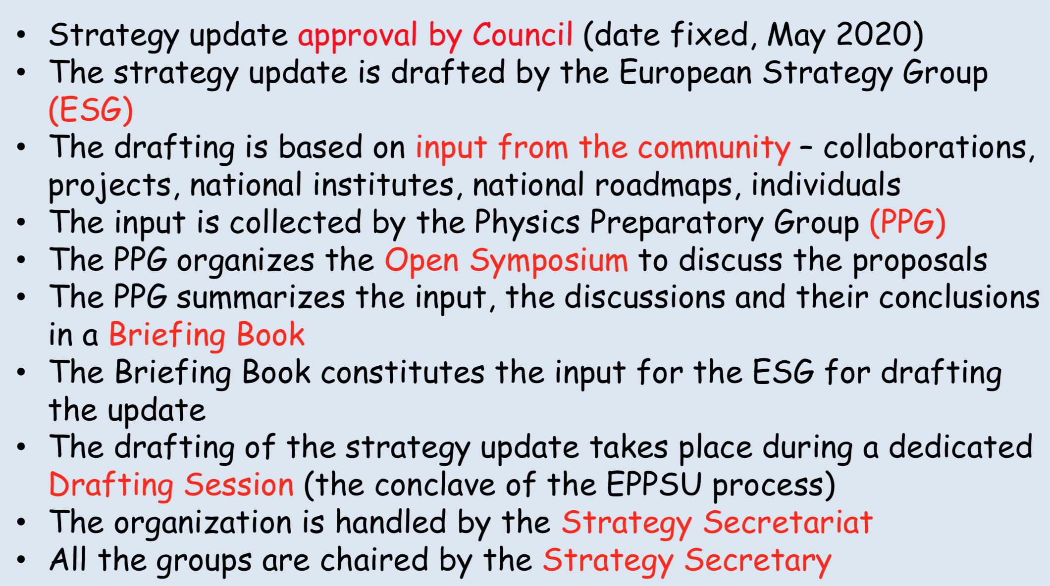
The Update of the European Strategy for Particle Physics
Reminder (2) – from H. Abramowicz
Halina Abramowicz
Strategy Secretary

Slide 6
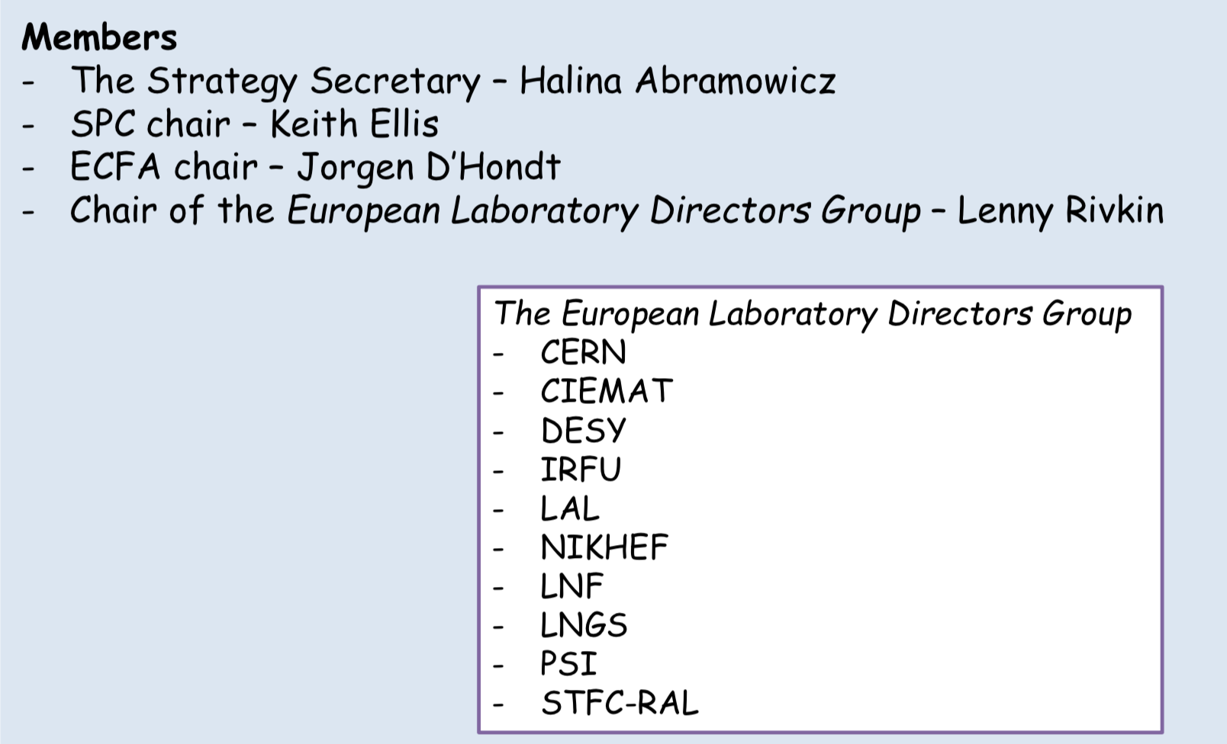
The Update of the European Strategy for Particle Physics
Members of the Strategy Secretariat

Slide 7
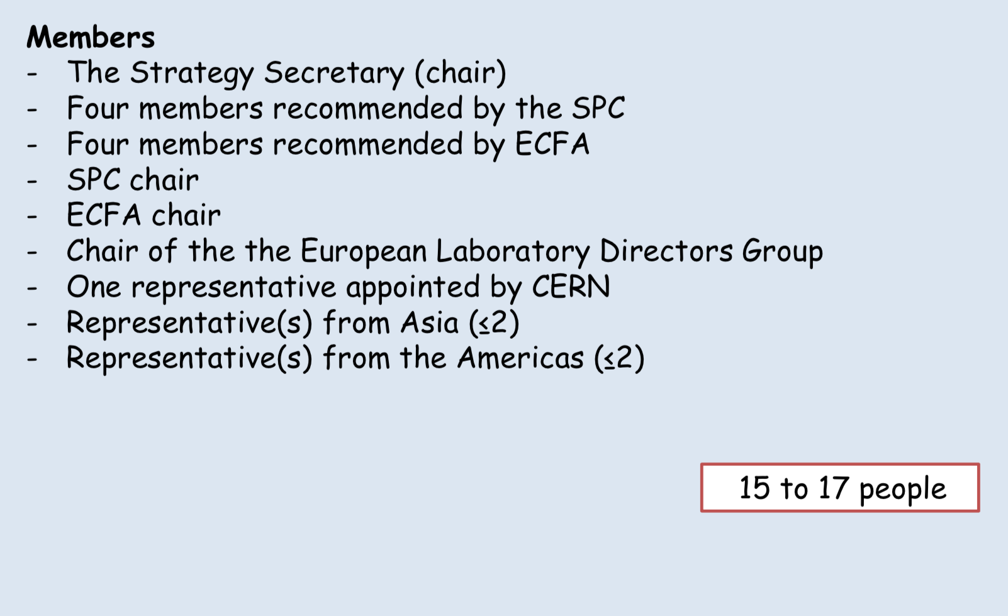
The Update of the European Strategy for Particle Physics
Members of the PPG

Slide 8
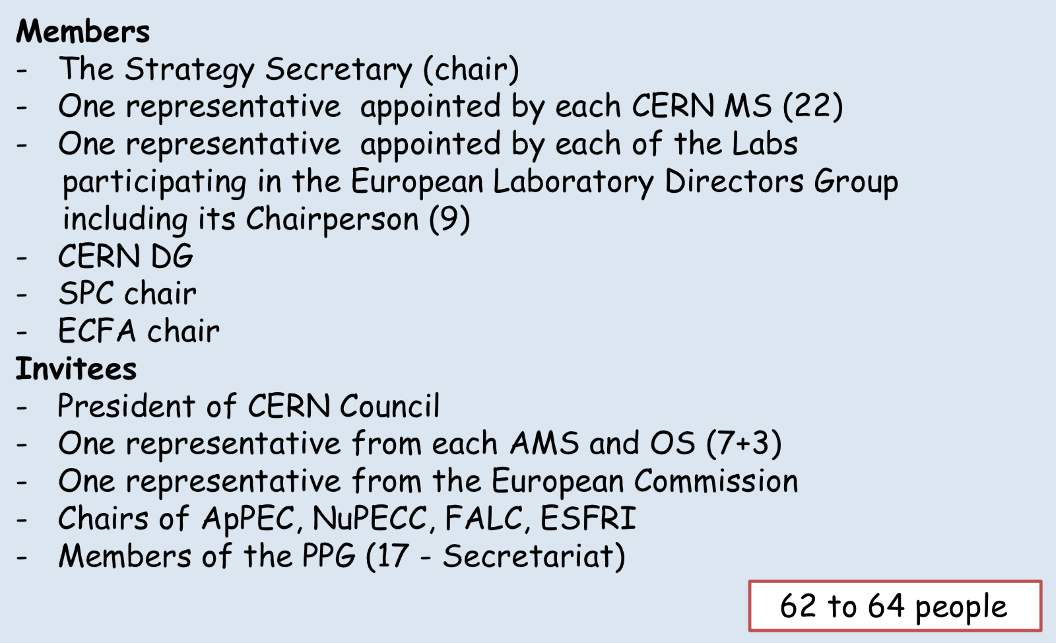
The Update of the European Strategy for Particle Physics
Members of the ESG

Slide 9
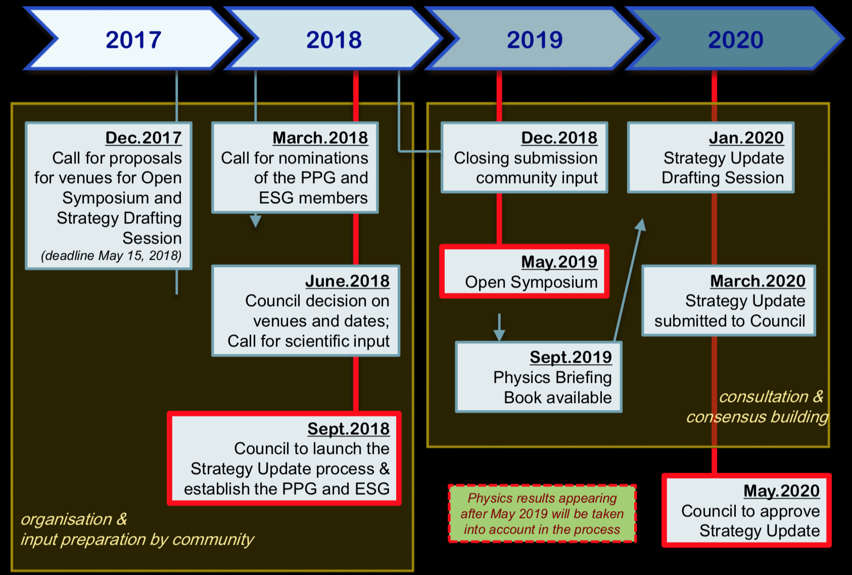
The Update of the European Strategy for Particle Physics
Timeline

Slide 10
Topics
The European Strategy Update Process
News from the European XFEL
Other SRF uses in Europe
The ILC European Action Plan

Slide 11
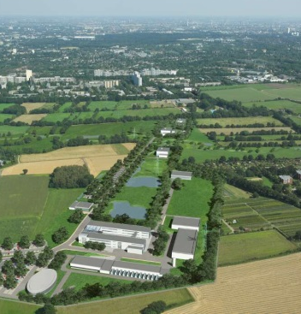
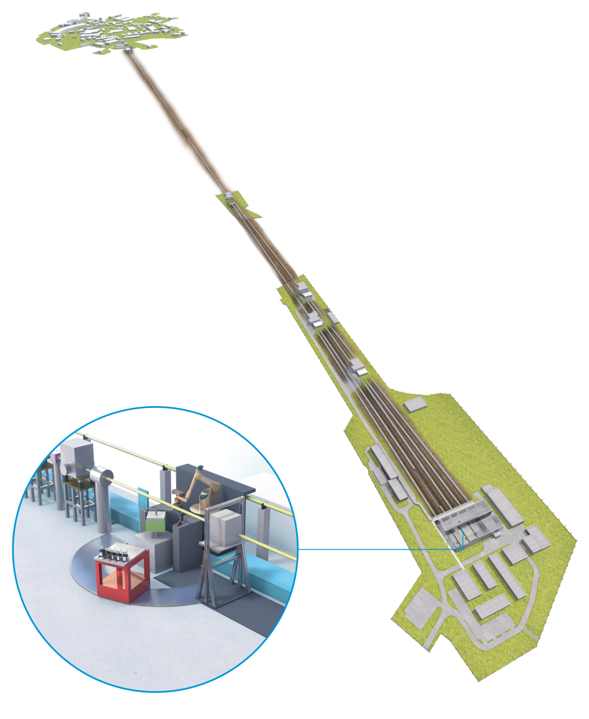

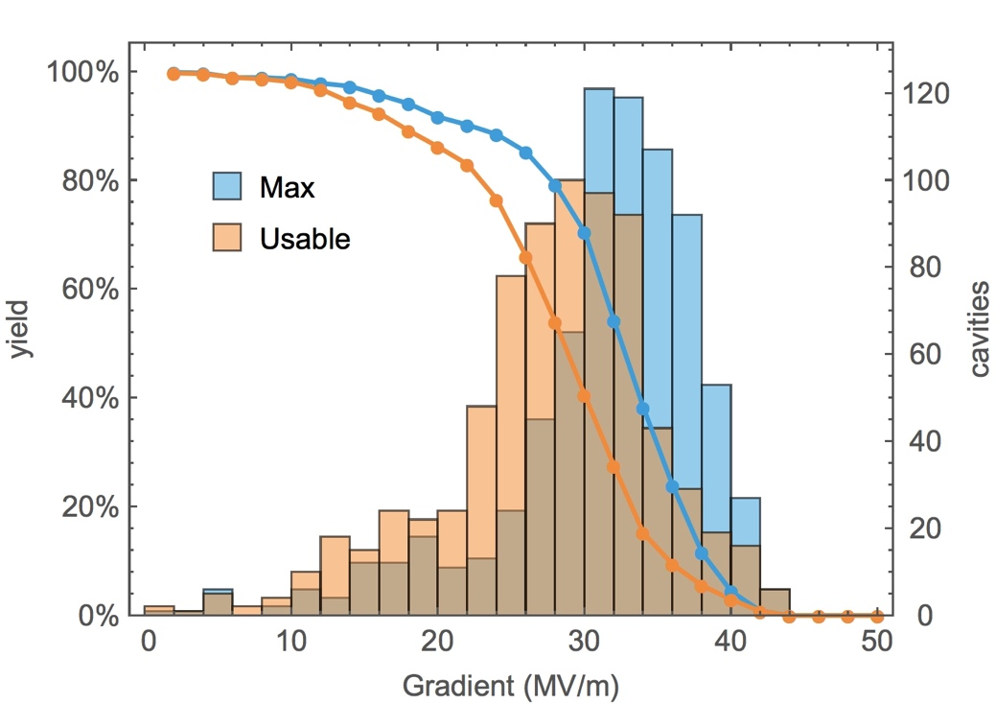
The European XFEL
Reminder
2.1 km 17.5 GeV SCRF linac
First light: May 2017
User operation since … now
800 cavities in 100 modules
Current energy: 14.6 GeV

Slide 12
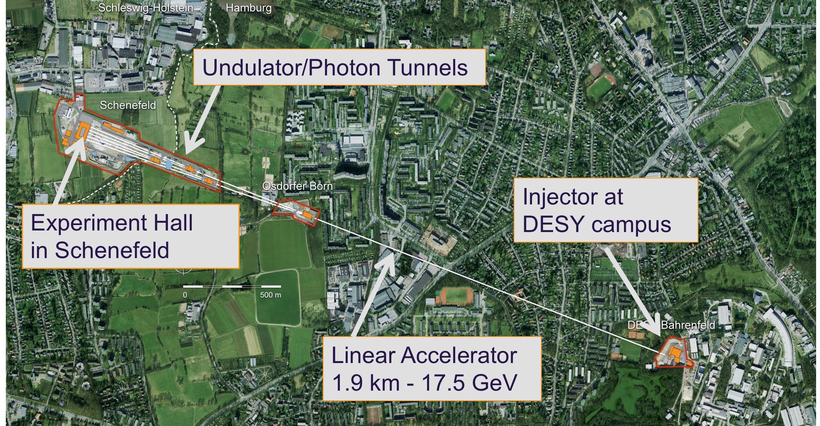
The European XFEL

Slide 13
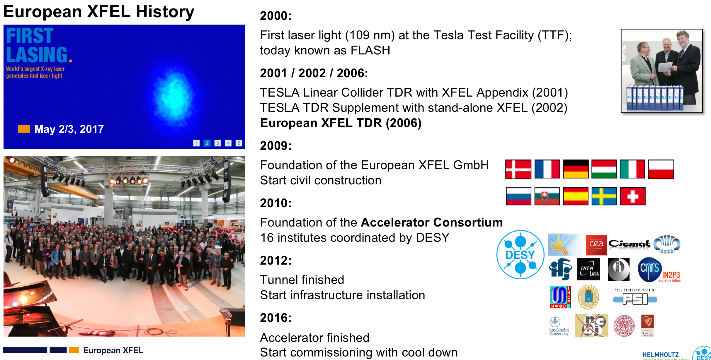
The European XFEL
History

Slide 14
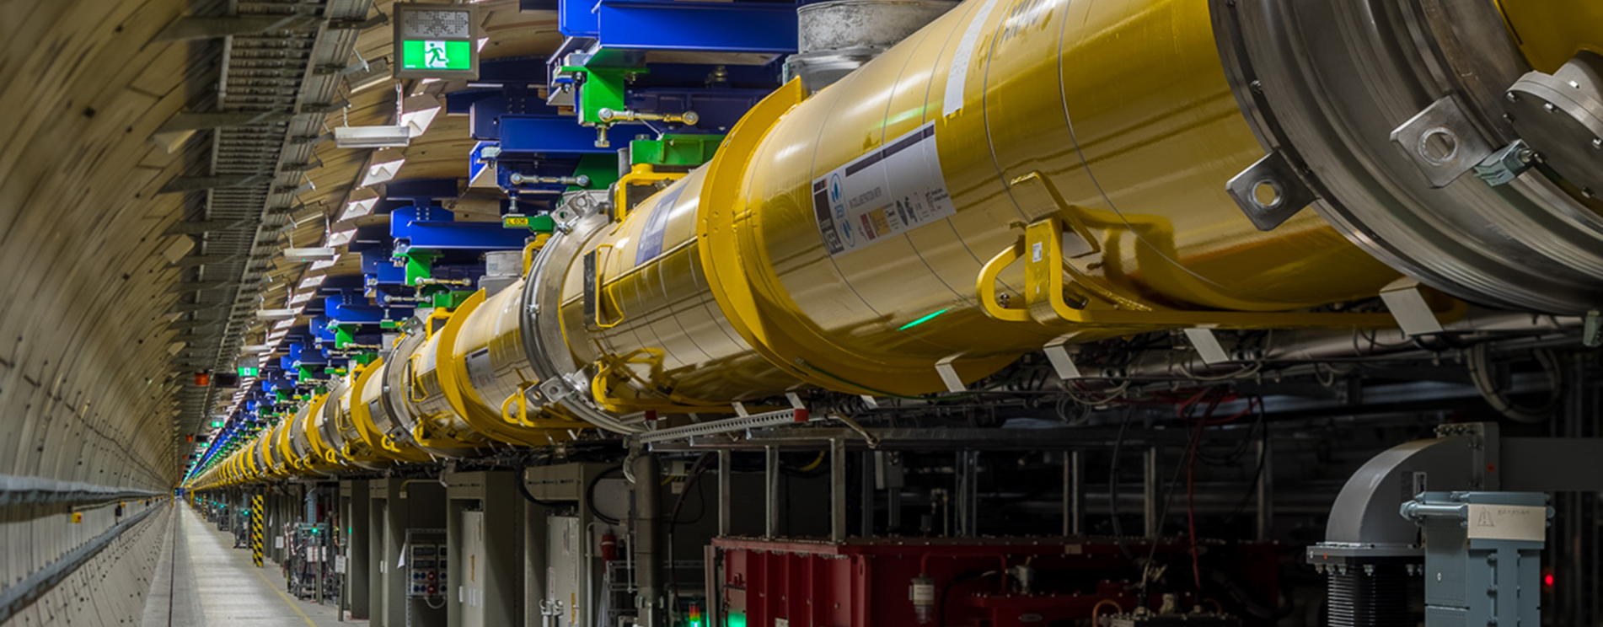
The European XFEL
The by far longest cold linac in the world

Slide 15
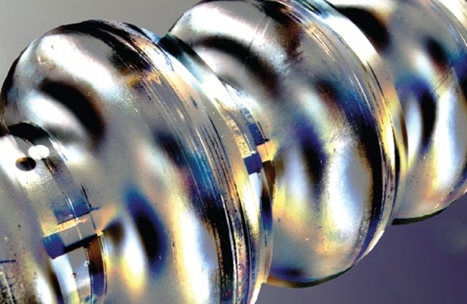
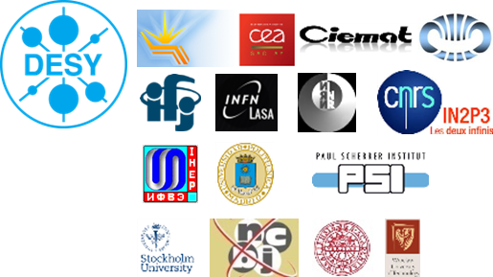
The European XFEL
Superconducting technology
Superconducting radiofrequency (SRF) accelerators are a figurehead of DESY‘s engagement in the design, construction and operation of accelerators for science.
The successful construction and commissioning of the European XFEL was the result of excellent cooperation within the DESY coordinated Accelerator Consortium consisting of 16 institutes.
The used TESLA technology was developed since the early 90ies. FLASH is the first result of this R&D and can be seen as the prototype.
With the European XFEL the fully successful technology transfer to industry reached an important point. Other worldwide projects (LCLS-II, ESS, new SRF based FELs at e.g. SINAP, China) are profiting greatly from DESY efforts.

Slide 16
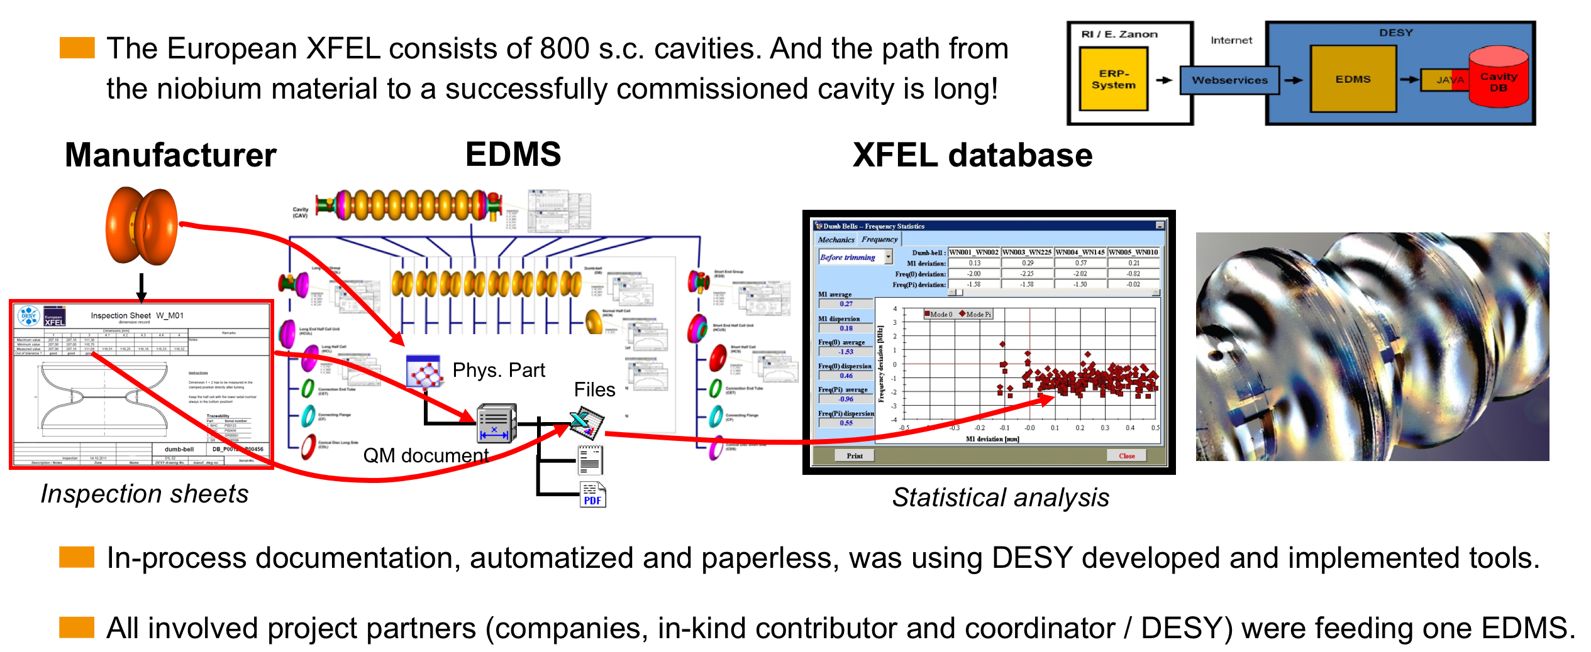
The European XFEL
Documentation was a Must

Slide 17
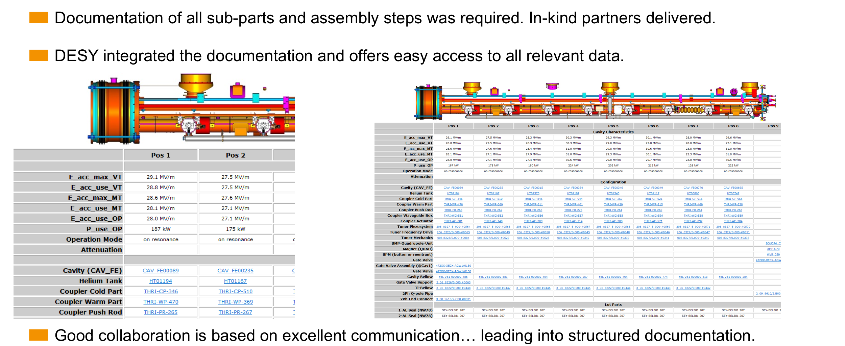
The European XFEL
Each accelerator module has 500 major sub-parts

Slide 18
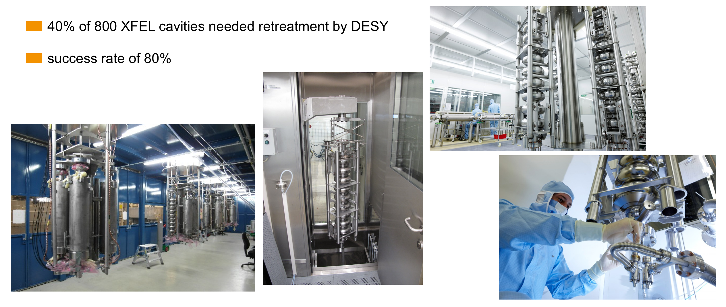
The European XFEL
Re-treatment of cavities

Slide 19
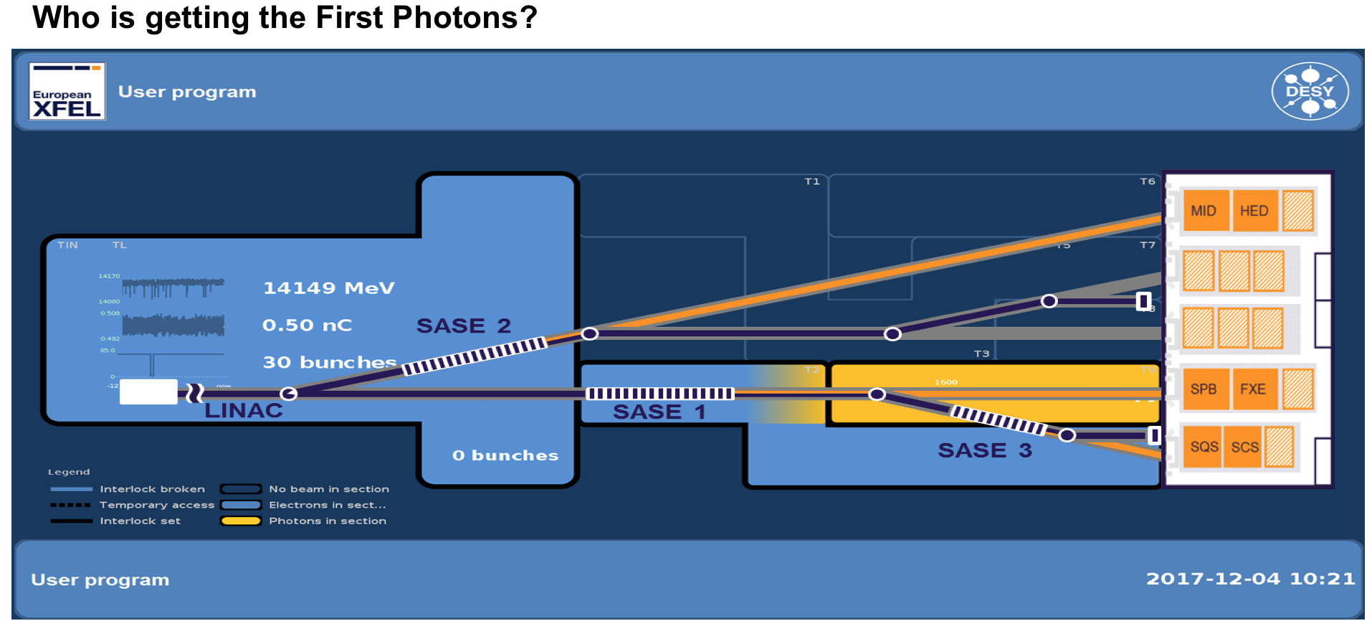
The European XFEL
Experiments

Slide 20
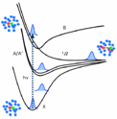
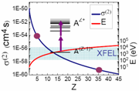

The European XFEL
Experiments
MID Materials Imaging & Dynamics
SASE 2
MID
HED
HED High Energy Density Science
U 2
SPB Single Particle & Biomolecules
U 1
FXE Femtosecond X-ray Experiments
SASE 1
SPB
FXE
SQS Small Quantum Systems
SASE 3
SQS
SCS
SCS Spectroscopy & Coherent Scattering

Slide 21
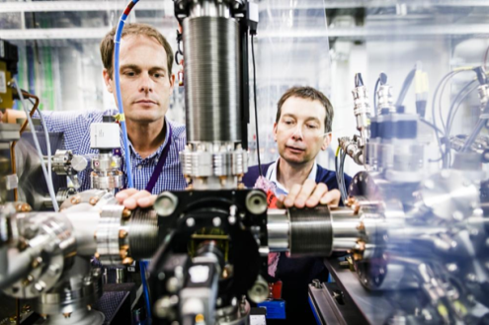
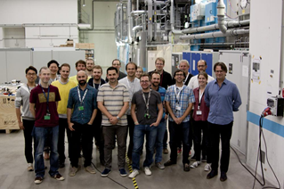
The European XFEL
Experiments
study of molecule structure and functions
SASE 2
MID
HED
U 2
SPB
SPB Single Particle & Biomolecules
U 1
FXE Femtosecond X-ray Experiments
SASE 1
SPB
FXE
molecular movies and chemical reactions
SASE 3
SQS
SCS
FXE

Slide 22
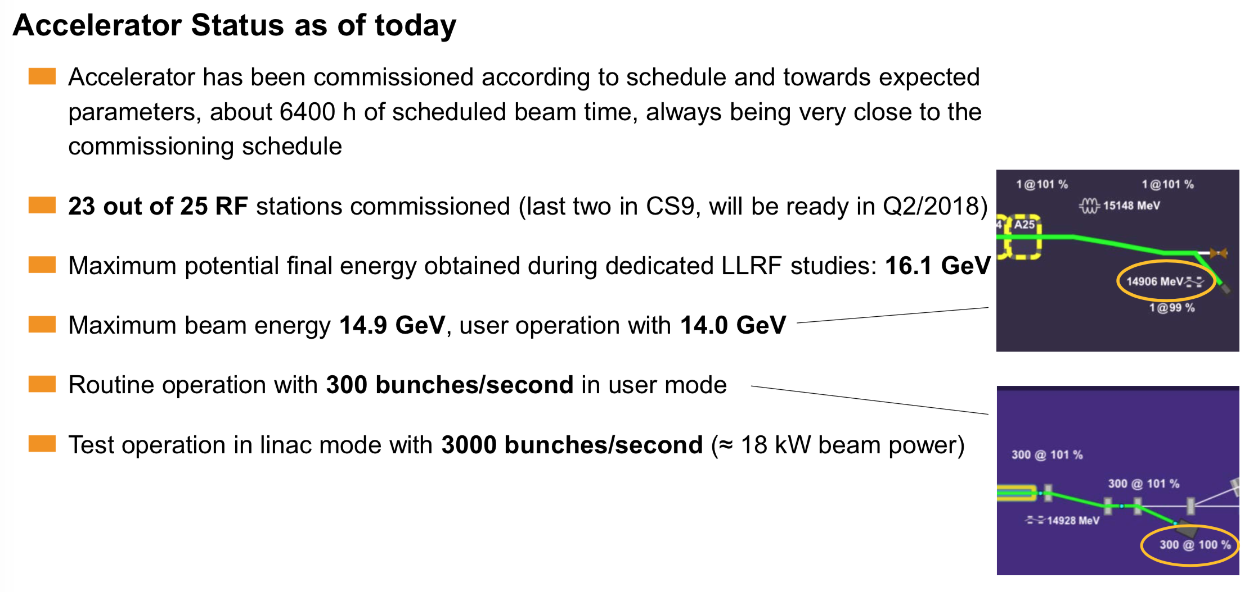
The European XFEL
Accelerator status of 20 January 2018

Slide 23
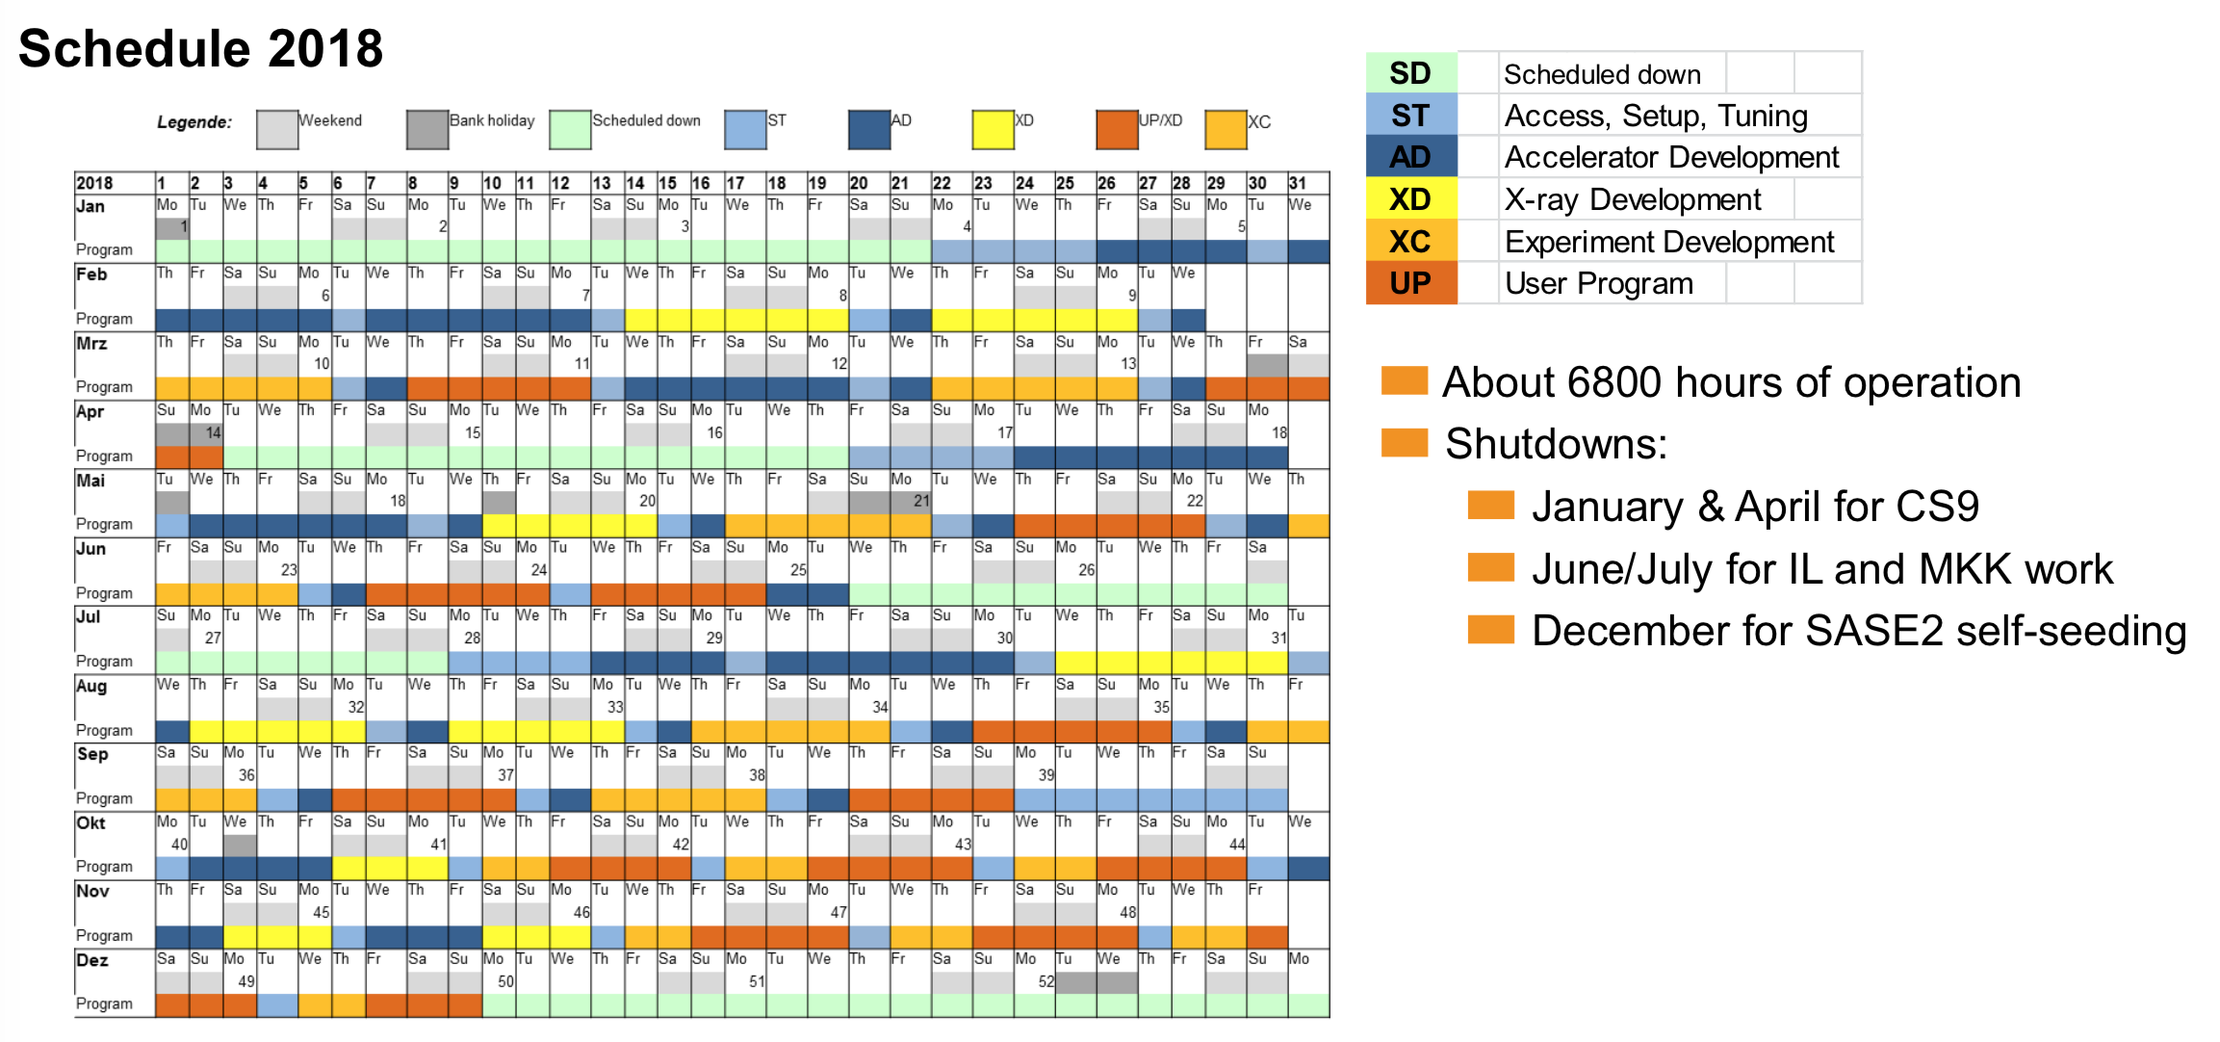
The European XFEL

Slide 24
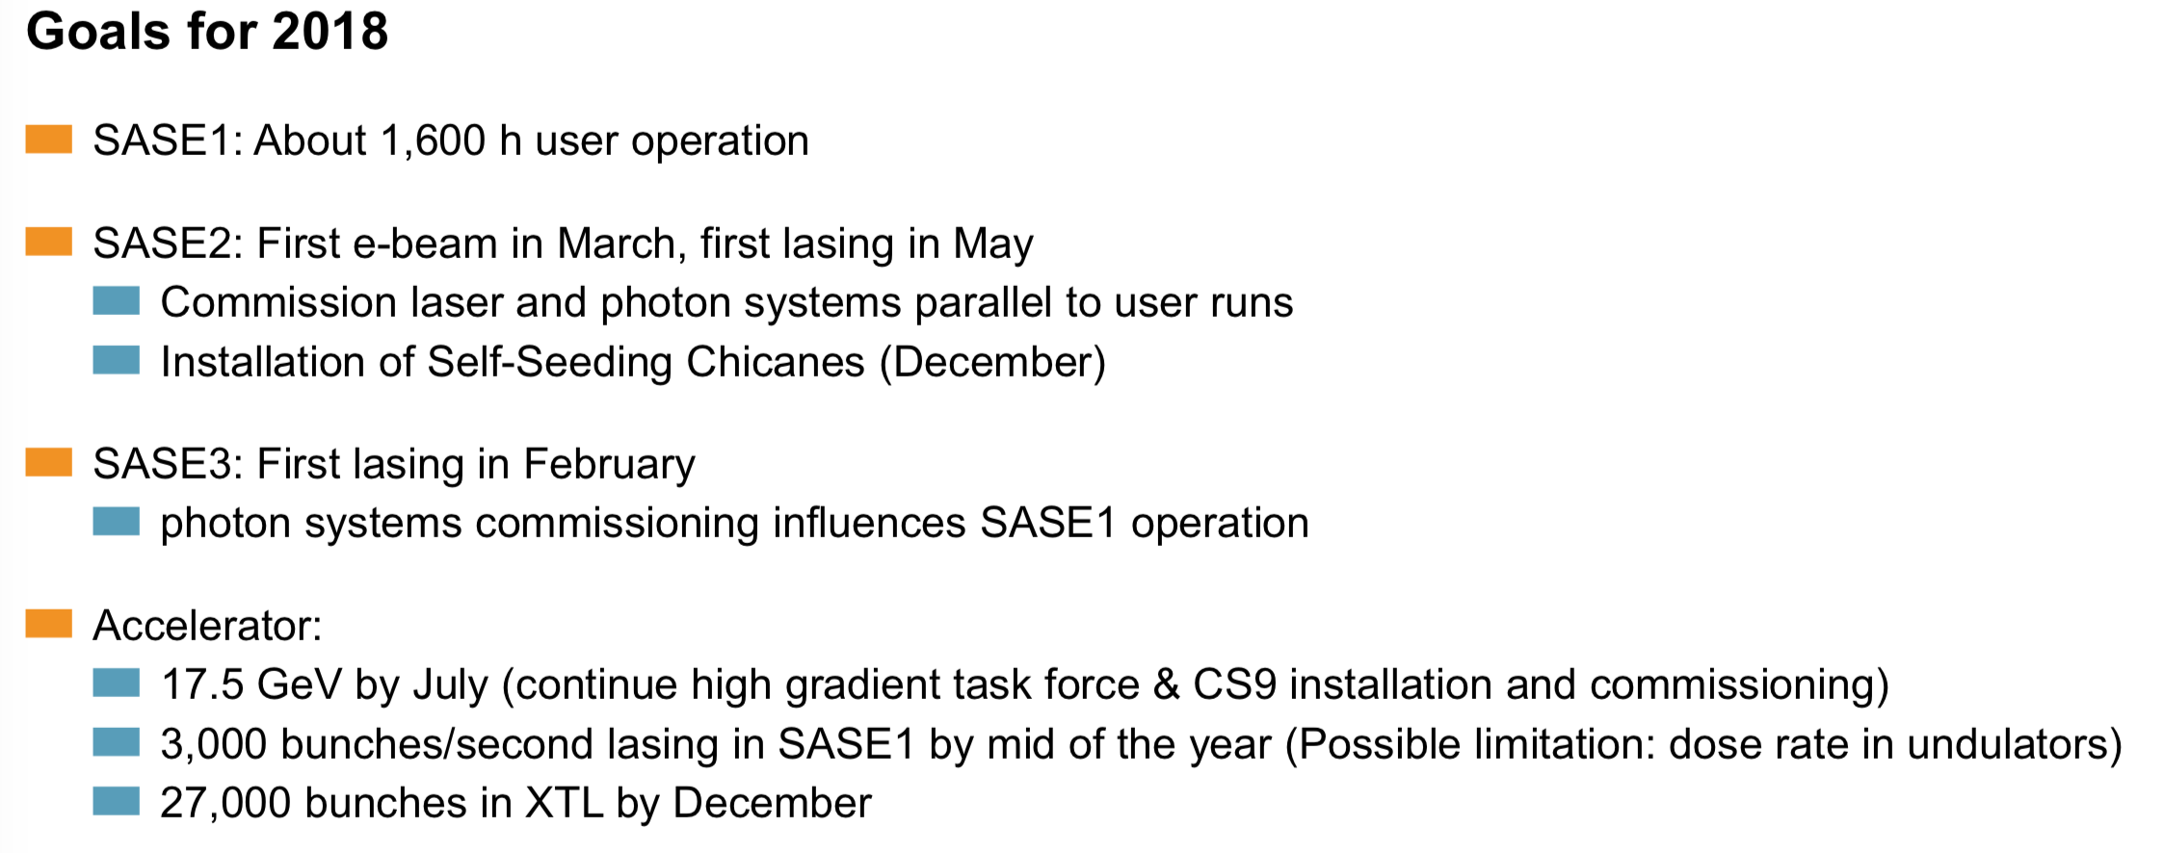
The European XFEL
Goals for 2018

Slide 25
Topics
The European Strategy Update Process
News from the European XFEL
Other SRF activities in Europe
The ILC European Action Plan

Slide 26
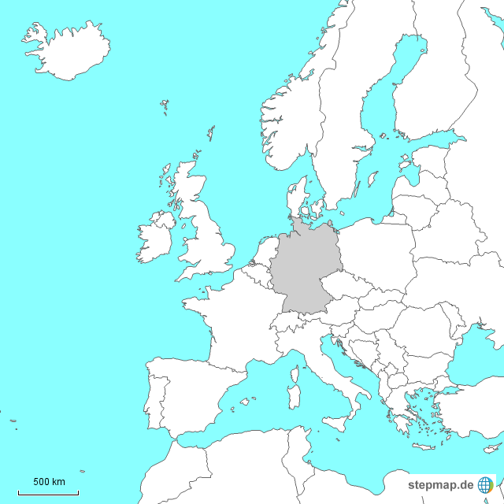
SCRF Developments in Europe
Overview
Projects
  European XFEL (DESY, +800 cavities)
  European Spallation Source (146)
  ELBE / HZDR (SRF gun R&D)
  BERLinPro (HZB): SRF ERL for accelerator
  R&D (gun, beam dynamics)
  SCRF accelerators at universities
  (Darmstadt, Mainz, Bonn, …)
Partners
  CEA Saclay, LAL Orsay, IRFU
  Uppsala U, Aarhus U
  INFN Milano
  STFC Daresbury
  Wroclaw U, IFJ
  +50 other
Notes:
Only Large Scale Projects and their R&D relevant for ILC
SRF Accelerator at Universities: Ausbildung neuer Physiker / SRF Nachwuchs
Partners named: Major SRF Contributions fuer XFEL / ESS (Coupler, Cavities, Tests, Module, Montage, Industriekontrolle,…)
Insgesamt 50 (davon ca. 40 in EU) andere Beitraege (Magnete, Diagnostics,…)

Slide 27
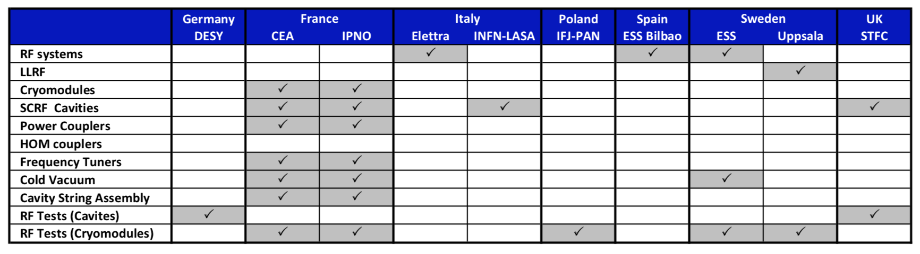
News from ESS
European Spallation Source, Lund (Sweden)
ESS: Neutron-source facility under construction in Lund
Size comparable to European XFEL, similar institutions and industries involved.
First beam from the medium-beta section in 2019; first 2 GeV beams 2022
Plan: Produce 5 MW average-power proton beams on spallation target.
Proton driver; SCRF linac with 62.5 mA proton beam pulsed with 4% duty cycle to 2 GeV.
Cold linac involves three families of cryomodules with 704 MHz RF resonators
Number of cryomodules / cavities much smaller than for European XFEL; but complexity, high input power and maximum cavity surface fields make project extremely challenging.
Responsibility matrix for the cryomodule production and testing for the ESS
Notes:
Only Large Scale Projects and their R&D relevant for ILC
SRF Accelerator at Universities: Ausbildung neuer Physiker / SRF Nachwuchs
Partners named: Major SRF Contributions fuer XFEL / ESS (Coupler, Cavities, Tests, Module, Montage, Industriekontrolle,…)
Insgesamt 50 (davon ca. 40 in EU) andere Beitraege (Magnete, Diagnostics,…)

Slide 28
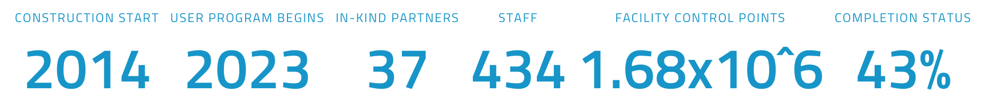
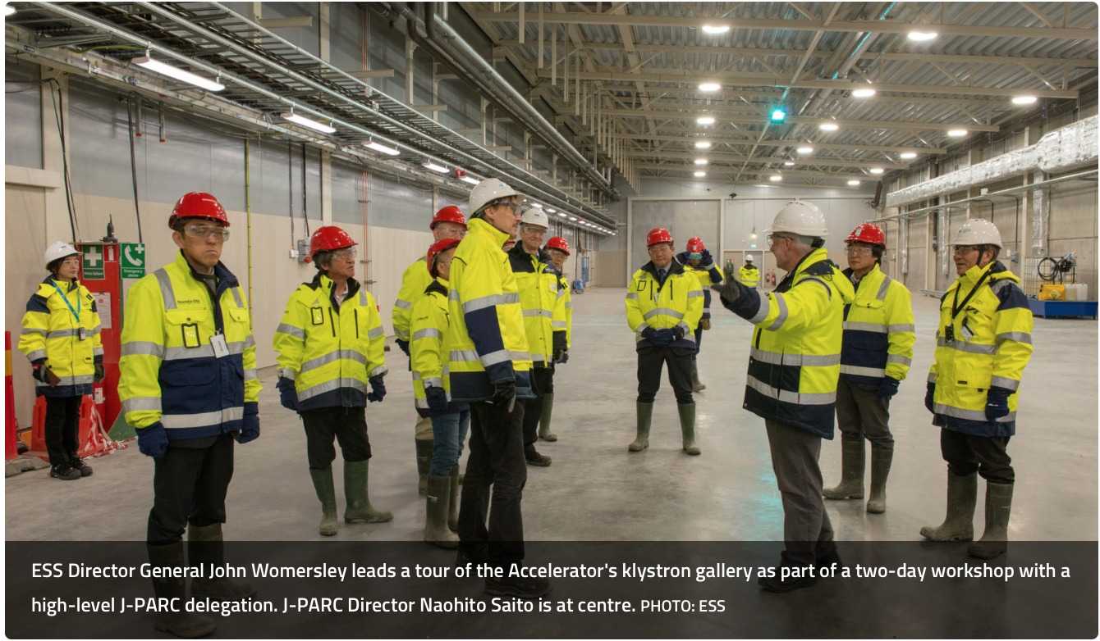
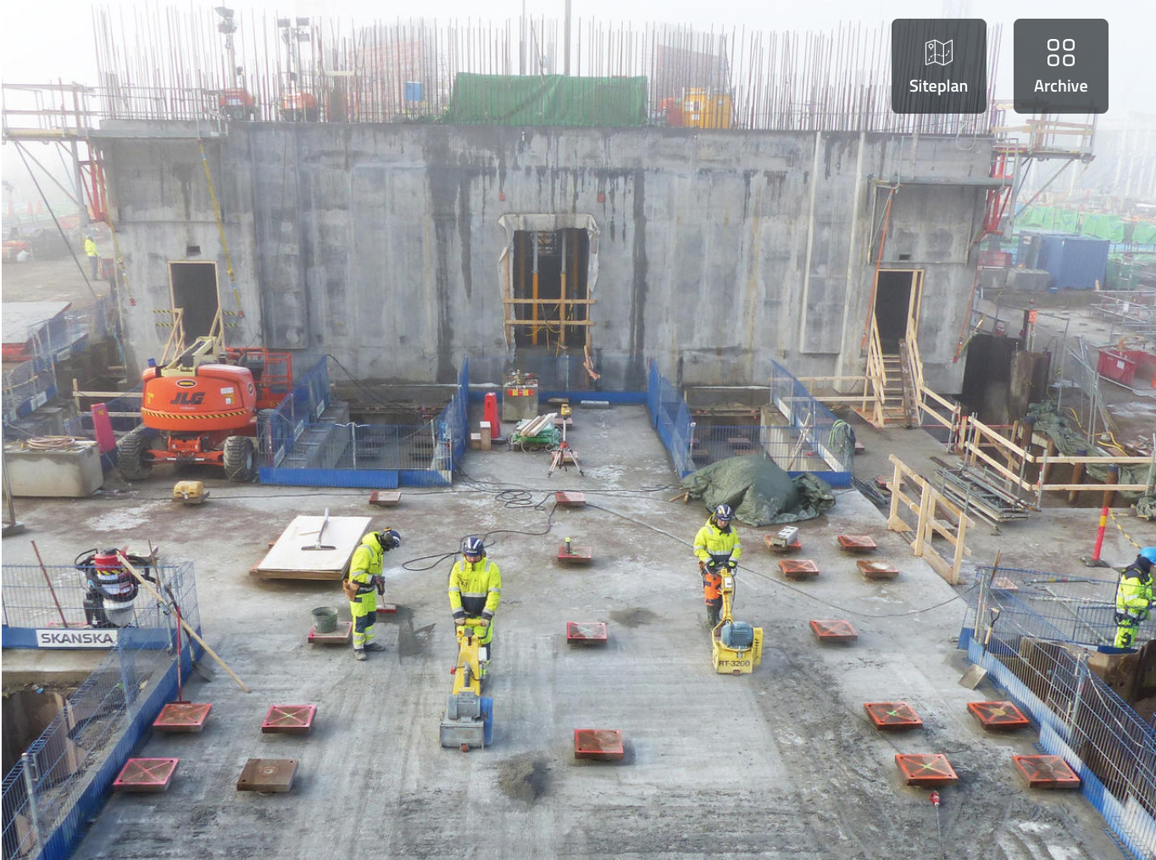
News from ESS
European Spallation Source, Lund (Sweden)
Memomrandum of Collaboration with J-PARC; common
workshop in Feb. 2018
Construction progressing well; new SRF installations in
Sweden and UK further anhancing Europe‘s SRF capabilities

Slide 29
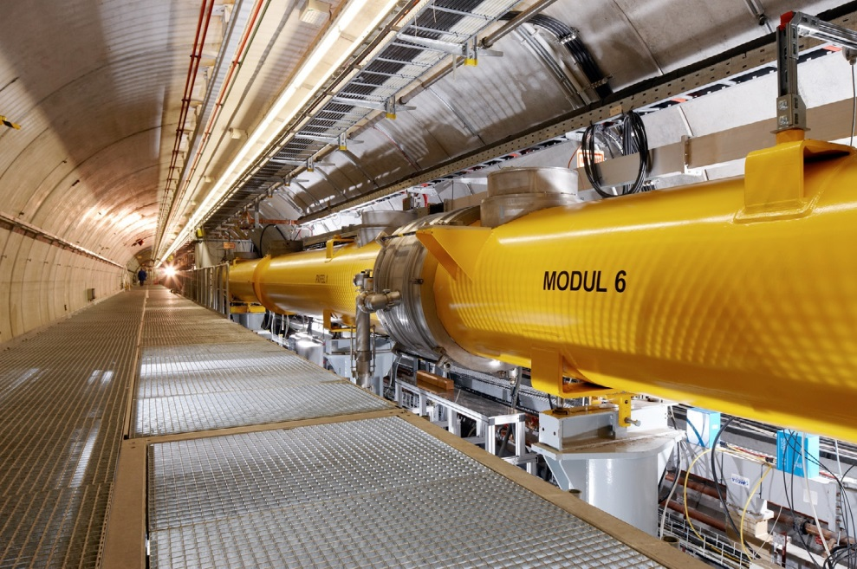
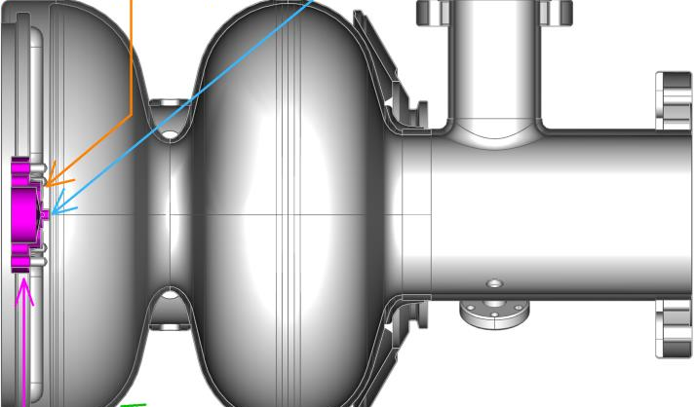
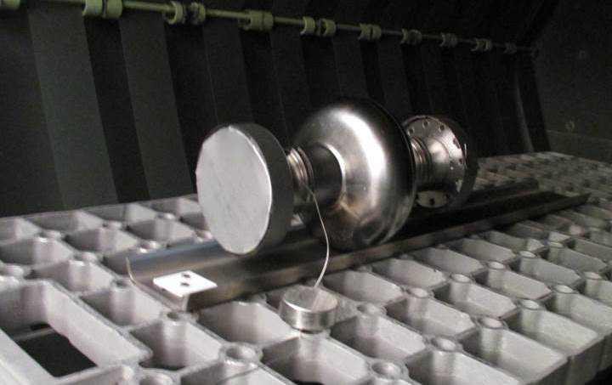
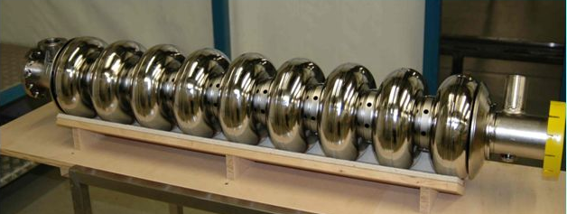
SCRF Developments at DESY
Only cavity R&D – no LLRF, couplers, cryomodules …
Project-based
  SRF gun
    Two guns produced (last week)
    XFEL upgrade for cw (long-term)
  FLASH upgrade
    Two modules exchanged
    One module: ILCHiGrade cavities
Fundamental R&D
  Infusion / doping: Nitrogen baking to reduce
  losses; cavity R&D - process parameter studies;
  sample R&D - material studies
  Large-grain studies: lower losses? Statistical
  analysis of cavity data, material studies
Notes:
Hab Probiert nur Cavity R&D zu nennen – ohne Rattenschwanz LLRF/Module etc.
Projektbasiert und Fundamental ist etwas vermischt, da beide ein Ziel teilen: CW Betrieb bei hohen Gradienten/Gueten
Organisatorisch ist die Trennung aber klar. Projekt: SRF Gun R&D fuer XFEL Upgrade (Kollaboration Berlin/Dresden) und FLASH Upgrade mit HiGrade Cavities
Fundamental: Large Grain/Infusion als potentielle Technologien fuer CW Upgrade; Large Grain geht es um das verstehen warum die besser sind – Infusion auch um das verstehen und vor allem welche Prozessparameter wichtig sind (reproduzierbarkeit!)
Bilder Zeigen: SRF 1.6 Cell Gun DESY Design
FLASH Tunnel
1st Cavity treated with infusion (failed due to contaminations)
DESY Large Grain Cavity – AC155 holds world record for highest gradient (45 MV/m) measured in 9cell cavity
2) Genau - Fine Grain (XFEL/FLASH) haben die Körner einen Durchmesser von d~50 micrometer, Large Grain haben d>2cm
3) KEK kann Infusion auch nicht reproduzieren, Doping schon. Doping machen wir nur Sample R&D, Materialanalysen um zu verstehen was passiert. Gedopte Cavities quenchen bei 20-24 MV/m und der Gradient ist zu niedrig fuer FLASH/XFEL Upgrades. Infusion haben wir zwei Cavities behandelt und sind deutlich schlechter geworden - ähnlich wie KEK. Cornell/JLAB haben es reproduziert, allerdings hat FNAL jetzt bei einem Ofen auf einmal auch Probleme. Fazit: Die bekannten Prozessparameter charakterisiert die notwendige Prozedur noch nicht vollständig. Der Ofen ist der Schluessel, daran arbeiten wir (auch zusammen mit KEK, speziell ich mit Kensei Umemori).
4) Genau: Höchster Gradient OHNE Infusion ist AC155 bei ILC Güte (1x10^10). Unser bestes XFEL Cavity CAV00725 ist sogar in Güte besser als die besten Infused cavities von FNAL, in max. Gradient gleich. Also weltbestes Cavity haben wir in den XFEL gebaut! ABER: Infusion macht 'schlechte' Cavities besser - mit schlechte meine ich aber auch schon gute Cavities.

Slide 30
Topics
The European Strategy Update Process
News from the European XFEL
Other SRF uses in Europe
The ILC European Action Plan

Slide 31
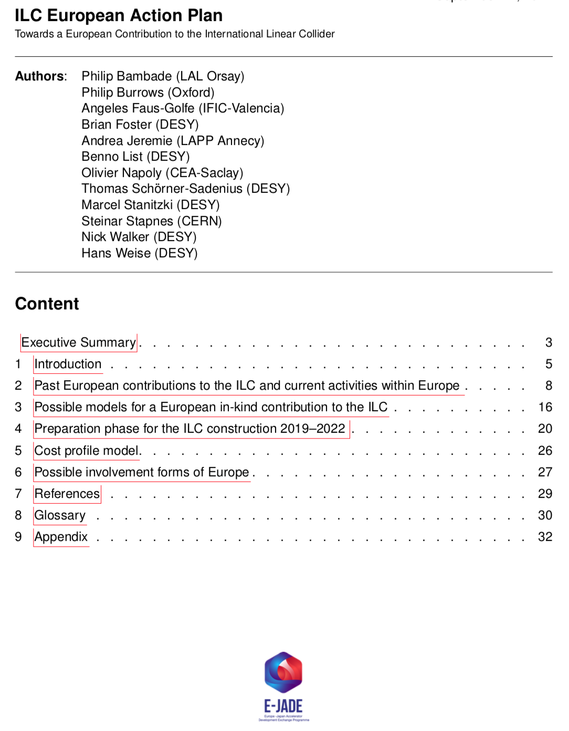
The European Action Plan
Towards defining a European contribution to the ILC?
The ILC EAP was originially requested by Okada-san,
as a complement to the KEK action plan.
Getting an overview of who in Europe could / might want to do
what in case of ILC greenlight.
History and contents:
Request to CERN management, passed on to E-JADE
Preparation of document since about 1 year.
Long version based on some sharing model presented to
CERN management; positive reaction
  Detailed discussion of possible contributions during pre-
  preparatory phase, preparatory phase, and construction.
Currently preparing shorter version without details
i.e. no models for cost and IKC sharing with European
countries – don’t want to prejudice the funding agencies
To be ready by Easter
Long version as input for European strategy update process

Slide 32
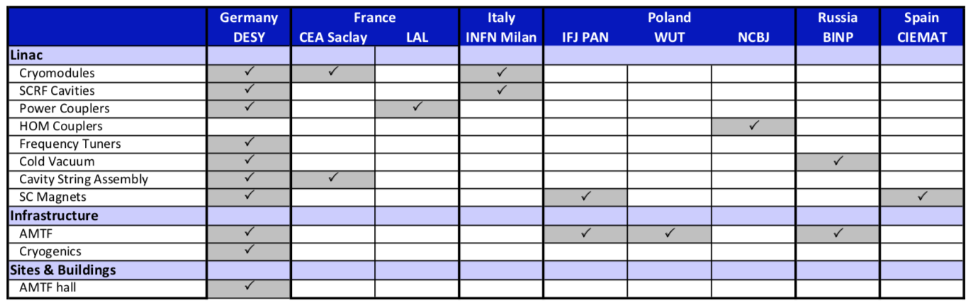
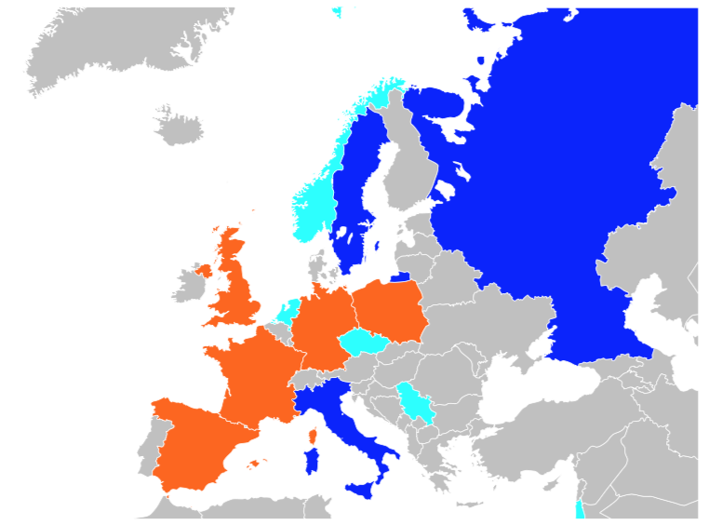
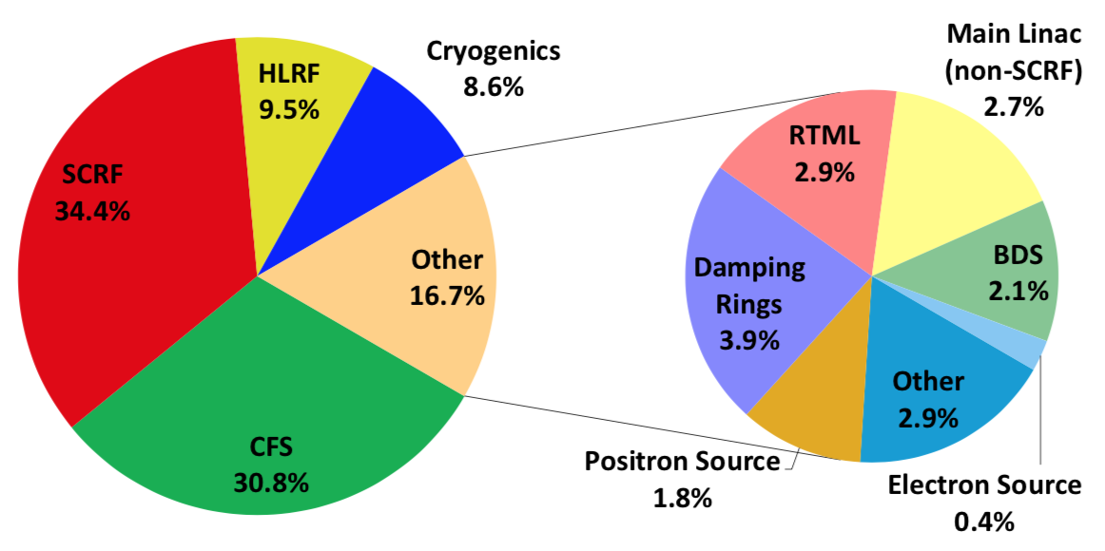
The ILC European Action Plan
Information contained in the EAP
Responsibility matrix for cryomodule production and testing for the European XFEL
European countries with ILC-related activities
(blue: acc., cyan: det., red: both)
Long version potentially (given political will) also containing
models for cost sharing and cost profile
concrete ideas for European contributions (mainly key R&D
issues) during 4-year preparatory phase
discussion of concrete forms of European involvement
…
Primary cost drivers for the ILC
(breakdown based on ILCU)

