Slide 1
The SDHCAL transportation issue
I.Laktineh

Slide 2
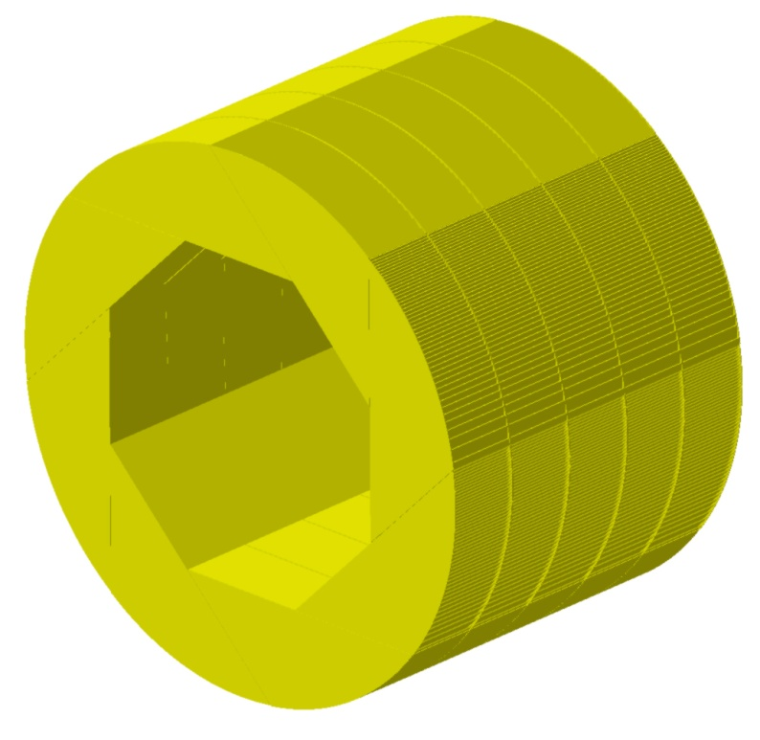
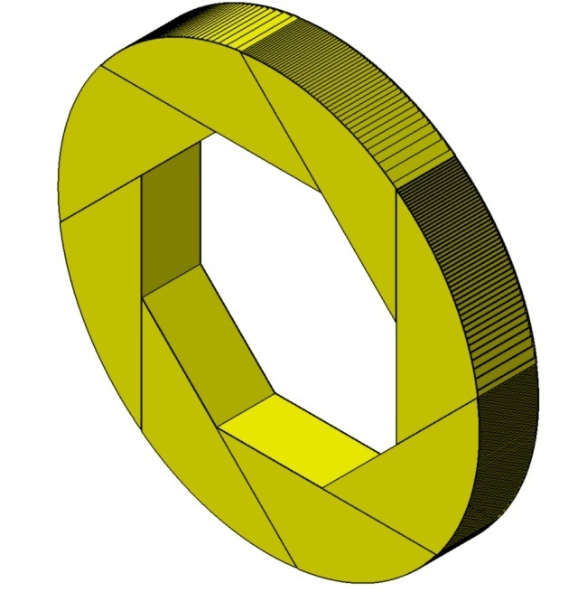
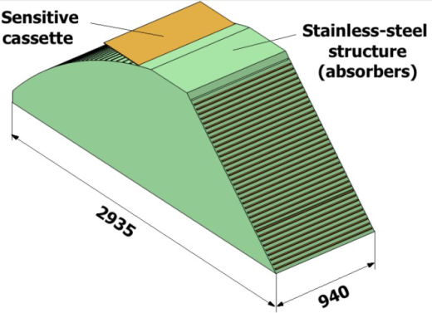
Barrel design
Ext. Diameter 6770 mm
Int. Diameter 4116 mm
Lenght 4700 mm
Thickness wheel face = 10 mm
Thickness absorbers= 15 mm
Ext. Diameter : 6770 mm
Int. Diameter :4116 mm
Lenght : 940 mm
x8
Stainless steel 1 wheel (8 mod.) 5 wheels
Weight (t): 88 t 440 t
Detectors W. (t): 36.8 t 184 t
Total Weight (t) : 124.8 t 624 t
1 module Barrel without detector 11 t→ no transportation problem

Slide 3
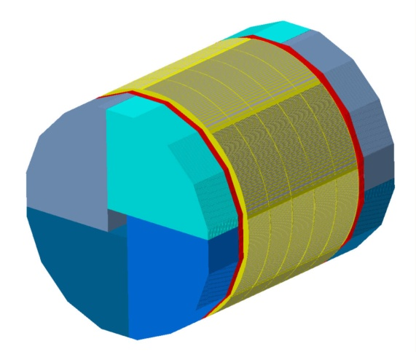
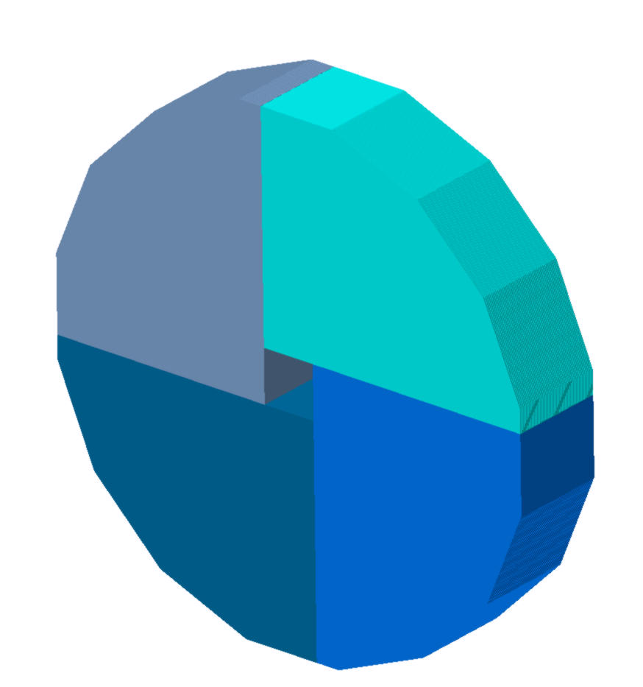
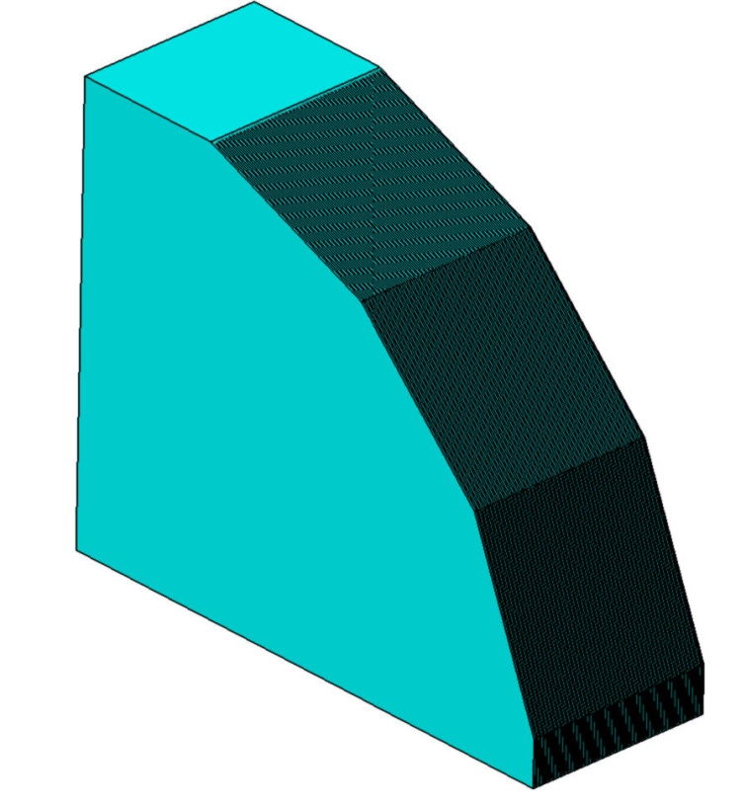
End caps design
8 sides -> 16 sides
Encap : 48 detectors
Endcap
2 endcaps
Material : stainless steel
Welded structure
Idem barrel
One module
Module Weight : 50 t
Detectors weight : 22.5 t
Total weight : 72.5 t
One endcap made of 4 modules
Endcap Weight : 200 t
Detectors weight : 90 t
Total weight : 290 t
1 module Endcap without detector 50 t→ a transportation problem

Slide 4
Solutions?
No matter the scenario the insertion of the detectors will take place on the ILC site:
Exceptional transportations for the 8 Endcap modules
Build half modules (25 t each + lorry weight) or three parts (16.5 t each + lorry weight) and assemble them two by two or three by three on site using standard welding
The second solution may reduce the total Endcap mechanical structure rigidity and could be a problem in case of an earthquake but this may be studied
Our favourite solution is to have robust roads capable to support the transportation of heavy pieces. These roads are probably needed to transportation the digging machine …

