Slide 1
Megatiles Studies
13.12.17 – CALICE AHCAL Main meeting
JGU Mainz – Marisol Robles
Volker Büscher, Phi Chau, Reinhold Degele, Karl-Heinz Geib, Sascha Krause, Yong Liu, Lucia Masetti, Anna Rosmanitz, Ulrich Schäfer, Stefan Tapprogge

Slide 2
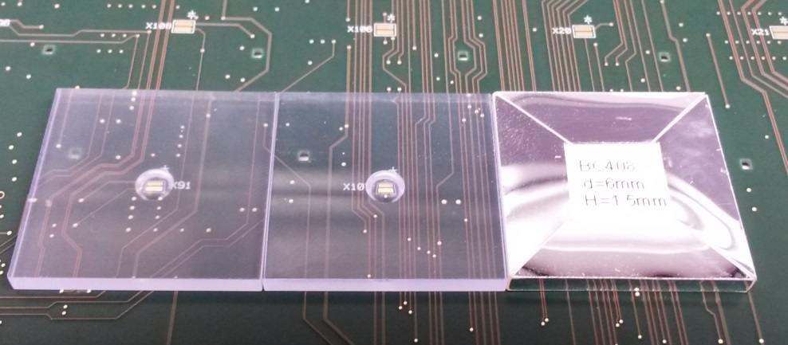
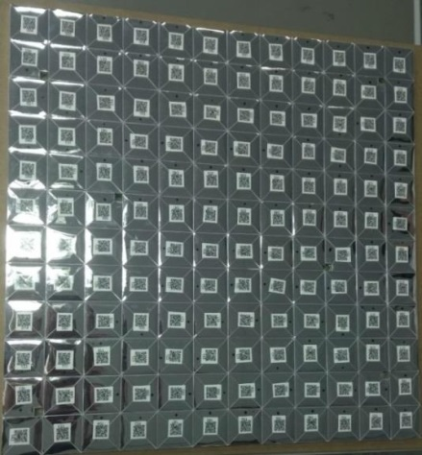
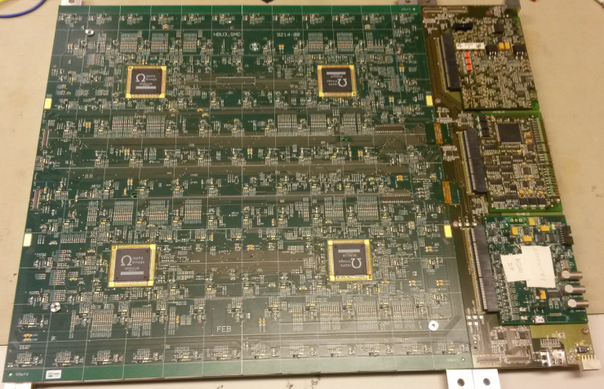
Design for AHCAL mass assembly
Reflective foil
SiPM
Scintillator Tile
Surface-mount tile design (Uni-Mainz)
  Suitable for mass assembly
  Optimized with Geant4 full simulation for response uniformity
PCB
  1st board built successfully in 2014
  6 boards assembled in 2016
  32 new HBU assembled in 2017 (Phi Chau’s talk)
  Baseline design for the AHCAL technological prototype
1st Mainz SMD-HBU with DESY
Further simplify mass assembly?
SMD-HBU: Bottom View
SMD-HBU: Top View
Y. Liu et al, IEEE NSS 2014
DOI: 10.1109/NSSMIC.2014.7431118

Slide 3

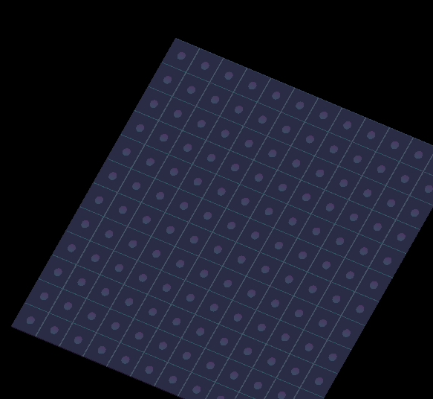
Overview: megatile
Motivations: further simplify mass assembly
  Scintillator plates with embedded structures
  Optically isolated for individual readout
Structure optimized by Geant4 simulation
  MIP response, cell-to-cell crosstalk

Slide 4
Megatile: production procedure
Trenches only in the bottom
4~6 mm
Optical trench
(TiO2+glue)
Scintillator Plate
Fill in glue+TiO2,
Mill down to 3mm
3.0 mm
Optical trench
(TiO2)
Reflective Foil (ESR)
Assembly:
SiPM and foil
Optical trench
(TiO2)
3.0 mm
SMD-SiPM
Trench schematics (side view): not to scale

Slide 5
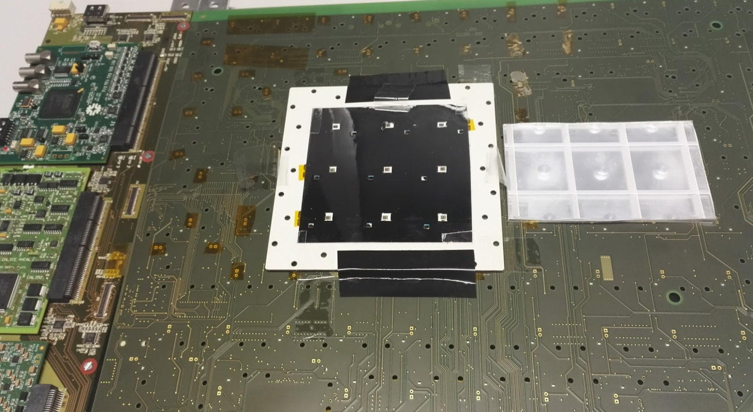
Test stand: HBU + megatile adapter board
Spare HBU3: originally designed for SiPMs with pins (THT-SiPMs)
  Megatile can not be directly measured
Megatile adapter board: white PCB for 3×3 SiPMs
  Equipped with 7 new SMD-SiPMs (Hamamatsu MPPCs)
  Connection between HBU3 and SMD-SiPMs: via pin connectors (directly plugged in)
Connected to the 7 channels in the 3rd ASIC
Spare HBU3 (without SiPMs)
by courtesy of DESY

Slide 6
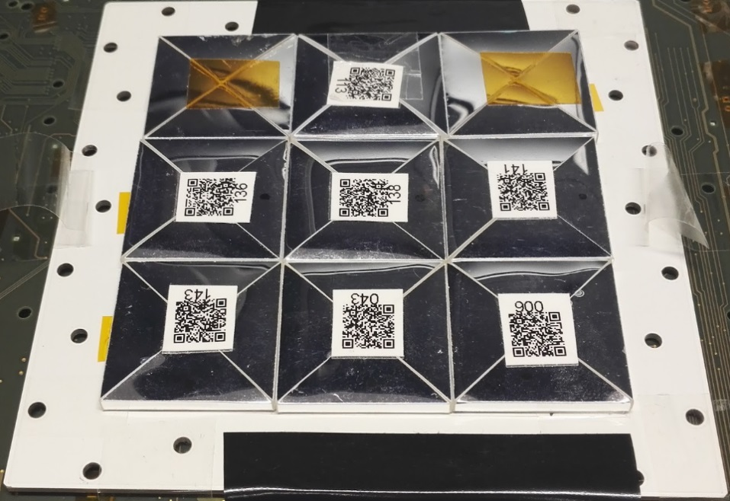
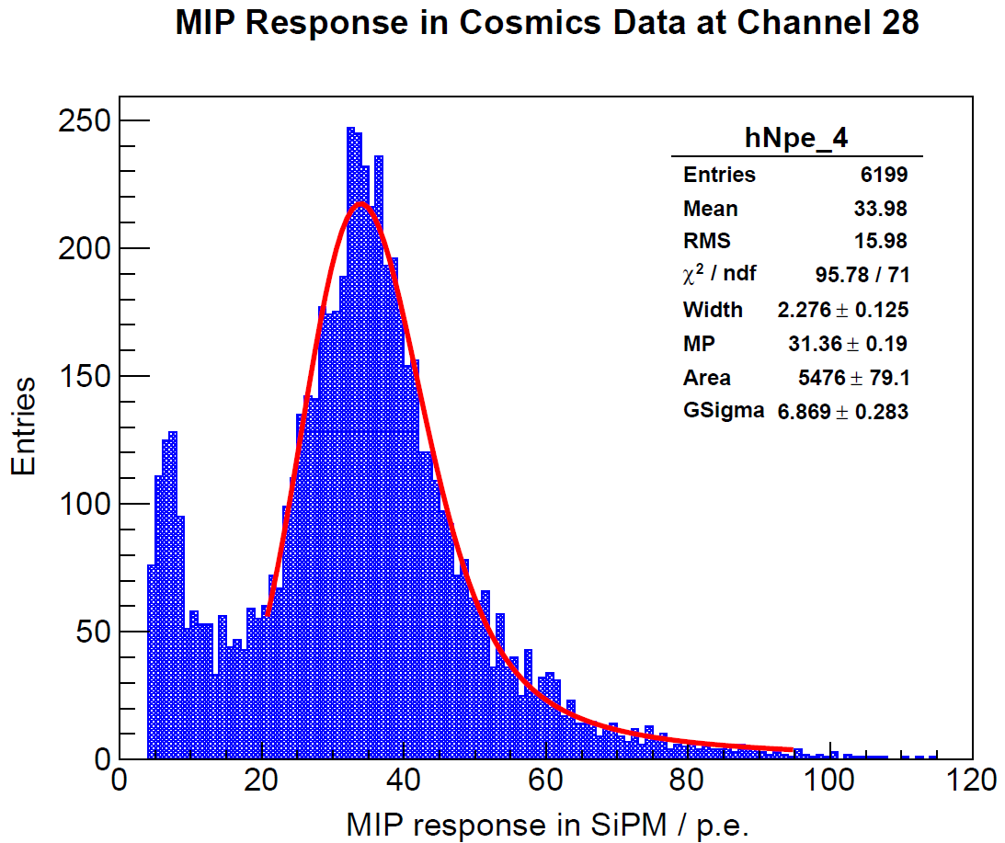
Cross check for megatile adapter board
Central tile:
37.4 p.e./MIP
Connected to the 7 channels in the 3rd ASIC
Adapter board: first time of testing with HBU
Cross check with individually wrapped tiles
  Spares (BC408) for 1st Mainz SMD-HBU in 2014
Cosmic-ray setup
  HBU validation: coincidence of 2 trigger scintillators
Most probable response: 37.4 p.e./MIP
  SiPMs operated with overvoltage of ~ 5.0 V
  Consistent with previous SMD-HBU measurements
Idea of megatile adapter board is verified with HBU
Spare HBU3 (without SiPMs)
by courtesy of DESY

Slide 7
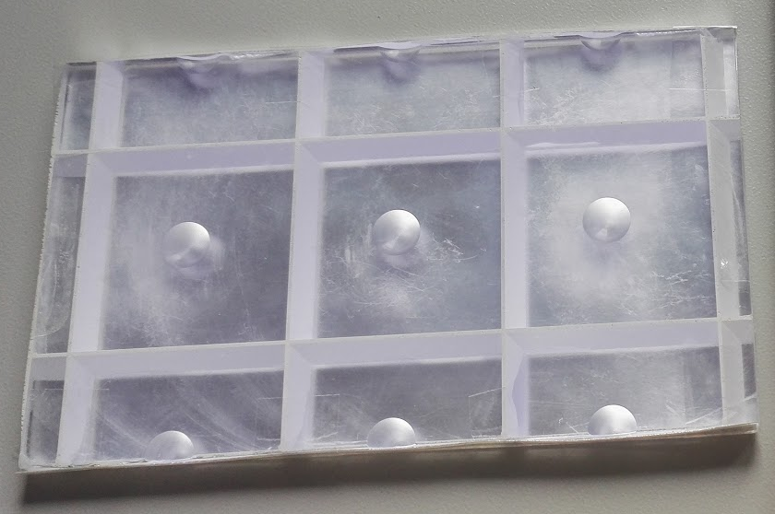
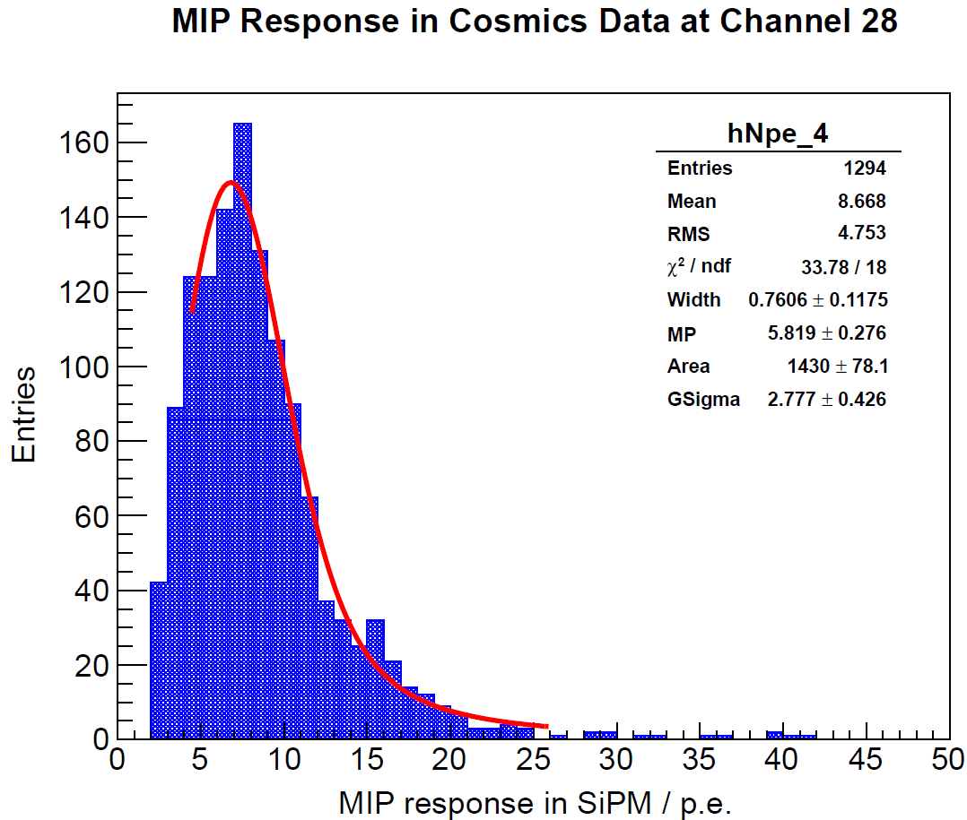
Megatile: 1st prototype
Central cell:
5.8 p.e./MIP
Connected to the 7 channels in the 3rd ASIC
DF2000MA foil on top surface and sides
1st megatile prototype: scintillator strip
  Geometry: not a full 3×3 megatile
    Constrained by original long strips (6 cm wide)
  PS-based scintillator: ~ 60% of intrinsic light yield of BC408
  Surface treatment: not good enough (scratches on the surface)
Most probable response: 5.8 p.e./MIP
  Though not high in amplitude, MIP signals can still be seen
    Benefit from low-noise SiPMs
Spare HBU3 (without SiPMs)
by courtesy of DESY

Slide 8
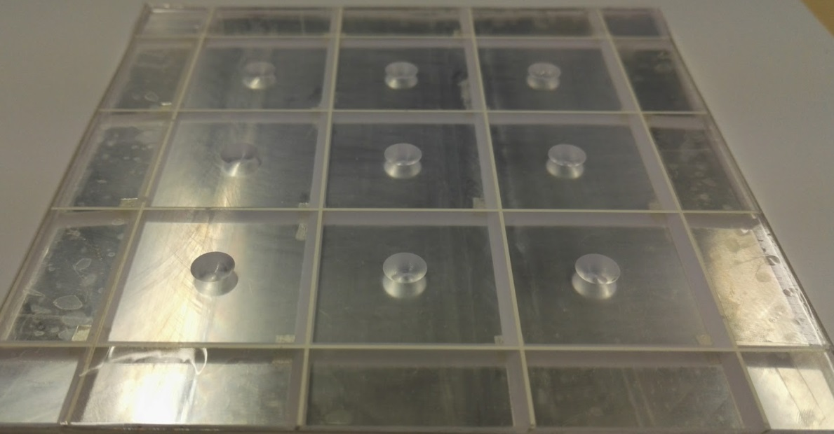
Megatile: 2nd prototype
Central cell:
31.4 p.e./MIP
Connected to the 7 channels in the 3rd ASIC
DF2000MA foil on top surface and 4 sides
DF2000MA foil on top surface and sides
2nd megatile prototype: scintillator plate
  Geometry: full 3×3 megatile (trenches tilted by 30°)
  PVT-based scintillator: intrinsic light yield comparable to BC412
  Better surface treatment
Most probable response: 31.4 p.e./MIP
  Good S/N ratio achieved
  Performance comparable to individually wrapped tiles
Spare HBU3 (without SiPMs)
by courtesy of DESY

Slide 9

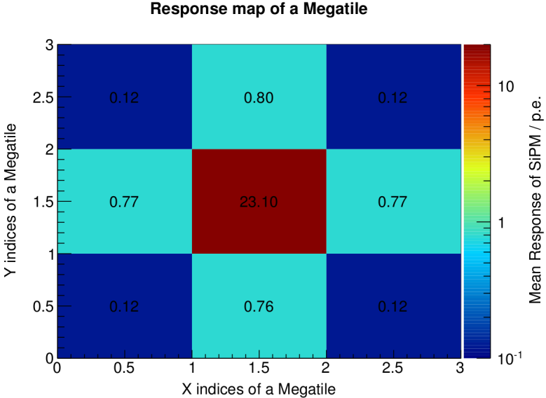
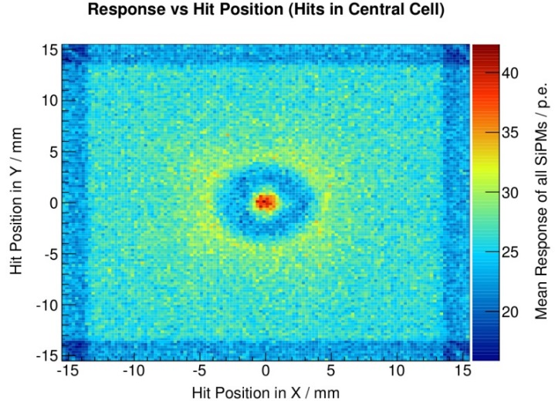
Megatile: full simulation with muons
Geant4 v9.6p02
Megatile geometry
  Size: 90×90×3 mm³ (3×3 cells)
  Trenches tilted by 45°, 0.5 mm wide
    Filled by white paint (diffuse reflector)
  Top & bottom surface covered by
    ESR foil: specular reflector
Response maps
  Mean SiPM response in a cell
    Cell indices
    Muon hit positions (within central cell)
Connected to the 7 channels in the 3rd ASIC
DF2000MA foil on top surface and 4 sides
DF2000MA foil on top surface and sides
Muon incidence always
perpendicular to megatile
Megatile with tilted trenches: minimal dead area
Spare HBU3 (without SiPMs)
by courtesy of DESY

Slide 10
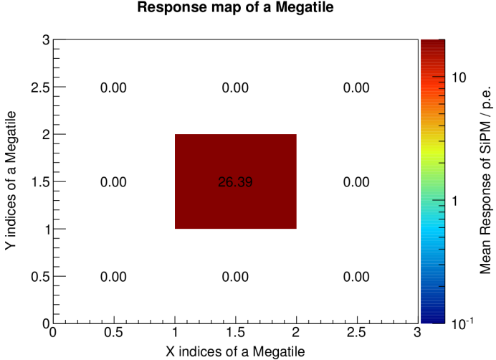

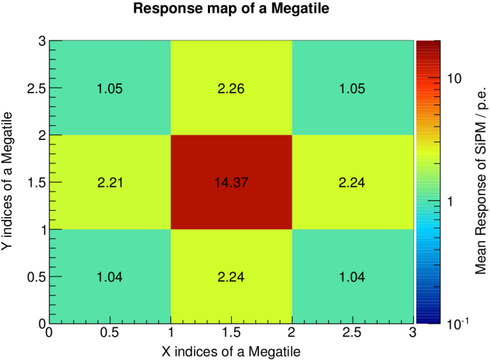
Crosstalk simulation: impact from air gaps
In reality reflective foil can not be completely flat (esp. in large scale)
  Air gap thickness vary between top/bottom surfaces and megatile
In simulation, airgap thickness is varied
  Still assumed perfectly flat; easier to model
Air Gap: 5 µm
Air Gap: 200 µm
Air Gap: 1 mm
Crosstalk: 0.0%
Crosstalk: 3.5%
Crosstalk: 15.7%
Low crosstalk expected by simulation with muons;
by thinning air gaps, crosstalk can be close to 0
Wildest assumption only to check the extreme case

Slide 11
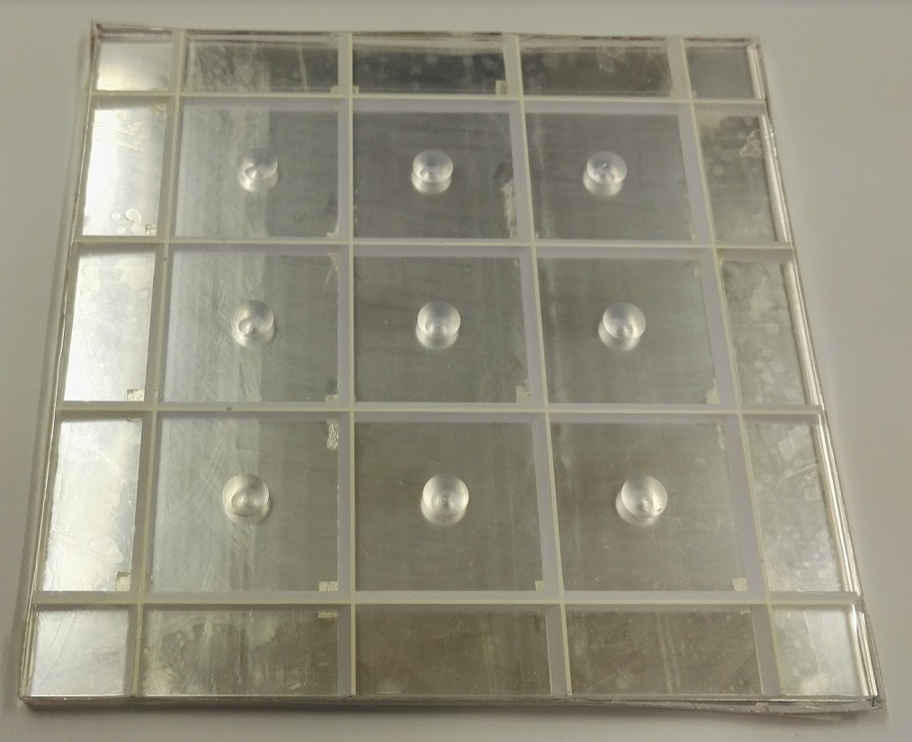
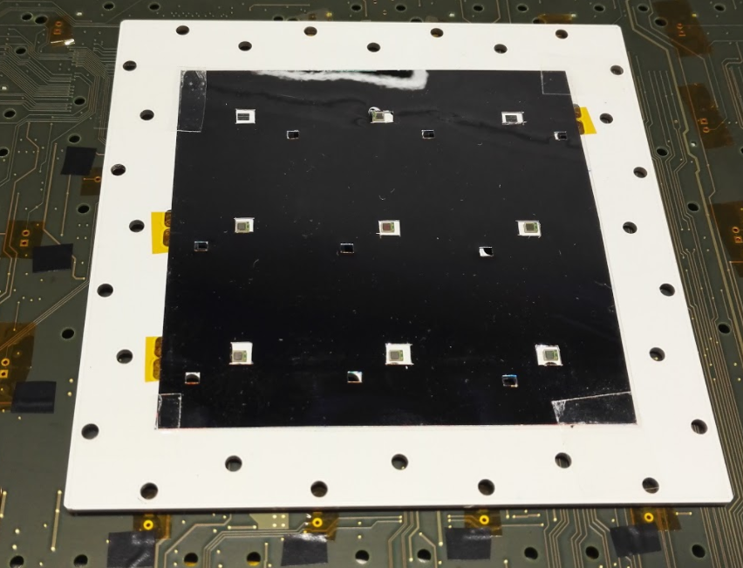
Megatile crosstalk: setup
  Need large signals to produce prominent optical crosstalk
    Especially important for this low-crosstalk megatile design
  Use on-board LED
  Problem: all LEDs will shine
    Can not disable LED channel-wise in slow control (LabView)
  Solution: cover unnecessary LED holes with thick black tape
    Uncertainty: how well the black tape stop photons when LED light is strong
    Simulation followed to understand the uncertainty

Slide 12
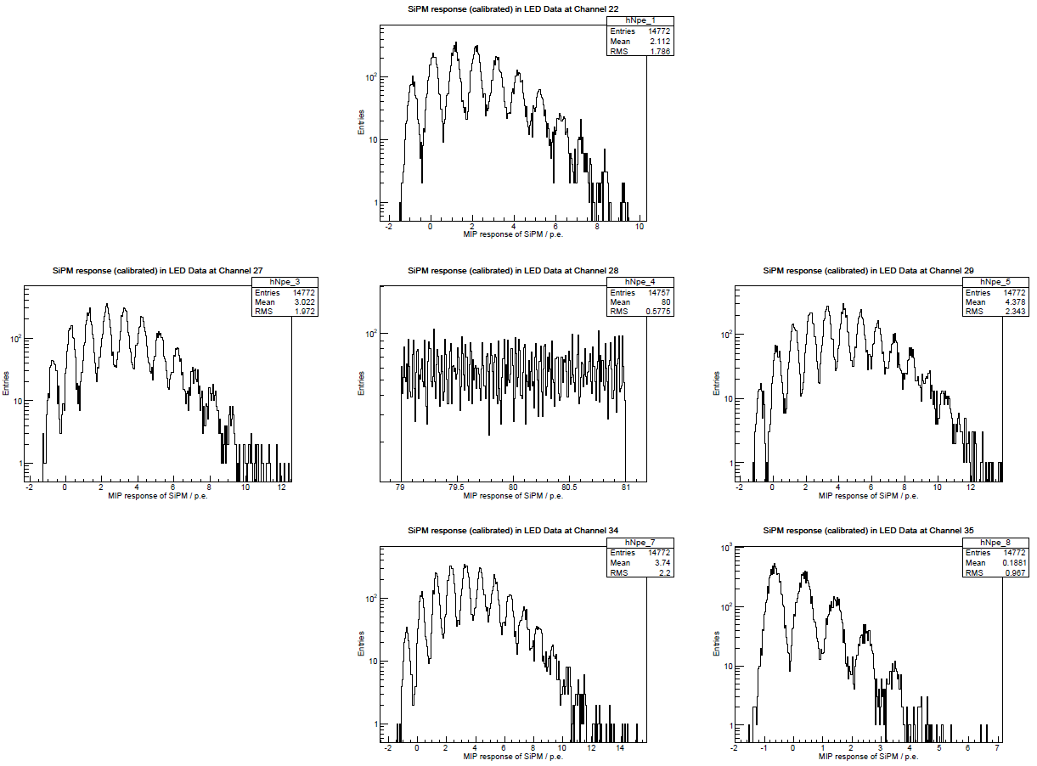
Crosstalk measurements: SiPM responses
LED data in external trigger
Pedestal corrected
  Using pedestal runs with VCalib=0 mV
Central cell
  Select events with SiPM response 80±1 p.e.
Neighboring cells
  Similar to single photon spectrum
  Pedestal decreases due to strong signals in the center
  Pedestal shift: < 1 p.e.
  Mean: 2.1 ~ 4.4 p.e. (excluding pedestal shift)
No SiPM
No SiPM
2.1 p.e.
3.0 p.e.
80 p.e.
4.4 p.e.
No Signal
3.7 p.e.
0.19 p.e.
LED voltage: VCalib=6600 mV
SiPM: 5.0 V overvoltage

Slide 13
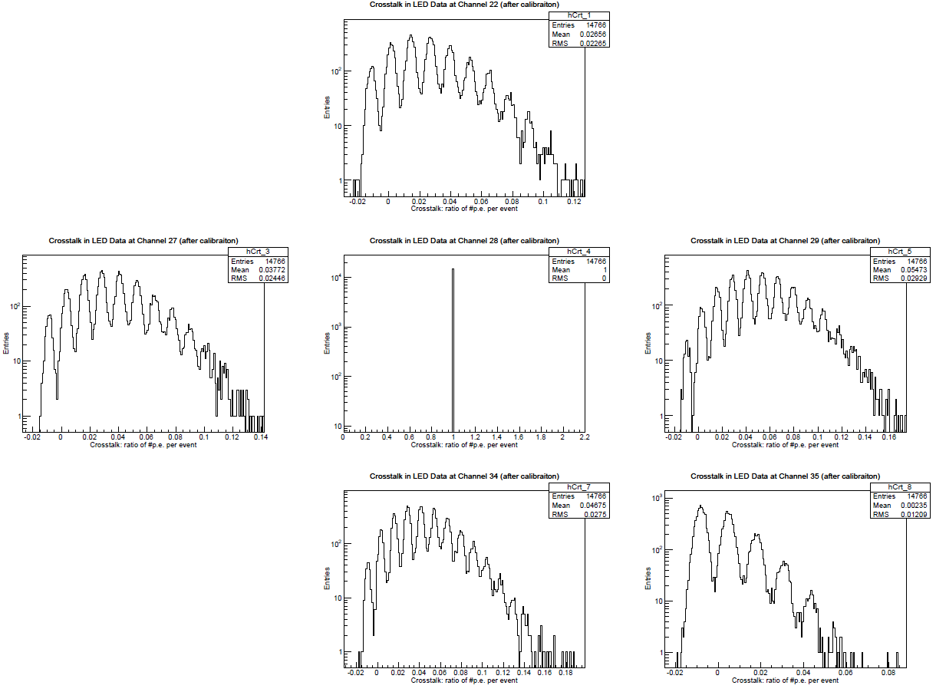
Crosstalk measurements: crosstalk
Same LED data
  Events with SiPM response 80±1 p.e.
Crosstalk
  SiPM response ratio of an outer cell and the center
  Calculated for each event
Neighboring cell crosstalk
  Mean: 2.7 ~ 5.5 % (excluding pedestal shift)
  Extra due to pedestal shift: 0.8 ~ 1.1%
No SiPM
No SiPM
2.7 %
3.8 %
5.5 %
No Signal
4.7 %
0.2 %
LED voltage: VCalib=6600 mV
SiPM: 5.0 V overvoltage

Slide 14
Crosstalk measurements: summary
Mean crosstalk measured with LED signals in the center
LED Voltage | Central cell | Ch22 (up) | Ch27 (left) | Ch34 (bottom) | Ch29 (right) | Ch35 (corner)
6550 mV | 50±1 p.e. | 4.4 % | 5.4 % | 6.3 % | 7.4 % | 1.2 %
 | 60±1 p.e. | 3.7 % | 4.5 % | 5.6 % | 6.3 % | 1.0 %
 | 70±1 p.e. | 3.3 % | 4.1 % | 5.0 % | 5.6 % | 0.9 %
6600 mV | 70±1 p.e. | 4.2 % | 5.2 % | 6.3 % | 7.3 % | 1.2 %
 | 80±1 p.e. | 3.8 % | 4.6 % | 5.6 % | 6.4 % | 1.1 %
 | 90±1 p.e. | 3.4 % | 4.2 % | 5.2 % | 5.8 % | 0.9 %
Pedestal shifts have been included
Crosstalk level in a few percentage in general
Inhomogeneous illumination: dependent on the LED position

Slide 15
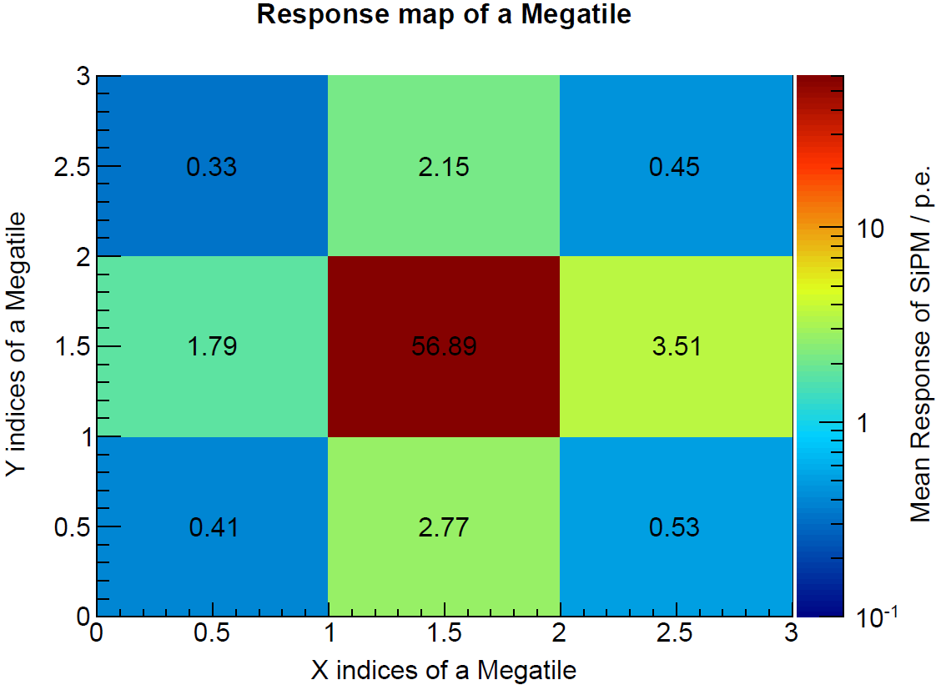
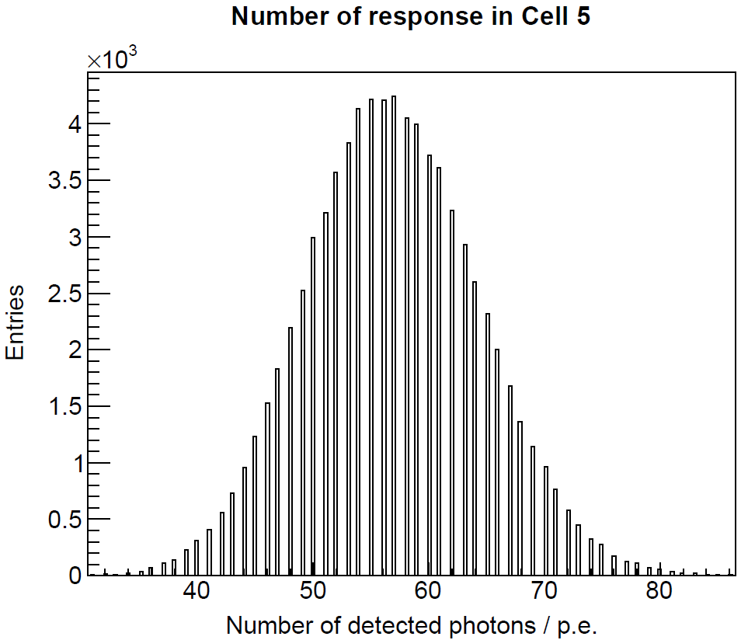
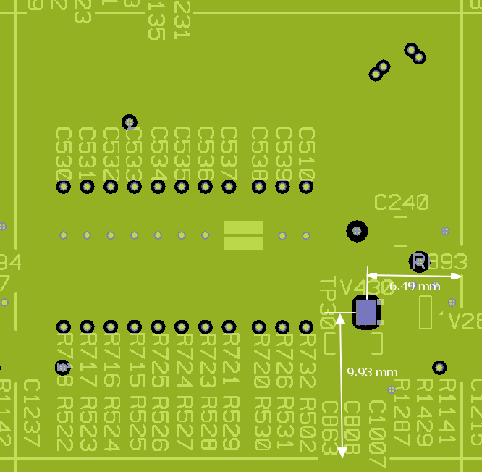
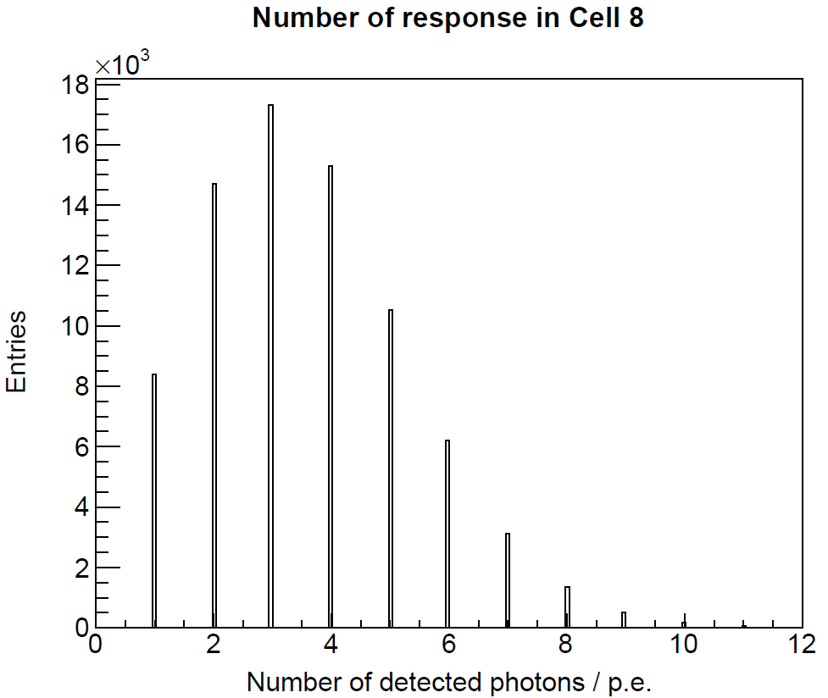
Simulation of LED illumination
Generate optical photons at same position as HBU-LED
  Simulate LED emission: wavelengths, angles (constrained by holes)
  Assumed megatile air gaps: 200 µm thick
Center:
56.9 p.e.
Crosstalk (mean value): 3.1 ~ 6.2 %
Similar crosstalk level to LED measurements
Right:
3.5 p.e.
More results in the backup slides

Slide 16
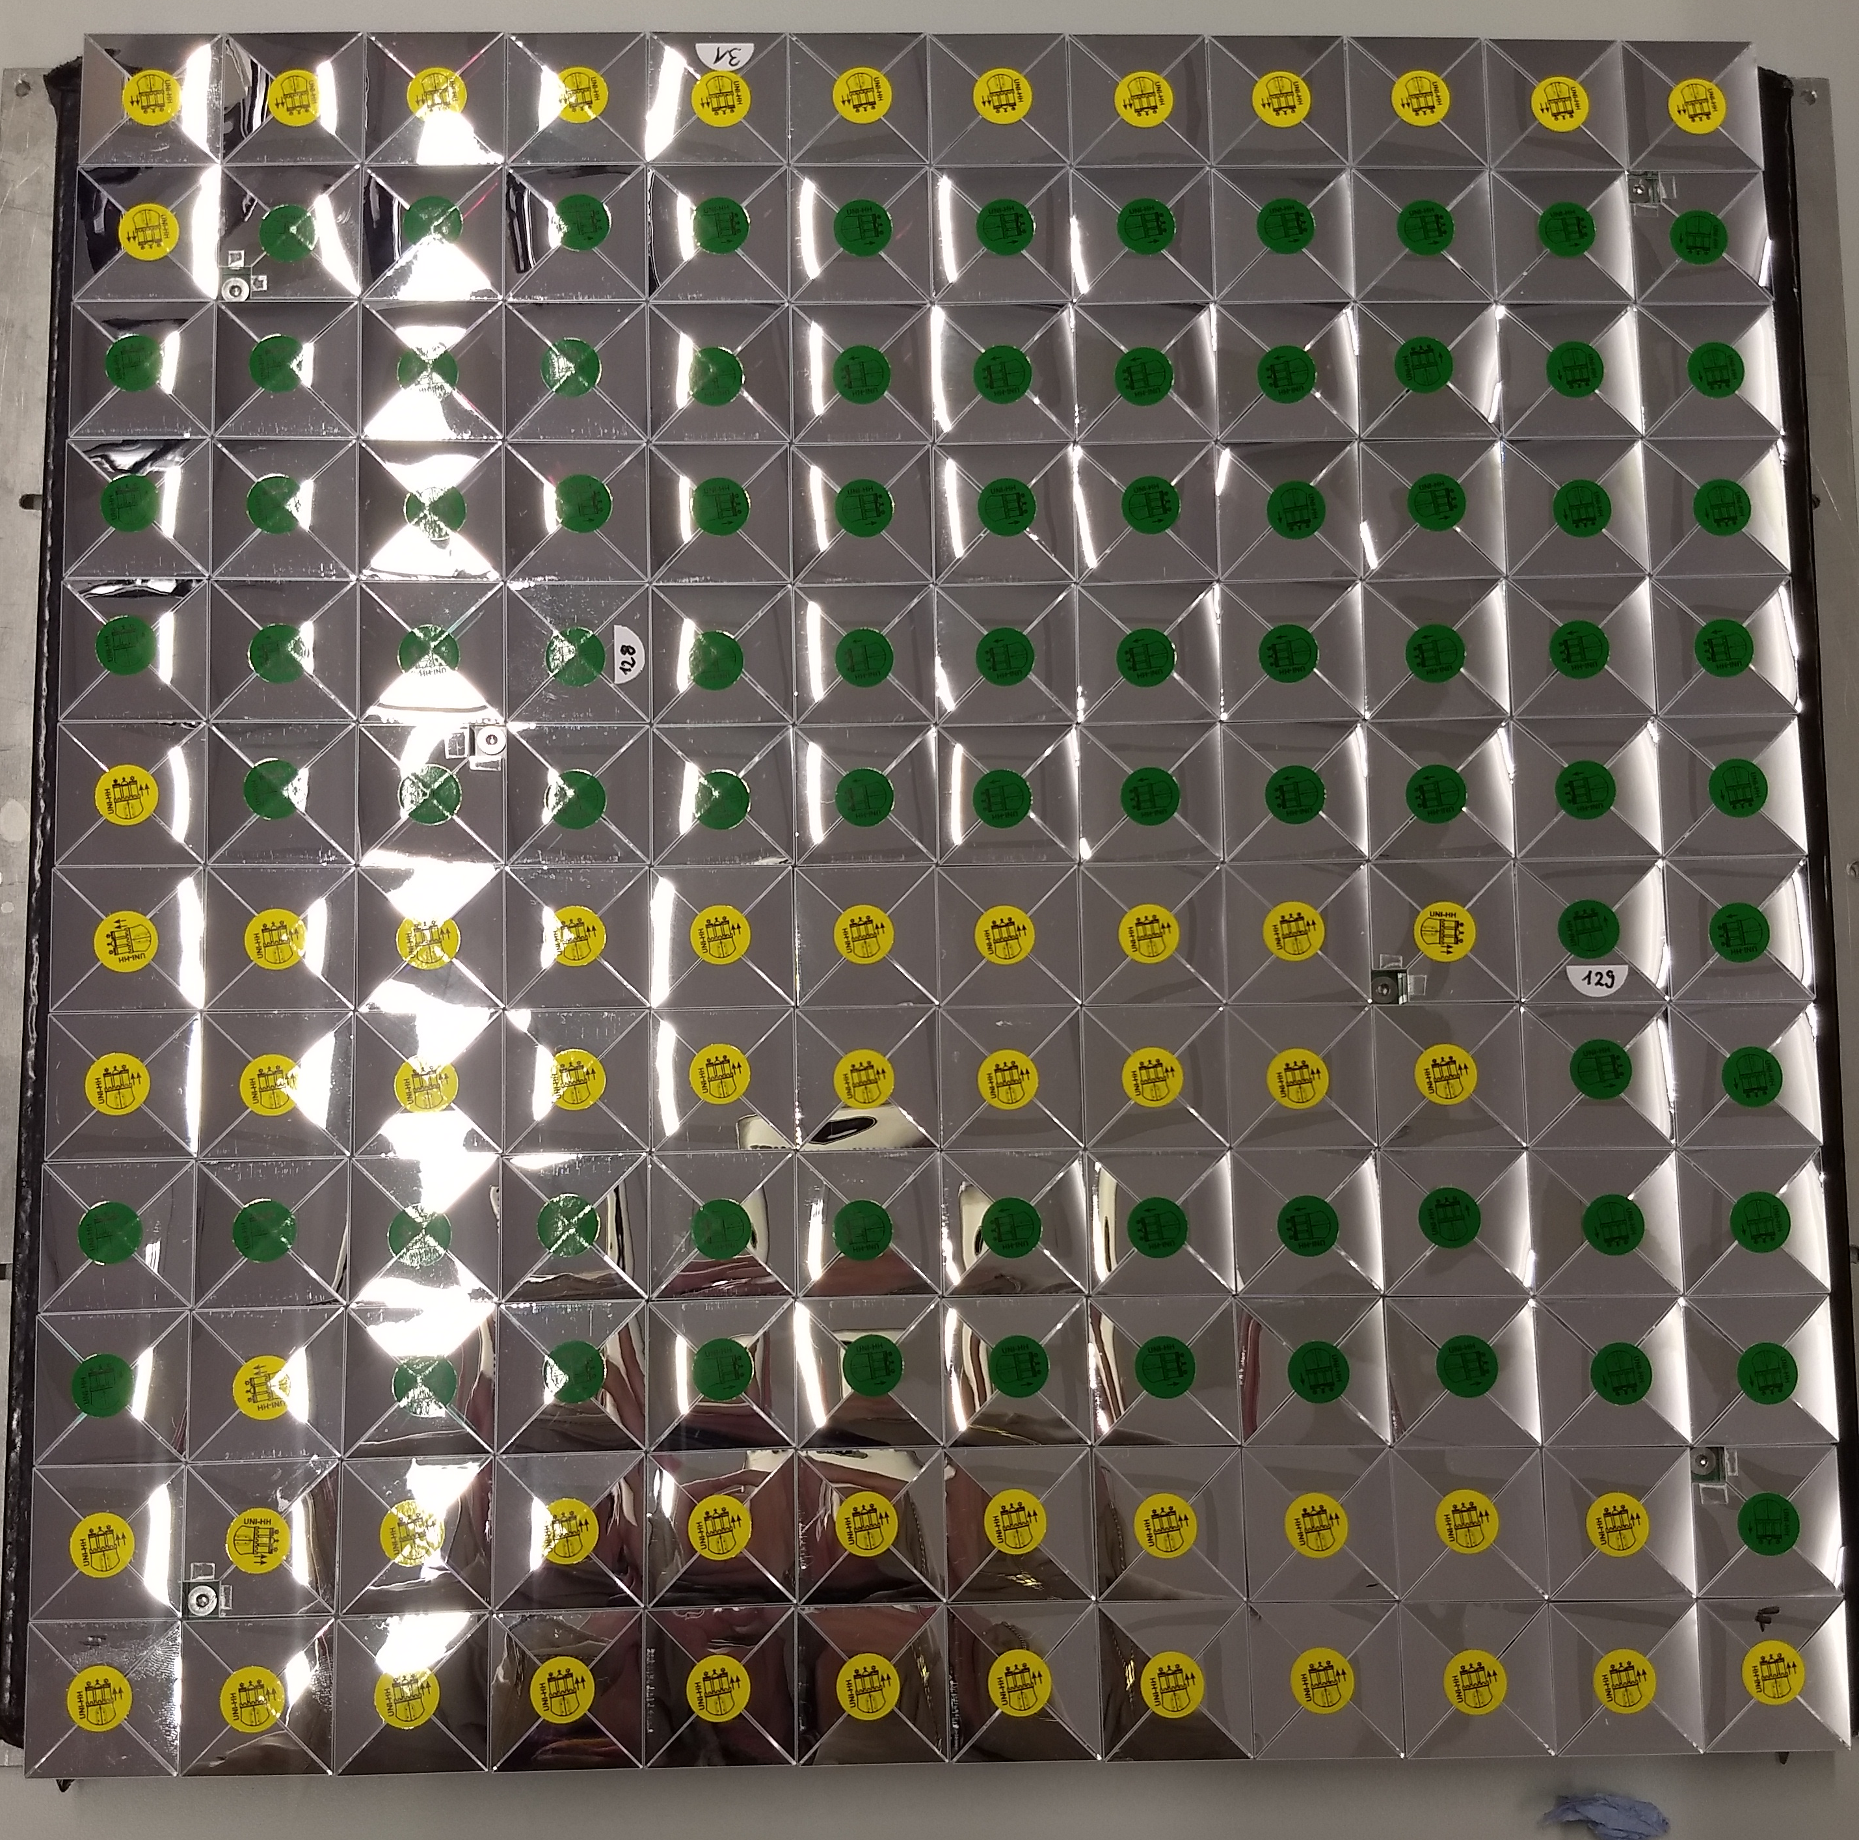
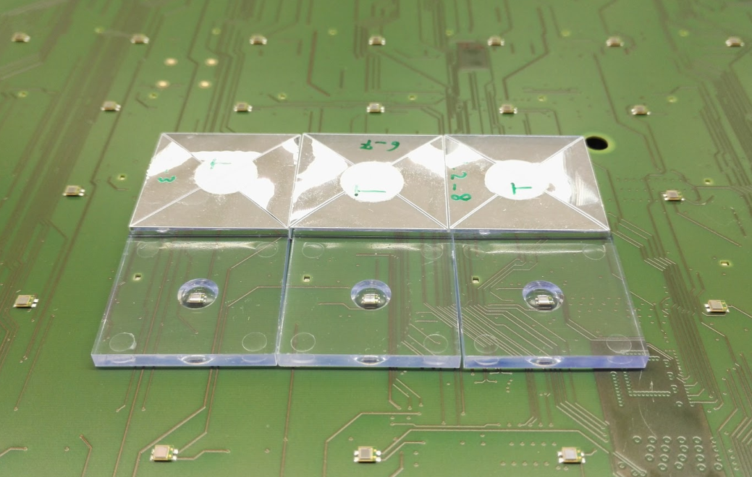
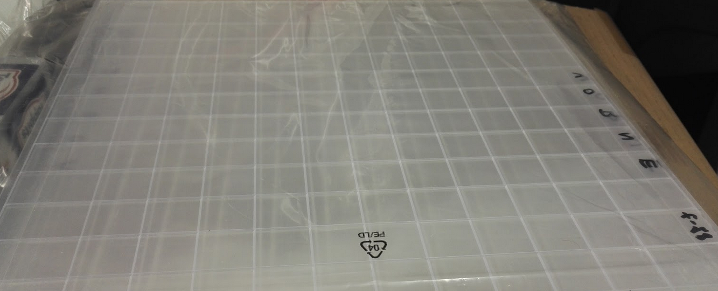
Outlook: From tiles to megatile
New readout board for AHCAL tech. prototype
Connected to the 7 channels in the 3rd ASIC
Steady steps towards fully scalable AHCAL technological prototype
Spare HBU3 (without SiPMs)
by courtesy of DESY
Megatile is now proved to be a promising design for AHCAL

Slide 17
Summary
Megatile R&D: to further simplify mass assembly
Simulation studies for megatile
  Various designs tried out
  A final design optimised
  Promising performance foreseen
Developed several generations of megatile prototypes
  Latest prototype with extensive tests
  Success: high MIP response, low optical crosstalk
Paved to way to develop full-size megatile (12×12 cells)
Connected to the 7 channels in the 3rd ASIC
Spare HBU3 (without SiPMs)
by courtesy of DESY

Slide 18
Thank you for your attention !

Slide 19
Backup

Slide 20



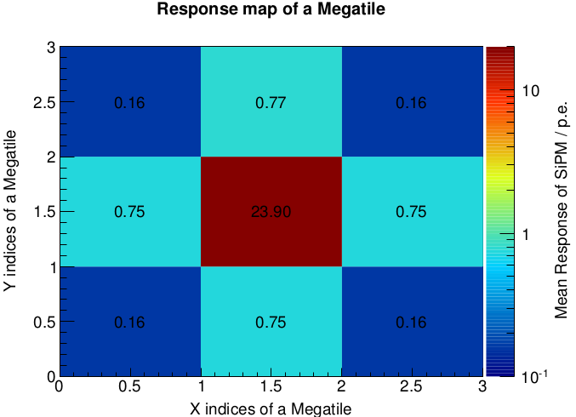
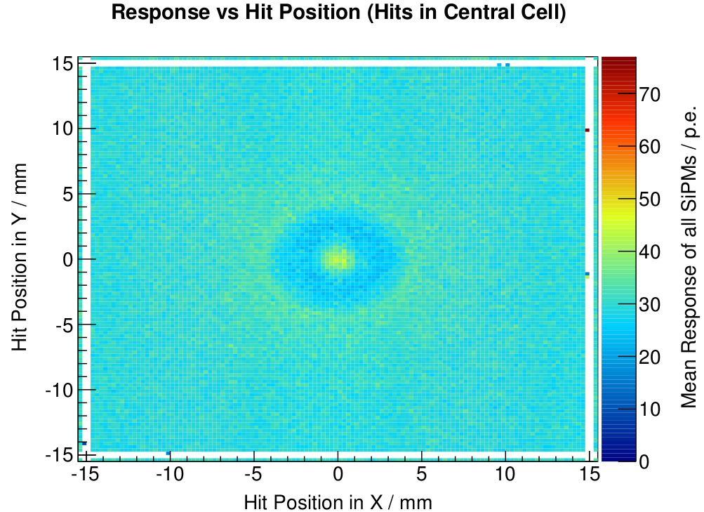
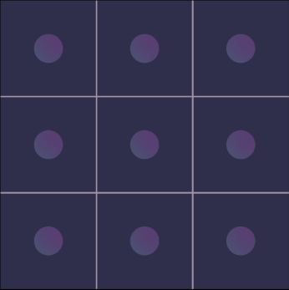
Uniformity maps: different trench designs
Tilted trenches (45°)
Connected to the 7 channels in the 3rd ASIC
Straight trenches
Spare HBU3 (without SiPMs)
by courtesy of DESY

Slide 21
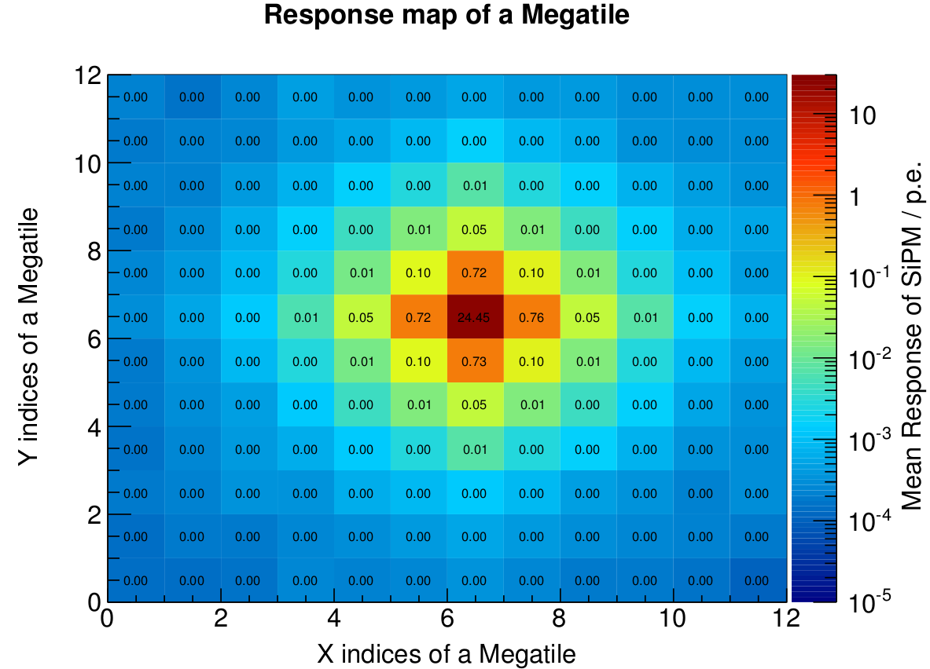
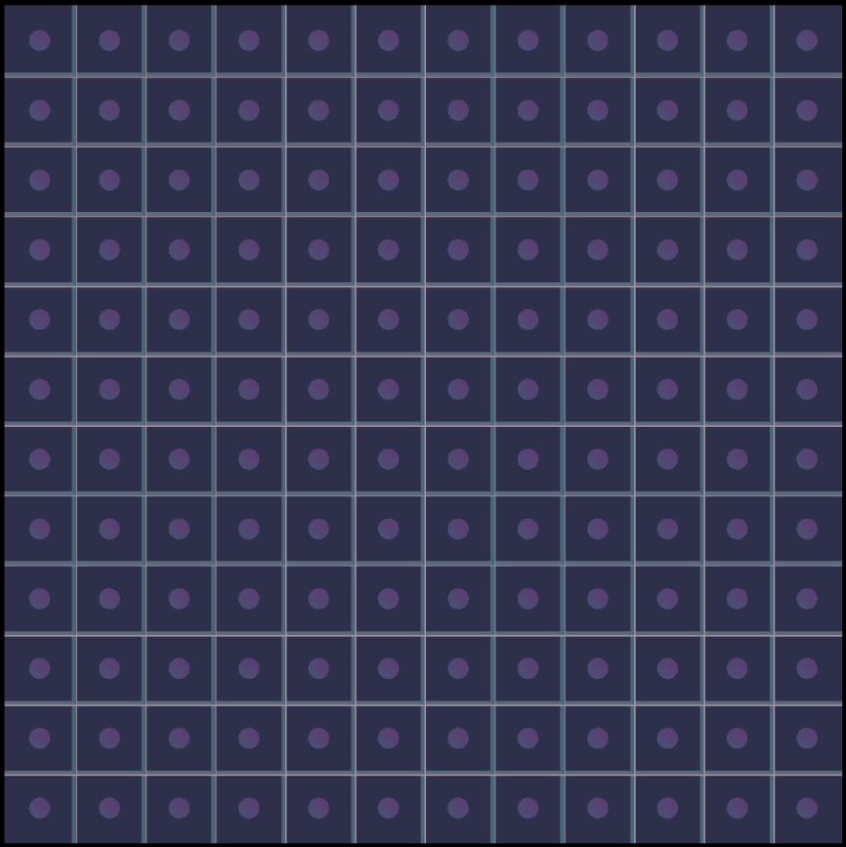
12×12 megatile simulation: tilted trenches (30º)
Tilted trenches (30°)
Muons pass through the center cell of 12×12 cells (one HBU size)
Connected to the 7 channels in the 3rd ASIC
Central cell: 24.5 p.e./MIP
Neighboring cell: 0.7~0.8 p.e./MIP
Cell-to-cell crosstalk: ~ 3 %
Air gap thickness: 0.2 mm
Moderately high MIP response
Lower optical crosstalk: thinner air gaps
Spare HBU3 (without SiPMs)
by courtesy of DESY

Slide 22
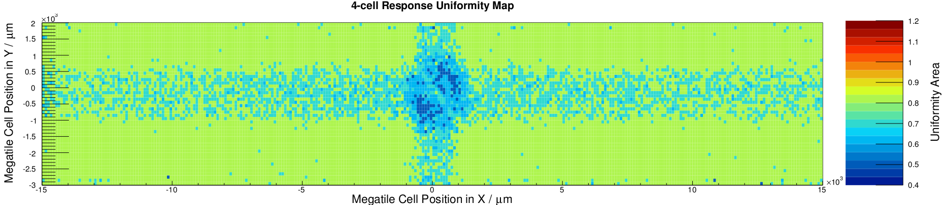
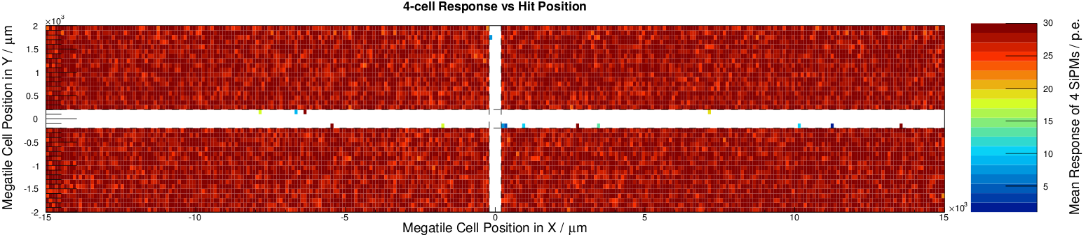
Why tilted trenches?
Geant4 simulation
Megatile: tilted trenches
Compared to cell mean response: 22.4 p.e.
99.3% area: uniformity 60%
96.1% area: uniformity 70%
79.1% area: uniformity 80%
51.7% area: uniformity 90%
Megatile: 4 corners
Individual wrapped tiles
Scintillator Tile
Connected to the 7 channels in the 3rd ASIC
Non-sensitive area: 400µm
between each cell (simulation)
Individual tiles: 4 corners
Individually wrapped tile: 29.6 × 29.6 mm²;
Dead area per tile 23.8 mm² (~ 2.6%)
Perpendicular tracks:
megatile with tilted trenches has minimal dead area;
projective cracks with layers of individually wrapped tiles
Spare HBU3 (without SiPMs)
by courtesy of DESY

Slide 23
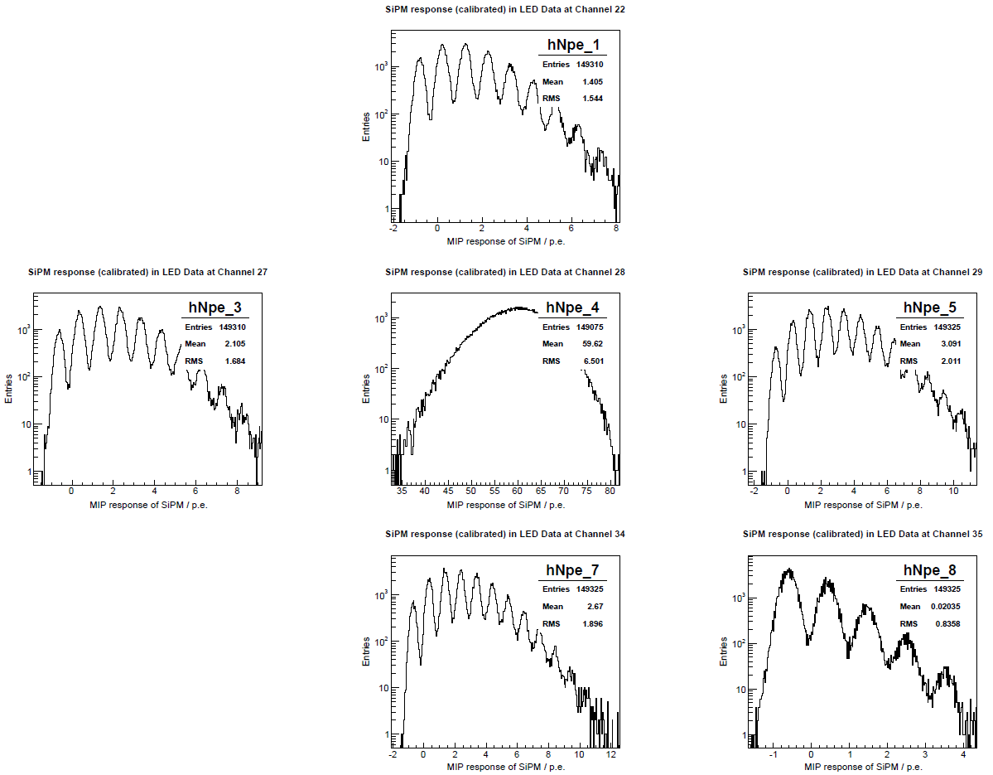
Megatile crosstalk measurements: SiPM responses
No SiPM
No SiPM
No Signal
LED: VCalib 6550 mV
  External trigger
  SiPM: +5.0 V overvoltage
After pedestal calibration
  Pedestal runs (VCalib=0 mV)
  Correction for each memory cell
Spare HBU3 (without SiPMs)
by courtesy of DESY

Slide 24
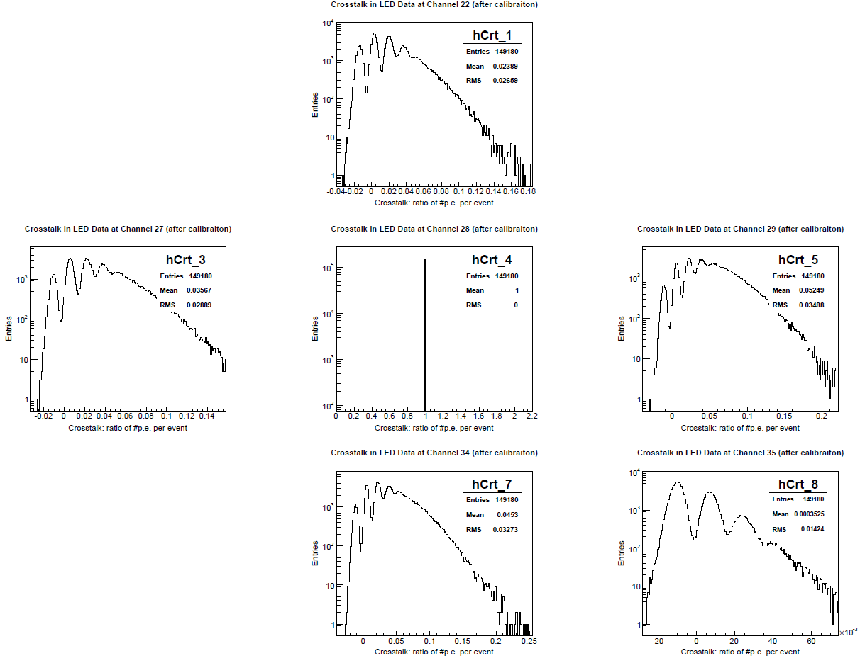
Megatile crosstalk measurements: response ratios
No SiPM
No SiPM
No Signal
LED: VCalib 6550 mV
  External trigger
  SiPM: +5.0 V overvoltage
After pedestal calibration
  Pedestal runs (VCalib=0 mV)
  Correction for each memory cell
Spare HBU3 (without SiPMs)
by courtesy of DESY

Slide 25
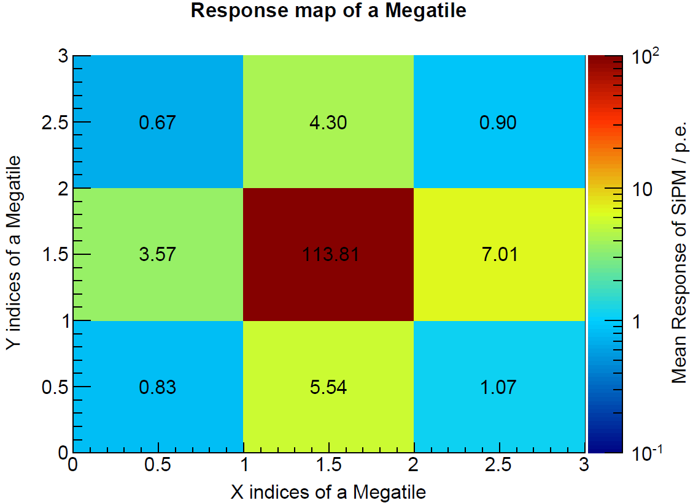
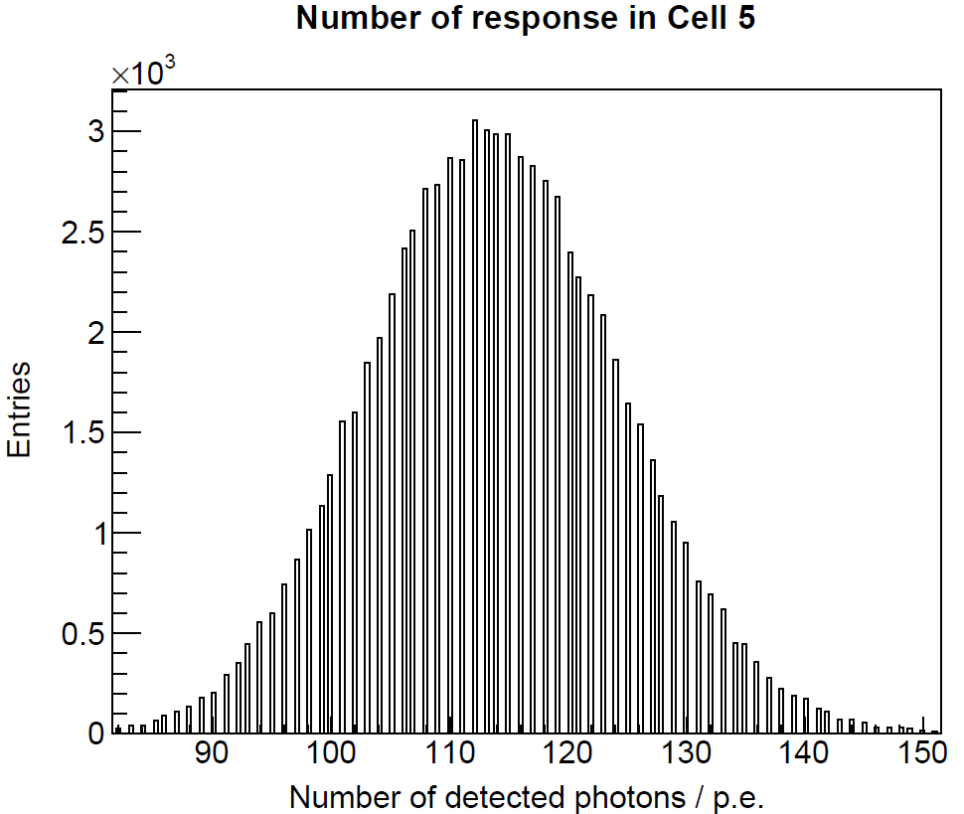
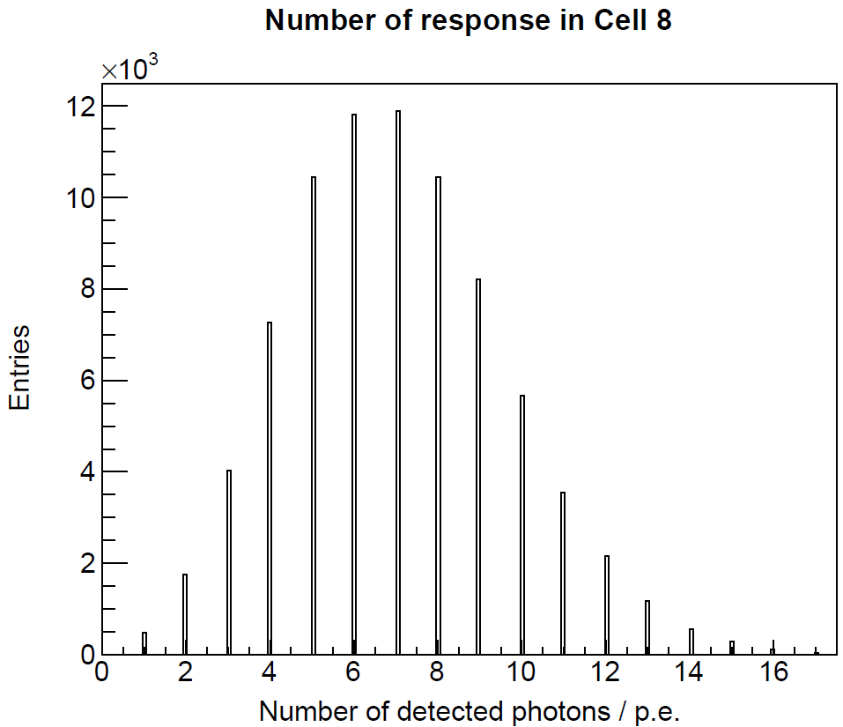
Simulation of LED illumination: tilted trenches (30º)
Center:
56.9 p.e.
Right:
3.5 p.e.
30k optical photons per event in the center. Crosstalk (mean): 3.1 ~ 6.2 %
Center:
113.8 p.e.
Right:
7.0 p.e.
Spare HBU3 (without SiPMs)
by courtesy of DESY
60k optical photons per event in the center. Crosstalk (mean): 3.1 ~ 6.1 %

Slide 26
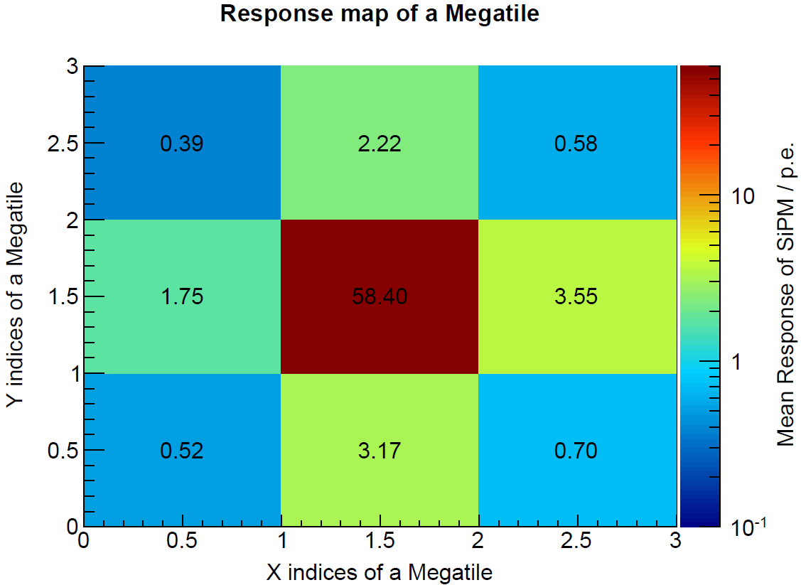
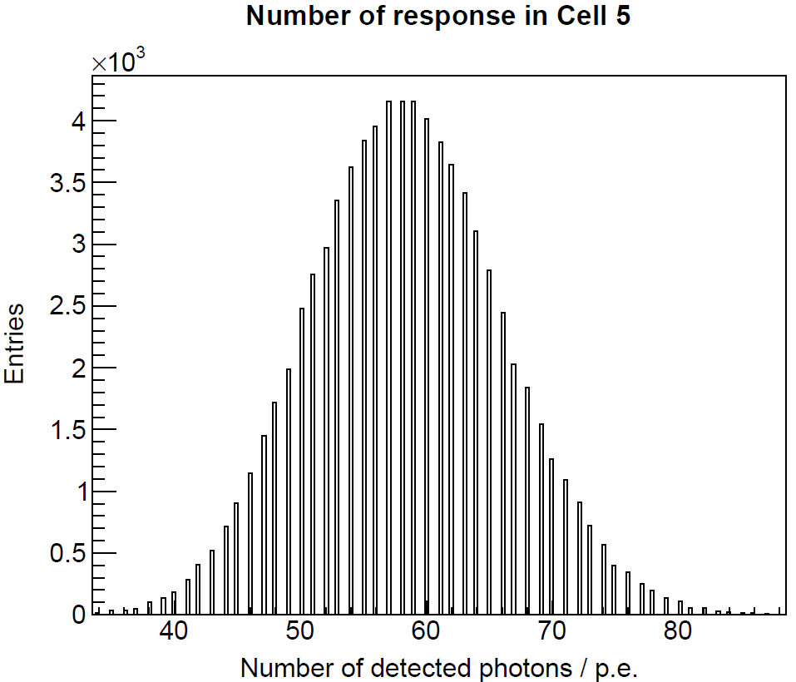
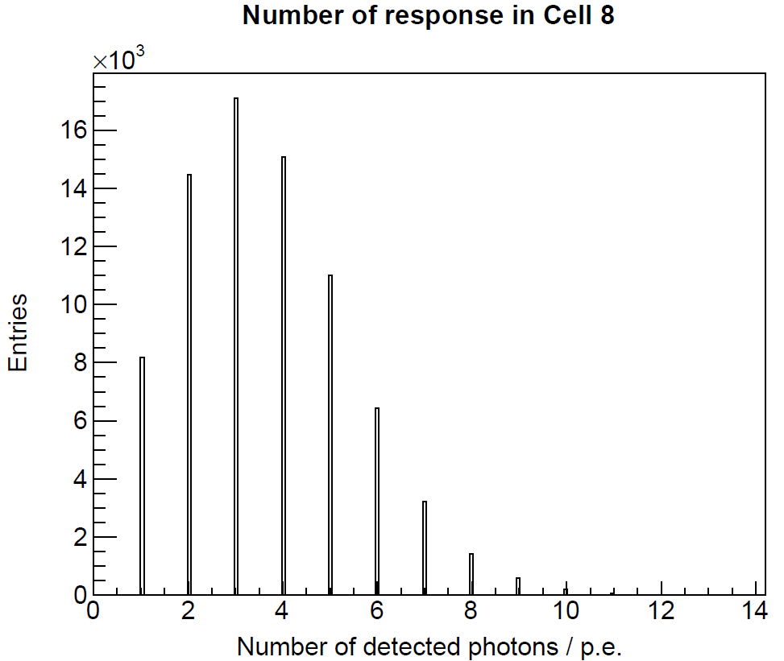
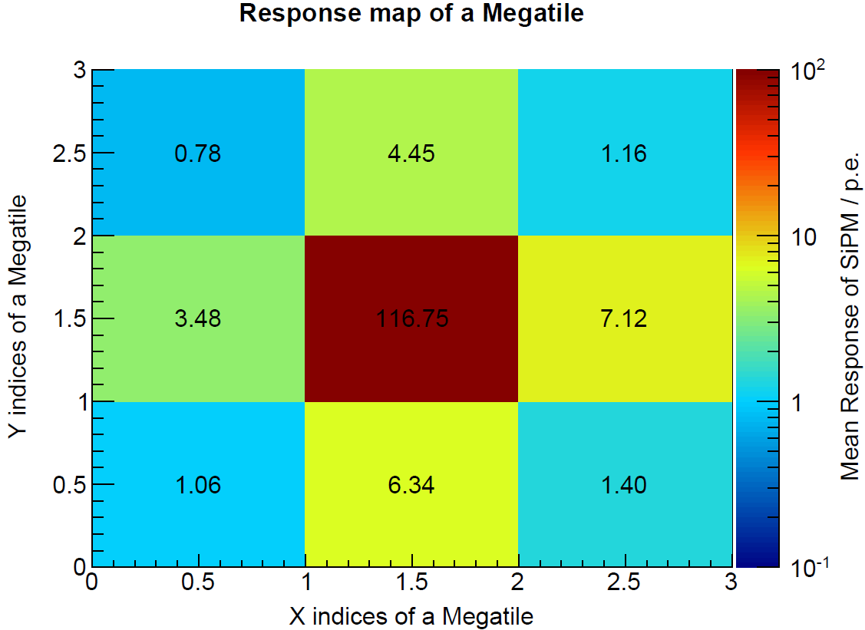
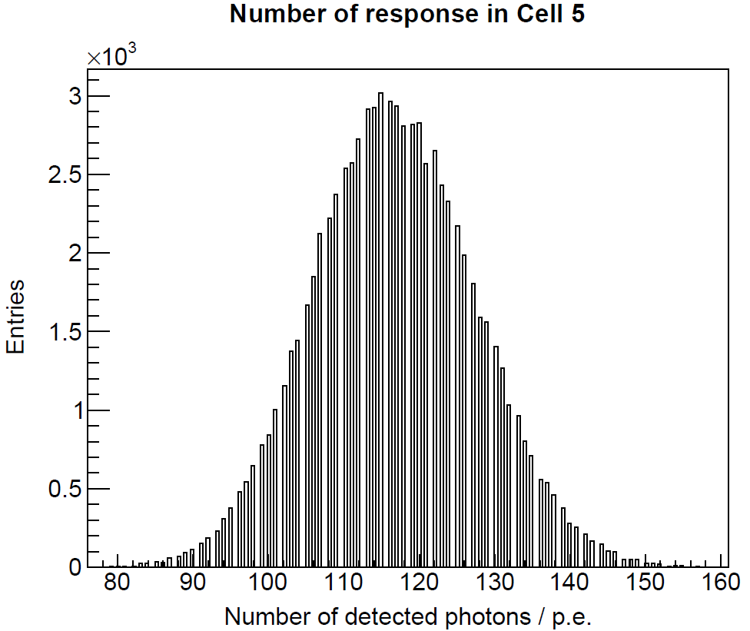
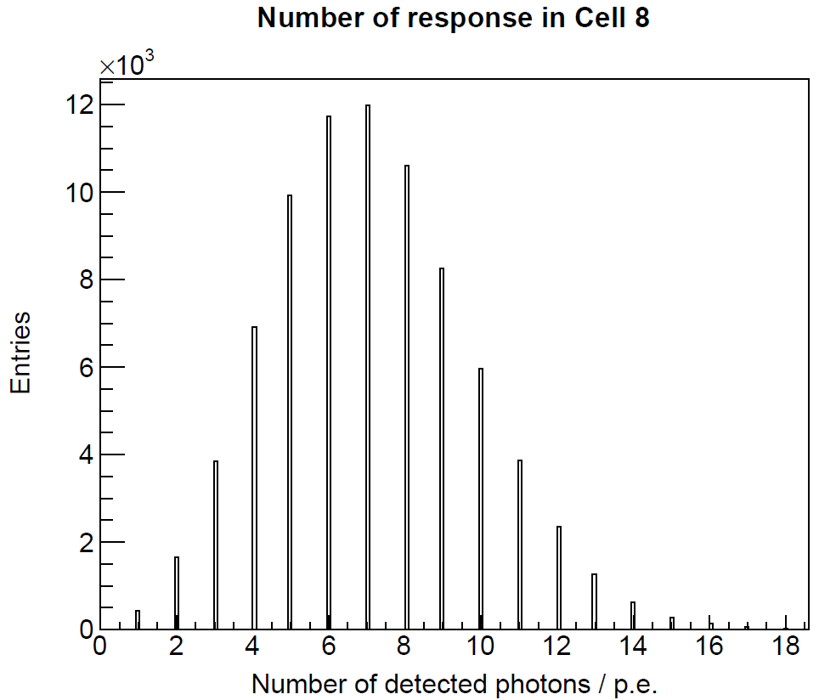
Simulation of LED illumination: tilted trenches (0º)
Center:
58.4 p.e.
Right:
3.5 p.e.
30k optical photons per event in the center. Crosstalk (mean): 3.0 ~ 6.1 %
Center:
116.7 p.e.
Right:
7.1 p.e.
60k optical photons per event in the center. Crosstalk (mean): 3.0 ~ 6.1 %

Slide 27
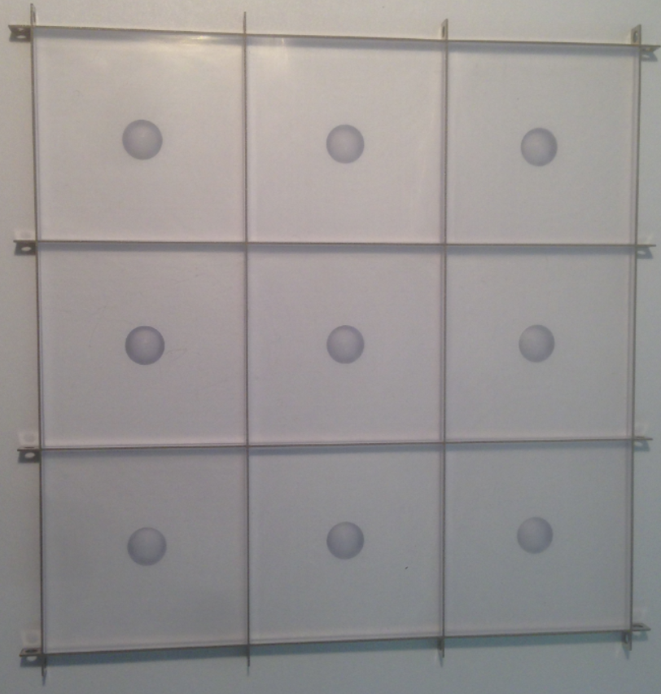
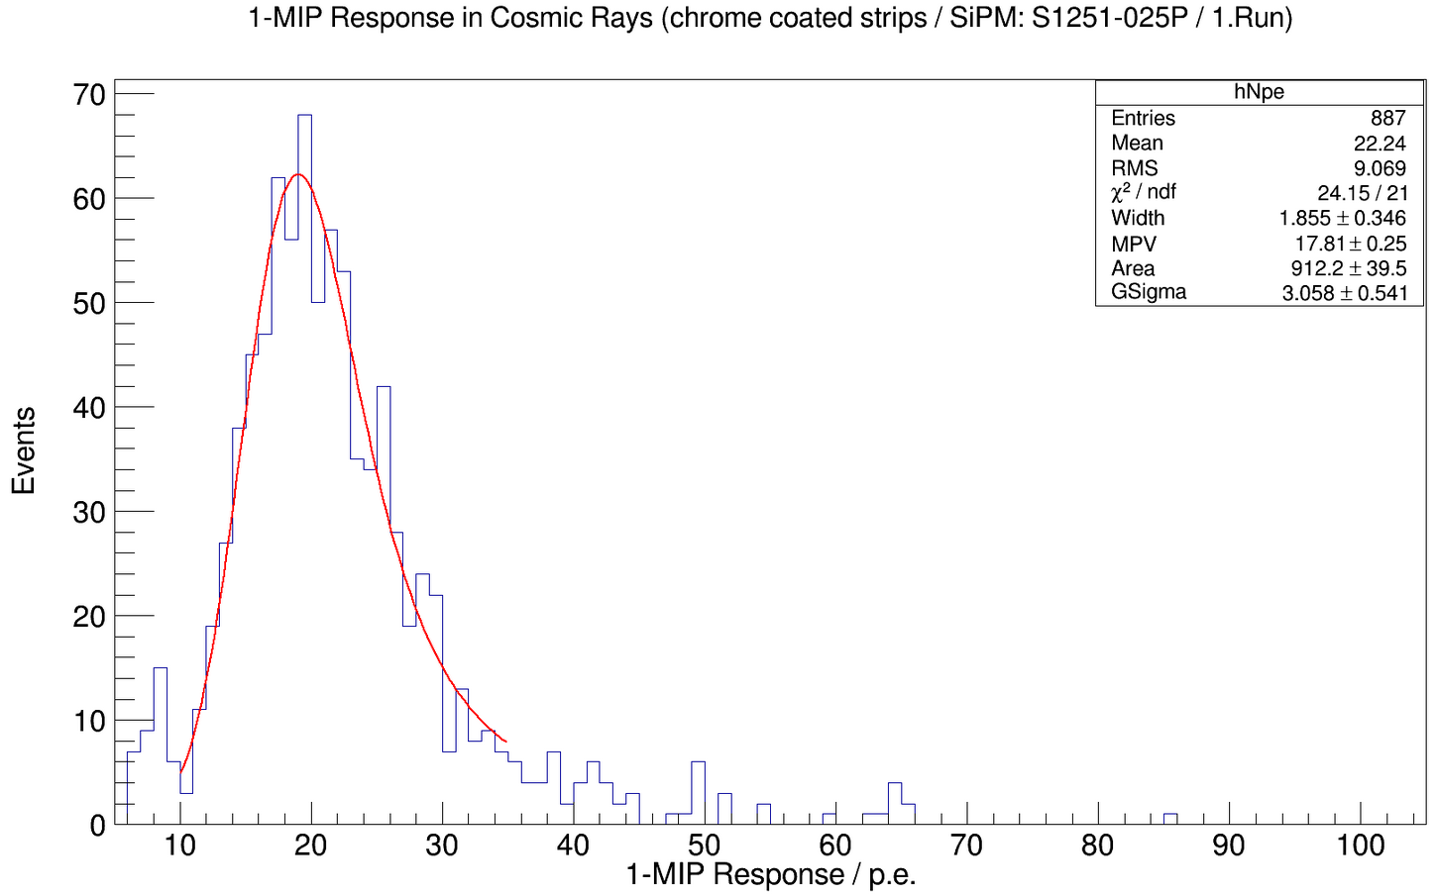
Efforts of MegaTile development at Mainz (1)
BC408 scintillator
Steel grids coated with chrome
1x1mm² HPK MPPC
Cosmic-ray measurement
17.8 p.e./MIP
Prototype with metal grids and individual tiles
  Idea: quickly produce metal grids
  A first prototype worked well with steel strips and individually machined tiles
  Many manufacturers tried, but could not produce the steel grids with sub-mm thickness at the size ~ 36x36 cm²

Slide 28
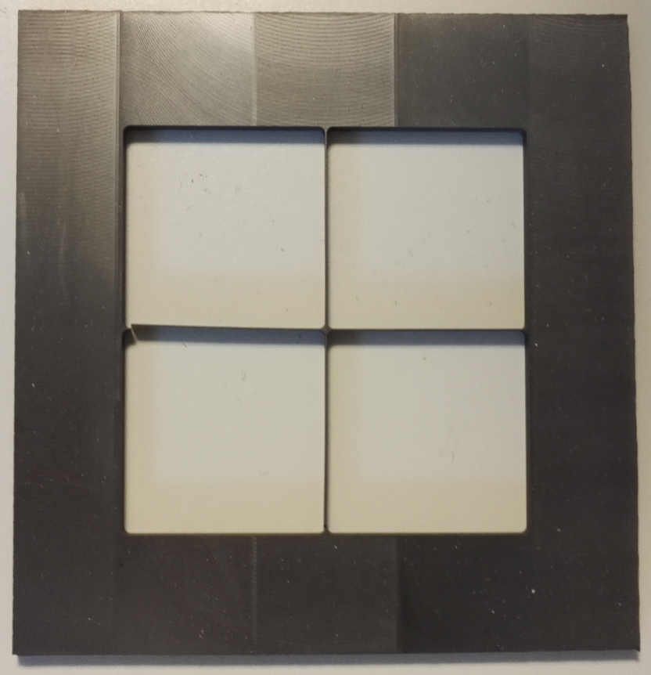
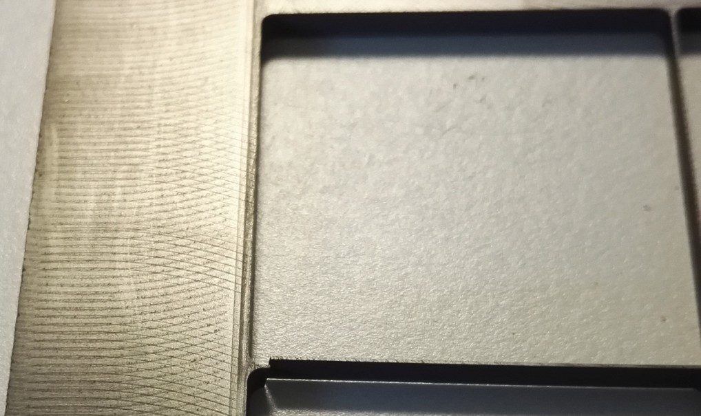
Efforts of MegaTile development at Mainz (2)
MegaTile with carbon-fiber
  Built a prototype of grids
    Carbon-fiber: many thin layers glued together
    Mechanically fragile
A small part fractured

