Slide 1
ILC new luminosity design and small beam experiments at ATF
ALCWS2018 2018.5.31
K. Kubo (KEK)

Slide 2
Luminosity at E_{CM}=250GeV
ILC TDR is optimized for 500GeV.
Luminosity at 250GeV was low
New design: Higher luminosity at 250 GeV
By reduction of horizontal beam size
(Increase beamstrahlung (energy loss in collision))
(Reported by K.Yokoya in AWLC2017)
TDR 500GeV | TDR 250 GeV | New 250GeV
1.79 x10³⁴ /cm²/s | 0.82 | 1.35
2

Slide 3
Reduce σ_{x}
By reducing horizontal emittance. 10 → 5 um.
(Reduction of beta_x* will cause problems.
Can be tried later.)
Need lower emittance in Damping Rings
  Possible with minor design change
Disruption (strength of beam-beam force) will become large → tighter positioning tolerance
  Cured by fast feedback

Slide 4
Part of parameter table

Slide 5
New Parameter Set
Half Horizontal Emittance
Same beta*
Luminosity
0.82 → 1.35 E34 /cm²/s
δ_{BS} 0.97 → 2.62%
D_{y} 24.5 → 34.5
ε_{x} 10 → 5 μm
5
2017/6/28 AWLC, Yokoya

Slide 6
Damping Ring Design for lower ε_{x}
Stronger focusing optics can make smaller horizontal emittance
Possible problem is reduction of dynamic aperture
There is a space to lengthen the dipoles in the arcs 3m → ~5m
  This (weaker bending field) will make dynamic aperture larger
Still conservative, compare with recent light sources
Dynamic aperture of small emittance (4 um) design
3 m long Bend 5 m long

Slide 7
Luminosity Preservation
At IP
Small beam
Position stability
Tested at ATF2

Slide 8
ILC
Accelerator Test Facility
Energy: 1.3 GeV, Repetition: 3.12 Hz
Intensity: 1x10¹⁰ e-/bunch (max. 2x10¹⁰),
1~20 bunches/pulse
Emittance: Design, 1 nm(H)/ 10 pm(V),
Achieved 4 pm(V)
Advanced Beam Instruments R&D
ATF2 beamline
Testing Final Focus System of LC
Damping Ring (~140m)
Low emittance beam
Cs₂Te Photocathode RF Gun
1.3 GeV S-band Electron LINAC (~70m)

Slide 9
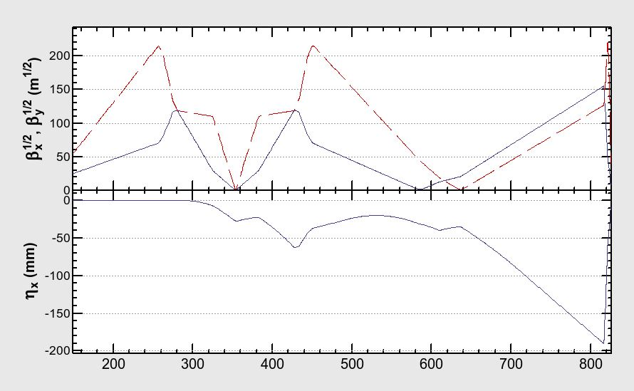
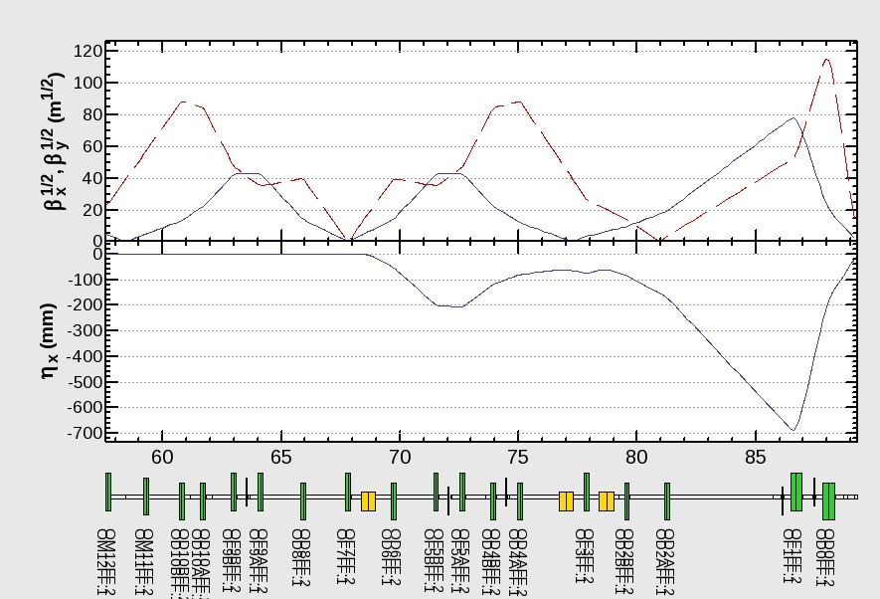
Final Focus Optics, ILC and ATF2
Almost identical optics
Same magnet configuration (Same magnet names)
ILC
125 GeV
~700 m
ATF2
1.3 GeV
~30 m

Slide 10
How can we compare difficulties in ILC and ATF2
 | TDR 500 | TDR 250 | New 250 | ATF2
Beam energy (GeV) | 250 | 125 | 125 | 1.3
Vertical size (nm) | 5.9 | 7.7 | 7.7 | 37/41 (Design/measured)
beta_y* (mm) | 0.48 | 0.41 | 0.41 | 0.1
Physical emittance (pm) | 0.08 | 0.16 | 0.16 | 12
L*/beta_y* (~Natural chromaticity) | 4100/0.48 | 4100/0.41 | 4100/0.41 | 1000/0.1
Energy spread (e-/e+) (%) | 0.12/0.07 | 0.19/0.15 | 0.19/0.15 | 0.06~0.08
Difficulty in final focus.
Roughly, relative difficulty can be represented by
L*/beta_y*
(for geometrical aberrations and chromatic aberrations)

Slide 11
How can we compare difficulty in ILC and ATF2
 | TDR 500 | TDR 250 | New 250 | ATF2
Beam energy (GeV) | 250 | 125 | 125 | 1.3
Vertical size (nm) | 5.9 | 7.7 | 7.7 | 37/41 (Design/measured)
beta_y* (mm) | 0.48 | 0.41 | 0.41 | 0.1
Physical emittance (pm) | 0.08 | 0.16 | 0.16 | 12
L*/beta_y* (~Natural chromaticity) | 4100/0.48 | 4100/0.41 | 4100/0.41 | 1000/0.1
Energy spread (e-/e+) (%) | 0.12/0.07 | 0.19/0.15 | 0.19/0.15 | 0.06~0.08
L*: Distance between final quad magnet to IP
Difficulty in final focus.
Roughly, relative difficulty can be represented by
L*/beta_y*
(for geometrical aberrations and chromatic aberrations)

Slide 12
How can we compare difficulty in ILC and ATF2
 | TDR 500 | TDR 250 | New 250 | ATF2
Beam energy (GeV) | 250 | 125 | 125 | 1.3
Vertical size (nm) | 5.9 | 7.7 | 7.7 | 37/41 (Design/measured)
beta_y* (mm) | 0.48 | 0.41 | 0.41 | 0.1
Physical emittance (pm) | 0.08 | 0.16 | 0.16 | 12
L*/beta* (~Natural chromaticity) | 4100/0.48 | 4100/0.41 | 4100/0.41 | 1000/0.1
Energy spread (e-/e+) (%) | 0.12/0.07 | 0.19/0.15 | 0.19/0.15 | 0.06~0.08
L*/beta*
~ Natural chromaticity
~ (beam size in final magnet) / (beam size at IP)
Difficulty in final focus.
Roughly, relative difficulty can be represented by
L*/beta_y*
(for chromatic aberrations and geometrical aberrations)

Slide 13
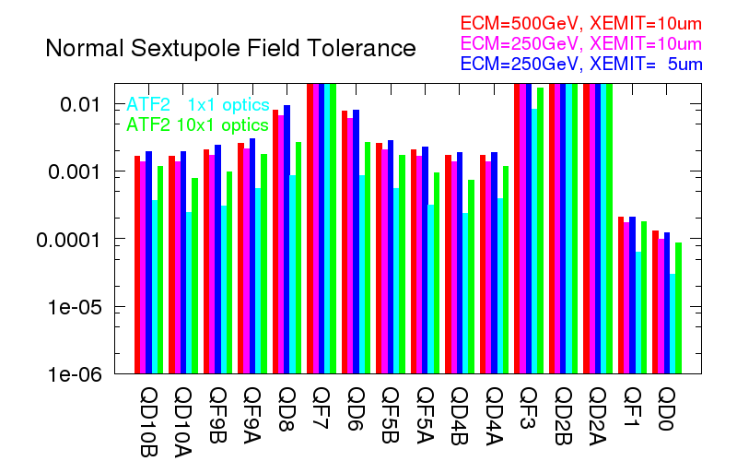
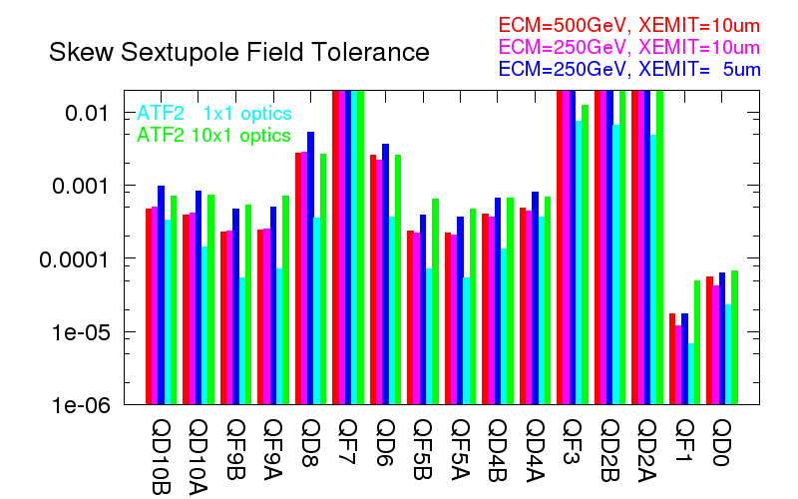
Tolerances of magnet field errors
ILC TDR 500 GeV
ILC TDR 250 GeV
ILC new 250 GeV
ATF2 1x1 optics (original design)
ATF2 10x1 optics (usual operation)
Normal sextupole and
Skew sextupole strength
causing 1% beam size growth
(by T.Okugi)

Slide 14
Tolerance of normal sextupole field of
QF1, QD0 (Final Doublet)
ILC new250
ATF2 10x1 (usual operation)
(by T.Okugi)

Slide 15
(by T.Okugi)

Slide 16
Roughly,
Tolerance of magnetic field error
in New250
~ TDR500
~ TDR250
~ ATF2 10x1 (usual optics)
> ATF2 1x1 (original design)
ATF2 10x1 (usual optics) is good for testing ILC Final Focus

Slide 17
Tuning knobs for vertical beam size
5 sextupole magnets (on movers) and
4 skew-sextupole magnets
Same design for ILC and ATF2
 |  | Corrected coupling
Linear knob | Horizontal move of sextupole magnets | yy’
 | vertical move of sextupole magnets | Ey
 |  | x’y
Non-linear knob | Strength change of sextupole magnets | x’yy’
 |  | Eyy’
 | Strength change of skew sextupole magnets | xxy
 |  | Exy
 |  | EEy
 |  | yy’y’
T. Okugi et al., Phys. Rev. ST-AB 17(2014) 023501.

Slide 18
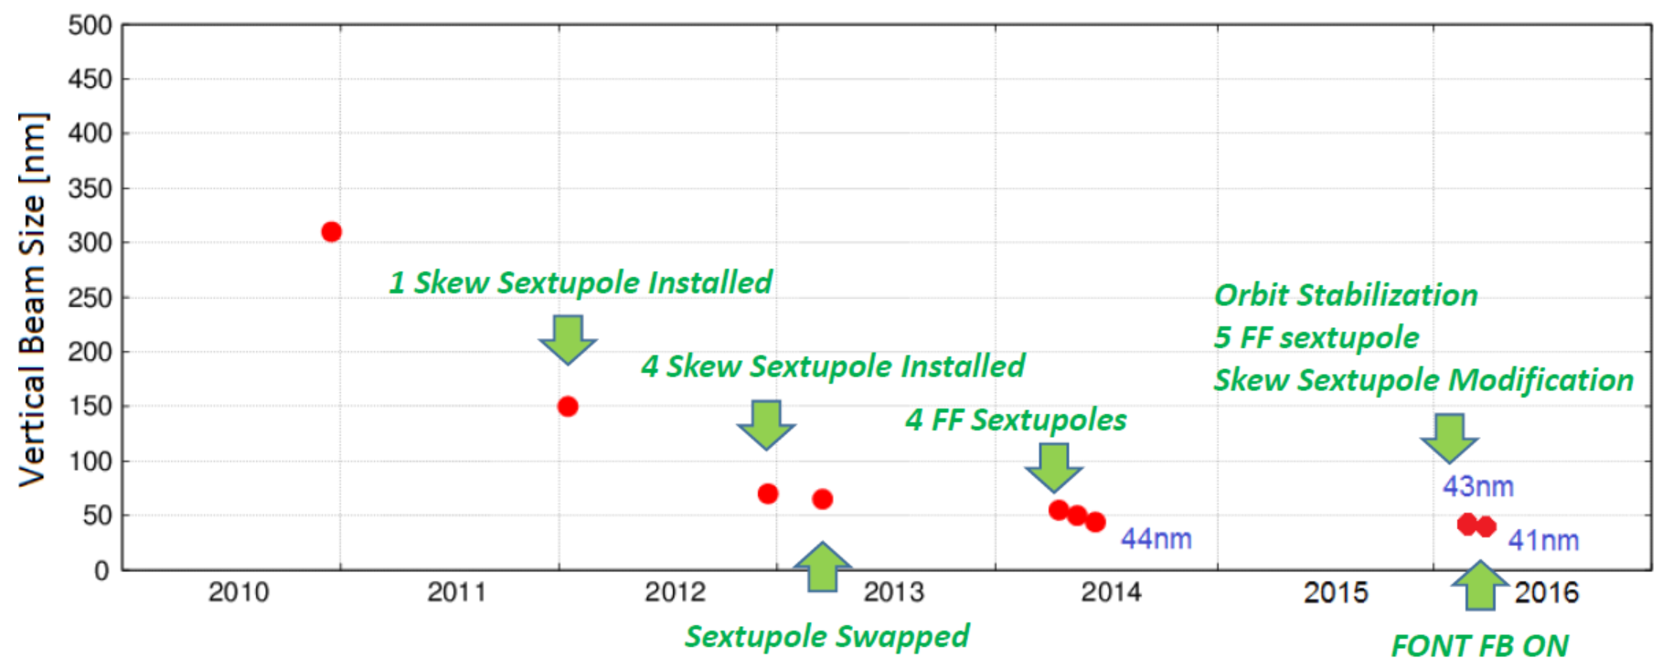
History of measured minimum beam size of ATF2
(Design size is 37 nm)
Achieved small beam, very close to design
Study continued
Understand Non-linear Aberrations in details
Possibility of smaller beta_y*
Intensity dependence (next slides)
Figure by T.Okugi

Slide 19
Intensity dependence at ATF2
Beam size depend on bunch intensity
Small beam (~40) nm observed only at low intensity
(N~1x10⁹) (ATF2 design 1x10¹⁰, ILC 2x10¹⁰)
Effect of wakefield
Beam profile at IP (simulation)
No wakefield
Reported in this workshop, ATF2 session

Slide 20
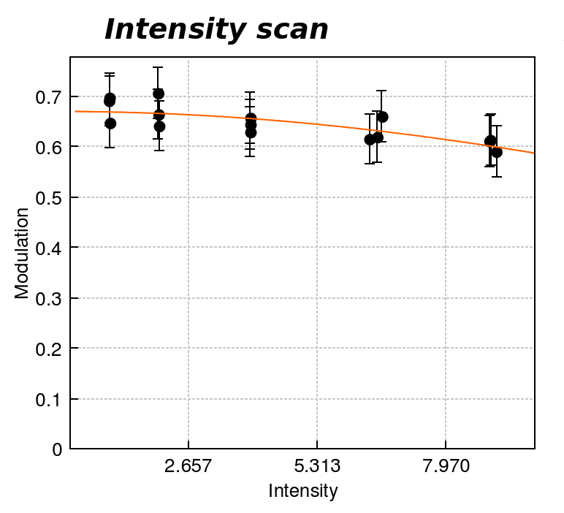
Beam size vs. bunch Intensity at ATF2
In recent operation,
w: ~ 10 nm/1e9
(beam size growth 3.6%
at N=1x10⁹)
Depending on conditions
2018.5.18 Preliminary

Slide 21
Comparison of Wakefield effect at ILC and ATF2
Assumptions
Wakefield sources
  At every quadrupole magnet
  Similar structure in ILC and ATF
Same random misalignment.
or
Same orbit jitter relative to beam size
Estimate beam size growth relative to beam size at IP

Slide 22
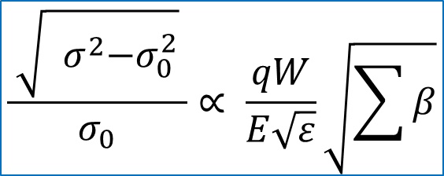
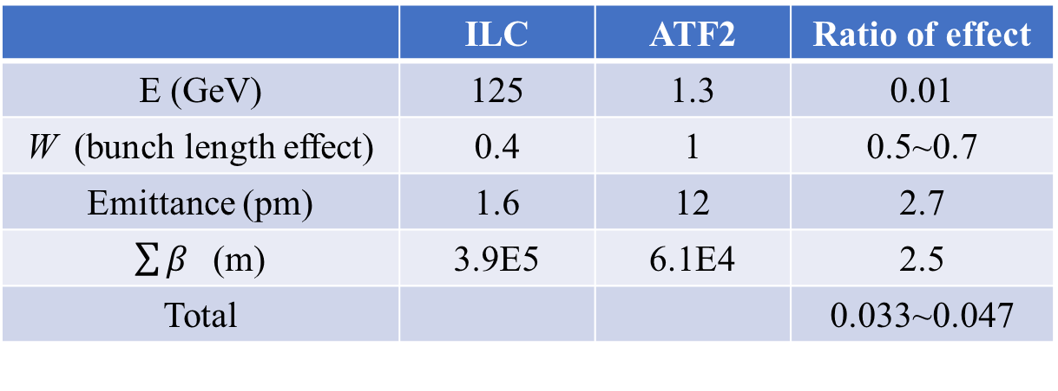
Effect of wakefield with Random misalignment
$$\frac{ \sqrt{{ σ}^{2}−σ_{0}^{2}} }{σ_{0}}∝ \frac{qW}{E\sqrt{ε}}\sqrt{\sum{β}}$$
q : bunch charge
W : strength of wakefield
E : beam energy
ε : emittance
β : beta-function at wake source
 | ILC | ATF2 | Ratio of effect
E (GeV) | 125 | 1.3 | 0.01
W (bunch length effect) | 0.4 | 1 | 0.5~0.7
Emittance (pm) | 1.6 | 12 | 2.7
$\sum{β}$(m) | 3.9E5 | 6.1E4 | 2.5
Total |  |  | 0.033~0.047
(Same bunch intensity)

Slide 23
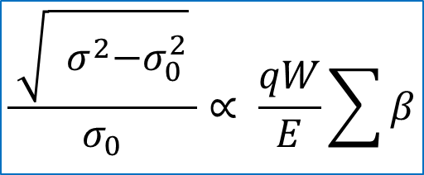
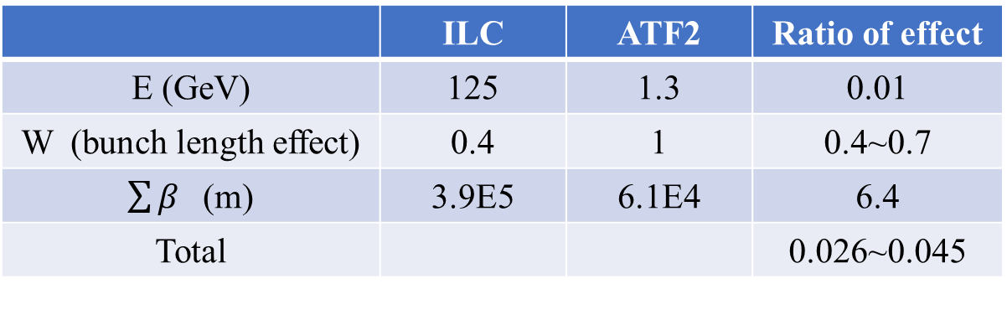
Effect of wakefield with
Orbit distortion (orbit jitter)
$$\frac{ \sqrt{{ σ}^{2}−σ_{0}^{2}} }{σ_{0}}∝ \frac{qW}{E}\sum{β}$$
 | ILC | ATF2 | Ratio of effect
E (GeV) | 125 | 1.3 | 0.01
W (bunch length effect) | 0.4 | 1 | 0.4~0.7
$\sum{β}$(m) | 3.9E5 | 6.1E4 | 6.4
Total |  |  | 0.026~0.045
(Same bunch intensity)

Slide 24
Wakefield effects at ILC and ATF2
Effect at ILC Final Focus line is factor
0.026~0.047
of effect at ATF2 for the same charge/bunch
ATF2 minimum beam size observed with
~0.1x10¹⁰ e/bunch
Corresponds to 2.1~3.8x10¹⁰ e/bunch > 2.0x10¹⁰ (ILC design)
Effect at ILC: smaller than ATF2 low intensity operation
Expect further reduction at ILC.
We did not realize the significance of wakefield effects and
ATF2 beam line was not carefully designed.

Slide 25
Luminosity Preservation
At IP
Small beam
Position stability
Tested at ATF2

Slide 26
Luminosity Sensitivity against vertical offset
Relative Luminosity reduction is larger in new design than TDR for the same offset.
Smaller beta*
New
TDR
Luminosity (all energy) (E34/cm²/s)
26
D. Jean, MDI KEK Meeting 2017

Slide 27
ILC intra-pulse Feedback
e+
e-
IP
Fig. by P.Burrows
ATF2 Review 2013
Kicked by opposite beam
Depending on offset
Required BPM resolution
~ (Kick angle at tolerated offset) x Distance
> 10 um for offset < 0.5 nm
BPM resolution is
not an issue

Slide 28
Kick angle vs. offset
Does not change much from TDR
Monotonical up to 200 nm offset
1 nm offset → >20 micro-radian kick
2017/6/28 AWLC, Yokoya
28
From slide D. Jean, MDI-KEK Meeting 2017, modified

Slide 29
Intra Pulse Feedback test at ATF2 (FONT)
ILC like beam in ATF2:
2 bunches/pulse or 3 bunches/pulse
Spacing 150 ns ~ 300 ns
Extraction 2 bunches/pulse
or 3 bunches/pulse
Damping Ring
140m circumference

Slide 30
FONT at ATF2
Fast Feedback demonstrated
Example: BPM A and C used to stabilize beam at BPM B
BPMs
Kicker
A
B
C
Beam
Distribution of
Measured position
at BPM B
Feed Back
OFF
ON
Measure Bunch 1 position and Feedback to Bunch 2:
Feedback OFF: jitter ~ 96nm
Feedback ON: jitter ~ 41nm
Bunch Spacing 280 ns
Latency 235ns
R. Ramjiawan, et.al., IPAC2017
Also reported in this workshop
BPM resolution is dominant source of residual jitter

Slide 31
Summary
New ECM 250 GeV designed for higher luminosity. (0.82 -> 1.35 (x10³⁴/cm²/s))
  Reduce horizontal emittance (half)
Making small beam
  Not more difficult than TDR250 design
  Tested at ATF2 (almost identical design)
Position stability
  Tighter tolerance than TDR
  Intra pulse feedback tested at ATF2

