Slide 1
Summary of
(including some inputs
from LCWS2017 Industry
session in Strasbourg)
Session Conveners: Tohru Takahashi (Hiroshima University), Masanori Matsuoka (AAA)
Nuria Catalan Lasheras (CERN), Hugh Montgomery (Jefferson Lab),
Marc Winter (IPHC), Thomas Schoerner-Sadenius (DESY), Maxim Titov (CEA Saclay)

Slide 2
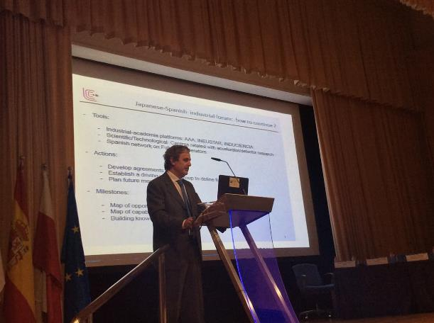
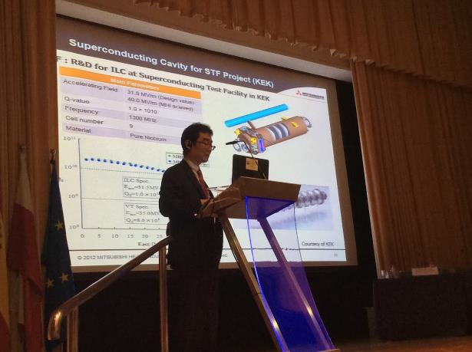

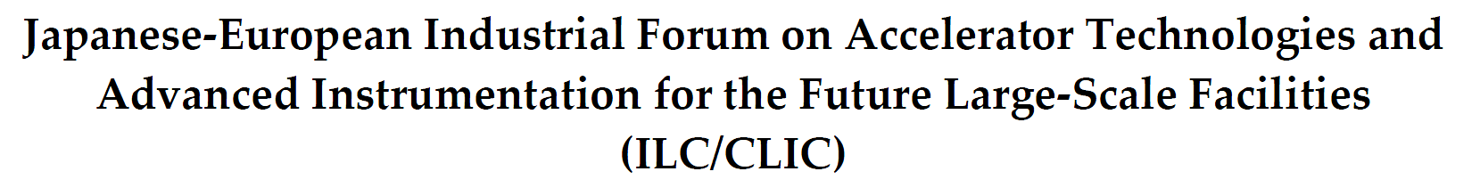
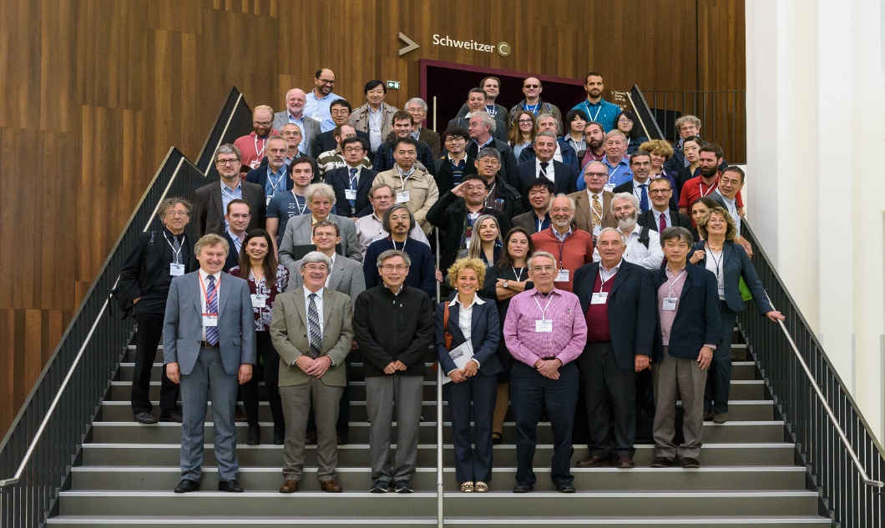
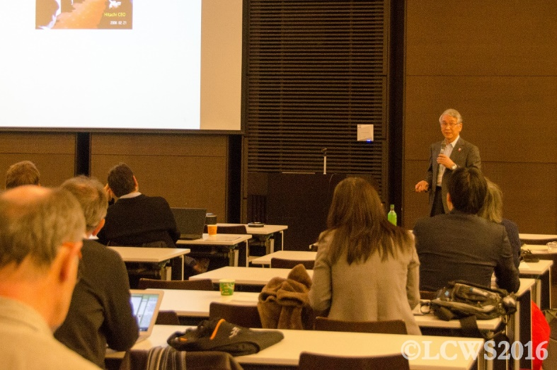
Recent Industry Events at the Linear Collider Workshops
ECFA LC2016 (Santander, Spain): Jun. 1, 2016
LCWS2017 (Strasbourg, France): Dec. 6, 2016
https://agenda.linearcollider.org/event/7645/sessions/4537/#20171025
Goal of Industry Forums on Linear Colliders →
synergies between different industrial proponents have to be found and deepened, which requires regular exchanges of information and points of view
https://agenda.linearcollider.org/event/7014/sessions/3895/#20160601
LCWS2016 (Morioka, Japan): Dec. 6, 2016
https://agenda.linearcollider.org/event/7371/sessions/4305/#20161206

Slide 3
G. Taylor
Very large (expensive) infrastructures in HEP have served as a driving force for various technologies evolutions ultimately changing the society:
The ILC/CLIC projects will boost and promote high-tech industry:
→ Advanced accelerator technologies for the society well-being
→ Importance of broadening international partnership to address social
challenges using high-tech technologies

Slide 4
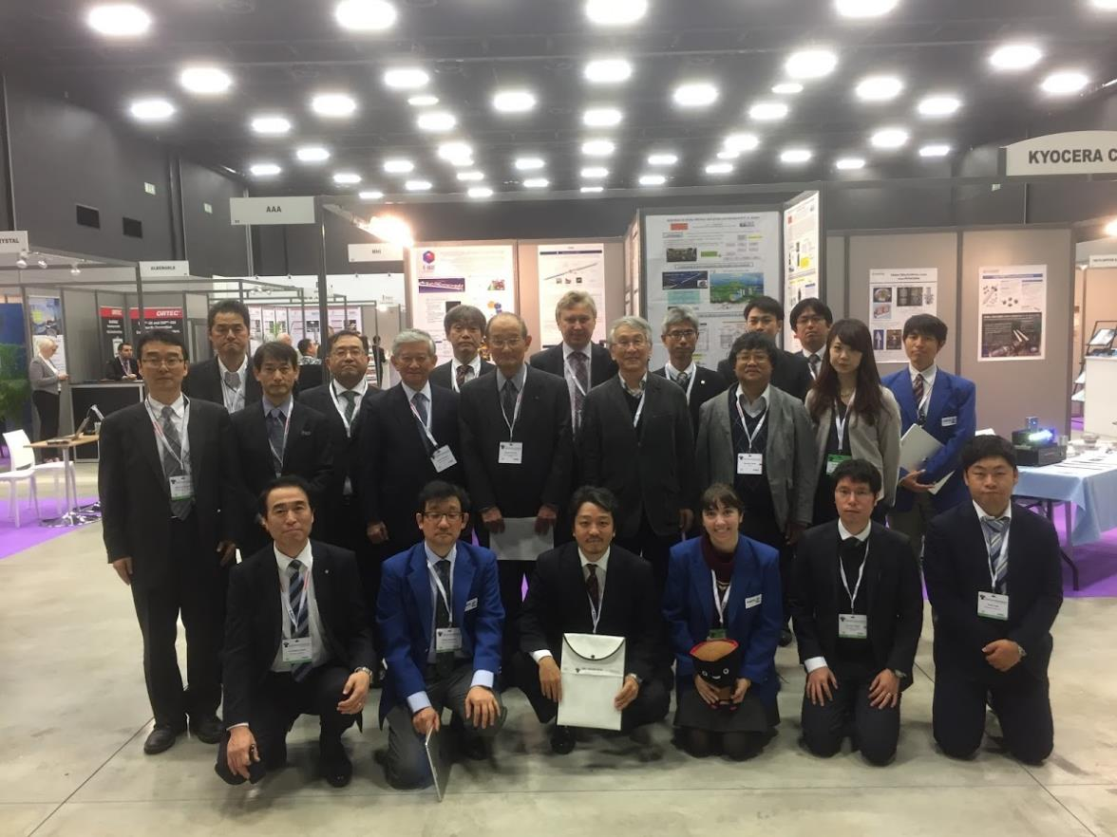
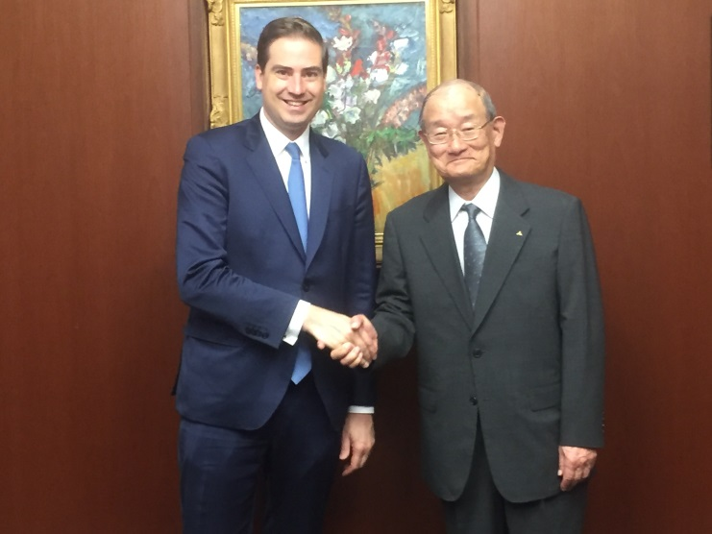
EU - Japan Industrial Cooperation
40 years of France-Japan industrial cooperation
J. Goto
2016 IEEE NSS/MIC/RTSD in Strasbourg
EU-Japan Center for Industrial Cooperation (offices in Brussels and Tokyo):
http://www.eu-japan.eu
The EU-Japan Centre is co-financed by the European Commission (DG - GROW) and the Japanese Ministry of Economy, Trade & Industry (METI) :
Special Event: “ILC - Industry – Innovation” is being
planned in Brussels in 2018/2019 (tbc):
→ A New Challenge for Japanese and European Industries
Meeting between Hon. Becht (CEEJA President) and Mr. Nishioka (AAA President) in Tokyo in May, 2018

Slide 5
Promoting Large-Scale International Projects in Advanced Science and Technology
Enhanced cooperation in energy,
accelerators, space and information
(e.g. ITER, LHC, ILC, …)
→ drivers of global innovation
M. Mori
First Plasma > 2025

Slide 6
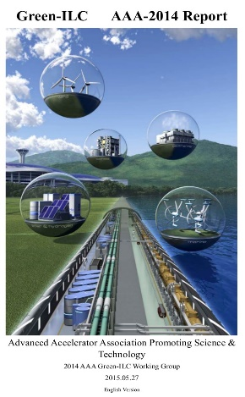
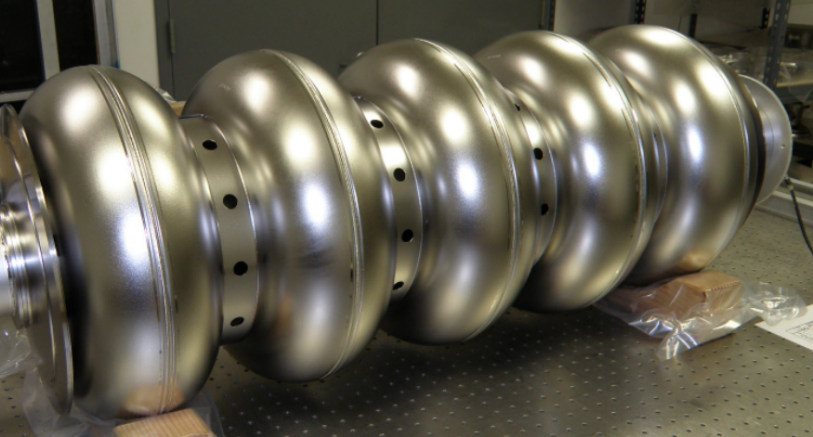
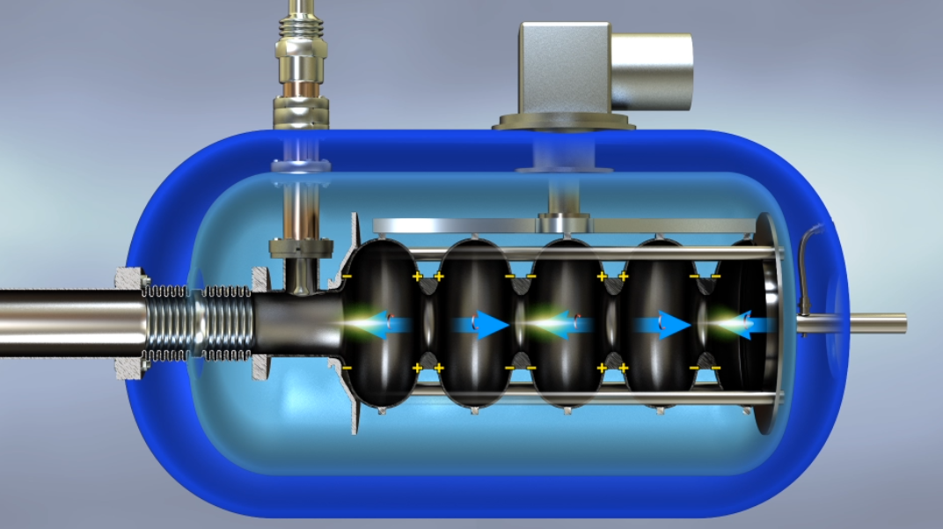
Next Generation of Particle Accelerators: Technologies for Industrial-Scale SRF Accelerators
Development of high
intensity particle beams:
Ordinary: electrons, protons, X-Ray
Specific: positrons, neutrons, ions, ...
Large-scale infrastructures: power saving issues, renewable energies
Develop new generation acceleration technics / structures:
Super-conducting accelerating cavities
Klystrons = energy sources
Higher accelerating gradients (plasma)
Klystrons
Particle
Accelerators
Potential to enable applications in waste-water treatment, border security, medical physics, compact light sources, material science – direct, positive impact on general public
Develop particle
transport systems:
vacuum systems
magnetic elements:
dipoles, sextupoles, ...
Develop particle beam focusing systems:
SC quadruples
Damping ring
Nanometers-scale beams
Develop beam
control systems:
non-destructive beam
diagnosis
fast high-precision
feedback / correction

Slide 7
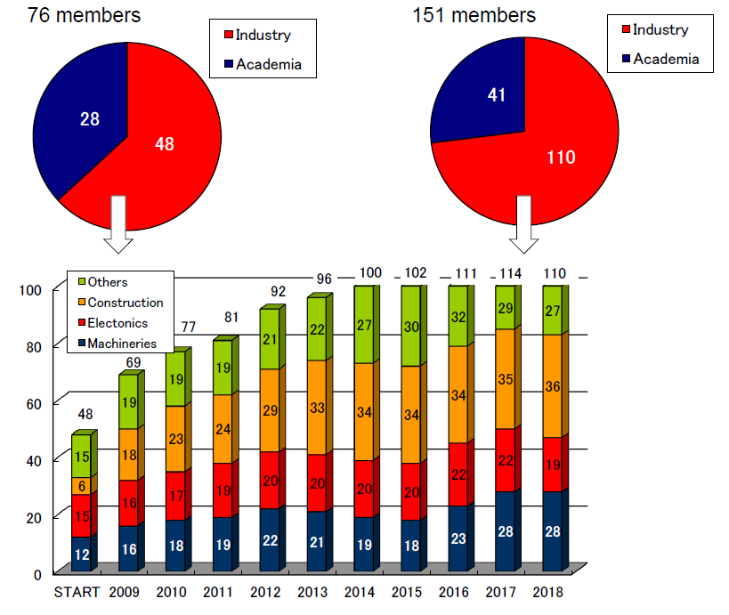
Academia – Industry Advanced Accelerator Association (AAA) in Japan
To Gain Public
Support:
AAA
Membership:
M. Matsuoka

Slide 8
Academia – Industry Advanced Accelerator Association (AAA) in Japan
To Gain Public
Support:
AAA in Japan serves as a forum on advanced accelerator R&D, IP and related areas
ILC as a “MODEL PROJECT CASE”
Finding synergies and common benefits of industries, including other research domains
AAA
Membership:
M. Matsuoka

Slide 9
Symposiums on Advanced Accelerators with AAA Participation
M. Matsuoka

Slide 10
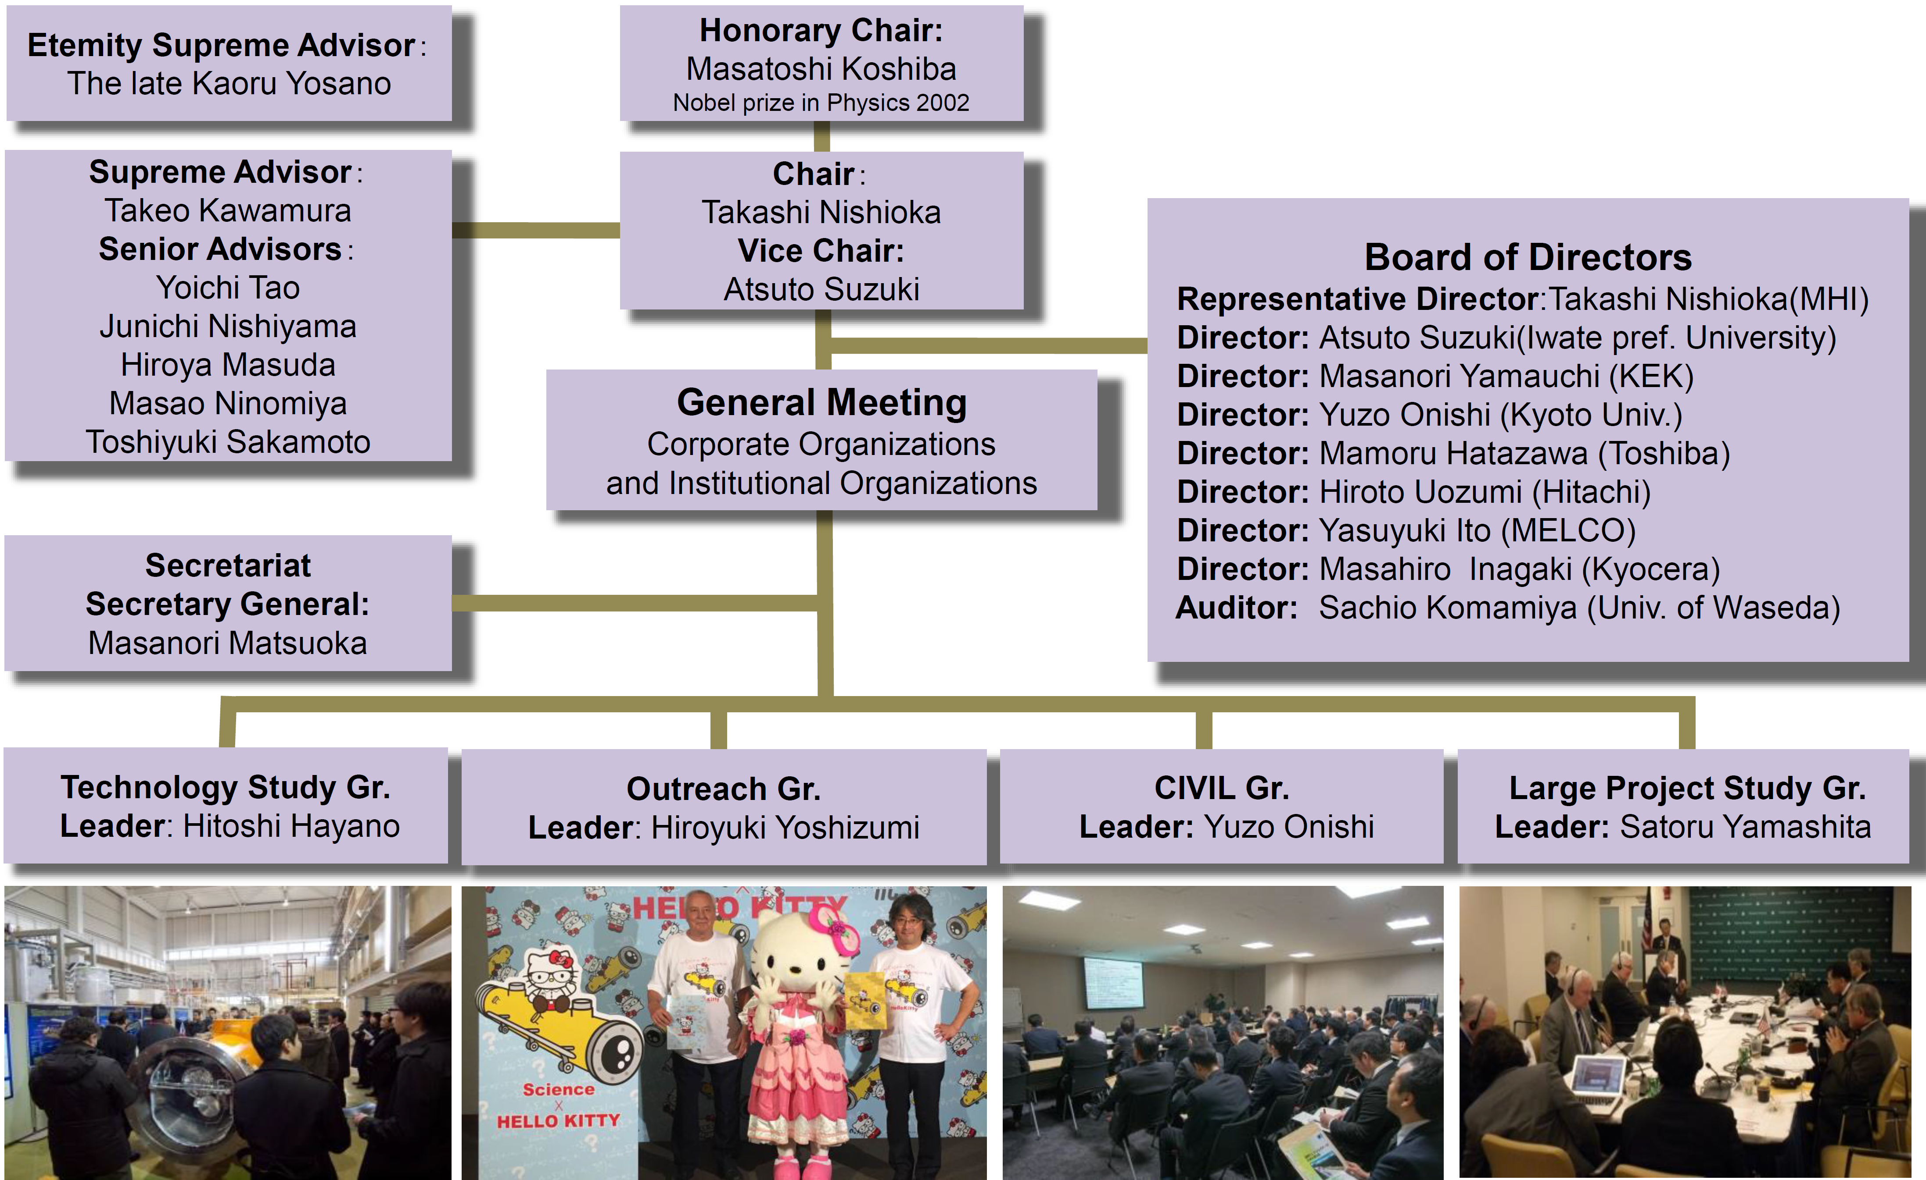
Academia – Industry Advanced Accelerator Association (AAA) in Japan
M. Matsuoka
Recently, new group has been established
(by combining Civil and Large Project Study groups)
→ the “Project Promoting Group”
to promote the International Collaboration for ILC
(with Diet, Government, Academy & Industry)

Slide 11
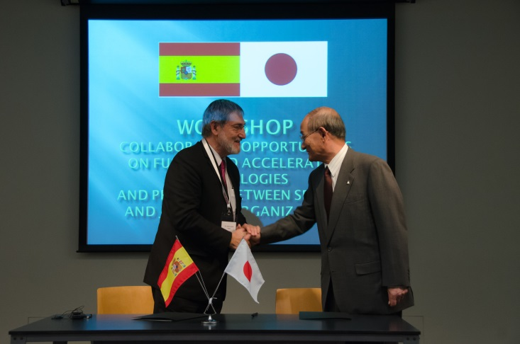
Collaboration Between Different Agents of the Spanish Science (INESTAR – AAA)
Collaboration Opportunities on Fusion and Accelerator Technologies and Projects, between Spanish and Japanese Organizations in 2016:
INEUSTAR → Spanish Science Industry
Association (private, no academia)
Collaboration between
different agents
in science industry:
Workshop at Spanish Embassy in Tokyo
(INEUSTAR – AAA)
J. Caceres

Slide 12
Tohoku Accelerator Production Cluster
M. Yoshioka

Slide 13
SppC related Technology Domestic Collaboration in China
J. Gao

Slide 14
CEPC Industrial Promotion Consortium (CIPC) in China
→ start as the Industrial Consortium with a possibility to transform to “Academy-Industry organization” in China
with “CEPC as a Model Project Case” (?)
J. Gao

Slide 15



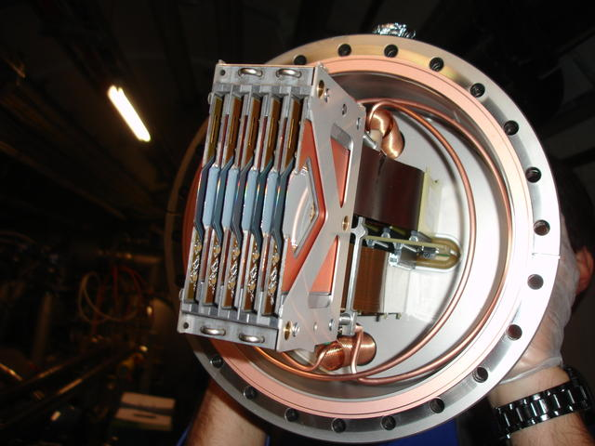

Technology Promotion Consortiums & Industrial Clusters @ LC Industry Forums
AMICI
PIGES (France):
EU-H2020:
Consolidate links and enlarge international cooperation between academia and industrial players involved in accelerator science for future large scale infrastructures
→ as a seed for more global Industrial consortiums (?)
Tohoku
Accelerator
Production
Cluster
(“ILC as the model case”)
Linear Collider Industry Forums

Slide 16
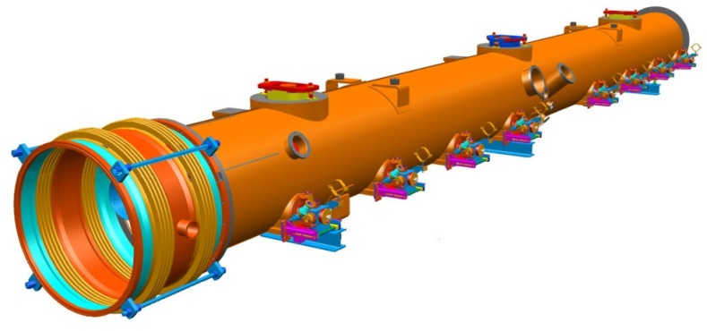
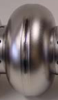




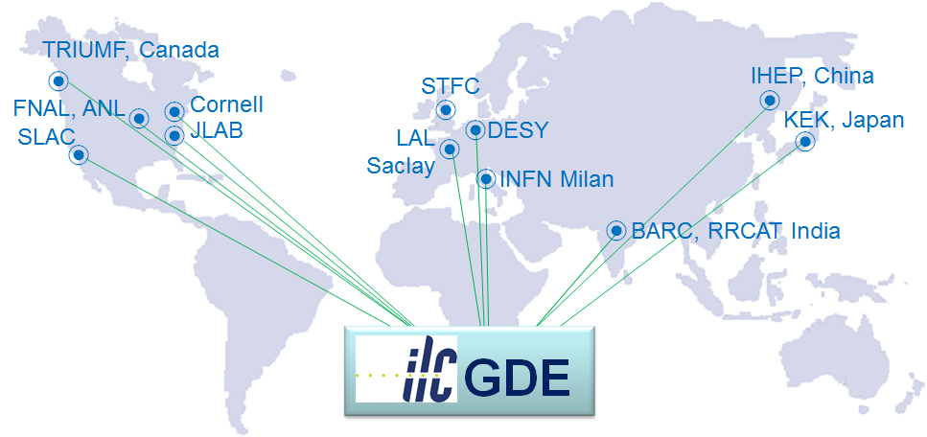
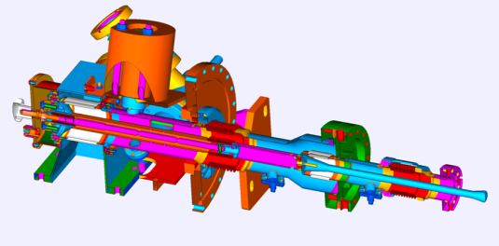
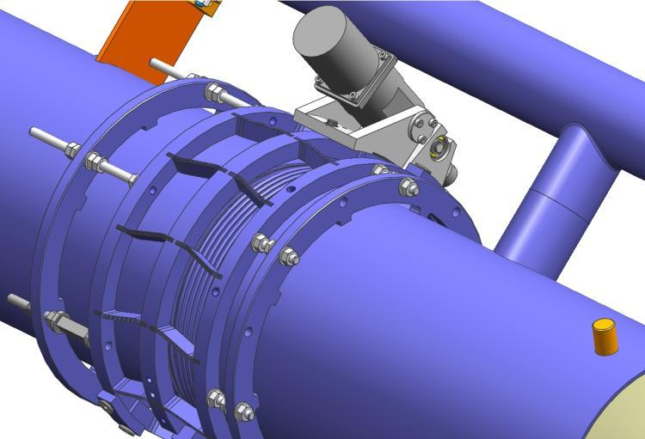
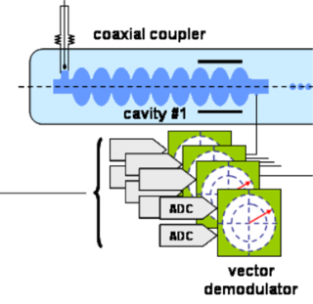
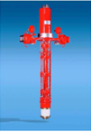
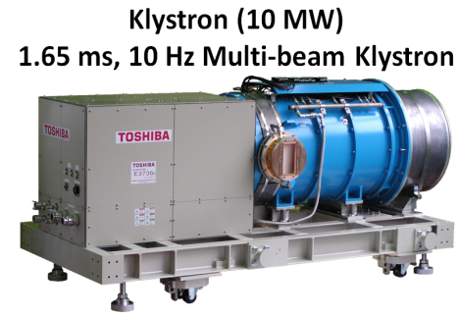
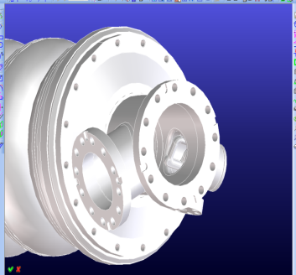
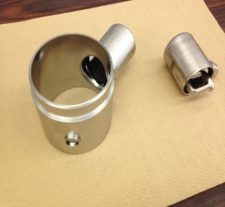
Global Superconducting RF Linac Technology
Cryomodule based on European XFEL (DESY) / LCLS-II type (USA)
RF Cavity
Cryomodule
Power
Coupler
Talks @ LCWS2017 / Strasbourg:
RF Cavities → Talks by EZ, RI
XFEL Village in CEA → ALSYOM
Couplers → THALES
Frequency
Tuner
SCRF Linac
Technology
LLRF
Acknowledging the efforts of the
TESLA Technology Collaboration
HOMs
(higher order
modes) coupler
RF
power

Slide 17
Global Superconducting RF Linac Technology
Cryomodule based on European XFEL (DESY) / LCLS-II type (USA)
RF Cavity
Cryomodule
Power
Coupler
Talks @ LCWS2017 / Strasbourg:
RF Cavities → Talks by EZ, RI
XFEL Village in CEA → ALSYOM
Couplers → THALES
Frequency
Tuner
Solid SRF technological base for the ILC on a global scale is now in place
→ promote development of 1.3 GHz cavities, expertize and infrastructure in all 3 regions
SCRF Linac
Technology
LLRF
Acknowledging the efforts of the
TESLA Technology Collaboration
HOMs
(higher order
modes) coupler
RF
power

Slide 18
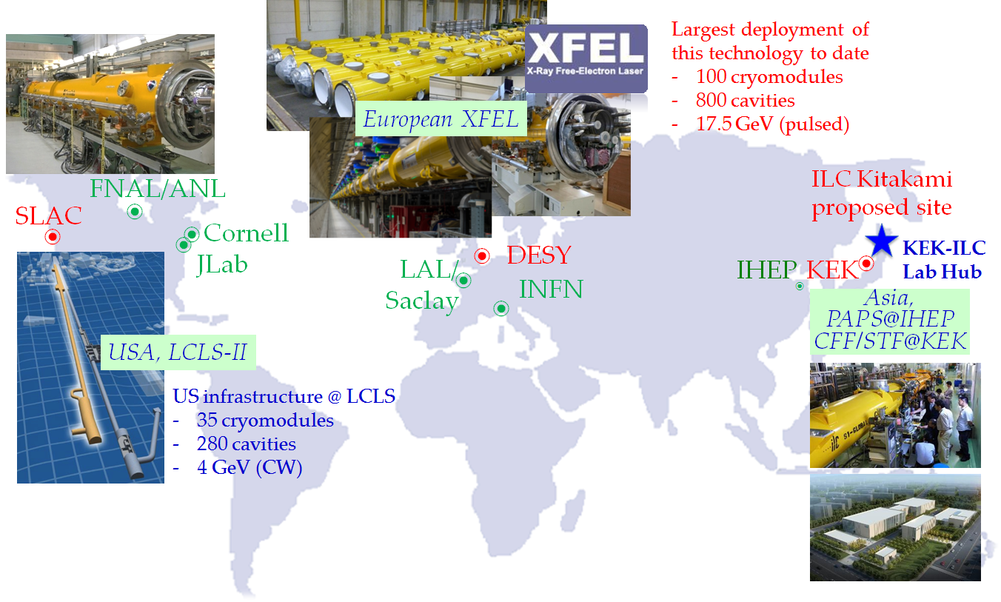
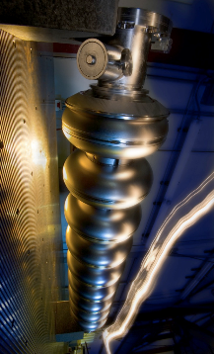
ILC-SRF Technology: Accelerators and Expertize Worldwide
EXFEL SRF Cavity Gradients:
800 cavities
(usable
gradients)
A “10% prototype” of the ILC: Industrialised cavity & cryomodule production up to ILC specifications
ILC specifications

Slide 19
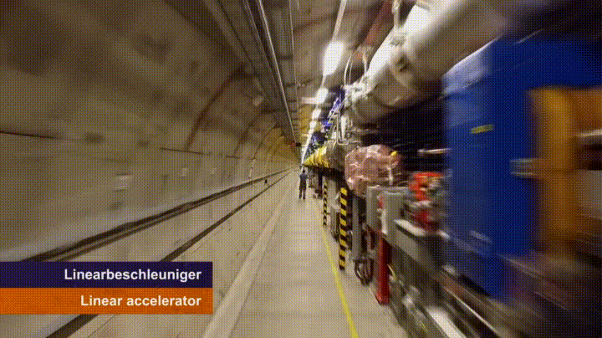
XFEL@ DESY: an Ultimate “Integrated System Test” for the ILC
EXFEL SRF Cavity Gradients:
800 cavities
(usable
gradients)
A “10% prototype” of the ILC: Industrialised cavity & cryomodule production up to ILC specifications
ILC specifications

Slide 20
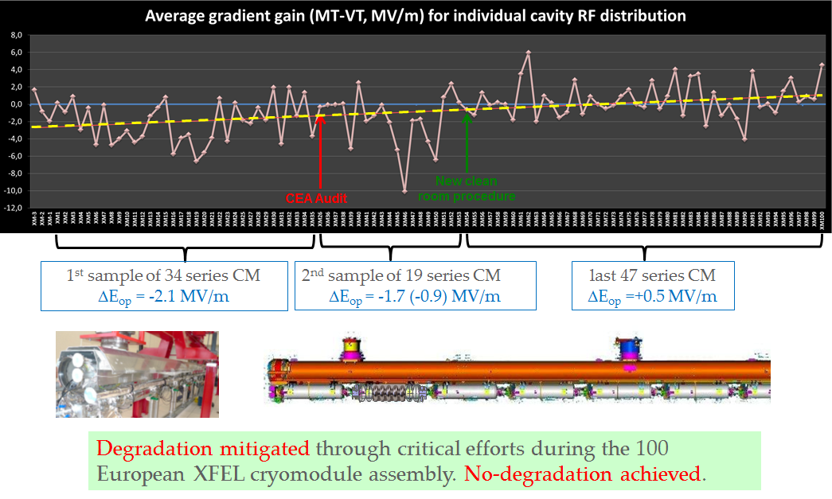
XFEL Gradient Performance: Cryomodule vs Cavity
Courtesy: O. Napoly
ALSYOM @ 2017LCWS
Assembly of ~100 (“ILC-like”)
cryomodules operated by an
industrial contractor using
CEA Saclay infrastructure
→ achieved goal to deliver
1 cryomodule per 4 days

Slide 21
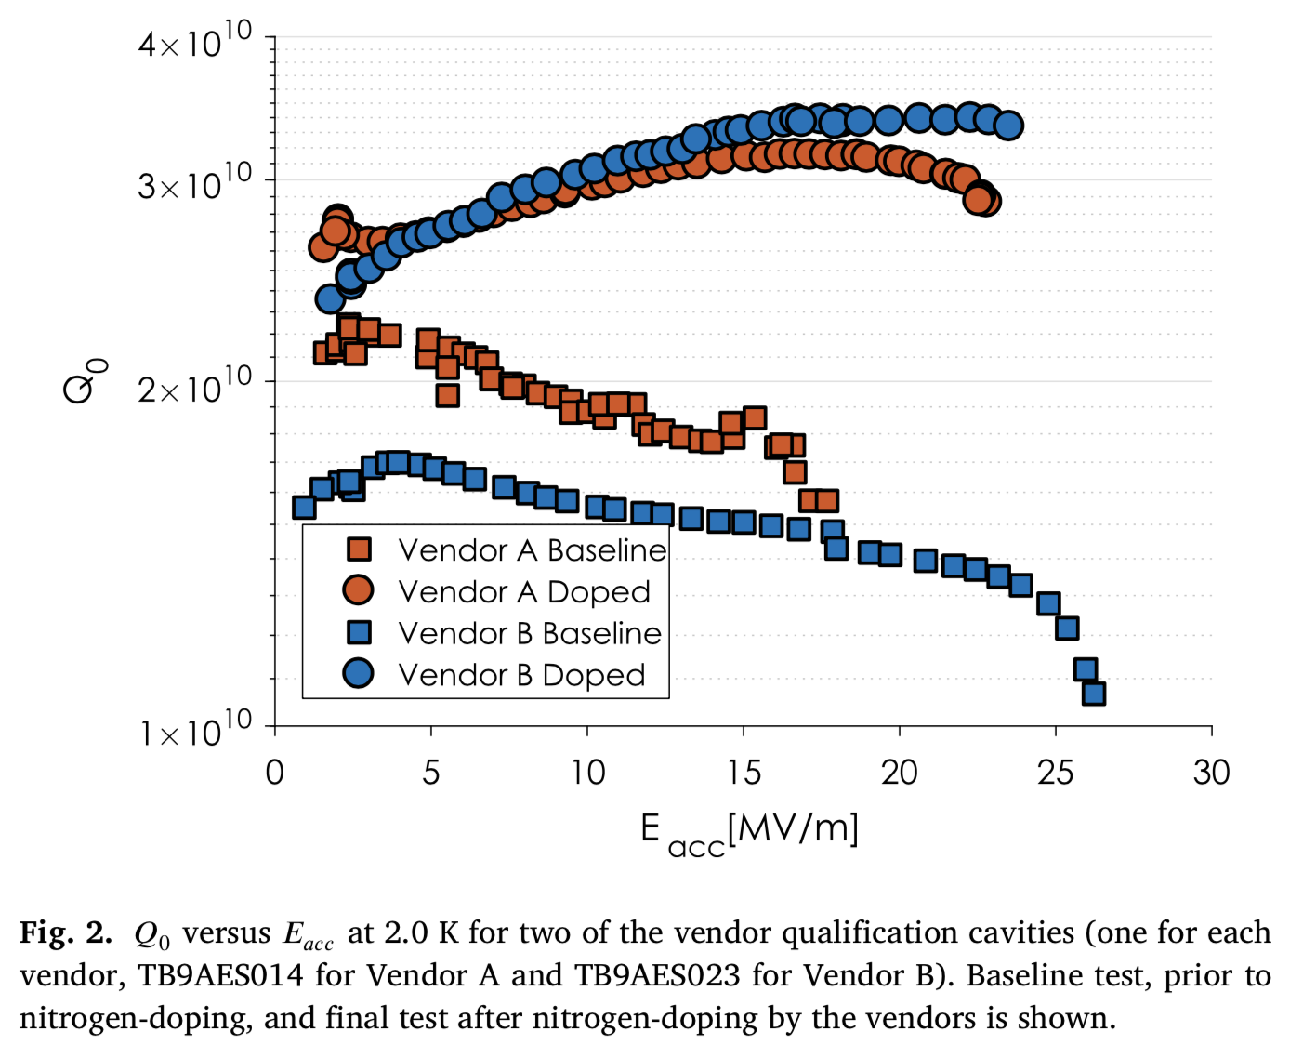
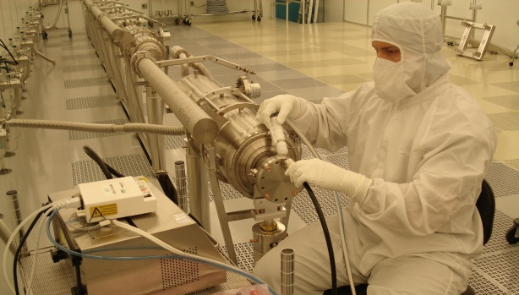
Industry-Research Institution Collaboration in the United States
Technology transfer of nitrogen doping treatment to cavity vendors for LCLS-II
Number of highly skilled US-vendors for SRF accelerator components
(e.g. contributing to LCLS-II and other projects, R&D) →
invite them to the next LCWS2018 Symposium in Texas
Production of LCLS-II 1.3 GHz CryoModules: ½ at JLab, ½ at Fermilab (300 cavities)
Fermilab cleanroom
Jefferson Lab cleanroom
S. Posen
Process includes vertical test qualification, string assembly, cold mass, vacuum vessel, cryomodule testing

Slide 22
1 company in China – experience
with “cold mass” assembly
3 companies in China
J. Gao

Slide 23
Experience of Industry-Academia Cooperation in CLIC
Engaging with industry from the prototype stage →
several forms of technology transfer and joint R&D are available
A. Solodko

Slide 24
Examples of Industrial Developments for CLIC
S. Stapnes ALCW2018
N. Catalan Lasheras, LCWS2017
General Overview: RF- Componets
Next phase:
Qualified companies, technical and commercial documentation, reliable costs (i.e. not first prototype), ideally (small) part of larger market

Slide 25
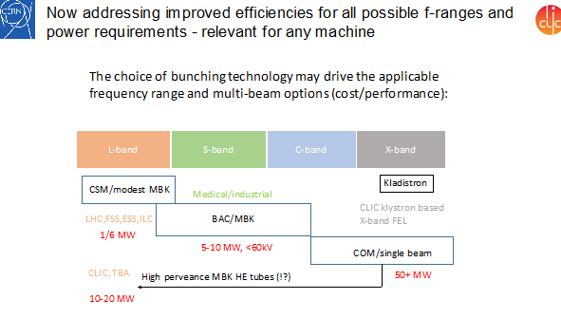
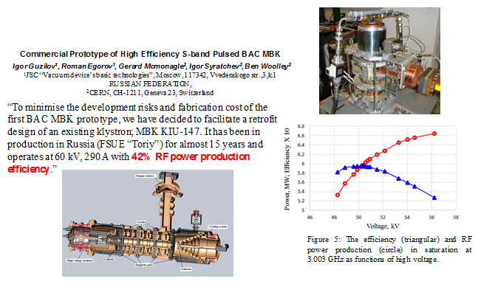
New Ideas on Klystron Efficiency: INITIAL study
S. Stapnes

Slide 26
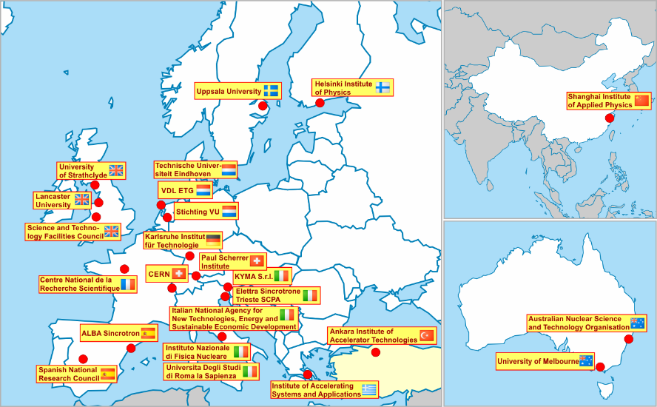
Existing and Planned X-band Infrastructure in Collaboration with CERN
There is a growing interest on the use of high gradient X-band technology outside HEP domain
S. Stapnes, ALCW2018
Beyond being a collaboration for CLIC, many
groups have their own X-band facilities and components (see overview)
Left: EU Design Study for X-Band FELs 2018-2020:
http://compact-light.web.cern.ch
In the CLIC preparation phase:
Take advantage of the widespread use of electron linacs, and rapidly increasing use of X-band → make technology available to other research institutes and companies

Slide 27
ALCW2018: Industrial Company Presentations
Akita Chemical Industries: Development of
copper plating solution suitable for couplers
IWATE IRON: Consideration of precision
adjustment abutment of ILC cryomodule
N. Sasaki
T. Okubo
Scandinova: High stability technology for
Klystron modulators
MHI-MS: New standards for the high pressure
gas safety act for ILC is needed
O. Yushiro
T. Yanagisawa

Slide 28
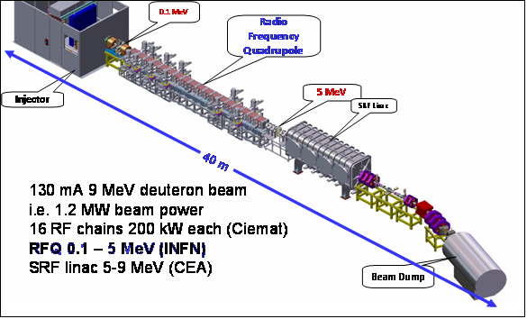
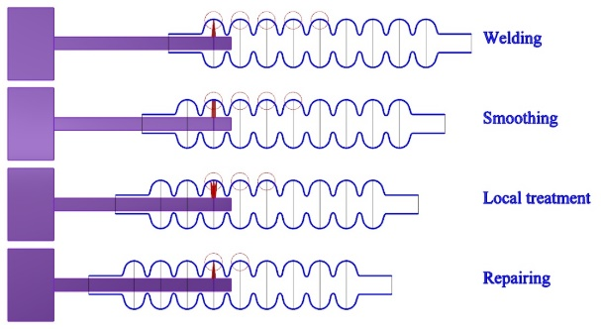
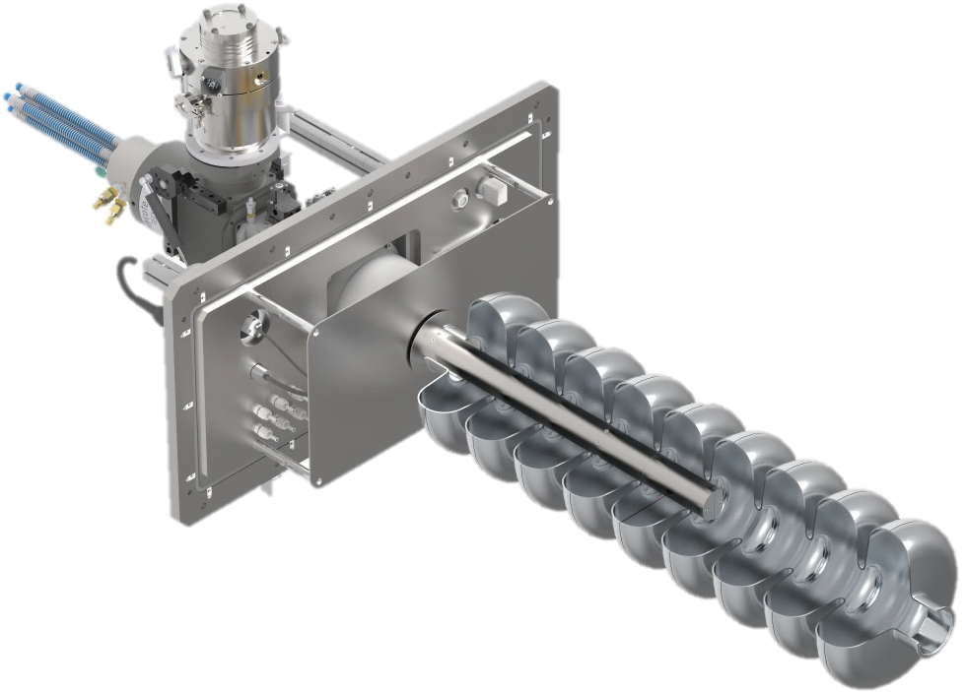
ALCW2018: Industrial Company Presentations
FUJIKURA: Development of GEM Gating Foils
Using Flexible Circuit Production Technique
SEVEN SOLUTIONS: RF Time and Distribution;
RF-cavities Control / Tune Systems
M. Yoshikai
T. Yonekawa
HAMAMATSU: Silicon Detectors for HEP
TECHMETA: Inside Cavity Welding of
Equatorial Weld
Collaboration for
proof and integration
P. Oving
Y. Ohashi

Slide 29
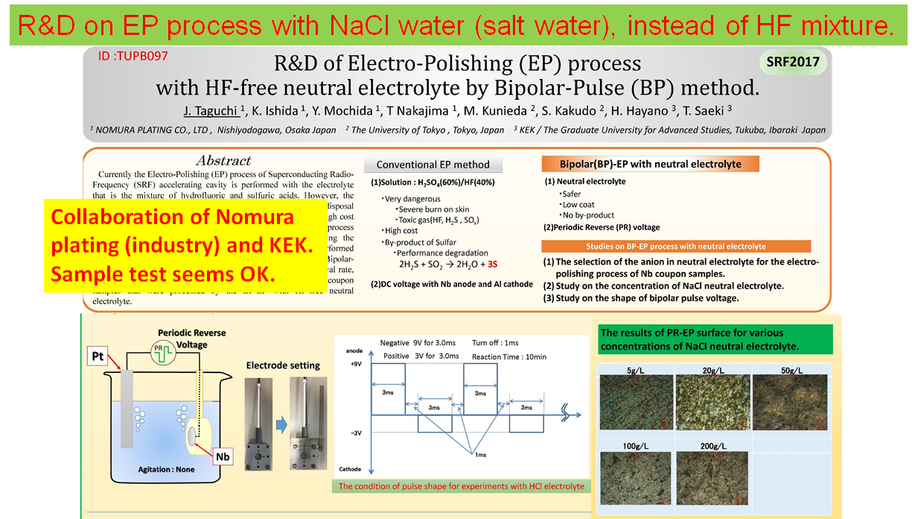
Future Direction for Industry – Academia Collaboration
A. Suzuku
M. Yoshioka
SUSTAINABILITY / HEAT - ENERGY RECOVERY
T. Saeki
Low activity in Europe
D. Perret-Gallix

Slide 30
Backup Slides

Slide 31
CERN Courier article, March 2013:
http://cerncourier.com/cws/article/cern/52358
In a view of the current and future large-scale, the IEEE NSS/MIC Symposium
is the natural place to address:
The role of particle physics and technology for medical physics and society well-being
The importance of broadening international partnership to address social challenges
using high-tech technologies

