Slide 1
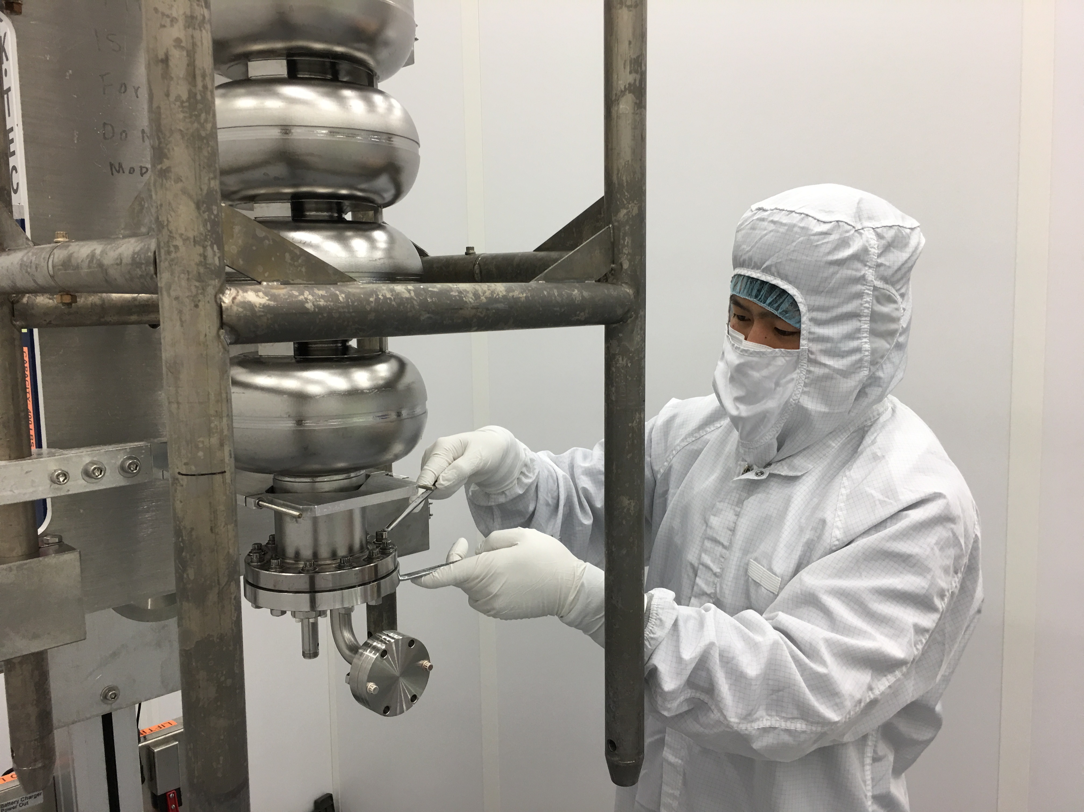
High-Gradient High-Efficiency SRF Cavity Development at JLAB
Latest Results on LSF-Shape Nb Cavities JLAB-KEK Collaboration Under US-Japan HEP Cooperation Program
Rongli Geng, JLAB
Hayato Ito, Hitoshi Hayano, KEK
Other collaborators:
Zenghai Li, Chris Adolphsen, SLAC
Jiankui Hao, Kexin Liu, PKU
Other Jefferson Lab contributors: Bill Clemens, Jim Follkie, Tom Goodman, Teena Harris, Chad Johnson, Ashley Mitchell, Pete Kushnick, Scott Williams

Slide 2
Outline
Long march of SRF technology and great success of new cavity shapes
Struggle for new shape demonstration in 9-cell cavities
LSF emerged as best cavity shape and its potential for high gradient & high efficiency
Moving forward, JLAB chose LSF+LG Nb approach – on ground of GDE SRF success
Single-cell LSF+LG Nb cavities
LSF5-1 first multi-cell LSF and its first tests
Conclusion and outlook

Slide 3
The Long March of SRF Technology
Breakthrough brought by
new cavity shapes
RE @ Cornell
LL/ICHIRO @ KEK
125

Slide 4
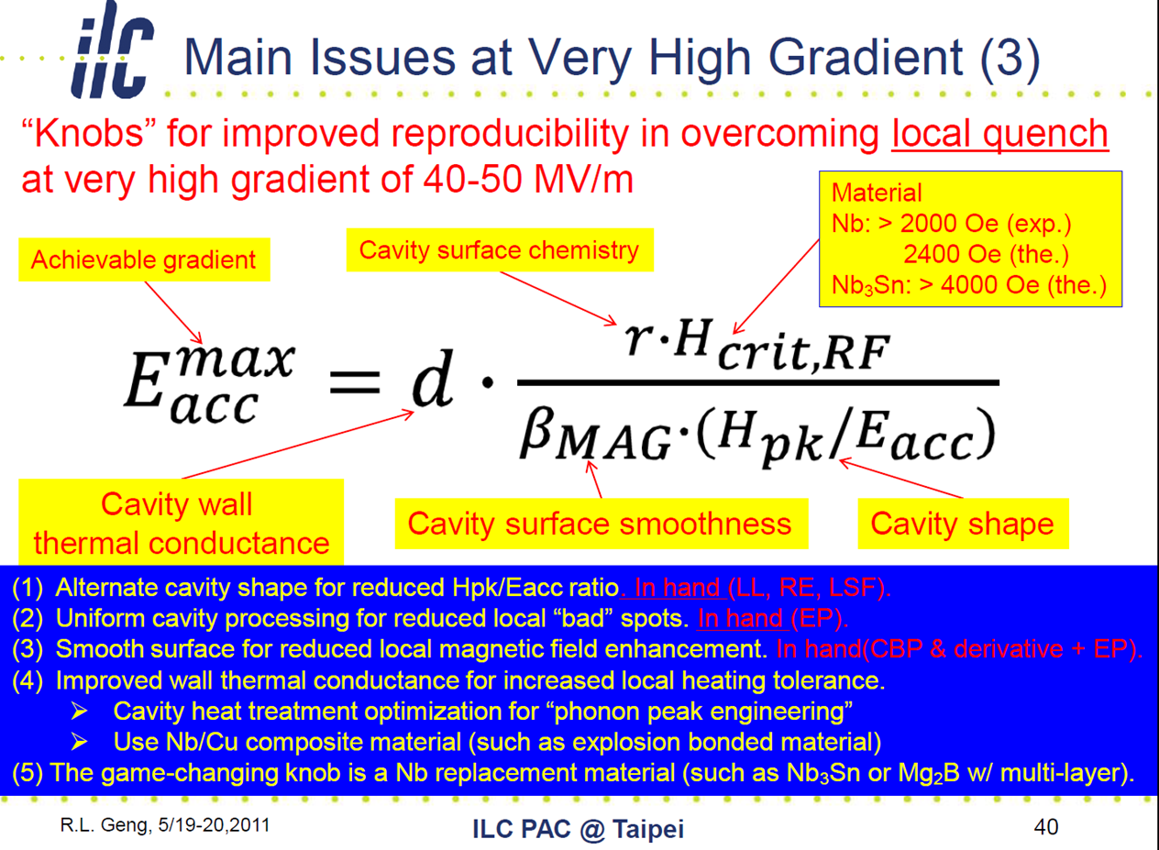
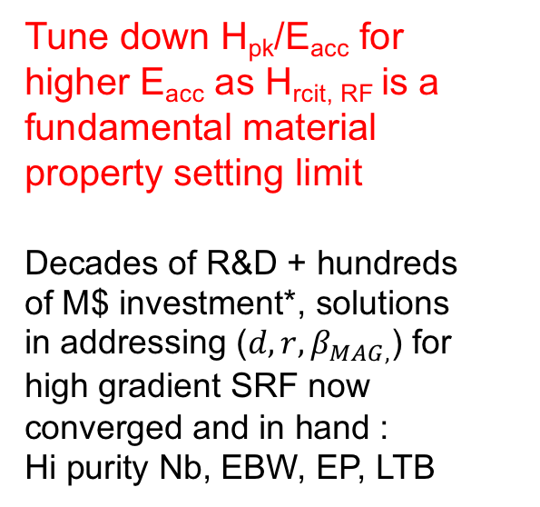
The Idea (as viewed though a “phenomenological law for gradient”)
EP
Tune down H_{pk}/E_{acc} for higher E_{acc} as H_{rcit, RF} is a fundamental material property setting limit
Decades of R&D + hundreds of M$ investment*, solutions in addressing ($d, r, β_{MAG,}$) for high gradient SRF now converged and in hand :
Hi purity Nb, EBW, EP, LTB
EBW, EP
High purity (RRR) Nb
* Kneisel, Hot Topics, SRF2009.

Slide 5
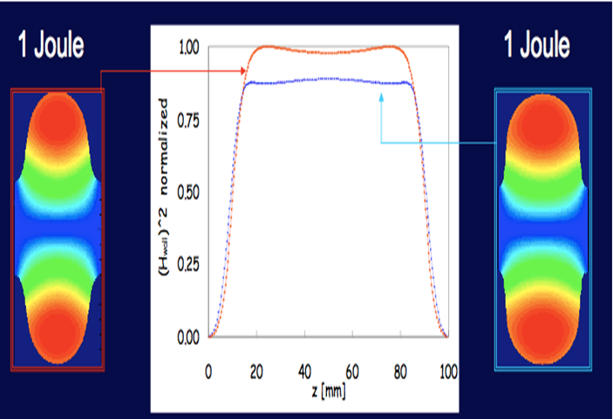
The Approach
Enlarge equator to “dilute” surface RF current hence to
Lower H_{pk}
Courtesy J. Sekutowicz
Courtesy J. Sekutowicz

Slide 6
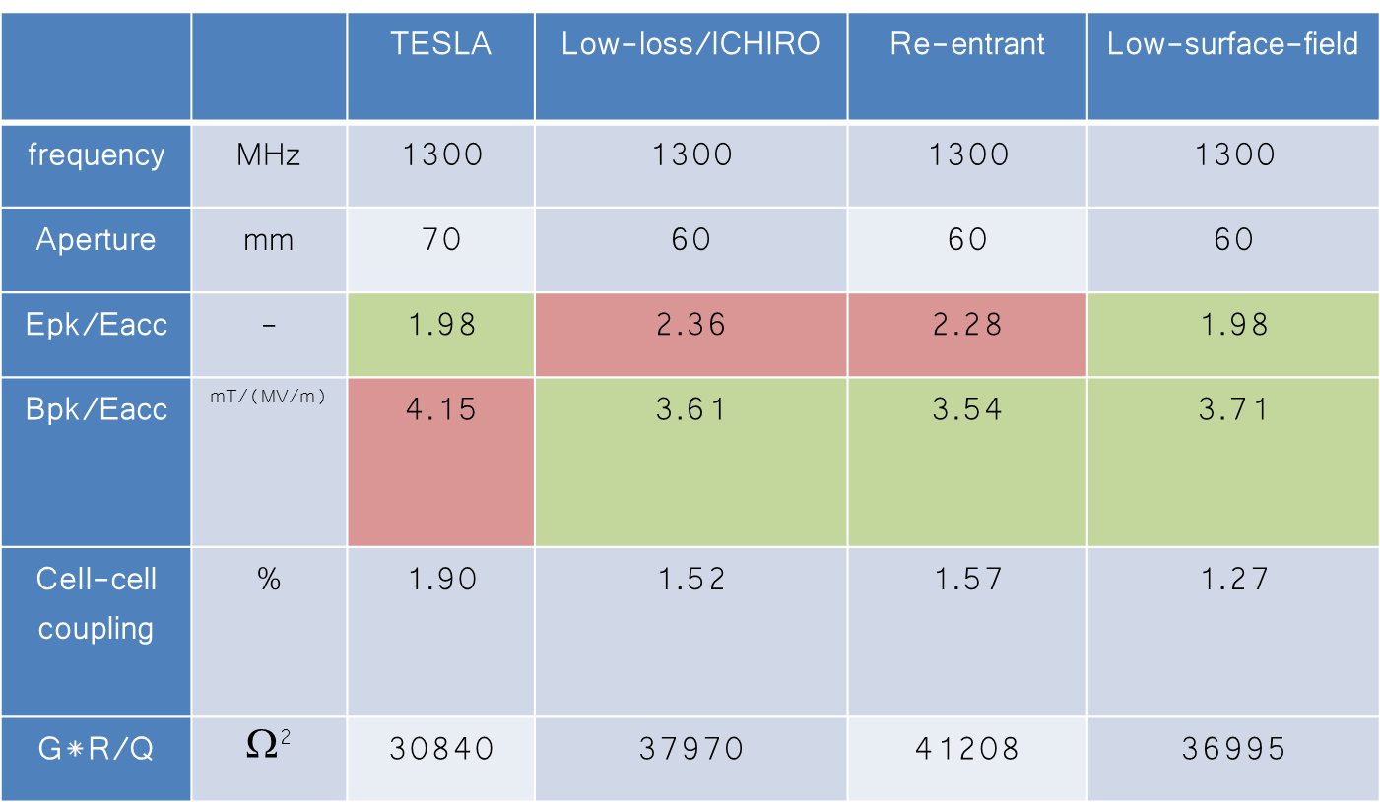
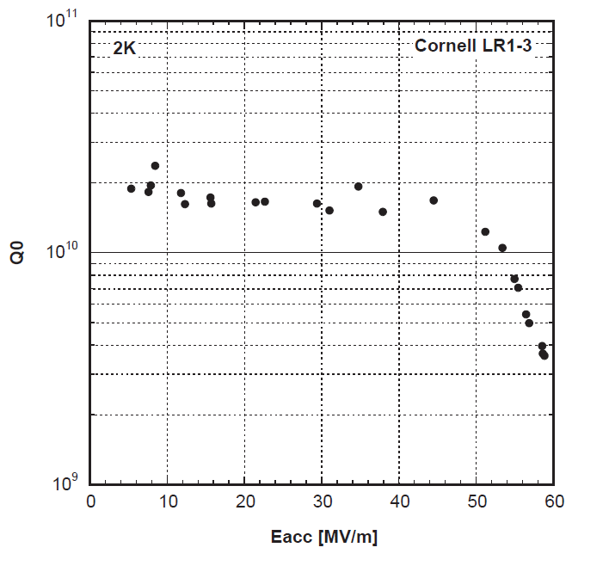
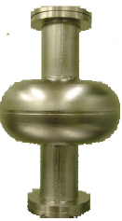
The Early Shape-Players in 2002-2003 and Great Success
Lowering H_{pk}/E_{acc} by 13-15%
E_{acc} 50-60 MV/m Achieved
Geng et al, PAC2007
RE
  Shemelin, Padamsee, Cornell Internal Report, SRF020128-01 (2002).
  Shemelin, Padamsee, Geng, NIM-A496(2003)1.
LL
  Sekutowicz, Kneisel, Ciovati, Wang, JLAB Tech Note, TN-02-023 (2002).
  Sekutowicz, Talk 1st ILC Workshop at KEK, Japan, Nov. 13-15, 2014.
TESLA
  Haebel et al., Proc. HEACC vol.2 , Hamburg (1992).
  Proch, Proc. 6th SRF Workshop, Newport News, VA, USA (1993).
Furuta el al, SRF2007

Slide 7
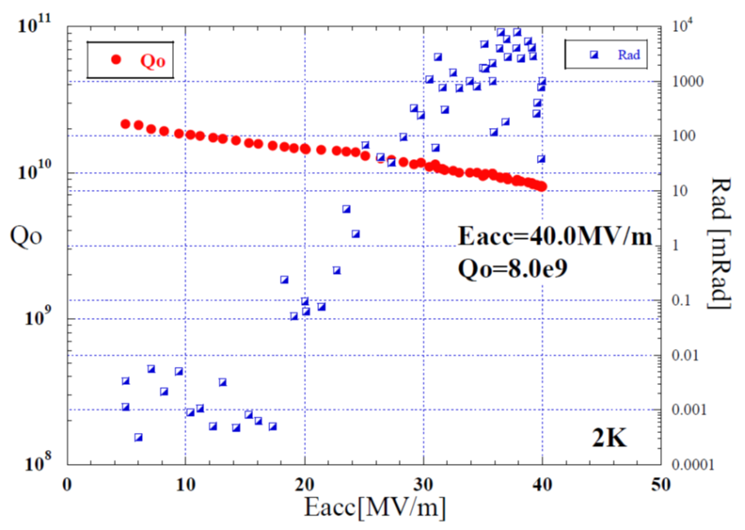

The Struggle in Extending Success to Full-Scale 9-Cell
50 MV/m not realized in 9-cells
Best 9-cell result 40 MV/m by ICHIRO7
Old enemy: Field Emission!
Furuta el al, SRF2011
H_{pk}/E_{acc} 13-15% reduction in RE & LL at cost of 15-20% increase in E_{pk}/E_{acc.}
Lessons learned: To materialize the full potential of new shapes, it is still required to fight against field emission, though it not being a fundamental limit.

Slide 8
The LSF Emerged as Best Shape
Lowering H_{pk}/E_{acc} by 11% while preserving the same E_{pk}/E_{acc}
Li, Adolphsen, LINAC08 (2008).
All new shapes offer additional
benefits in higher efficiency
20-34% saving in power dissi.

Slide 9
JLAB Chose LSF + LG Nb as the New Approach in 2013
ILC S0 program concluded and TDR published in 2013
  90% yield vertical qualification test at avg gradient 35 MV/m (TESLA shape + FG Nb + EP).
Moving forward, built upon successful outcome of SRF R&D under GDE, and in recognition of
  Solid knowledge in cell shape properties.
  10-year’s global experience in new shape cavity prototyping and testing since 2003.
  Observed higher Q₀ in LG Nb cavities in 2011-2013 (its origin subsequently understood).
  (See more in backup slides).
A new approach chosen at JLAB for demonstrating higher SRF gradient and for help lower ILC project risk and cost via more gradient margin and better efficiency:
LSF shape + LG Nb (high purity) + EP

Slide 10
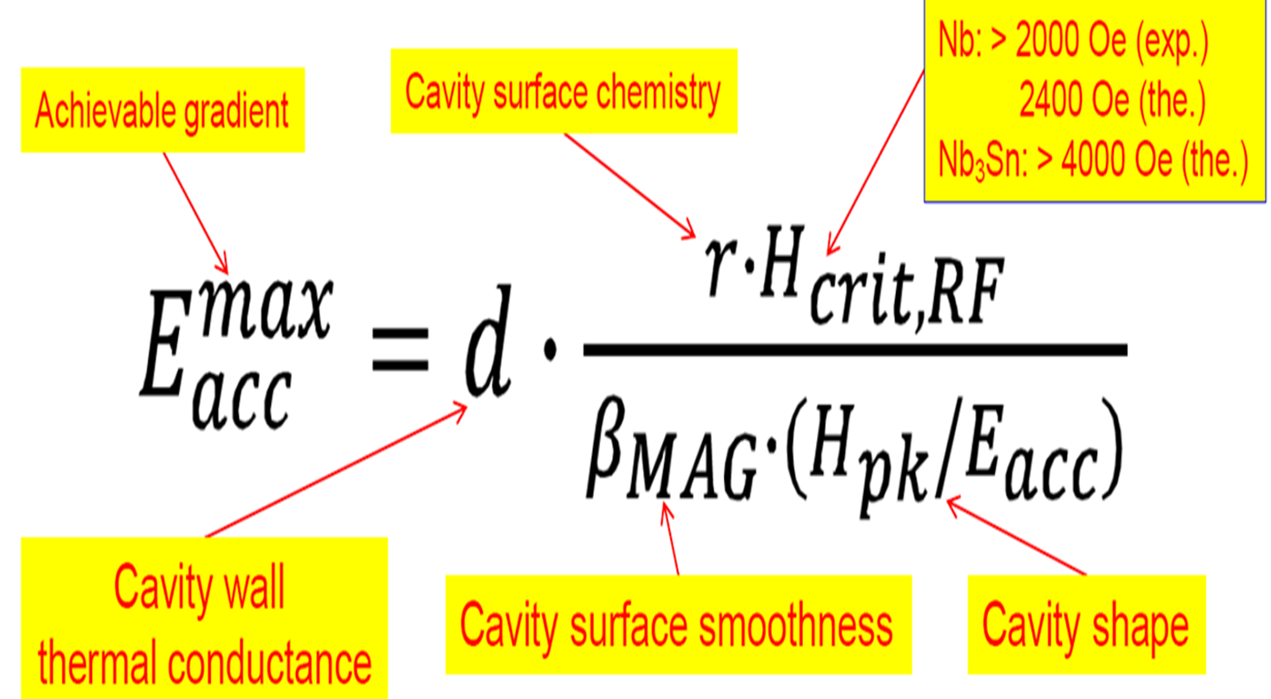
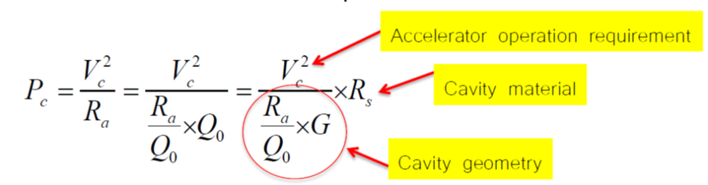
JLAB Selected LSF + LG Nb as the New Approach in 2013 (cont.)
Goal: 11% more gradient margin and 45% better efficiency underpinned by selected shape & material
11% more gradient margin by tuning one parameter
Other parameters untouched hence avoid provoking new risks
25-30% from material
40-45% better efficiency
15% from shape

Slide 11
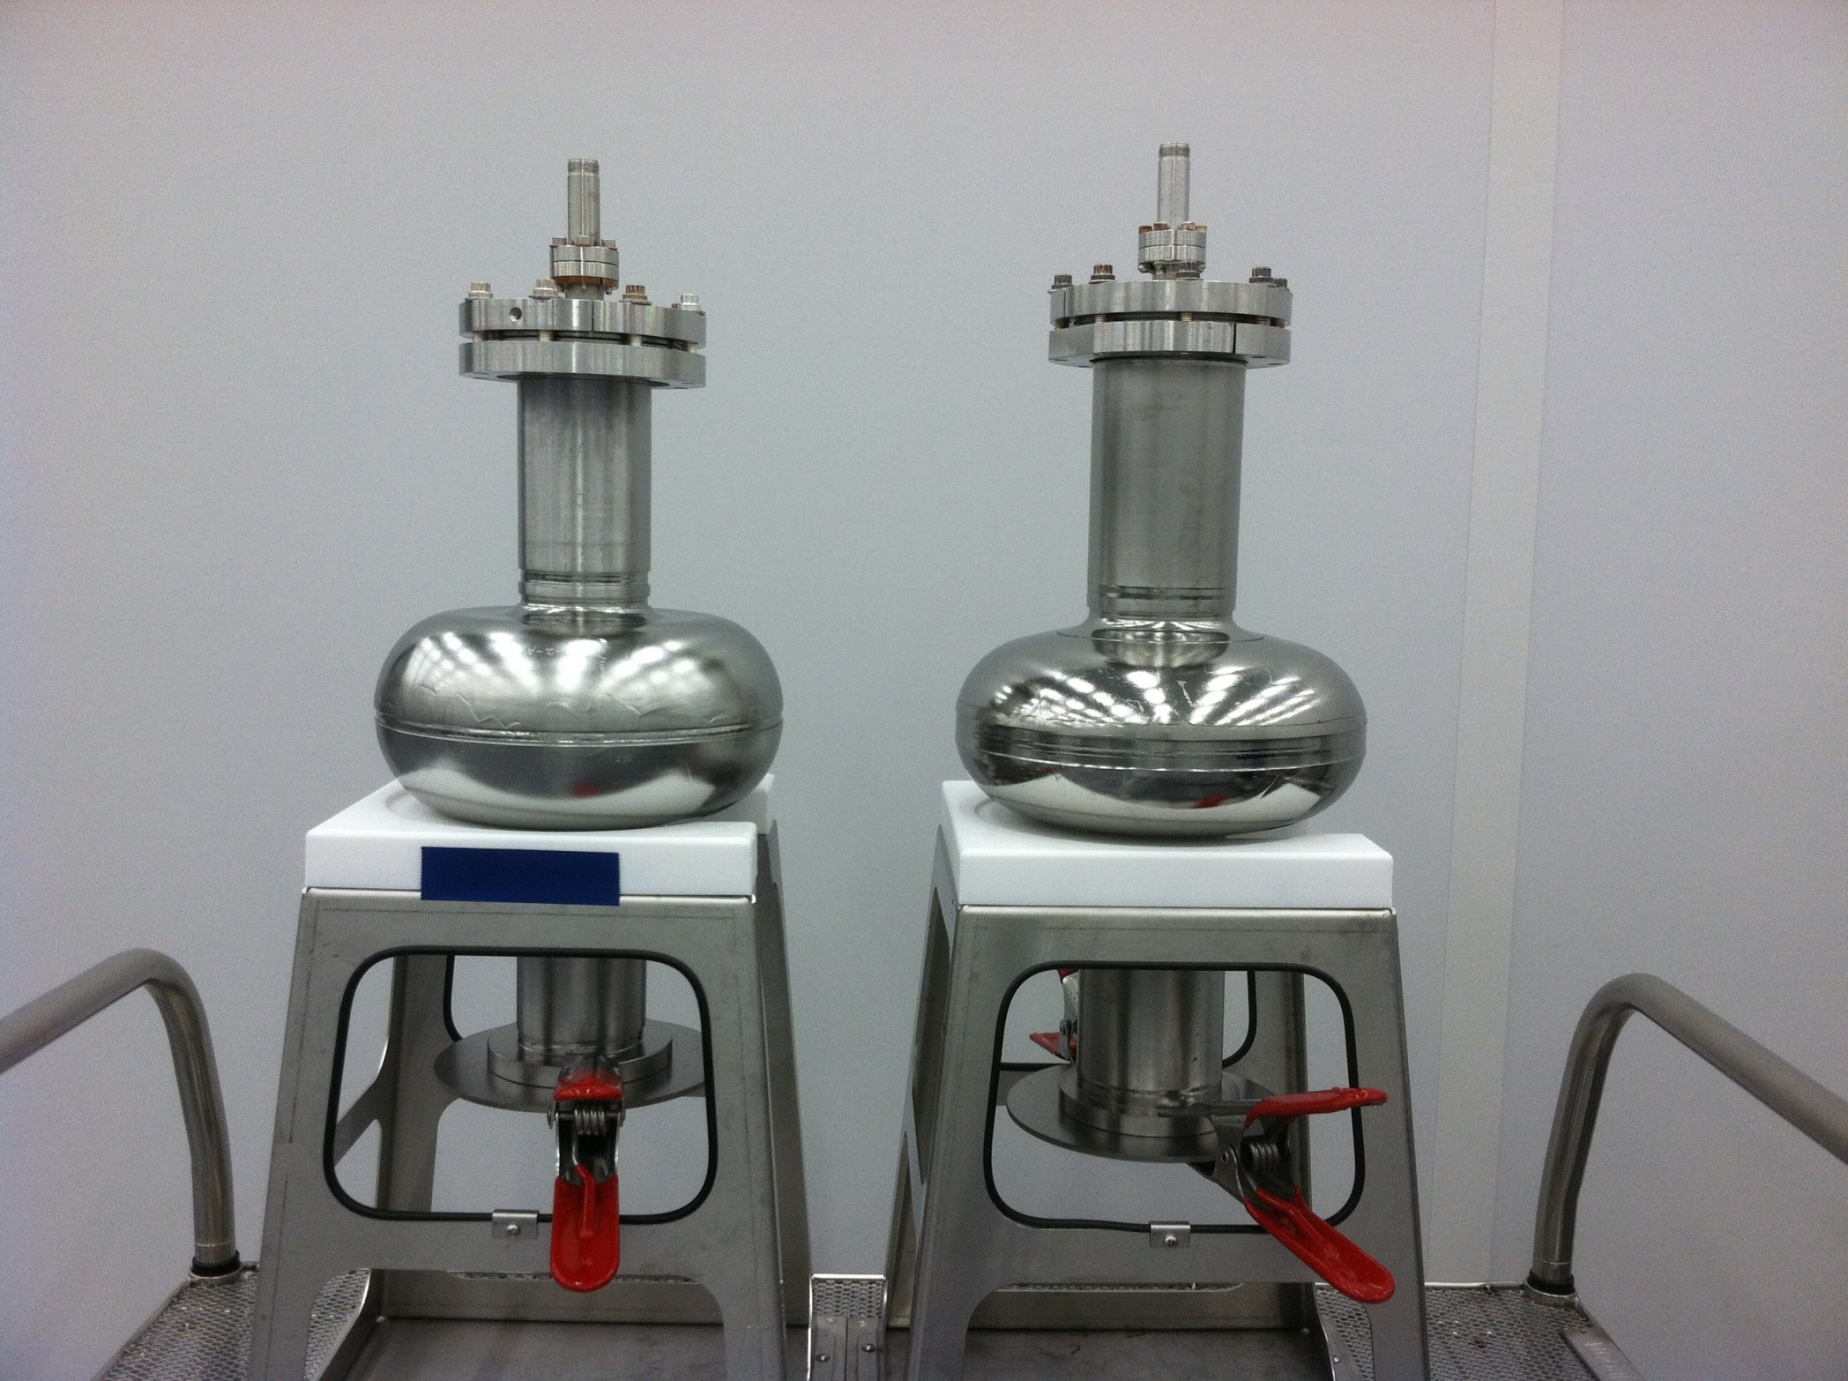
Single-Cell LSF LG Nb Cavities – Early Fruits Through a Collaboration
Collaborators: JLAB, PKU, SLAC
LSF
TESLA
Two 1-cell LSF LG Nb cavities built and tested.
Ningxia high-purity LG Nb.
~38 MV/m @ Q0 ~2E10 after surface BCP only.
Surface EP now in progress to raise Eacc.
Geng et al., WEPWI013, IPAC2015 (2015)

Slide 12
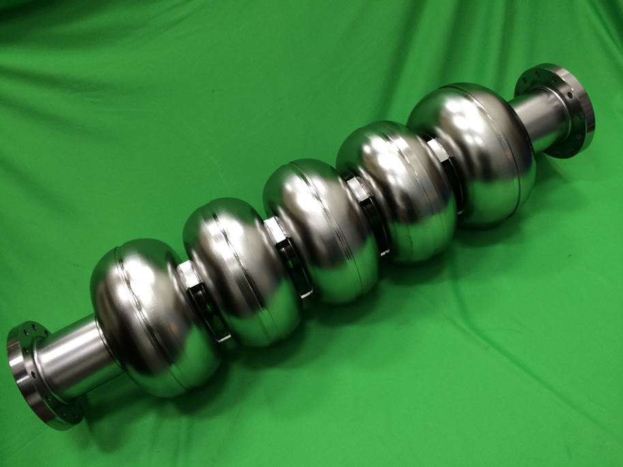
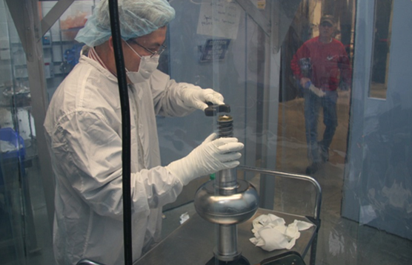
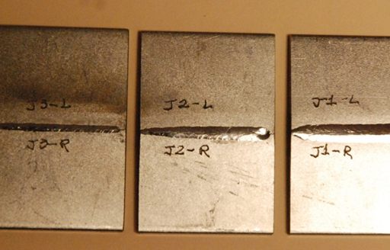
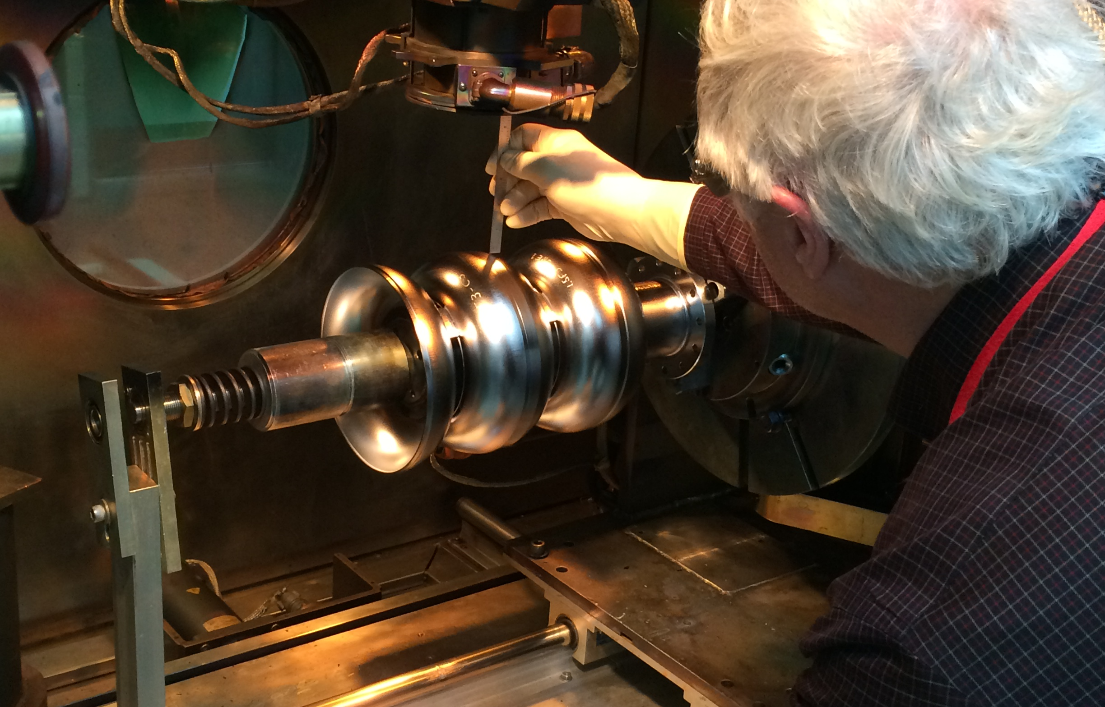
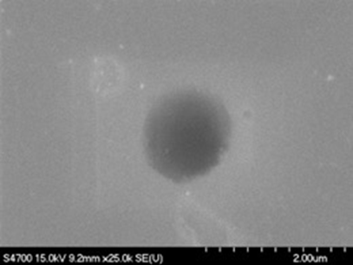
March 3, 2016 Birth of first multi-cell LSF cavity – enabled by US-Japan Collaboration
A new pre-EBW cleaning recipe was established at JLab – an outcome of weld porosity study of prior years (2014-2015) joint study between JLAB and KEK under US-Japan collaboration.
The new recipe was first applied to the in-house fabrication of 1-cell LSF shape cavities.
The same recipe was applied to in-house fabrication of 5-cell LSF shape cavity LSF5-1.
Fine-grain Nb (to allow comparison with TESLA & LL/ICHIRO).
LSF5-1
JLAB EBW sample shipped to KEK
KEK result of weld porosity

Slide 13
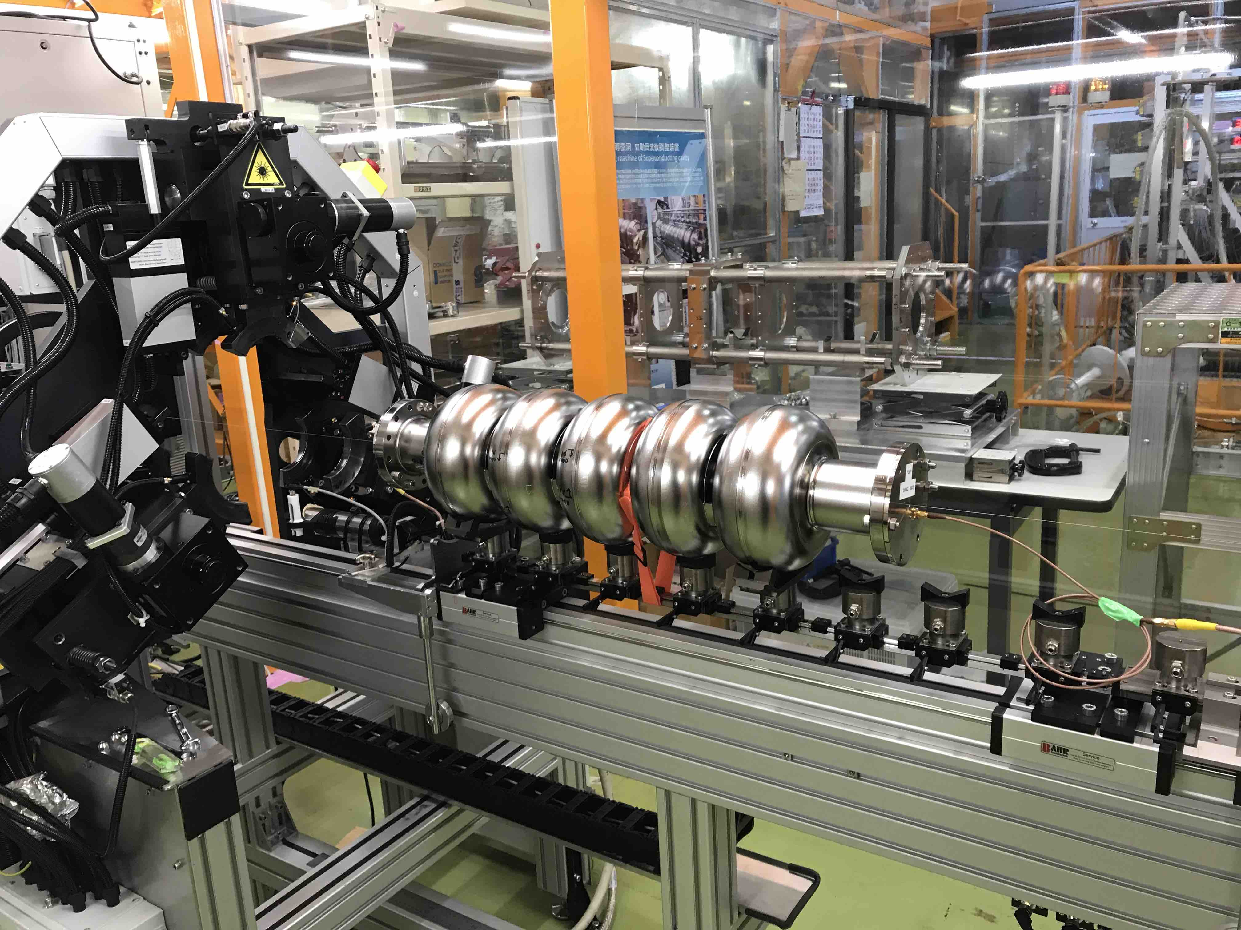
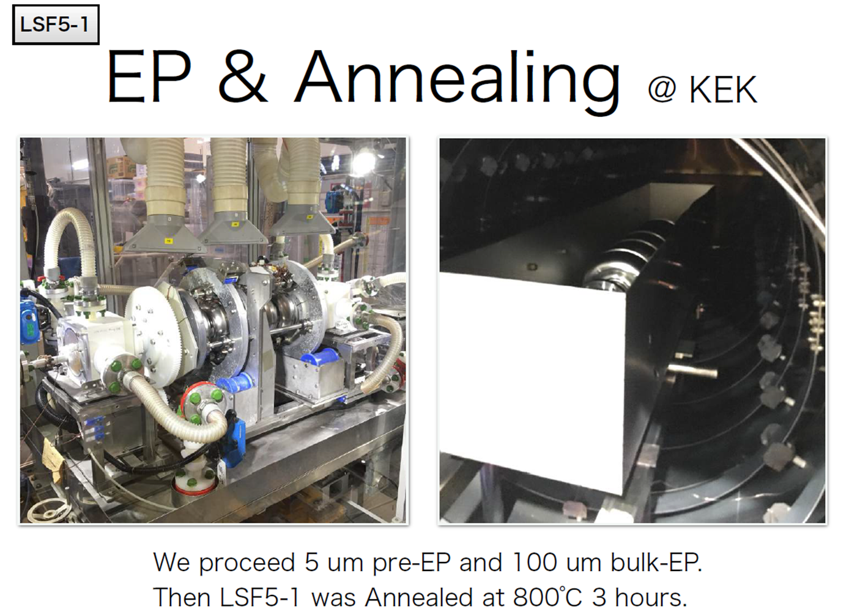
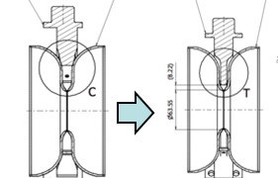
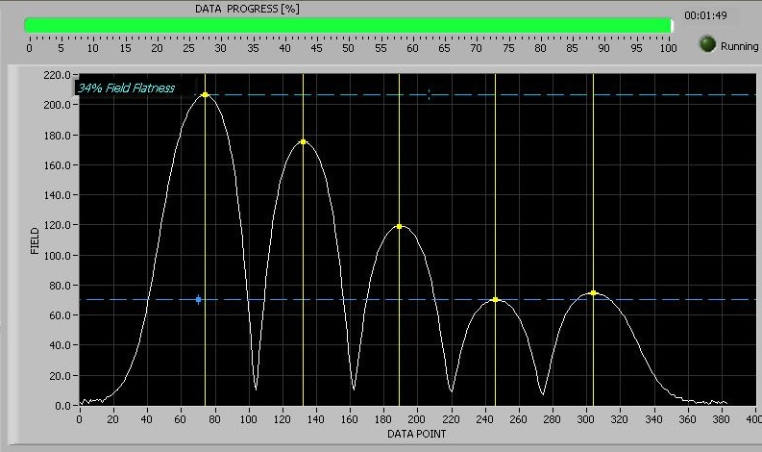
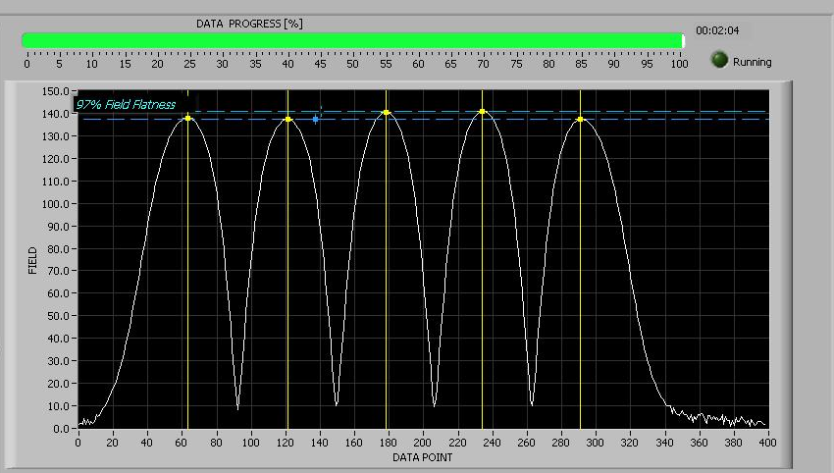
LSF5-1 Processing at KEK with Its Proven High Gradient Yield ILC-Style Recipe
Pre-EP 5um and
bulk EP 100 um
Vacuum furnace 800C 3hr
heat treatment
Tuning
KEK tuning machine Jaws modification
KEK tuning machine Jaws modification
More
thinner
Blade
Field flatness
34% as received
Field flatness
tuned to 97%

Slide 14
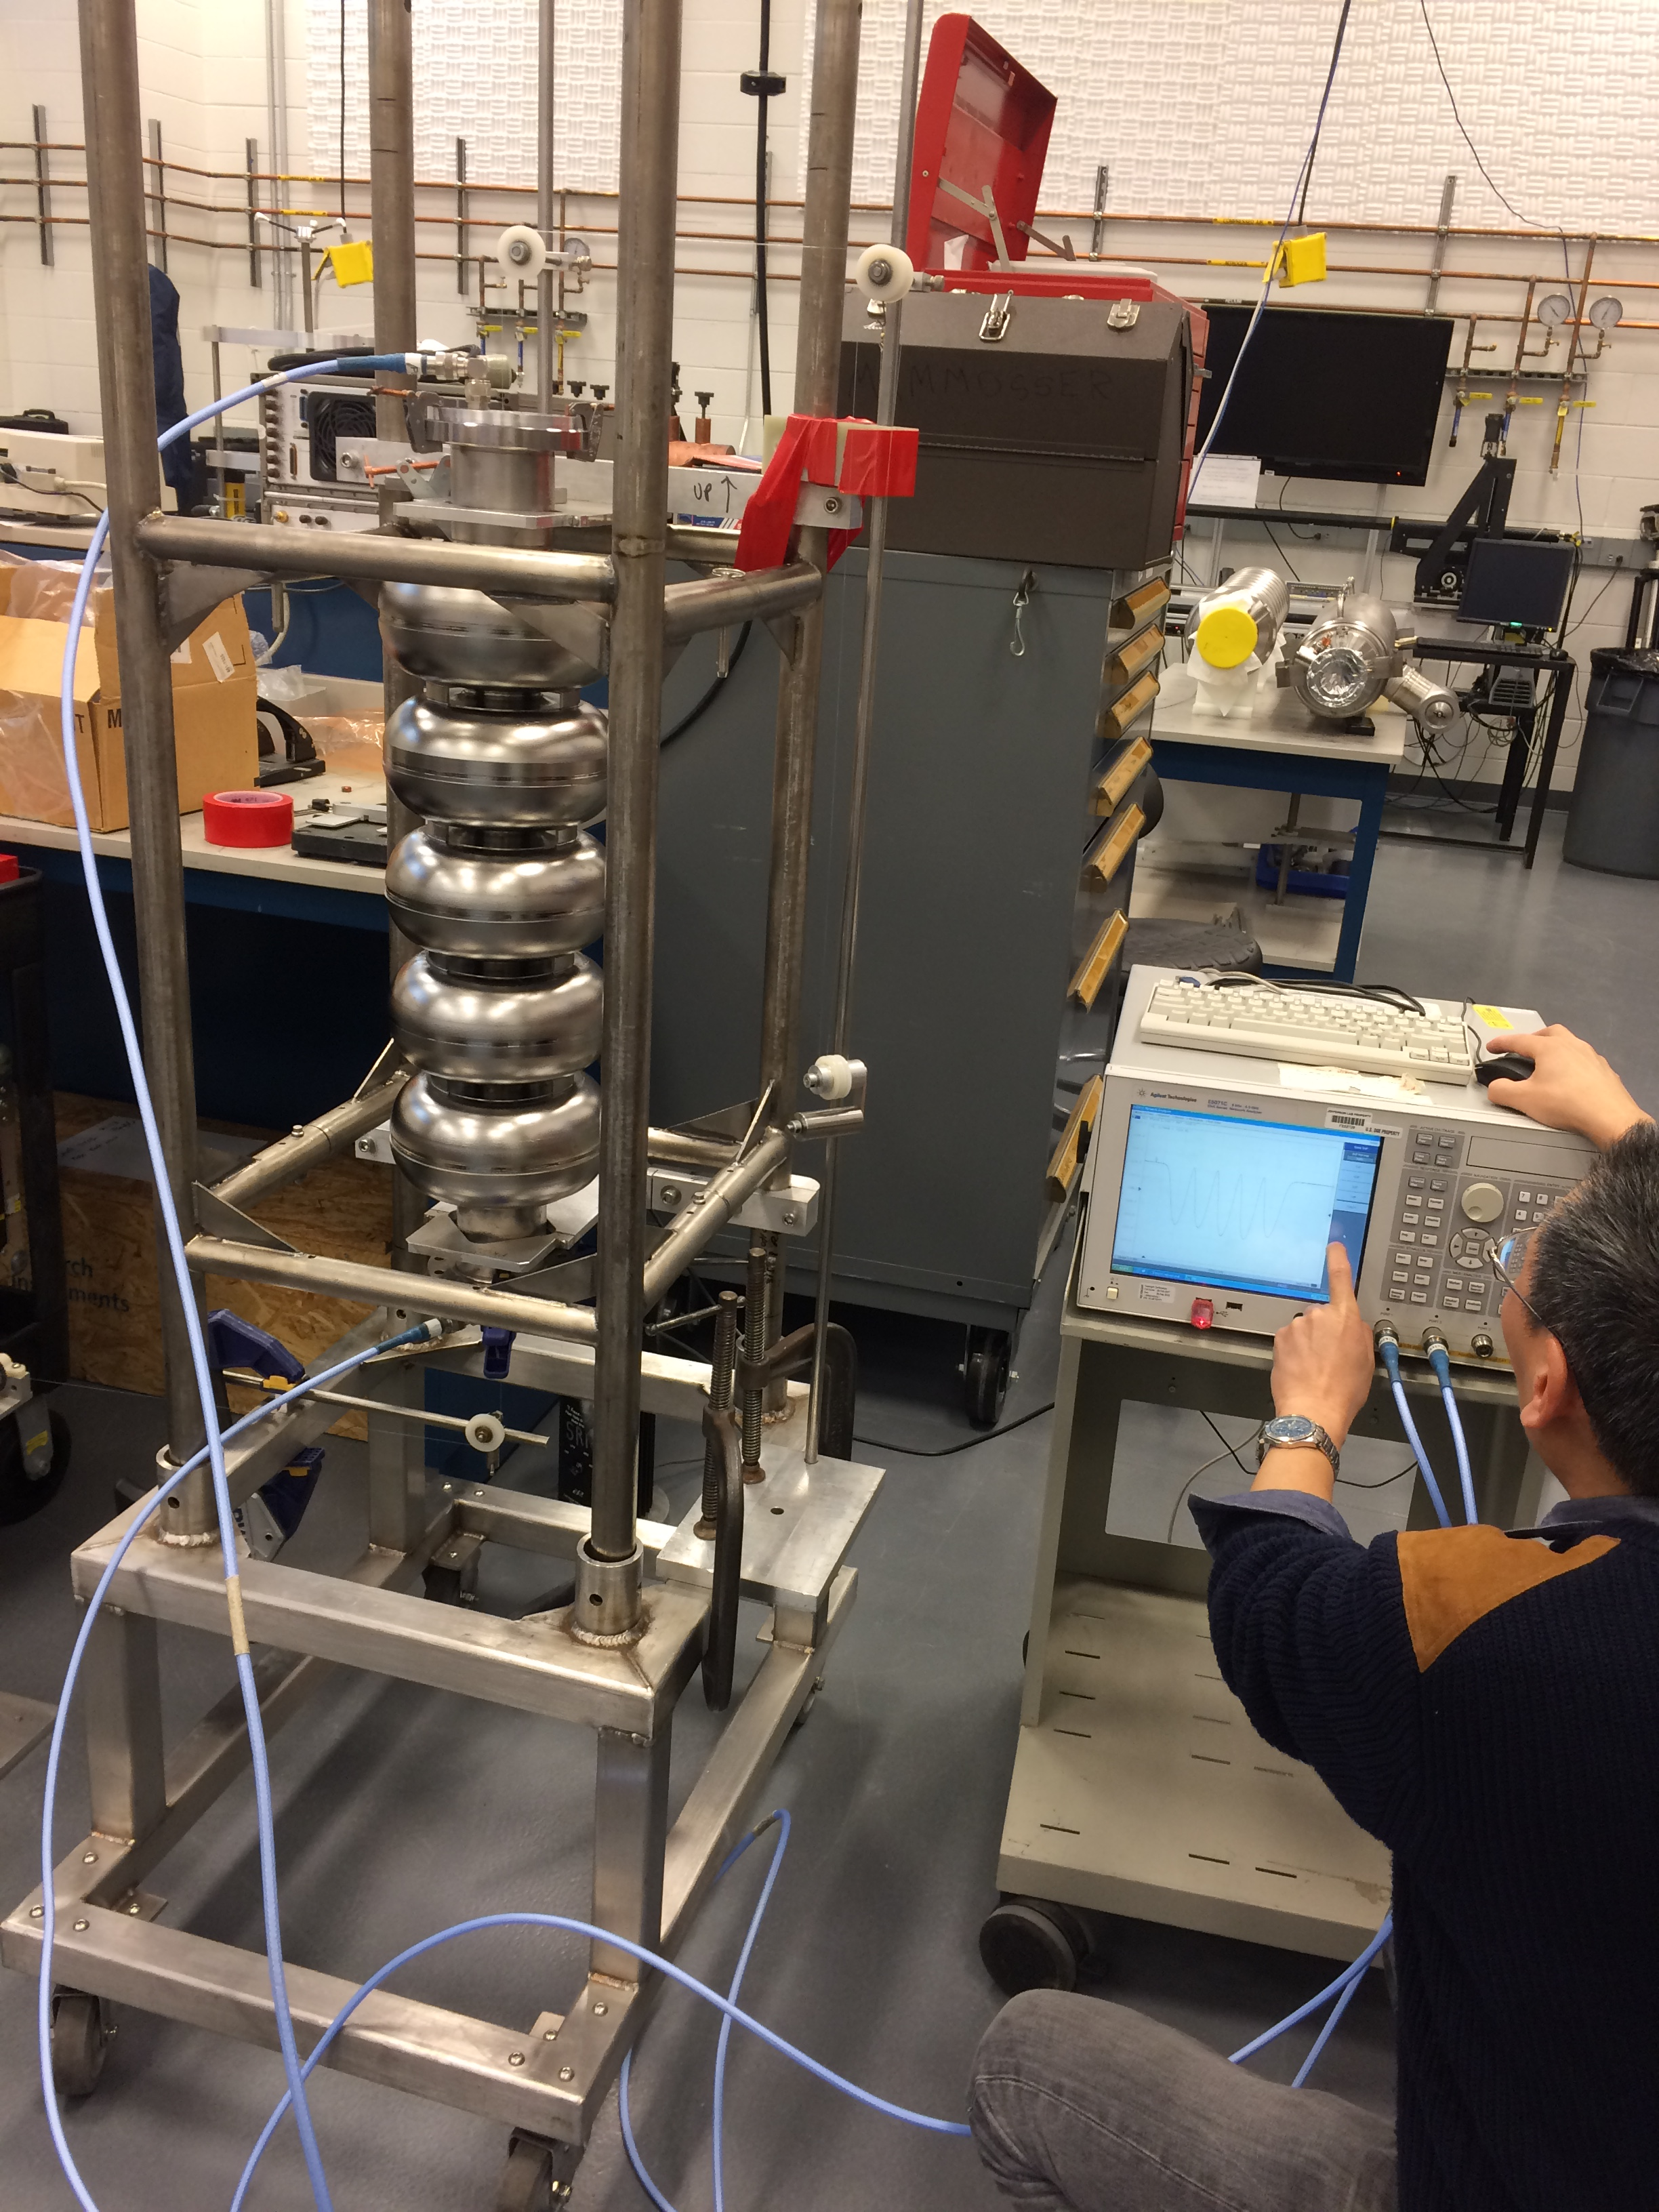
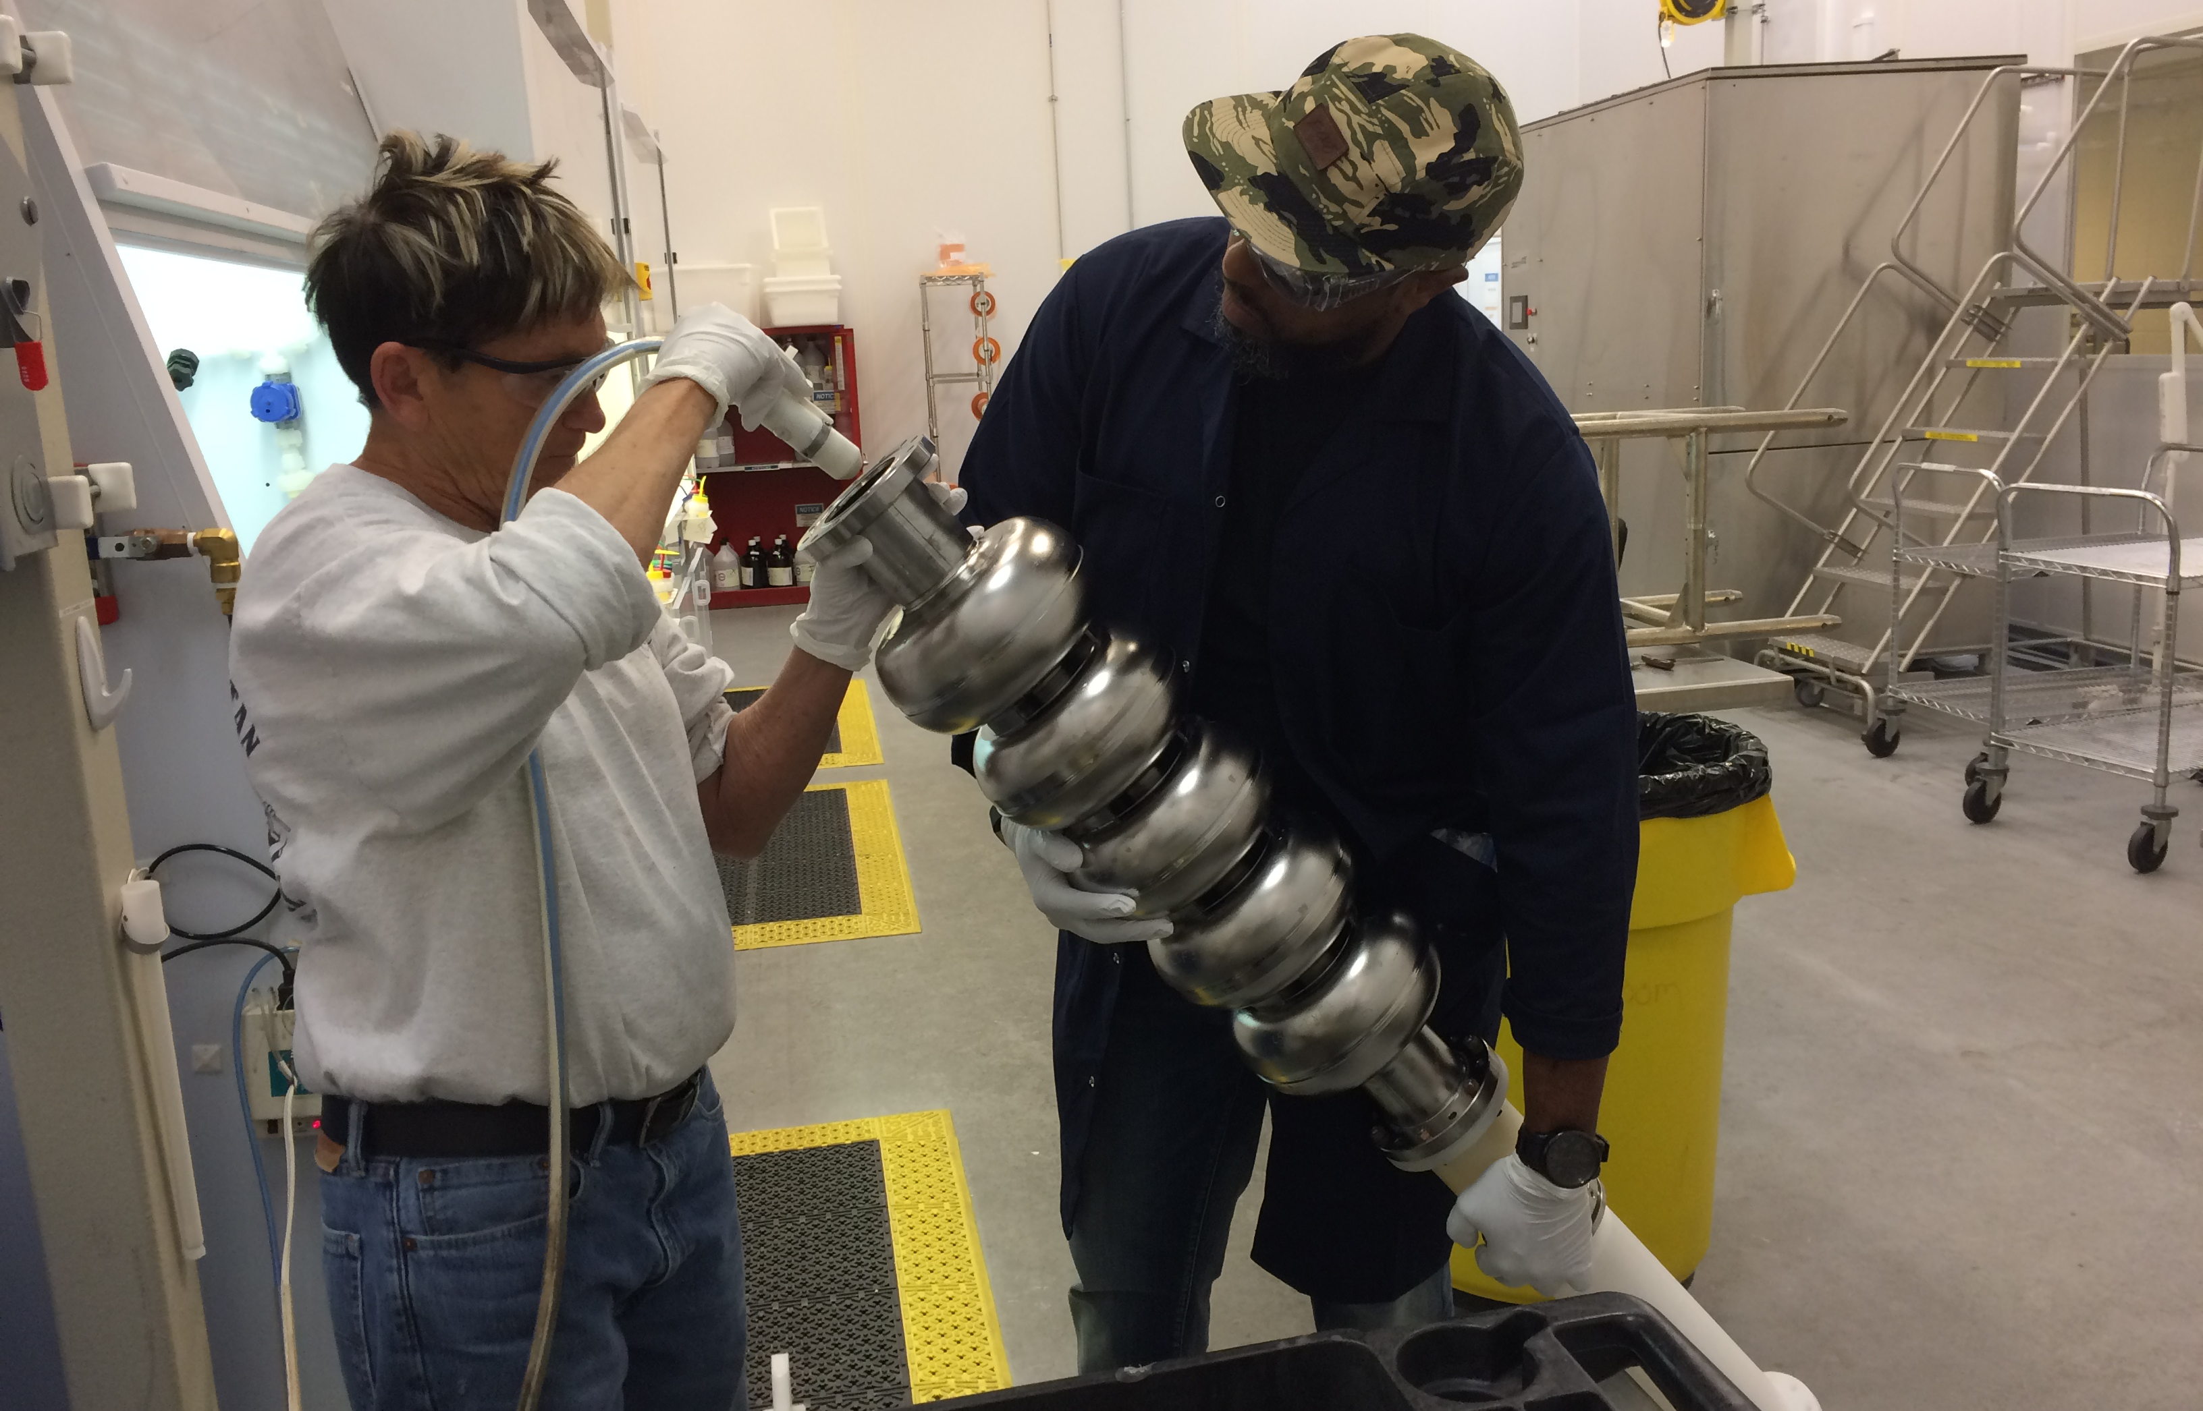
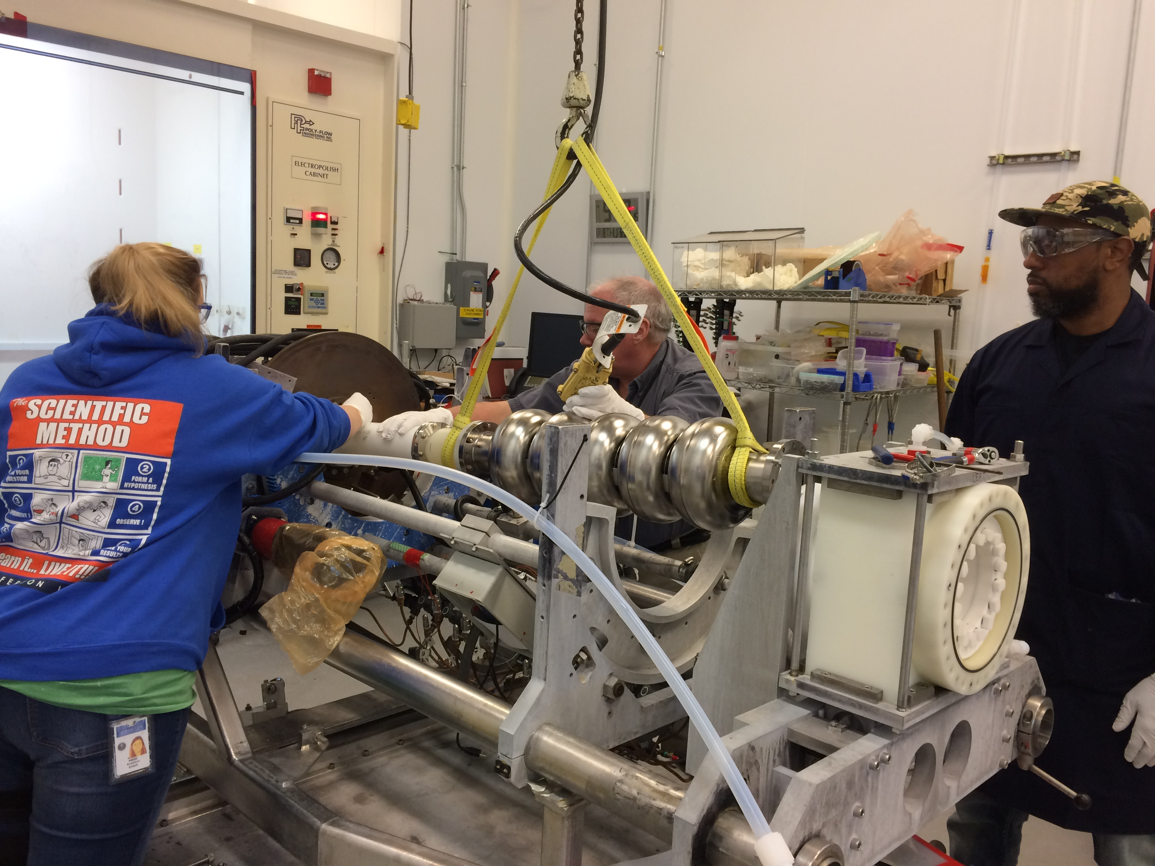
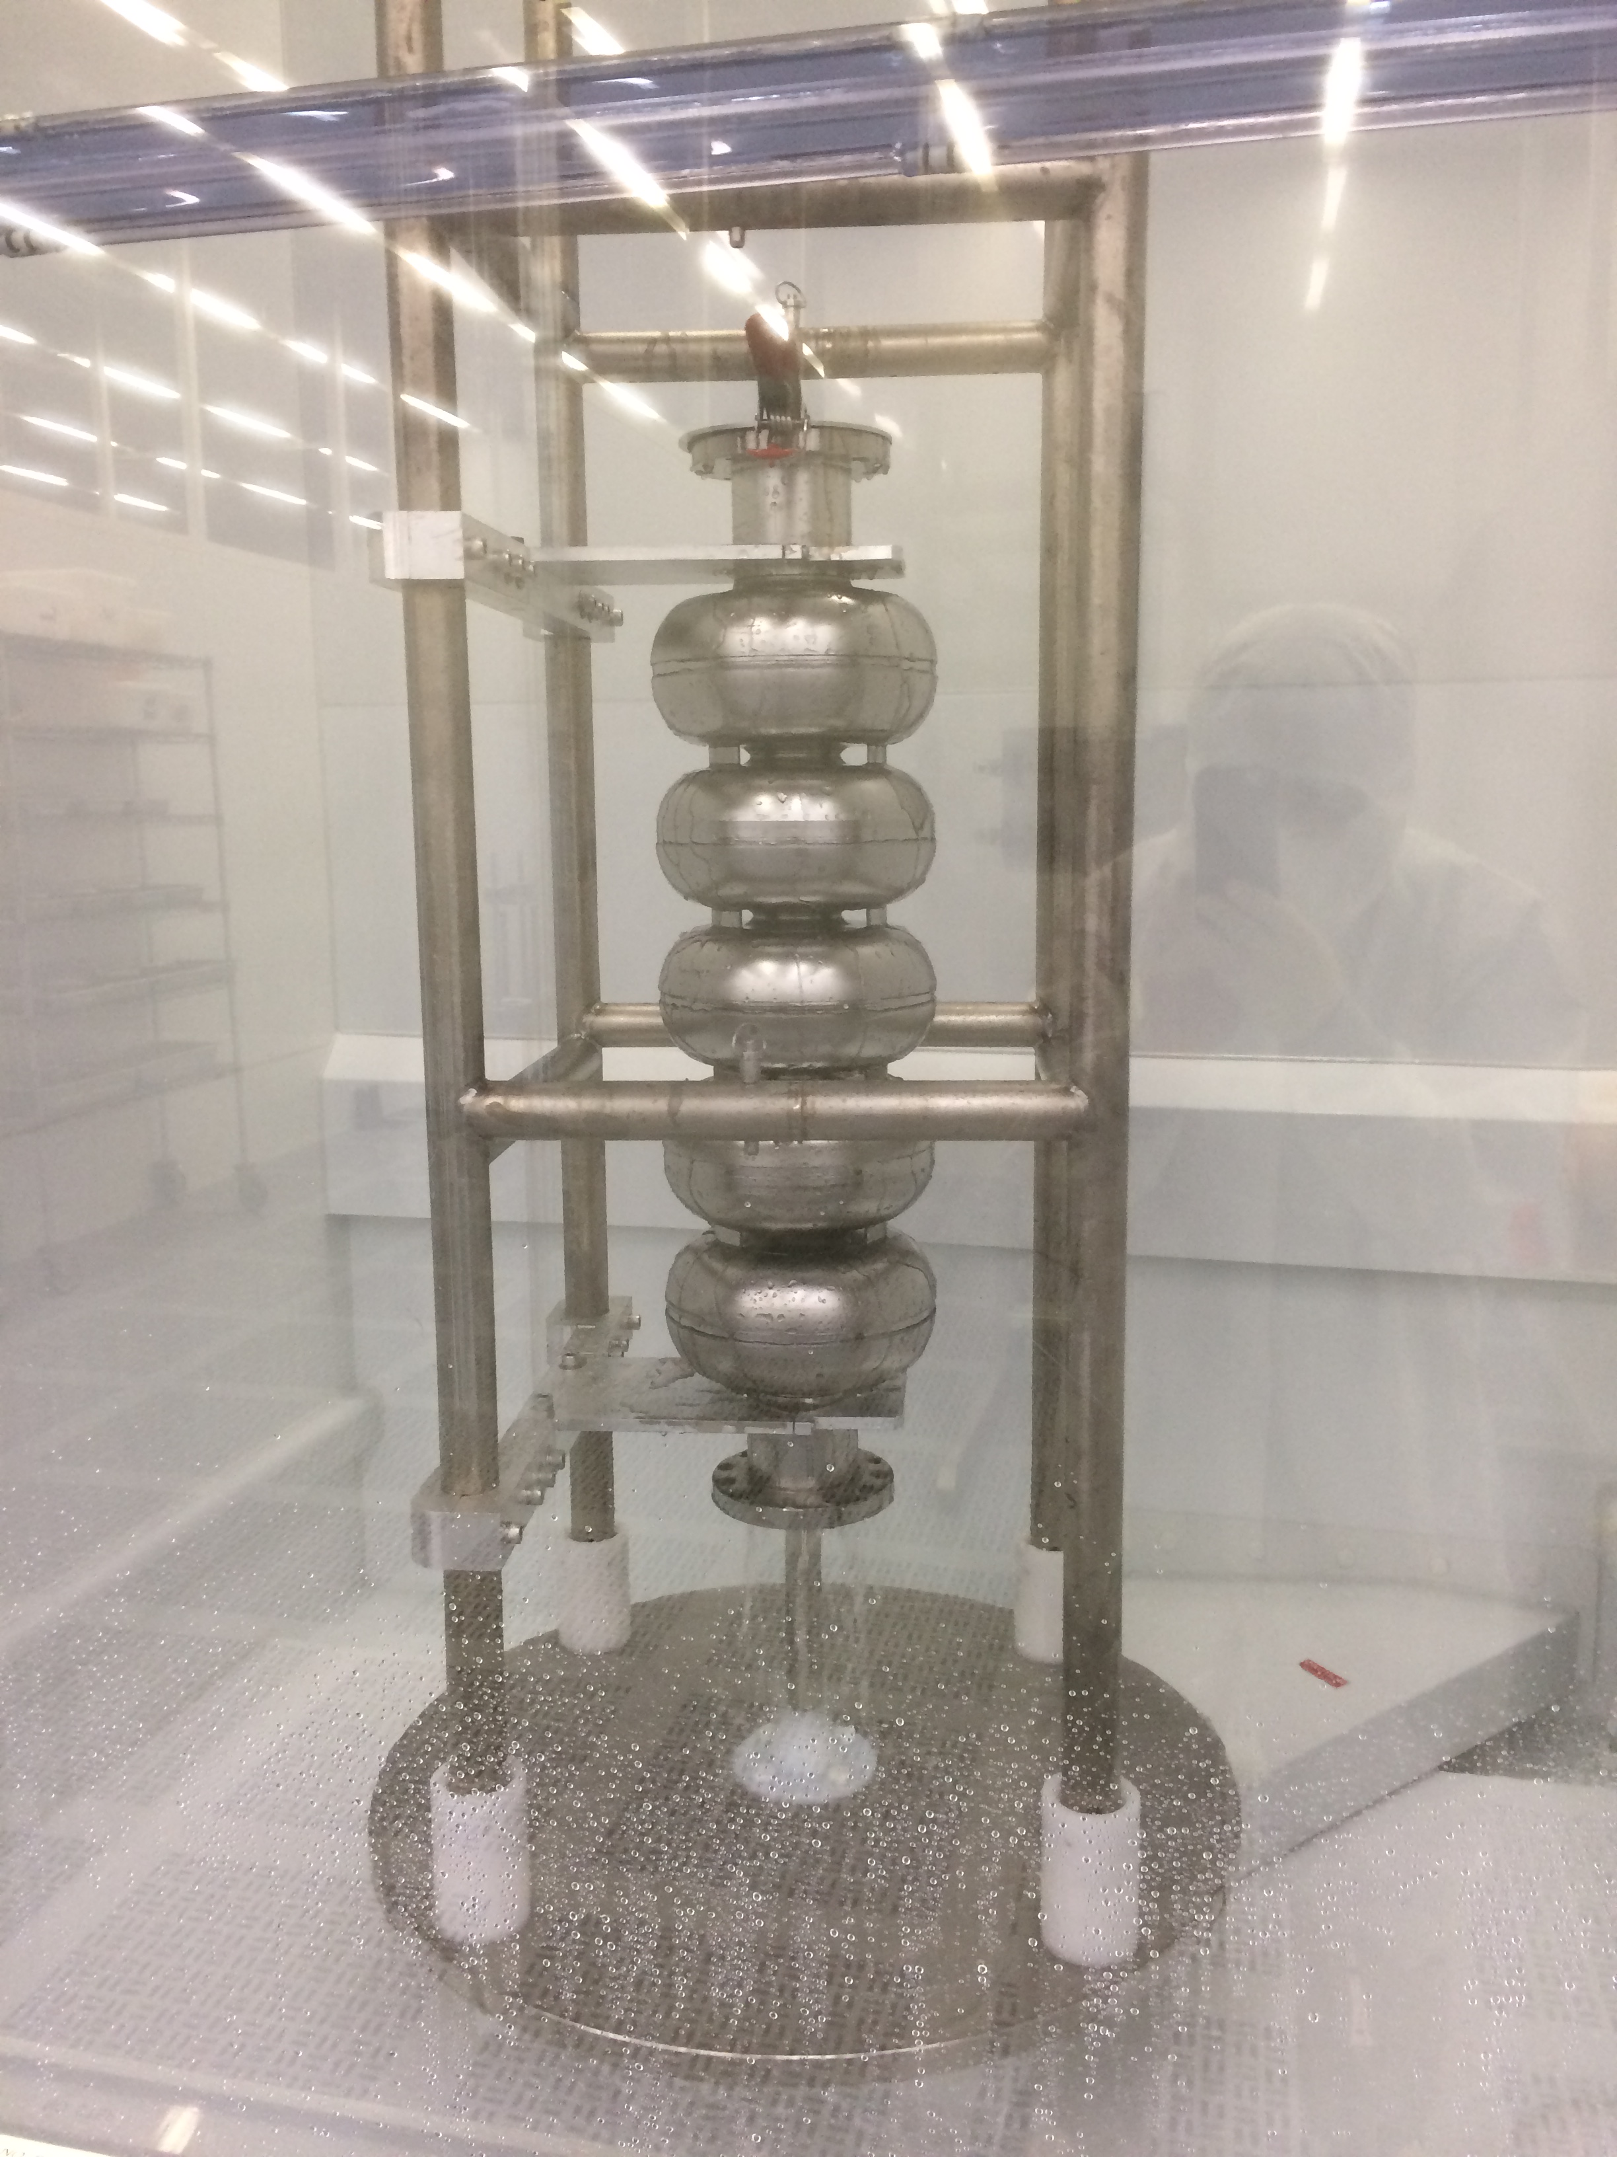
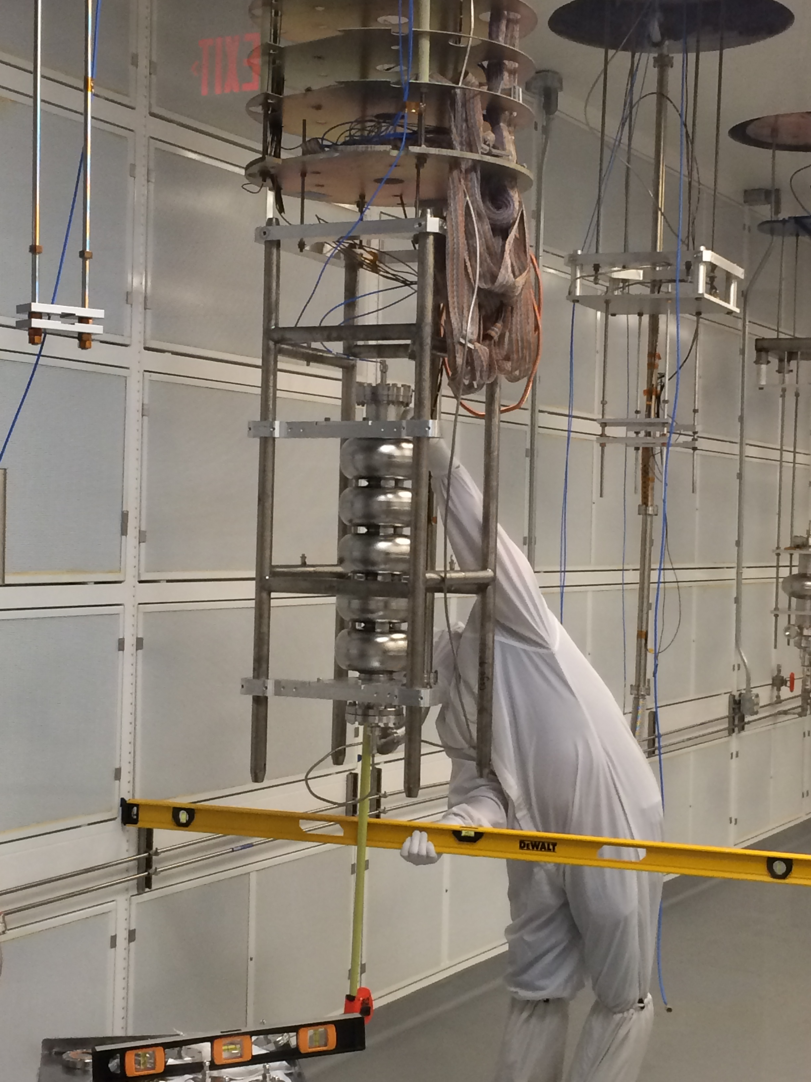
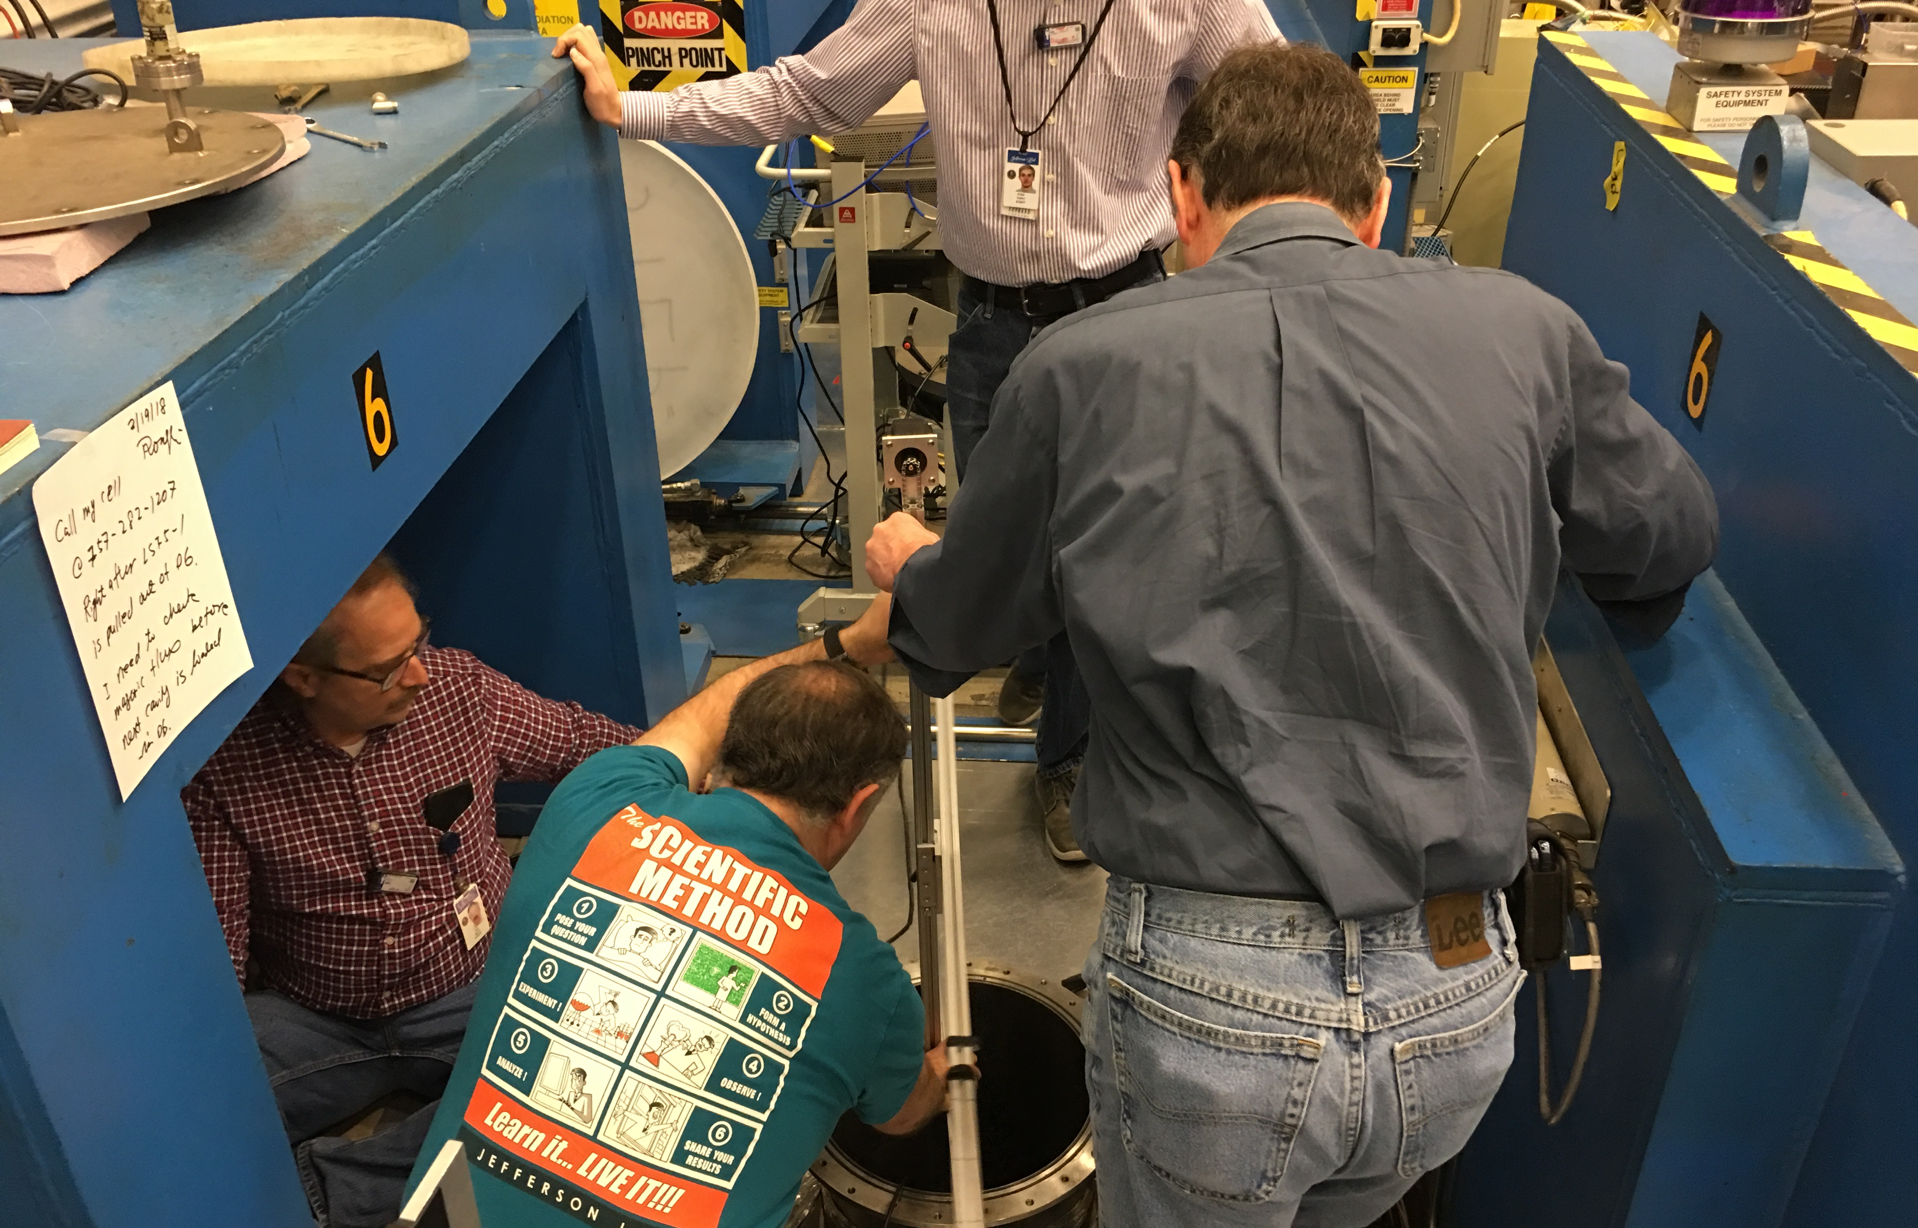
LSF5-1 Processing and Preparation for First Vertical Test at JLAB in 2018
Vertical bead pull
Prep for final EP
Final EP
HPR
Attach to test stand
Dewar Mag survey

Slide 15
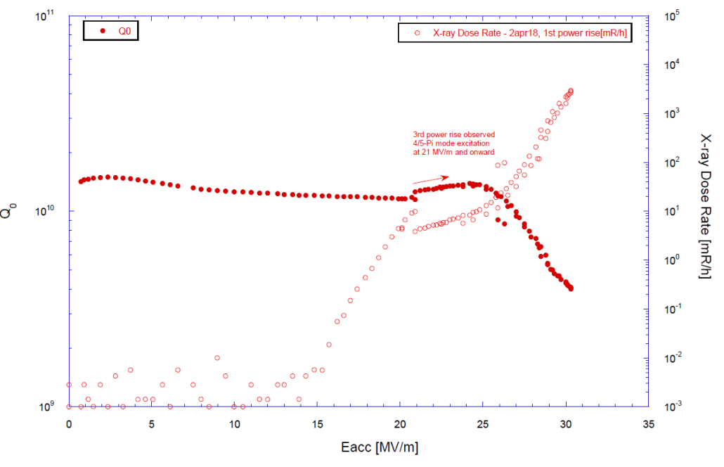
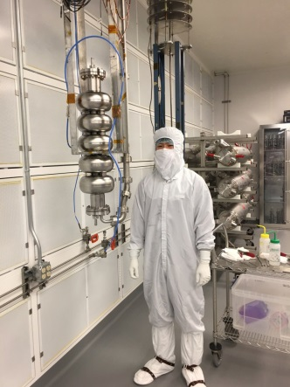
Results of First Cold Tests of LSF5-1
Hayato Ito, graduate student of
SOKENDAI/KEK at JLAB for prep and testing in January - February 2018
Pressure detuning df/dp -186 Hz/torr; Lorentz force detuning coeff. -4.4 Hz/(MV/m)².
Highest Eacc achieved 30 MV/m.
  Limited by pass-band mode (4/5-π) excitation and evidence of end group heating.
Gradient reach probed by pass-band technique: 33 MV/m end cells; 36-38 MV/m inner cells.
  Pointing toward end group limitation as well.

Slide 16
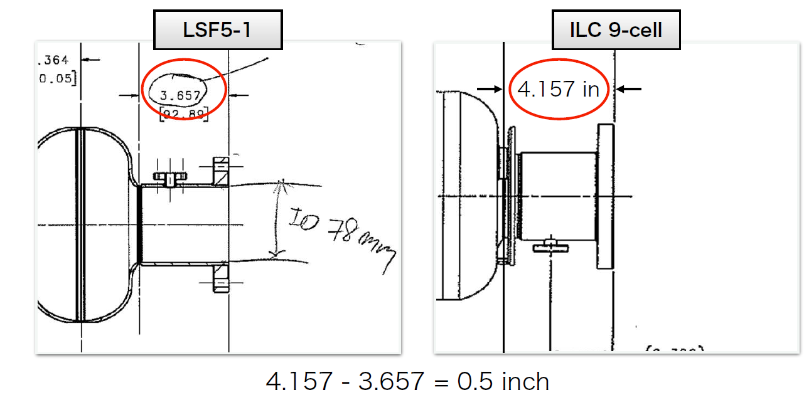
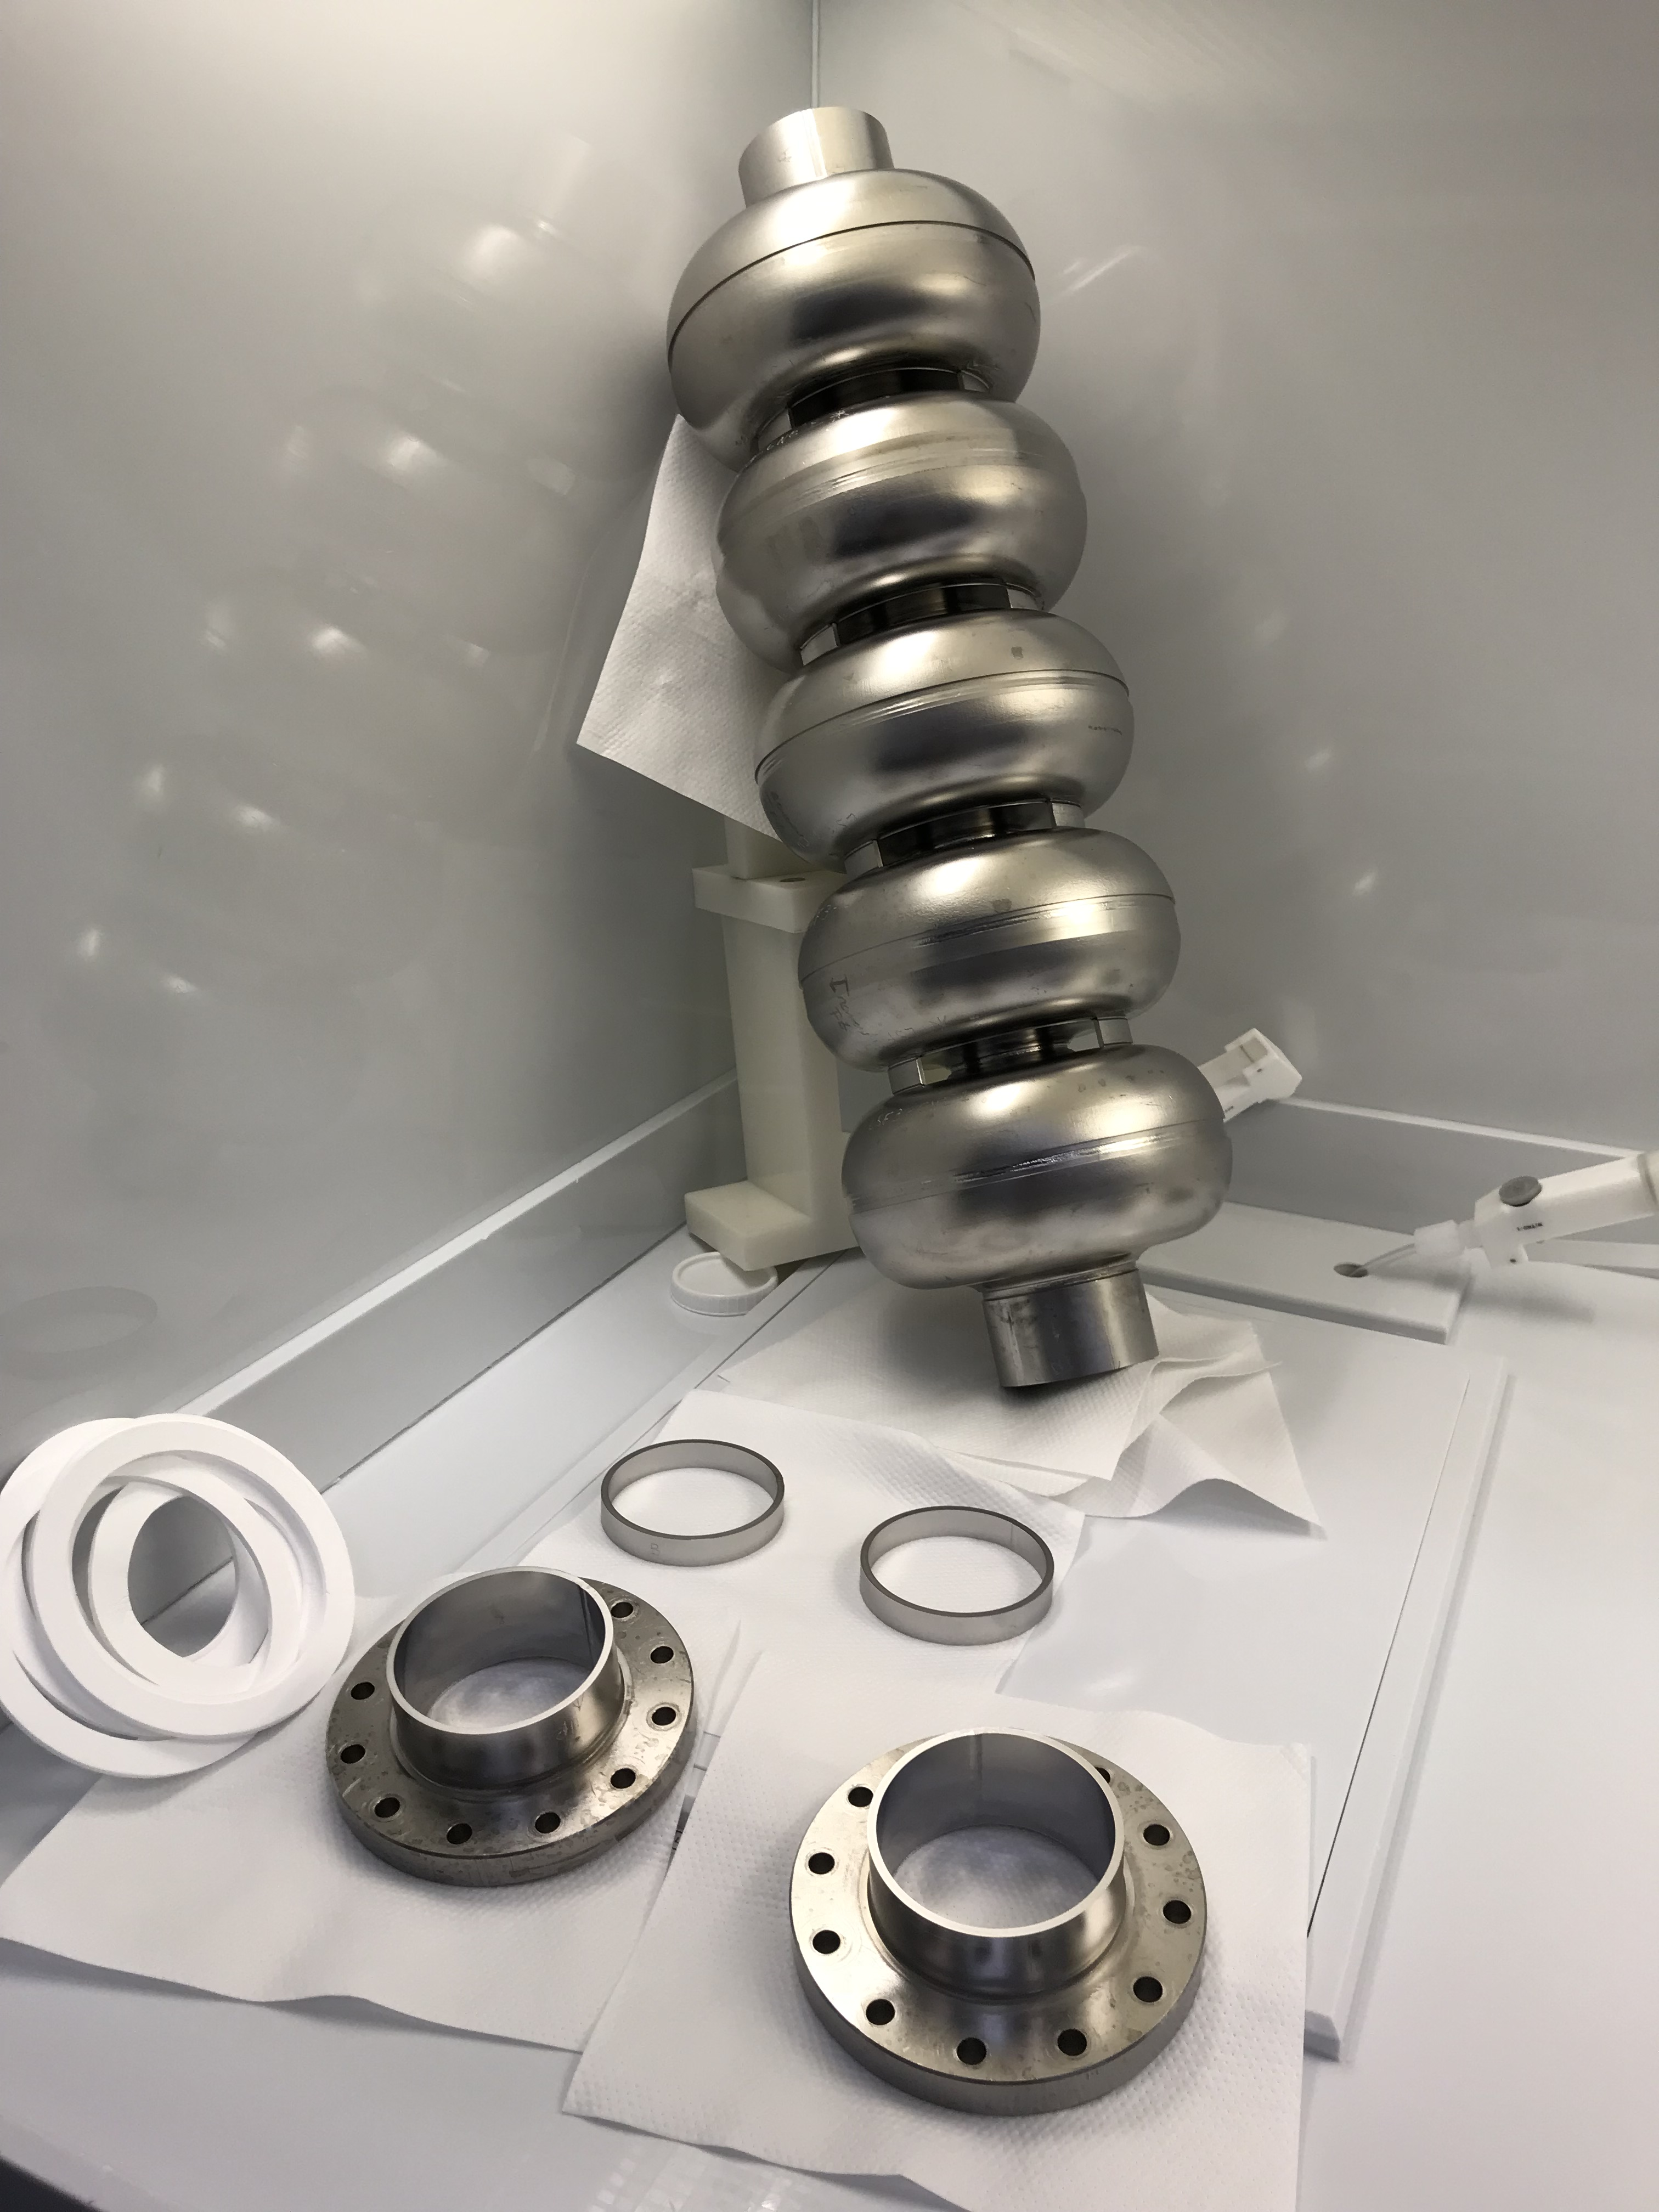
Understanding LSF5-1 First Tests and Actions for Next Steps
High gradient reach of 36-38 MV/m by inner cells confirmed high quality equator weld & surface processing.
30 MV/m cavity gradient limitation by pass-band mode (4/5-π) excitation and end group heating.
  Field emitters in end cells (contaminants in test stand ).
  Missing the 0.5 inch length in beam tube has consequence!
  Moving forward: Add 0.5 in ring in beam tube; restore test stand.
Lorentz force detuning coeff. 10% better than ICHIRO7.
  Validating design & fabrication of new stiffening components.
Field flatness preserved within 3% from handling/evacuation
  Indicating design efficacy in dealing LSF’s small cell-to-cell coupling.
Beam tubes wire EDM cut, EBW in progress, re-test coming.

Slide 17
Conclusion and Outlook
JLAB has chosen LSF shape +LG Nb as a new approach for advancing high gradient SRF to the next level. Steady effort since 2013. New boost from US-Japan collaboration.
Two 1-cell LG & one 5-cell FG cavities are being tested. 9-cell (FG & LG) is next.
While on the one hand, this LSF cavity development has been driven by the goal of shifting performance frontier beyond 50 MV/m in full-scale 9-cell cavities,
There is, on the other hand, a second motivation of shifting ILC project risk in the right direction (fraction of quench limited cavities still large, see XFEL cav. data analysis*).
  11% more margin in gradient.
This work is as well expected to save ILC accelerator cost, still a largely unfilled need.
  40-45% cryo loss saving underpinned by selected shape and material.
* Walker, TTC at CEA Saclay, July 5-8, 2016.

Slide 18
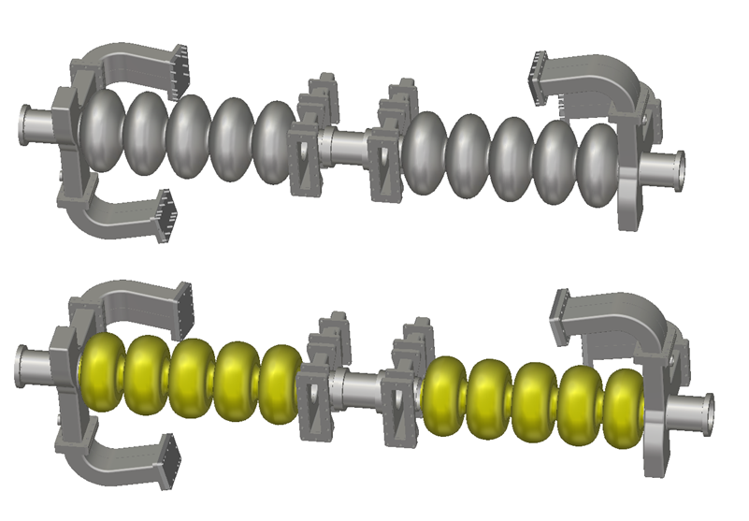
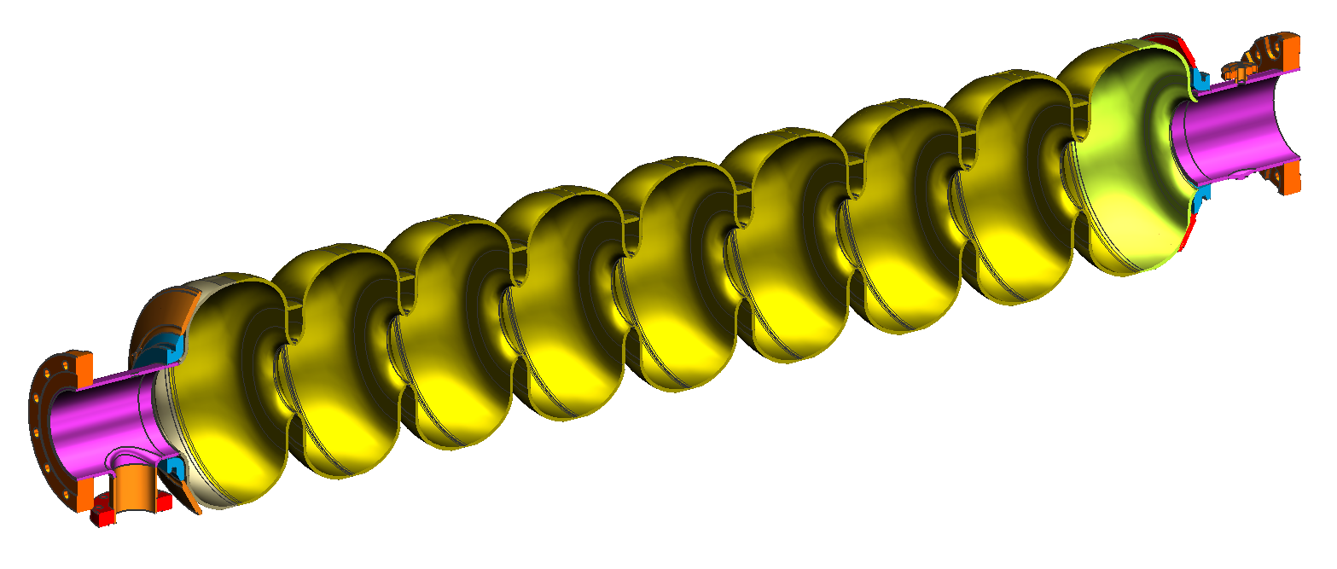
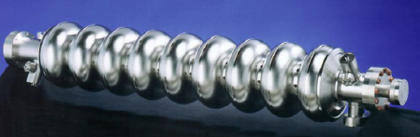
Last But Not The Least: Plug Compatibility
CEBAF refurbish
LSF
Replace center cells with LG Nb & new shape
Preserve end groups
TESLA
Original CEBAF
Ciovati, Rimmer et al, TTC at Milan, Feb 6-9, 2018.

Slide 19
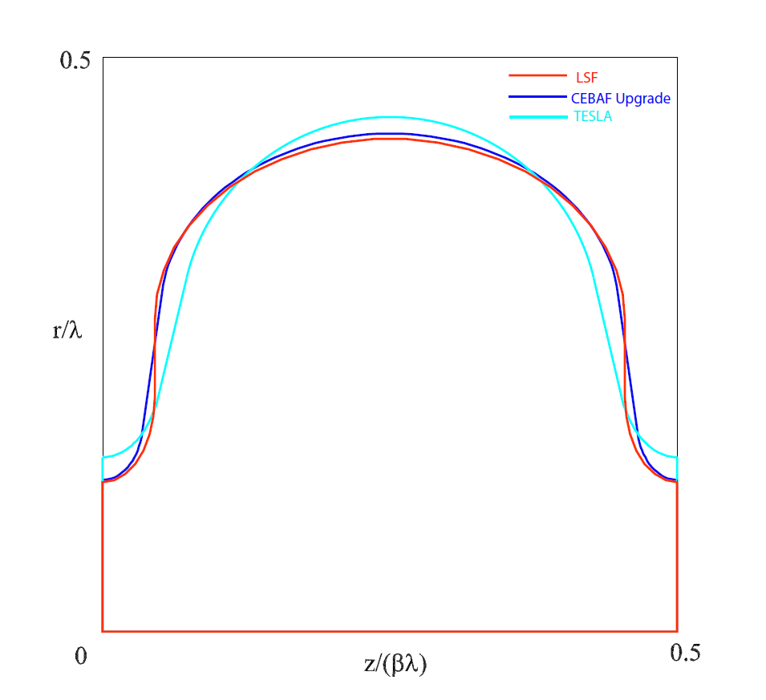
Backup: 3 Key Elements Underpinning Perspective of LSF+LG Nb Approach
  Solid knowledge and understandings.
    Shape properties, aperture compatibility w/ beam*.
    Proven ILC-style TDR baseline surface processing.
    Origin of LG Nb’s superior Q_{0.}
  Extensive experiences.
    Cornell: ~10 year on RE.
    KEK: ~ 10 years on LL/Ichiro.
    JLAB: 15 years on LL (CEBAF) + 5 years LSF.
  Actual test in real accelerator systems with beam.
    LL shape cavities: > 4 yr in 12 GeV CEBAF.
    LG Nb cavities:
      8 yr LG 9-cells (2 EA) in FLASH.
      3 ys LG 9-cells (2 EA) in PKU FEL (replacing now w/ two new 9-cells).
      1 ys LG 5-cell (2 EA) in CEBAF C50-13 (module w/ 8xLG in progress).
 |  | TESLA | Low-loss/ICHIRO | Low-surface-field | CEBAF upgrade LL
frequency | MHz | 1300 | 1300 | 1300 | 1497
# of cells | - | 9 | 9 | 9 | 7
Aperture | Mm | 70 | 60 | 60 | 53
Epk/Eacc | - | 1.98 | 2.36 | 1.98 | 2.17
Hpk/Eacc | mT/(MV/m) | 4.15 | 3.61 | 3.71 | 3.74
Cell-cell coupling | % | 1.90 | 1.52 | 1.27 | 1.49
G*R/Q | Ω² | 30840 | 37970 | 36995 | 36103
* Zagorodnov, Solyak, EPAC06, THPCH037 (2006)
Courtesy H. Wang

Slide 20
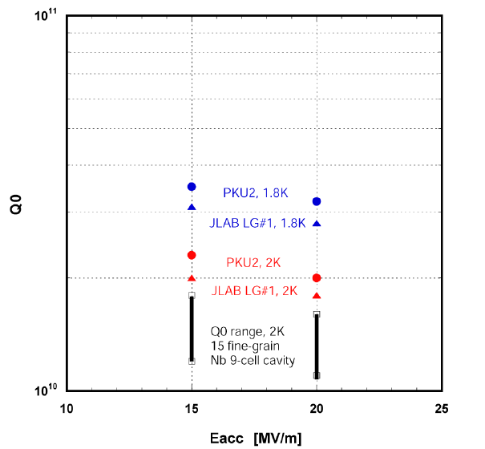
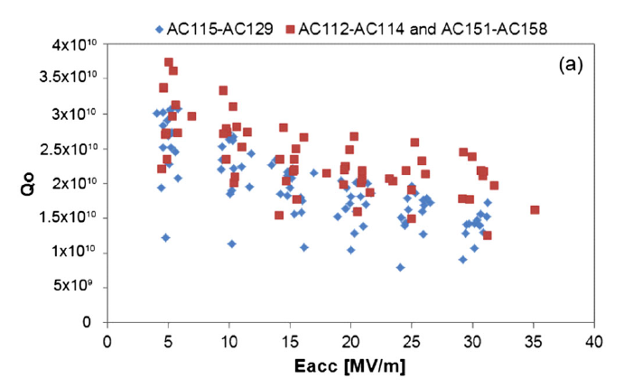
Backup: A Few Words About LG Nb
The idea of LG Nb introduced at JLAB in 2004.
Subsequent world-wide development reviewed by Kneisel et al, NIM-A 774 (2015)133-150.
LG Nb also known as “ingot Nb”.
Initial motivation of LG Nb: save cost, arising from the effect of eliminating steps in producing Nb sheets by ingot slicing.
Initially high purity (high RRR), now active work on “not so high purity” (medium- or low- RRR).
LG Nb in this talk referred to high-purity for best insurance of high gradient, as is well understood.
Observation of higher Q₀ at high gradient as compared to FG Nb similarly processed with ILC-style TDR baseline recipe and tested in identical facilities at JLAB and DESY.
Geng et al., TUPO049, SRF2011 (2011)
Singer et al., PRST-AB 16, 012003 (2013)

Slide 21
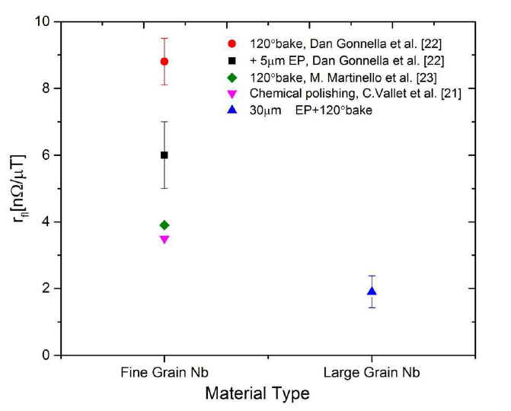
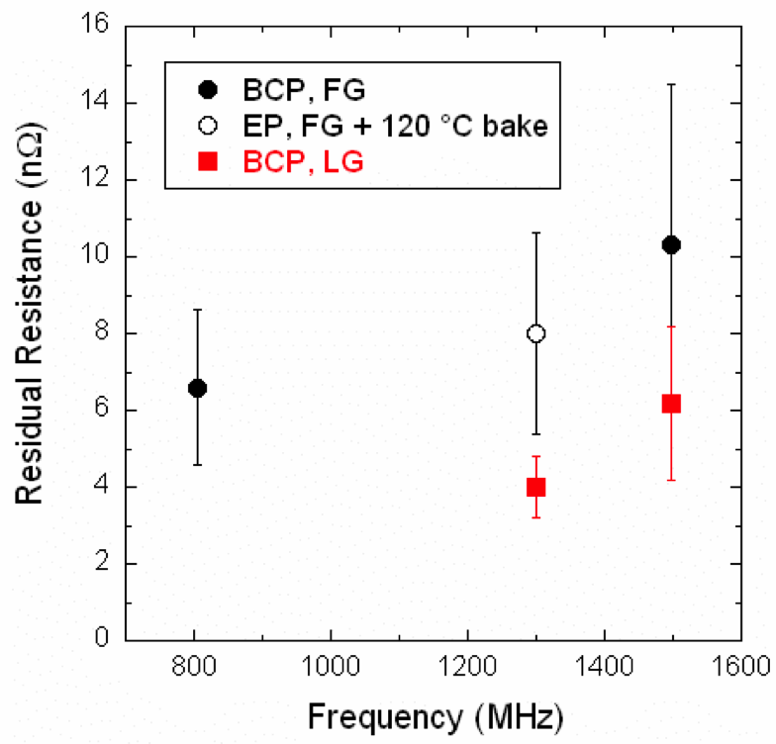
Backup: A Few Words About LG Nb (cont.)
The reason for observed higher Q₀ is understood.
  Lower residual resistance
    Ciovati, Kneisel, Myneni, AIP Conference Proceedings, 1352, Melville, NY(2011).
  Deeper understanding for lower residual resistance: lower sensitivity to trapped flux
    Huang, Kubo, Geng, PRAB 19, 082001 (2016).
Further observation of stable surface resistance in LG Nb cavities against repeated quench
  Geng, Huang, WEPMR033, IPAC2016 (2016).
Very large Q₀ at 1.8 K, optimal temperature at 1.9K for LG Nb?
  Singer et al., AIP Conference Proceedings, 1352, Melville, NY(2011).
  Kostin, Sekutowitz, TTC at Milan, Feb 6-9, 2018.
Ciovati et al, AIP Conf. Proc. 1352, Melville, NY(2011)
Huang, Kubo, Geng, PRAB 19, 082001 (2016)

